Slide 1
Elementary Statistics – Welcome!
Dr. Ab Mosca (they/them)
Slides based off slides courtesy of OpenIntro and John McGreedy of Johns Hopkins University

Slide 2
Plan for Today
Who am I?
Who are you?
What will we do in this class?
What is statistics?
Research questions

Slide 3



Who Am I?

Slide 4


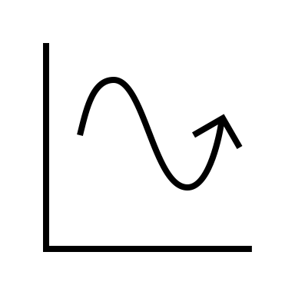
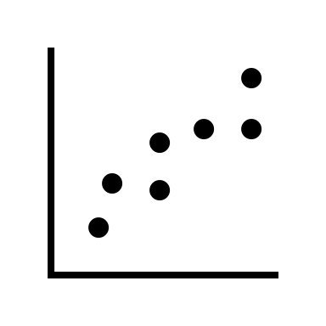

Who Am I?
Dr.

Slide 5



Who Am I?
Dr.

Slide 6
Who Are You?
Form groups of 3
Introduce yourselves (name, pronouns)
Share:
A highlight of your hometown
Find 1 thing that your entire group has in common (favorite color? hometown? left-handed? Be creative!)
After about 5 minutes we will go around, introduce ourselves, and share what each group has in common

Slide 7
Who Are You?
Form new groups of 3 (move around!)
Introduce yourselves (name, pronouns)
Share:
Would you rather have a cat or a dog?
Find 1 thing that your entire group has in common (favorite color? hometown? left-handed? Be creative!)
After about 5 minutes we will go around, introduce ourselves, and share what each group has in common

Slide 8
Who Are You?
Form new new groups of 3 (move around!)
Introduce yourselves (name, pronouns)
Share:
Would you rather have a self-driving car but always hit red lights OR drive yourself and never hit red lights?
Find 1 thing that your entire group has in common (favorite color? hometown? left-handed? Be creative!)
After about 5 minutes we will go around, introduce ourselves, and share what each group has in common

Slide 9
What You Will Learn & Logistics

Slide 10
What Is This Class?
An introduction to statistics
You will learn…
How to collect sample data from a population
How to appropriately summarize data
How to make inferences from data
How to communicate the outcome of a statistical analysis

Slide 11
**Important Info**
Course website (write this down!): https://amosca01.github.io/MATH108-F23/
PLATO: please use for all course related communication
OH’s: T/R 11:30 – 13:30 (stop by and say hi!) **starting NEXT week**

Slide 12
**Important Info**
Textbook: OpenIntro Statistics, Fourth Edition
Available for free here: https://www.openintro.org/
Assignments:
Turn in on PLATO
Homeworks – largely effort based
Mini-Projects – review and application of skills
Final Project – group based, application of skills
Due Dates: As listed on course schedule.
24hr grace period; no late submissions
Lowest homework dropped
No regrades; see syllabus for revise and resubmit instructions

Slide 13
**Important Info**
I’m here to help you succeed
Please come to office hours or reach out on PLATO if you need any additional support

Slide 14
Now the good stuff

Slide 15
What is Statistics?
Work with whoever is sitting next to you to brainstorm what you think statistics is
Add your definition to the board

Slide 16
What is Statistics?
Definition: Statistics is the study of how best to collect, analyze, and draw conclusions from data

Slide 17
What is Statistics?
Definition: Statistics is the study of how best to collect, analyze, and draw conclusions from data
Notes:
So, we need to understand
data
analysis
interpretation
dissemination

Slide 18
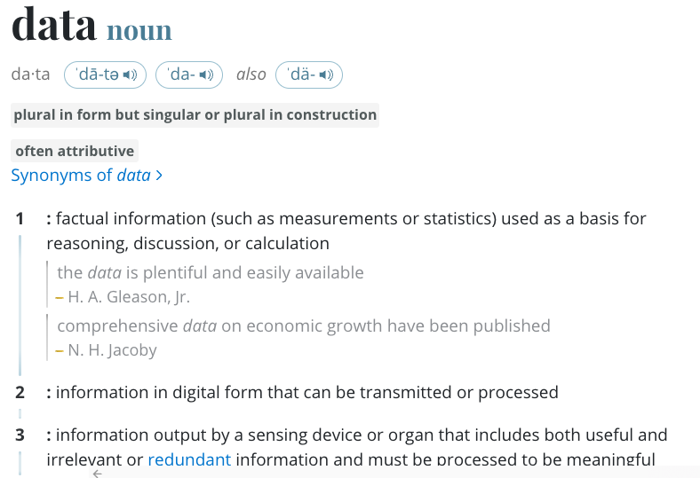
Data
https://www.merriam-webster.com/dictionary/data

Slide 19
Data
What examples of data can you come up with?
Brainstorm with whoever is next to you

Slide 20
Data + Analysis
What if we add analysis to the mix? What can we learn or do from analyzing data?
Brainstorm with whoever is next to you

Slide 21






Data + Analysis
weather
sales
roadways
investing
medicine
urban planning
Notes:
Predict weather (will it rain? snow?)
Track sales (what items are doing well or not?)
Build / change roadways (where is there the most traffic? should we change patterns?)
Investing (which stokes are likely to do well?)
Medical studies (does this new treatment work?)
Urban planning (how many apartments, shops, etc. should we build?)

Slide 22
Analysis
Different techniques for different needs
Summarizing
Inference
Prediction

Slide 23
Analysis
Different techniques for different needs
Summarizing
Inference
Prediction
Regression
AI / ML

Slide 24
What is Statistics?
Definition: Statistics is the study of how best to collect, analyze, and draw conclusions from data
Why?

Slide 25
Research Questions

Slide 26
What is a research question?
A research question (RQ) is a question that a research project sets out to answer
Formulation of Research Question – Stepwise Approach. Ratan et al. (2019).

Slide 27
What is a research question?
A research question (RQ) is a question that a research project sets out to answer
Good RQs are FINER:
Feasible
Interesting
Novel
Ethical
Relevant
Formulation of Research Question – Stepwise Approach. Ratan et al. (2019).

Slide 28



What is a research question?
A research question (RQ) is a question that a research project sets out to answer
Good RQs are FINER:
Feasible
Formulation of Research Question – Stepwise Approach. Ratan et al. (2019).
Notes:
Consider time, resources, skillset

Slide 29

What is a research question?
A research question (RQ) is a question that a research project sets out to answer
Good RQs are FINER:
Interesting
Formulation of Research Question – Stepwise Approach. Ratan et al. (2019).
Notes:
Study something you want to know about!

Slide 30

What is a research question?
A research question (RQ) is a question that a research project sets out to answer
Good RQs are FINER:
Novel
Formulation of Research Question – Stepwise Approach. Ratan et al. (2019).
Notes:
Not a copy of previously done work, something new or adding to something already done

Slide 31

What is a research question?
A research question (RQ) is a question that a research project sets out to answer
Good RQs are FINER:
Ethical
Formulation of Research Question – Stepwise Approach. Ratan et al. (2019).
Notes:
Experiments should minimize risk to participants
Data should be kept private and confidential
Participants must be able to withdraw
Avoids deceptive practices, like p-hacking

Slide 32

What is a research question?
A research question (RQ) is a question that a research project sets out to answer
Good RQs are FINER:
Relevant
Formulation of Research Question – Stepwise Approach. Ratan et al. (2019).
Notes:
Interesting to the field as well as you! Should be something people will care about

Slide 33
Research Questions
Developing a RQ
Identify an area of interest
Research the area
What is known?
What do you (we) still need to know?
What question(s) does II imply?
Narrow and refine
Formulation of Research Question – Stepwise Approach. Ratan et al. (2019).

Slide 34
Research Questions
Developing a RQ
Identify an area of interest
Research the area
What is known?
What do you (we) still need to know?
What question(s) does II imply?
Narrow and refine
Interactive graphs
Formulation of Research Question – Stepwise Approach. Ratan et al. (2019).

Slide 35
Research Questions
Developing a RQ
Identify an area of interest
Research the area
What is known?
What do you (we) still need to know?
What question(s) does II imply?
Narrow and refine
Interactive graphs
Interaction improves exploration, interaction makes apps harder to build and use
Formulation of Research Question – Stepwise Approach. Ratan et al. (2019).

Slide 36
Research Questions
Developing a RQ
Identify an area of interest
Research the area
What is known?
What do you (we) still need to know?
What question(s) does II imply?
Narrow and refine
Interactive graphs
Interaction improves exploration, interaction makes apps harder to build and use
How interaction affects reasoning with graphs
Formulation of Research Question – Stepwise Approach. Ratan et al. (2019).

Slide 37
Research Questions
Developing a RQ
Identify an area of interest
Research the area
What is known?
What do you (we) still need to know?
What question(s) does II imply?
Narrow and refine
Interactive graphs
Interaction improves exploration, interaction makes apps harder to build and use
How interaction affects reasoning with graphs
How does interaction affect reasoning with graphs?
Formulation of Research Question – Stepwise Approach. Ratan et al. (2019).

Slide 38
Research Questions
Developing a RQ
Identify an area of interest
Research the area
What is known?
What do you (we) still need to know?
What question(s) does II imply?
Narrow and refine
Interactive graphs
Interaction improves exploration, interaction makes apps harder to build and use
How interaction affects reasoning with graphs
How does interaction affect reasoning with graphs?
Formulation of Research Question – Stepwise Approach. Ratan et al. (2019).
Notes:
-

Slide 39
Research Questions
Developing a RQ
Identify an area of interest
Research the area
What is known?
What do you (we) still need to know?
What question(s) does II imply?
Narrow and refine (FINER)
How does interaction affect reasoning with graphs?
Very broad
Formulation of Research Question – Stepwise Approach. Ratan et al. (2019).
Notes:
Feasible
Interesting
Novel
Ethical
Relevant
How can we make this more feasible?
Reduce graphs to specific type
Ask a specific question about reasoning

Slide 40
Research Questions
Developing a RQ
Identify an area of interest
Research the area
What is known?
What do you (we) still need to know?
What question(s) does II imply?
Narrow and refine (FINER)
How does an interactive icon array affect accuracy on a reasoning task?
Formulation of Research Question – Stepwise Approach. Ratan et al. (2019).
Notes:
Feasible
Interesting
Novel
Ethical
Relevant
How can we make this more feasible?
Reduce graphs to specific type
Ask a specific question about reasoning

Slide 41
Research Questions
Developing a RQ
Identify an area of interest
Research the area
What is known?
What do you (we) still need to know?
What question(s) does II imply?
Narrow and refine (FINER)
Your turn! Find two people to work with and develop a research question. Be ready to share with the class
Formulation of Research Question – Stepwise Approach. Ratan et al. (2019).
Notes:
Feasible
Interesting
Novel
Ethical
Relevant
How can we make this more feasible?
Reduce graphs to specific type
Ask a specific question about reasoning

