Slide 1
Assessing Discrete Data: Binomial Distribution
Dr. Ab Mosca (they/them)
Slides based off slides courtesy of OpenIntro and John McGreedy of Johns Hopkins University

Slide 2
Scenario
If a person randomly guesses the answers to 10 multiple
choice questions, we can ask questions like:
What is the probability that they get none right?
What is the probability that they get all ten right?
What is the probability that they get at least three right?
How many do they get right on average?
https://www3.nd.edu/~dgalvin1/10120/10120_S16/Topic19_8p6_Galvin.pdf

Slide 3
Scenario
If a person randomly guesses the answers to 10 multiple
choice questions, we can ask questions like:
What is the probability that they get none right?
What is the probability that they get all ten right?
What is the probability that they get at least three right?
How many do they get right on average?
These are examples of Bernoulli Experiments
https://www3.nd.edu/~dgalvin1/10120/10120_S16/Topic19_8p6_Galvin.pdf

Slide 4
Bernoulli Experiments
The experiment consists of trials, repeated n times.
The outcome of each trial is a success or a failure; and these are the only two possible outcomes for each trial.
The probability of success remains the same for each trial. We use p for the probability of success (on each trial) and q = 1 - p for the probability of failure.
The trials are independent (the outcome of previous trials has no influence on the outcome of the next trial).
We are interested in the random variable X where X = the number of successes. Note the possible values of X are 0, 1, 2, 3, …, n.
https://www3.nd.edu/~dgalvin1/10120/10120_S16/Topic19_8p6_Galvin.pdf

Slide 5
Experiment
A person randomly guesses the answers to 10 multiple
choice questions (each questions has 4 answers to chose from). We record the number of correct answers, and ask what is the probability of getting 8 answers correct?
What is a trial?

Slide 6
Experiment
A person randomly guesses the answers to 10 multiple
choice questions (each questions has 4 answers to chose from). We record the number of correct answers, and ask what is the probability of getting 8 answers correct?
What is a trial?
one guess

Slide 7
Experiment
A person randomly guesses the answers to 10 multiple
choice questions (each questions has 4 answers to chose from). We record the number of correct answers, and ask what is the probability of getting 8 answers correct?
What is a trial?
one guess
What is success and what is failure?

Slide 8
Experiment
A person randomly guesses the answers to 10 multiple
choice questions (each questions has 4 answers to chose from). We record the number of correct answers, and ask what is the probability of getting 8 answers correct?
What is a trial?
one guess
What is success and what is failure?
correct answer == success, wrong answer == failure

Slide 9
Experiment
A person randomly guesses the answers to 10 multiple
choice questions (each questions has 4 answers to chose from). We record the number of correct answers, and ask what is the probability of getting 8 answers correct?
What is a trial?
one guess
What is success and what is failure?
correct answer == success, wrong answer == failure
What is the probability of success (p)?

Slide 10
Experiment
A person randomly guesses the answers to 10 multiple
choice questions (each questions has 4 answers to chose from). We record the number of correct answers, and ask what is the probability of getting 8 answers correct?
What is a trial?
one guess
What is success and what is failure?
correct answer == success, wrong answer == failure
What is the probability of success (p)?
1 / 4 = 0.25

Slide 11
Experiment
A person randomly guesses the answers to 10 multiple
choice questions (each questions has 4 answers to chose from). We record the number of correct answers, and ask what is the probability of getting 8 answers correct?
What is a trial?
one guess
What is success and what is failure?
correct answer == success, wrong answer == failure
What is the probability of success (p)?
1 / 4 = 0.25
What is the probability of failure (q)?

Slide 12
Experiment
A person randomly guesses the answers to 10 multiple
choice questions (each questions has 4 answers to chose from). We record the number of correct answers, and ask what is the probability of getting 8 answers correct?
What is a trial?
one guess
What is success and what is failure?
correct answer == success, wrong answer == failure
What is the probability of success (p)?
1 / 4 = 0.25
What is the probability of failure (q)?
1 – p = 1 – 0.25 = 0.75

Slide 13
Experiment
A person randomly guesses the answers to 10 multiple
choice questions (each questions has 4 answers to chose from). We record the number of correct answers, and ask what is the probability of getting 8 answers correct?
What is a trial?
one guess
What is success and what is failure?
correct answer == success, wrong answer == failure
What is the probability of success (p)?
1 / 4 = 0.25
What is the probability of failure (q)?
1 – p = 1 – 0.25 = 0.75
What values can X take?

Slide 14
Experiment
A person randomly guesses the answers to 10 multiple
choice questions (each questions has 4 answers to chose from). We record the number of correct answers, and ask what is the probability of getting 8 answers correct?
What is a trial?
one guess
What is success and what is failure?
correct answer == success, wrong answer == failure
What is the probability of success (p)?
1 / 4 = 0.25
What is the probability of failure (q)?
1 – p = 1 – 0.25 = 0.75
What values can X take?
0, 1, 2, . . . , 10

Slide 15
Another Experiment
A person flips a coin 12 times. We record the number of heads, and ask what is the probability of getting 3 heads?
What is a trial?
What is success and what is failure?
What is the probability of success (p)?
What is the probability of failure (q)?
What values can X take?

Slide 16
Another Experiment
A person flips a coin 12 times. We record the number of heads, and ask what is the probability of getting 3 heads?
What is a trial?
one coin flip
What is success and what is failure?
heads == success, tails == failure
What is the probability of success (p)?
1 / 2 = 0.5
What is the probability of failure (q)?
1 – p = 1 – 0.5 = 0.5
What values can X take?
0, 1, 2, . . . , 12

Slide 17
Another Experiment
A person rolls a die 5 times. We record the number of times 1 is rolled, and ask what is the probability of rolling 1 three times?
What is a trial?
What is success and what is failure?
What is the probability of success (p)?
What is the probability of failure (q)?
What values can X take?

Slide 18
Another Experiment
A person rolls a die 5 times. We record the number of times 1 is rolled, and ask what is the probability of rolling 1 three times?
What is a trial?
one roll
What is success and what is failure?
1 == success, all other numbers == failure
What is the probability of success (p)?
1 / 6 = 0.17
What is the probability of failure (q)?
1 – p = 1 – 0.17 = 0.83
What values can X take?
0, 1, 2, 3, 4, 5

Slide 19
Bernoulli Experiments
Typically we are interested in the number of successes among all of our trials.
We call the number of successes k .

Slide 20
Bernoulli Experiments
Typically we are interested in the number of successes among all of our trials.
We call the number of successes k .
Ex.
Ex.
Ex.
A person randomly guesses the answers to 10 multiple
choice questions (each questions has 4 answers to chose from). We record the number of correct answers, and ask what is the probability of getting 8 answers correct?
A person flips a coin 12 times. We record the number of heads, and ask what is the probability of getting 3 heads?
A person rolls a die 5 times. We record the number of times 1 is rolled, and ask what is the probability of rolling 1 three times?

Slide 21
Binomial distribution
The questions from the prior slides asked for the probability of a given number of successes, k, in a given number of trials, n, we calculated this probability as
# of scenarios x P(single scenario)

Slide 22
Binomial distribution
The questions from the prior slides asked for the probability of a given number of successes, k, in a given number of trials, n, we calculated this probability as
# of scenarios x P(single scenario)
# of scenarios – next slide
P(single scenario) = p^{k}(1-p)^{n-k} where p is the probability of success to the power of number of successes

Slide 23
Binomial distribution
The questions from the prior slides asked for the probability of a given number of successes, k, in a given number of trials, n, we calculated this probability as
# of scenarios x P(single scenario)
# of scenarios – next slide
P(single scenario) = p^{k}(1-p)^{n-k} where p is the probability of success to the power of number of successes
The Binomial distribution describes the probability of having exactly k successes in n independent Bernoulli trials with probability of success p.

Slide 24
Computing the # of scenarios

Slide 25

Computing the # of scenarios
Combinations
A combination is useful for calculating the number of ways to choose k successes in n trials.

Slide 26
Computing the # of scenarios
Combinations
A combination is useful for calculating the number of ways to choose k successes in n trials.
A person randomly guesses the answers to 10 multiple
choice questions (each questions has 4 answers to chose from). We record the number of correct answers, and ask what is the probability of getting 8 answers correct?

Slide 27
Computing the # of scenarios
Combinations
A combination is useful for calculating the number of ways to choose k successes in n trials.
n
A person randomly guesses the answers to 10 multiple
choice questions (each questions has 4 answers to chose from). We record the number of correct answers, and ask what is the probability of getting 8 answers correct?
k

Slide 28
Computing the # of scenarios
Combinations
A combination is useful for calculating the number of ways to choose k successes in n trials.
n
A person randomly guesses the answers to 10 multiple
choice questions (each questions has 4 answers to chose from). We record the number of correct answers, and ask what is the probability of getting 8 answers correct?
k
$\left({10 \atop 8}\right)= \frac{10!}{8!\left(10 −8\right)!}=\frac{10∗9∗8∗…∗2∗1}{8∗7∗…∗2∗1(2∗1)}=\frac{10∗9∗8∗…∗2∗1}{8∗7∗…∗2∗1(2∗1)}$ = 45

Slide 29
Computing the # of scenarios
Combinations
A combination is useful for calculating the number of ways to choose k successes in n trials.
use a calculator or type “10 choose 8” into google
n
A person randomly guesses the answers to 10 multiple
choice questions (each questions has 4 answers to chose from). We record the number of correct answers, and ask what is the probability of getting 8 answers correct?
k
$\left({10 \atop 8}\right)= \frac{10!}{8!\left(10 −8\right)!}=\frac{10∗9∗8∗…∗2∗1}{8∗7∗…∗2∗1(2∗1)}=\frac{10∗9∗8∗…∗2∗1}{8∗7∗…∗2∗1(2∗1)}$ = 45

Slide 30
Computing the # of scenarios
Combinations
A combination is useful for calculating the number of ways to choose k successes in n trials.
A person flips a coin 12 times. We record the number of heads, and ask what is the probability of getting 3 heads?

Slide 31
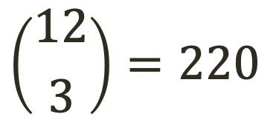
Computing the # of scenarios
Combinations
A combination is useful for calculating the number of ways to choose k successes in n trials.
n
A person flips a coin 12 times. We record the number of heads, and ask what is the probability of getting 3 heads?
k
$$\left({12 \atop 3}\right)=220$$

Slide 32
Computing the # of scenarios
Combinations
A combination is useful for calculating the number of ways to choose k successes in n trials.
A person rolls a die 5 times. We record the number of times 1 is rolled, and ask what is the probability of rolling 1 three times?

Slide 33
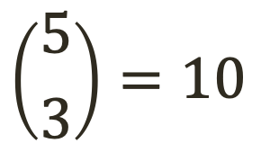
Computing the # of scenarios
Combinations
A combination is useful for calculating the number of ways to choose k successes in n trials.
n
A person rolls a die 5 times. We record the number of times 1 is rolled, and ask what is the probability of rolling 1 three times?
k
$$\left({5 \atop 3}\right)=10$$

Slide 34
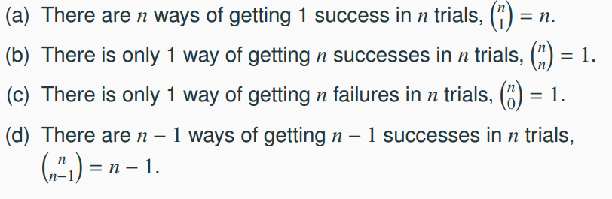
Practice
Which of the following is false?

Slide 35
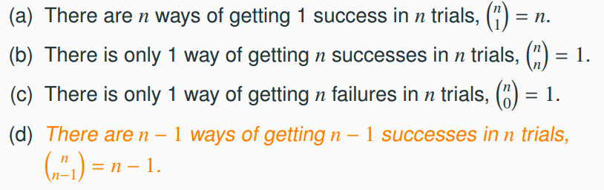
Practice
Which of the following is false?

Slide 36
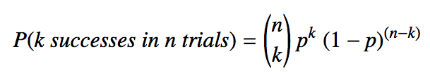
Binomial distribution (cont.)
Binomial probabilities
If p represents probability of success, (1-p) represents probability of failure, n represents number of independent trials, and k represents number of successes
P(k successes in n trials) = # of scenarios x P(single scenario)

Slide 37
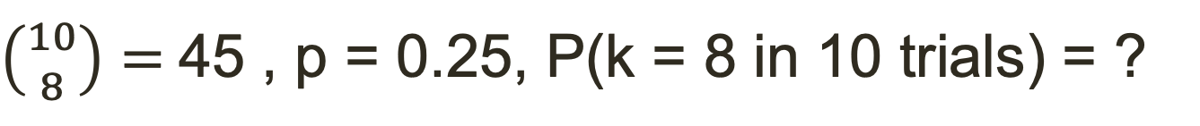
Binomial distribution (cont.)
Binomial probabilities
If p represents probability of success, (1-p) represents probability of failure, n represents number of independent trials, and k represents number of successes
n
A person randomly guesses the answers to 10 multiple
choice questions (each questions has 4 answers to chose from). We record the number of correct answers, and ask what is the probability of getting 8 answers correct?
k
$\left({10 \atop 8}\right)=$45 , p = 0.25, P(k = 8 in 10 trials) = ?

Slide 38
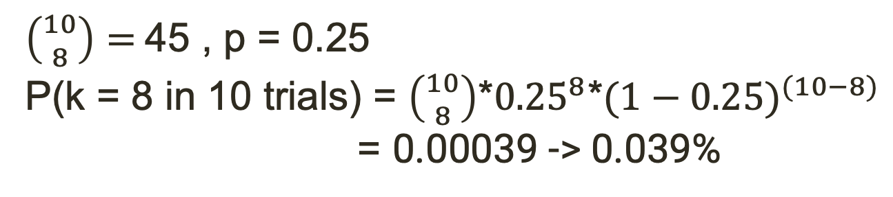
Binomial distribution (cont.)
Binomial probabilities
If p represents probability of success, (1-p) represents probability of failure, n represents number of independent trials, and k represents number of successes
n
A person randomly guesses the answers to 10 multiple
choice questions (each questions has 4 answers to chose from). We record the number of correct answers, and ask what is the probability of getting 8 answers correct?
k
$\left({10 \atop 8}\right)=$45 , p = 0.25
P(k = 8 in 10 trials) = $\left({10 \atop 8}\right)$*${0.25}^{8}{\text{*}(1−0.25)}^{(10−8)}$
= 0.00039 -> 0.039%

Slide 39
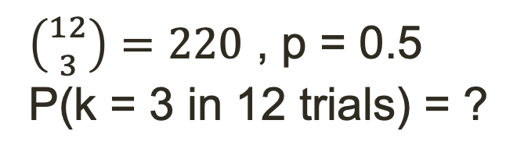
Binomial distribution (cont.)
Binomial probabilities
If p represents probability of success, (1-p) represents probability of failure, n represents number of independent trials, and k represents number of successes
n
A person flips a coin 12 times. We record the number of heads, and ask what is the probability of getting 3 heads?
k
$\left({12 \atop 3}\right)=220$ , p = 0.5
P(k = 3 in 12 trials) = ?

Slide 40
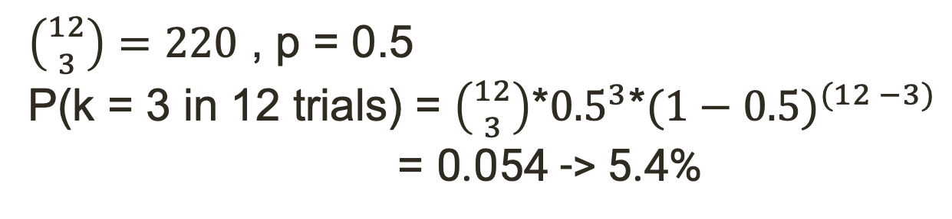
Binomial distribution (cont.)
Binomial probabilities
If p represents probability of success, (1-p) represents probability of failure, n represents number of independent trials, and k represents number of successes
n
A person flips a coin 12 times. We record the number of heads, and ask what is the probability of getting 3 heads?
k
$\left({12 \atop 3}\right)=220$ , p = 0.5
P(k = 3 in 12 trials) = $\left({12 \atop 3}\right)$*${0.5}^{3}{\text{*}(1−0.5)}^{(12 −3)}$
= 0.054 -> 5.4%

Slide 41
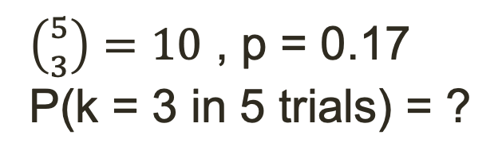
Binomial distribution (cont.)
Binomial probabilities
If p represents probability of success, (1-p) represents probability of failure, n represents number of independent trials, and k represents number of successes
n
A person rolls a die 5 times. We record the number of times 1 is rolled, and ask what is the probability of rolling 1 three times?
k
$\left({5 \atop 3}\right)=10$ , p = 0.17
P(k = 3 in 5 trials) = ?

Slide 42
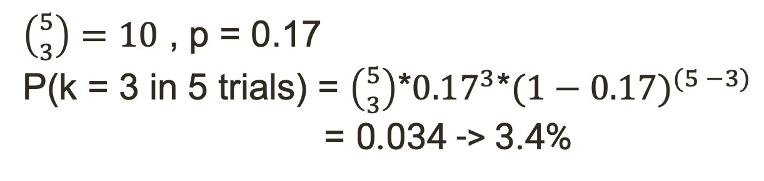
Binomial distribution (cont.)
Binomial probabilities
If p represents probability of success, (1-p) represents probability of failure, n represents number of independent trials, and k represents number of successes
n
A person rolls a die 5 times. We record the number of times 1 is rolled, and ask what is the probability of rolling 1 three times?
k
$\left({5 \atop 3}\right)=10$ , p = 0.17
P(k = 3 in 5 trials) = $\left({5 \atop 3}\right)$*${0.17}^{3}{\text{*}(1−0.17)}^{(5 −3)}$
= 0.034 -> 3.4%

Slide 43
Practice
Which of the following is not a condition that needs to be met for the binomial distribution to be applicable?
the trials must be independent
the number of trials, n, must be fixed
each trial outcome must be classified as a success or a failure
the number of desired successes, k, must be greater than the number of trials
the probability of success, p, must be the same for each trial

Slide 44
Practice
Which of the following is not a condition that needs to be met for the binomial distribution to be applicable?
the trials must be independent
the number of trials, n, must be fixed
each trial outcome must be classified as a success or a failure
the number of desired successes, k, must be greater than the number of trials
the probability of success, p, must be the same for each trial

Slide 45

Expected value and its variability
Mean and standard deviation of binomial distribution

Slide 46

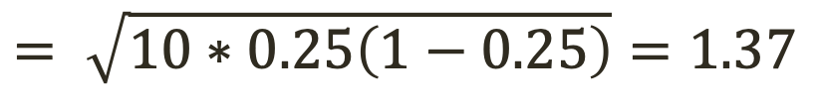
Expected value and its variability
Mean and standard deviation of binomial distribution
Going back to the multiple choice problems:
$$= \sqrt{10∗0.25\left(1−0.25\right)}=1.37$$

Slide 47
Expected value and its variability
Mean and standard deviation of binomial distribution
Going back to the multiple choice problems:
$$= \sqrt{10∗0.25\left(1−0.25\right)}=1.37$$
We would expect 2.5 out of 10 problems to be correct, with a standard deviation of 1.37.

Slide 48
Unusual observations
Using the notion that observations that are more than 2 standard deviations away from the mean are considered unusual and the mean and the standard deviation we just computed, we can calculate a range for the plausible number of correct answers in samples of 10.
2.5 ± (2 x 1.37) → (0, 5.24)

Slide 49
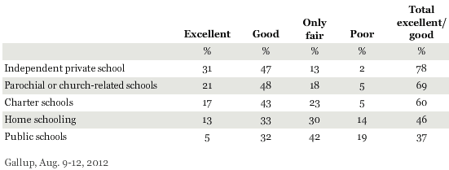
Practice
An August 2012 Gallup poll suggests that 13% of Americans think home schooling provides an excellent education for children. Would a random sample of 1,000 Americans where only 100 share this opinion be considered unusual?
(a) Yes (b) No
http://www.gallup.com/poll/156974/private-schools-top-marks-educating-children.aspx

Slide 50

Practice
An August 2012 Gallup poll suggests that 13% of Americans think home schooling provides an excellent education for children. Would a random sample of 1,000 Americans where only 100 share this opinion be considered unusual?
(a) Yes (b) No
http://www.gallup.com/poll/156974/private-schools-top-marks-educating-children.aspx

Slide 51
Practice
An August 2012 Gallup poll suggests that 13% of Americans think home schooling provides an excellent education for children. Would a random sample of 1,000 Americans where only 100 share this opinion be considered unusual?
(a) Yes (b) No
http://www.gallup.com/poll/156974/private-schools-top-marks-educating-children.aspx

Slide 52
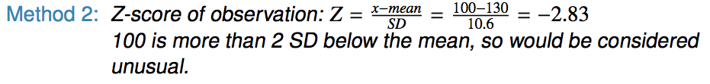
Practice
An August 2012 Gallup poll suggests that 13% of Americans think home schooling provides an excellent education for children. Would a random sample of 1,000 Americans where only 100 share this opinion be considered unusual?
(a) Yes (b) No
http://www.gallup.com/poll/156974/private-schools-top-marks-educating-children.aspx

Slide 53
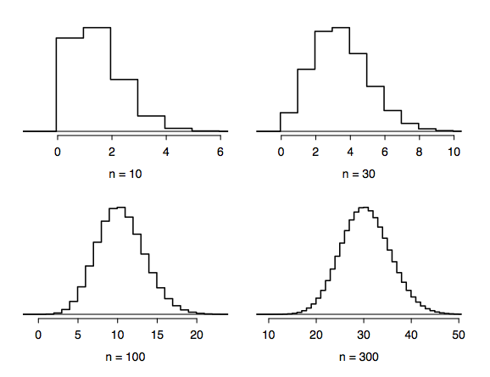
Distributions of number
of successes
Hollow histograms of samples from the binomial model where p = 0.10 and n = 10, 30, 100, and 300. What happens as n increases?

Slide 54
How large is large enough?
The sample size is considered large enough to be approximated by the normal distribution if the expected number of successes and failures are both at least 10.
np ≥ 10 and n(1 - p) ≥ 10

Slide 55
Practice
Below are four pairs of Binomial distribution parameters. Which distribution can be approximated by the normal distribution?
n = 100, p = 0.95
n = 25, p = 0.45
n = 150, p = 0.05
n = 500, p = 0.015
Below are four pairs of Binomial distribution parameters. Which distribution can be approximated by the normal distribution?
n = 100, p = 0.95
n = 25, p = 0.45
n = 150, p = 0.05
n = 500, p = 0.015
np ≥ 10 and n(1 - p) ≥ 10

Slide 56
Practice
Below are four pairs of Binomial distribution parameters. Which distribution can be approximated by the normal distribution?
n = 100, p = 0.95
n = 25, p = 0.45
n = 150, p = 0.05
n = 500, p = 0.015
Below are four pairs of Binomial distribution parameters. Which distribution can be approximated by the normal distribution?
n = 100, p = 0.95
n = 25, p = 0.45 → 25 x 0.45 = 11.25, 25 x 0.55 = 13.75
n = 150, p = 0.05
n = 500, p = 0.015
np ≥ 10 and n(1 - p) ≥ 10

Slide 57
Ex. An analysis of Facebook users
A recent study found that “Facebook users get more than they give”. For example:
40% of Facebook users in our sample made a friend request, but 63% received at least one request
Users in our sample pressed the like button next to friends' content an average of 14 times, but had their content ``liked" an average of 20 times
Users sent 9 personal messages, but received 12
12% of users tagged a friend in a photo, but 35% were themselves tagged in a photo
Any guesses for how this pattern can be explained?
http://www.pewinternet.org/Reports/2012/Facebook-users/Summary.aspx

Slide 58
Ex. An analysis of Facebook users
A recent study found that “Facebook users get more than they give”. For example:
40% of Facebook users in our sample made a friend request, but 63% received at least one request
Users in our sample pressed the like button next to friends' content an average of 14 times, but had their content ``liked" an average of 20 times
Users sent 9 personal messages, but received 12
12% of users tagged a friend in a photo, but 35% were themselves tagged in a photo
Any guesses for how this pattern can be explained?
Power users contribute much more content than the typical user.
http://www.pewinternet.org/Reports/2012/Facebook-users/Summary.aspx

Slide 59
Ex. Facebook
This study also found that approximately 25% of Facebook users are considered power users. The same study found that the average Facebook user has 245 friends. What is the probability that the average Facebook user with 245 friends has 70 or more friends who would be considered power users? Note any assumptions you must make.
We are given that n = 245, p = 0.25, and we are asked for the probability P(K ≥70). To proceed, we need independence, which we'll assume but could check if we had access to more Facebook data.

Slide 60
Ex. Facebook
This study also found that approximately 25% of Facebook users are considered power users. The same study found that the average Facebook user has 245 friends. What is the probability that the average Facebook user with 245 friends has 70 or more friends who would be considered power users? Note any assumptions you must make.
We are given that n = 245, p = 0.25, and we are asked for the probability P(K ≥70). To proceed, we need independence, which we'll assume but could check if we had access to more Facebook data.
P(X ≥ 70) = P(K = 70 or K = 71 or K = 72 or … or K = 245) = P(K = 70) + P(K = 71) + P(K = 72) + … + P(K = 245)

Slide 61
Ex. Facebook
This study also found that approximately 25% of Facebook users are considered power users. The same study found that the average Facebook user has 245 friends. What is the probability that the average Facebook user with 245 friends has 70 or more friends who would be considered power users? Note any assumptions you must make.
We are given that n = 245, p = 0.25, and we are asked for the probability P(K ≥70). To proceed, we need independence, which we'll assume but could check if we had access to more Facebook data.
P(X ≥ 70) = P(K = 70 or K = 71 or K = 72 or … or K = 245) = P(K = 70) + P(K = 71) + P(K = 72) + … + P(K = 245)
This seems like an awful lot of work...

Slide 62
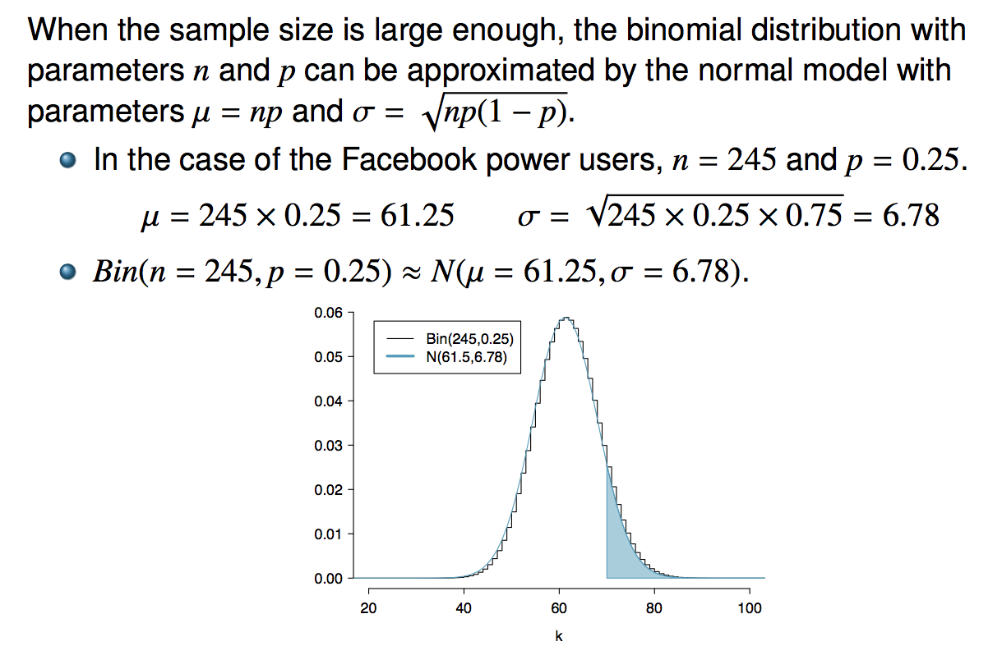
Normal approximation
to the binomial

Slide 63
Practice
What is the probability that the average Facebook user with 245 friends has 70 or more friends who would be considered power users?

Slide 64
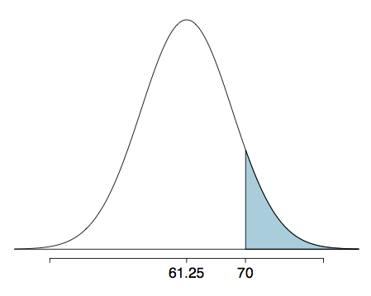
Practice
What is the probability that the average Facebook user with 245 friends has 70 or more friends who would be considered power users?

Slide 65
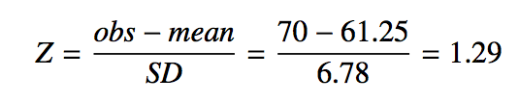
Practice
What is the probability that the average Facebook user with 245 friends has 70 or more friends who would be considered power users?

Slide 66
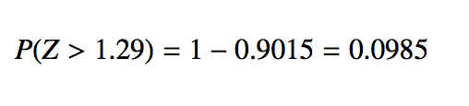
Practice
What is the probability that the average Facebook user with 245 friends has 70 or more friends who would be considered power users?

Slide 67
The normal approximation breaks down on small intervals
The normal approximation to the binomial distribution tends to perform poorly when estimating the probability of a small range of counts, even when the conditions are met.

