Slide 1
Inference for Difference Between Many Proportions
Dr. Ab Mosca (they/them)
Slides based off slides courtesy of OpenIntro and John McGreedy of Johns Hopkins University

Slide 2
Plan for Today
Chi-Square Test of Independence
Goodness of Fit

Slide 3
Chi-Square test of Goodness of Fit (GOF)

Slide 4
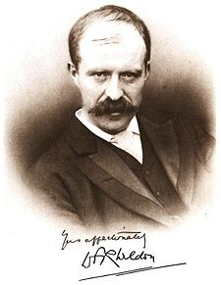
Weldon's dice
Walter Frank Raphael Weldon (1860 - 1906), was an English evolutionary biologist and a founder of biometry. He was the joint founding editor of Biometrika, with Francis Galton and Karl Pearson.
In 1894, he rolled 12 dice 26,306 times, and recorded the number of 5s or 6s (which he considered to be a success).
It was observed that 5s or 6s occurred more often than expected, and Pearson hypothesized that this was probably due to the construction of the dice. Most inexpensive dice have hollowed-out pips, and since opposite sides add to 7, the face with 6 pips is lighter than its opposing face, which has only 1 pip.

Slide 5
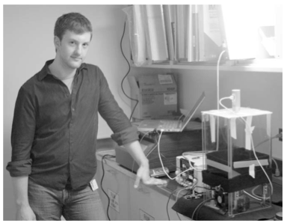
Labby's dice
In 2009, Zacariah Labby (U of Chicago), repeated Weldon's experiment using a homemade dice-throwing, pip counting machine.
www.youtube.com/watch?v=95EErdouO2w
The rolling-imaging process took about 20 seconds per roll.
Each day there were ~150 images to process manually.
At this rate Weldon's experiment was repeated in a little more than six full days.

Slide 6
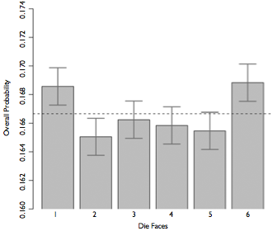
Labby's dice (cont.)
Labby did not actually observe the same phenomenon that Weldon observed (higher frequency of 5s and 6s).
Automation allowed Labby to collect more data than Weldon did in 1894, instead of recording "successes" and "failures", Labby recorded the individual number of pips on each die.

Slide 7
Expected counts
Labby rolled 12 dice 26,306 times. If each side is equally likely to come up, how many 1s, 2s, ..., 6s would he expect to have observed?
1/6
12/6
26,306 / 6
12 x 26,306 / 6

Slide 8
Expected counts
Labby rolled 12 dice 26,306 times. If each side is equally likely to come up, how many 1s, 2s, ..., 6s would he expect to have observed?
1/6
12 / 6
26,306 / 6
12 x 26,306 / 6 = 52,612
Odds of 1’s, 2’s etc. on one roll for one die:
1/6
Odds of 1’s, 2’s etc. on one roll for 12 dice:
1/6 * 12 = 12/6
Expected number of 1’s, 2’s etc. for 26,306 rolls of 12 dice:
12/6 * 26306

Slide 9
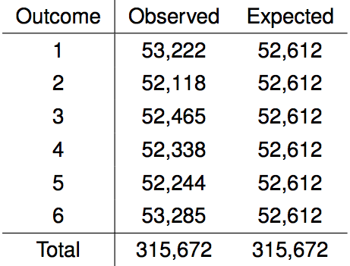
Summarizing Labby's results
The table below shows the observed and expected counts from Labby's experiment.

Slide 10
Summarizing Labby's results
The table below shows the observed and expected counts from Labby's experiment.
Why are the expected counts the same for all outcomes but the observed counts are different? Is there a significant inconsistency between the observed and expected counts?

Slide 11
Summarizing Labby's results
The table below shows the observed and expected counts from Labby's experiment.
Why are the expected counts the same for all outcomes but the observed counts are different? Is there a significant inconsistency between the observed and expected counts?
We can answer this question with a Chi-squared GOF test

Slide 12
Setting the hypotheses
Do these data provide convincing evidence of an inconsistency between the observed and expected counts?

Slide 13
Setting the hypotheses
Do these data provide convincing evidence of an inconsistency between the observed and expected counts?
H₀: There is no inconsistency between the observed and the expected counts. The observed counts follow the same distribution as the expected counts.
H_{A}: There is an inconsistency between the observed and the expected counts. The observed counts do not follow the same distribution as the expected counts. (There is a bias in which side comes up on the roll of a die.)

Slide 14
Evaluating the hypotheses
To evaluate these hypotheses, we quantify how different the observed counts are from the expected counts.

Slide 15
Evaluating the hypotheses
To evaluate these hypotheses, we quantify how different the observed counts are from the expected counts.
Large deviations from what would be expected based on sampling variation (chance) alone provide strong evidence for the alternative hypothesis.

Slide 16
Evaluating the hypotheses
To evaluate these hypotheses, we quantify how different the observed counts are from the expected counts.
Large deviations from what would be expected based on sampling variation (chance) alone provide strong evidence for the alternative hypothesis.
This is called a goodness of fit test since we're evaluating how well the observed data fit the expected distribution.

Slide 17
Chi-square statistic
When dealing with counts and investigating how far the observed counts are from the expected counts, we use a new test statistic called the chi-square (χ²) statistic.

Slide 18
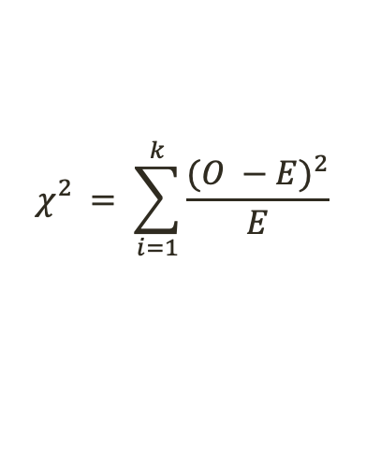
Chi-square statistic
When dealing with counts and investigating how far the observed counts are from the expected counts, we use a new test statistic called the chi-square (χ²) statistic.
$$χ_{}^{2}= \sum_{i=1}^{k}{\frac{{(O −E)}^{2}}{E}}$$
where k = total number of cells

Slide 19
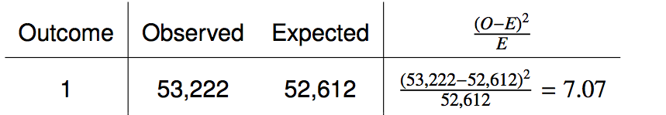


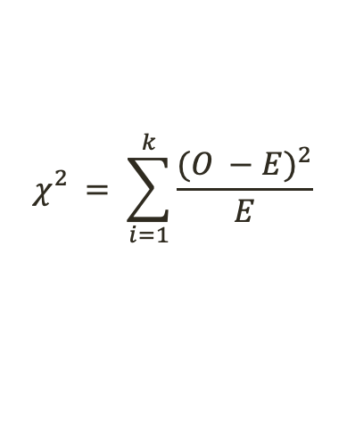
Calculating the chi-square statistic
$$χ_{}^{2}= \sum_{i=1}^{k}{\frac{{(O −E)}^{2}}{E}}$$
where k = total number of cells

Slide 20
Calculating the chi-square statistic

Slide 21
Calculating the chi-square statistic
Calculate the chi-squared statistic

Slide 22
Calculating the chi-square statistic

Slide 23
The chi-square distribution
In order to determine if the χ² statistic we calculated is considered unusually high or not we need to first describe its distribution.

Slide 24
The chi-square distribution
In order to determine if the χ² statistic we calculated is considered unusually high or not we need to first describe its distribution.
The chi-square distribution has just one parameter called degrees of freedom (df), which influences the shape, center, and spread of the distribution.

Slide 25
The chi-square distribution
In order to determine if the χ² statistic we calculated is considered unusually high or not we need to first describe its distribution.
The chi-square distribution has just one parameter called degrees of freedom (df), which influences the shape, center, and spread of the distribution.
Remember
So far we've seen three other continuous distributions:
Z (normal) distribution: unimodal and symmetric with two parameters: mean and standard deviation
T distribution: unimodal and symmetric with one parameter: degrees of freedom
F distribution: unimodal and right skewed with two parameters: degrees of freedom or numerator (between group variance) and denominator (within group variance)

Slide 26
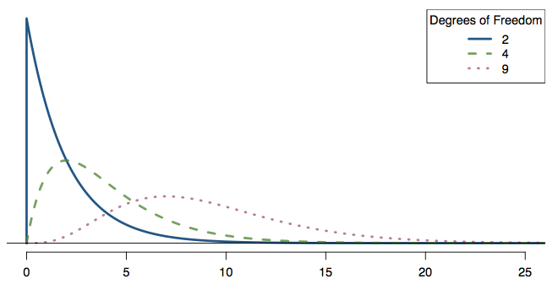
Practice
Which of the following is false?
As the df increases,
the center of the χ² distribution increases as well
the variability of the χ² distribution increases as well
the shape of the χ² distribution becomes more skewed (less like a normal)

Slide 27
Practice
Which of the following is false?
As the df increases,
the center of the χ² distribution increases as well
the variability of the χ² distribution increases as well
the shape of the χ² distribution becomes more skewed (less like a normal)

Slide 28
Finding areas under the chi-square curve
p-value = tail area under the chi-square distribution (as usual)

Slide 29
Finding areas under the chi-square curve
p-value = tail area under the chi-square distribution (as usual)
For this we can use technology, or a chi-square probability table.

Slide 30
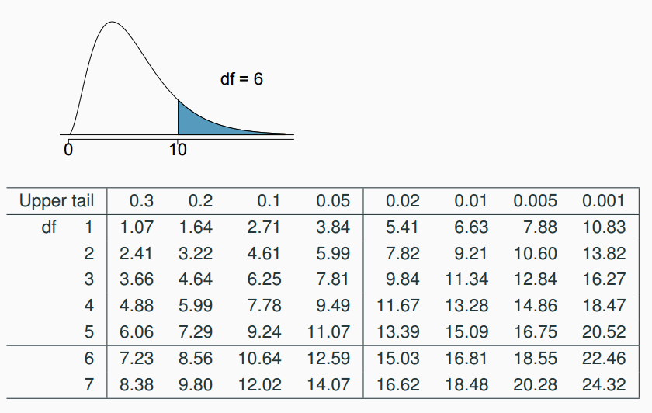
Finding areas under the chi-square curve
Estimate the shaded area under the chi-square curve with df = 6.

Slide 31
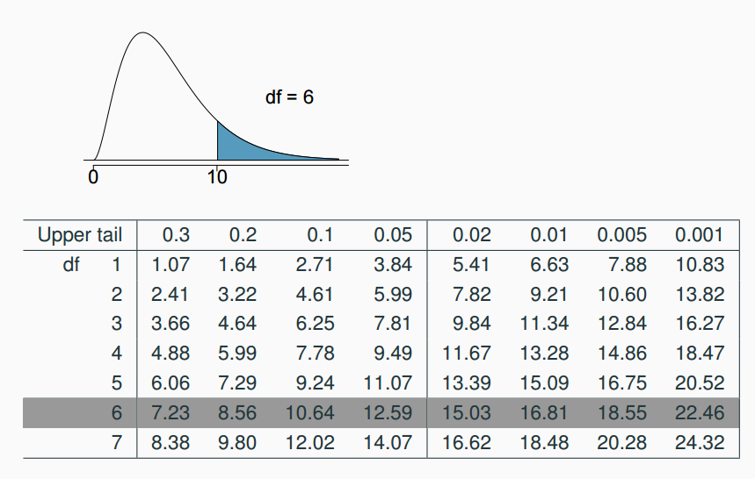
Finding areas under the chi-square curve (cont.)
Estimate the shaded area under the chi-square curve with df = 6.

Slide 32
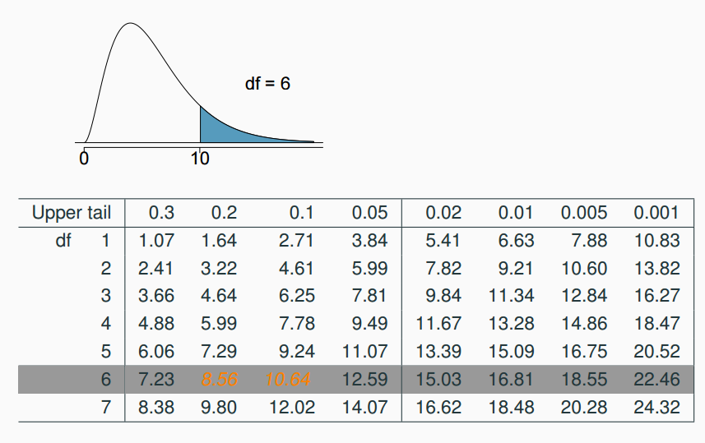
Finding areas under the chi-square curve (cont.)
Estimate the shaded area under the chi-square curve with df = 6.

Slide 33
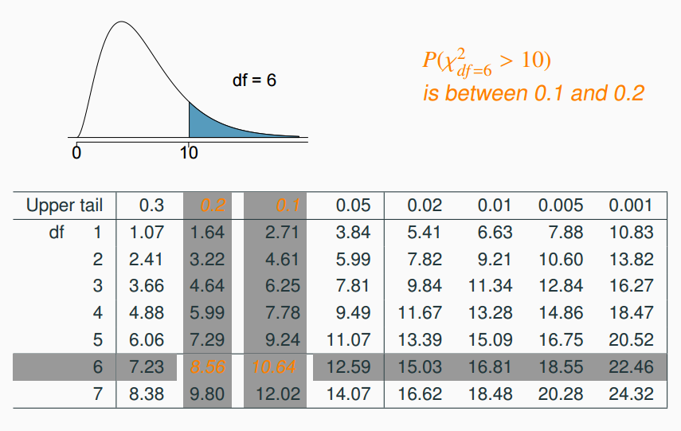
Finding areas under the chi-square curve (cont.)
Estimate the shaded area under the chi-square curve with df = 6.

Slide 34
Back to Labby's dice
The research question was: Do these data provide convincing evidence of an inconsistency between the observed and expected counts?

Slide 35
Back to Labby's dice
The research question was: Do these data provide convincing evidence of an inconsistency between the observed and expected counts?
The hypotheses were:
H₀: There is no inconsistency between the observed and the expected counts. The observed counts follow the same distribution as the expected counts.
H_{A}: There is an inconsistency between the observed and the expected counts. The observed counts do not follow the same distribution as the expected counts. There is a bias in which side comes up on the roll of a die.

Slide 36
Back to Labby's dice
The research question was: Do these data provide convincing evidence of an inconsistency between the observed and expected counts?
The hypotheses were:
H₀: There is no inconsistency between the observed and the expected counts. The observed counts follow the same distribution as the expected counts.
H_{A}: There is an inconsistency between the observed and the expected counts. The observed counts do not follow the same distribution as the expected counts. There is a bias in which side comes up on the roll of a die.
We had calculated a test statistic of χ² = 24.67.

Slide 37
Back to Labby's dice
The research question was: Do these data provide convincing evidence of an inconsistency between the observed and expected counts?
The hypotheses were:
H₀: There is no inconsistency between the observed and the expected counts. The observed counts follow the same distribution as the expected counts.
H_{A}: There is an inconsistency between the observed and the expected counts. The observed counts do not follow the same distribution as the expected counts. There is a bias in which side comes up on the roll of a die.
We had calculated a test statistic of χ² = 24.67.
All we need is the df and we can calculate the tail area (the p-value) and make a decision on the hypotheses.

Slide 38
Degrees of freedom for a goodness of fit test
When conducting a goodness of fit test to evaluate how well the observed data follow an expected distribution, the degrees of freedom are calculated as the number of cells (k) minus 1. df = k - 1

Slide 39
Degrees of freedom for a goodness of fit test
When conducting a goodness of fit test to evaluate how well the observed data follow an expected distribution, the degrees of freedom are calculated as the number of cells (k) minus 1. df = k - 1
For dice outcomes, k = 6, therefore df = 6 - 1 = 5

Slide 40
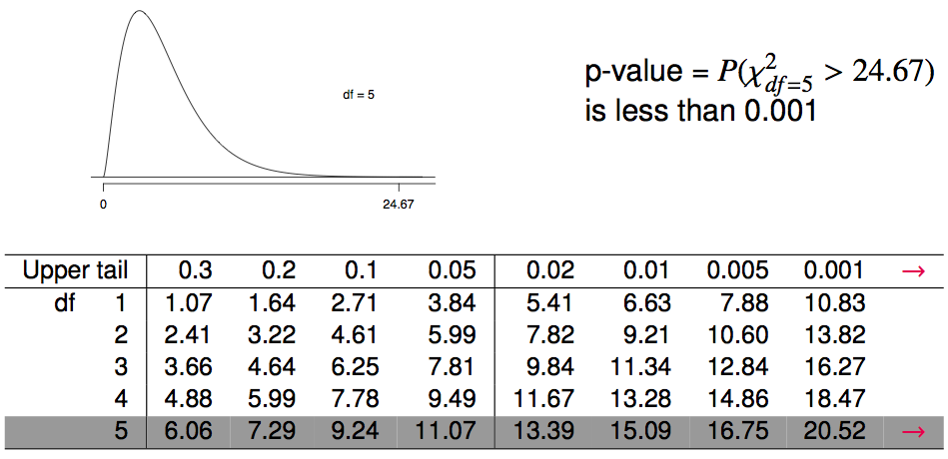
Finding a p-value for a chi-square test
The p-value for a chi-square test is defined as the tail area above the calculated test statistic.

Slide 41
Finding a p-value for a chi-square test
The p-value for a chi-square test is defined as the tail area above the calculated test statistic.

Slide 42
Conclusion of the hypothesis test
We calculated a p-value less than 0.001. At 5% significance level, what is the conclusion of the hypothesis test?
Reject H₀, the data provide convincing evidence that the dice are fair.
Reject H₀, the data provide convincing evidence that the dice are biased.
Fail to reject H₀, the data provide convincing evidence that the dice are fair.
Fail to reject H₀, the data provide convincing evidence that the dice are biased.

Slide 43
Conclusion of the hypothesis test
We calculated a p-value less than 0.001. At 5% significance level, what is the conclusion of the hypothesis test?
Reject H₀, the data provide convincing evidence that the dice are fair.
Reject H₀, the data provide convincing evidence that the dice are biased.
Fail to reject H₀, the data provide convincing evidence that the dice are fair.
Fail to reject H₀, the data provide convincing evidence that the dice are biased.

Slide 44
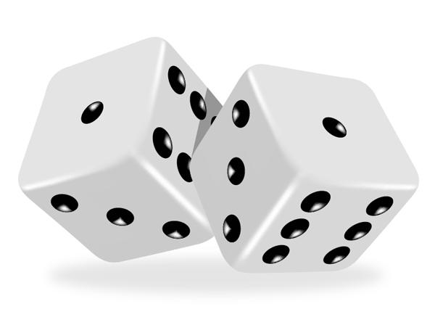

Turns out...
The 1-6 axis is consistently shorter than the other two (2-5 and 3-4), thereby supporting the hypothesis that the faces with one and six pips are larger than the other faces.
Pearson's claim that 5s and 6s appear more often due to the carved-out pips is not supported by these data.
Dice used in casinos have flush faces, where the pips are filled in with a plastic of the same density as the surrounding material and are precisely balanced.

Slide 45
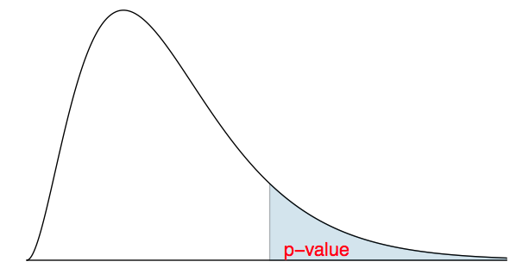
Recap: p-value for a chi-square test
The p-value for a chi-square test is defined as the tail area above the calculated test statistic.
This is because the test statistic is always positive, and a higher test statistic means a stronger deviation from the null hypothesis.

Slide 46
Conditions for the chi-square test
Independence: Each case that contributes a count to the table must be independent of all the other cases in the table.

Slide 47
Conditions for the chi-square test
Independence: Each case that contributes a count to the table must be independent of all the other cases in the table.
Sample size: Each particular scenario (i.e. cell) must have at least 5 expected cases.

Slide 48
Conditions for the chi-square test
Independence: Each case that contributes a count to the table must be independent of all the other cases in the table.
Sample size: Each particular scenario (i.e. cell) must have at least 5 expected cases.
df > 1: Degrees of freedom must be greater than 1.

Slide 49
Conditions for the chi-square test
Independence: Each case that contributes a count to the table must be independent of all the other cases in the table.
Sample size: Each particular scenario (i.e. cell) must have at least 5 expected cases.
df > 1: Degrees of freedom must be greater than 1.
Failing to check conditions may unintentionally affect the test's error rates.

Slide 50
Chi-Square Test of Independence

Slide 51
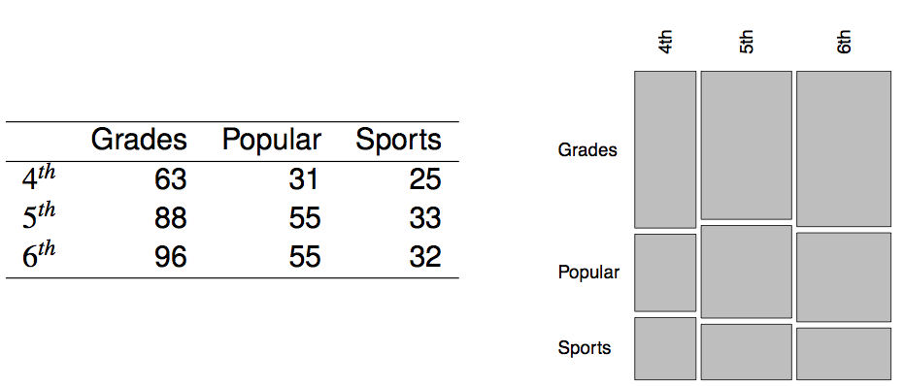
Motivation: Popular kids
In the dataset popular, students in grades 4-6 were asked whether good grades, athletic ability, or popularity was most important to them. A two-way table separating the students by grade and by choice of most important factor is shown below. Do these data provide evidence to suggest that goals vary by grade?

Slide 52
Chi-square test of independence
The hypotheses are:
H₀: Grade and goals are independent. Goals do not vary by grade.
H_{A}: Grade and goals are dependent. Goals vary by grade.

Slide 53
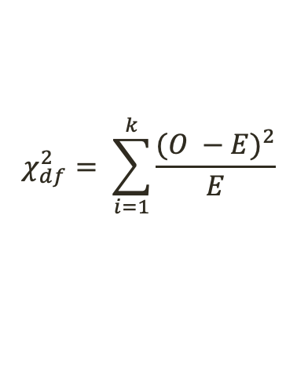

Chi-square test of independence
The hypotheses are:
H₀: Grade and goals are independent. Goals do not vary by grade.
H_{A}: Grade and goals are dependent. Goals vary by grade.
The test statistic is calculated as
where k is the number of cells, R is the number of rows, and C is the number of columns in our contingency table, O is observed counts, and E is expected counts
_______________
Note: we calculate df differently for one-way and two-way tables.
$$χ_{df}^{2}= \sum_{i=1}^{k}{\frac{{(O −E)}^{2}}{E}}$$
$$df=\left(R −1\right)∗(C−1)$$

Slide 54
Expected counts in two-way tables
Factor
 | Grades | Popular | Sports | Total
4th | 63 | 31 | 25 | 119
5th | 88 | 55 | 33 | 176
6th | 96 | 55 | 32 | 183
Total | 247 | 141 | 90 | 478
Grade
Observed

Slide 55
Expected counts in two-way tables
Factor
 | Grades | Popular | Sports | Total
4th | 63 | 31 | 25 | 119
5th | 88 | 55 | 33 | 176
6th | 96 | 55 | 32 | 183
Total | 247 | 141 | 90 | 478
Grade
Observed
Factor
 | Grades | Popular | Sports | Total
4th | ? | ? | ? | 119
5th | ? | ? | ? | 176
6th | ? | ? | ? | 183
Total | 247 | 141 | 90 | 478
Grade
Expected

Slide 56
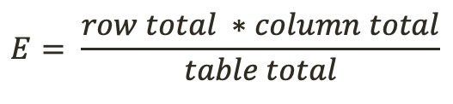
Expected counts in two-way tables
Factor
 | Grades | Popular | Sports | Total
4th | 63 | 31 | 25 | 119
5th | 88 | 55 | 33 | 176
6th | 96 | 55 | 32 | 183
Total | 247 | 141 | 90 | 478
Grade
Observed
Factor
$$E= \frac{row total ∗column total}{table total}$$
 | Grades | Popular | Sports | Total
4th | ? | ? | ? | 119
5th | ? | ? | ? | 176
6th | ? | ? | ? | 183
Total | 247 | 141 | 90 | 478
Grade
Expected

Slide 57
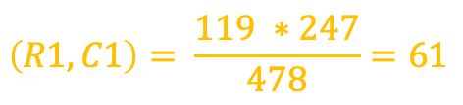
Expected counts in two-way tables
Factor
 | Grades | Popular | Sports | Total
4th | 63 | 31 | 25 | 119
5th | 88 | 55 | 33 | 176
6th | 96 | 55 | 32 | 183
Total | 247 | 141 | 90 | 478
Grade
Observed
Factor
$$E= \frac{row total ∗column total}{table total}$$
 | Grades | Popular | Sports | Total
4th | ? | ? | ? | 119
5th | ? | ? | ? | 176
6th | ? | ? | ? | 183
Total | 247 | 141 | 90 | 478
Grade
$$\left(R1, C1\right)= \frac{119 ∗247}{478}=61$$
Expected

Slide 58
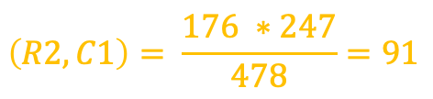
Expected counts in two-way tables
Factor
 | Grades | Popular | Sports | Total
4th | 63 | 31 | 25 | 119
5th | 88 | 55 | 33 | 176
6th | 96 | 55 | 32 | 183
Total | 247 | 141 | 90 | 478
Grade
Observed
Factor
$$E= \frac{row total ∗column total}{table total}$$
 | Grades | Popular | Sports | Total
4th | 61 | ? | ? | 119
5th | ? | ? | ? | 176
6th | ? | ? | ? | 183
Total | 247 | 141 | 90 | 478
Grade
$$\left(R2, C1\right)= \frac{176 ∗247}{478}=91$$
Expected

Slide 59
Expected counts in two-way tables
Factor
 | Grades | Popular | Sports | Total
4th | 63 | 31 | 25 | 119
5th | 88 | 55 | 33 | 176
6th | 96 | 55 | 32 | 183
Total | 247 | 141 | 90 | 478
Grade
Observed
Factor
$$E= \frac{row total ∗column total}{table total}$$
 | Grades | Popular | Sports | Total
4th | 61 | ? | ? | 119
5th | 91 | ? | ? | 176
6th | ? | ? | ? | 183
Total | 247 | 141 | 90 | 478
Grade
$$\left(R2, C1\right)= \frac{176 ∗247}{478}=91$$
Expected
Fill in the rest of the table

Slide 60
Expected counts in two-way tables
Factor
 | Grades | Popular | Sports | Total
4th | 63 | 31 | 25 | 119
5th | 88 | 55 | 33 | 176
6th | 96 | 55 | 32 | 183
Total | 247 | 141 | 90 | 478
Grade
Observed
Factor
$$E= \frac{row total ∗column total}{table total}$$
 | Grades | Popular | Sports | Total
4th | 61 | 35 | 23 | 119
5th | 91 | 52 | 33 | 176
6th | 95 | 54 | 34 | 183
Total | 247 | 141 | 90 | 478
Grade
Expected

Slide 61
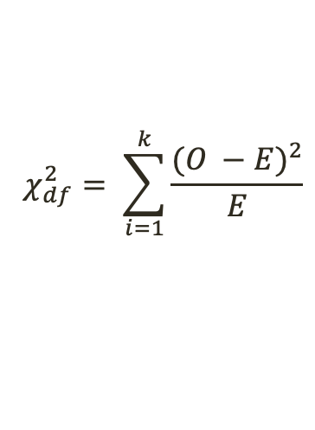

Calculating the test statistic in two-way tables
Observed
Expected
Factor
Factor
 | Grades | Popular | Sports | Total
4th | 63 | 31 | 25 | 119
5th | 88 | 55 | 33 | 176
6th | 96 | 55 | 32 | 183
Total | 247 | 141 | 90 | 478
 | Grades | Popular | Sports | Total
4th | 61 | 35 | 23 | 119
5th | 91 | 52 | 33 | 176
6th | 95 | 54 | 34 | 183
Total | 247 | 141 | 90 | 478
Grade
Grade
$$χ_{df}^{2}= \sum_{i=1}^{k}{\frac{{(O −E)}^{2}}{E}}$$
$$df=\left(R −1\right)∗(C−1)$$
What is the Chi-squared statistic?

Slide 62

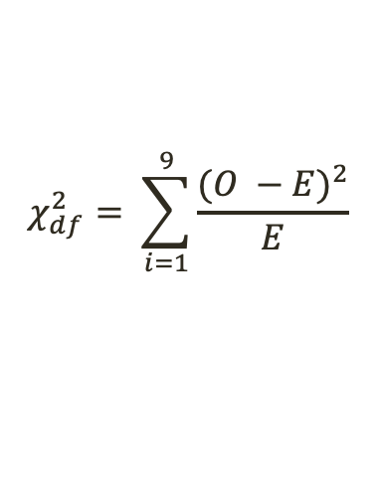
Calculating the test statistic in two-way tables
Observed
Expected
Factor
Factor
 | Grades | Popular | Sports | Total
4th | 63 | 31 | 25 | 119
5th | 88 | 55 | 33 | 176
6th | 96 | 55 | 32 | 183
Total | 247 | 141 | 90 | 478
 | Grades | Popular | Sports | Total
4th | 61 | 35 | 23 | 119
5th | 91 | 52 | 33 | 176
6th | 95 | 54 | 34 | 183
Total | 247 | 141 | 90 | 478
Grade
Grade
$$χ_{df}^{2}= \sum_{i=1}^{k}{\frac{{(O −E)}^{2}}{E}}$$
$$df=\left(R −1\right)∗(C−1)$$
$$χ_{df}^{2}= \sum_{i=1}^{9}{\frac{{(O −E)}^{2}}{E} }$$
$$=\frac{{(63−61)}^{2}}{61}+\frac{{(31−35)}^{2}}{35}+\frac{{(25−23)}^{2}}{23}+\frac{{(88−91)}^{2}}{91}+\frac{{(55−52)}^{2}}{52}+\frac{{(33−33)}^{2}}{33}+\frac{{(96−95)}^{2}}{95}+\frac{{(55−54)}^{2}}{54}+\frac{{(32−34)}^{2}}{34}$$
$$=1.3121$$

Slide 63

Calculating the test statistic in two-way tables
Observed
Expected
Factor
Factor
 | Grades | Popular | Sports | Total
4th | 63 | 31 | 25 | 119
5th | 88 | 55 | 33 | 176
6th | 96 | 55 | 32 | 183
Total | 247 | 141 | 90 | 478
 | Grades | Popular | Sports | Total
4th | 61 | 35 | 23 | 119
5th | 91 | 52 | 33 | 176
6th | 95 | 54 | 34 | 183
Total | 247 | 141 | 90 | 478
Grade
Grade
$$χ_{df}^{2}= \sum_{i=1}^{k}{\frac{{(O −E)}^{2}}{E}}$$
$$df=\left(R −1\right)∗(C−1)$$
$$χ_{df}^{2}=1.3121$$
What are the degrees of freedom?

Slide 64

Calculating the test statistic in two-way tables
Observed
Expected
Factor
Factor
 | Grades | Popular | Sports | Total
4th | 63 | 31 | 25 | 119
5th | 88 | 55 | 33 | 176
6th | 96 | 55 | 32 | 183
Total | 247 | 141 | 90 | 478
 | Grades | Popular | Sports | Total
4th | 61 | 35 | 23 | 119
5th | 91 | 52 | 33 | 176
6th | 95 | 54 | 34 | 183
Total | 247 | 141 | 90 | 478
Grade
Grade
$$χ_{df}^{2}= \sum_{i=1}^{k}{\frac{{(O −E)}^{2}}{E}}$$
$$df=\left(R −1\right)∗(C−1)$$
$$χ_{df}^{2}=1.3121$$
$$df=\left(3 −1\right)∗\left(3 −1\right)=4$$

Slide 65
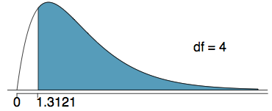
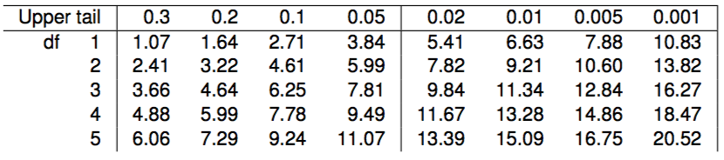
Calculating the p-value
Which of the following is the correct p-value for this hypothesis test?
χ²_{df} = 1.3121 df = 4
more than 0.3
between 0.3 and 0.2
between 0.2 and 0.1
between 0.1 and 0.05
less than 0.001

Slide 66
Calculating the p-value
Which of the following is the correct p-value for this hypothesis test?
χ²_{df} = 1.3121 df = 4
more than 0.3
between 0.3 and 0.2
between 0.2 and 0.1
between 0.1 and 0.05
less than 0.001

Slide 67

Conclusion
Do these data provide evidence to suggest that goals vary by grade?
H₀: Grade and goals are independent. Goals do not vary by grade.
H_{A}: Grade and goals are dependent. Goals vary by grade.
$$p−value>0.3$$

Slide 68

Conclusion
Do these data provide evidence to suggest that goals vary by grade?
H₀: Grade and goals are independent. Goals do not vary by grade.
H_{A}: Grade and goals are dependent. Goals vary by grade.
$$p−value>0.3, α=0.05$$
Since the p-value is large, we fail to reject H₀.The data do not provide convincing evidence that grade and goals are dependent. It doesn't appear that goals vary by grade.

Slide 69
Practice

Slide 70
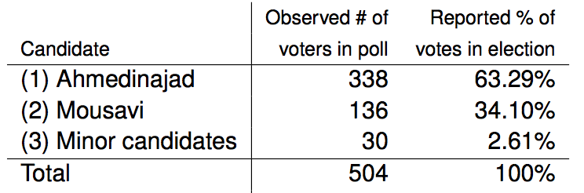
2009 Iran Election
There was lots of talk of election fraud in the 2009 Iran election. We'll compare the data from a poll conducted before the election (observed data) to the reported votes in the election to see if the two follow the same distribution.

Slide 71
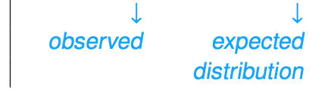
2009 Iran Election
There was lots of talk of election fraud in the 2009 Iran election. We'll compare the data from a poll conducted before the election (observed data) to the reported votes in the election to see if the two follow the same distribution.

Slide 72
Hypotheses
What are the hypotheses for testing if the distributions of reported and polled votes are different?

Slide 73
Hypotheses
What are the hypotheses for testing if the distributions of reported and polled votes are different?
H₀: The observed counts from the poll follow the same distribution as the reported votes.
H_{A}: The observed counts from the poll do not follow the same distribution as the reported votes.

Slide 74
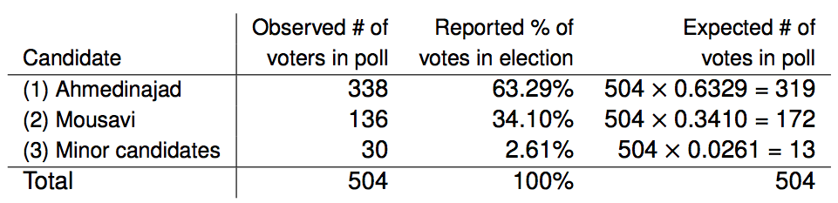
Calculation of the test statistic

Slide 75

Calculation of the test statistic

Slide 76

Calculation of the test statistic

Slide 77

Calculation of the test statistic

Slide 78

Calculation of the test statistic

Slide 79
Conclusion
Based on these calculations what is the conclusion of the hypothesis test?
p-value is low, H₀ is rejected. The observed counts from the poll do not follow the same distribution as the reported votes.
p-value is high, H₀ is not rejected. The observed counts from the poll follow the same distribution as the reported votes.
p-value is low, H₀ is rejected. The observed counts from the poll follow the same distribution as the reported votes
p-value is low, H₀ is not rejected. The observed counts from the poll do not follow the same distribution as the reported votes.

Slide 80
Conclusion
Based on these calculations what is the conclusion of the hypothesis test?
p-value is low, H₀ is rejected. The observed counts from the poll do not follow the same distribution as the reported votes.
p-value is high, H₀ is not rejected. The observed counts from the poll follow the same distribution as the reported votes.
p-value is low, H₀ is rejected. The observed counts from the poll follow the same distribution as the reported votes
p-value is low, H₀ is not rejected. The observed counts from the poll do not follow the same distribution as the reported votes.

