Slide 1
Confidence Intervals
Dr. Ab Mosca (they/them)
Slides based off slides courtesy of OpenIntro and John McGreedy of Johns Hopkins University

Slide 2
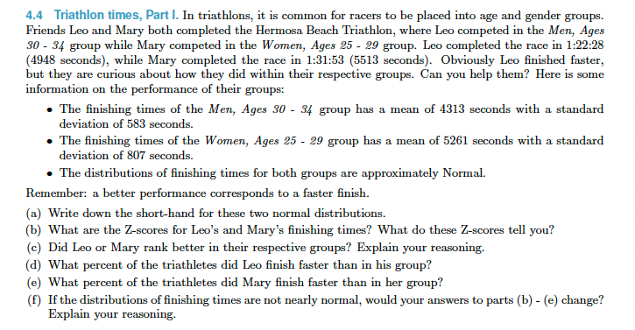
Warm Up

Slide 3
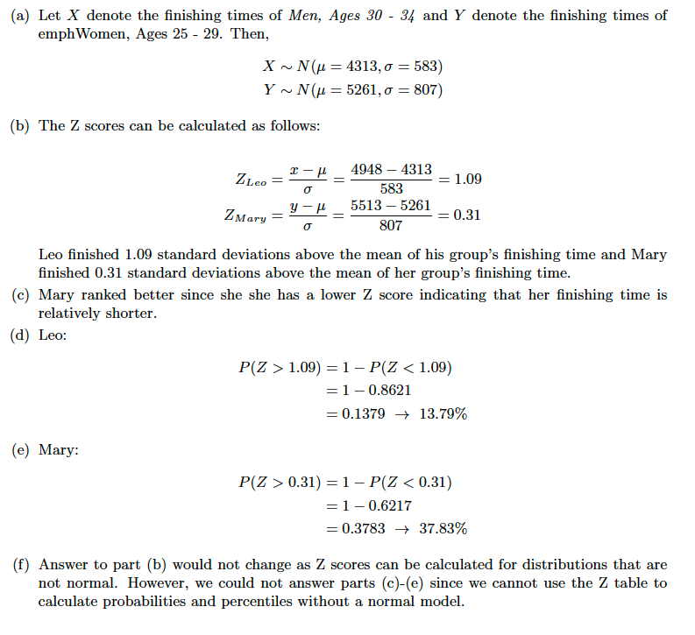
Warm Up

Slide 4
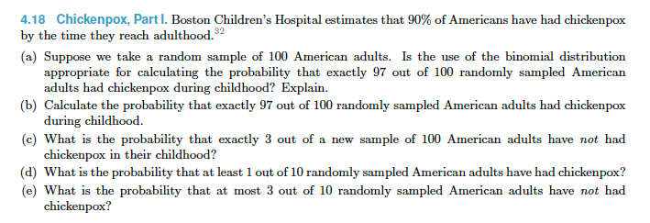
Warm Up

Slide 5
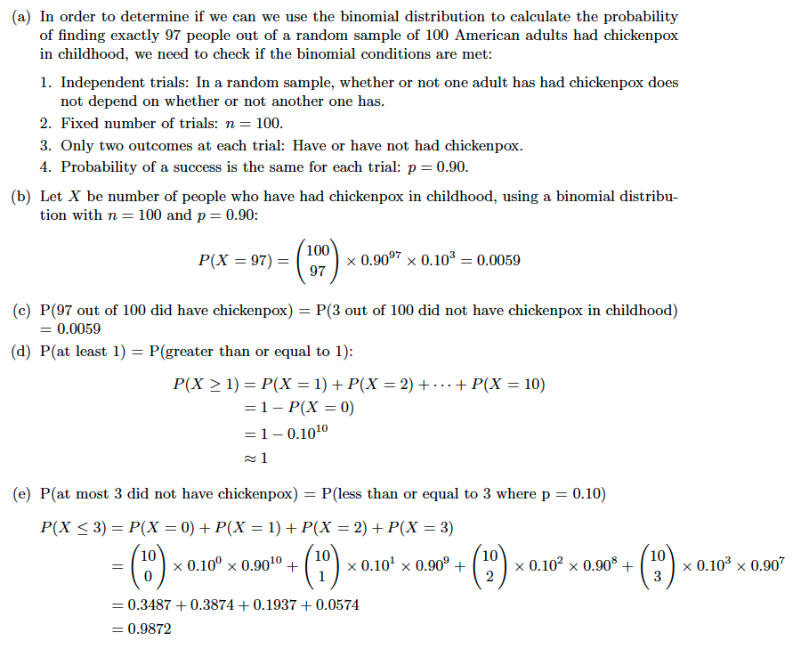
Warm Up

Slide 6
Plan for Today
Confidence Intervals (CI’s) for means
Confidence Intervals for proportions

Slide 7


Confidence intervals
A plausible range of values for the population parameter is called a confidence interval.
Using only a sample statistic to estimate a parameter is like fishing in a murky lake with a spear, and using a confidence interval is like fishing with a net.
We can throw a spear where we saw a fish but we will probably miss. If we toss a net in that area, we have a good chance of catching the fish.
If we report a point estimate, we probably won't hit the exact population parameter. If we report a range of plausible values we have a good shot at capturing the parameter.
Photos by Mark Fischer (http://www.flickr.com/photos/fischerfotos/7439791462)
and Chris Penny (http://www.flickr.com/photos/clearlydived/7029109617) on Flickr.

Slide 8
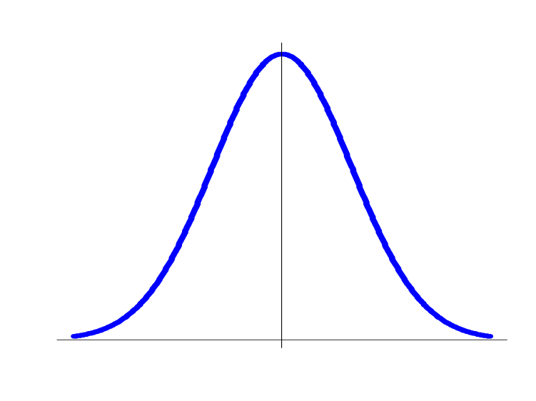
The Central Limit Theorem, Revisited—1
The CLT states that if all possible random samples of the same size, n, were taken from the same population, and a summary statistic were computed (mean, proportion) for each sample, then the distribution of the summary statistic values across these samples is:

Slide 9
The Central Limit Theorem, Revisited—2
Most (95%) of the summary statistic values fall within two standard deviations of the truth they are estimating (even more [99%] fall within three standard deviations)

Slide 10
The Central Limit Theorem, Revisited—3
In research, only one sample will be taken from each population under study
So how will the CLT help research?

Slide 11
The Central Limit Theorem, Revisited—3
In research, only one sample will be taken from each population under study
So how will the CLT help research?
By allowing us to take a point estimate and extrapolate a range of very likely true population values.

Slide 12
Examples with Means

Slide 13
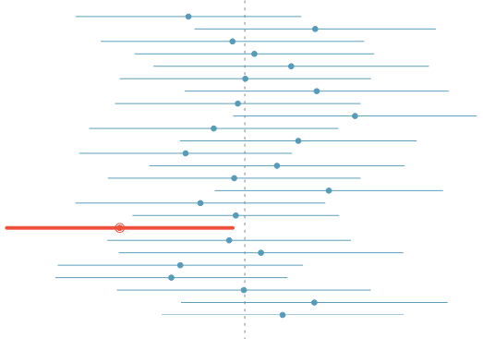
What does 95% confident mean?
Suppose we took many samples and built a confidence interval from each sample using the equation point estimate ± 2 x SE.
Then about 95% of those intervals would contain the true population mean (µ).
The figure shows this process with 25 samples, where 24 of the resulting confidence intervals contain the true average number of exclusive relationships, and one does not.

Slide 14
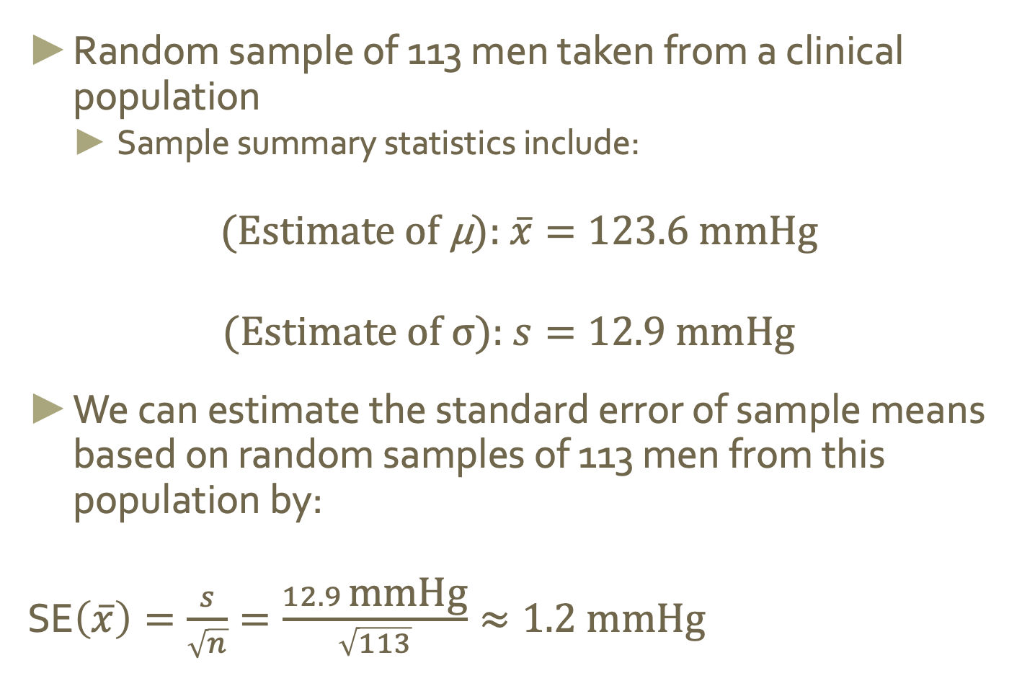
Example: 95% CI for SBP Mean, Bases on Sample of 113 Men—1
Random sample of 113 men taken from a clinical population
Sample summary statistics include:
$$\text{(}\text{Estimate} \text{of} \text{µ}\text{): }\overline{x}=123.6 \text{mmHg} \\ \text{(}\text{Estimate} \text{of} \text{σ}\text{): }s=12.9 \text{mmHg}$$
We can estimate the standard error of sample means based on random samples of 113 men from this population by:
SE$\left(\overline{x}\right)=\frac{s}{\sqrt{n}}=\frac{12.9 \text{mmHg}}{\sqrt{113}}≈1.2 \text{mmHg}$

Slide 15

Example: 95% CI for SBP Mean, Bases on Sample of 113 Men—1
Random sample of 113 men taken from a clinical population
Sample summary statistics include:
$$\text{(}\text{Estimate} \text{of} \text{µ}\text{): }\overline{x}=123.6 \text{mmHg} \\ \text{(}\text{Estimate} \text{of} \text{σ}\text{): }s=12.9 \text{mmHg}$$
We can estimate the standard error of sample means based on random samples of 113 men from this population by:
SE$\left(\overline{x}\right)=\frac{s}{\sqrt{n}}=\frac{12.9 \text{mmHg}}{\sqrt{113}}≈1.2 \text{mmHg}$
SE of a statistic is the standard deviation of the sampling distribution

Slide 16
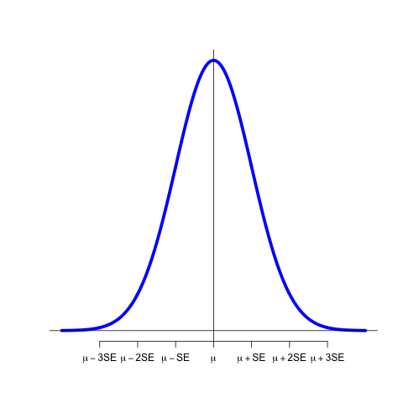
Example: 95% CI for SBP Mean, Bases on Sample of 113 Men—2
The standard error estimate quantifies how far, on average, SBP means based on 113 randomly sampled men from this clinical population will fall from the true population mean blood pressure
In other words, this standard error estimate quantifies the variability in sample means based on random samples of 113, across the samples

Slide 17
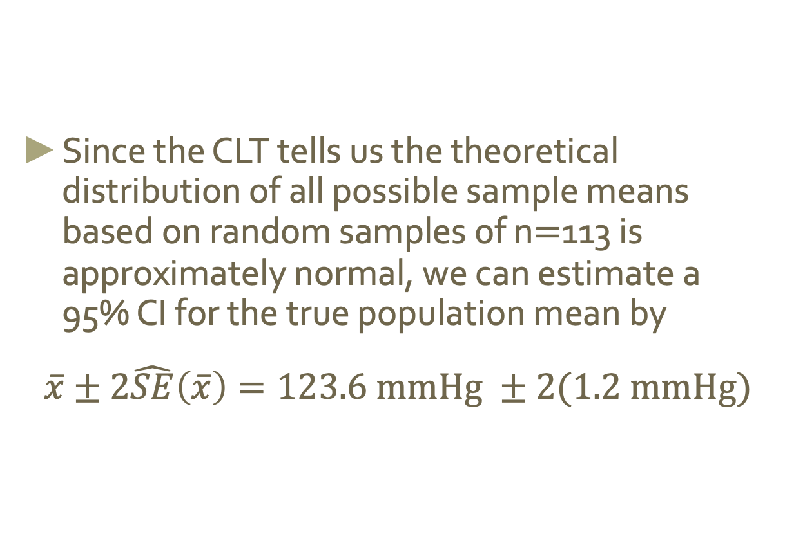
Example: 95% CI for SBP Mean, Bases on Sample of 113 Men—3
Since the CLT tells us the theoretical distribution of all possible sample means based on random samples of n$=$113 is approximately normal, we can estimate a 95% CI for the true population mean by
$$\overline{x}±2\hat{SE}\left(\overline{x}\right)=123.6 \text{mmHg} ±2(1.2 \text{mmHg}\text{)}$$

Slide 18
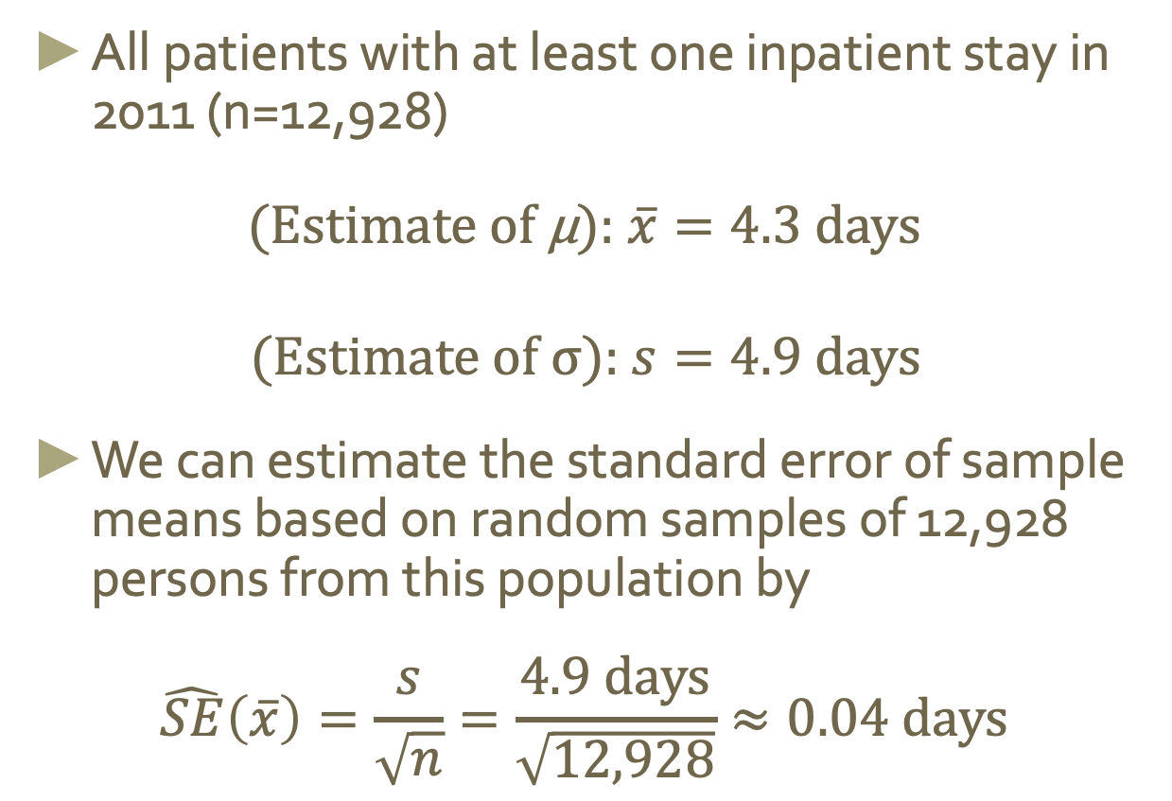
Example: Heritage Health Length of Stay—1
All patients with at least one inpatient stay in 2011 (n=12,928)
$$\text{(}\text{Estimate} \text{of} \text{µ}\text{): }\overline{x}=4.3 \text{days} \\ \text{(}\text{Estimate} \text{of} \text{σ}\text{): }s=4.9 \text{days}$$
We can estimate the standard error of sample means based on random samples of 12,928 persons from this population by
$$\hat{SE}\left(\overline{x}\right)=\frac{s}{\sqrt{n}}=\frac{4.9 \text{days}}{\sqrt{12,928}}≈0.04 \text{days}$$

Slide 19
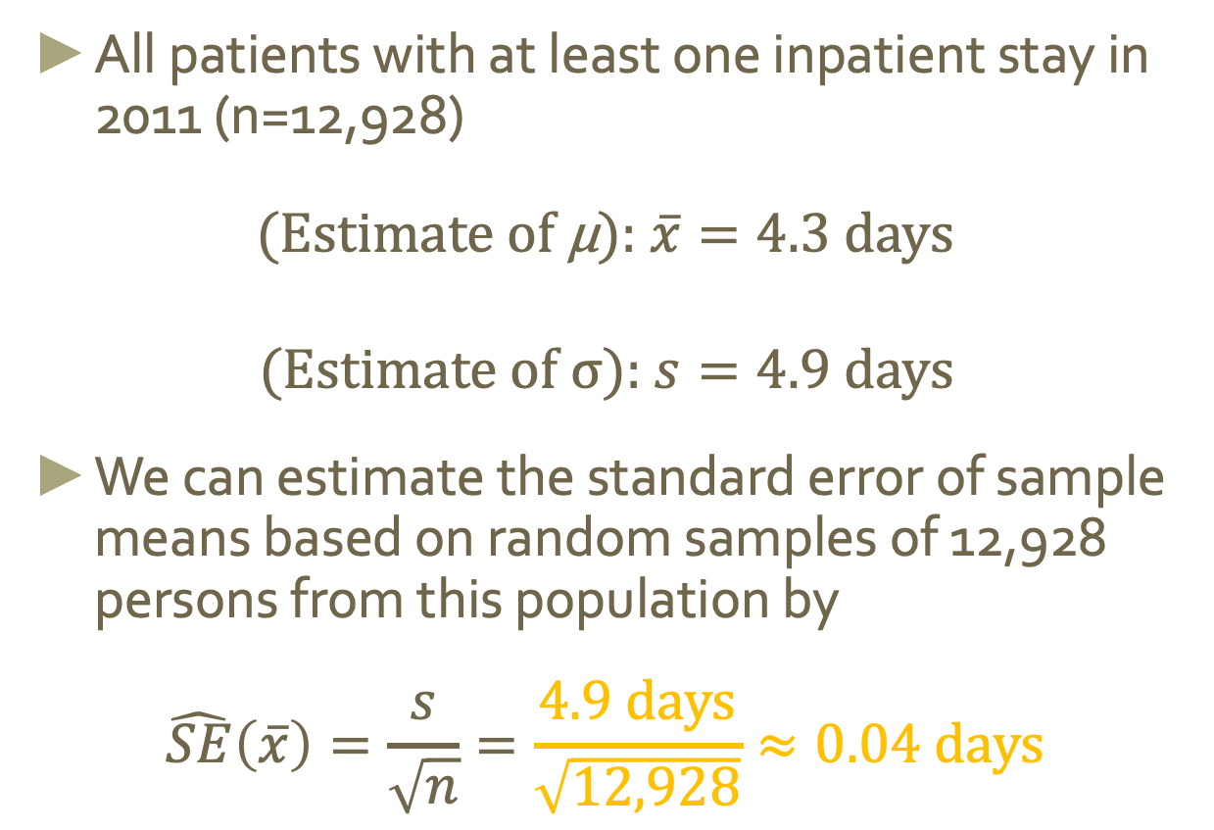
Example: Heritage Health Length of Stay—1
All patients with at least one inpatient stay in 2011 (n=12,928)
$$\text{(}\text{Estimate} \text{of} \text{µ}\text{): }\overline{x}=4.3 \text{days} \\ \text{(}\text{Estimate} \text{of} \text{σ}\text{): }s=4.9 \text{days}$$
We can estimate the standard error of sample means based on random samples of 12,928 persons from this population by
$$\hat{SE}\left(\overline{x}\right)=\frac{s}{\sqrt{n}}=\frac{4.9 \text{days}}{\sqrt{12,928}}≈0.04 \text{days}$$

Slide 20
Example: Heritage Health Length of Stay—2
The standard error estimate quantifies how far length of stay means based on 12,928 patients from the insurance population will fall from the true population mean length of stay

Slide 21
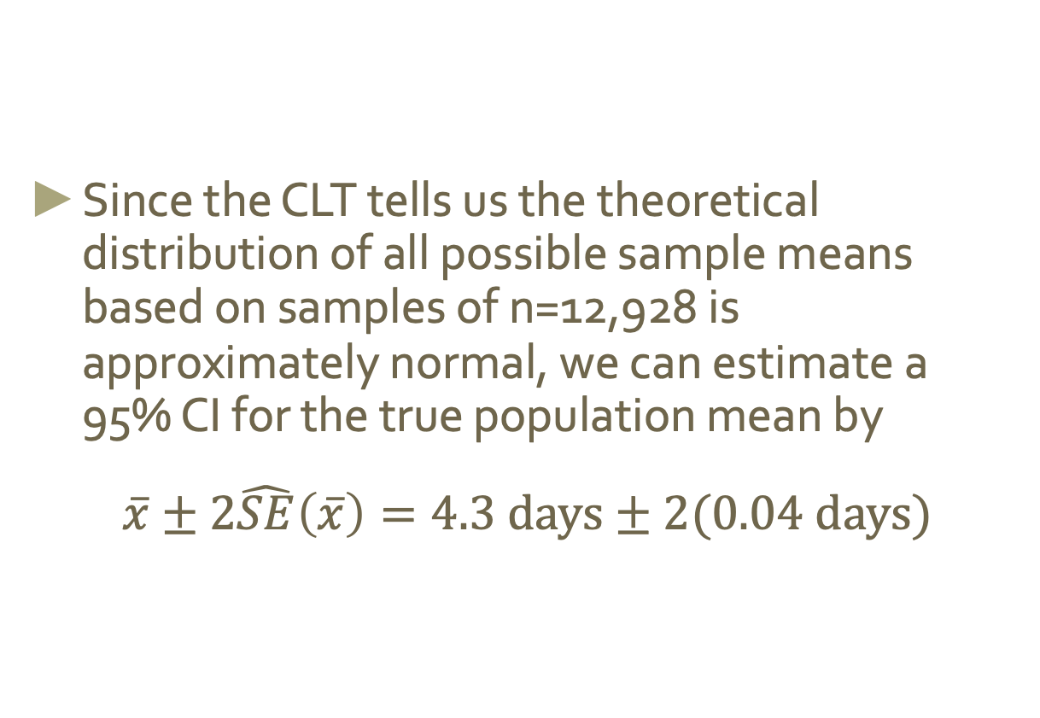
Example: Heritage Health Length of Stay—3
Since the CLT tells us the theoretical distribution of all possible sample means based on samples of n=12,928 is approximately normal, we can estimate a 95% CI for the true population mean by
$$\overline{x}±2\hat{SE}\left(\overline{x}\right)=4.3 \text{days}±2(0.04 \text{days}\text{)}$$

Slide 22
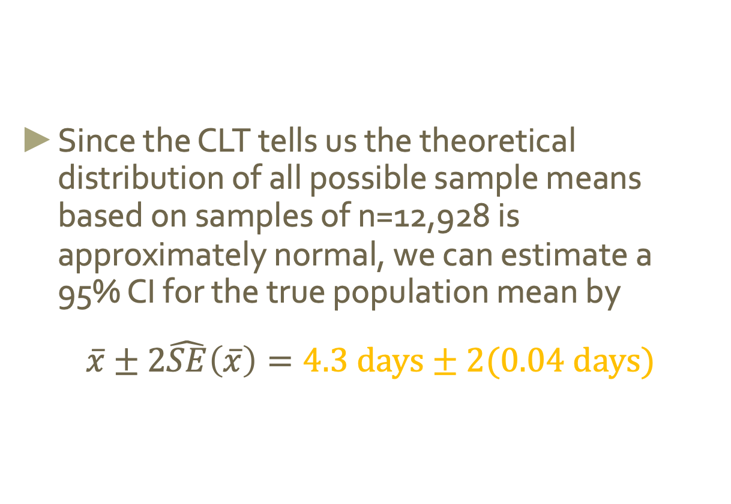
Example: Heritage Health Length of Stay—3
Since the CLT tells us the theoretical distribution of all possible sample means based on samples of n=12,928 is approximately normal, we can estimate a 95% CI for the true population mean by
$$\overline{x}±2\hat{SE}\left(\overline{x}\right)=4.3 \text{days}±2(0.04 \text{days}\text{)}$$

Slide 23
Ex. Average number of exclusive relationships
A random sample of 50 college students were asked how many exclusive relationships they have been in so far. This sample yielded a mean of 3.2 and a standard deviation of 1.74. Estimate the true average number of exclusive relationships using this sample.

Slide 24
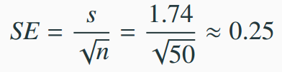
Average number of exclusive relationships
A random sample of 50 college students were asked how many exclusive relationships they have been in so far. This sample yielded a mean of 3.2 and a standard deviation of 1.74. Estimate the true average number of exclusive relationships using this sample.
The approximate 95% confidence interval is defined as
point estimate ± 2 x SE

Slide 25
Average number of exclusive relationships
A random sample of 50 college students were asked how many exclusive relationships they have been in so far. This sample yielded a mean of 3.2 and a standard deviation of 1.74. Estimate the true average number of exclusive relationships using this sample.
The approximate 95% confidence interval is defined as : point estimate ± 2 x SE
x̄ = 3.2 s = 1.74
x̄ ± 2 x SE → 3.2 ± 2 x 0.25.
→ (3.2 - 0.5, 3.2 + 0.5)
→ (2.7, 3.7)

Slide 26
Practice
Which of the following is the correct interpretation of this confidence interval?
(2.7, 3.7)
We are 95% confident that
(a) the average number of exclusive relationships college students in this sample have been in is between 2.7 and 3.7.
(b) college students on average have been in between 2.7 and 3.7 exclusive relationships.
(c) a randomly chosen college student has been in 2.7 to 3.7 exclusive relationships.
(d) 95% of college students have been in 2.7 to 3.7 exclusive relationships.

Slide 27
Practice
Which of the following is the correct interpretation of this confidence interval?
(2.7, 3.7)
We are 95% confident that
(a) the average number of exclusive relationships college students in this sample have been in is between 2.7 and 3.7.
(b) college students on average have been in between 2.7 and 3.7 exclusive relationships.
(c) a randomly chosen college student has been in 2.7 to 3.7 exclusive relationships.
(d) 95% of college students have been in 2.7 to 3.7 exclusive relationships.

Slide 28
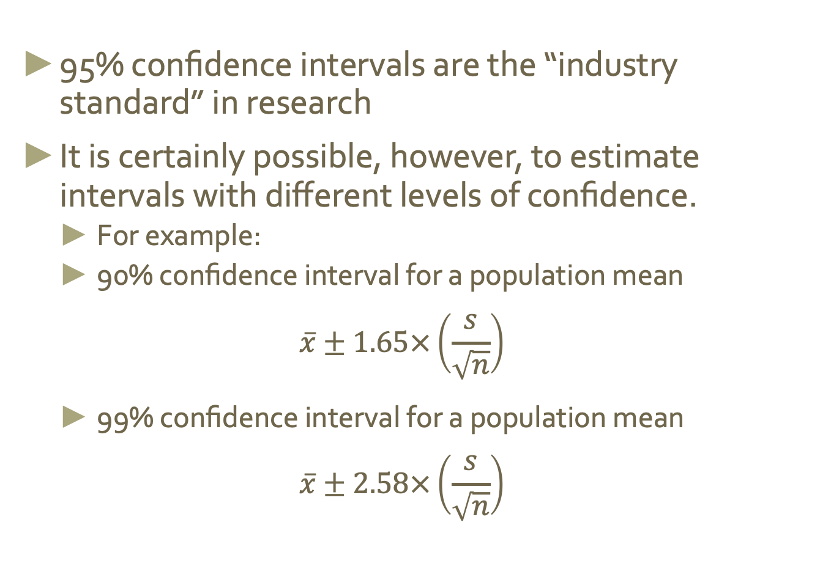
A Note on Level of Confidence
95% confidence intervals are the “industry standard” in research
It is certainly possible, however, to estimate intervals with different levels of confidence.
For example:
90% confidence interval for a population mean
$$\overline{x}±1.65×\left(\frac{s}{\sqrt{n}}\right)$$
99% confidence interval for a population mean
$$\overline{x}±2.58×\left(\frac{s}{\sqrt{n}}\right)$$

Slide 29
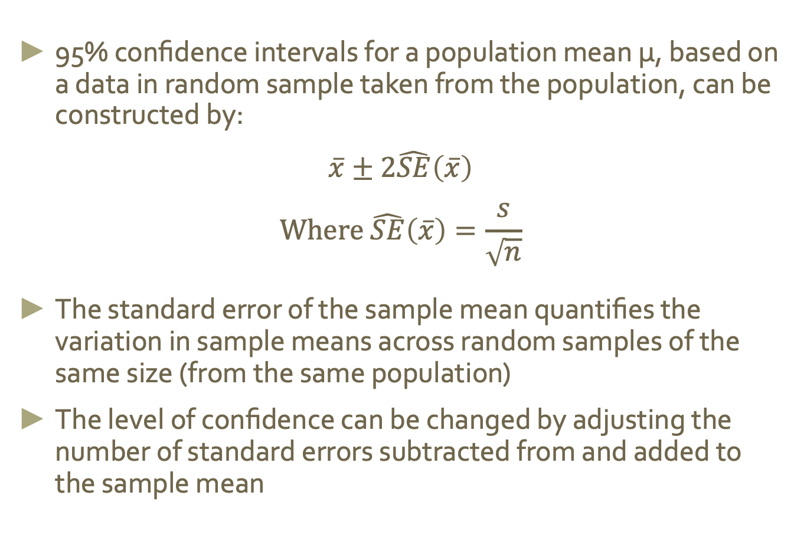
Summary
95% confidence intervals for a population mean μ, based on a data in random sample taken from the population, can be constructed by:
$$\overline{x}±2\hat{SE}\left(\overline{x}\right)$$
$$\text{Where} \hat{SE}\left(\overline{x}\right)=\frac{s}{\sqrt{n}}$$
The standard error of the sample mean quantifies the variation in sample means across random samples of the same size (from the same population)
The level of confidence can be changed by adjusting the number of standard errors subtracted from and added to the sample mean

Slide 30
Examples with Proportions

Slide 31
Ex. Facebook’s categorization of user interests
Most commercial websites (e.g. social media platforms, news out- lets, online retailers) collect a data about their users’ behaviors and use these data to deliver targeted content, recommendations, and ads. To understand whether Americans think their lives line up with how the algorithm-driven classification systems categorizes them, Pew Research asked a representative sample of 850 American Facebook users how accurately they feel the list of categories Facebook has listed for them on the page of their supposed interests actually represents them and their interests. 67% of the respondents said that the listed categories were accurate. Estimate the true proportion of American Facebook users who think the Facebook categorizes their interests accurately.
https://www.pewinternet.org/2019/01/16/facebook-algorithms-and-personal-data/

Slide 32
Ex. Facebook’s categorization of user interests
Most commercial websites (e.g. social media platforms, news out- lets, online retailers) collect a data about their users’ behaviors and use these data to deliver targeted content, recommendations, and ads. To understand whether Americans think their lives line up with how the algorithm-driven classification systems categorizes them, Pew Research asked a representative sample of 850 American Facebook users how accurately they feel the list of categories Facebook has listed for them on the page of their supposed interests actually represents them and their interests. 67% of the respondents said that the listed categories were accurate. Estimate the true proportion of American Facebook users who think the Facebook categorizes their interests accurately.
https://www.pewinternet.org/2019/01/16/facebook-algorithms-and-personal-data/
Calculate the 95% confidence interval for the true proportion

Slide 33
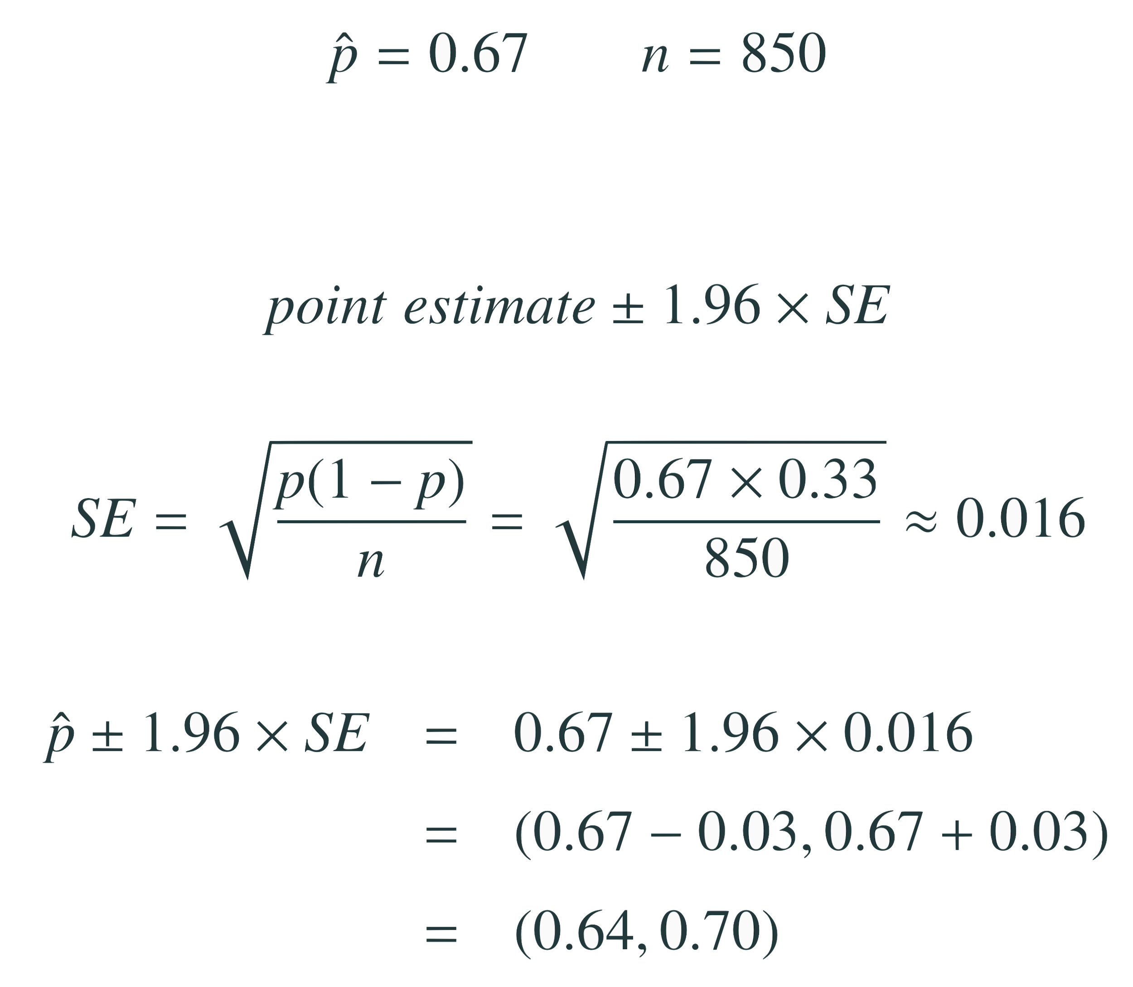
Ex. Facebook’s categorization of user interests
Most commercial websites (e.g. social media platforms, news out- lets, online retailers) collect a data about their users’ behaviors and use these data to deliver targeted content, recommendations, and ads. To understand whether Americans think their lives line up with how the algorithm-driven classification systems categorizes them, Pew Research asked a representative sample of 850 American Facebook users how accurately they feel the list of categories Facebook has listed for them on the page of their supposed interests actually represents them and their interests. 67% of the respondents said that the listed categories were accurate. Estimate the true proportion of American Facebook users who think the Facebook categorizes their interests accurately.
https://www.pewinternet.org/2019/01/16/facebook-algorithms-and-personal-data/
Calculate the 95% confidence interval for the true proportion
The approximate 95% confidence interval is defined as
2

Slide 34
Ex. Facebook’s categorization of user interests
Most commercial websites (e.g. social media platforms, news out- lets, online retailers) collect a data about their users’ behaviors and use these data to deliver targeted content, recommendations, and ads. To understand whether Americans think their lives line up with how the algorithm-driven classification systems categorizes them, Pew Research asked a representative sample of 850 American Facebook users how accurately they feel the list of categories Facebook has listed for them on the page of their supposed interests actually represents them and their interests. 67% of the respondents said that the listed categories were accurate. Estimate the true proportion of American Facebook users who think the Facebook categorizes their interests accurately.
https://www.pewinternet.org/2019/01/16/facebook-algorithms-and-personal-data/
Calculate the 95% confidence interval for the true proportion
The approximate 95% confidence interval is defined as
2

Slide 35
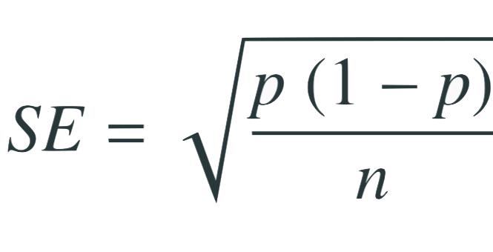
Ex. Facebook’s categorization of user interests
Most commercial websites (e.g. social media platforms, news out- lets, online retailers) collect a data about their users’ behaviors and use these data to deliver targeted content, recommendations, and ads. To understand whether Americans think their lives line up with how the algorithm-driven classification systems categorizes them, Pew Research asked a representative sample of 850 American Facebook users how accurately they feel the list of categories Facebook has listed for them on the page of their supposed interests actually represents them and their interests. 67% of the respondents said that the listed categories were accurate. Estimate the true proportion of American Facebook users who think the Facebook categorizes their interests accurately.
https://www.pewinternet.org/2019/01/16/facebook-algorithms-and-personal-data/
population proportion
Calculate the 95% confidence interval for the true proportion
The approximate 95% confidence interval is defined as
2
sample size

Slide 36
Ex. Facebook’s categorization of user interests
Most commercial websites (e.g. social media platforms, news out- lets, online retailers) collect a data about their users’ behaviors and use these data to deliver targeted content, recommendations, and ads. To understand whether Americans think their lives line up with how the algorithm-driven classification systems categorizes them, Pew Research asked a representative sample of 850 American Facebook users how accurately they feel the list of categories Facebook has listed for them on the page of their supposed interests actually represents them and their interests. 67% of the respondents said that the listed categories were accurate. Estimate the true proportion of American Facebook users who think the Facebook categorizes their interests accurately.
https://www.pewinternet.org/2019/01/16/facebook-algorithms-and-personal-data/
population proportion
Calculate the 95% confidence interval for the true proportion
The approximate 95% confidence interval is defined as
2
sample size

Slide 37
Ex. Facebook’s categorization of user interests
Most commercial websites (e.g. social media platforms, news out- lets, online retailers) collect a data about their users’ behaviors and use these data to deliver targeted content, recommendations, and ads. To understand whether Americans think their lives line up with how the algorithm-driven classification systems categorizes them, Pew Research asked a representative sample of 850 American Facebook users how accurately they feel the list of categories Facebook has listed for them on the page of their supposed interests actually represents them and their interests. 67% of the respondents said that the listed categories were accurate. Estimate the true proportion of American Facebook users who think the Facebook categorizes their interests accurately.
https://www.pewinternet.org/2019/01/16/facebook-algorithms-and-personal-data/
population proportion
Calculate the 95% confidence interval for the true proportion
The approximate 95% confidence interval is defined as
2
sample size

Slide 38
Ex. Facebook’s categorization of user interests
The approximate 95% confidence interval is defined as
2
2
2

Slide 39
Ex. Facebook’s categorization of user interests
95% confidence interval:
Which of the following is the correct interpretation of this confidence interval? We are 95% confident that...
64% to 70% of American Facebook users in this sample think Facebook categorizes their interests accurately.
64% to 70% of all American Facebook users think Facebook categorizes their interests accurately
there is a 64% to 70% chance that a randomly chosen American Facebook user’s interests are categorized accurately.
there is a 64% to 70% chance that 95% of American Facebook users’ interests are categorized accurately.

Slide 40
Ex. Facebook’s categorization of user interests
Which of the following is the correct interpretation of this confidence interval? We are 95% confident that...
64% to 70% of American Facebook users in this sample think Facebook categorizes their interests accurately.
64% to 70% of all American Facebook users think Facebook categorizes their interests accurately
there is a 64% to 70% chance that a randomly chosen American Facebook user’s interests are categorized accurately.
there is a 64% to 70% chance that 95% of American Facebook users’ interests are categorized accurately.

Slide 41
Width of an interval
If we want to be more certain that we capture the population parameter, i.e. increase our confidence level, should we use a wider interval or a smaller interval?

Slide 42
Width of an interval
If we want to be more certain that we capture the population parameter, i.e. increase our confidence level, should we use a wider interval or a smaller interval?
A wider interval.

Slide 43
Width of an interval
If we want to be more certain that we capture the population parameter, i.e. increase our confidence level, should we use a wider interval or a smaller interval?
A wider interval.
Can you see any drawbacks to using a wider interval?

Slide 44
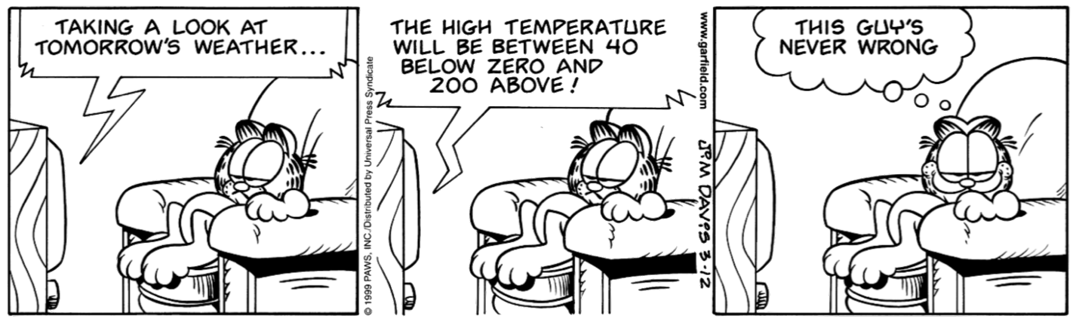
Width of an interval
If we want to be more certain that we capture the population parameter, i.e. increase our confidence level, should we use a wider interval or a smaller interval?
A wider interval.
Can you see any drawbacks to using a wider interval?
If the interval is too wide it may not be very informative.

Slide 45
Changing the confidence level
point estimate ± z* x SE
In a confidence interval, z* x SE is called the margin of error, and for a given sample, the margin of error changes as the confidence level changes.
In order to change the confidence level we need to adjust z* in the above formula.
Commonly used confidence levels in practice are 90%, 95%, 98%, and 99%.
For a 95% confidence interval, z* is about 2.
However, using the standard normal (z) distribution, it is possible to find the appropriate z* for any confidence level.

Slide 46
Interpreting confidence intervals
Confidence intervals are ...
always about the population
are not probability statements
only about population parameters, not individual observations
only reliable if the sample statistic they’re based on is an unbiased estimator of the population parameter

