Slide 1
Inference with One Sample Means and Small Samples
Dr. Ab Mosca (they/them)
Slides based off slides courtesy of OpenIntro and John McGreedy of Johns Hopkins University

Slide 2
Plan for Today
Hypothesis testing with small samples

Slide 3
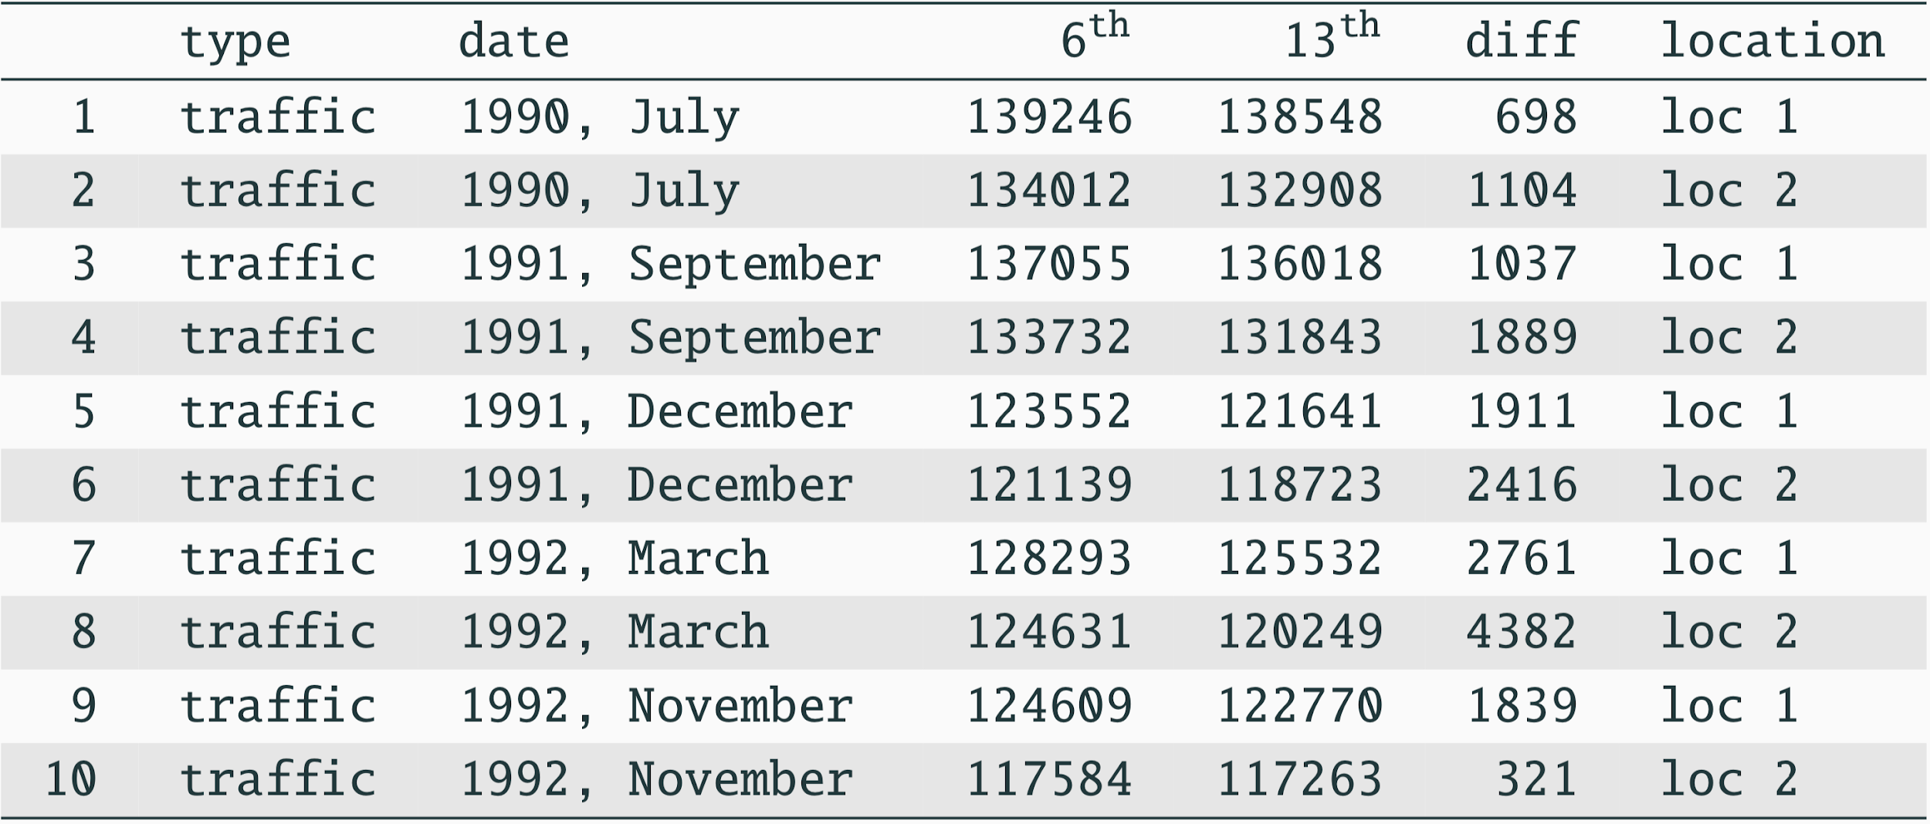
Friday the 13th
Between 1990 - 1992 researchers in the UK collected data on traffic flow, accidents, and hospital admissions on Friday 13th and the previous Friday, Friday 6th. Below is an excerpt from this data set on traffic flow. We can assume that traffic flow on given day at locations 1 and 2 are independent.

Slide 4
Friday the 13th
We want to investigate if people’s behavior is different on Friday the 13th compared to Friday 6th.

Slide 5
Friday the 13th
We want to investigate if people’s behavior is different on Friday the 13th compared to Friday 6th.
One approach is to compare the traffic flow on these two days.

Slide 6
Friday the 13th
We want to investigate if people’s behavior is different on Friday the 13th compared to Friday 6th.
One approach is to compare the traffic flow on these two days.
What is our research question?
What are H_{o} and H_{a}?

Slide 7
Friday the 13th
We want to investigate if people’s behavior is different on Friday the 13th compared to Friday 6th.
One approach is to compare the traffic flow on these two days.
What is our research question?
What are H_{o} and H_{a}?
Does traffic flow change on Friday the 13th compared to Friday the 6th?

Slide 8
Friday the 13th
We want to investigate if people’s behavior is different on Friday the 13th compared to Friday 6th.
One approach is to compare the traffic flow on these two days.
H₀ : Average traffic flow on Friday 6th and 13th are equal.
H_{A} : Average traffic flow on Friday 6th and 13th are different.

Slide 9
Friday the 13th
We want to investigate if people’s behavior is different on Friday the 13th compared to Friday 6th.
One approach is to compare the traffic flow on these two days.
H₀ : Average traffic flow on Friday 6th and 13th are equal.
H_{A} : Average traffic flow on Friday 6th and 13th are different.
Each row in the data set represents traffic flow recorded at one location in the same month of the same year: one count from Friday 6th and the other Friday 13th. Are these two counts independent?

Slide 10
Friday the 13th
We want to investigate if people’s behavior is different on Friday the 13th compared to Friday 6th.
One approach is to compare the traffic flow on these two days.
H₀ : Average traffic flow on Friday 6th and 13th are equal.
H_{A} : Average traffic flow on Friday 6th and 13th are different.
Each case in the data set represents traffic flow recorded at the same location in the same month of the same year: one count from Friday 6th and the other Friday 13th. Are these two counts independent?
No! Why not?

Slide 11
Friday the 13th
We want to investigate if people’s behavior is different on Friday the 13th compared to Friday 6th.
One approach is to compare the traffic flow on these two days.
H₀ : Average traffic flow on Friday 6th and 13th are equal.
H_{A} : Average traffic flow on Friday 6th and 13th are different.
Each case in the data set represents traffic flow recorded at the same location in the same month of the same year: one count from Friday 6th and the other Friday 13th. Are these two counts independent?
No! If there’s a lot of traffic on the 6th, I might take a different route on the 13th.

Slide 12

Hypotheses
What are the hypotheses (in symbols) for testing for a difference between the average traffic flow between Friday 6th and 13th?
H₀ : 𝞵_{6th} = 𝞵_{13th}
H_{A} : 𝞵_{6th} ≠ 𝞵_{13th}
H₀ : 𝙥_{6th} = 𝙥_{13th}
H_{A} : 𝙥_{6th} ≠ 𝙥_{13th}
H₀ : 𝞵_{diff} = 0
H_{A} : 𝞵_{diff} ≠ 0
H₀ : = 0
H_{A} : ≠ 0
H₀ : Average traffic flow on Friday 6th and 13th are equal.
H_{A} : Average traffic flow on Friday 6th and 13th are different.

Slide 13
Hypotheses
What are the hypotheses (in symbols) for testing for a difference between the average traffic flow between Friday 6th and 13th?
H₀ : 𝞵_{6th} = 𝞵_{13th}
H_{A} : 𝞵_{6th} ≠ 𝞵_{13th}
H₀ : 𝙥_{6th} = 𝙥_{13th}
H_{A} : 𝙥_{6th} ≠ 𝙥_{13th}
H₀ : 𝞵_{diff} = 0
H_{A} : 𝞵_{diff} ≠ 0
H₀ : = 0
H_{A} : ≠ 0
H₀ : Average traffic flow on Friday 6th and 13th are equal.
H_{A} : Average traffic flow on Friday 6th and 13th are different.

Slide 14
Conditions
Independence
Sample size / skew

Slide 15
Conditions
Independence: We are told to assume that cases (rows) are independent
Sample size / skew

Slide 16
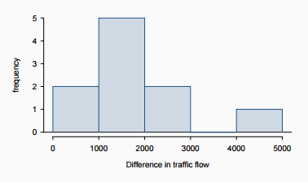
Conditions
Independence: We are told to assume that cases (rows) are independent
Sample size / skew:
The sample distribution does not appear to be extremely skewed, but it’s very difficult to assess with such a small sample size. We might want to think about whether we would expect the population distribution to be skewed or not (probably not, it should be equally likely to have days with lower than average traffic and higher than average traffic)
We do not know 𝞼 and n is too small to assume s is reliable estimate for 𝞼

Slide 17
Conditions
Independence: We are told to assume that cases (rows) are independent
Sample size / skew:
The sample distribution does not appear to be extremely skewed, but it’s very difficult to assess with such a small sample size. We might want to think about whether we would expect the population distribution to be skewed or not (probably not, it should be equally likely to have days with lower than average traffic and higher than average traffic)
We do not know 𝞼 and n is too small to assume s is reliable estimate for 𝞼
What do we do when the sample size is small?

Slide 18

Review: what purpose does a large sample server?
As long as observations are independent, and the population distribution is not extremely skewed, a large sample would ensure that...
the sampling distribution of the mean is nearly normal
the estimate of the standard error, as , is reliable

Slide 19
The normality condition
The CLT, which states that sampling distributions will be nearly normal, holds true for any sample size as long as the population distribution is nearly normal

Slide 20
The normality condition
The CLT, which states that sampling distributions will be nearly normal, holds true for any sample size as long as the population distribution is nearly normal
While this is a helpful special case, it’s inherently difficult to verify normality in small data sets

Slide 21
The normality condition
The CLT, which states that sampling distributions will be nearly normal, holds true for any sample size as long as the population distribution is nearly normal
While this is a helpful special case, it’s inherently difficult to verify normality in small data sets
We should exercise caution when verifying the normality condition for small samples. It is important to not only examine the data but also think about where the data come from
For example, ask: would I expect this distribution to be symmetric, and am I confident that outliers are rare?

Slide 22
The 𝒕 distribution
When the population standard deviation is unknown (almost always), the uncertainty of the standard error estimate is addressed by using a new distribution: the 𝒕 distribution.

Slide 23
The 𝒕 distribution
When the population standard deviation is unknown (almost always), the uncertainty of the standard error estimate is addressed by using a new distribution: the 𝒕 distribution.
This distribution also has a bell shape, but its tails are thicker than the normal model’s.

Slide 24
The 𝒕 distribution
When the population standard deviation is unknown (almost always), the uncertainty of the standard error estimate is addressed by using a new distribution: the 𝒕 distribution.
This distribution also has a bell shape, but its tails are thicker than the normal model’s.
Therefore observations are more likely to fall beyond two SDs from the mean than under the normal distribution

Slide 25
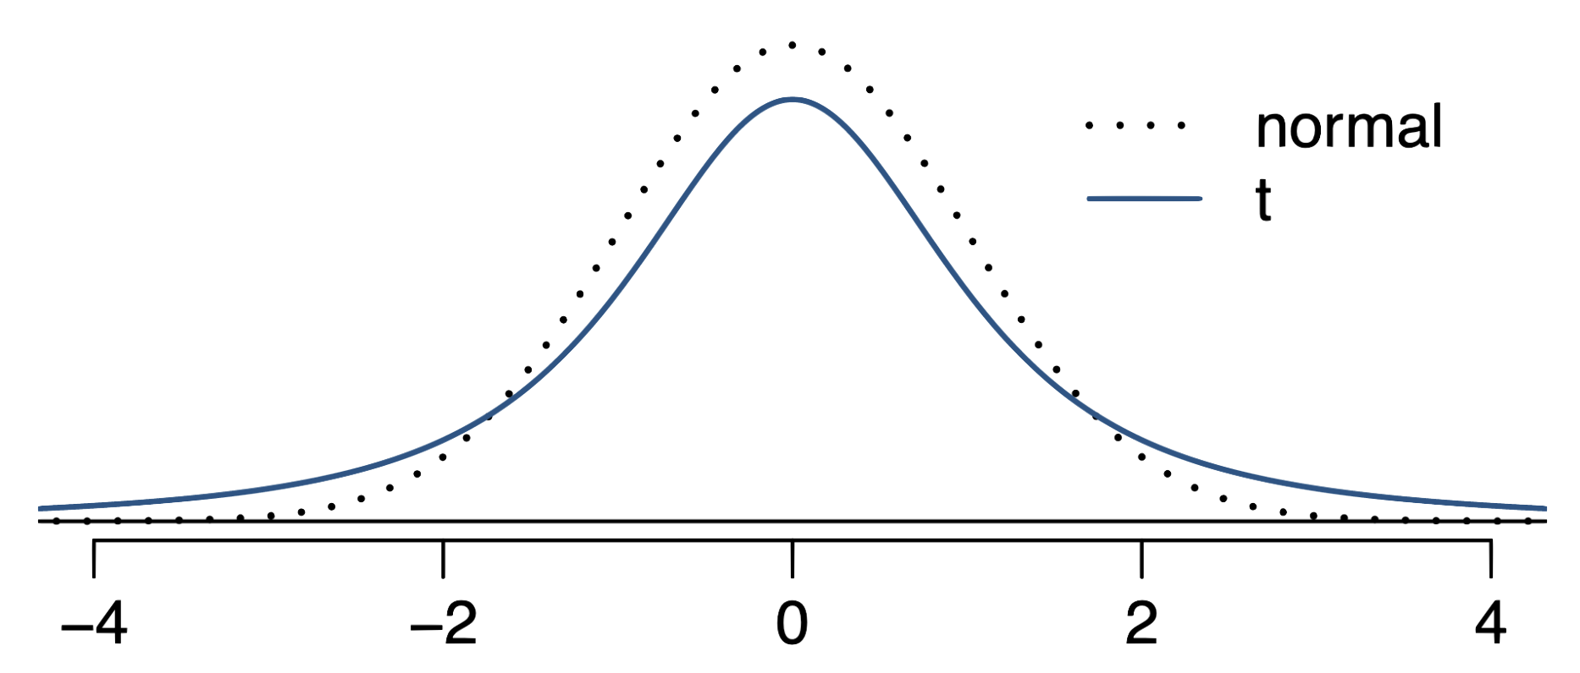
The 𝒕 distribution
When the population standard deviation is unknown (almost always), the uncertainty of the standard error estimate is addressed by using a new distribution: the 𝒕 distribution.
This distribution also has a bell shape, but its tails are thicker than the normal model’s.
Therefore observations are more likely to fall beyond two SDs from the mean than under the normal distribution
These extra thick tails are helpful for resolving our problem with a less reliable estimate for the standard error (since n is small)

Slide 26
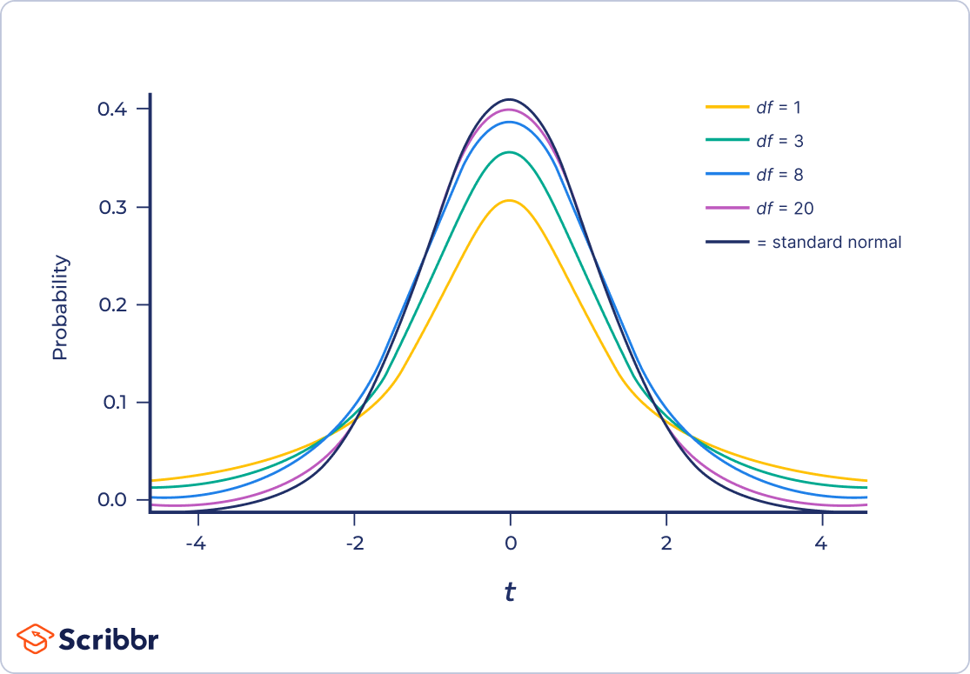
The 𝒕 distribution (cont.)
Always centered at zero, like the standard normal (𝓏) distribution
Has a single parameter: degrees of freedom (df).

Slide 27
The 𝒕 distribution (cont.)
Always centered at zero, like the standard normal (𝓏) distribution
Has a single parameter: degrees of freedom (df).
What happens to the shape of the 𝒕 distribution as df increases?

Slide 28
The 𝒕 distribution (cont.)
Always centered at zero, like the standard normal (𝓏) distribution
Has a single parameter: degrees of freedom (df).
What happens to the shape of the 𝒕 distribution as df increases?
Approaches normal

Slide 29
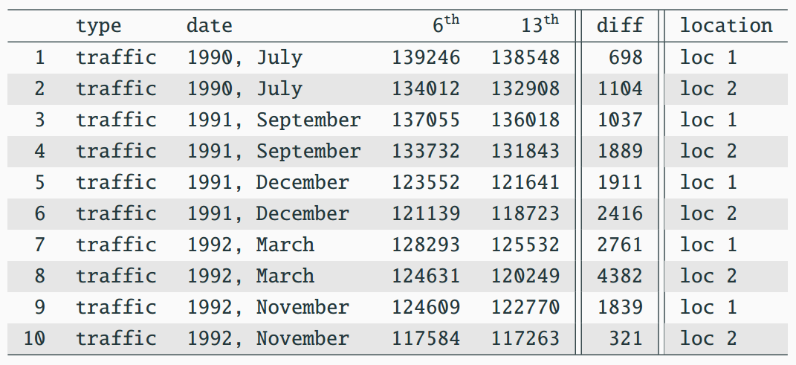


Back to Friday the 13th

Slide 30
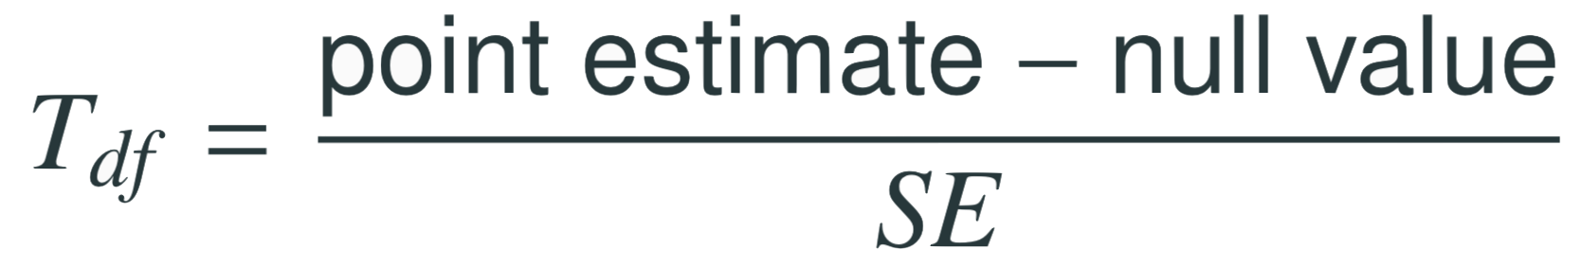
Find the test statistic
Test statistic for inference on a small sample mean
The test statistic for inference on a small sample (n < 50) mean is the 𝑇 statistic with df = n - 1
Note: Null value is 0 because in the null hypothesis we set 𝞵_{diff} = 0

Slide 31
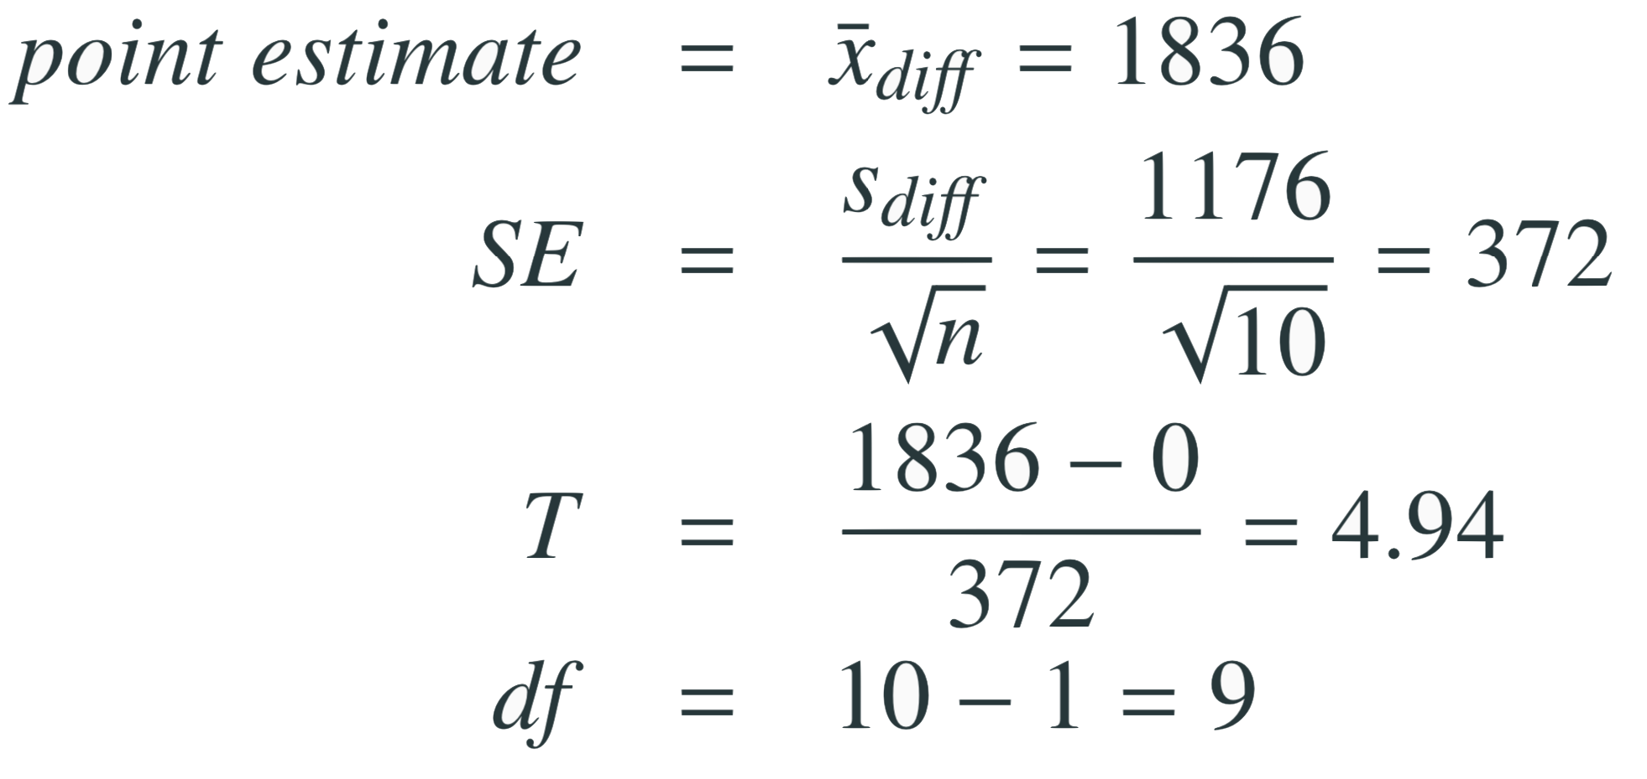
Find the test statistic
Test statistic for inference on a small sample mean
The test statistic for inference on a small sample (n < 50) mean is the 𝑇 statistic with df = n - 1
in context...
Note: Null value is 0 because in the null hypothesis we set 𝞵_{diff} = 0

Slide 32
Find the test statistic
Test statistic for inference on a small sample mean
The test statistic for inference on a small sample (n < 50) mean is the 𝑇 statistic with df = n - 1
in context...
Note: Null value is 0 because in the null hypothesis we set 𝞵_{diff} = 0

Slide 33
Find the test statistic
Test statistic for inference on a small sample mean
The test statistic for inference on a small sample (n < 50) mean is the 𝑇 statistic with df = n - 1
in context...
Note: Null value is 0 because in the null hypothesis we set 𝞵_{diff} = 0

Slide 34
Find the test statistic
Test statistic for inference on a small sample mean
The test statistic for inference on a small sample (n < 50) mean is the 𝑇 statistic with df = n - 1
in context...
Note: Null value is 0 because in the null hypothesis we set 𝞵_{diff} = 0

Slide 35
Finding the p-value

Slide 36
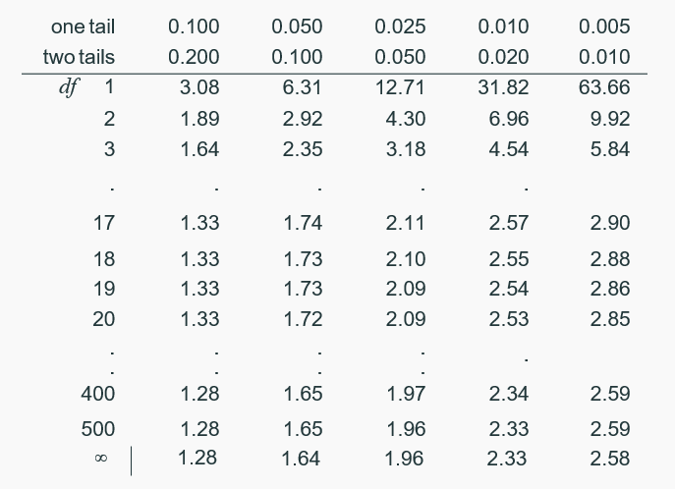
Finding the p-value
Locate the calculated 𝑇 statistic on the appropriate df row, obtain the p-value from the corresponding column heading (one or two tail, depending on the alternative hypothesis).

Slide 37
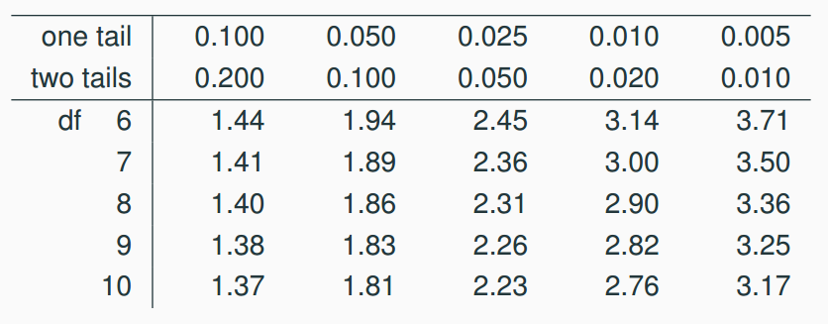
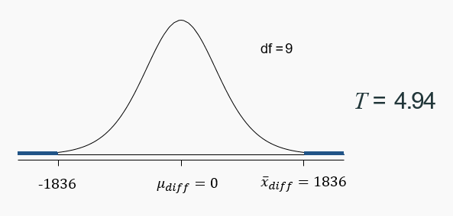
Finding the p-value (cont.)

Slide 38
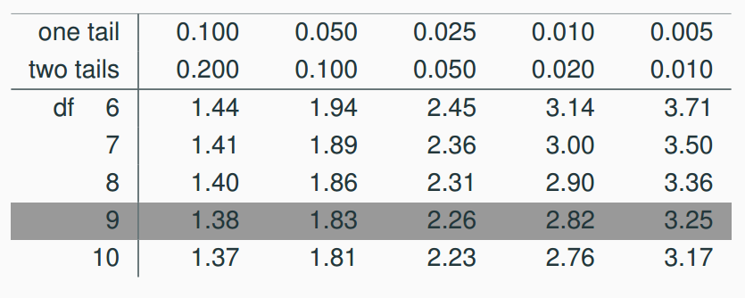
Finding the p-value (cont.)

Slide 39
Finding the p-value (cont.)

Slide 40
Finding the p-value (cont.)
p < 0.010

Slide 41
Finding the p-value (cont.)
p < 0.010
What is the conclusion of the hypothesis test?

Slide 42
Finding the p-value (cont.)
p < 0.010
What is the conclusion of the hypothesis test?
The data provides convincing evidence of a difference between traffic flow on Friday 6th and 13th

Slide 43
Conclusion of the test
What is the conclusion of this hypothesis test?
Since the p-value is quite low (< 0.01), we conclude that the data provide strong evidence of a difference between traffic flow on Friday 6th and 13th.

Slide 44
What is the difference?
We concluded that there is a difference in the traffic flow between Friday 6th and 13th

Slide 45
What is the difference?
We concluded that there is a difference in the traffic flow between Friday 6th and 13th
But it would be more interesting to find out what exactly this difference is

Slide 46
What is the difference?
We concluded that there is a difference in the traffic flow between Friday 6th and 13th
But it would be more interesting to find out what exactly this difference is
We can use a confidence interval to estimate this difference

Slide 47

Confidence interval for a small sample mean
Confidence intervals are always of the form

Slide 48
Confidence interval for a small sample mean
Confidence intervals are always of the form
ME is always calculated as the product of a critical value and SE

Slide 49

Confidence interval for a small sample mean
Confidence intervals are always of the form
ME is always calculated as the product of a critical value and SE
Since small sample means follow a 𝙩 distribution (and not a 𝓏 distribution), the critical value is a 𝙩* (as opposed to a 𝓏*?).

Slide 50
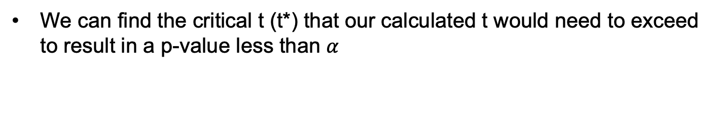
Finding the critical 𝒕 (𝒕*)
We can find the critical t (t*) that our calculated t would need to exceed to result in a p-value less than $α$

Slide 51
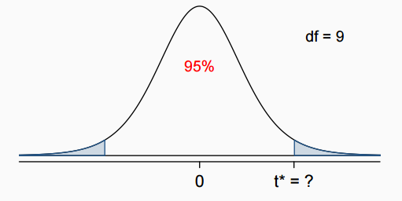
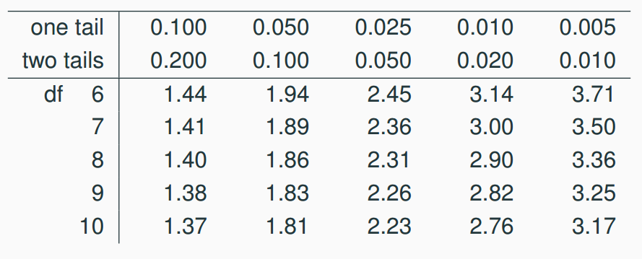
Finding the critical 𝒕 (𝒕*)
n = 10, df = 10 - 1 = 9, t* is at the intersection of rows df = 9 and two tail probability 0.05

Slide 52
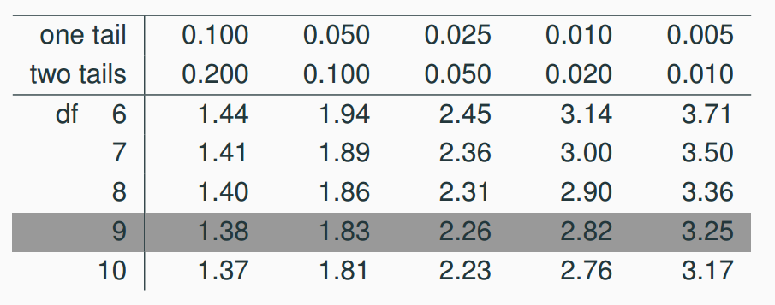
Finding the critical 𝒕 (𝒕*)
n = 10, df = 10 - 1 = 9, t* is at the intersection of rows df = 9 and two tail probability 0.05

Slide 53
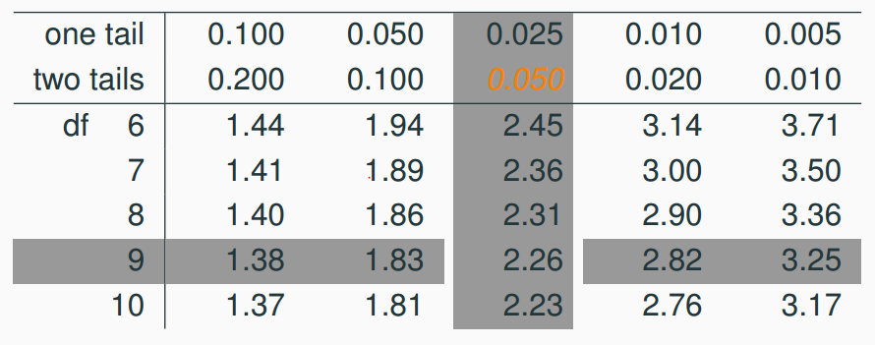
Finding the critical 𝒕 (𝒕*)
n = 10, df = 10 - 1 = 9, t* is at the intersection of rows df = 9 and two tail probability 0.05

Slide 54
Finding the critical 𝒕 (𝒕*)
n = 10, df = 10 - 1 = 9, t* is at the intersection of rows df = 9 and two tail probability 0.05
2.26

Slide 55
Constructing a CI for a small sample mean
Which of the following is the correct calculation of a 95% confidence interval for the difference between the traffic flow between Friday 6th and 13th?
t* = 2.26
1836 ± 1.96 x 372
1836 ± 2.26 x 372
1836 ± -2.26 x 372
1836 ± 2.26 x 1176

Slide 56
Constructing a CI for a small sample mean
Which of the following is the correct calculation of a 95% confidence interval for the difference between the traffic flow between Friday 6th and 13th?
t* = 2.26
1836 ± 1.96 x 372
1836 ± 2.26 x 372 (995, 2677)
1836 ± -2.26 x 372
1836 ± 2.26 x 1176

Slide 57

Interpreting the CI
Which of the following is the best interpretation for the confidence interval we just calculated?
We are 95% confident that…
the difference between the average number of cars on the road on Friday 6th and 13th is between 995 and 2,677
on Friday 6th there are 995 to 2,677 fewer cars on the road than on the Friday 13th, on average
on Friday 6th there are 995 fewer to 2,677 more cars on the road than on the Friday 13th, on average
on Friday 13th there are 995 to 2,677 fewer cars on the road than on the Friday 6th, on average

Slide 58
Interpreting the CI
Which of the following is the best interpretation for the confidence interval we just calculated?
We are 95% confident that…
the difference between the average number of cars on the road on Friday 6th and 13th is between 995 and 2,677
on Friday 6th there are 995 to 2,677 fewer cars on the road than on the Friday 13th, on average
on Friday 6th there are 995 fewer to 2,677 more cars on the road than on the Friday 13th, on average
on Friday 13th there are 995 to 2,677 fewer cars on the road than on the Friday 6th, on average

Slide 59
Synthesis
Does the conclusion from the hypothesis test agree with the findings of the confidence interval?
Do you think the findings of this study suggests that people believe Friday 13th is a day of bad luck?

Slide 60
Synthesis
Does the conclusion from the hypothesis test agree with the findings of the confidence interval?
Yes, the hypothesis test found a significant difference, and the CI does not contain the null value of 0.
Do you think the findings of this study suggests that people believe Friday 13th is a day of bad luck?

Slide 61
Synthesis
Does the conclusion from the hypothesis test agree with the findings of the confidence interval?
Yes, the hypothesis test found a significant difference, and the CI does not contain the null value of 0
Do you think the findings of this study suggests that people believe Friday 13th is a day of bad luck?
No, this is an observational study. We have just observed a significant difference between the number of cars on the road on these two days. We have not tested for people’s beliefs

Slide 62

Recap: Inference using the 𝒕-distribution
If 𝞼 is unknown, use the 𝒕-distribution with

Slide 63
Recap: Inference using the 𝒕-distribution
If 𝞼 is unknown, use the 𝒕-distribution with
Conditions:
independence of observations (often verified by a random sample, and if sampling without replacement, n < 10% of population)
no extreme skew

Slide 64

Recap: Inference using the 𝒕-distribution
If 𝞼 is unknown, use the 𝒕-distribution with
Conditions:
independence of observations (often verified by a random sample, and if sampling without replacement, n < 10% of population)
no extreme skew
Hypothesis Testing:

Slide 65

Recap: Inference using the 𝒕-distribution
If 𝞼 is unknown, use the 𝒕-distribution with
Conditions:
independence of observations (often verified by a random sample, and if sampling without replacement, n < 10% of population)
no extreme skew
Hypothesis Testing:
Confidence interval:

Slide 66
Recap: Inference using the 𝒕-distribution
If 𝞼 is unknown, use the 𝒕-distribution with
Conditions:
independence of observations (often verified by a random sample, and if sampling without replacement, n < 10% of population)
no extreme skew
Hypothesis Testing:
Confidence interval:
Note: The example we used was for paired means (difference between dependent groups). We took the difference between the observations and used only these differences (one sample) in our analysis

Slide 67
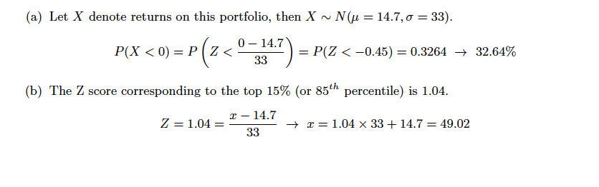
Useful tool
http://gallery.shinyapps.io/dist_calc/

Slide 68
Useful tool
http://gallery.shinyapps.io/dist_calc/

Slide 69
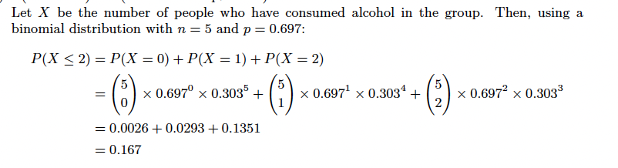
Useful tool
http://gallery.shinyapps.io/dist_calc/

Slide 70
Useful tool
http://gallery.shinyapps.io/dist_calc/

Slide 71
Useful tool
http://gallery.shinyapps.io/dist_calc/

Slide 72
Useful tool
http://gallery.shinyapps.io/dist_calc/
p = 0.0006

