Slide 1
Elementary Statistics - Collecting Data
Dr. Ab Mosca (they/them)
Slides based off slides courtesy of OpenIntro and John McGreedy of Johns Hopkins University

Slide 2
Plan for Today
Populations vs samples
Sampling
Study design

Slide 3
Populations vs Samples

Slide 4

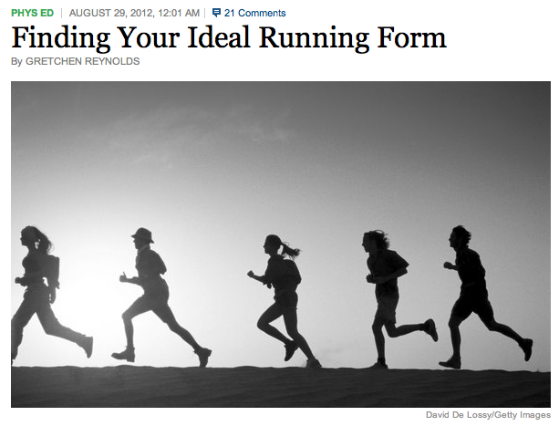
Study Example
Research Question:
https://bit.ly/45vscjA

Slide 5
Study Example
Research Question: Can people become better, more efficient runners on their own, merely by running?
https://bit.ly/45vscjA

Slide 6
Study Example
Research Question: Can people become better, more efficient runners on their own, merely by running?
Population of Interest:
https://bit.ly/45vscjA

Slide 7
Study Example
Research Question: Can people become better, more efficient runners on their own, merely by running?
Population of Interest: All people
https://bit.ly/45vscjA

Slide 8
Study Example
Research Question: Can people become better, more efficient runners on their own, merely by running?
Population of Interest: All people
People in the study:
https://bit.ly/45vscjA

Slide 9
Study Example
Research Question: Can people become better, more efficient runners on their own, merely by running?
Population of Interest: All people
People in the study: Group of adult women who recently joined a running group
https://bit.ly/45vscjA

Slide 10
Study Example
Research Question: Can people become better, more efficient runners on their own, merely by running?
Population of Interest: All people
People in the study: Group of adult women who recently joined a running group
https://bit.ly/45vscjA
Population to which results can be generalized:

Slide 11
Study Example
Research Question: Can people become better, more efficient runners on their own, merely by running?
Population of Interest: All people
People in the study: Group of adult women who recently joined a running group
https://bit.ly/45vscjA
Population to which results can be generalized: Adult women (assuming the data are randomly sampled)

Slide 12
Study Example
Research Question: Can people become better, more efficient runners on their own, merely by running?
Population of Interest: All people
People in the study: Group of adult women who recently joined a running group
https://bit.ly/45vscjA
Why don’t our results generalize to the population of interest?
Population to which results can be generalized: Adult women (assuming the data are randomly sampled)

Slide 13

Study Example
Research Question: Can people become better, more efficient runners on their own, merely by running?
Population of Interest: All people
$$≉$$
People in the study: Group of adult women who recently joined a running group
https://bit.ly/45vscjA
Why don’t our results generalize to the population of interest?
Population to which results can be generalized: Adult women (assuming the data are randomly sampled)

Slide 14
Study Example
Research Question: Can people become better, more efficient runners on their own, merely by running?
Population of Interest: All people
$$≉$$
People in the study Sample: Group of adult women who recently joined a running group
https://bit.ly/45vscjA
Why don’t our results generalize to the population of interest?
Population to which results can be generalized: Adult women (assuming the data are randomly sampled)

Slide 15
Populations and Samples
In statistics…
a population is the group about which you are trying to answer a question
a sample is the portion of the population you are actually analyzing

Slide 16
Populations and Samples
In statistics…
a population is the group about which you are trying to answer a question
a sample is the portion of the population you are actually analyzing
Wouldn't it be better to just include everyone and "sample" the entire population?

Slide 17
Populations and Samples
In statistics…
a population is the group about which you are trying to answer a question
a sample is the portion of the population you are actually analyzing
Wouldn't it be better to just include everyone and "sample" the entire population?
This is called a census.

Slide 18
Populations and Samples
Problems with a census
It can be difficult to complete a census: there always seem to be some individuals who are hard to locate or hard to measure. And these difficult-to-find people may have certain characteristics that distinguish them from the rest of the population.
Populations rarely stand still. Even if you could take a census, the population changes constantly, so it's never possible to get a perfect measure.
Taking a census may be more complex than sampling.

Slide 19
Populations and Samples
(Some) Problems with the US census…
Does not reach all subpopulations equally
undercounts Hispanic, Black, and Native American residents
overcounts white and Asian American residents
undocumented residents
undercounts residents living in poor urban areas
undercounts unhoused people
Does not collect data in a representative way
sex (only binary options, no intersex option)
gender is not collected
race includes no multiracial option

Slide 20
Because a census is problematic, we use samples and infer
Populations and Samples
Notes:
Think about sampling something you are cooking - you taste (examine) a small part of what you're cooking to get an idea about the dish as a whole.
When you taste a spoonful of soup and decide the spoonful you tasted isn't salty enough, that's exploratory analysis.
If you generalize and conclude that your entire soup needs salt, that's an inference.
For your inference to be valid, the spoonful you tasted (the sample) needs to be representative of the entire pot (the population).
If your spoonful comes only from the surface and the salt is collected at the bottom of the pot, what you tasted is probably not representative of the whole pot.
If you first stir the soup thoroughly before you taste, your spoonful will more likely be representative of the whole pot.

Slide 21
Because a census is problematic, we use samples and infer
Think about cooking
You might taste a spoonful of soup and decide the spoonful you tasted isn't salty enough
If you generalize and conclude that your entire soup needs salt, that's an inference
Populations and Samples
Notes:
Think about sampling something you are cooking - you taste (examine) a small part of what you're cooking to get an idea about the dish as a whole.
When you taste a spoonful of soup and decide the spoonful you tasted isn't salty enough, that's exploratory analysis.
If you generalize and conclude that your entire soup needs salt, that's an inference.
For your inference to be valid, the spoonful you tasted (the sample) needs to be representative of the entire pot (the population).
If your spoonful comes only from the surface and the salt is collected at the bottom of the pot, what you tasted is probably not representative of the whole pot.
If you first stir the soup thoroughly before you taste, your spoonful will more likely be representative of the whole pot.

Slide 22
Because a census is problematic, we use samples and infer
Think about cooking
You might taste a spoonful of soup and decide the spoonful you tasted isn't salty enough
If you generalize and conclude that your entire soup needs salt, that's an inference
For your inference to be valid, the spoonful you tasted (the sample) needs to be representative of the entire pot (the population).
If your spoonful comes only from the surface and the salt is collected at the bottom of the pot, what you tasted is probably not representative of the whole pot.
If you first stir the soup thoroughly before you taste, your spoonful will more likely be representative of the pot.
Populations and Samples
Notes:
Think about sampling something you are cooking - you taste (examine) a small part of what you're cooking to get an idea about the dish as a whole.
When you taste a spoonful of soup and decide the spoonful you tasted isn't salty enough, that's exploratory analysis.
If you generalize and conclude that your entire soup needs salt, that's an inference.
For your inference to be valid, the spoonful you tasted (the sample) needs to be representative of the entire pot (the population).
If your spoonful comes only from the surface and the salt is collected at the bottom of the pot, what you tasted is probably not representative of the whole pot.
If you first stir the soup thoroughly before you taste, your spoonful will more likely be representative of the whole pot.

Slide 23
Sampling

Slide 24
It is unethical to collect data from and/or perform research on someone who has not consented to participation
Samples consist of volunteered information
As a result, bias can occur
Samples

Slide 25
Bias is caused by…
Non-response: If only a small fraction of sampled people choose to participate, the sample may no longer be representative of the population.
Voluntary response: Occurs when the sample consists of people who volunteer to participate because they have strong opinions on the issue. Such a sample will also not be representative of the population.
Convenience sample: Individuals who are easily accessible are more likely to be included in the sample.
Sampling Bias

Slide 26
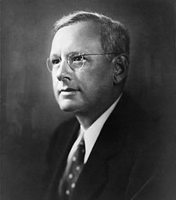
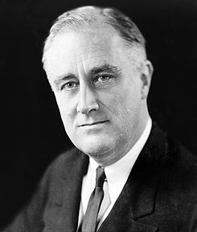
Sampling Bias
An historical example of a biased sample yielding misleading results
In 1936, Landon sought the Republican presidential nomination opposing the re-election of FDR.

Slide 27

The Literary Digest Poll
Sampling Bias
The Literary Digest polled about 10 million Americans, and got responses from about 2.4 million.
The poll showed that Landon would likely be the overwhelming winner and FDR would get only 43% of the votes.
Election result: FDR won, with 62% of the votes.
The magazine was completely discredited because of the poll, and was soon discontinued.

Slide 28
The Literary Digest Poll -
what went wrong?
Sampling Bias
The magazine had surveyed
its own readers,
registered automobile owners, and
registered telephone users.
These groups had incomes well above the national average of the day (remember, this is Great Depression era) which resulted in lists of voters far more likely to support Republicans than a truly typical voter of the time, i.e. the sample was not representative of the American population at the time.

Slide 29
Large samples are preferable, but...
Sampling
The Literary Digest election poll was based on a sample size of 2.4 million, which is huge, but since the sample was biased, the sample did not yield an accurate prediction.
Back to the soup analogy: If the soup is not well stirred, it doesn't matter how large a spoon you have, it will still not taste right. If the soup is well stirred, a small spoon will suffice to test the soup.

Slide 30
A school district is considering whether it will no longer allow high school students to park at school after two recent accidents where students were severely injured. As a first step, they survey parents by mail, asking them whether or not the parents would object to this policy change. Of 6,000 surveys that go out, 1,200 are returned. Of these 1,200 surveys that were completed, 960 agreed with the policy change and 240 disagreed. Which of the following statements are true?
Some of the mailings may have never reached the parents.
The school district has strong support from parents to move forward with the policy approval.
It is possible that majority of the parents of high school students disagree with the policy change.
The survey results are unlikely to be biased because all parents were mailed a survey.
(a) only I (b) I and II (c) I and III (d) III and IV (e) only IV
Practice

Slide 31
A school district is considering whether it will no longer allow high school students to park at school after two recent accidents where students were severely injured. As a first step, they survey parents by mail, asking them whether or not the parents would object to this policy change. Of 6,000 surveys that go out, 1,200 are returned. Of these 1,200 surveys that were completed, 960 agreed with the policy change and 240 disagreed. Which of the following statements are true?
Some of the mailings may have never reached the parents.
The school district has strong support from parents to move forward with the policy approval.
It is possible that majority of the parents of high school students disagree with the policy change.
The survey results are unlikely to be biased because all parents were mailed a survey.
(a) only I (b) I and II (c) I and III (d) III and IV (e) only IV
Practice

Slide 32
Studies

Slide 33
Studies explore the (potential) relationship between a stimuli or treatment (independent or explanatory variable(s)) and an outcome or response (dependent or response variable(s))
Studies

Slide 34

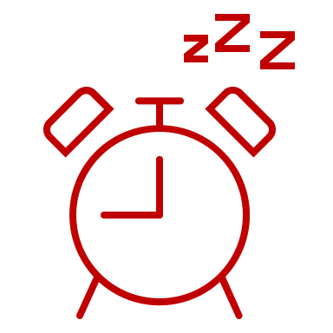
Studies explore the (potential) relationship between a stimuli or treatment (independent or explanatory variable(s)) and an outcome or response (dependent or response variable(s))
Ex. Caffeine and Sleep
Studies

Slide 35
Studies explore the (potential) relationship between a stimuli or treatment (independent or explanatory variable(s)) and an outcome or response (dependent or response variable(s))
Ex. Caffeine and Sleep
There are two main types of studies
Observational
Experimental
Studies

Slide 36
Observational Studies

Slide 37
Researchers collect data in a way that does not directly interfere with how the data arise.
Ex. Look at medical records and receipts to see if people who bought coffee went to the doctor for sleep related issues
Observational Studies

Slide 38
Researchers collect data in a way that does not directly interfere with how the data arise.
Ex. Look at medical records and receipts to see if people who bought coffee went to the doctor for sleep related issues
Observational Studies
Explanatory
Var.
Response
Var.

Slide 39
Researchers collect data in a way that does not directly interfere with how the data arise.
Ex. Look at medical records and receipts to see if people who bought coffee went to the doctor for sleep related issues
Observational Studies
Explanatory
Var.
 | Coffee | No Coffee
Sleep Issues
No Sleep Issues
Response
Var.

Slide 40
Researchers collect data in a way that does not directly interfere with how the data arise.
Ex. Look at medical records and receipts to see if people who bought coffee went to the doctor for sleep related issues
Can show an association, but not causal connection
Observational Studies
Explanatory
Var.
 | Coffee | No Coffee
Sleep Issues
No Sleep Issues
Response
Var.

Slide 41
There are different methods for sampling to reduce bias
Remember, the goal is to get as representative a sample as possible
Sampling for Observational Studies

Slide 42
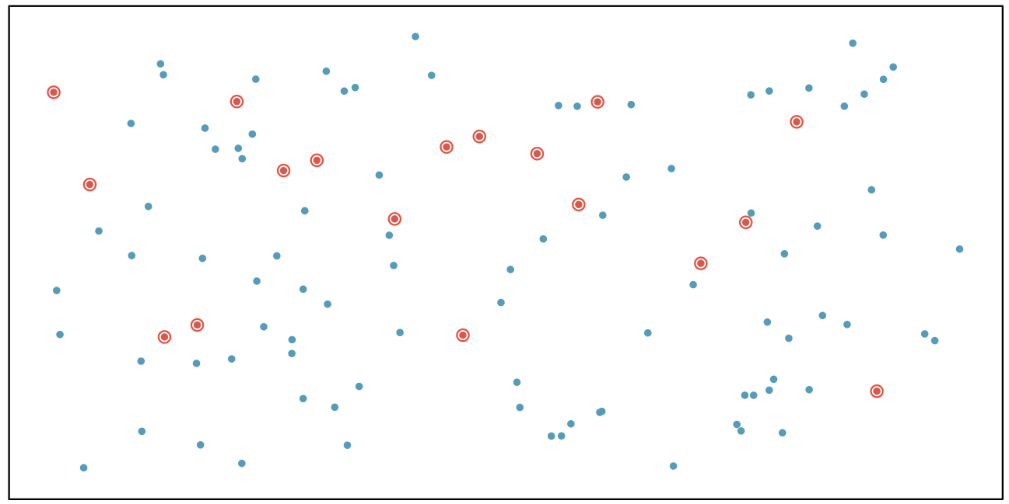
Randomly select cases from the population, where there is no implied connection between the points that are selected.
Simple Random Sample

Slide 43
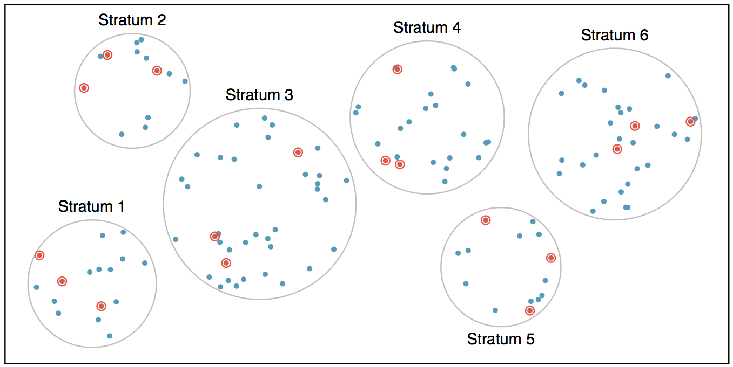
Strata are made up of similar observations. We take a simple random sample from each stratum.
Stratified Sample
Notes:
Ex. Teams in baseball

Slide 44
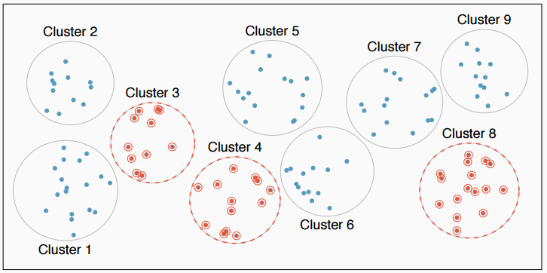
Clusters are usually not made up of homogeneous observations. We take a simple random sample of clusters, and then sample all observations in that cluster. Usually preferred for economical reasons.
Cluster Sample
Notes:
Ex. Neighborhoods

Slide 45
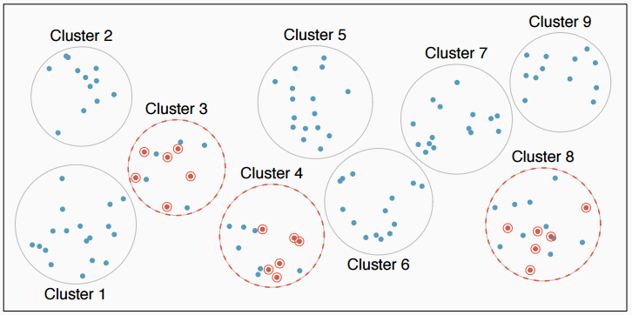
Clusters are usually not made up of homogeneous observations. We take a simple random sample of clusters, and then take a simple random sample of observations from the sampled clusters
Multistage Sample

Slide 46
A city council has requested a household survey be conducted in a suburban area of their city. The area is broken into many distinct and unique neighborhoods, some including large homes, some with only apartments. Which approach would likely be the least effective?
(a) Simple random sampling
(b) Cluster sampling
(c) Stratified sampling
(d) Multistage sampling
Practice

Slide 47
A city council has requested a household survey be conducted in a suburban area of their city. The area is broken into many distinct and unique neighborhoods, some including large homes, some with only apartments. Which approach would likely be the least effective?
(a) Simple random sampling
(b) Cluster sampling
(c) Stratified sampling
(d) Multistage sampling
Practice

Slide 48
Experiments

Slide 49
Researchers collect data in a highly structured way.
Ex. Have some people drink coffee at 8am and noon every day for 3 months, record how many hours of sleep they get each night. Compare to people who drink no coffee
Experimental Studies

Slide 50
Researchers collect data in a highly structured way.
Ex. Have some people drink coffee at 8am and noon every day for 3 months, record how many hours of sleep they get each night. Compare to people who drink no coffee
Experimental Studies
Explanatory
Var.
Response
Var.

Slide 51
Researchers collect data in a highly structured way.
Ex. Have some people drink coffee at 8am and noon every day for 3 months, record how many hours of sleep they get each night. Compare to people who drink no coffee
Experimental Studies
Explanatory
Var.
 | Coffee | No Coffee
Hours of Sleep
Response
Var.

Slide 52
Researchers collect data in a highly structured way.
Ex. Have some people drink coffee at 8am and noon every day for 3 months, record how many hours of sleep they get each night. Compare to people who drink no coffee
Experimental Studies
Explanatory
Var.
 | Coffee | No Coffee
Hours of Sleep
Response
Var.
Explanatory variable is also called a factor in experiments. Factors have distinct levels, in this case Coffee and No Coffee.

Slide 53
Researchers collect data in a highly structured way.
Ex. Have some people drink coffee at 8am and noon every day for 3 months, record how many hours of sleep they get each night. Compare to people who drink no coffee
Experimental Studies
What other levels could the coffee factor have?
Explanatory
Var.
 | Coffee | No Coffee
Hours of Sleep
Response
Var.
Explanatory variable is also called a factor in experiments. Factors have distinct levels, in this case Coffee and No Coffee.

Slide 54
Researchers collect data in a highly structured way.
Ex. Have some people drink coffee at 8am and noon every day for 3 months, record how many hours of sleep they get each night. Compare to people who drink no coffee
Experimental Studies
What other factors could we add to this experiment?
Explanatory
Var.
 | Coffee | No Coffee
Hours of Sleep
Response
Var.
Explanatory variable is also called a factor in experiments. Factors have distinct levels, in this case Coffee and No Coffee.

Slide 55

Researchers collect data in a highly structured way.
Ex. Have some people drink coffee at 8am and noon every day for 3 months, record how many hours of sleep they get each night. Compare to people who drink no coffee
Random Assignment
Explanatory
Var.
 | Coffee | No Coffee
Hours of Sleep
Response
Var.
Participants get randomly assigned to a group

Slide 56
Researchers collect data in a highly structured way.
Ex. Have some people drink coffee at 8am and noon every day for 3 months, record how many hours of sleep they get each night. Compare to people who drink no coffee
Experimental Studies
Explanatory
Var.
 | Coffee | No Coffee
Hours of Sleep
Response
Var.
Treatment
Group
Control
Group

Slide 57
Researchers collect data in a highly structured way.
Ex. Have some people drink coffee at 8am and noon every day for 3 months, record how many hours of sleep they get each night. Compare to people who drink no coffee
Blocking
Explanatory
Var.
 | Coffee | No Coffee
Hours of Sleep
Response
Var.
Participants are blocked then randomly assigned to a group
Anxious
Not Anxious

Slide 58
Researchers collect data in a highly structured way.
Ex. Have some people drink coffee at 8am and noon every day for 3 months, record how many hours of sleep they get each night. Compare to people who drink no coffee
Can show a causal connection
Experimental Studies
Explanatory
Var.
 | Coffee | No Coffee
Hours of Sleep
Response
Var.
Treatment
Group
Control
Group

Slide 59
Principles of experimental design
Control: Compare treatment of interest to a control group.
Randomize: Randomly assign subjects to treatments, and randomly sample from the population whenever possible.
Replicate: Within a study, replicate by collecting a sufficiently large sample. Or replicate the entire study.
Block: If there are variables that are known or suspected to affect the response variable, first group subjects into blocks based on these variables, and then randomize cases within each block to treatment groups.
Principles of Experiment Design

Slide 60
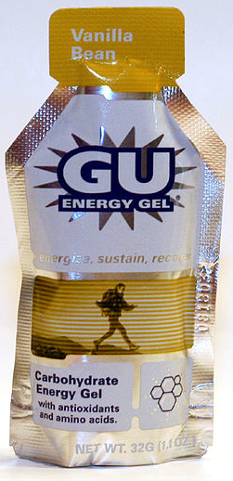
Design an experiment to investigate if energy gels makes you run faster:
Treatment: ?
Control: ?
Experiment Design

Slide 61
Design an experiment to investigate if energy gels makes you run faster:
Treatment: energy gel
Control: no energy gel
Experiment Design

Slide 62
Design an experiment to investigate if energy gels makes you run faster:
Treatment: energy gel
Control: no energy gel
It is suspected that energy gels might affect pro and amateur athletes differently.
How do you design your experiment?
Experiment Design

Slide 63
Design an experiment to investigate if energy gels makes you run faster:
Treatment: energy gel
Control: no energy gel
It is suspected that energy gels might affect pro and amateur athletes differently, therefore we block for pro status:
Divide the sample to pro and amateur
Randomly assign pro athletes to treatment and control groups
Randomly assign amateur athletes to treatment and control groups
Pro/amateur status is equally represented in the resulting treatment and control groups
Experiment Design
Why is this important? Can you think of other variables to block for?

Slide 64
A study is designed to test the effect of light level and noise level on exam performance of students. The researcher also believes that light and noise levels might have different effects on high and low income students, so wants to make sure both economic statuses are equally represented in each group. Which of the below is correct?
There are 3 explanatory variables (light, noise, economic status) and 1 response variable (exam performance)
There are 2 explanatory variables (light and noise), 1 blocking variable (economic status), and 1 response variable (exam performance)
There is 1 explanatory variable (economic status) and 3 response variables (light, noise, exam performance)
There are 2 blocking variables (light and noise), 1 explanatory variable (economic status), and 1 response variable (exam performance)
Practice

Slide 65
A study is designed to test the effect of light level and noise level on exam performance of students. The researcher also believes that light and noise levels might have different effects on high and low income students, so wants to make sure both economic statuses are equally represented in each group. Which of the below is correct?
There are 3 explanatory variables (light, noise, economic status) and 1 response variable (exam performance)
There are 2 explanatory variables (light and noise), 1 blocking variable (economic status), and 1 response variable (exam performance)
There is 1 explanatory variable (economic status) and 3 response variables (light, noise, exam performance)
There are 2 blocking variables (light and noise), 1 explanatory variable (economic status), and 1 response variable (exam performance)
Experiment Design

Slide 66
Difference Between Blocking and Explanatory Variables
Experiment Design
Stimuli are conditions we can impose on the experimental units.
Blocking variables are characteristics that the experimental units come with, that we would like to control for. [Otherwise these characteristics could be confounding factors]
Blocking is like stratifying, except used in experimental settings when randomly assigning, as opposed to when sampling.

Slide 67
More Experimental Design Terminology...
Experiment Design
Placebo: fake treatment, often used as the control group for medical studies
Placebo effect: experimental units showing improvement simply because they believe they are receiving a special treatment
Blinding: when experimental units do not know whether they are in the control or treatment group
Double-blind: when both the experimental units and the researchers who interact with the patients do not know who is in the control and who is in the treatment group

Slide 68
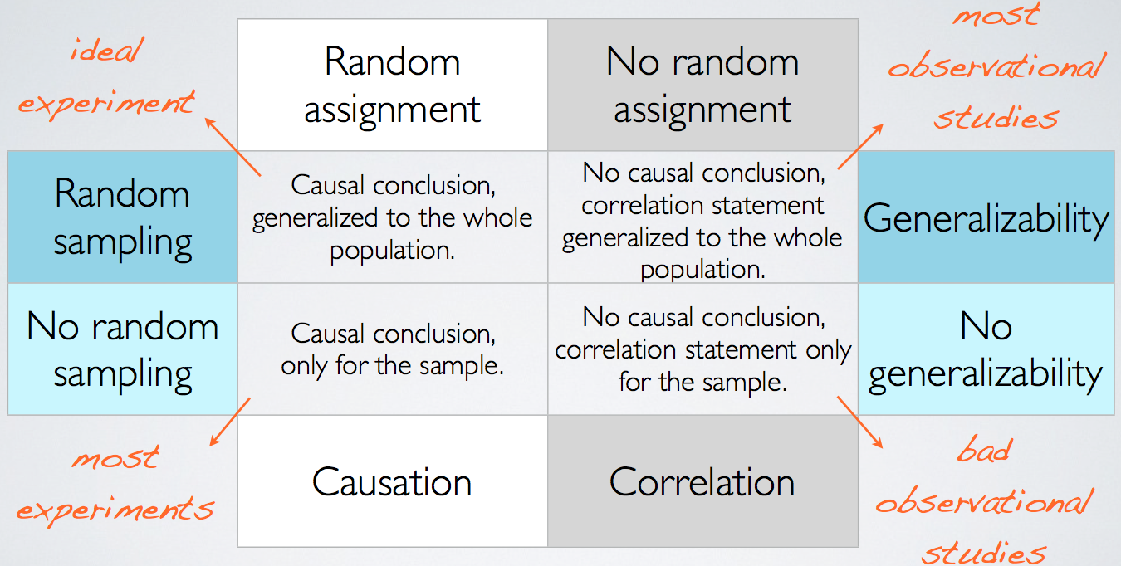
Random Assignment
vs. Random Sampling
Study Design

Slide 69
Work with 2 other people
Develop a research question of interest to you
Design a study to answer that question
Observational or Experiment?
How will you collect a sample or design your experiment?
Etc..
Be prepared to share with everyone
Practice

