Slide 1
Elementary Statistics – Probability
Dr. Ab Mosca (they/them)
Slides based off slides courtesy of Kaitlyn Cook (https://www.smith.edu/people/kaitlyn-cook)

Slide 2
Plan for Today
Probability
Rules
Independence

Slide 3
Recall: Course Overview
Given a statistical question. . .
Population |  |  | Parameter
 | Probability
Sample |  |  | Statistics & Visualizations
Population: the target group about which we wish to make claims or predictions
Parameter: numerical summary of the population Sample: the data that we have at hand
Statistic: numerical summary of the sample

Slide 4
Recall: Course Overview
Given a statistical question. . .
Population |  |  | Parameter
 | Probability
Sample |  |  | Statistics & Visualizations
Where do our data come from?

Slide 5
Recall: Course Overview
Given a statistical question. . .
Population |  |  | Parameter
 | Probability
Sample |  |  | Statistics & Visualizations
How do we summarize and make sense of all this data (in a way that informs our research question)?

Slide 6
Course Overview
Given a statistical question. . .
Population |  |  | Parameter
 | Probability
Sample |  |  | Statistics & Visualizations
How can we use ideas from mathematics to relate our sample (and sample statistic) back to the population (and parameter of interest)?

Slide 7
What is Probability?
Suppose I have a fair coin and give it a toss. What is the chance that it lands heads up?

Slide 8
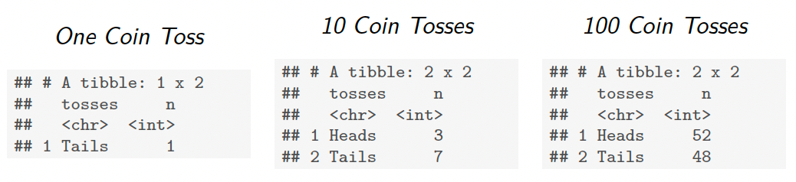
What is Probability?
Suppose I have a fair coin and give it a toss. What is the chance that it lands heads up?
Simulated Coin Tosses
Notice how frequency of the event relates to outcomes.

Slide 9
What is Probability?
Suppose I have a fair coin and give it a toss. What is the chance that it lands heads up?
Simulated Coin Tosses
Notice how frequency of the event relates to outcomes.
The probability of an event is the long-run relative frequency with which that events occurs if we were to repeat the random process (ex. flipping a coin) an infinite number of times.

Slide 10
What is Probability?
What about 10 sided-dice?
Frequencies when everyone tosses once:
Twice:
Three times:
Four times:

Slide 11
Probability Vocab
A random experiment is some activity, process, or experiment whose outcome is uncertain.
Call and ask a doctor whether they approve of a treatment
Forecast snow tomorrow
Conduct two consecutive coin flips

Slide 12
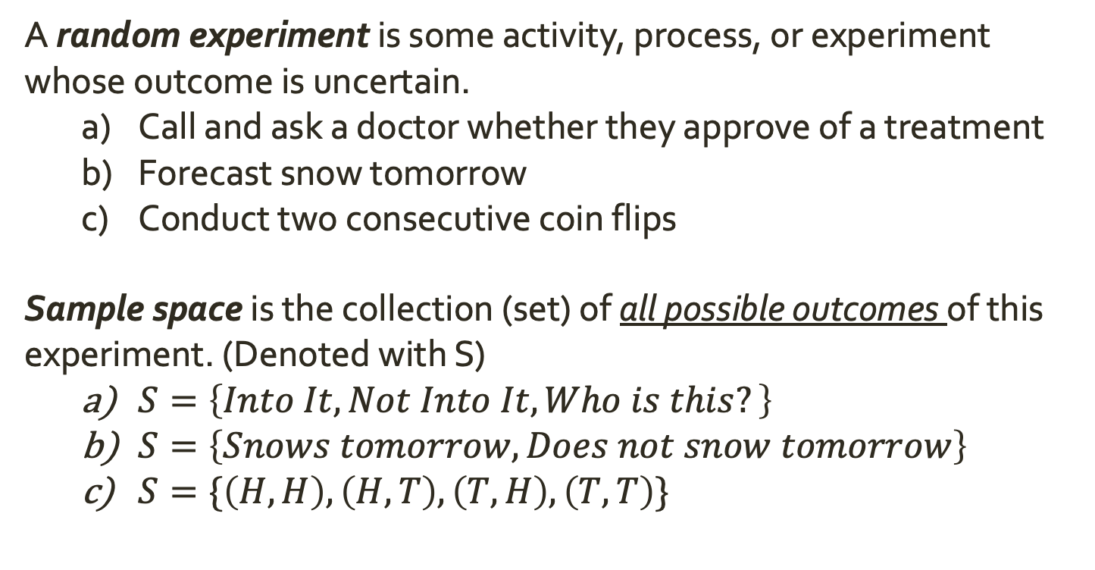
Probability Vocab
A random experiment is some activity, process, or experiment whose outcome is uncertain.
Call and ask a doctor whether they approve of a treatment
Forecast snow tomorrow
Conduct two consecutive coin flips
Sample space is the collection (set) of all possible outcomes of this experiment. (Denoted with S)
$S=\left\{Into It, Not Into It, Who is this?\right\}$
$S=\left\{Snows tomorrow, Does not snow tomorrow\right\}$
$S=\{\left(H,H\right), \left(H, T\right), \left(T, H\right), \left(T,T\right)\}$

Slide 13
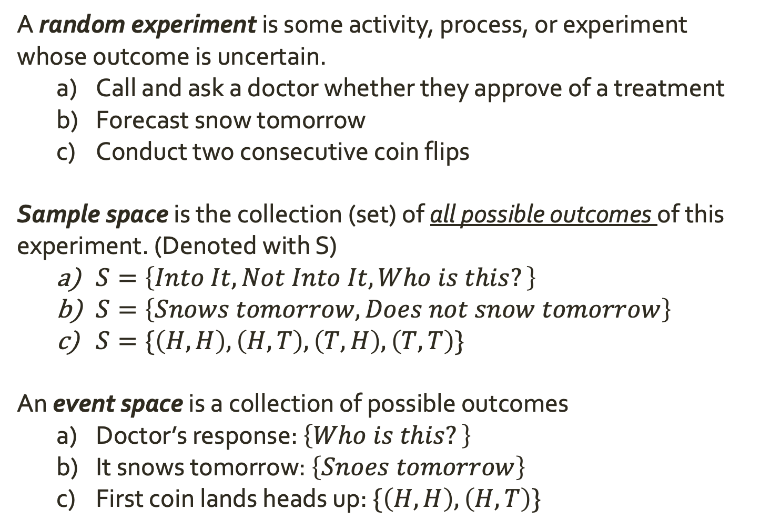
Probability Vocab
A random experiment is some activity, process, or experiment whose outcome is uncertain.
Call and ask a doctor whether they approve of a treatment
Forecast snow tomorrow
Conduct two consecutive coin flips
Sample space is the collection (set) of all possible outcomes of this experiment. (Denoted with S)
$S=\left\{Into It, Not Into It, Who is this?\right\}$
$S=\left\{Snows tomorrow, Does not snow tomorrow\right\}$
$S=\{\left(H,H\right), \left(H, T\right), \left(T, H\right), \left(T,T\right)\}$
An event space is a collection of possible outcomes
Doctor’s response: $\left\{Who is this?\right\}$
It snows tomorrow: $\left\{Snoes tomorrow\right\}$
First coin lands heads up: $\{\left(H,H\right), \left(H,T\right)\}$

Slide 14
Probability Vocab
A random experiment is some activity, process, or experiment whose outcome is uncertain.
Sample space is the collection (set) of all possible outcomes of this experiment. (Denoted with S)
An event space is a collection of possible outcomes
Practice: Suppose you roll the 10 sided dice you were given earlier. What is the sample space of that die roll? Give two examples of event spaces.
Suppose I have a shuffled deck of cards and deal 4 of them. What is the sample space of this experiment? Give two examples of event spaces.

Slide 15
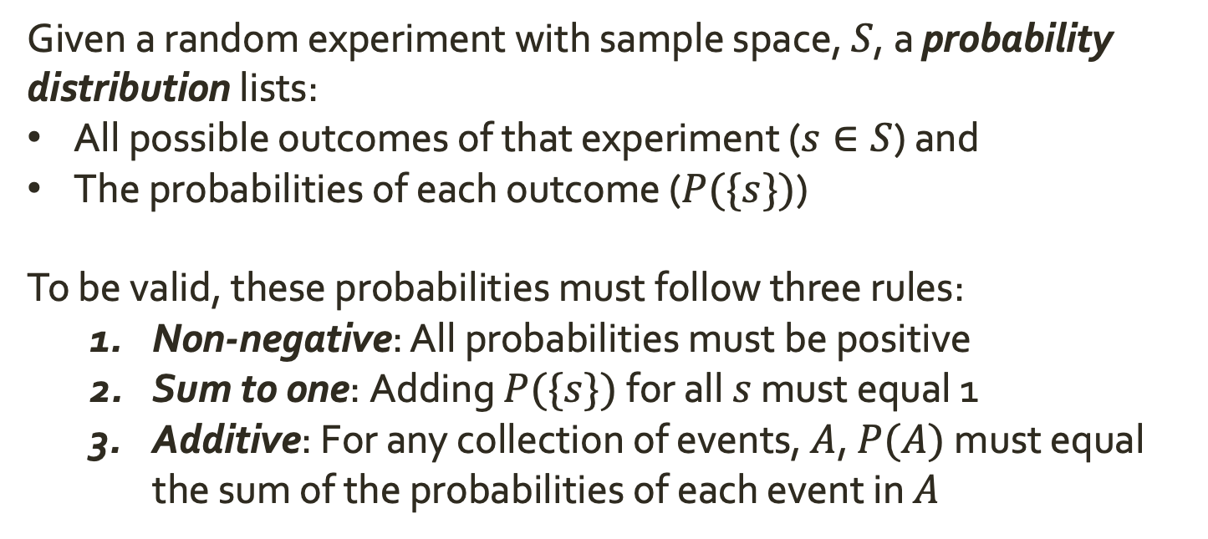
Foundational Rules of Probability
Given a random experiment with sample space, $S$, a probability distribution lists:
All possible outcomes of that experiment ($s∈S$) and
The probabilities of each outcome ($P(\{s\})$)
To be valid, these probabilities must follow three rules:
Non-negative: All probabilities must be positive
Sum to one: Adding $P(\{s\})$ for all $s$ must equal 1
Additive: For any collection of events, $A$, $P(A)$ must equal the sum of the probabilities of each event in $A$

Slide 16
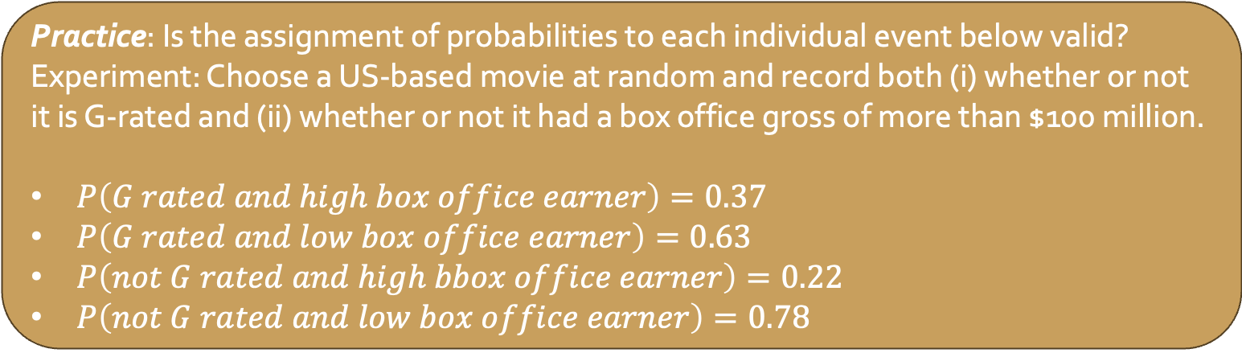
Foundational Rules of Probability
Given a random experiment with sample space, $S$, a probability distribution lists:
All possible outcomes of that experiment ($s∈S$) and
The probabilities of each outcome ($P(\{s\})$)
To be valid, these probabilities must follow three rules:
Non-negative: All probabilities must be positive
Sum to one: Adding $P(\{s\})$ for all $s$ must equal 1
Additive: For any collection of events, $A$, $P(A)$ must equal the sum of the probabilities of each event in $A$
Practice: Is the assignment of probabilities to each individual event below valid?
Experiment: Choose a US-based movie at random and record both (i) whether or not it is G-rated and (ii) whether or not it had a box office gross of more than $100 million.
$P\left(G rated and high box office earner\right)=0.37$
$P\left(G rated and low box office earner\right)=0.63$
$P\left(not G rated and high bbox office earner\right)=0.22$
$P\left(not G rated and low box office earner\right)=0.78$
Notes:
No! Adds to 2

Slide 17
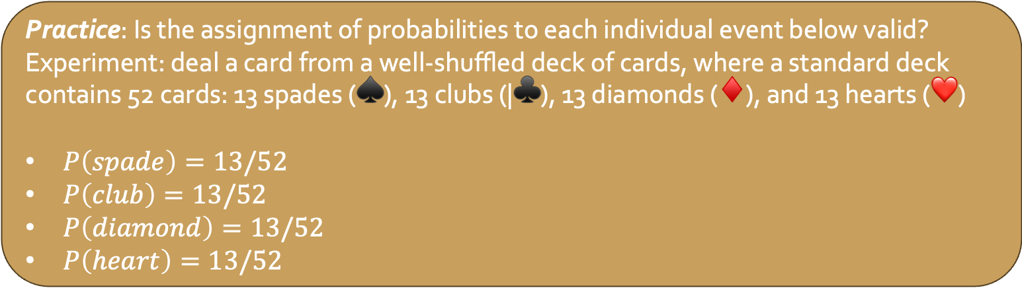
Foundational Rules of Probability
Given a random experiment with sample space, $S$, a probability distribution lists:
All possible outcomes of that experiment ($s∈S$) and
The probabilities of each outcome ($P(\{s\})$)
To be valid, these probabilities must follow three rules:
Non-negative: All probabilities must be positive
Sum to one: Adding $P(\{s\})$ for all $s$ must equal 1
Additive: For any collection of events, $A$, $P(A)$ must equal the sum of the probabilities of each event in $A$
Practice: Is the assignment of probabilities to each individual event below valid?
Experiment: deal a card from a well-shuffled deck of cards, where a standard deck contains 52 cards: 13 spades (♠️), 13 clubs (|♣️), 13 diamonds (♦️), and 13 hearts (❤️)
$P\left(spade\right)=13/52$
$P\left(club\right)=13/52$
$P\left(diamond\right)=13/52$
$P\left(heart\right)=13/52$
Notes:
Yes!

Slide 18
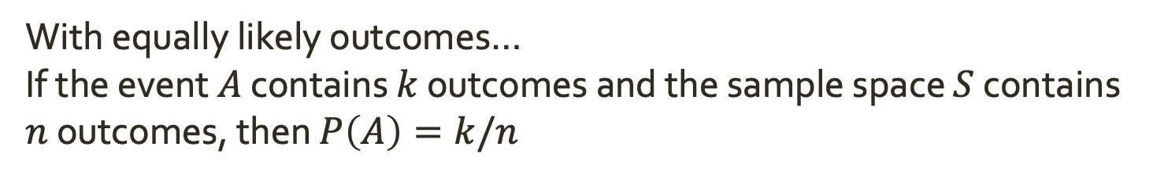
Assigning Probabilities to Events
Problem
We don’t often have the time, energy, ability, etc. to repeat an experiment an infinite number of times. How do we assign probabilities to events in a realistic way?
With equally likely outcomes…
If the event $A$ contains $k$ outcomes and the sample space $S$ contains $n$ outcomes, then $P\left(A\right)=k/n$

Slide 19

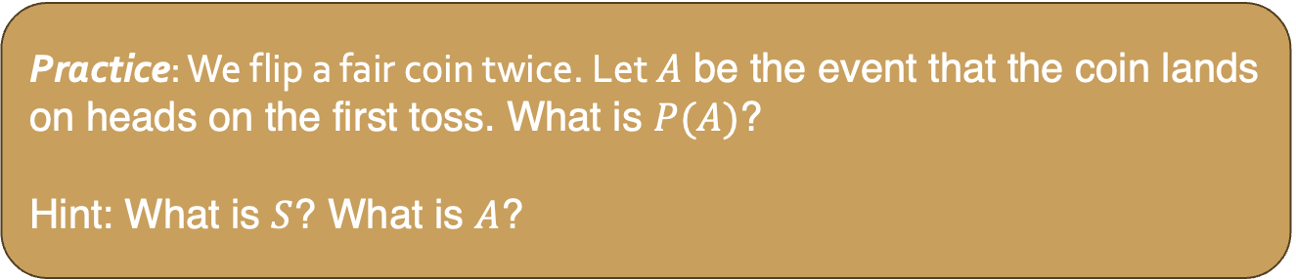
Assigning Probabilities to Events
Problem
We don’t often have the time, energy, ability, etc. to repeat an experiment an infinite number of times. How do we assign probabilities to events in a realistic way?
With equally likely outcomes…
If the event $A$ contains $k$ outcomes and the sample space $S$ contains $n$ outcomes, then $P\left(A\right)=k/n$
Practice: We flip a fair coin twice. Let $A$ be the event that the coin lands on heads on the first toss. What is $P(A)$?
Hint: What is $S$? What is $A$?
Notes:
S = {(H,H), (H, T), (T,H), (T, T)}.
A = {(H,H), (H, T)}.

Slide 20
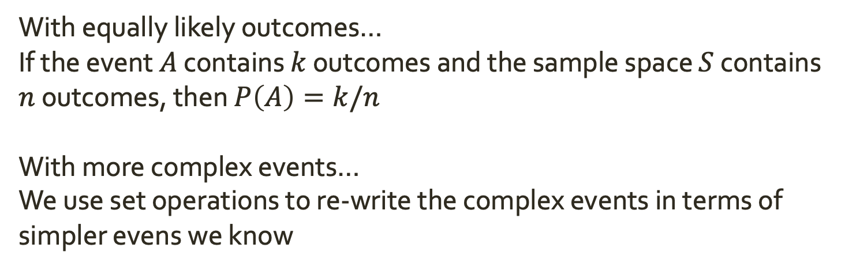
Assigning Probabilities to Events
Problem
We don’t often have the time, energy, ability, etc. to repeat an experiment an infinite number of times. How do we assign probabilities to events in a realistic way?
With equally likely outcomes…
If the event $A$ contains $k$ outcomes and the sample space $S$ contains $n$ outcomes, then $P\left(A\right)=k/n$
With more complex events…
We use set operations to re-write the complex events in terms of simpler evens we know
Notes:
S = {(H,H), (H, T), (T,H), (T, T)}.
A = {(H,H), (H, T)}.

Slide 21
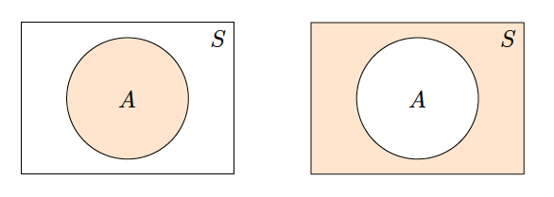

Assigning Probabilities to Events
Let $A$ be an event.
The probability of “not $A$” ($A^{c}$) is equivalent to 1 minus the probability of $A$
$$P\left(A^{c}\right)=1−P(A)$$
Notes:
S = {(H,H), (H, T), (T,H), (T, T)}.
A = {(H,H), (H, T)}.

Slide 22
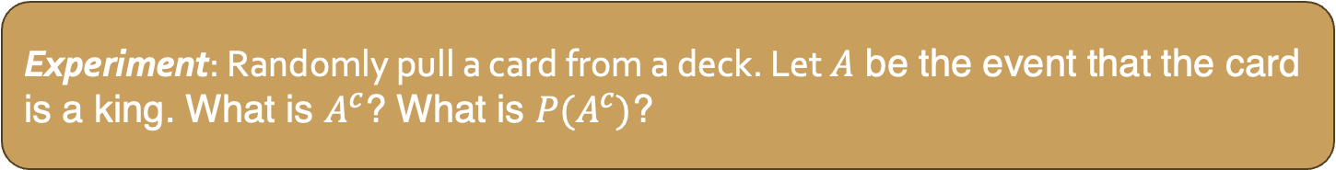
Assigning Probabilities to Events
Let $A$ be an event.
The probability of “not $A$” ($A^{c}$) is equivalent to 1 minus the probability of $A$
$$P\left(A^{c}\right)=1−P(A)$$
Experiment: Randomly pull a card from a deck. Let $A$ be the event that the card is a king. What is $A^{c}$? What is $P(A^{c})$?
Notes:
Not 1, 5/6

Slide 23
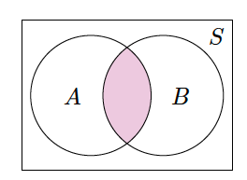

Assigning Probabilities to Events
Let $A$ and $B$ be events.
The probability of $A$ and $B$ is the probability of the intersection (shared events) of the two
$$P\left(A∩B\right)$$
Notes:
S = {(H,H), (H, T), (T,H), (T, T)}.
A = {(H,H), (H, T)}.

Slide 24
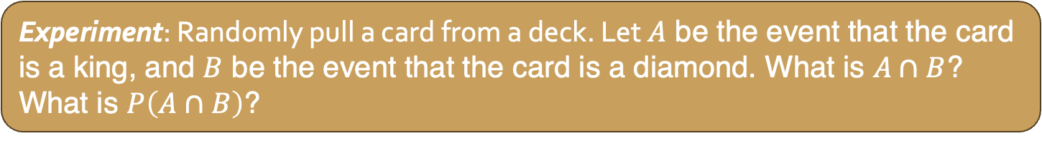
Assigning Probabilities to Events
Let $A$ and $B$ be events.
The probability of $A$ and $B$ is the probability of the intersection (shared events) of the two
$$P\left(A∩B\right)$$
Experiment: Randomly pull a card from a deck. Let $A$ be the event that the card is a king, and $B$ be the event that the card is a diamond. What is $A∩B$? What is $P\left(A∩B\right)$?

Slide 25
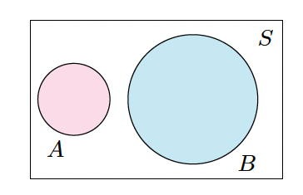
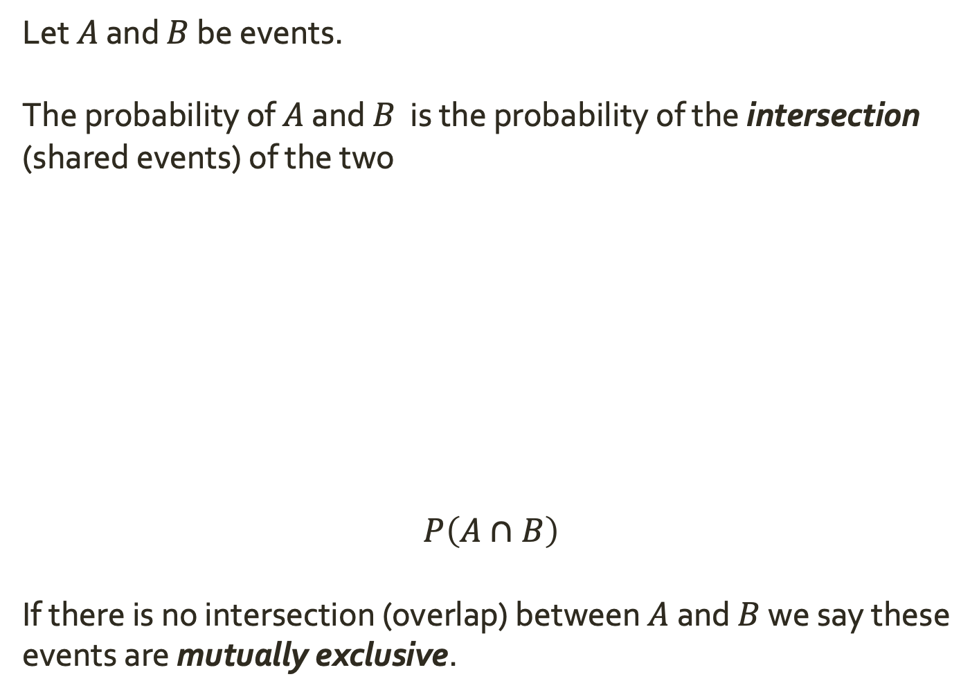
Assigning Probabilities to Events
Let $A$ and $B$ be events.
The probability of $A$ and $B$ is the probability of the intersection (shared events) of the two
$$P\left(A∩B\right)$$
If there is no intersection (overlap) between $A$ and $B$ we say these events are mutually exclusive.
Notes:
S = {(H,H), (H, T), (T,H), (T, T)}.
A = {(H,H), (H, T)}.

Slide 26
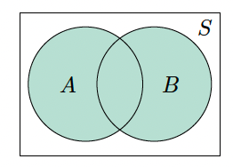

Assigning Probabilities to Events
Let $A$ and $B$ be events.
The probability of $A$ or $B$ is the probability of the union of the two. The union consists of all evens in either $A$ or $B$ or both.
$$P\left(A∪B\right)$$
Notes:
S = {(H,H), (H, T), (T,H), (T, T)}.
A = {(H,H), (H, T)}.

Slide 27


Assigning Probabilities to Events
Let $A$ and $B$ be events.
The probability of $A$ or $B$ is the probability of the union of the two. The union consists of all evens in either $A$ or $B$ or both.
$$P\left(A∪B\right)$$
Experiment: Randomly pull a card from a deck. Let $A$ be the event that the card is a king, and $B$ be the event that the card is a diamond. What is $A∪B$? What is $P\left(A∪B\right)$?
Notes:
S = {(H,H), (H, T), (T,H), (T, T)}.
A = {(H,H), (H, T)}.

Slide 28
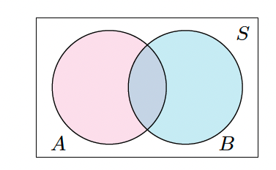

Assigning Probabilities to Events
Let $A$ and $B$ be events.
General Addition Rule: $P\left(A∪B\right)=P\left(A\right)+P\left(B\right)−P(A∩B)$
Notes:
S = {(H,H), (H, T), (T,H), (T, T)}.
A = {(H,H), (H, T)}.

Slide 29

Assigning Probabilities to Events
Let $A$ and $B$ be events.
General Addition Rule: $P\left(A∪B\right)=P\left(A\right)+P\left(B\right)−P(A∩B)$
Practice: If A and B are mutually exclusive, what does $P\left(A∪B\right)$ simplify to?
Notes:
S = {(H,H), (H, T), (T,H), (T, T)}.
A = {(H,H), (H, T)}.

Slide 30
Assigning Probabilities to Events
Let $A$ and $B$ be events.
General Addition Rule: $P\left(A∪B\right)=P\left(A\right)+P\left(B\right)−P(A∩B)$
Practice: Suppose that 100 individuals were surveyed about their TV watching habits. 35 of those surveyed reported watching the TV show Survivor, 15 reported watching Big Brother, and 10 reported watching both. What percentage of the 100 individuals watched either Survivor or Big Brother?
Notes:
S = {(H,H), (H, T), (T,H), (T, T)}.
A = {(H,H), (H, T)}.

Slide 31
Independance
Two events are independent if knowing the outcome of one provides no useful information about the outcome of the other
Ex. In consecutive coin flips, knowing the first coin flip landed on heads does not provide any information on the determining what the second coin flip landed on.
Consecutive coin flips are independent
Ex. In drawing cards from a deck without replacement, knowing that the first car draw was an ace does provide useful information for determining what the next card might be.
Consecutive card draws are not independent!
Notes:
S = {(H,H), (H, T), (T,H), (T, T)}.
A = {(H,H), (H, T)}.

Slide 32
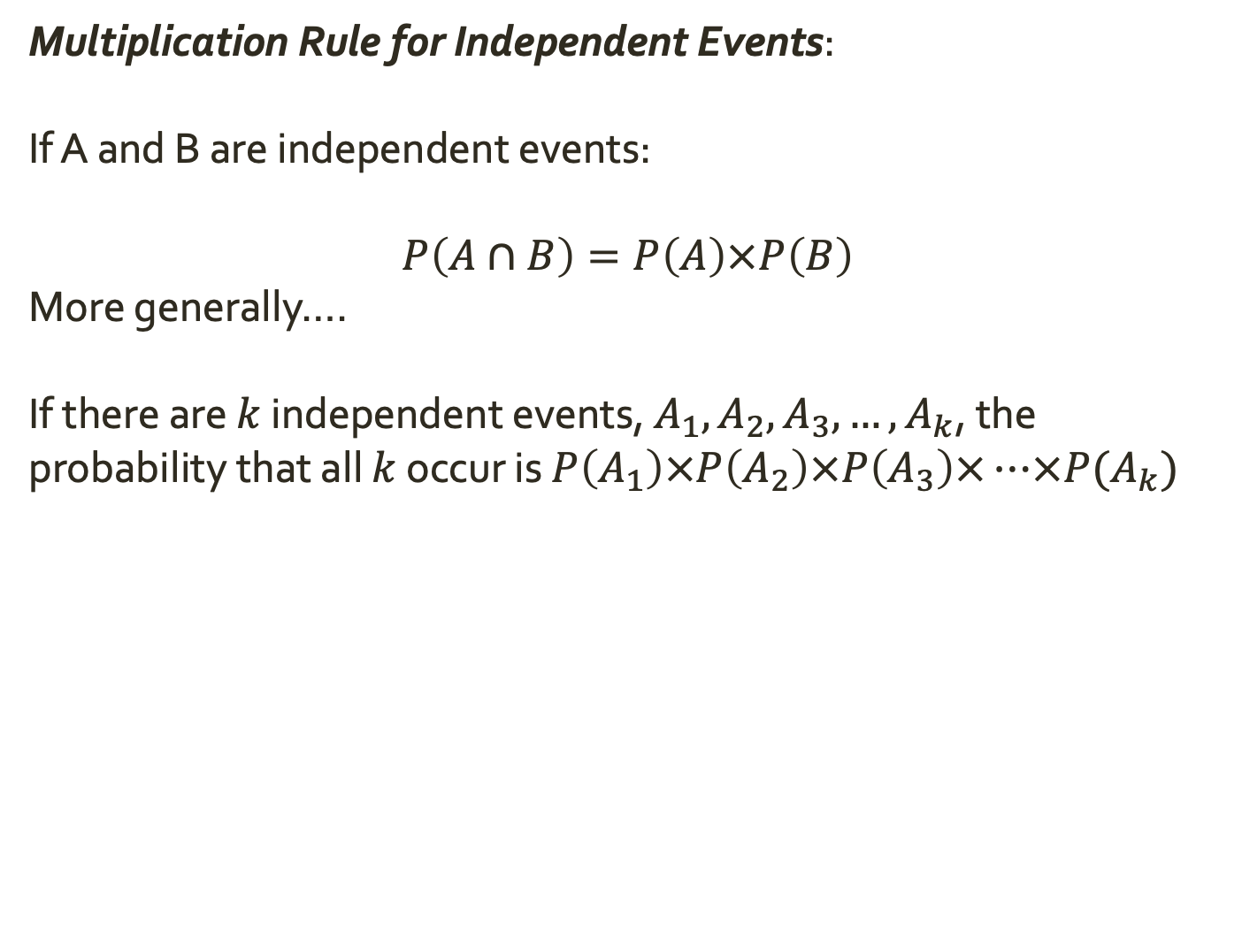
Assigning Probabilities to Events
Multiplication Rule for Independent Events:
If A and B are independent events:
$$P\left(A∩B\right)=P\left(A\right)×P\left(B\right)$$
More generally….
If there are $k$ independent events, $A_{1}, A_{2},A_{3},…,A_{k}$, the probability that all $k$ occur is $P\left(A_{1}\right)×P\left(A_{2}\right)×P\left(A_{3}\right)×…×P(A_{k})$
Notes:
S = {(H,H), (H, T), (T,H), (T, T)}.
A = {(H,H), (H, T)}.

Slide 33

Assigning Probabilities to Events
Multiplication Rule for Independent Events:
If A and B are independent events:
$$P\left(A∩B\right)=P\left(A\right)×P\left(B\right)$$
More generally….
If there are $k$ independent events, $A_{1}, A_{2},A_{3},…,A_{k}$, the probability that all $k$ occur is $P\left(A_{1}\right)×P\left(A_{2}\right)×P\left(A_{3}\right)×…×P(A_{k})$
Practice: Suppose you toss your 10 sided die twice in a row. What is the probability of getting a 2 both times?
Notes:
S = {(H,H), (H, T), (T,H), (T, T)}.
A = {(H,H), (H, T)}.

Slide 34
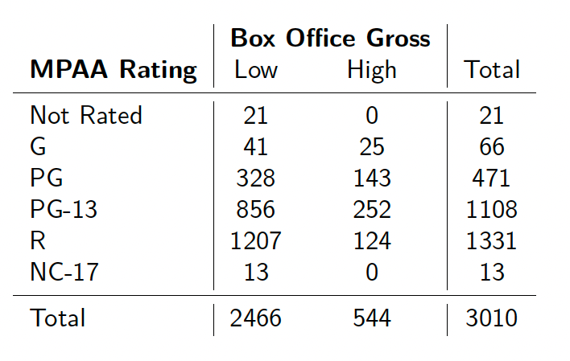
Marginal, Joint, and Conditional Probabilities
Recall
A contingency table summarizes the distribution of two categorical variables by displaying the number of observations falling into each unique combination of levels
Notes:
S = {(H,H), (H, T), (T,H), (T, T)}.
A = {(H,H), (H, T)}.

Slide 35
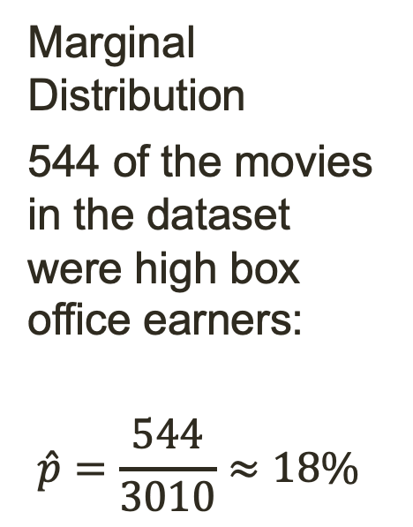
Marginal, Joint, and Conditional Probabilities
Recall
A contingency table summarizes the distribution of two categorical variables by displaying the number of observations falling into each unique combination of levels
Marginal Distribution
544 of the movies in the dataset were high box office earners:
$$\hat{p}=\frac{544}{3010}≈18\%$$
Notes:
S = {(H,H), (H, T), (T,H), (T, T)}.
A = {(H,H), (H, T)}.

Slide 36
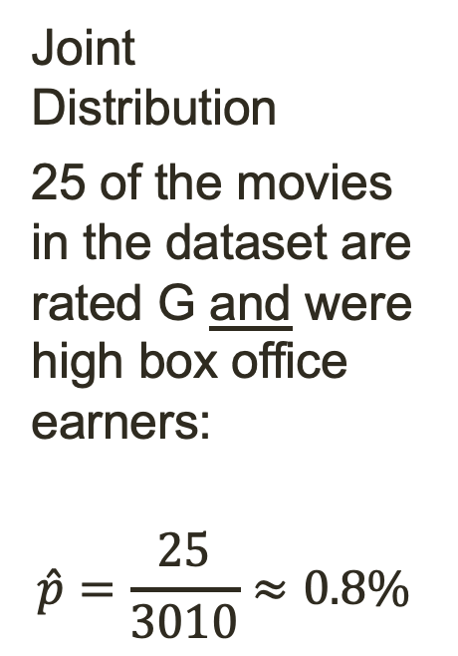
Marginal, Joint, and Conditional Probabilities
Recall
A contingency table summarizes the distribution of two categorical variables by displaying the number of observations falling into each unique combination of levels
Joint Distribution
25 of the movies in the dataset are rated G and were high box office earners:
$$\hat{p}=\frac{25}{3010}≈0.8\%$$
Notes:
S = {(H,H), (H, T), (T,H), (T, T)}.
A = {(H,H), (H, T)}.

Slide 37
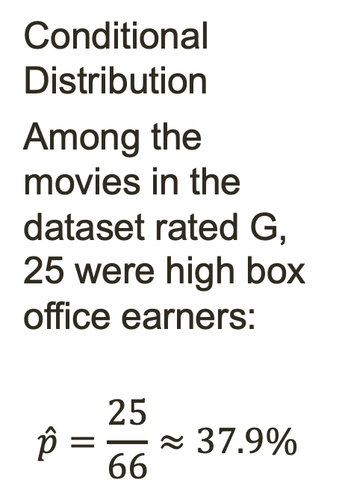
Marginal, Joint, and Conditional Probabilities
Recall
A contingency table summarizes the distribution of two categorical variables by displaying the number of observations falling into each unique combination of levels
Conditional Distribution
Among the movies in the dataset rated G, 25 were high box office earners:
$$\hat{p}=\frac{25}{66}≈37.9\%$$
Notes:
S = {(H,H), (H, T), (T,H), (T, T)}.
A = {(H,H), (H, T)}.

Slide 38
Marginal, Joint, and Conditional Probabilities
Marginal probability captures information about a single
event/process at a time
Joint probability considers how these two (or more) processes behave simultaneously
Conditional probability encodes how the probability of one event changes given that we know that the second event has occurred
Notes:
S = {(H,H), (H, T), (T,H), (T, T)}.
A = {(H,H), (H, T)}.

Slide 39

Marginal, Joint, and Conditional Probabilities
Suppose we want to understand the relationship between two events: M (the event that a movie is a high box office earner) and G (the event that a movie is G rated)
Marginal probability captures information about a single
event/process at a time
$$P\left(M\right)=18\%$$
Joint probability considers how these two (or more) processes behave simultaneously
$$P\left(M⋂G\right)=P\left(M and G\right)=0.8\%$$
Conditional probability encodes how the probability of one event changes given that we know that the second event has occurred
$$P\left(M | G\right)=P\left(M given G\right)= \frac{P(M∩G)}{P(G)}=38\%$$
Notes:
S = {(H,H), (H, T), (T,H), (T, T)}.
A = {(H,H), (H, T)}.

Slide 40

Marginal, Joint, and Conditional Probabilities
Practice: A 1989 study of first-line therapies for cocaine dependency randomly assigned 72 chronic users into three groups: desipramine (antidepressant), lithium (standard treatment at the time), and placebo. Results of the study are summarized below:
What is the probability that a patient did not relapse over the course of the study?
What is the probability that a patient received desipramine and relapsed?
Given that a patient received desipramine, what is the probability that they relapsed?
Suppose we want to understand the relationship between two events: M (the event that a movie is a high box office earner) and G (the event that a movie is G rated)
Marginal probability captures information about a single
event/process at a time
$$P\left(M\right)=18\%$$
Joint probability considers how these two (or more) processes behave simultaneously
$$P\left(M⋂G\right)=P\left(M and G\right)=0.8\%$$
Conditional probability encodes how the probability of one event changes given that we know that the second event has occurred
$$P\left(M | G\right)=P\left(M given G\right)= \frac{P(M∩G)}{P(G)}=38\%$$
 | relapse | no relapse | total
desipramine | 10 | 14 | 24
lithium | 18 | 6 | 24
placebo | 20 | 4 | 24
total | 48 | 24 | 72

