Slide 1
Elementary Statistics – Exploratory Data Analysis (EDA)
Dr. Ab Mosca (they/them)
Slides based off slides courtesy of Kaitlyn Cook (https://www.smith.edu/people/kaitlyn-cook)

Slide 2
Plan for Today
For a single variable:
Descriptive statistics
Summary visualizations

Slide 3
Warm Up
Study Designs
Observational: Researchers observe both the explanatory and response variables without interfering in how the data arises
Experiments: Researchers intervene and assign treatments (the explanatory variable) to each participant in the study (ideally randomly)
Variables
Response variable: the measured outcome of interest.
Explanatory variable: a variable that potentials explains or predicts changes in the response.
Confounds are associated with the explanatory and response variables, and obscure true relationships.
A researcher observes that towns with higher numbers of doctors also report higher numbers of crimes. They conclude that doctors must commit crimes at higher rate than the general population does.
What type of study is this?
As stated by the researcher, what are the response and explanatory variables?
Is there a confound? If so, what?

Slide 4
Warm Up
Study Designs
Observational: Researchers observe both the explanatory and response variables without interfering in how the data arises
Experiments: Researchers intervene and assign treatments (the explanatory variable) to each participant in the study (ideally randomly)
Variables
Response variable: the measured outcome of interest.
Explanatory variable: a variable that potentials explains or predicts changes in the response.
Confounds are associated with the explanatory and response variables, and obscure true relationships.
A researcher believes that light levels might effect how students perform on exams. They randomly assign students to a treatment: fluorescent overhead lighting, yellow overhead lighting, and no overhead lighting (only desk lamps), and have the students take an exam in that lighting. Note: light levels might have different effects on people who wear glasses and people who don’t. Some students wear glasses and others do not.
What type of study is this?
As stated by the researcher, what are the response and explanatory variables?
Is there a confound? If so, what?

Slide 5
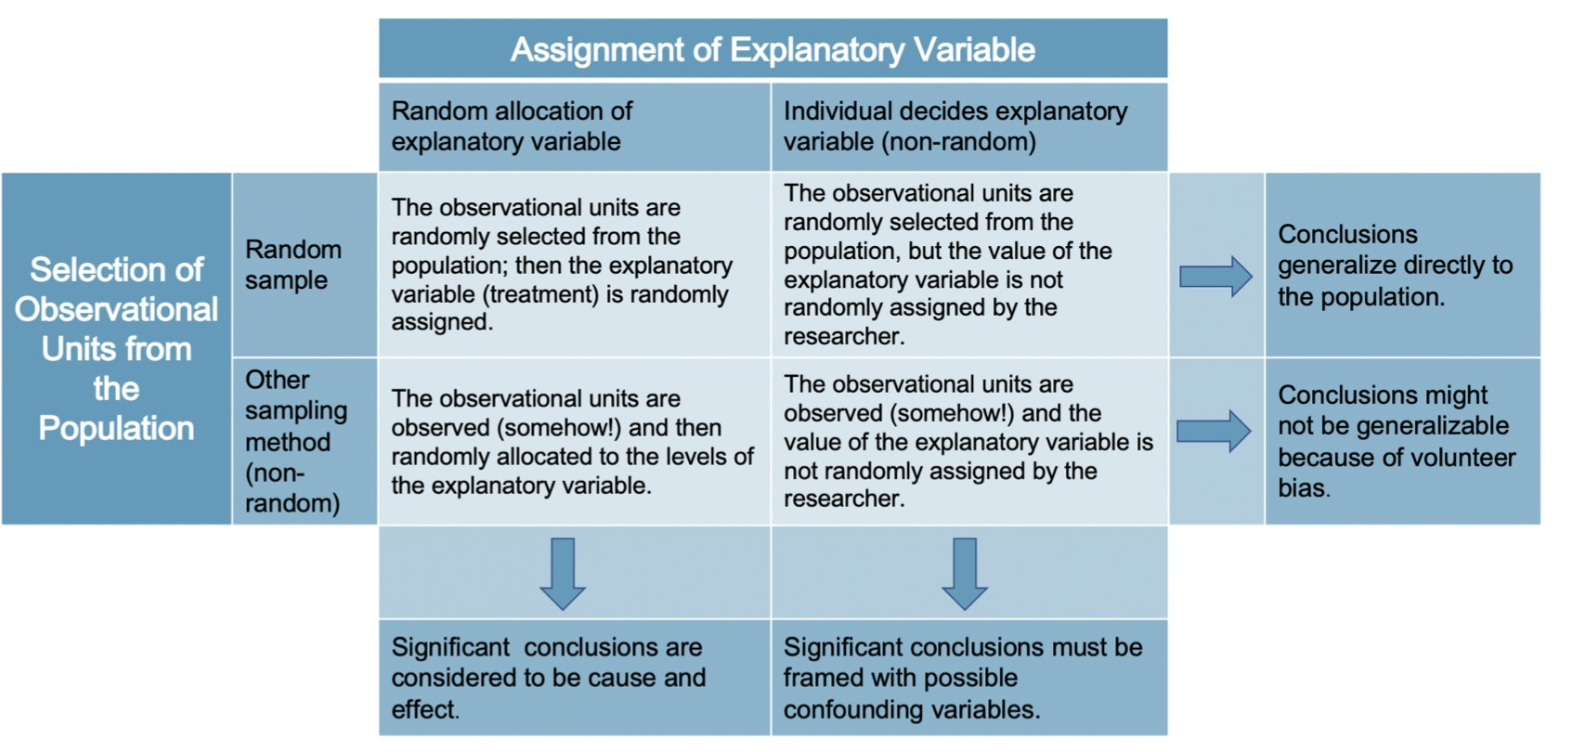
Big Picture
Thus far we’ve focused on understanding where our data come from:
Do those data represent a random sample from our target population? Was the explanatory variable randomly allocated?
This in turn determines what sorts of conclusions we can draw and to
whom we can generalize those results:

Slide 6
Big Picture
Thus far we’ve focused on understanding where our data come from:
Do those data represent a random sample from our target population? Was the explanatory variable randomly allocated?
This in turn determines what sorts of conclusions we can draw and to
whom we can generalize those results:

Slide 7
Big Picture
Thus far we’ve focused on understanding where our data come from:
Do those data represent a random sample from our target population? Was the explanatory variable randomly allocated?
This in turn determines what sorts of conclusions we can draw and to
whom we can generalize those results:

Slide 8
Big Picture
Thus far we’ve focused on understanding where our data come from:
Do those data represent a random sample from our target population? Was the explanatory variable randomly allocated?
This in turn determines what sorts of conclusions we can draw and to
whom we can generalize those results:

Slide 9
Big Picture
Thus far we’ve focused on understanding where our data come from:
Do those data represent a random sample from our target population? Was the explanatory variable randomly allocated?
This in turn determines what sorts of conclusions we can draw and to
whom we can generalize those results:

Slide 10
Big Picture
Thus far we’ve focused on understanding where our data come from:
Do those data represent a random sample from our target population? Was the explanatory variable randomly allocated?
This in turn determines what sorts of conclusions we can draw and to
whom we can generalize those results:
But once we have our data. . . then what?

Slide 11
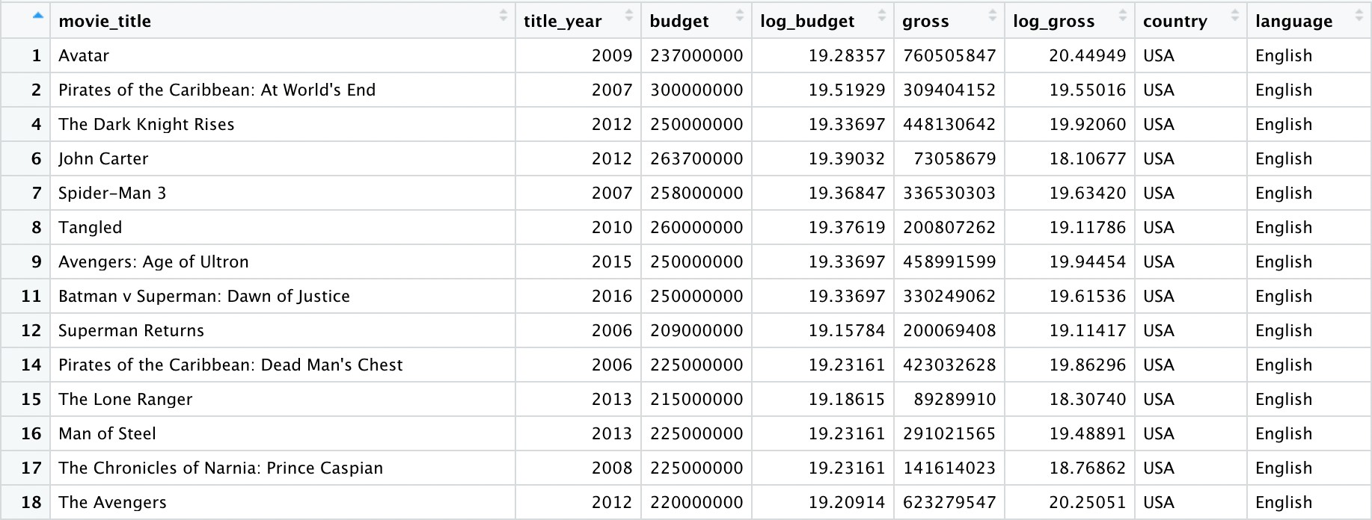
IMDB Movie Dataset
For the next few classes, we’ll be working with data on movies in order to understand how the attributes of these movies associate with box office gross!
Data on 3,039 movies made in the US between 1929 and 2016, scraped from IMDB
Data are from Kaggle.com and are available at https://github.com/kaitlyncook/data-sets

Slide 12
Exploratory Data Analysis
Exploratory data analysis (EDA) refers to the practice of reducing and summarizing data in ways that:
Help us make sense of the information that we have
Help to inform our understanding of our research question
You can think of EDA as the data version of tl;dr.

Slide 13
Exploratory Data Analysis
Exploratory data analysis (EDA) refers to the practice of reducing and summarizing data in ways that:
Help us make sense of the information that we have
Help to inform our understanding of our research question
Graphical Summaries (Data Visualizations)
A visual representation of how our data are distributed across the observations in our sample
Numeric Summaries (Summary Statistics)
A single number or set of numbers that captures important features of that distribution, such as its center and spread
You can think of EDA as the data version of tl;dr.

Slide 14
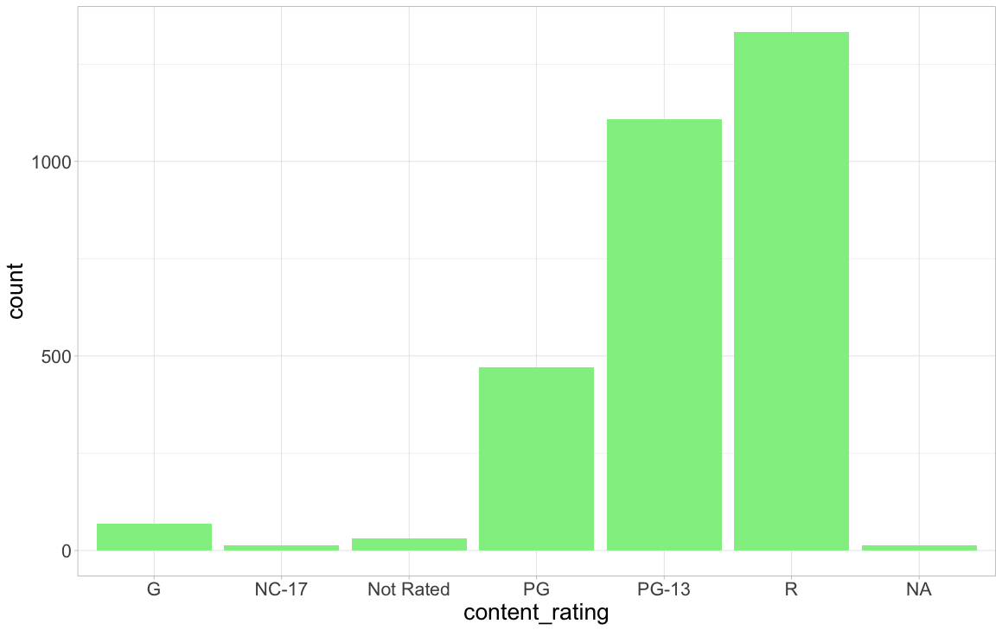
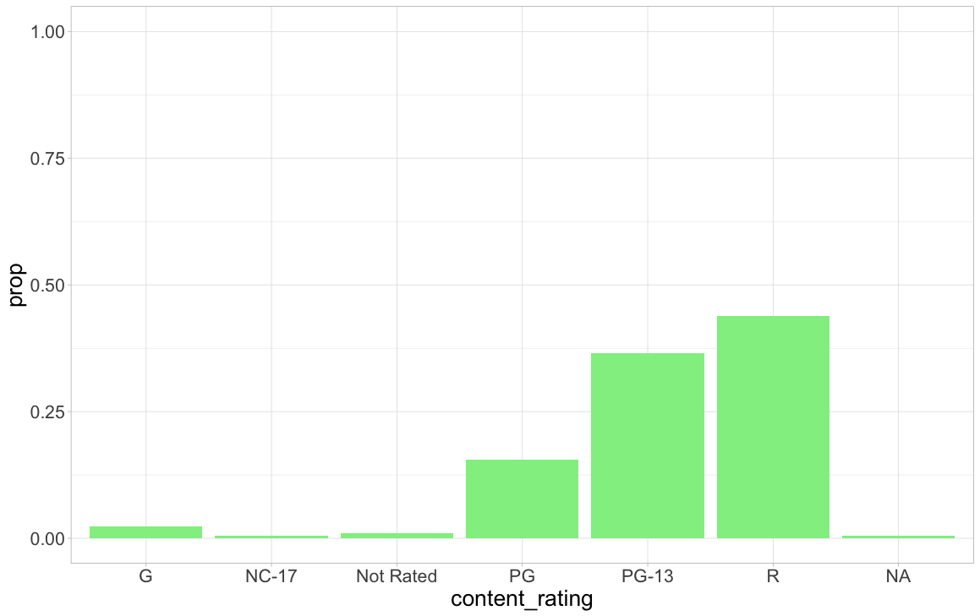
EDA for Categorical Variables: Bar Plots
The empirical distribution of a categorical variable is comprised of:
The possible levels or values of the categorical variable
The (relative) frequency of those levels in the observed data
One method of visualizing this distribution is through a bar plot:
Bar plot showing frequency of MPAA ratings.
Bar plot showing relative frequency of MPAA ratings.

Slide 15
EDA for Categorical Variables: Bar Plots
The empirical distribution of a categorical variable is comprised of:
The possible levels or values of the categorical variable
The (relative) frequency of those levels in the observed data
One method of visualizing this distribution is through a bar plot:
Example
Work with 2-3 other people to visualize the distribution of years (first year, sophomore, junior, senior) in this class.
Bar plot showing frequency of MPAA ratings.
Bar plot showing relative frequency of MPAA ratings.

Slide 16
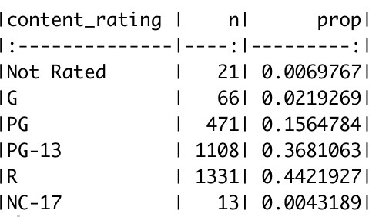
EDA for Categorical Variables: Summary Statistics
We can present this same information numerically using a frequency table, which displays both:
the number of movies (n) that obtained each rating
the relative frequency of (prop) those ratings

Slide 17
EDA for Categorical Variables: Summary Statistics
We can present this same information numerically using a frequency table, which displays both:
the number of movies (n) that obtained each rating
the relative frequency of (prop) those ratings
Example
Work with 2-3 other people to represent the distribution of years (first year, sophomore, junior, senior) in this class with a frequency table.

Slide 18
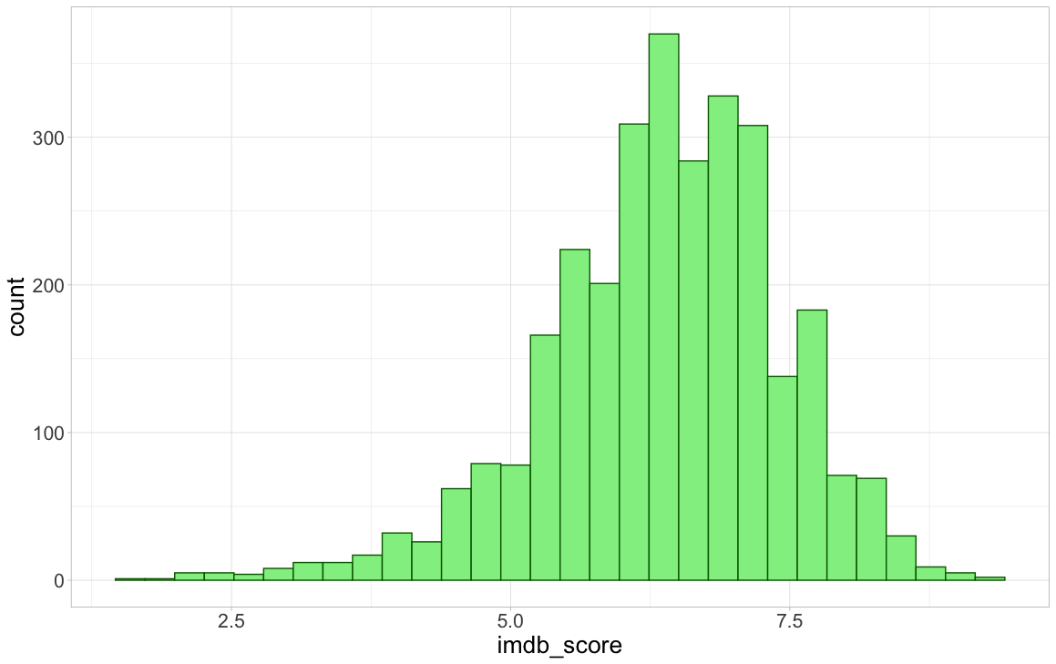
EDA for Numerical Variables: Histograms
When the variable that we’re summarizing is numerical, we can instead visualize its distribution using either a histogram or density plot
Histogram: numerical analog of the frequency bar plot
Created by:
Dividing the range of IMDB ratings (here from 1.6 to 9.3) into intervals (also called “bins”) of equal width
Counting the number of movies whose IMDB rating falls into each bin

Slide 19
EDA for Numerical Variables: Histograms
When the variable that we’re summarizing is numerical, we can instead visualize its distribution using either a histogram or density plot
Histogram: numerical analog of the frequency bar plot
Example
Work with 2-3 other people to visualize the distribution of ages in this class with a histogram.
Created by:
Dividing the range of IMDB ratings (here from 1.6 to 9.3) into intervals (also called “bins”) of equal width
Counting the number of movies whose IMDB rating falls into each bin

Slide 20
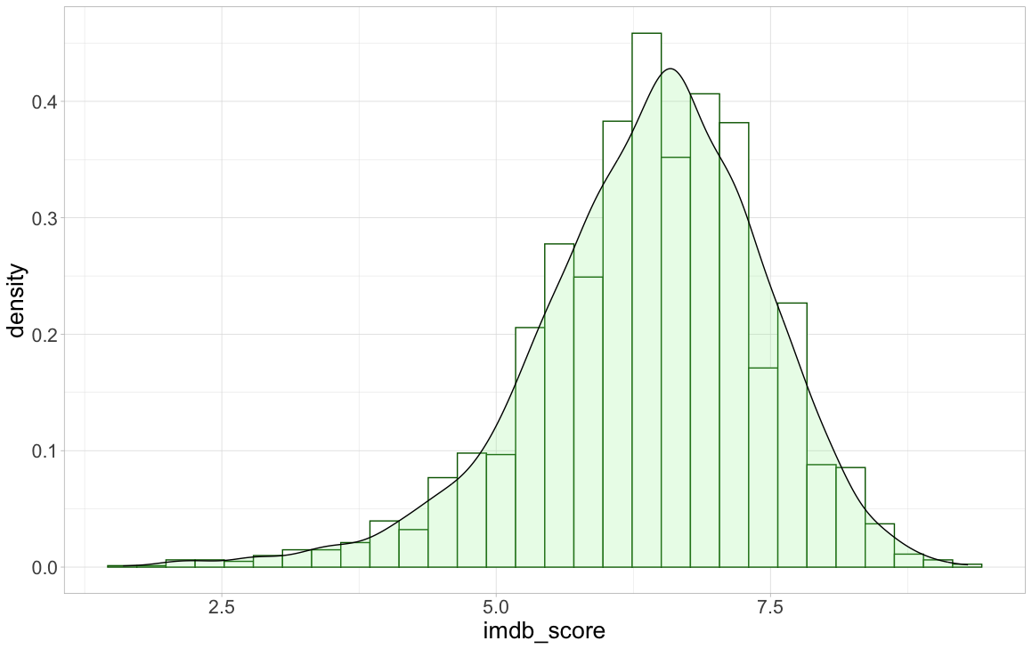
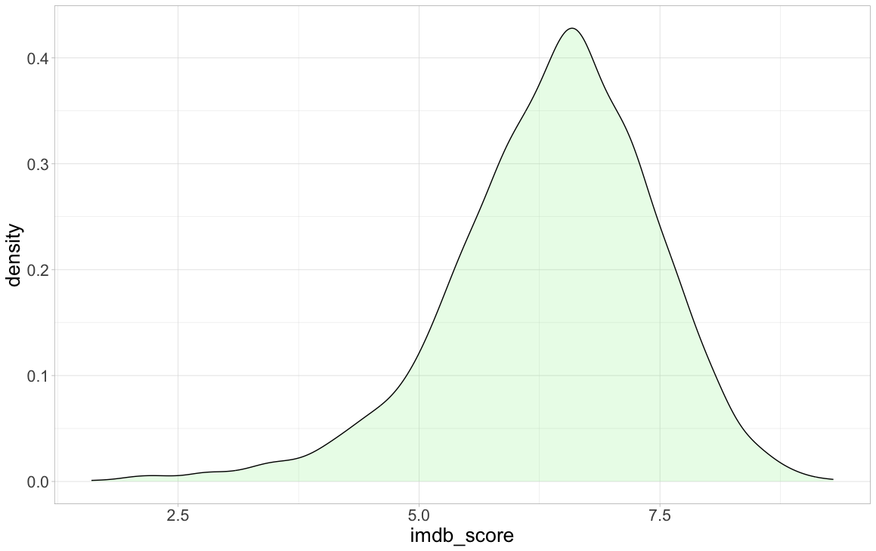
EDA for Numerical Variables: Density Plots
When the variable that we’re summarizing is numerical, we can instead visualize its distribution using either a histogram or density plot
Density plot: numerical analog of relative frequency bar plot
Created by standardizing and smoothing over the corresponding histogram

Slide 21
EDA for Numerical Variables: Density Plots
When the variable that we’re summarizing is numerical, we can instead visualize its distribution using either a histogram or density plot
Density plot: numerical analog of relative frequency bar plot
Example
Work with 2-3 other people to visualize the distribution of ages in this class with a density plot.
Created by standardizing and smoothing over the corresponding histogram

Slide 22
Interlude: Describing Distributions
When looking at a variable’s distribution, we want to pay attention to and describe the following attributes:
Skewness Modality
Center Spread

Slide 23
Interlude: Describing Distributions
When looking at a variable’s distribution, we want to pay attention to and describe the following attributes:
Skewness Modality
Center Spread
Graphical
Summary Statistics

Slide 24
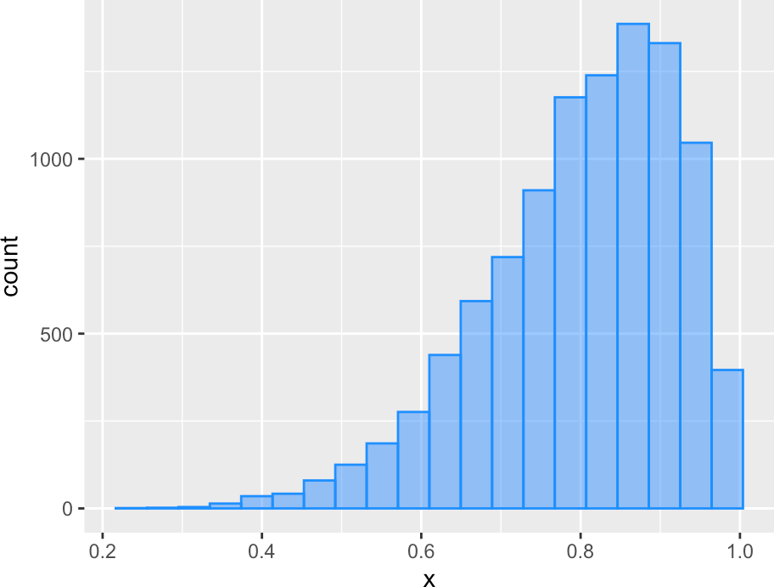
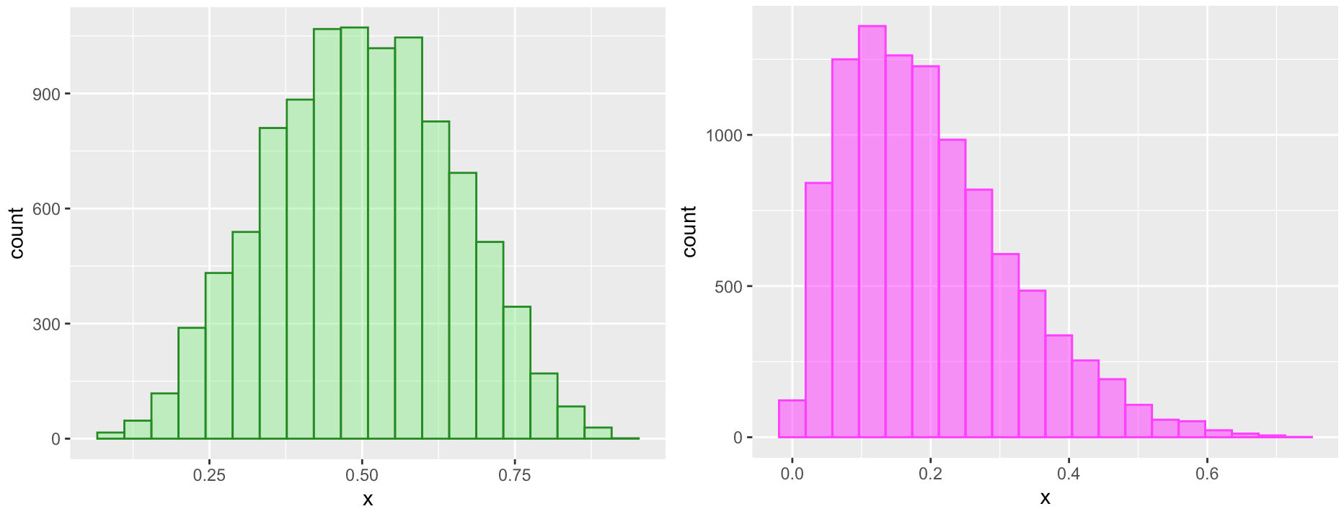
Interlude: Describing Distributions
When looking at a variable’s distribution, we want to pay attention to and describe the following attributes:
Skewness Modality
Center Spread
Graphical
Summary Statistics
Skewness is a measure of (a)symmetry!
→ Why pay attention to skew? Later in this course we’ll see statistical tools that assume our data are (close to) symmetric, and we need to be able to assess whether this assumption is reasonable.
Left (“negative”) skewed distribution.
Symmetric distribution.
Right (“positive”) skewed distribution.
Tip: Whatever side the long tail is on is the side of skew

Slide 25
Interlude: Describing Distributions
When looking at a variable’s distribution, we want to pay attention to and describe the following attributes:
Skewness Modality
Center Spread
Graphical
Summary Statistics
Skewness is a measure of (a)symmetry!
Example
What is the skewness of our age data?
→ Why pay attention to skew? Later in this course we’ll see statistical tools that assume our data are (close to) symmetric, and we need to be able to assess whether this assumption is reasonable.
Left (“negative”) skewed distribution.
Symmetric distribution.
Right (“positive”) skewed distribution.
Tip: Whatever side the long tail is on is the side of skew

Slide 26
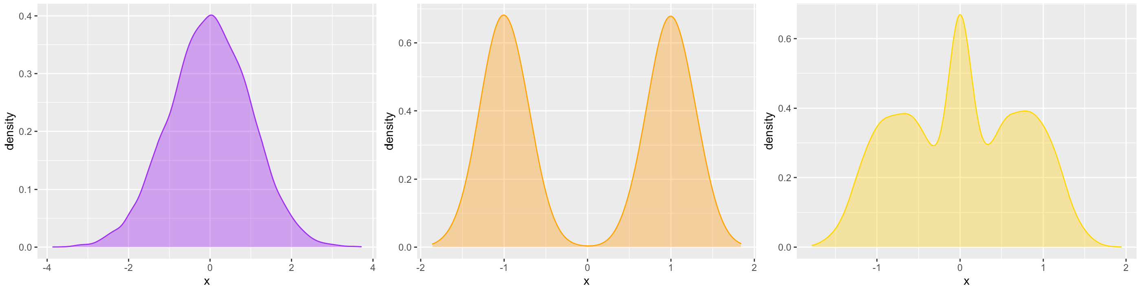
Interlude: Describing Distributions
When looking at a variable’s distribution, we want to pay attention to and describe the following attributes:
Skewness Modality
Center Spread
Graphical
Summary Statistics
Modality is a measure of how many peaks (“modes”) the distribution has
→ Why pay attention to modality? A mode is a value that occurs with high frequency in our data, and it can help to inform our understanding of what values our variable tends to take on
Unimodal distribution.
Bimodal distribution.
Multimodal distribution

Slide 27
Interlude: Describing Distributions
When looking at a variable’s distribution, we want to pay attention to and describe the following attributes:
Skewness Modality
Center Spread
Graphical
Summary Statistics
Example
What is the modality of our age data?
Modality is a measure of how many peaks (“modes”) the distribution has
→ Why pay attention to modality? A mode is a value that occurs with high frequency in our data, and it can help to inform our understanding of what values our variable tends to take on
Unimodal distribution.
Bimodal distribution.
Multimodal distribution

Slide 28
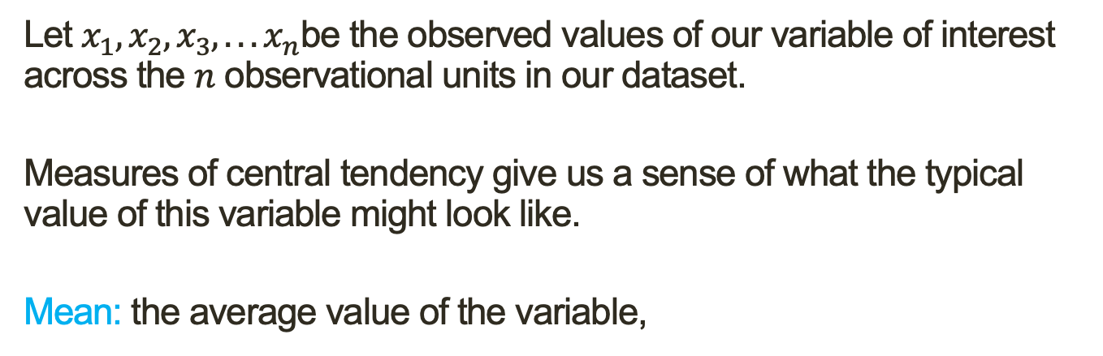
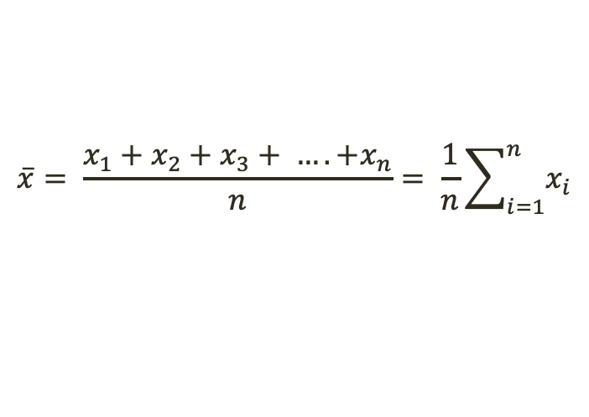
Interlude: Describing Distributions
When looking at a variable’s distribution, we want to pay attention to and describe the following attributes:
Skewness Modality
Center Spread
Graphical
Summary Statistics
Let $x_{1},x_{2},x_{3},. . . x_{n}$be the observed values of our variable of interest across the $n$ observational units in our dataset.
Measures of central tendency give us a sense of what the typical value of this variable might look like.
Mean: the average value of the variable,
$$\overline{x}= \frac{x_{1}+x_{2}+x_{3}+ …. +x_{n}}{n}= \frac{1}{n}\sum_{i=1}^{n}{x_{i}}$$
Median: suppose we order the observations from smallest to largest. the median is the value of x_{i} that falls in the middle (or, if n is even, the average of the two middle values).
⇒At least half of our data are less than or equal to the median and at least half are greater than or equal to the median

Slide 29
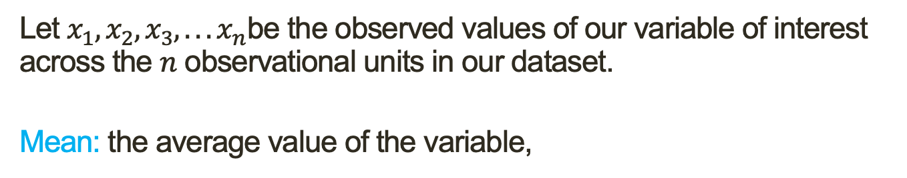
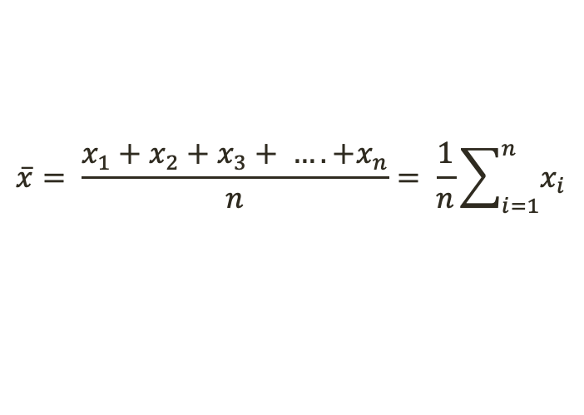
Interlude: Describing Distributions
When looking at a variable’s distribution, we want to pay attention to and describe the following attributes:
Skewness Modality
Center Spread
Graphical
Summary Statistics
Let $x_{1},x_{2},x_{3},. . . x_{n}$be the observed values of our variable of interest across the $n$ observational units in our dataset.
Mean: the average value of the variable,
$$\overline{x}= \frac{x_{1}+x_{2}+x_{3}+ …. +x_{n}}{n}= \frac{1}{n}\sum_{i=1}^{n}{x_{i}}$$
Example
Work with 2-3 other people to find the mean age of students in this class.

Slide 30
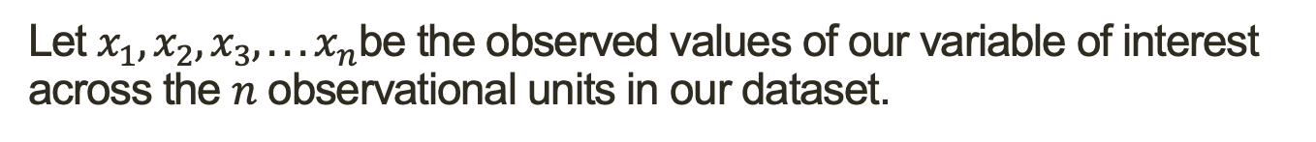
Interlude: Describing Distributions
When looking at a variable’s distribution, we want to pay attention to and describe the following attributes:
Skewness Modality
Center Spread
Graphical
Summary Statistics
Let $x_{1},x_{2},x_{3},. . . x_{n}$be the observed values of our variable of interest across the $n$ observational units in our dataset.
Median: suppose we order the observations from smallest to largest. the median is the value of x_{i} that falls in the middle (or, if n is even, the average of the two middle values).
Example
Work with 2-3 other people to find the median age of students in this class.

Slide 31
Interlude: Describing Distributions
When looking at a variable’s distribution, we want to pay attention to and describe the following attributes:
Skewness Modality
Center Spread
Graphical
Summary Statistics
Measures of dispersion give us a sense of how much observation to observation variability there is in a variable.

Slide 32
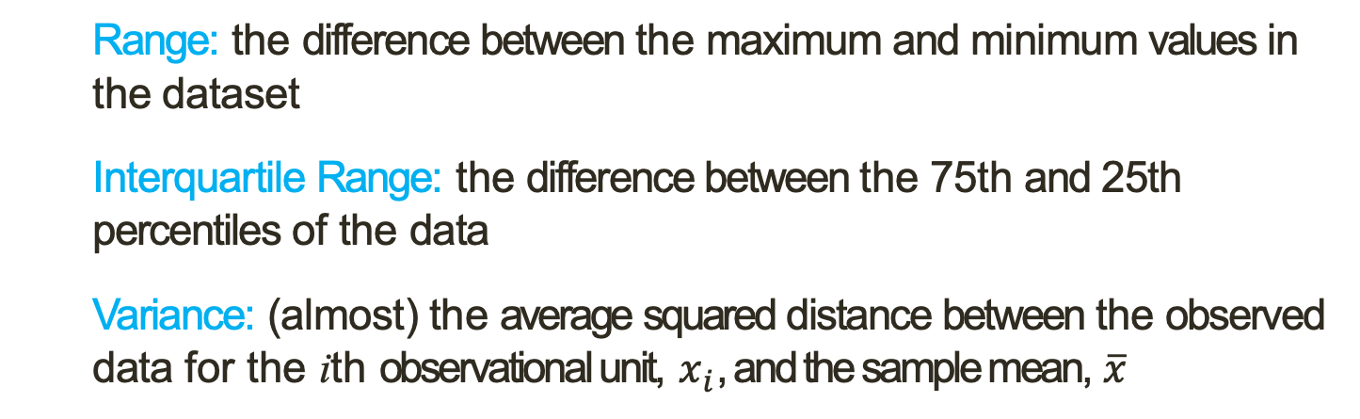
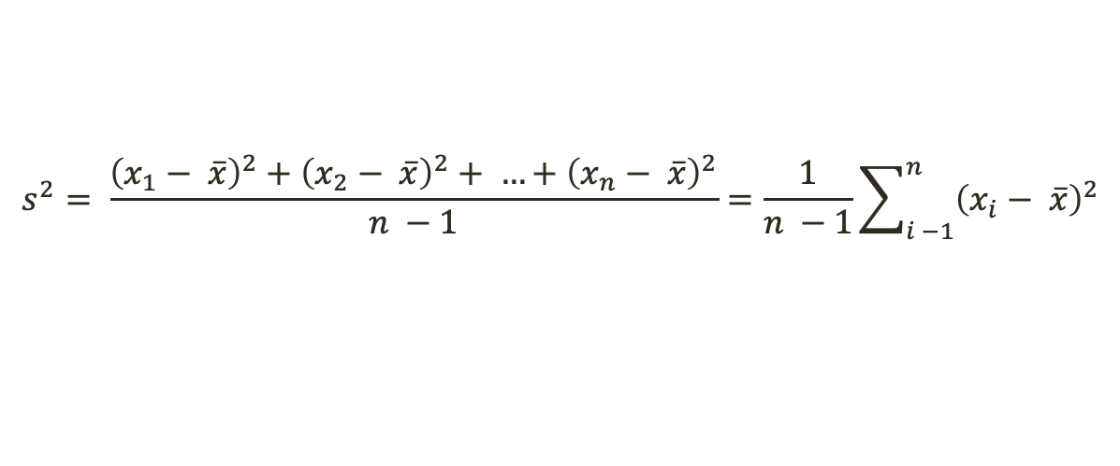
Interlude: Describing Distributions
When looking at a variable’s distribution, we want to pay attention to and describe the following attributes:
Skewness Modality
Center Spread
Graphical
Summary Statistics
Measures of dispersion give us a sense of how much observation to observation variability there is in a variable.
Range: the difference between the maximum and minimum values in the dataset
Interquartile Range: the difference between the 75th and 25th percentiles of the data
Variance: (almost) the average squared distance between the observed data for the ith observational unit, $x_{i}$, and the sample mean, $\overline{x}$
$$s^{2}= \frac{{\left(x_{1}− \overline{x}\right)}^{2}+{\left(x_{2}− \overline{x}\right)}^{2}+ …+{\left(x_{n}− \overline{x}\right)}^{2}}{n −1}=\frac{1}{n −1}\sum_{i −1}^{n}{{\left(x_{i}− \overline{x}\right)}^{2}}$$
Standard Deviation: the square root of the variance, $s= \sqrt{s^{2}}$

Slide 33
Interlude: Describing Distributions
When looking at a variable’s distribution, we want to pay attention to and describe the following attributes:
Skewness Modality
Center Spread
Graphical
Summary Statistics
Measures of dispersion give us a sense of how much observation to observation variability there is in a variable.
Range: the difference between the maximum and minimum values in the dataset
Example
Work with 2-3 other people to find the range of age.

Slide 34
Interlude: Describing Distributions
When looking at a variable’s distribution, we want to pay attention to and describe the following attributes:
Skewness Modality
Center Spread
Graphical
Summary Statistics
Measures of dispersion give us a sense of how much observation to observation variability there is in a variable.
Interquartile Range: the difference between the 75th and 25th percentiles of the data
Example
Work with 2-3 other people to find the interquartile range of age.
Hint: The 25th percentile is the median of the lower half of your data and the 75th percentile is the median of the upper half of your data.

Slide 35

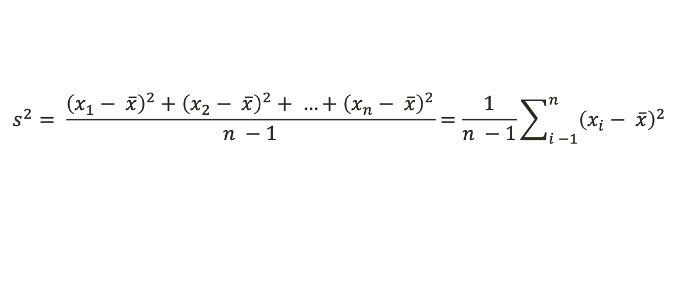
Interlude: Describing Distributions
When looking at a variable’s distribution, we want to pay attention to and describe the following attributes:
Skewness Modality
Center Spread
Graphical
Summary Statistics
Measures of dispersion give us a sense of how much observation to observation variability there is in a variable.
Variance: (almost) the average squared distance between the observed data for the ith observational unit, $x_{i}$, and the sample mean, $\overline{x}$
$$s^{2}= \frac{{\left(x_{1}− \overline{x}\right)}^{2}+{\left(x_{2}− \overline{x}\right)}^{2}+ …+{\left(x_{n}− \overline{x}\right)}^{2}}{n −1}=\frac{1}{n −1}\sum_{i −1}^{n}{{\left(x_{i}− \overline{x}\right)}^{2}}$$
Example
Work with 2-3 other people to find variance of age.

Slide 36
Interlude: Describing Distributions
When looking at a variable’s distribution, we want to pay attention to and describe the following attributes:
Skewness Modality
Center Spread
Graphical
Summary Statistics
Measures of dispersion give us a sense of how much observation to observation variability there is in a variable.
Standard Deviation: the square root of the variance, $s= \sqrt{s^{2}}$
Example
Work with 2-3 other people to find standard deviation of age.

Slide 37
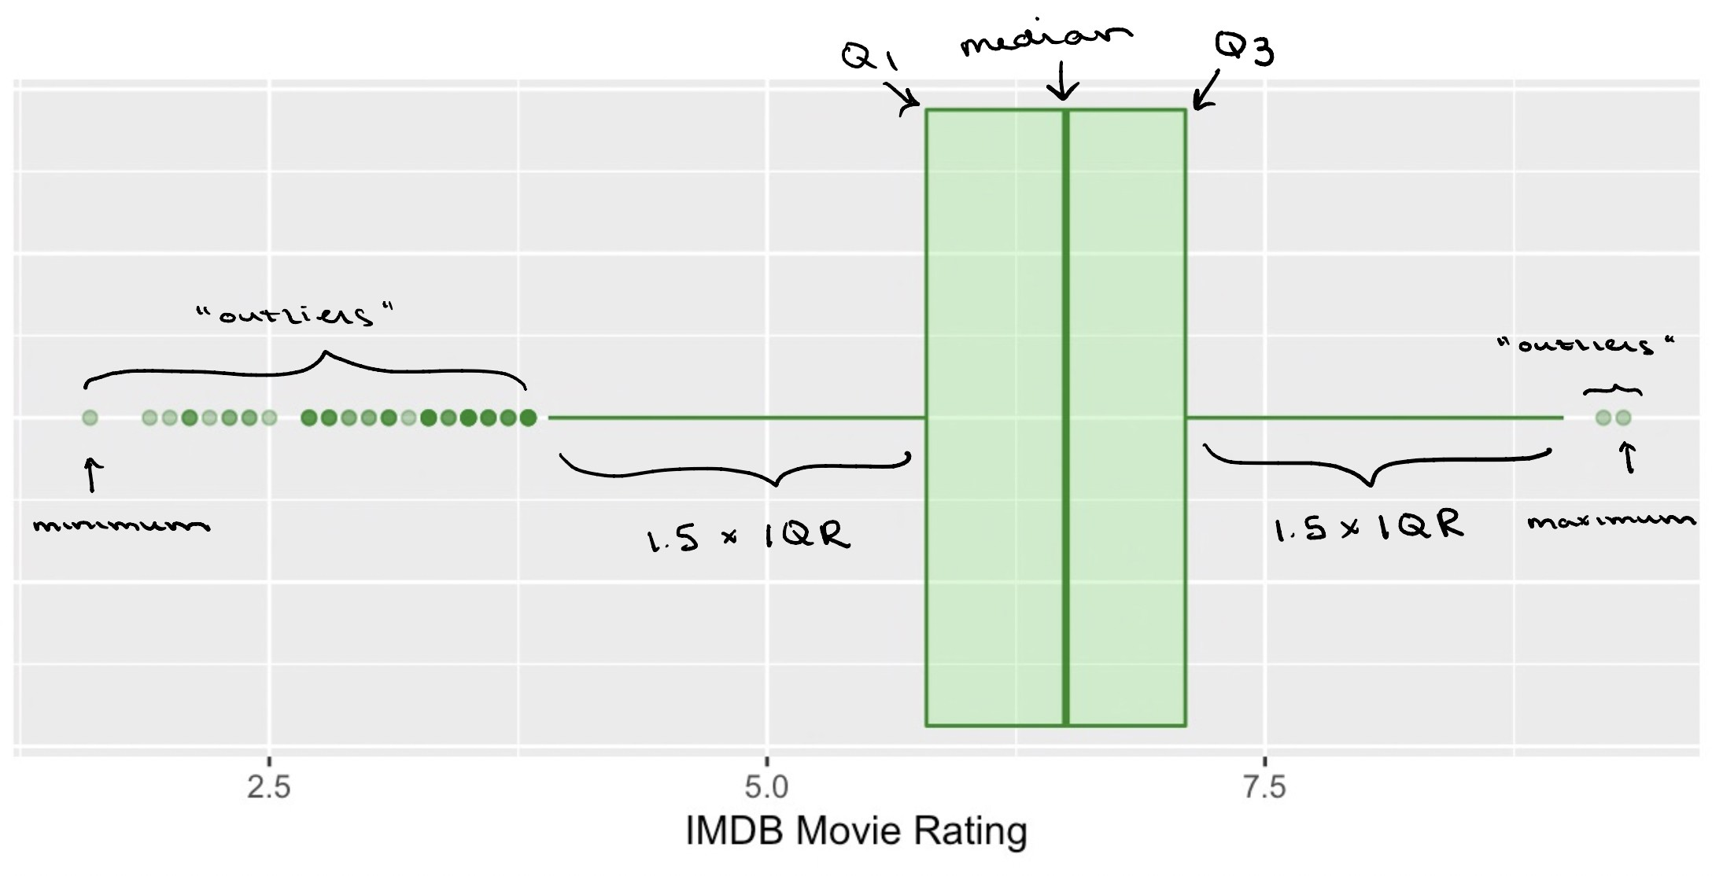
Interlude: Describing Distributions
When looking at a variable’s distribution, we want to pay attention to and describe the following attributes:
Skewness Modality
Center Spread
Graphical
Summary Statistics
The following five statistics make up the five-number summary, which captures information about both the center and spread of the data:
Minimum 25th percentile Median 75th percentile Maximum
We can use a box plot to visualize all of these statistics in one go:

Slide 38
Interlude: Describing Distributions
When looking at a variable’s distribution, we want to pay attention to and describe the following attributes:
Example
Work with 2-3 other people to visualize the five-number summary of age.
Skewness Modality
Center Spread
Graphical
Summary Statistics
The following five statistics make up the five-number summary, which captures information about both the center and spread of the data:
Minimum / 25th percentile (Q1) / Median / 75th percentile (Q3) / Maximum
We can use a box plot to visualize all of these statistics in one go:

Slide 39
EDA Practice
Open movies.csv (under Demos on the course website) in excel or google sheets.
Work with 1-2 other people.
Choose 1 categorical and 1 numerical variable. For each variable, generate the appropriate summary visualizations and summary statistics.
You in some cases, you will need to manipulate the raw data and use formulas. Helpful tips can be found here:
Excel
https://www.princeton.edu/~otorres/Excel/excelstata.htm
https://statisticsbyjim.com/basics/descriptive-statistics-excel/
Google Sheets
http://www.comfsm.fm/~dleeling/statistics/text6.html#page-031
https://www.groovypost.com/howto/quickly-get-column-statistics-in-google-sheets/

