Slide 1
Elementary Statistics – Exploratory Data Analysis (EDA) Pt 2
Dr. Ab Mosca (they/them)
Slides based off slides courtesy of Kaitlyn Cook (https://www.smith.edu/people/kaitlyn-cook)

Slide 2
Reminder!
First quiz is out today!
The quiz is a week long assignment; expect to spend 5-7 hours on it (this is standard for a college class)

Slide 3
Plan for Today
Relationships between Two Variables

Slide 4
R Appendix (I)
Set-Up Chunk
# Unpacking the necessary R packages and tools
library(tidyverse)
# Reading in the IMDB movie dataset
movies <- read.csv("https://raw.githubusercontent.com/kaitlyncook/data-sets/main/movies.csv")
EDA for a Single Categorical Variable
# Storing MPAA ratings as a factor variable with "Not Rated" as the reference
movies$content_rating <- factor(movies$content_rating,
levels=c("Not Rated", "G", "PG", "PG-13", "R", "NC-17"))
# Restricting the data to movies released after 1969 (when the MPAA system began)
mpaa.movies <- movies |> filter(title_year > 1969)
# Creating a frequency bar plot
ggplot(mpaa.movies, mapping=aes(x=content_rating)) + geom_bar(fill="light green") +
ylab("Frequency") + xlab("MPAA Rating") + theme(axis.text.x=element_text(angle=45, hjust=1))
# Creating a relative frequency bar plot
ggplot(mpaa.movies, mapping=aes(x=content_rating, y=(..count..)/sum(..count..))) + geom_bar(fill="light green") + ylab("Relative Frequency") + xlab("MPAA Rating") + theme(axis.text.x=element_text(angle=45, hjust=1))
EDA

Slide 5
R Appendix (II)
EDA for a Single Categorical Variable (cont.)
# Creating a frequency table
mpaa.movies |> group_by(content_rating) |> summarize(n=n()) |> mutate(prop=n/sum(n))
EDA for a Single Numerical Variable
# Creating a histogram
ggplot(movies, mapping=aes(x=imdb_score)) +
geom_histogram(bins=16, col="forest green", fill="light green", alpha=0.4) +
ylab("Count") + xlab("IMDB Movie Rating")
# Creating a density plot
ggplot(movies, mapping=aes(x=imdb_score)) + geom_density(col="forest green", fill="light green", alpha=0.4) + ylab("Density") + xlab("IMDB Movie Rating")
# Creating a box plot
ggplot(movies, mapping=aes(x=imdb_score)) + geom_boxplot(col="forest green", fill="light green", alpha=0.4) + xlab("IMDB Movie Rating") +
theme(axis.text.y = element_blank(), axis.ticks.y=element_blank())
EDA

Slide 6
R Appendix (III)
EDA for a Single Numerical Variable (cont.)
# Obtaining measures of center mean(movies$imdb_score) # sample mean median(movies$imdb_score) # sample median
# Obtaining measures of spread
max(movies$imdb_score) - min(movies$imdb_score) # range
IQR(movies$imdb_score) # IQR var(movies$imdb_score) # sample variance sd(movies$imdb_score) # sample standard deviation
# Using summarize() to collect all the summary measures in one place!
movies |> summarize(min_imdb = min(imdb_score),
mean_imdb = mean(imdb_score), med_imdb = median(imdb_score), max_imdb = max(imdb_score), iqr_imdb = IQR(imdb_score), sd_imdb = sd(imdb_score))
EDA

Slide 7
Big Picture
On Monday, we discussed how we might use both numbers and visuals to summarize individual variables in our dataset:
Categorical variables
Bar plots and frequency tables
Numerical variables
Histograms and density plots =⇒ the distribution of the variable
Statistics like the mean and standard deviation =⇒ center and spread
EDA
2 / 26

Slide 8

Big Picture
On Monday, we discussed how we might use both numbers and visuals to summarize individual variables in our dataset:
Categorical variables
Bar plots and frequency tables
Numerical variables
Histograms and density plots =⇒ the distribution of the variable
Statistics like the mean and standard deviation =⇒ center and spread
Life is multidimensional, and our statistics need to be, too!
How do we conduct exploratory data analysis in a way that informs our understanding of the bivariate (two-way) relationships between variables?
EDA
2 / 26

Slide 9
Relationships Between Two Categorical Variables
EDA

Slide 10
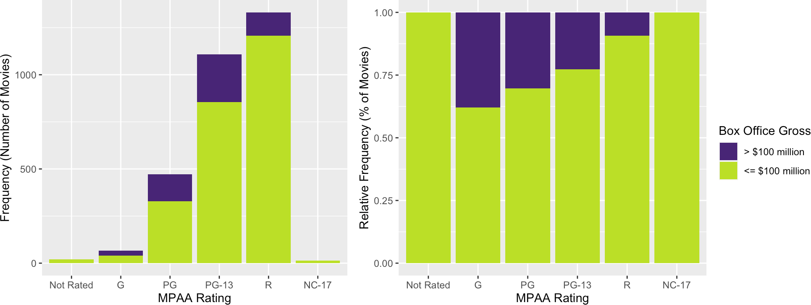
Data Visualizations: Stacked Bar Plots
Suppose we want to understand the relationship between a movie’s MPAA rating and whether it grosses more than $100 million at the box office
→ How does the distribution of movies with large versus small to moderate box office earnings differ based on MPAA rating?
Enter stage left: the stacked barplot!
Each bar in a standard barplot is divided into stacked sub-bars, each corresponding to the level of the second categorical variable
EDA

Slide 11
Summary Statistics: Contingency Tables (I)
Just as a frequency table contains the same information as a univariate barplot, we can use a contingency table to numerically summarize the distribution of two categorical variables!
Displays the number of observations falling into each unique combination of levels for the two variables:
Box Office Gross
Low High
MPAA Rating
Total
Not Rated | 21 | 0 | 21
G | 41 | 25 | 66
PG | 328 | 143 | 471
PG-13 | 856 | 252 | 1108
R | 1207 | 124 | 1331
NC-17 | 13 | 0 | 13
We can use these tables to glean a lot of information about our two variables!
Total
2466
544
3010
EDA

Slide 12
Summary Statistics: Contingency Tables (II)
Just as a frequency table contains the same information as a univariate barplot, we can use a contingency table to numerically summarize the distribution of two categorical variables!
Displays the number of observations falling into each unique combination of levels for the two variables:
Box Office Gross
Low High
21 0
MPAA Rating
Total
Marginal Distribution
66 of the movies in our dataset are rated G:
Not Rated G
PG PG-13 R
NC-17
21
41 25
66
328
856
1207
13
143
252
124
0
471
1108
1331
13
p = ⁶⁶ ≈ 2.2%
,,_ 3010
Total
2466
544
3010
EDA

Slide 13
Summary Statistics: Contingency Tables (III)
Just as a frequency table contains the same information as a univariate barplot, we can use a contingency table to numerically summarize the distribution of two categorical variables!
Displays the number of observations falling into each unique combination of levels for the two variables:
Box Office Gross
Low High
MPAA Rating
Total
Marginal Distribution
544 of the movies in our dataset were high box office earners:
Not Rated | 21 | 0 | 21
G | 41 | 25 | 66
PG | 328 | 143 | 471
PG-13 | 856 | 252 | 1108
R | 1207 | 124 | 1331
NC-17 | 13 | 0 | 13
544 3010
=
p,,_
≈ 18.0%
Total
2466
544
3010
EDA

Slide 14
Summary Statistics: Contingency Tables (IV)
Just as a frequency table contains the same information as a univariate barplot, we can use a contingency table to numerically summarize the distribution of two categorical variables!
Displays the number of observations falling into each unique combination of levels for the two variables:
Box Office Gross
Low High
MPAA Rating
Total
Joint Distribution
25 of the movies in our dataset are rated G and were high box office earners:
Not Rated | 21 | 0 | 21
G | 41 | 25 | 66
PG | 328 | 143 | 471
PG-13 | 856 | 252 | 1108
R | 1207 | 124 | 1331
NC-17 | 13 | 0 | 13
= ²⁵ ≈ 0.8%
p,,_
3010
Total
2466
544
3010
EDA

Slide 15
Summary Statistics: Contingency Tables (V)
Just as a frequency table contains the same information as a univariate barplot, we can use a contingency table to numerically summarize the distribution of two categorical variables!
Displays the number of observations falling into each unique combination of levels for the two variables:
Box Office Gross
Low High
MPAA Rating
Total
Conditional Distribution
Among the movies that are rated G, 25 were high box of- fice earners:
Not Rated | 21 | 0 | 21
G
 | 41 | 25 | 66
PG
 | 328 | 143 | 471
PG-13 | 856 | 252 | 1108
R | 1207 | 124 | 1331
NC-17 | 13 | 0 | 13
= ²⁵ ≈ 37.9%
p,,_
66
Total
2466
544
3010
EDA

Slide 16
Relationships Between One Categorical Variable and One Numerical Variable
EDA

Slide 17
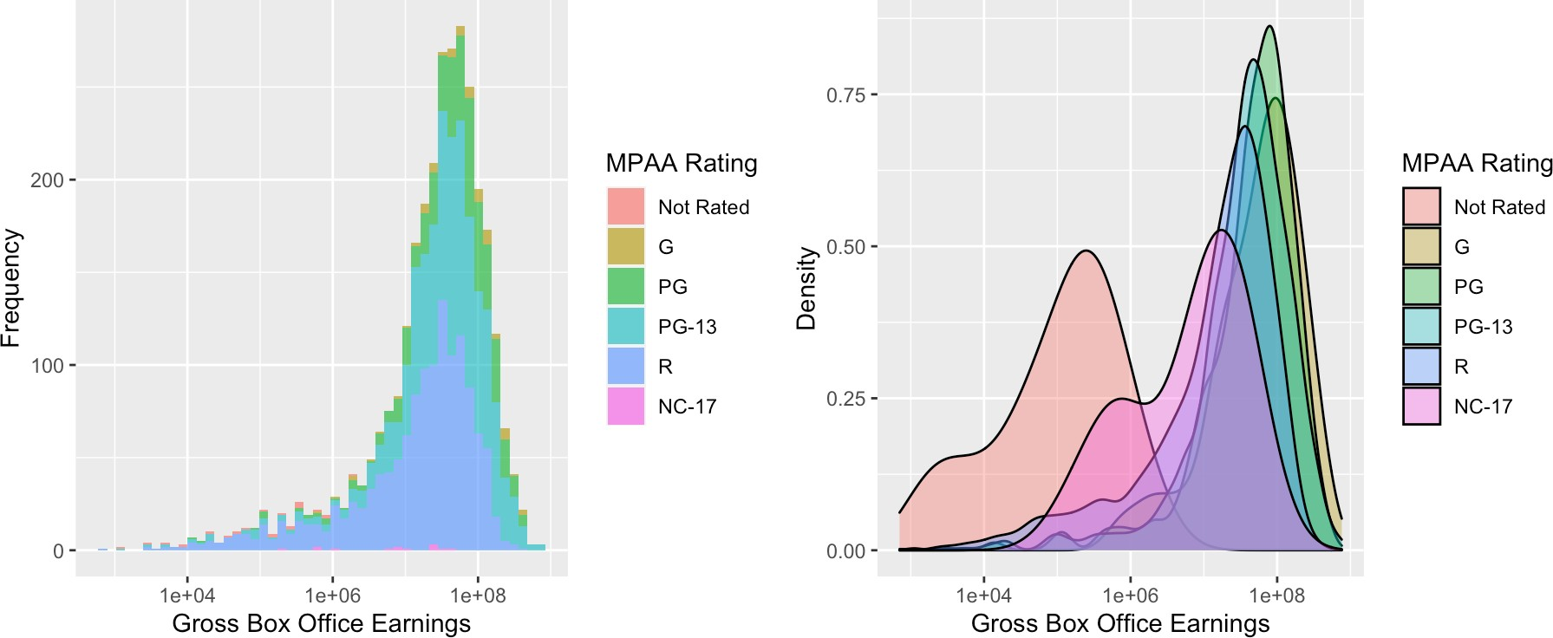
Data Visualizations: Overlaid Histograms/Density Plots
We can visualize the distribution of gross box office earnings within each level of MPAA ratings—and compare these distributions with one another—using overlaid histograms and density plots:
Gross box office earnings is being shown on a log₁₀ scale
EDA

Slide 18
Aside: Overlaid Density Plots & Multi-Modal Distributions
These visualizations can be particularly informative if your data appear to be multi-modal, as there may be (and often is) something more going on in the story
For example, consider the following density plot showing the distribution of in-state college tuition costs during the 2018–2019 academic year:
3e−05
density
2e−05
1e−05
0e+00
0
20000 40000 60000
Total In−State Tuition and Fees
EDA

Slide 19
Aside: Overlaid Density Plots & Multi-Modal Distributions
These visualizations can be particularly informative if your data appear to be multi-modal, as there may be (and often is) something more going on in the story
For example, consider the following density plot showing the distribution of in-state college tuition costs during the 2018–2019 academic year:
3e−05
Funding Model
For Profit Private Public
7.5e−05
density
2e−05
Density
5.0e−05
1e−05
2.5e−05
0e+00
0.0e+00
0
20000 40000 60000
Total In−State Tuition and Fees
0
20000 40000 60000
Total In−State Tuition and Fees
EDA

Slide 20
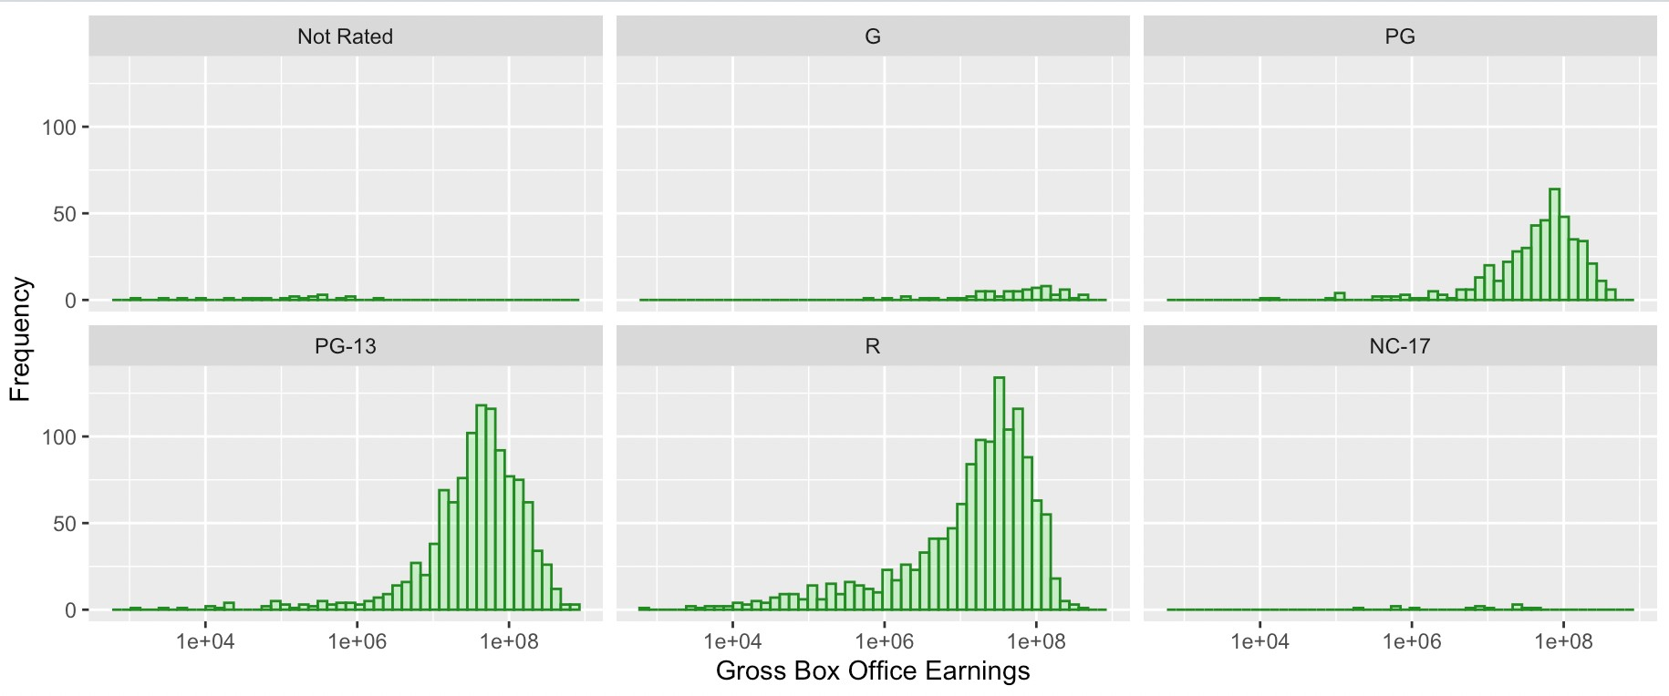
Data Visualizations: “Faceted” Histograms/Density Plots
. . . Of course, overlaying all of our histograms or density plots on top of one another can sometimes be a hot mess, particularly if the categorical variable we’re looking at has a lot of possible levels
→ We can instead display the histograms in side-by-side plots, each with the same x and y axis limits, for easier comparison across levels!
EDA

Slide 21
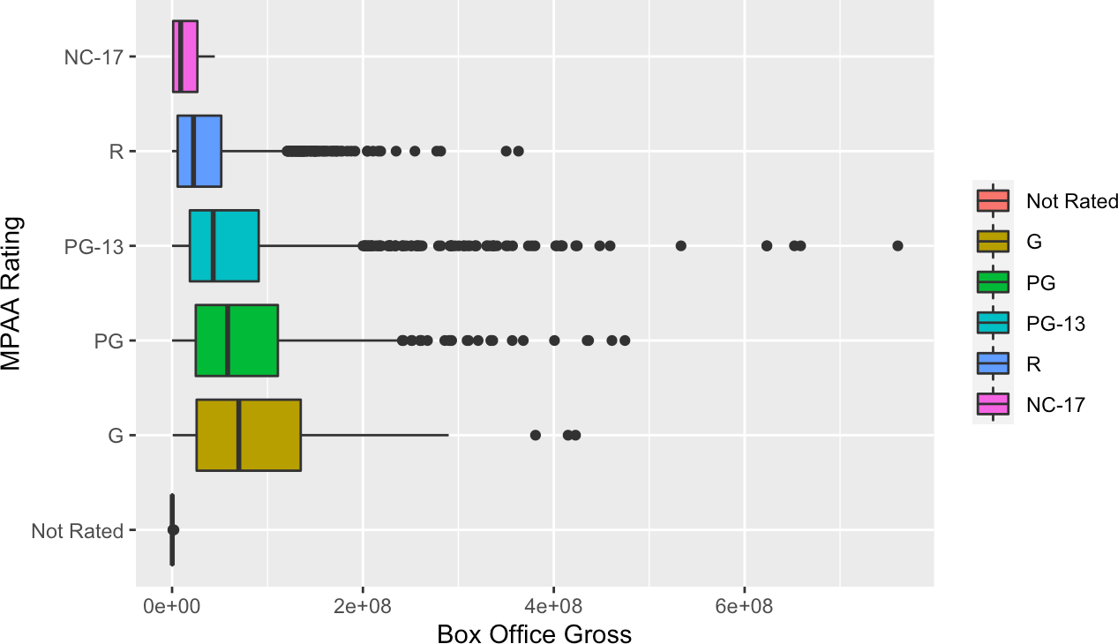
Data Visualizations: Side-by-Side Boxplots
We can also create side-by-side boxplots to visually compare measures of center and spread for the numerical variable across levels of the categorical variable
This figure (and this figure only) is not on the log₁₀ scale.
EDA

Slide 22
Relationships Between Two Numerical Variables
EDA

Slide 23
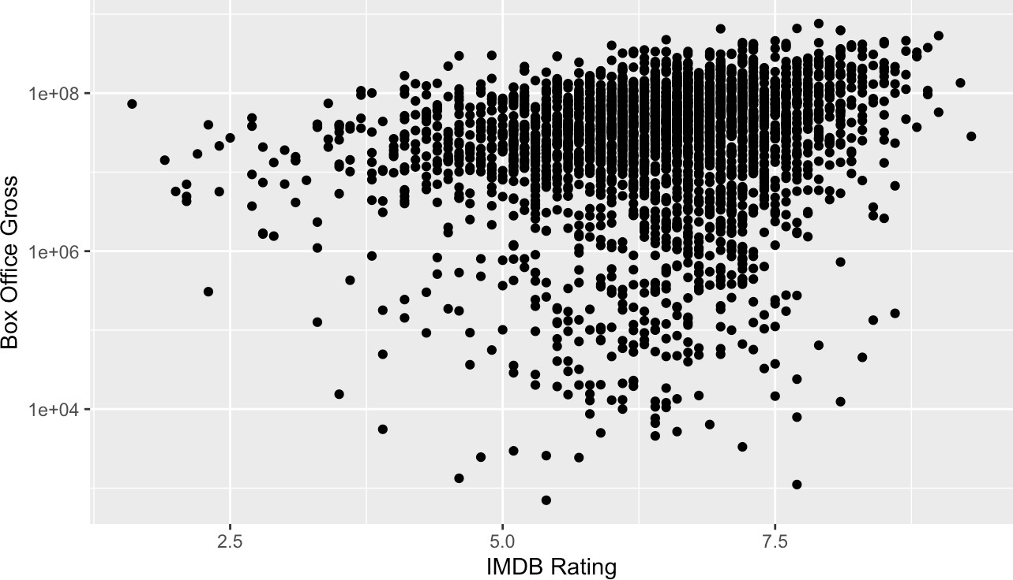
Data Visualizations: Scatterplots
Scatterplots are one of the most common ways of visualizing the relationship between two numerical variables.
For the ith observational unit, let x_{i} be the value of the explanatory variable and y_{i} the value of the response variable.
We plot each (x_{i}, y_{i}) pair for all n observations in our sample.
EDA

Slide 24
Summary Statistics: Pearson Correlation Coefficient
The Pearson correlation coefficient quantifies the strength of the (linear) relationship between our explanatory and response variables:
3 4
A B
n
1
n − 1 s_{x} s_{y}
Ø
¯
x − x¯ y − y
r =
i i
,
i=1
where x¯ and y¯ are the sample means and s_{x} and s_{y} are the sample standard deviations
What aspects of the distribution does r capture?
Direction of the association
Ex: Do higher-rated movies tend to make more or less money at the box office?
Degree of noisiness =⇒ think two-dimensional spread!
Ex: If a movie receives a 7.4 IMDB rating, how certain are we (and how much uncertainty remains) in the box office totals?
1
2
EDA

Slide 25
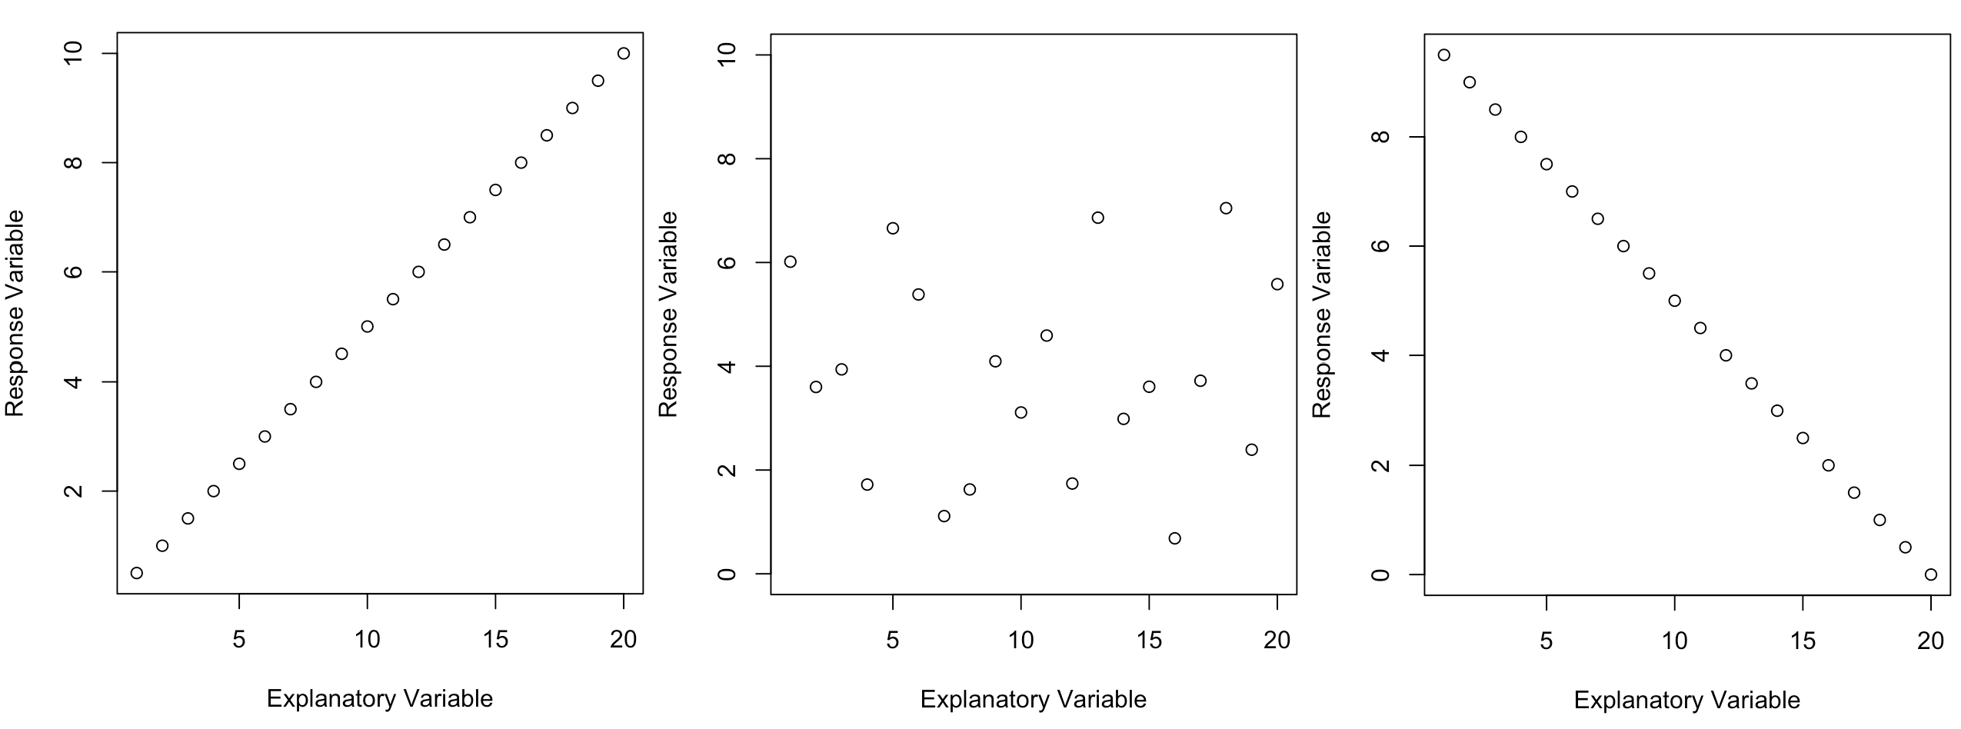
Summary Statistics: Properties of the Correlation
The correlation takes on values between −1 ≤ r ≤ 1, where:
Perfect positive correlation, r = 1
No correlation, r = 0
Perfect negative correlation, r = −1
EDA

Slide 26
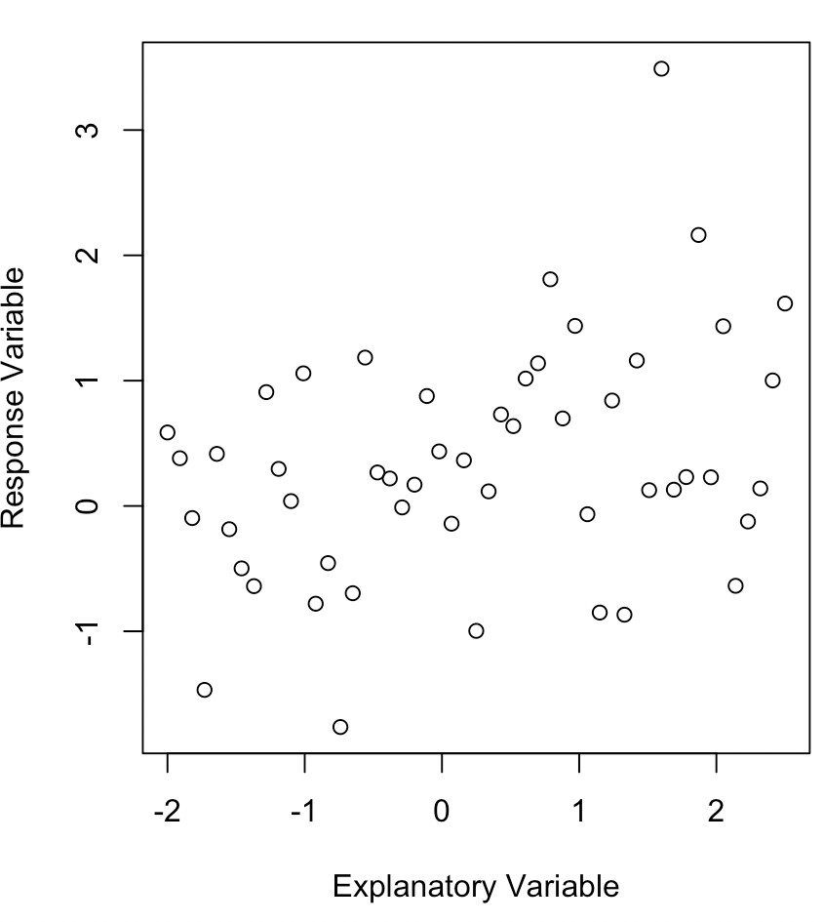

Post Credits Scene: Exploring Correlations (I)
What is the Pearson correlation coefficient, r, associated with this scatterplot?
Respond at PollEv.com/kcook93 or
EDA

Slide 27
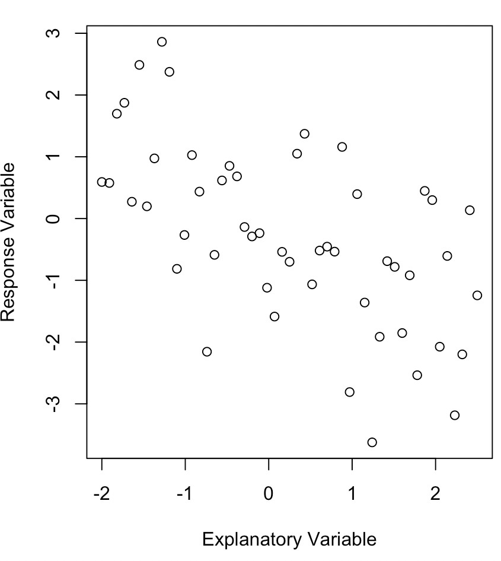
Post Credits Scene: Exploring Correlations (II)
What is the Pearson correlation coefficient, r, associated with this scatterplot?
Respond at PollEv.com/kcook93 or
EDA

Slide 28
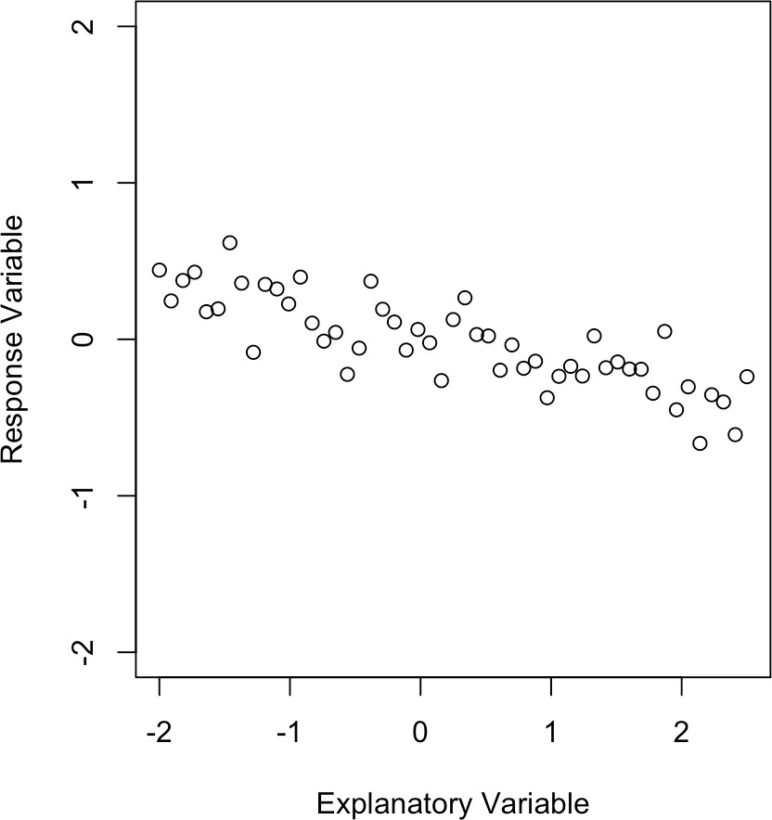
Post Credits Scene: Exploring Correlations (III)
What is the Pearson correlation coefficient, r, associated with this scatterplot?
Respond at PollEv.com/kcook93 or
EDA

Slide 29
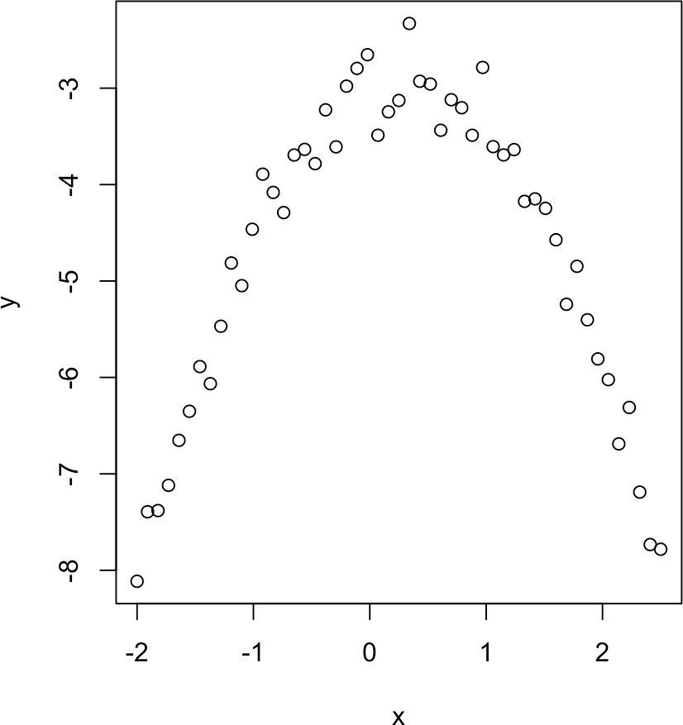
Post Credits Scene: Exploring Correlations (IV)
What is the Pearson correlation coefficient, r, associated with this scatterplot?
Respond at PollEv.com/kcook93 or
EDA

Slide 30
Next Time On. . . SDS 220
Big Ideas:
1
2
How do we conduct exploratory data analysis in R?
The correlation captures the extent to which there is a linear relationship between our explanatory variable, X, and our response variable, Y . How can we use this notion of a line to help us:
Better understand the association between X and Y ?
Use the information we have about X to predict Y ?
To Do:
Complete the check-in survey for today’s class by 11:59pm tonight
Lab assignment 1 due Friday by 5pm HW 2 due next Monday (2/13) by 5pm
Finish reading IMS Ch 7.1 and start reading IMS Ch 7.2.1–7.2.3
1
2
3
4
EDA

Slide 31
R Appendix (I)
Set-Up Chunk
# Unpacking the necessary R packages and tools
library(tidyverse)
# Reading in the IMDB movie dataset
movies <- read.csv("https://raw.githubusercontent.com/kaitlyncook/data-sets/main/movies.csv")
# Reading in the college tuition dataset
tuition <- read.csv("https://raw.githubusercontent.com/kaitlyncook/data-sets/main/tuition.csv")
Data Processing: EDA for Two Categorical Variables
# Storing MPAA ratings as a factor variable with "Not Rated" as the reference
movies$content_rating <- factor(movies$content_rating,
levels=c("Not Rated", "G", "PG", "PG-13", "R", "NC-17"))
# Restricting the data to movies released after 1969 (when the MPAA system began)
mpaa.movies <- movies |> filter(title_year > 1969)
# Creating a new categorical variable indicating whether earnings are over 100 million
mpaa.movies <- mpaa.movies |> mutate(large_gross=case_when(gross > 100000000 ˜ "> $100 million",
gross <= 100000000 ˜ "<= $100 million")) mpaa.movies$large_gross <- factor(mpaa.movies$large_gross, levels=c("> $100 million", "<= $100 million"))
EDA

Slide 32
R Appendix (II)
EDA for Two Categorical Variables
EDA for One Categorical Variable and One Numerical Variable
# Creating a dataset to use when generating the stacked barplots
mpaa.plot <- mpaa.movies |> count(content_rating, large_gross)
# Creating a stacked frequency barplot
ggplot(mpaa.plot, aes(fill=large_gross, x=content_rating, y=n)) + geom_bar(position="stack", stat="identity") + scale_fill_viridis_d(begin=0.1, end=0.9) + ylab("Frequency (Number of Movies)") + xlab("MPAA Rating") +
labs(fill="Box Office Gross")
# Creating a stacked relative Frequency barplot
ggplot(mpaa.plot, aes(fill=large_gross, x=content_rating, y=n)) + geom_bar(position="fill", stat="identity") + scale_fill_viridis_d(begin=0.1, end=0.9) + ylab("Relative Frequency (% of Movies)") + xlab("MPAA Rating") +
labs(fill="Box Office Gross")
# Creating the contingency table
ct <- table(mpaa.movies$content_rating, mpaa.movies$large_gross, dnn=c("MPAA Rating", "Box Office Gross"))
addmargins(ct)
# Creating an overlaid histogram of box office earnings
ggplot(mpaa.movies, aes(x=gross, group=content_rating, fill=content_rating)) + geom_histogram(alpha=0.7, bins=50) + scale_x_continuous(trans=1log101) + xlab("Gross Box Office Earnings") + ylab("Frequency") + labs(fill="MPAA Rating")
EDA

Slide 33
R Appendix (III)
EDA for One Categorical Variable and One Numerical Variable (cont.)
# Creating an overlaid density plot of box office earnings
ggplot(mpaa.movies, aes(x=gross, group=content_rating, fill=content_rating)) +
geom_density(alpha=0.4) + scale_x_continuous(trans=1log101) +
xlab("Gross Box Office Earnings") + ylab("Density") + labs(fill="MPAA Rating")
# Aside: creating an overlaid density plot of in-state college tuition
ggplot(tuition, aes(x=in_state_total)) + geom_density() + xlab("Total In-State Tuition and Fees")
ggplot(tuition, aes(x=in_state_total, group=type, fill=type)) + geom_density(alpha=0.4) + xlab("Total In-State Tuition and Fees") + ylab("Density") + scale_fill_discrete(name="Funding Model") + theme(legend.position = c(0.85, 0.8))
# Using facet_wrap() to better visualize the histogram of gross box office revenue for each possible # MPAA rating
ggplot(mpaa.movies, aes(x=gross)) + geom_histogram(col="forest green", fill="light green",
alpha=0.4, bins=50) +
scale_x_continuous(trans=1log101) +
xlab("Gross Box Office Earnings") + ylab("Frequency") + facet_wrap(˜content_rating)
EDA for Two Numerical Variables
# Creating a scatterplot of gross box office revenue against IMDB movie rating
ggplot(movies, aes(x=imdb_score, y=gross)) + geom_point() + xlab("IMDB Rating") + ylab("Box Office Gross") + scale_y_continuous(trans="log10")
# Computing the Pearson correlation coefficient for the linear relationship # between these two variables
cor(movies$imdb_score, movies$gross)
EDA

