Slide 1
Elementary Statistics – Inference for Categorical Data Pt. 1
Dr. Ab Mosca (they/them)
Slides based off slides courtesy of Kaitlyn Cook (https://www.smith.edu/people/kaitlyn-cook)

Slide 2
Plan for Today
Inference for comparing two proportions

Slide 3
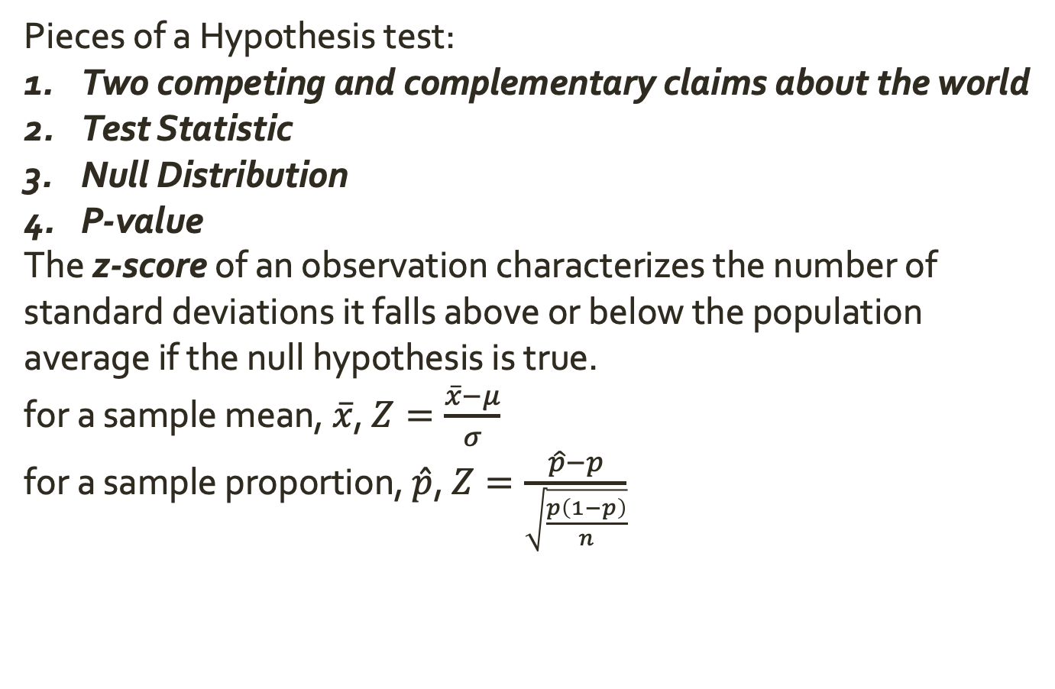
Warm-Up: Hypothesis Testing
Pieces of a Hypothesis test:
Two competing and complementary claims about the world
Test Statistic
Null Distribution
P-value
The z-score of an observation characterizes the number of standard deviations it falls above or below the population average if the null hypothesis is true.
for a sample mean, $\overline{x}$, $Z=\frac{\overline{x}−μ}{σ}$
for a sample proportion, $\hat{p}$, $Z=\frac{\hat{p}−p}{\sqrt{\frac{p\left(1−p\right)}{n}}}$

Slide 4

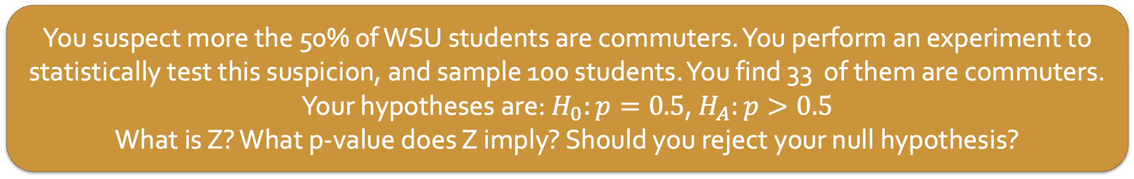
Warm-Up: Hypothesis Testing
Pieces of a Hypothesis test:
Two competing and complementary claims about the world
Test Statistic
Null Distribution
P-value
The z-score of an observation characterizes the number of standard deviations it falls above or below the population average if the null hypothesis is true.
for a sample mean, $\overline{x}$, $Z=\frac{\overline{x}−μ}{σ}$
for a sample proportion, $\hat{p}$, $Z=\frac{\hat{p}−p}{\sqrt{\frac{p\left(1−p\right)}{n}}}$
You suspect more the 50% of WSU students are commuters. You perform an experiment to statistically test this suspicion, and sample 100 students. You find 33 of them are commuters.
Your hypotheses are: $H_{0}:p=0.5$, $H_{A}:p>0.5$
What is Z? What p-value does Z imply? Should you reject your null hypothesis?

Slide 5
Comparing Two Proportions
So far, we’ve done hypothesis tests to see if our population proportion differs from some hypothesized value.
Ex. Is the proportion of WSU students who commute greater than 50%?
Sometimes our research question instead focuses on comparing proportions from two groups.
Ex. Is the proportion of WSU students who commute larger than the proportion of Springfield College students who commute?

