Slide 1
Elementary Statistics – Inference for Categorical Data Pt. 2
Dr. Ab Mosca (they/them)
Slides based off slides courtesy of Kaitlyn Cook (https://www.smith.edu/people/kaitlyn-cook)

Slide 2
Plan for Today
Inference for categorical variables

Slide 3
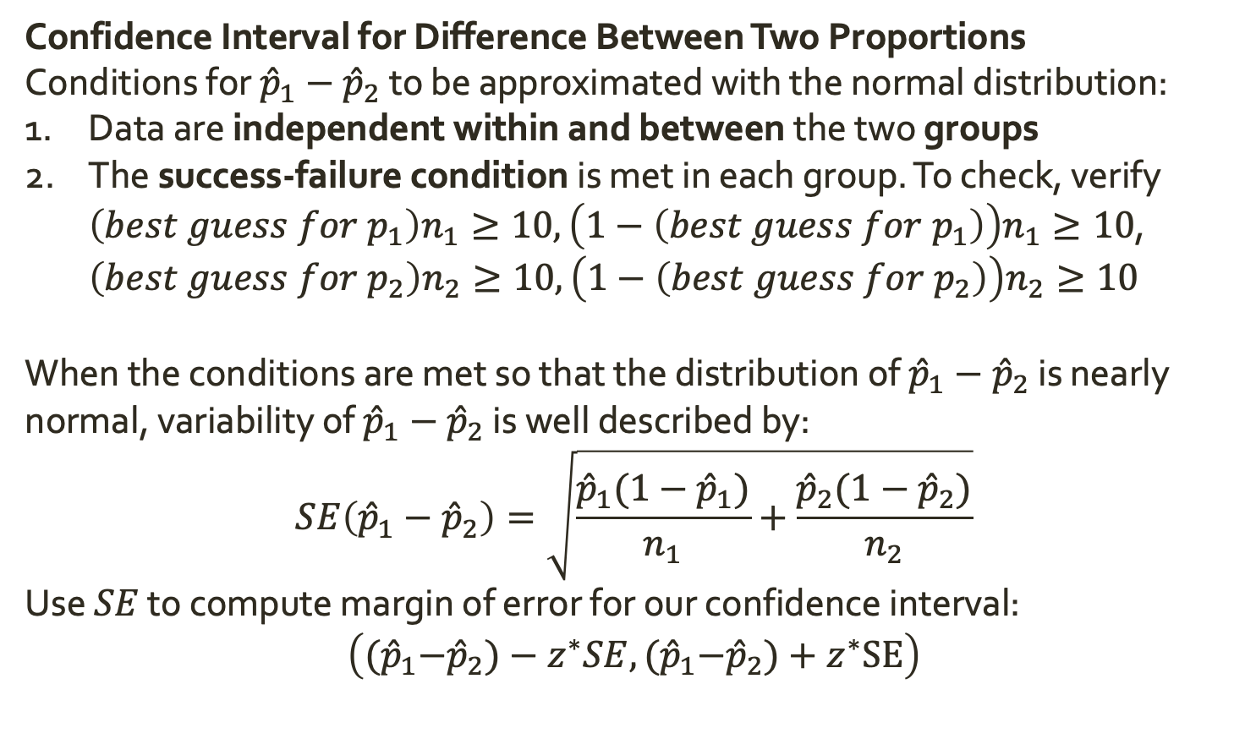
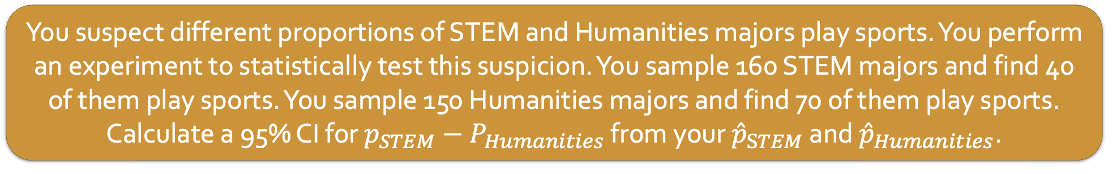
Warm Up: Inference for Two Proportions
Confidence Interval for Difference Between Two Proportions
Conditions for ${\hat{p}}_{1}−{\hat{p}}_{2}$ to be approximated with the normal distribution:
Data are independent within and between the two groups
The success-failure condition is met in each group. To check, verify $\left(best guess for p_{1}\right)n_{1}≥10, \left(1−\left(best guess for p_{1}\right)\right)n_{1}≥10$, $\left(best guess for p_{2}\right)n_{2}≥10, \left(1−\left(best guess for p_{2}\right)\right)n_{2}≥10$
When the conditions are met so that the distribution of ${\hat{p}}_{1}−{\hat{p}}_{2}$ is nearly normal, variability of ${\hat{p}}_{1}−{\hat{p}}_{2}$ is well described by:
$$SE\left({\hat{p}}_{1}−{\hat{p}}_{2}\right)=\sqrt{\frac{{\hat{p}}_{1}(1−{\hat{p}}_{1})}{n_{1}}+\frac{{\hat{p}}_{2}(1−{\hat{p}}_{2})}{n_{2}}}$$
Use $SE$ to compute margin of error for our confidence interval:
$$\left({(\hat{p}}_{1}−{\hat{p}}_{2})−z^{∗}SE,{(\hat{p}}_{1}−{\hat{p}}_{2})+z^{∗}SE\right)$$
You suspect different proportions of STEM and Humanities majors play sports. You perform an experiment to statistically test this suspicion. You sample 160 STEM majors and find 40 of them play sports. You sample 150 Humanities majors and find 70 of them play sports. Calculate a 95% CI for $p_{STEM}−P_{Humanities}$ from your ${\hat{p}}_{STEM}$ and ${\hat{p}}_{Humanities}$.

Slide 4
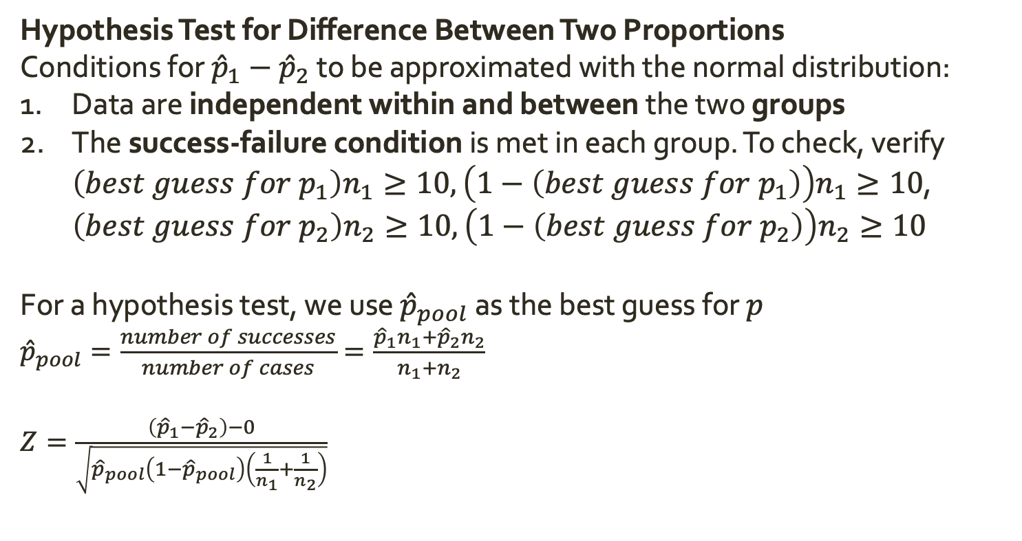
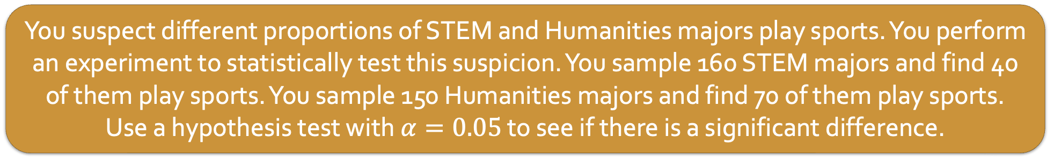
Warm Up: Inference for Two Proportions
Hypothesis Test for Difference Between Two Proportions
Conditions for ${\hat{p}}_{1}−{\hat{p}}_{2}$ to be approximated with the normal distribution:
Data are independent within and between the two groups
The success-failure condition is met in each group. To check, verify $\left(best guess for p_{1}\right)n_{1}≥10, \left(1−\left(best guess for p_{1}\right)\right)n_{1}≥10$, $\left(best guess for p_{2}\right)n_{2}≥10, \left(1−\left(best guess for p_{2}\right)\right)n_{2}≥10$
For a hypothesis test, we use ${\hat{p}}_{pool}$ as the best guess for $p$
${\hat{p}}_{pool}=\frac{number of successes}{number of cases}=\frac{{\hat{p}}_{1}n_{1}+{\hat{p}}_{2}n_{2}}{n_{1}+n_{2}}$
$Z=\frac{\left({\hat{p}}_{1}−{\hat{p}}_{2}\right)−0}{\sqrt{{\hat{p}}_{pool}\left(1−{\hat{p}}_{pool}\right)\left(\frac{1}{n_{1}}+\frac{1}{n_{2}}\right)}}$
You suspect different proportions of STEM and Humanities majors play sports. You perform an experiment to statistically test this suspicion. You sample 160 STEM majors and find 40 of them play sports. You sample 150 Humanities majors and find 70 of them play sports. Use a hypothesis test with $α=0.05$ to see if there is a significant difference.

Slide 5
Inference for Categorical Variables
So far we have focused on questions like
Is the proportion of WSU students who major in math more than 50%?
Is the proportion of WSU students who major in math different than the proportion of Springfield College students who major in math?

Slide 6
Inference for Categorical Variables
So far we have focused on questions like
Is the proportion of WSU students who major in math more than 50%?
Is the proportion of WSU students who major in math different than the proportion of Springfield College students who major in math?
However, many research questions are posed in terms of categorical variables that have more than 2 levels. Ex.
What is the comparative effectiveness of three drug treatments (drug A, drug B, drug C)?
Has the distribution of educational attainment in the US changed since 2000?

Slide 7
Inference for Categorical Variables
Many research questions are posed in terms of categorical variables that have more than 2 levels. Ex.
What is the comparative effectiveness of three drug treatments (drug A, drug B, drug C)?
Has the distribution of educational attainment in the US changed since 2000?
In these cases, we want to understand joint behavior of all possible levels of our categorical variables. There is no longer a single population parameter of interest.

Slide 8
Inference for Categorical Variables
Many research questions are posed in terms of categorical variables that have more than 2 levels. Ex.
What is the comparative effectiveness of three drug treatments (drug A, drug B, drug C)?
Has the distribution of educational attainment in the US changed since 2000?
In these cases, we want to understand joint behavior of all possible levels of our categorical variables. There is no longer a single population parameter of interest.
We typically do not construct CI’s in this context
We can still conduct hypothesis tests

Slide 9
Inference for Categorical Variables
So far we have focused on questions like
Is the proportion of WSU students who major in math more than 50%?
Is the proportion of WSU students who major in math different than the proportion of Springfield College students who major in math?
However, many research questions are posed in terms of categorical variables that have more than 2 levels. Ex.
What is the comparative effectiveness of three drug treatments (drug A, drug B, drug C)?
Has the distribution of educational attainment in the US changed since 2000?
In these cases, we want to understand joint behavior of all possible levels of our categorical variables. There is no longer a single population parameter of interest.

