Slide 1
Elementary Statistics – Simple Linear Regression Pt 1
Dr. Ab Mosca (they/them)
Slides based off slides courtesy of Kaitlyn Cook (https://www.smith.edu/people/kaitlyn-cook)

Slide 2
Plan for Today
Simple Linear Regression
Why?
Interpretation

Slide 3
Warm Up: EDA for two Numerical Variables
Download the Housing_Data.csv from the course website (under the Examples tab).
What is the observational unit in this dataset? What are the variables?
Create a data visualization to summarize the relationship between the LivingSpace and Price variables. (Use Excel, GoogleSheets, or some other tool of your choosing.)

Slide 4
Warm Up: EDA for two Numerical Variables
Download the Housing_Data.csv from the course website (under the Examples tab).
What is the observational unit in this dataset? What are the variables?
Create a data visualization to summarize the relationship between the LivingSpace and Price variables. (Use Excel, GoogleSheets, or some other tool of your choosing.)
Calculate the Pearson Correlation between Price and LivingSpace.
Do you think there is a relationship? What type? Is it strong?

Slide 5
Big Picture
Over the last few days, we’ve seen visuals and single number summaries for describing the distribution of individual variables, as well as the form, direction, and strength of their relationship with one another.
We can use statistical models to capture all of these features in a more precise and quantitative way!
→ In this class, we’ll focus on linear regression models, where we seek to model this relationship using a straight line

Slide 6
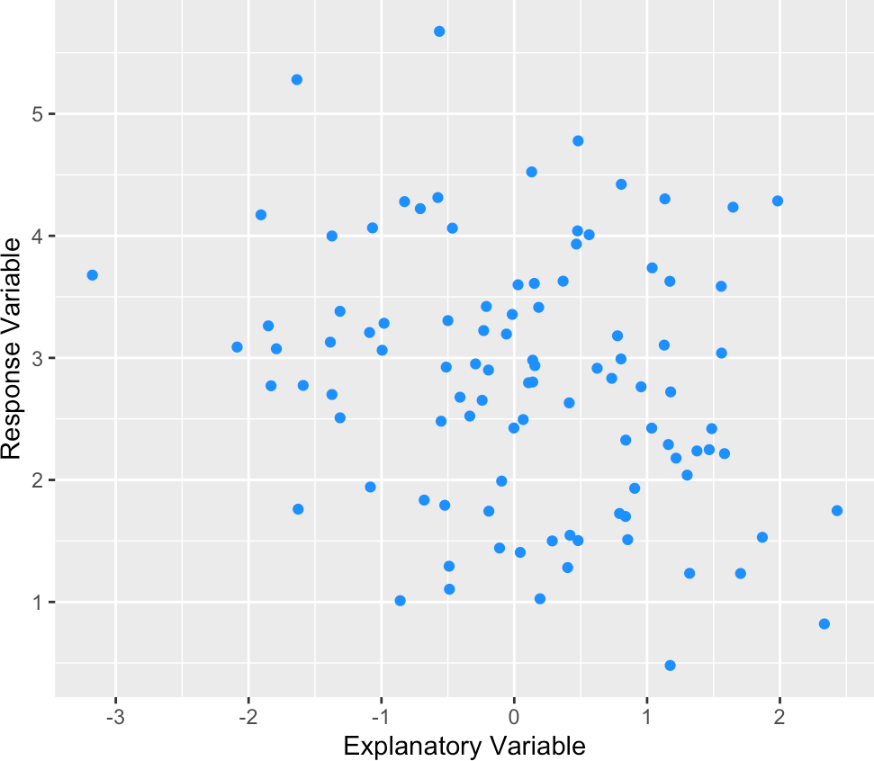
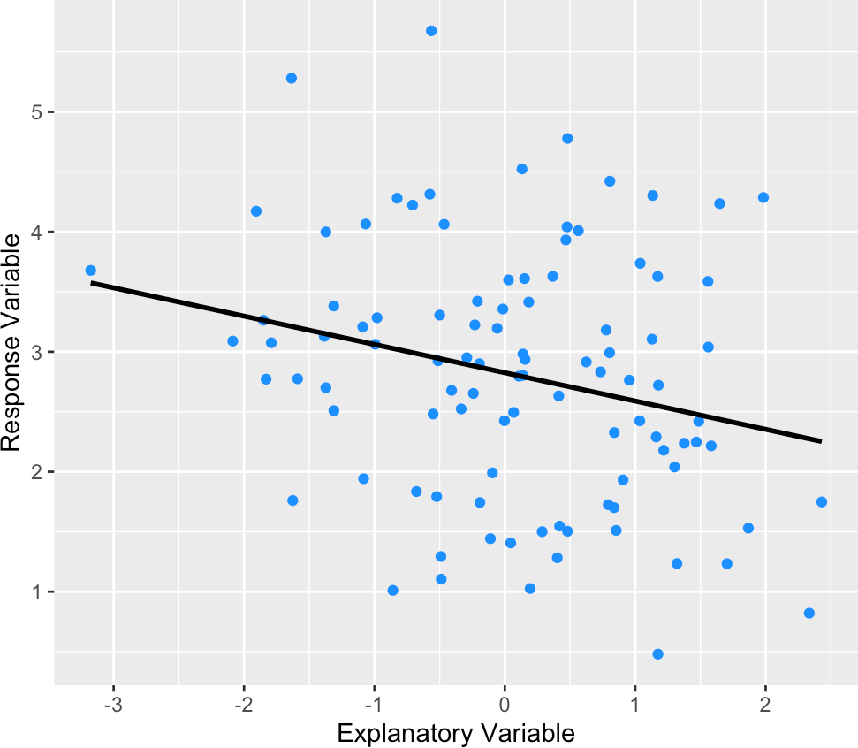
Big Picture
We can use statistical models to capture form, direction, and strength of relationships between variables in a more precise and quantitative way!
→ In this class, we’ll focus on linear regression models, where we seek to model this relationship using a straight line

Slide 7
Motivating Example
Suppose that you manufacture button-down dress shirts for Jackson & Connor (a clothing brand) and want to better understand how their shirts should be sized.

Slide 8
Motivating Example
Suppose that you manufacture button-down dress shirts for Jackson & Connor (a clothing brand) and want to better understand how their shirts should be sized.
Then we may wish to build a regression model for the relationship between neck size (cm) and chest size (cm) in order to:
Explain and quantify the association between our variables of interest
How do an individual’s neck and chest size relate with one another?
Model or predict the possible values of our response variable
Given that an individual has a neck size of 38 cm, what might we expect their chest size to be?

Slide 9
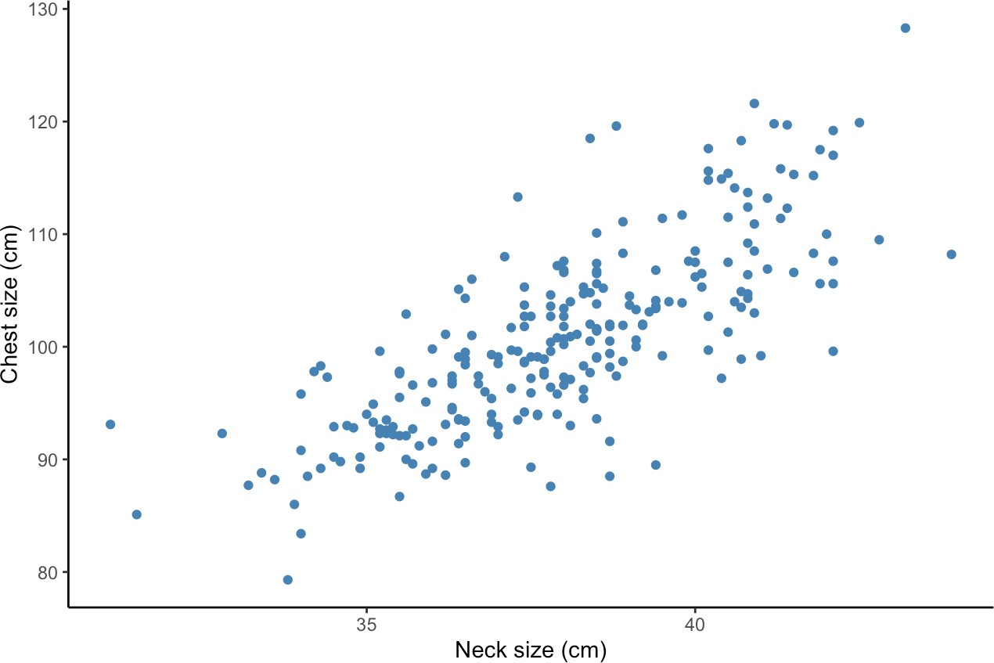
Motivating Example
The following scatterplot displays neck and chest size measurements for 251 individuals:

Slide 10

Motivating Example
The following scatterplot displays neck and chest size measurements for 251 individuals:
If Jackson & Connor were to offer only one shirt size, they might tailor it to fit an individual of average neck size ($\overline{x}$) and average chest size ($\overline{y}$). . .

Slide 11
Motivating Example
The following scatterplot displays neck and chest size measurements for 251 individuals:
If Jackson & Connor were to offer only one shirt size, they might tailor it to fit an individual of average neck size ($\overline{x}$) and average chest size ($\overline{y}$). . .
Avg. Chest Size
Avg. Neck Size

Slide 12
Motivating Example
The following scatterplot displays neck and chest size measurements for 251 individuals:
If Jackson & Connor were to offer only one shirt size, they might tailor it to fit an individual of average neck size ($\overline{x}$) and average chest size ($\overline{y}$). . .
Does this seem like the best marketing approach? Why or why not?
Avg. Chest Size
Avg. Neck Size

Slide 13
Motivating Example
The following scatterplot displays neck and chest size measurements for 251 individuals:
If Jackson & Connor were to offer only one shirt size, they might tailor it to fit an individual of average neck size ($\overline{x}$) and average chest size ($\overline{y}$). . .
What might work better?
Avg. Chest Size
Avg. Neck Size

Slide 14
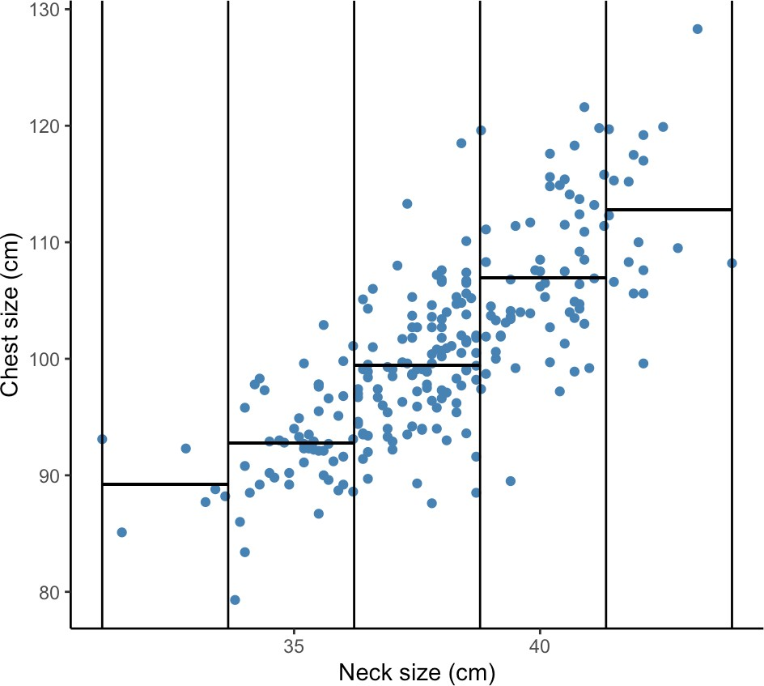
Motivating Example
In order to improve the fit of their shirts (and to allow them to be worn by more individuals!), Jackson & Connor might want to incorporate more information about how average chest sizes varies as a function of neck size:
Five shirt sizes: XS, S, M, L, XL

Slide 15
Motivating Example
In order to improve the fit of their shirts (and to allow them to be worn by more individuals!), Jackson & Connor might want to incorporate more information about how average chest sizes varies as a function of neck size:
Is this a better approach? Why or why not?
Five shirt sizes: XS, S, M, L, XL

Slide 16
Motivating Example
In order to improve the fit of their shirts (and to allow them to be worn by more individuals!), Jackson & Connor might want to incorporate more information about how average chest sizes varies as a function of neck size:
If you were to improve it, how could you?
Five shirt sizes: XS, S, M, L, XL

Slide 17
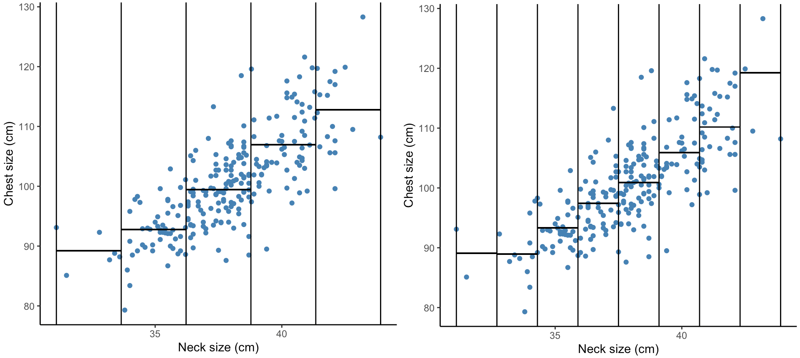
Motivating Example
In order to improve the fit of their shirts (and to allow them to be worn by more individuals!), Jackson & Connor might want to incorporate more information about how average chest sizes varies as a function of neck size:
Five shirt sizes: XS, S, M, L, XL
More sizes (this will fit more people)

Slide 18
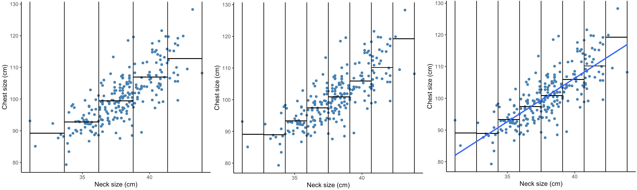
Motivating Example
In order to improve the fit of their shirts (and to allow them to be worn by more individuals!), Jackson & Connor might want to incorporate more information about how average chest sizes varies as a function of neck size:
Five shirt sizes: XS, S, M, L, XL
More sizes (this will fit more people)
Fit a line for infinite sizes

Slide 19
Motivating Example
In order to improve the fit of their shirts (and to allow them to be worn by more individuals!), Jackson & Connor might want to incorporate more information about how average chest sizes varies as a function of neck size:
Five shirt sizes: XS, S, M, L, XL
More sizes (this will fit more people)
Fit a line for infinite sizes
Linear Regression!

Slide 20
Population Regression Line
Primary Motivation for Regression Modeling
There is a lot of variability in outcomes (Y ) in the world, and we believe that at least some of this variability can be explained by other factors of interest (X)!

Slide 21
Population Regression Line
Primary Motivation for Regression Modeling
There is a lot of variability in outcomes (Y ) in the world, and we believe that at least some of this variability can be explained by other factors of interest (X)!
We capture this intuition through the following model:
Y_{i} = β₀ + β₁X_{i} + €_{i}

Slide 22
Population Regression Line
Primary Motivation for Regression Modeling
There is a lot of variability in outcomes (Y ) in the world, and we believe that at least some of this variability can be explained by other factors of interest (X)!
We capture this intuition through the following model:
Y_{i} = β₀ + β₁X_{i} + €_{i}
chest size

Slide 23
Population Regression Line
Primary Motivation for Regression Modeling
There is a lot of variability in outcomes (Y ) in the world, and we believe that at least some of this variability can be explained by other factors of interest (X)!
We capture this intuition through the following model:
Y_{i} = β₀ + β₁X_{i} + €_{i}
chest size
explained by neck size

Slide 24
Population Regression Line
Primary Motivation for Regression Modeling
There is a lot of variability in outcomes (Y ) in the world, and we believe that at least some of this variability can be explained by other factors of interest (X)!
We capture this intuition through the following model:
Y_{i} = β₀ + β₁X_{i} + €_{i}
chest size
explained by everything else (error!)
explained by neck size

Slide 25
Population Regression Line
Primary Motivation for Regression Modeling
There is a lot of variability in outcomes (Y ) in the world, and we believe that at least some of this variability can be explained by other factors of interest (X)!
We capture this intuition through the following model:
Y_{i} = β₀ + β₁X_{i} + €_{i}
This line might not perfectly capture everyone in our population, but we assume that—on average—it provides an accurate picture.
chest size
explained by everything else (error!)
explained by neck size

Slide 26
Interpreting the Regression Line
Given a linear regression line where Y_{i} represents an individual’s chest size (in cm) and X_{i} their neck size (in cm):
Y_{i} = β₀ + β₁X_{i} + €_{i}
β₀: the intercept term captures the average chest size for the population of individuals who have a neck size of 0 cm
β₁: the slope term captures the expected (average) change in chest size associated with a one centimeter increase in neck size

Slide 27
Interpreting the Regression Line
Given a linear regression line where Y_{i} represents an individual’s chest size (in cm) and X_{i} their neck size (in cm):
Y_{i} = β₀ + β₁X_{i} + €_{i}
β₀: the intercept term captures the average chest size for the population of individuals who have a neck size of 0 cm
β₁: the slope term captures the expected (average) change in chest size associated with a one centimeter increase in neck size
These describe characteristics of the entire population. . .
⇒ β₀, β₁ are population parameters!
Practice: Suppose the regression is:
Y_{i} = 5 + 3X_{i}
What is the average chest size for someone with a neck size of 0 cm?
How much would you expect chest size to change with a one cm increase in neck size?
What would the chest size for someone with a neck size of 15 cm be?

Slide 28
Interpreting the Regression Line
Given a linear regression line where Y_{i} represents an individual’s chest size (in cm) and X_{i} their neck size (in cm):
Y_{i} = β₀ + β₁X_{i} + €_{i}
β₀: the intercept term captures the average chest size for the population of individuals who have a neck size of 0 cm
β₁: the slope term captures the expected (average) change in chest size associated with a one centimeter increase in neck size
These describe characteristics of the entire population. . .
⇒ β₀, β₁ are population parameters!
Practice: Suppose the regression is:
Y_{i} = 2.5X_{i}
What is the average chest size for someone with a neck size of 0 cm?
How much would you expect chest size to change with a one cm increase in neck size?
What would the chest size for someone with a neck size of 15 cm be?

Slide 29
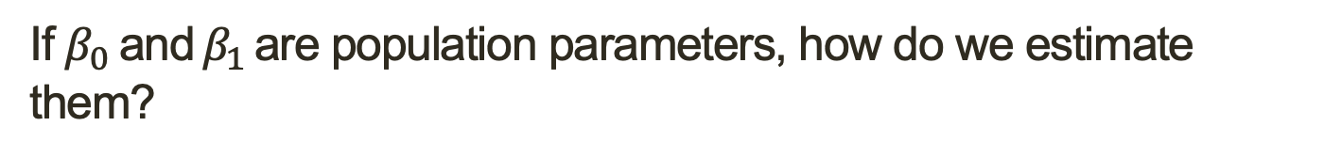
Estimating the Regression Line
If $β_{0} \text{and}$ $β_{1}$ are population parameters, how do we estimate them?

Slide 30
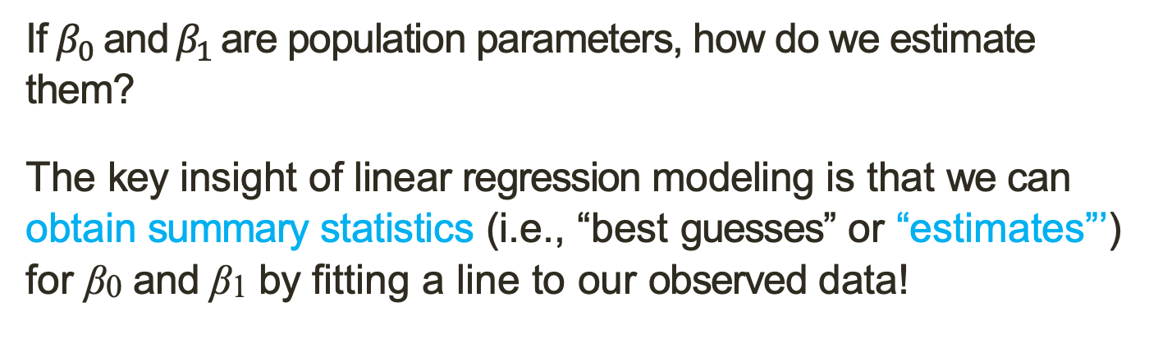
Estimating the Regression Line
If $β_{0} \text{and}$ $β_{1}$ are population parameters, how do we estimate them?
The key insight of linear regression modeling is that we can obtain summary statistics (i.e., “best guesses” or “estimates”’) for β₀ and β₁ by fitting a line to our observed data!

Slide 31
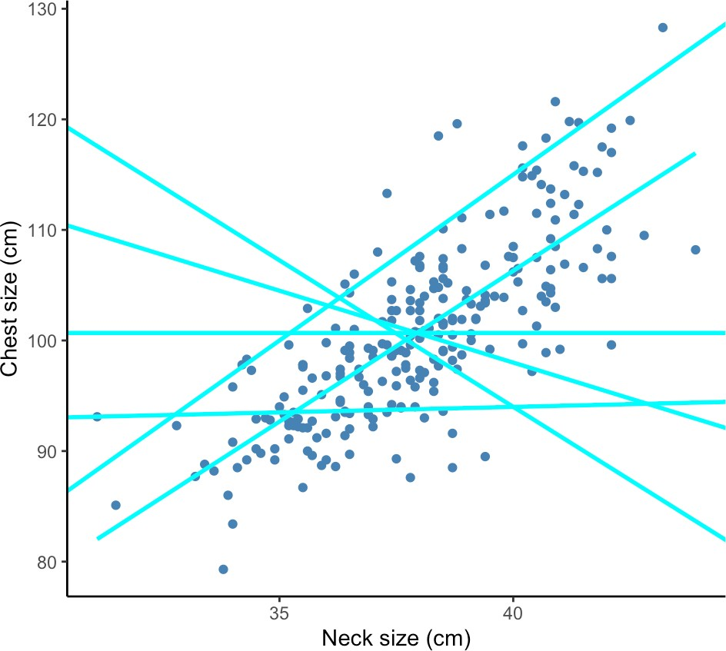
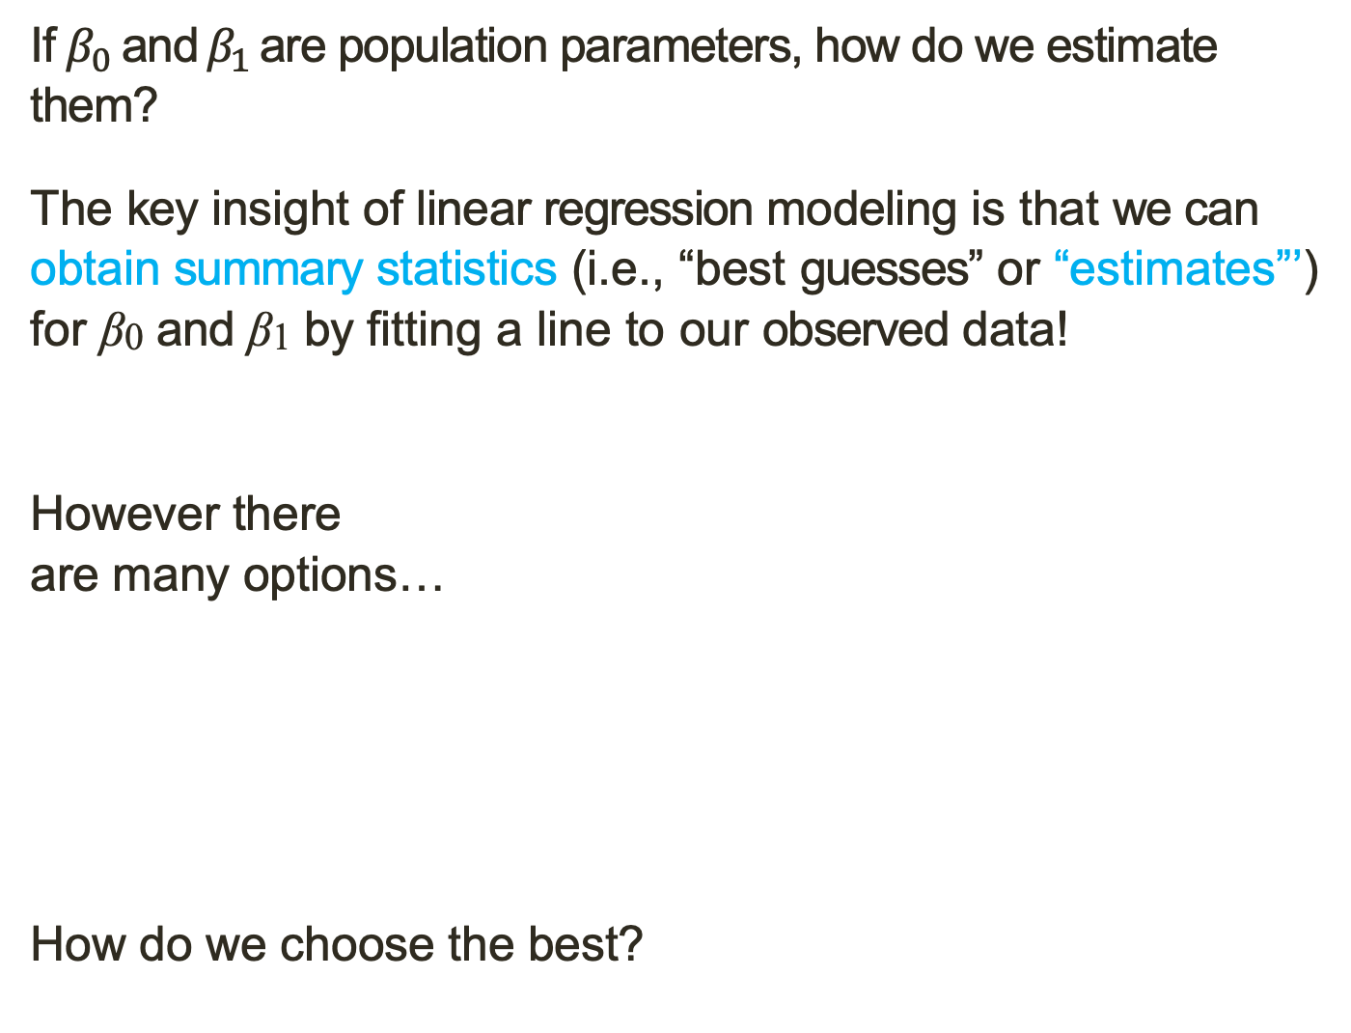
Estimating the Regression Line
If $β_{0} \text{and}$ $β_{1}$ are population parameters, how do we estimate them?
The key insight of linear regression modeling is that we can obtain summary statistics (i.e., “best guesses” or “estimates”’) for β₀ and β₁ by fitting a line to our observed data!
However there
are many options…
How do we choose the best?

Slide 32
Estimating the Regression Line
If $β_{0} \text{and}$ $β_{1}$ are population parameters, how do we estimate them?
The key insight of linear regression modeling is that we can obtain summary statistics (i.e., “best guesses” or “estimates”’) for β₀ and β₁ by fitting a line to our observed data!
However there
are many options…
How do we choose the best?
Ideas? Which lines look good to you in this chart? Which look bad? Why?

Slide 33
Estimating the Regression Line
If $β_{0} \text{and}$ $β_{1}$ are population parameters, how do we estimate them?
The key insight of linear regression modeling is that we can obtain summary statistics (i.e., “best guesses” or “estimates”’) for β₀ and β₁ by fitting a line to our observed data!
However there
are many options…
How do we choose the best?
Ideas? Which lines look good to you in this chart? Which look bad? Why?

Slide 34
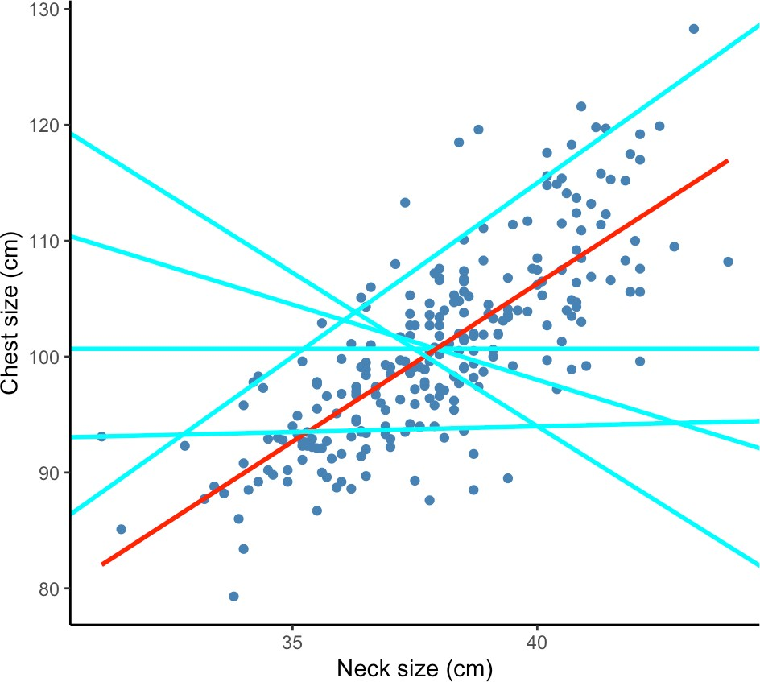
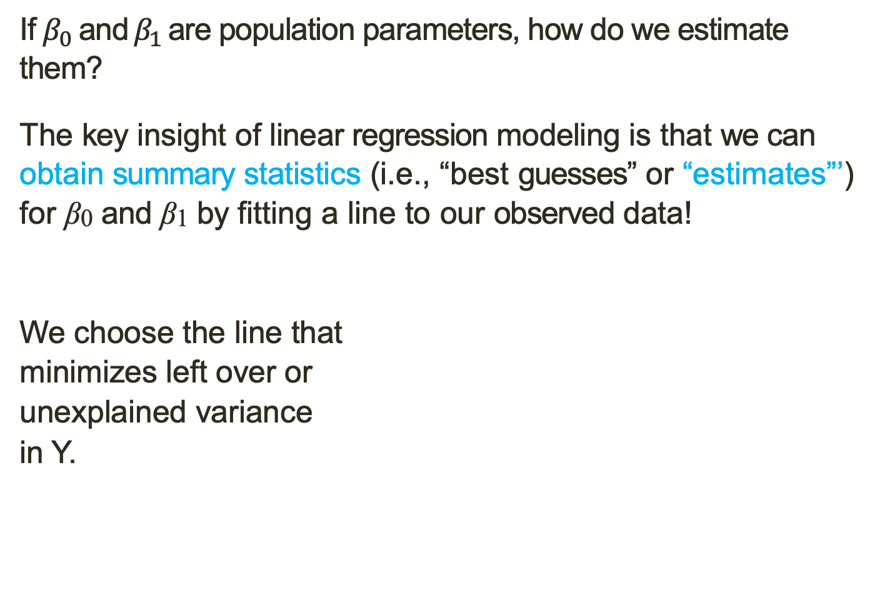
Estimating the Regression Line
If $β_{0} \text{and}$ $β_{1}$ are population parameters, how do we estimate them?
The key insight of linear regression modeling is that we can obtain summary statistics (i.e., “best guesses” or “estimates”’) for β₀ and β₁ by fitting a line to our observed data!
We choose the line that
minimizes left over or
unexplained variance
in Y.

Slide 35
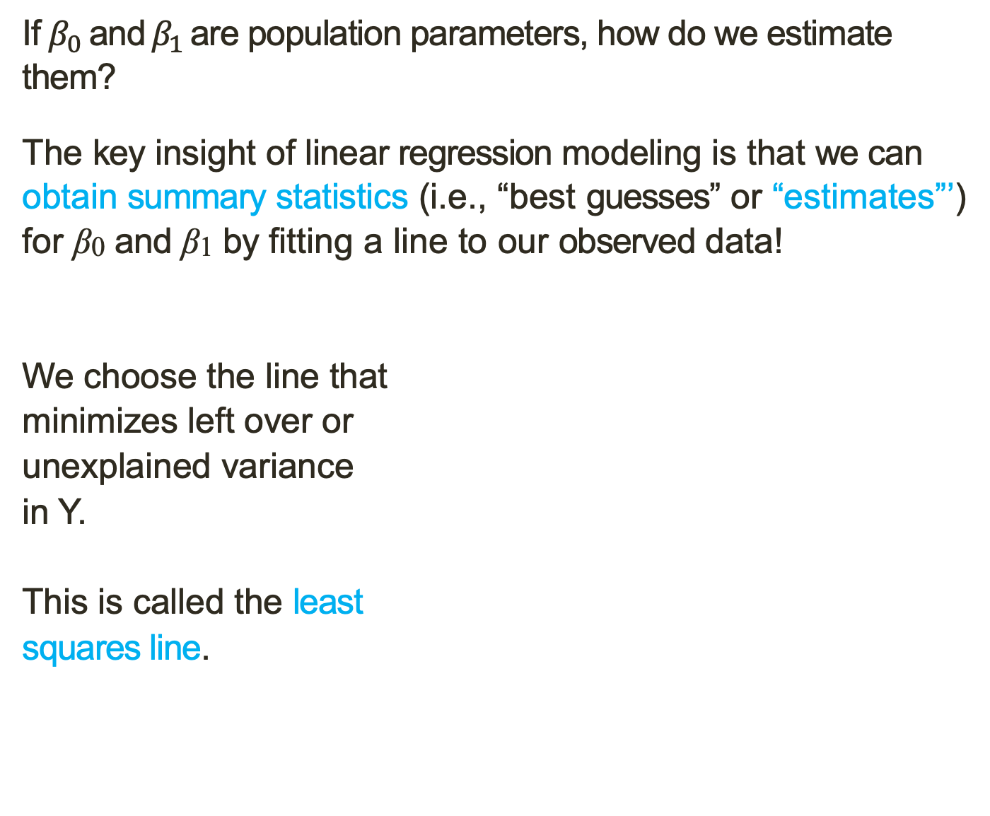
Estimating the Regression Line
If $β_{0} \text{and}$ $β_{1}$ are population parameters, how do we estimate them?
The key insight of linear regression modeling is that we can obtain summary statistics (i.e., “best guesses” or “estimates”’) for β₀ and β₁ by fitting a line to our observed data!
We choose the line that
minimizes left over or
unexplained variance
in Y.
This is called the least
squares line.

Slide 36
Estimating the Regression Line
If $β_{0} \text{and}$ $β_{1}$ are population parameters, how do we estimate them?
The key insight of linear regression modeling is that we can obtain summary statistics (i.e., “best guesses” or “estimates”’) for β₀ and β₁ by fitting a line to our observed data!
We choose the line that
minimizes left over or
unexplained variance
in Y.
This is called the least
squares line.
Error or residual is the difference between the Y in my dataset for a given X, and the X value my regression predicts for that X.

Slide 37
Estimating the Regression Line
If $β_{0} \text{and}$ $β_{1}$ are population parameters, how do we estimate them?
The key insight of linear regression modeling is that we can obtain summary statistics (i.e., “best guesses” or “estimates”’) for β₀ and β₁ by fitting a line to our observed data!
We choose the line that
minimizes left over or
unexplained variance
in Y.
This is called the least
squares line.
Error or residual is the difference between the Y in my dataset for a given X, and the X value my regression predicts for that X.
The big idea behind least squares is that we minimize the value we get when we square and sum residuals for every observation in the data.

