Slide 1
Elementary Statistics – Inference for Categorical Data Pt. 1
Dr. Ab Mosca (they/them)
Slides based off slides courtesy of Kaitlyn Cook (https://www.smith.edu/people/kaitlyn-cook)

Slide 2
Plan for Today
Inference for comparing two proportions

Slide 3
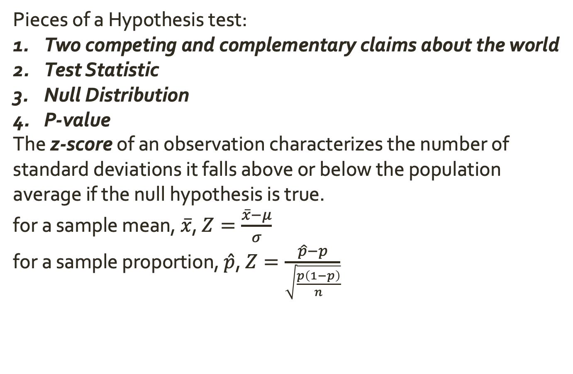
Warm-Up: Hypothesis Testing
Pieces of a Hypothesis test:
Two competing and complementary claims about the world
Test Statistic
Null Distribution
P-value
The z-score of an observation characterizes the number of standard deviations it falls above or below the population average if the null hypothesis is true.
for a sample mean, $\overline{x}$, $Z=\frac{\overline{x}−μ}{σ}$
for a sample proportion, $\hat{p}$, $Z=\frac{\hat{p}−p}{\sqrt{\frac{p\left(1−p\right)}{n}}}$

Slide 4

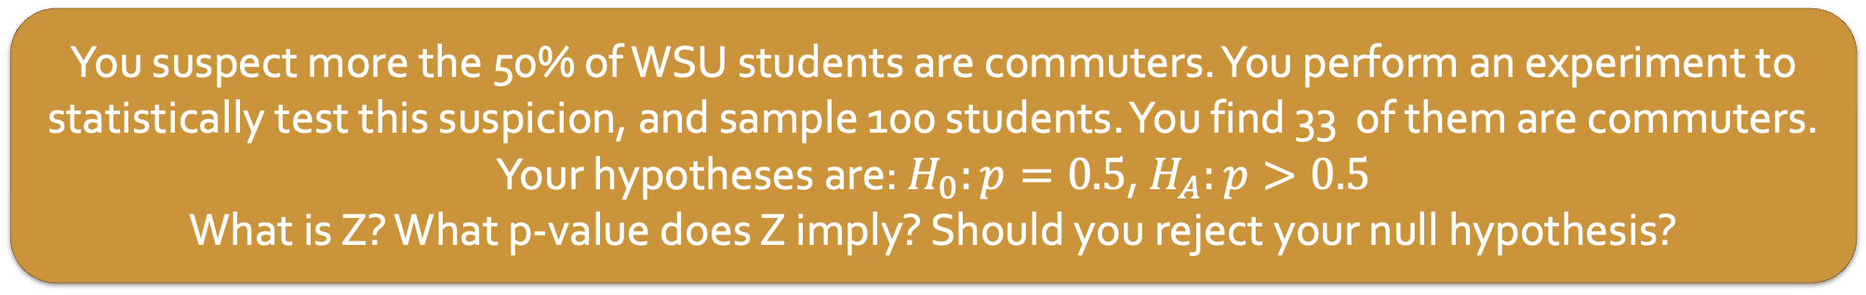
Warm-Up: Hypothesis Testing
Pieces of a Hypothesis test:
Two competing and complementary claims about the world
Test Statistic
Null Distribution
P-value
The z-score of an observation characterizes the number of standard deviations it falls above or below the population average if the null hypothesis is true.
for a sample mean, $\overline{x}$, $Z=\frac{\overline{x}−μ}{σ}$
for a sample proportion, $\hat{p}$, $Z=\frac{\hat{p}−p}{\sqrt{\frac{p\left(1−p\right)}{n}}}$
You suspect more the 50% of WSU students are commuters. You perform an experiment to statistically test this suspicion, and sample 100 students. You find 33 of them are commuters.
Your hypotheses are: $H_{0}:p=0.5$, $H_{A}:p>0.5$
What is Z? What p-value does Z imply? Should you reject your null hypothesis?

Slide 5
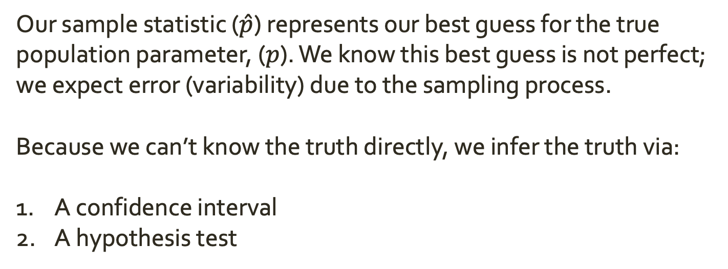
Inference for One Proportion
Our sample statistic ($\hat{p}$) represents our best guess for the true population parameter, ($p$). We know this best guess is not perfect; we expect error (variability) due to the sampling process.
Because we can’t know the truth directly, we infer the truth via:
A confidence interval
A hypothesis test

Slide 6
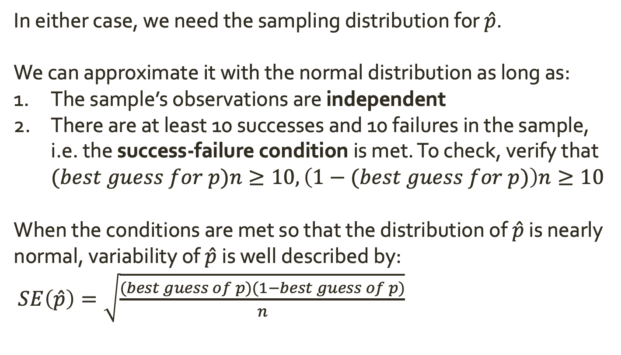
Inference for One Proportion
In either case, we need the sampling distribution for $\hat{p}$.
We can approximate it with the normal distribution as long as:
The sample’s observations are independent
There are at least 10 successes and 10 failures in the sample, i.e. the success-failure condition is met. To check, verify that $(best guess for p)n≥10, \left(1−(best guess for p)\right)n≥10$
When the conditions are met so that the distribution of $\hat{p}$ is nearly normal, variability of $\hat{p}$ is well described by:
$SE\left(\hat{p}\right)=\sqrt{\frac{(best guess of p)(1−best guess of p)}{n}}$

Slide 7
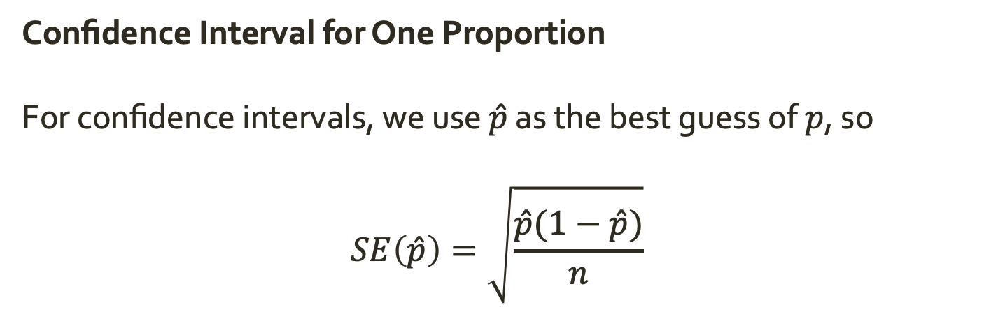
Inference for One Proportion
Confidence Interval for One Proportion
For confidence intervals, we use $\hat{p}$ as the best guess of $p$, so
$$SE\left(\hat{p}\right)=\sqrt{\frac{\hat{p}(1−\hat{p})}{n}}$$

Slide 8
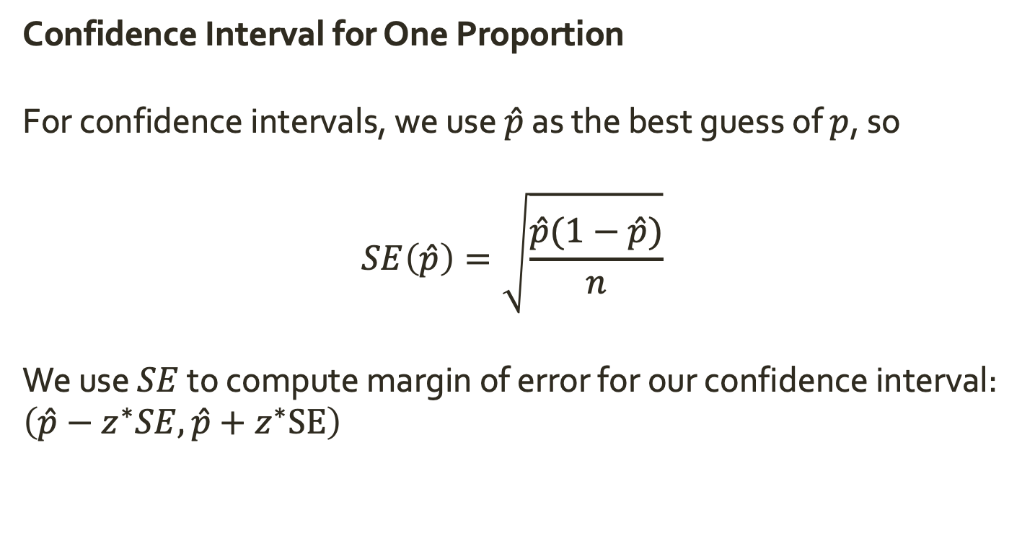
Inference for One Proportion
Confidence Interval for One Proportion
For confidence intervals, we use $\hat{p}$ as the best guess of $p$, so
$$SE\left(\hat{p}\right)=\sqrt{\frac{\hat{p}(1−\hat{p})}{n}}$$
We use $SE$ to compute margin of error for our confidence interval: $\left(\hat{p}−z^{∗}SE,\hat{p}+z^{∗}SE\right)$

Slide 9
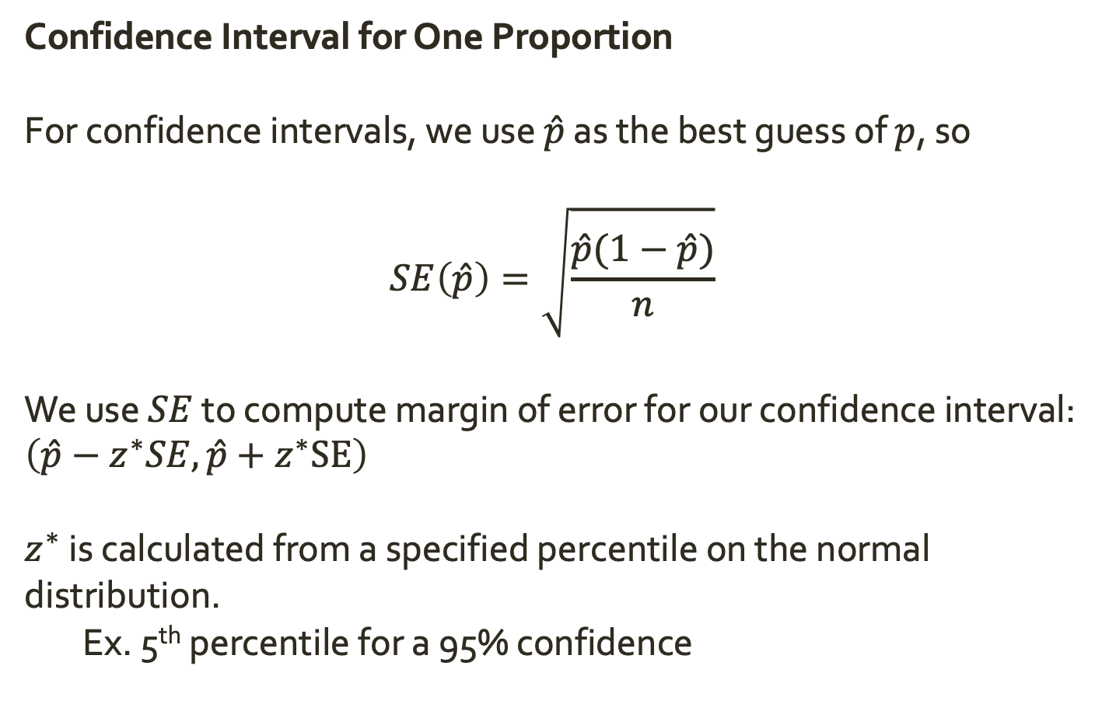
Inference for One Proportion
Confidence Interval for One Proportion
For confidence intervals, we use $\hat{p}$ as the best guess of $p$, so
$$SE\left(\hat{p}\right)=\sqrt{\frac{\hat{p}(1−\hat{p})}{n}}$$
We use $SE$ to compute margin of error for our confidence interval: $\left(\hat{p}−z^{∗}SE,\hat{p}+z^{∗}SE\right)$
$z^{∗}$ is calculated from a specified percentile on the normal distribution.
Ex. 5th percentile for a 95% confidence

Slide 10


Inference for One Proportion
Confidence Interval for One Proportion
For confidence intervals, we use $\hat{p}$ as the best guess of $p$, so
$$SE\left(\hat{p}\right)=\sqrt{\frac{\hat{p}(1−\hat{p})}{n}}$$
We use $SE$ to compute margin of error for our confidence interval: $\left(\hat{p}−z^{∗}SE,\hat{p}+z^{∗}SE\right)$
$z^{∗}$ is calculated from a specified percentile on the normal distribution.
Ex. 5th percentile for a 95% confidence
Find $z^{∗}$ for a 95% CI, a 90% CI, and a 99% CI

Slide 11
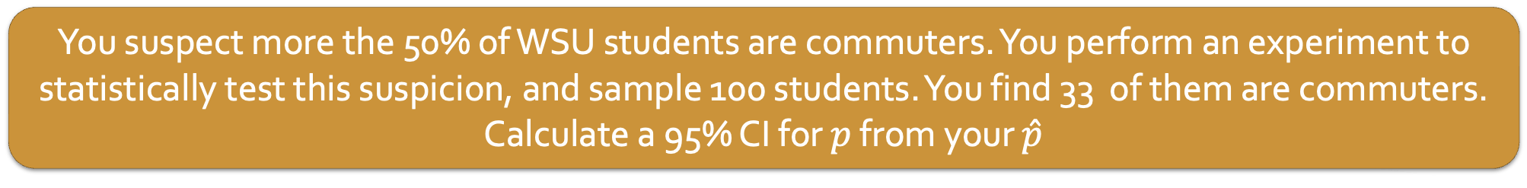
Inference for One Proportion
Confidence Interval for One Proportion
For confidence intervals, we use $\hat{p}$ as the best guess of $p$, so
$$SE\left(\hat{p}\right)=\sqrt{\frac{\hat{p}(1−\hat{p})}{n}}$$
We use $SE$ to compute margin of error for our confidence interval: $\left(\hat{p}−z^{∗}SE,\hat{p}+z^{∗}SE\right)$
$z^{∗}$ is calculated from a specified percentile on the normal distribution.
Ex. 5th percentile for a 95% confidence
You suspect more the 50% of WSU students are commuters. You perform an experiment to statistically test this suspicion, and sample 100 students. You find 33 of them are commuters. Calculate a 95% CI for $p$ from your $\hat{p}$

Slide 12
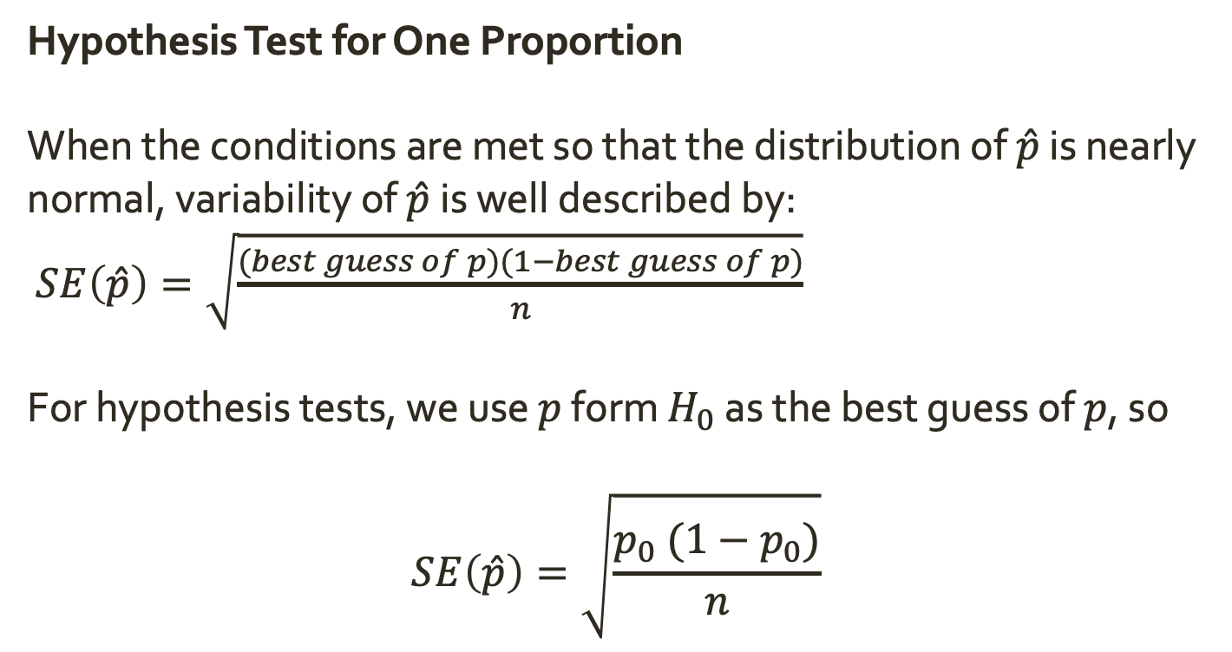
Inference for One Proportion
Hypothesis Test for One Proportion
When the conditions are met so that the distribution of $\hat{p}$ is nearly normal, variability of $\hat{p}$ is well described by:
$SE\left(\hat{p}\right)=\sqrt{\frac{(best guess of p)(1−best guess of p)}{n}}$
For hypothesis tests, we use $p$ form $H_{0}$ as the best guess of $p$, so
$$SE\left(\hat{p}\right)=\sqrt{\frac{p_{0} (1−p_{0})}{n}}$$

Slide 13
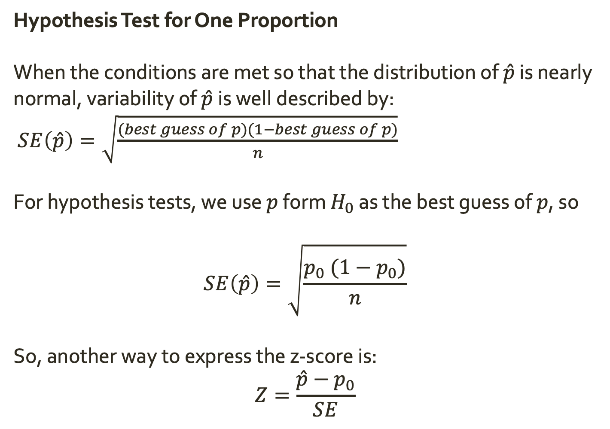
Inference for One Proportion
Hypothesis Test for One Proportion
When the conditions are met so that the distribution of $\hat{p}$ is nearly normal, variability of $\hat{p}$ is well described by:
$SE\left(\hat{p}\right)=\sqrt{\frac{(best guess of p)(1−best guess of p)}{n}}$
For hypothesis tests, we use $p$ form $H_{0}$ as the best guess of $p$, so
$$SE\left(\hat{p}\right)=\sqrt{\frac{p_{0} (1−p_{0})}{n}}$$
So, another way to express the z-score is:
$$Z=\frac{\hat{p}−p_{0}}{SE}$$

Slide 14
Comparing Two Proportions
So far, we’ve done inference to see if our population proportion differs from some hypothesized value.
Ex. Is the proportion of WSU students who commute greater than 50%?
Sometimes our research question instead focuses on comparing proportions from two groups.
Ex. Is the proportion of WSU students who commute different than the proportion of Springfield College students who commute?

Slide 15
Comparing Two Proportions
So far, we’ve done inference to see if our population proportion differs from some hypothesized value.
Ex. Is the proportion of WSU students who commute greater than 50%?
Sometimes our research question instead focuses on comparing proportions from two groups.
Ex. Is the proportion of WSU students who commute different than the proportion of Springfield College students who commute?
Just like with one proportion, we can use sample statistics to infer the population level answer to this question with
(a) a confidence interval and/or
(b) a hypothesis test

Slide 16
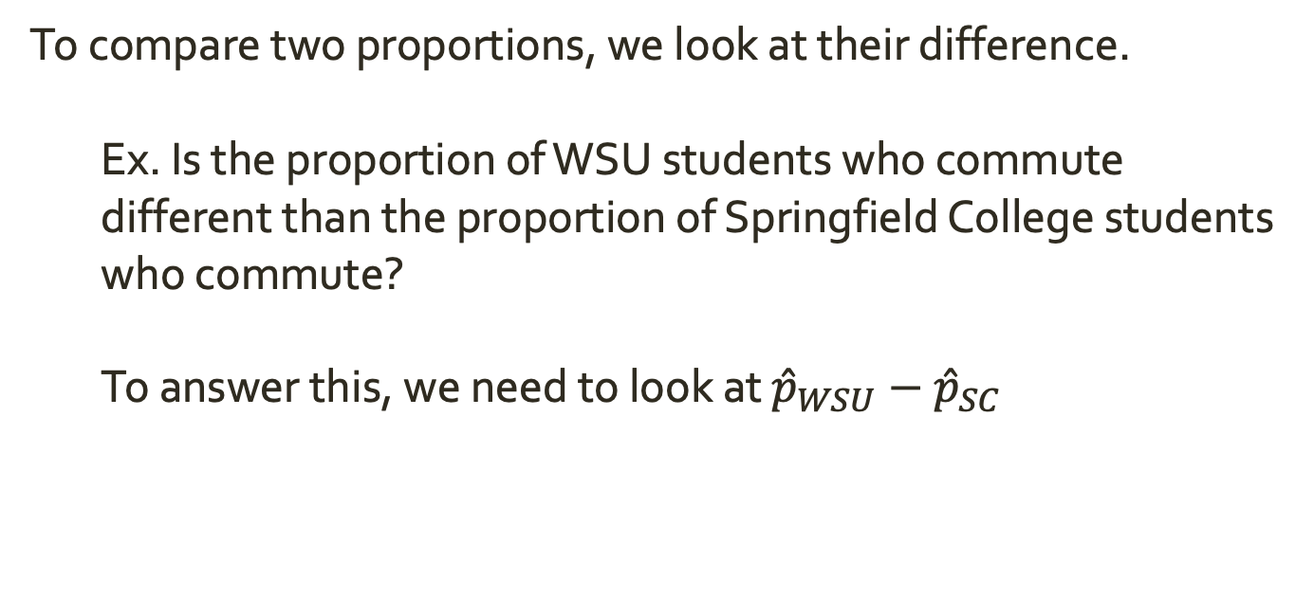
Comparing Two Proportions
To compare two proportions, we look at their difference.
Ex. Is the proportion of WSU students who commute different than the proportion of Springfield College students who commute?
To answer this, we need to look at ${\hat{p}}_{WSU}−{\hat{p}}_{SC}$

Slide 17
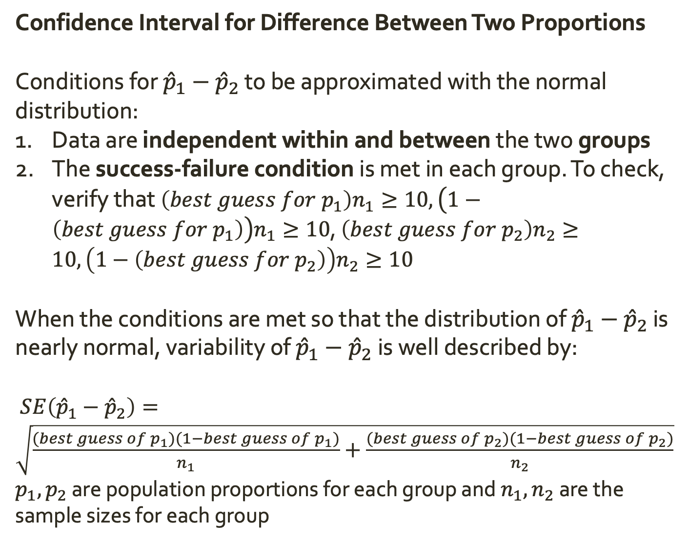
Inference for Two Proportions
Confidence Interval for Difference Between Two Proportions
Conditions for ${\hat{p}}_{1}−{\hat{p}}_{2}$ to be approximated with the normal distribution:
Data are independent within and between the two groups
The success-failure condition is met in each group. To check, verify that $\left(best guess for p_{1}\right)n_{1}≥10, \left(1−\left(best guess for p_{1}\right)\right)n_{1}≥10$, $\left(best guess for p_{2}\right)n_{2}≥10, \left(1−\left(best guess for p_{2}\right)\right)n_{2}≥10$
When the conditions are met so that the distribution of ${\hat{p}}_{1}−{\hat{p}}_{2}$ is nearly normal, variability of ${\hat{p}}_{1}−{\hat{p}}_{2}$ is well described by:
$SE\left({\hat{p}}_{1}−{\hat{p}}_{2}\right)=\sqrt{\frac{(best guess of p_{1})(1−best guess of p_{1})}{n_{1}}+\frac{(best guess of p_{2})(1−best guess of p_{2})}{n_{2}}}$
$p_{1}, p_{2}$ are population proportions for each group and $n_{1},n_{2}$ are the sample sizes for each group

Slide 18
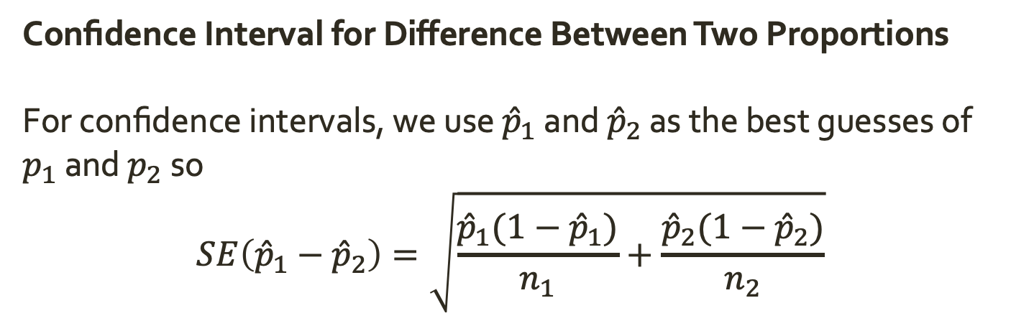
Inference for Two Proportions
Confidence Interval for Difference Between Two Proportions
For confidence intervals, we use ${\hat{p}}_{1}$ and ${\hat{p}}_{2}$ as the best guesses of $p_{1}$ and $p_{2}$ so
$$SE\left({\hat{p}}_{1}−{\hat{p}}_{2}\right)=\sqrt{\frac{{\hat{p}}_{1}(1−{\hat{p}}_{1})}{n_{1}}+\frac{{\hat{p}}_{2}(1−{\hat{p}}_{2})}{n_{2}}}$$

Slide 19
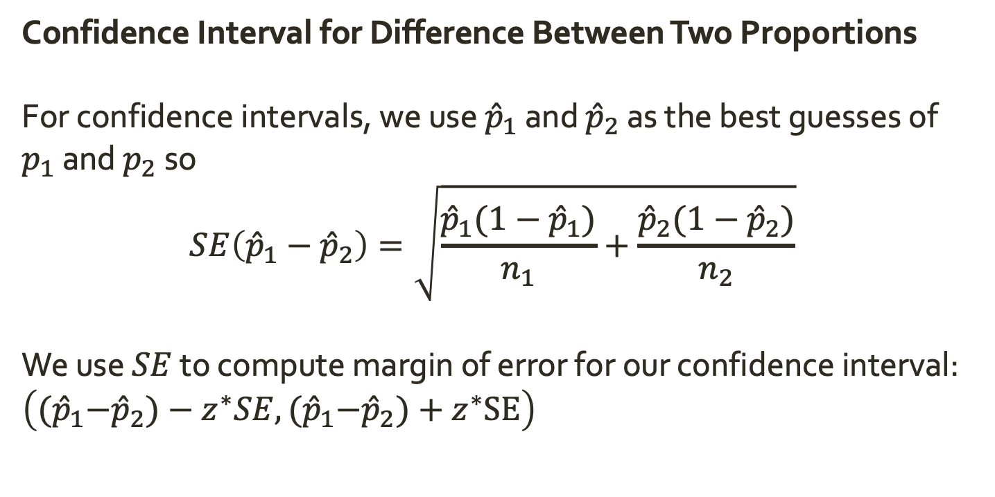
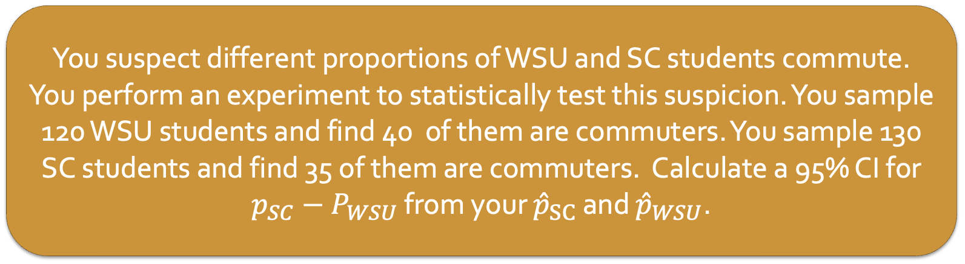
Inference for Two Proportions
Confidence Interval for Difference Between Two Proportions
For confidence intervals, we use ${\hat{p}}_{1}$ and ${\hat{p}}_{2}$ as the best guesses of $p_{1}$ and $p_{2}$ so
$$SE\left({\hat{p}}_{1}−{\hat{p}}_{2}\right)=\sqrt{\frac{{\hat{p}}_{1}(1−{\hat{p}}_{1})}{n_{1}}+\frac{{\hat{p}}_{2}(1−{\hat{p}}_{2})}{n_{2}}}$$
We use $SE$ to compute margin of error for our confidence interval: $\left({(\hat{p}}_{1}−{\hat{p}}_{2})−z^{∗}SE,{(\hat{p}}_{1}−{\hat{p}}_{2})+z^{∗}SE\right)$
You suspect different proportions of WSU and SC students commute. You perform an experiment to statistically test this suspicion. You sample 120 WSU students and find 40 of them are commuters. You sample 130 SC students and find 35 of them are commuters. Calculate a 95% CI for $p_{SC}−P_{WSU}$ from your ${\hat{p}}_{SC}$ and ${\hat{p}}_{WSU}$.

Slide 20
Inference for Two Proportions
Hypothesis Test for Difference Between Two Proportions
For a hypothesis test, our null hypothesis will be that there is no difference between proportions.

Slide 21
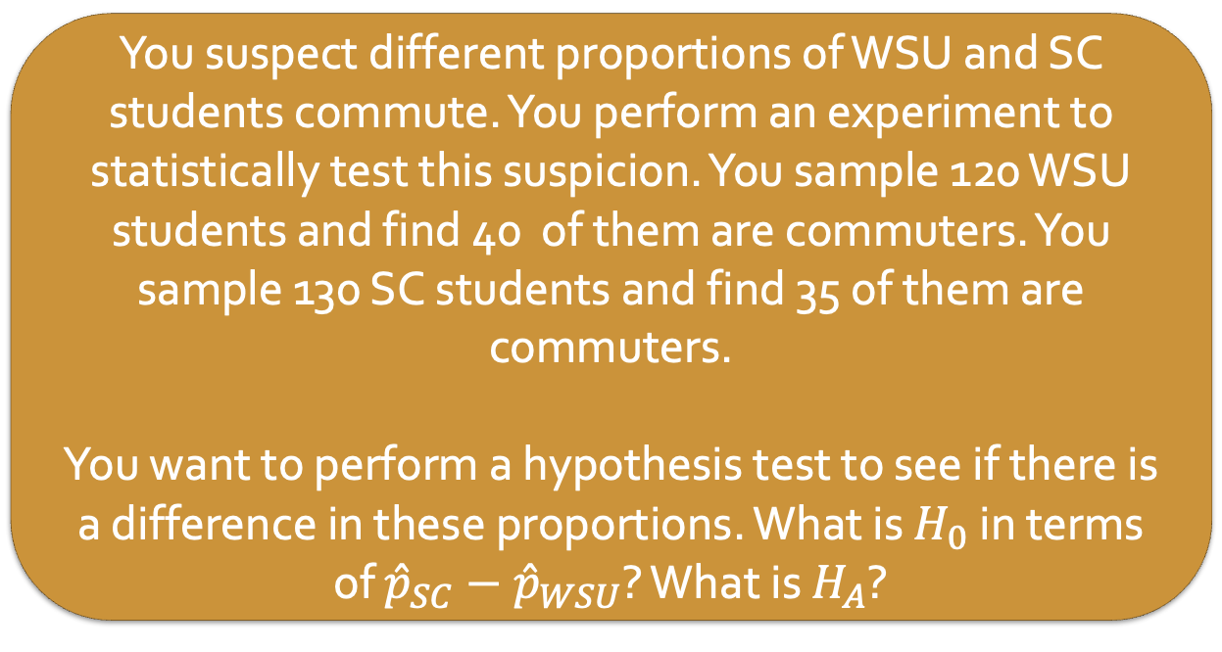
Inference for Two Proportions
Hypothesis Test for Difference Between Two Proportions
For a hypothesis test, our null hypothesis will be that there is no difference between proportions.
You suspect different proportions of WSU and SC students commute. You perform an experiment to statistically test this suspicion. You sample 120 WSU students and find 40 of them are commuters. You sample 130 SC students and find 35 of them are commuters.
You want to perform a hypothesis test to see if there is a difference in these proportions. What is $H_{0}$ in terms of ${\hat{p}}_{SC}−{\hat{p}}_{WSU}$? What is $H_{A}$?

Slide 22
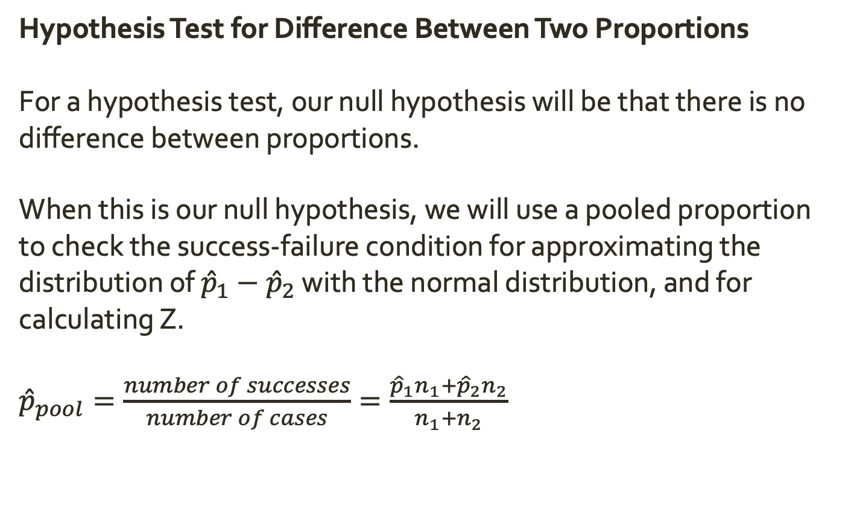
Inference for Two Proportions
Hypothesis Test for Difference Between Two Proportions
For a hypothesis test, our null hypothesis will be that there is no difference between proportions.
When this is our null hypothesis, we will use a pooled proportion to check the success-failure condition for approximating the distribution of ${\hat{p}}_{1}−{\hat{p}}_{2}$ with the normal distribution, and for calculating Z.
${\hat{p}}_{pool}=\frac{number of successes}{number of cases}=\frac{{\hat{p}}_{1}n_{1}+{\hat{p}}_{2}n_{2}}{n_{1}+n_{2}}$

Slide 23
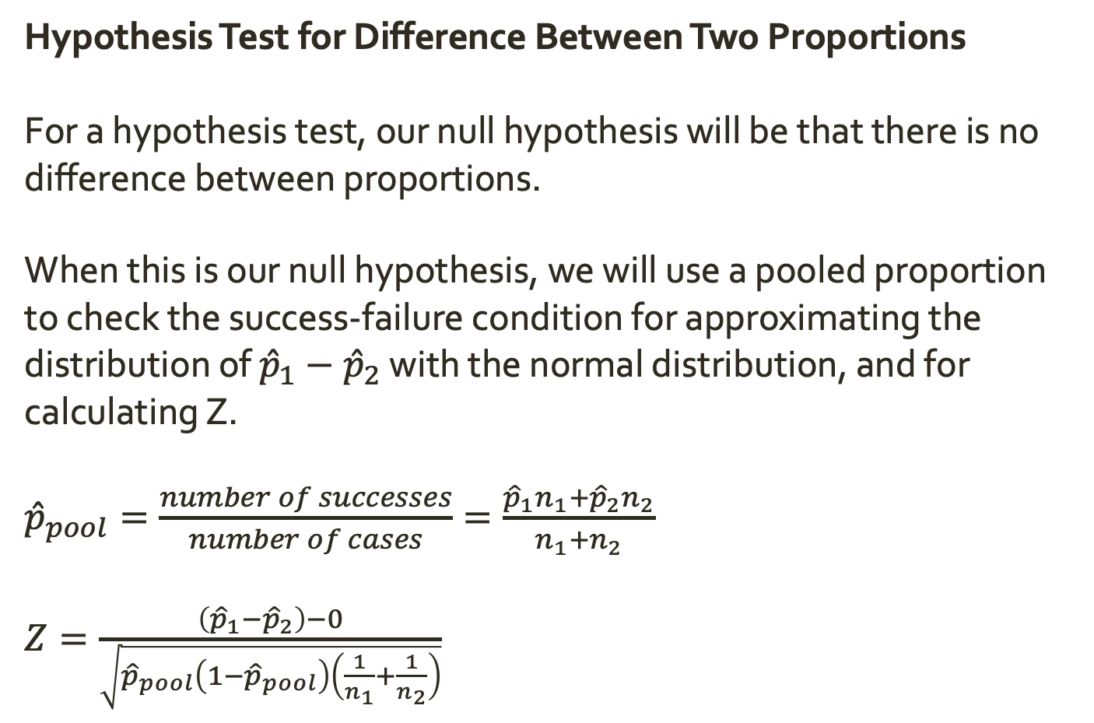
Inference for Two Proportions
Hypothesis Test for Difference Between Two Proportions
For a hypothesis test, our null hypothesis will be that there is no difference between proportions.
When this is our null hypothesis, we will use a pooled proportion to check the success-failure condition for approximating the distribution of ${\hat{p}}_{1}−{\hat{p}}_{2}$ with the normal distribution, and for calculating Z.
${\hat{p}}_{pool}=\frac{number of successes}{number of cases}=\frac{{\hat{p}}_{1}n_{1}+{\hat{p}}_{2}n_{2}}{n_{1}+n_{2}}$
$Z=\frac{\left({\hat{p}}_{1}−{\hat{p}}_{2}\right)−0}{\sqrt{{\hat{p}}_{pool}\left(1−{\hat{p}}_{pool}\right)\left(\frac{1}{n_{1}}+\frac{1}{n_{2}}\right)}}$

Slide 24

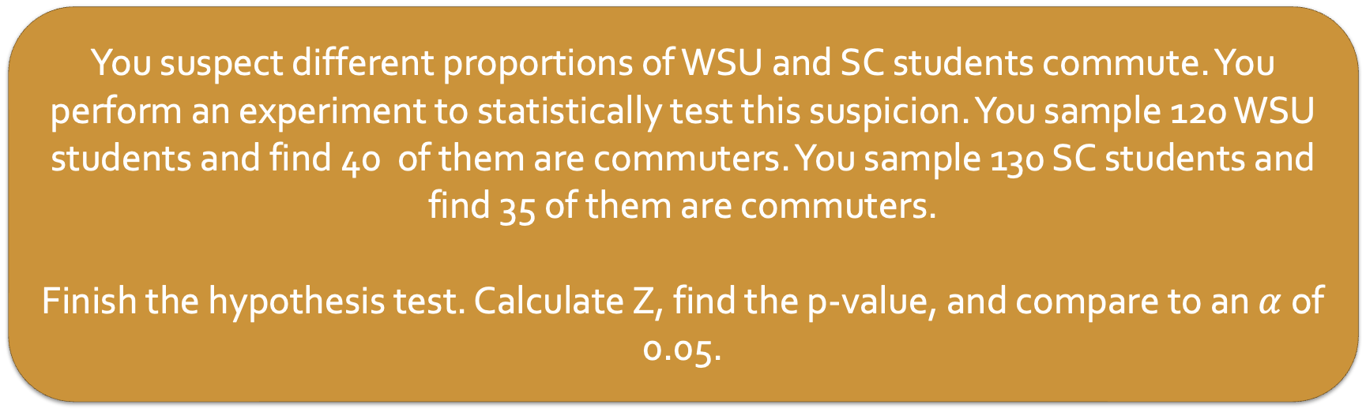
Inference for Two Proportions
Hypothesis Test for Difference Between Two Proportions
For a hypothesis test, our null hypothesis will be that there is no difference between proportions.
When this is our null hypothesis, we will use a pooled proportion to check the success-failure condition for approximating the distribution of ${\hat{p}}_{1}−{\hat{p}}_{2}$ with the normal distribution, and for calculating Z.
${\hat{p}}_{pool}=\frac{number of successes}{number of cases}=\frac{{\hat{p}}_{1}n_{1}+{\hat{p}}_{2}n_{2}}{n_{1}+n_{2}}$
$Z=\frac{\left({\hat{p}}_{1}−{\hat{p}}_{2}\right)−0}{\sqrt{{\hat{p}}_{pool}\left(1−{\hat{p}}_{pool}\right)\left(\frac{1}{n_{1}}+\frac{1}{n_{2}}\right)}}$
You suspect different proportions of WSU and SC students commute. You perform an experiment to statistically test this suspicion. You sample 120 WSU students and find 40 of them are commuters. You sample 130 SC students and find 35 of them are commuters.
Finish the hypothesis test. Calculate Z, find the p-value, and compare to an $α$ of 0.05.

Slide 25
Inference Practice
Work with a small group on the proportion-inference practice problems under Demos on the course website.
Be prepared to share your answers with the class.

