Slide 1
Elementary Statistics – Inference for Numerical Data Pt. 2
Dr. Ab Mosca (they/them)
Slides based off slides courtesy of Kaitlyn Cook (https://www.smith.edu/people/kaitlyn-cook)

Slide 2
Plan for Today
Final project
Inference for numerical variables
Paired means
Note: We will work on Quiz 5 in class on Thursday

Slide 3
Final Project
Any questions?

Slide 4
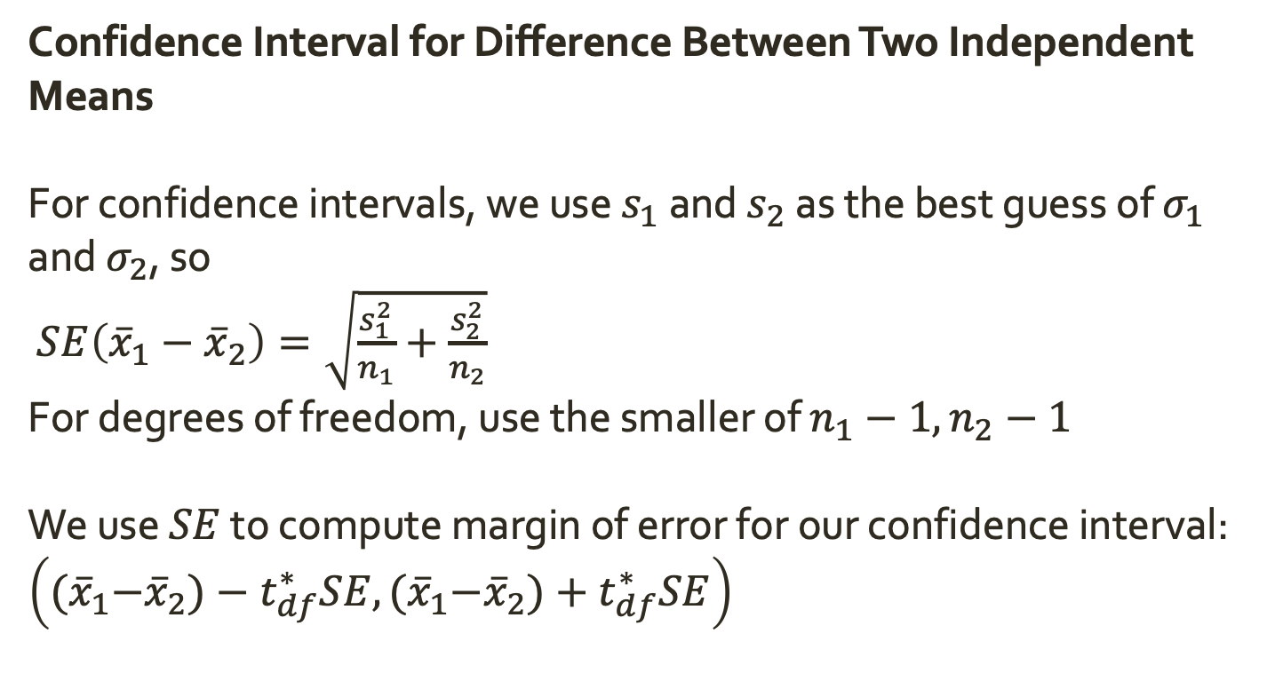
Warm Up: Inference for Two Independent Means
Confidence Interval for Difference Between Two Independent Means
For confidence intervals, we use $s_{1}$ and $s_{2}$ as the best guess of $σ_{1}$ and $σ_{2}$, so
$SE\left({\overline{x}}_{1}−{\overline{x}}_{2}\right)=\sqrt{\frac{s_{1}^{2}}{n_{1}}+\frac{s_{2}^{2}}{n_{2}}}$
For degrees of freedom, use the smaller of $n_{1}−1, n_{2}−1$
We use $SE$ to compute margin of error for our confidence interval: $\left({(\overline{x}}_{1}−{\overline{x}}_{2})−t_{df}^{∗}SE,{(\overline{x}}_{1}−{\overline{x}}_{2})+t_{df}^{∗}SE\right)$

Slide 5
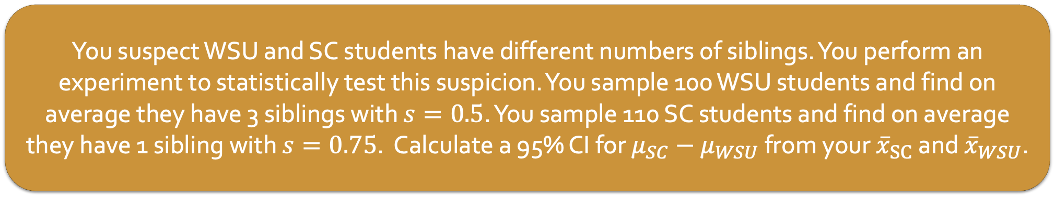
Warm Up: Inference for Two Independent Means
Confidence Interval for Difference Between Two Independent Means
For confidence intervals, we use $s_{1}$ and $s_{2}$ as the best guess of $σ_{1}$ and $σ_{2}$, so
$SE\left({\overline{x}}_{1}−{\overline{x}}_{2}\right)=\sqrt{\frac{s_{1}^{2}}{n_{1}}+\frac{s_{2}^{2}}{n_{2}}}$
For degrees of freedom, use the smaller of $n_{1}−1, n_{2}−1$
We use $SE$ to compute margin of error for our confidence interval: $\left({(\overline{x}}_{1}−{\overline{x}}_{2})−t_{df}^{∗}SE,{(\overline{x}}_{1}−{\overline{x}}_{2})+t_{df}^{∗}SE\right)$
You suspect WSU and SC students have different numbers of siblings. You perform an experiment to statistically test this suspicion. You sample 100 WSU students and find on average they have 3 siblings with $s=0.5$. You sample 110 SC students and find on average they have 1 sibling with $s=0.75$. Calculate a 95% CI for $μ_{SC}−μ_{WSU}$ from your ${\overline{x}}_{SC}$ and ${\overline{x}}_{WSU}$.

Slide 6
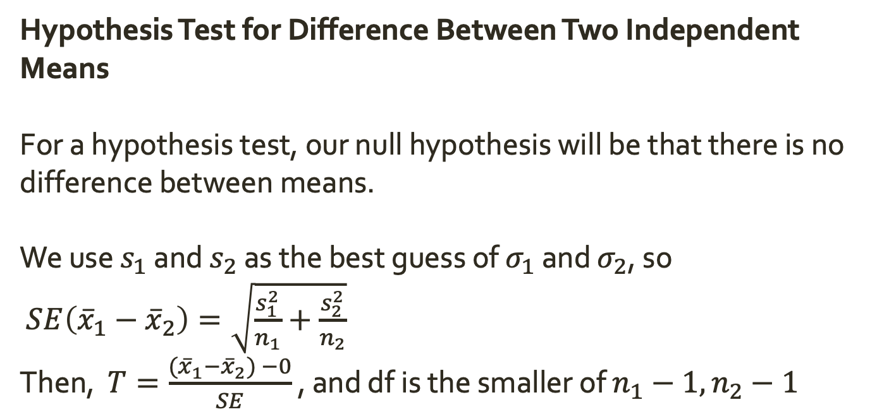
Warm Up: Inference for Two Independent Means
Hypothesis Test for Difference Between Two Independent Means
For a hypothesis test, our null hypothesis will be that there is no difference between means.
We use $s_{1}$ and $s_{2}$ as the best guess of $σ_{1}$ and $σ_{2}$, so
$SE\left({\overline{x}}_{1}−{\overline{x}}_{2}\right)=\sqrt{\frac{s_{1}^{2}}{n_{1}}+\frac{s_{2}^{2}}{n_{2}}}$
Then, $T=\frac{{(\overline{x}}_{1}−{\overline{x}}_{2}) −0}{SE}$ , and df is the smaller of $n_{1}−1, n_{2}−1$

Slide 7
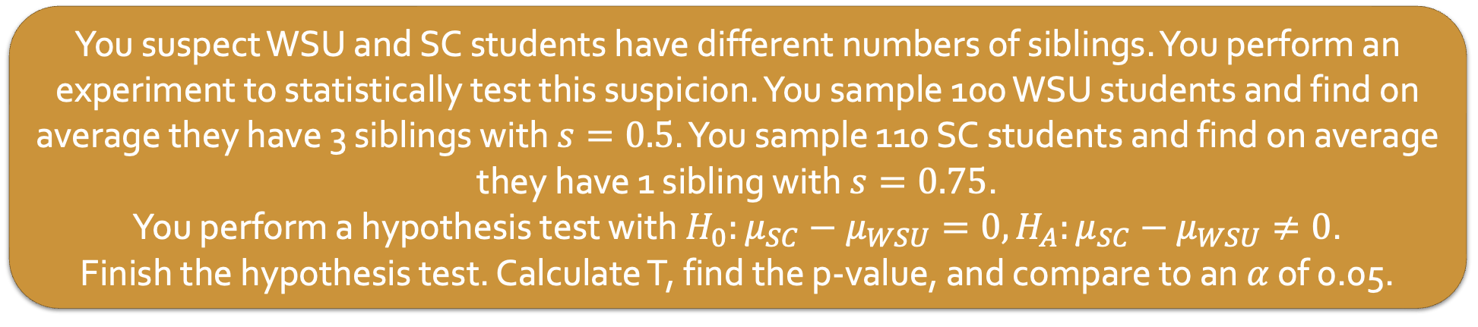
Warm Up: Inference for Two Independent Means
Hypothesis Test for Difference Between Two Independent Means
For a hypothesis test, our null hypothesis will be that there is no difference between means.
We use $s_{1}$ and $s_{2}$ as the best guess of $σ_{1}$ and $σ_{2}$, so
$SE\left({\overline{x}}_{1}−{\overline{x}}_{2}\right)=\sqrt{\frac{s_{1}^{2}}{n_{1}}+\frac{s_{2}^{2}}{n_{2}}}$
Then, $T=\frac{{(\overline{x}}_{1}−{\overline{x}}_{2}) −0}{SE}$ , and df is the smaller of $n_{1}−1, n_{2}−1$
You suspect WSU and SC students have different numbers of siblings. You perform an experiment to statistically test this suspicion. You sample 100 WSU students and find on average they have 3 siblings with $s=0.5$. You sample 110 SC students and find on average they have 1 sibling with $s=0.75$.
You perform a hypothesis test with $H_{0}:μ_{SC}−μ_{WSU}=0, H_{A}:μ_{SC}−μ_{WSU}≠0$.
Finish the hypothesis test. Calculate T, find the p-value, and compare to an $α$ of 0.05.

Slide 8
Inference for Dependent Means
So far, we have looked at inference for categorical variables, single means, and independent means.
All of the tests we covered had the requirement that observations in the data are independent.
Notes:
hypotheses
test statistic
null distribution (assumptions)
p-value

Slide 9
Inference for Dependent Means
So far, we have looked at inference for categorical variables, single means, and independent means.
All of the tests we covered had the requirement that observations in the data are independent.
But what if observations are not independent?
Notes:
hypotheses
test statistic
null distribution (assumptions)
p-value

Slide 10
Inference for Dependent Means
So far, we have looked at inference for categorical variables, single means, and independent means.
All of the tests we covered had the requirement that observations in the data are independent.
But what if observations are not independent?
Sometimes, dependency cannot be addresses through a statistical method. However, one specific type of dependency, pairing, can be with tools we already know.
Notes:
hypotheses
test statistic
null distribution (assumptions)
p-value

Slide 11
Paired Means
Paired data result from a specific type of experimental structure.
In this type of experiment:
The observational unit is paired across two levels of the explanatory variable
For each observational unit, quantitative measures are made on each of the two levels of the explanatory variable. The two measurements are subtracted and only the difference is retained

Slide 12
Paired Means
Paired data result from a specific type of experimental structure.
In this type of experiment:
The observational unit is paired across two levels of the explanatory variable
For each observational unit, quantitative measures are made on each of the two levels of the explanatory variable. The two measurements are subtracted and only the difference is retained
Observational Unit | Explanatory Variable | Measurement | Response Variable
Car | Smooth Turn vs. Quick Turn | Amount of tire tread after 1000 miles | Difference in tread

Slide 13
Paired Means
Paired data result from a specific type of experimental structure.
In this type of experiment:
The observational unit is paired across two levels of the explanatory variable
For each observational unit, quantitative measures are made on each of the two levels of the explanatory variable. The two measurements are subtracted and only the difference is retained
Observational Unit | Explanatory Variable | Measurement | Response Variable
Car | Smooth Turn vs. Quick Turn | Amount of tire tread after 1000 miles | Difference in tread
Textbook | UCLA vs. Amazon | Price of new text | Difference in price

Slide 14
Paired Means
Are the following data paired? If yes, identify the observational unit, explanatory variable, measurement, and response variable.
Compare pre- (beginning of semester) and post-test (end of semester) scores of students.
Assess gender-related salary gap by comparing salaries of randomly sampled men and women.
Compare artery thicknesses at the beginning of a study and after 2 years of taking Vitamin E for the same group of patients.
Assess effectiveness of a diet regimen by comparing the before and after weights of subjects.
Paired data result from a specific type of experimental structure.
In this type of experiment:
The observational unit is paired across two levels of the explanatory variable
For each observational unit, quantitative measures are made on each of the two levels of the explanatory variable. The two measurements are subtracted and only the difference is retained
Observational Unit | Explanatory Variable | Measurement | Response Variable
Car | Smooth Turn vs. Quick Turn | Amount of tire tread after 1000 miles | Difference in tread
Textbook | UCLA vs. Amazon | Price of new text | Difference in price

Slide 15
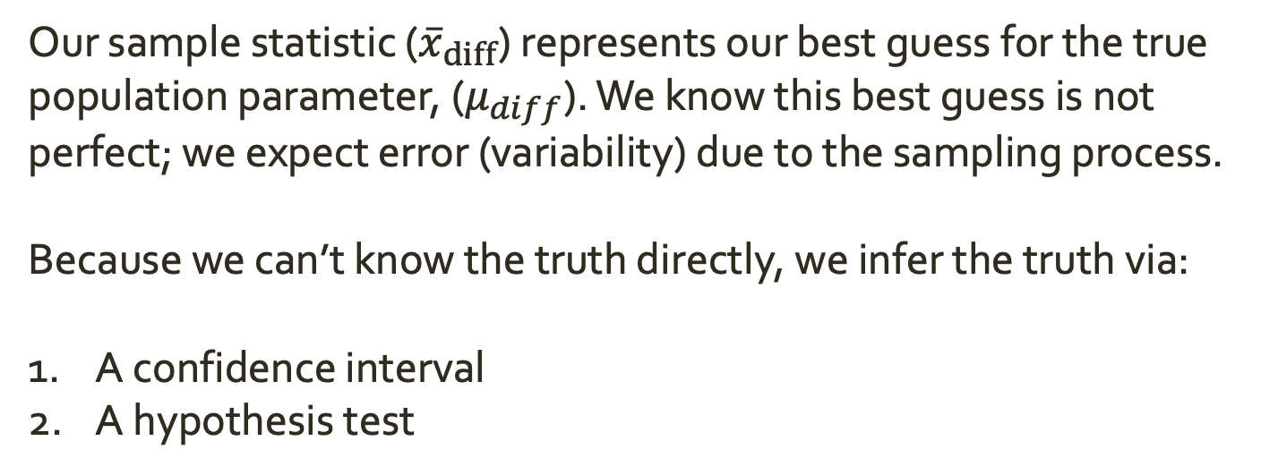
Inference for Paired Means
Our sample statistic (${\overline{x}}_{diff}$) represents our best guess for the true population parameter, ($μ_{diff}$). We know this best guess is not perfect; we expect error (variability) due to the sampling process.
Because we can’t know the truth directly, we infer the truth via:
A confidence interval
A hypothesis test
Notes:
hypotheses
test statistic
null distribution (assumptions)
p-value

Slide 16
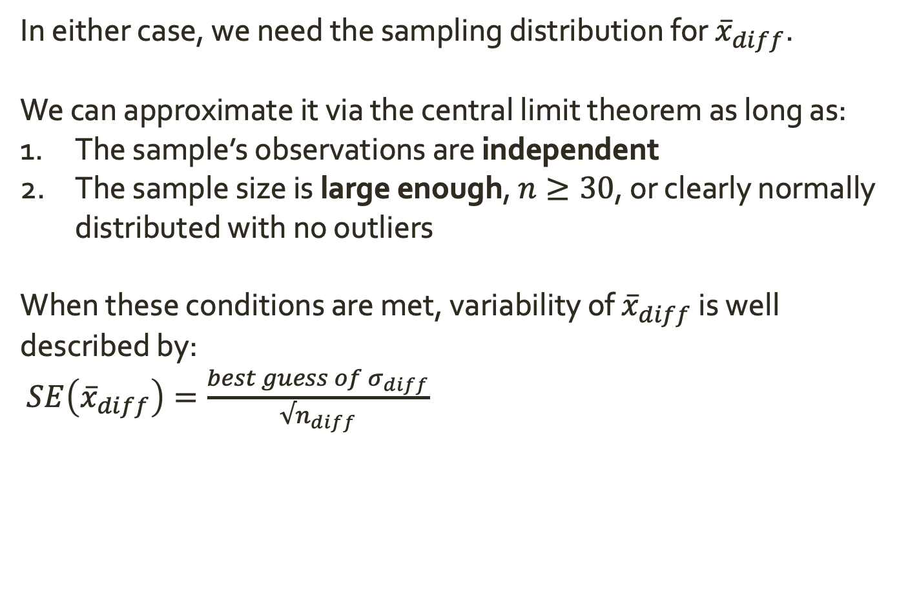
Inference for Paired Means
In either case, we need the sampling distribution for ${\overline{x}}_{diff}$.
We can approximate it via the central limit theorem as long as:
The sample’s observations are independent
The sample size is large enough, $n≥30$, or clearly normally distributed with no outliers
When these conditions are met, variability of ${\overline{x}}_{diff}$ is well described by:
$SE\left({\overline{x}}_{diff}\right)=\frac{best guess of σ_{diff}}{√n_{diff}}$

Slide 17
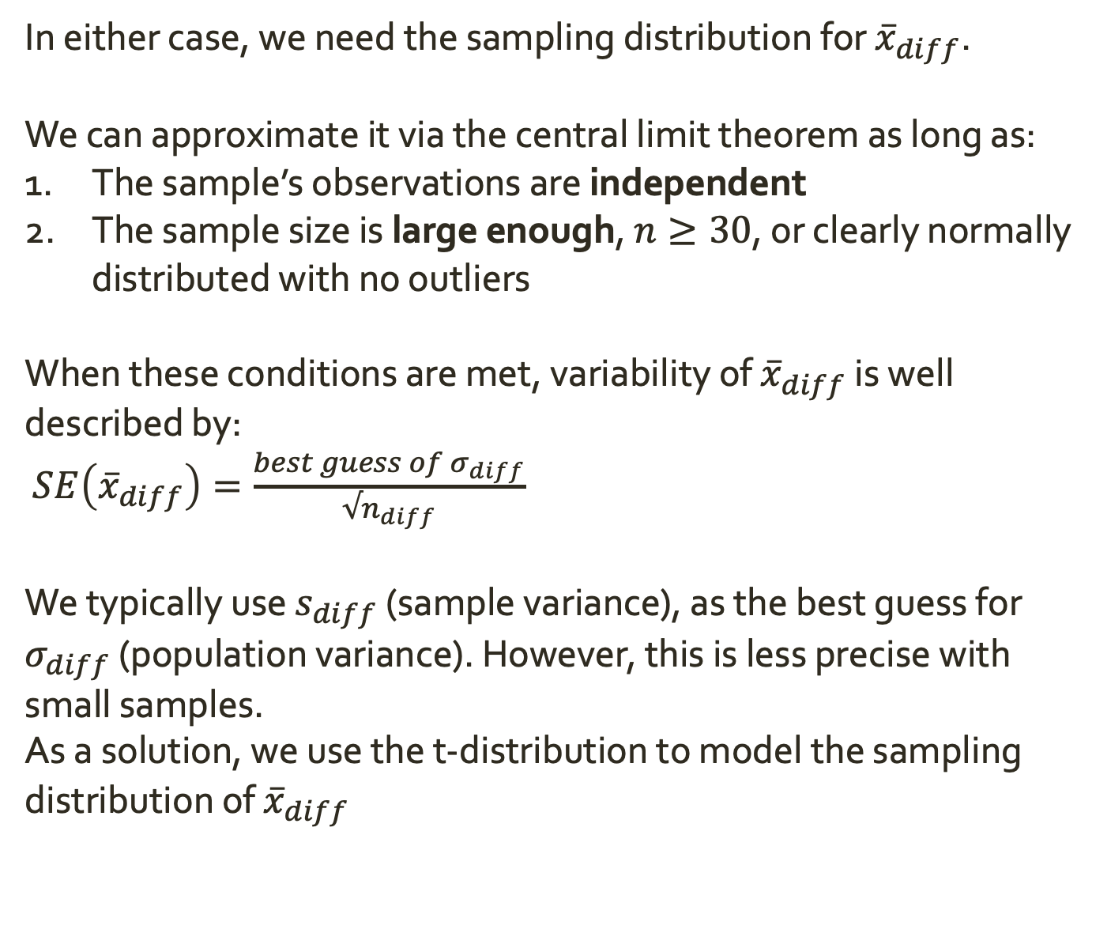
Inference for Paired Means
In either case, we need the sampling distribution for ${\overline{x}}_{diff}$.
We can approximate it via the central limit theorem as long as:
The sample’s observations are independent
The sample size is large enough, $n≥30$, or clearly normally distributed with no outliers
When these conditions are met, variability of ${\overline{x}}_{diff}$ is well described by:
$SE\left({\overline{x}}_{diff}\right)=\frac{best guess of σ_{diff}}{√n_{diff}}$
We typically use $s_{diff}$ (sample variance), as the best guess for $σ_{diff}$ (population variance). However, this is less precise with small samples.
As a solution, we use the t-distribution to model the sampling distribution of ${\overline{x}}_{diff}$

Slide 18
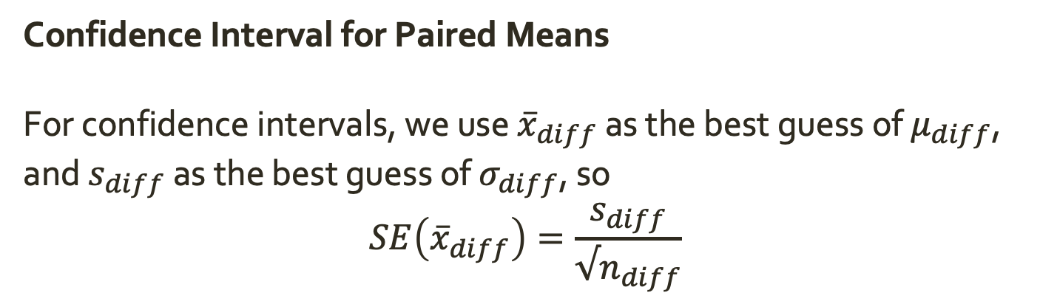
Inference for Paired Means
Confidence Interval for Paired Means
For confidence intervals, we use ${\overline{x}}_{diff}$ as the best guess of $μ_{diff}$, and $s_{diff}$ as the best guess of $σ_{diff}$, so
$$SE\left({\overline{x}}_{diff}\right)=\frac{s_{diff}}{√n_{diff}}$$

Slide 19
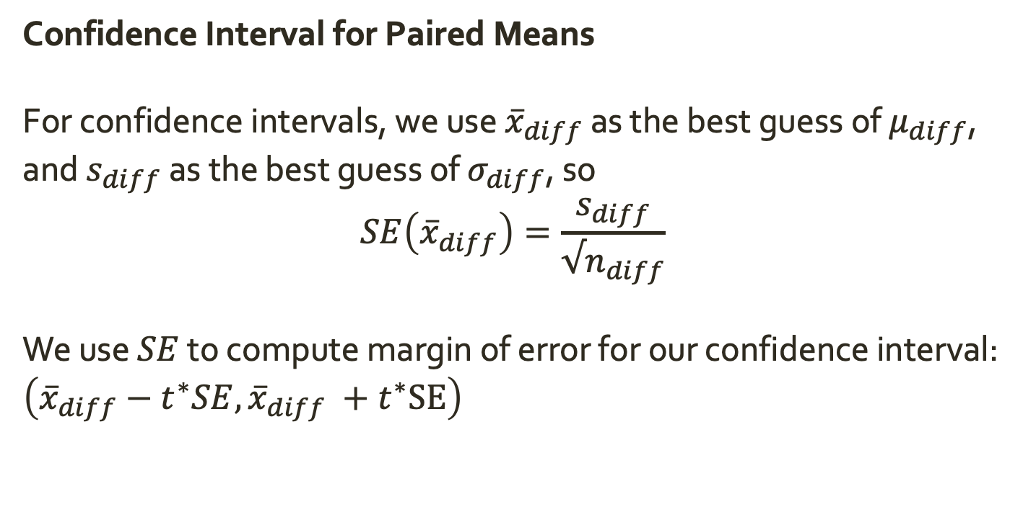
Inference for Paired Means
Confidence Interval for Paired Means
For confidence intervals, we use ${\overline{x}}_{diff}$ as the best guess of $μ_{diff}$, and $s_{diff}$ as the best guess of $σ_{diff}$, so
$$SE\left({\overline{x}}_{diff}\right)=\frac{s_{diff}}{√n_{diff}}$$
We use $SE$ to compute margin of error for our confidence interval: $\left({\overline{x}}_{diff}−t^{∗}SE,{\overline{x}}_{diff} +t^{∗}SE\right)$

Slide 20
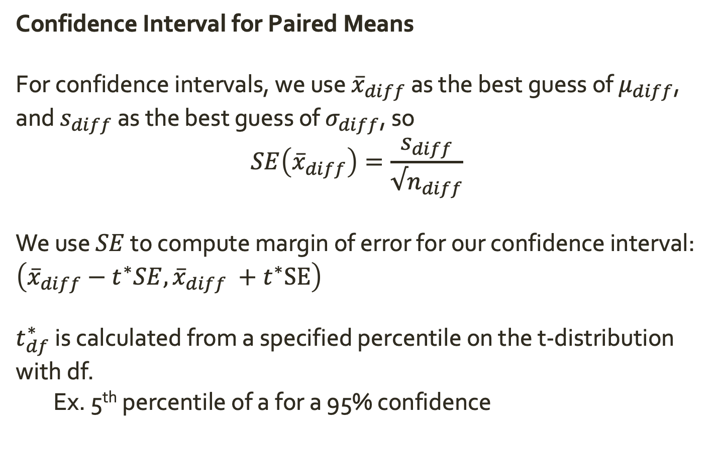
Inference for Paired Means
Confidence Interval for Paired Means
For confidence intervals, we use ${\overline{x}}_{diff}$ as the best guess of $μ_{diff}$, and $s_{diff}$ as the best guess of $σ_{diff}$, so
$$SE\left({\overline{x}}_{diff}\right)=\frac{s_{diff}}{√n_{diff}}$$
We use $SE$ to compute margin of error for our confidence interval: $\left({\overline{x}}_{diff}−t^{∗}SE,{\overline{x}}_{diff} +t^{∗}SE\right)$
$t_{df}^{∗}$ is calculated from a specified percentile on the t-distribution with df.
Ex. 5th percentile of a for a 95% confidence

Slide 21
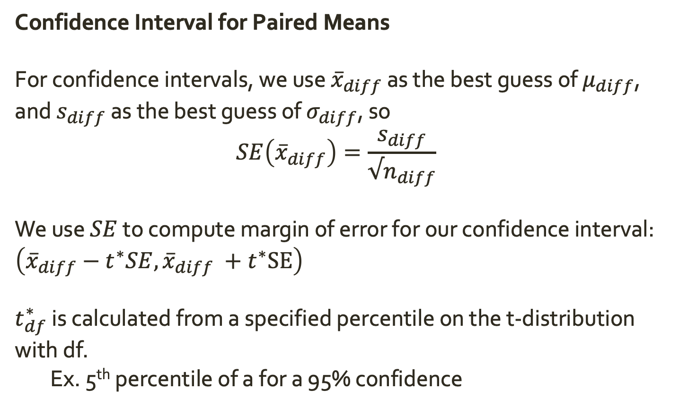
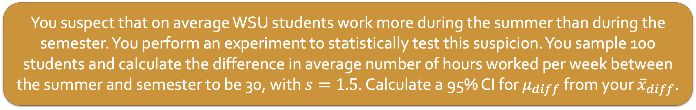
Inference for a Single Mean
Confidence Interval for Paired Means
For confidence intervals, we use ${\overline{x}}_{diff}$ as the best guess of $μ_{diff}$, and $s_{diff}$ as the best guess of $σ_{diff}$, so
$$SE\left({\overline{x}}_{diff}\right)=\frac{s_{diff}}{√n_{diff}}$$
We use $SE$ to compute margin of error for our confidence interval: $\left({\overline{x}}_{diff}−t^{∗}SE,{\overline{x}}_{diff} +t^{∗}SE\right)$
$t_{df}^{∗}$ is calculated from a specified percentile on the t-distribution with df.
Ex. 5th percentile of a for a 95% confidence
You suspect that on average WSU students work more during the summer than during the semester. You perform an experiment to statistically test this suspicion. You sample 100 students and calculate the difference in average number of hours worked per week between the summer and semester to be 30, with $s=1.5$. Calculate a 95% CI for $μ_{diff}$ from your ${\overline{x}}_{diff}$.

Slide 22
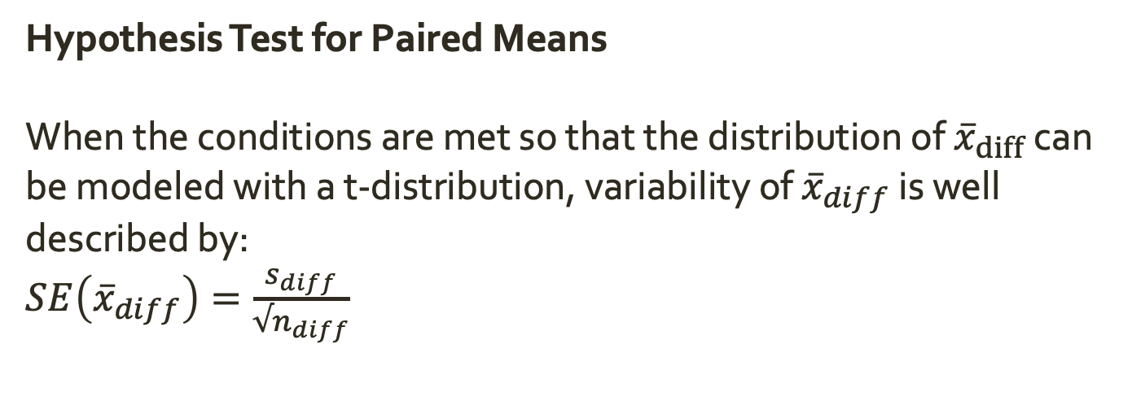
Inference for Paired Means
Hypothesis Test for Paired Means
When the conditions are met so that the distribution of ${\overline{x}}_{diff}$ can be modeled with a t-distribution, variability of ${\overline{x}}_{diff}$ is well described by:
$SE\left({\overline{x}}_{diff}\right)=\frac{s_{diff}}{√n_{diff}}$

Slide 23
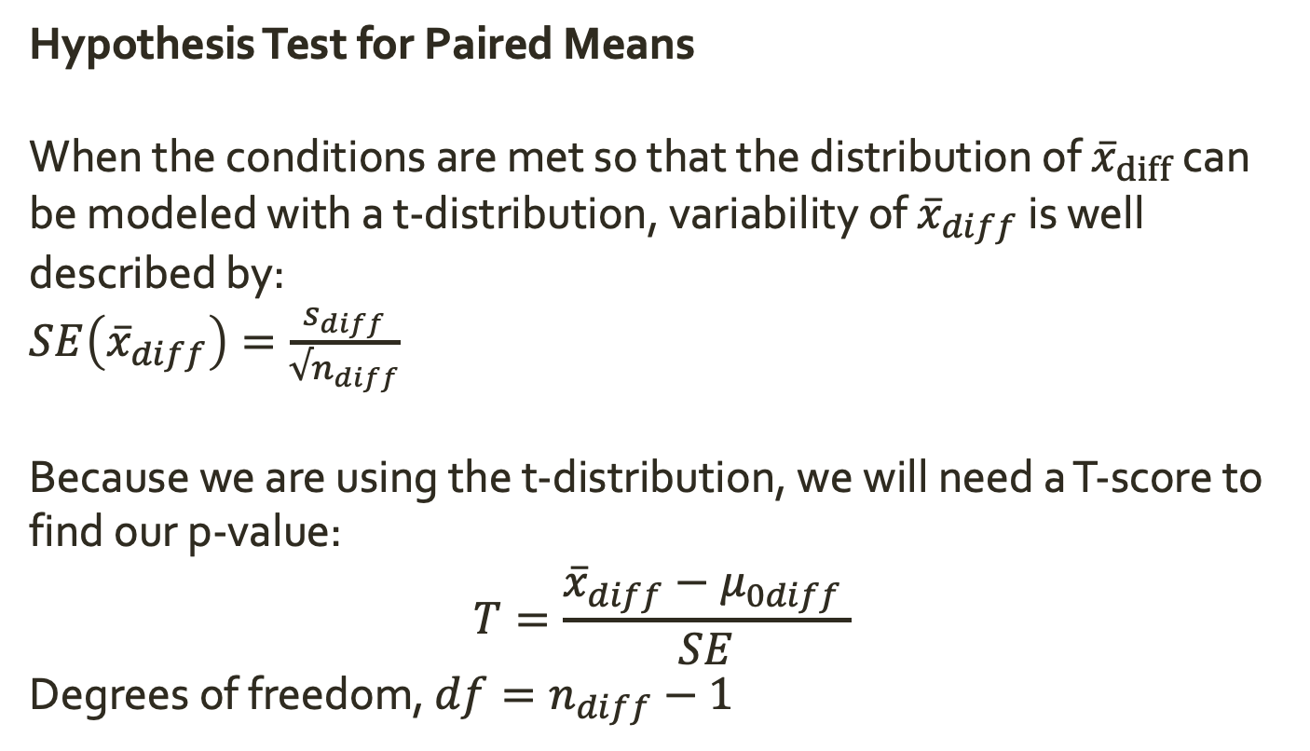
Inference for Paired Means
Hypothesis Test for Paired Means
When the conditions are met so that the distribution of ${\overline{x}}_{diff}$ can be modeled with a t-distribution, variability of ${\overline{x}}_{diff}$ is well described by:
$SE\left({\overline{x}}_{diff}\right)=\frac{s_{diff}}{√n_{diff}}$
Because we are using the t-distribution, we will need a T-score to find our p-value:
$$T=\frac{{\overline{x}}_{diff}−μ_{0diff }}{SE}$$
Degrees of freedom, $df=n_{diff}−1$

Slide 24
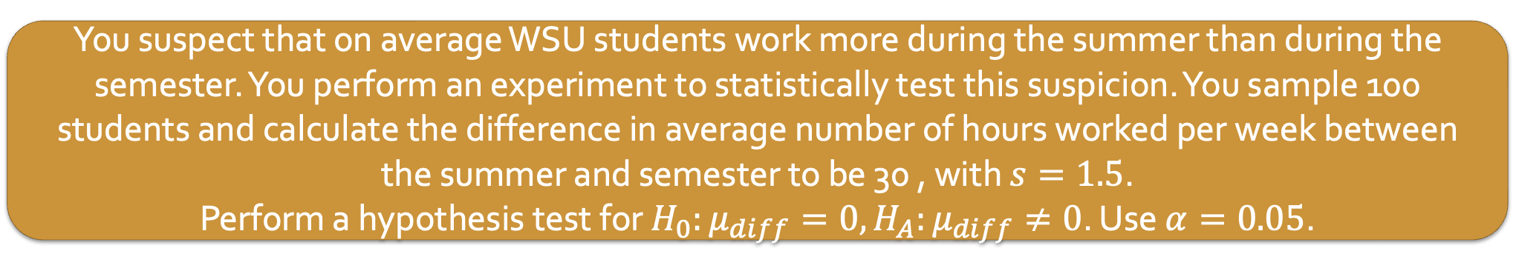
Inference for Paired Means
Hypothesis Test for Paired Means
When the conditions are met so that the distribution of ${\overline{x}}_{diff}$ can be modeled with a t-distribution, variability of ${\overline{x}}_{diff}$ is well described by:
$SE\left({\overline{x}}_{diff}\right)=\frac{s_{diff}}{√n_{diff}}$
Because we are using the t-distribution, we will need a T-score to find our p-value:
$$T=\frac{{\overline{x}}_{diff}−μ_{0diff }}{SE}$$
Degrees of freedom, $df=n_{diff}−1$
You suspect that on average WSU students work more during the summer than during the semester. You perform an experiment to statistically test this suspicion. You sample 100 students and calculate the difference in average number of hours worked per week between the summer and semester to be 30 , with $s=1.5$.
Perform a hypothesis test for $H_{0}:μ_{diff}=0, H_{A}:μ_{diff}≠0$. Use $α=0.05$.

Slide 25
Quiz 5
Open up Quiz 5 on PLATO
Find a group to work with. Everyone in the group must participate (I will be checking).
Go through the quiz; for each problem write down the problem and your work to solve it on paper (write your name on the paper, too!). At the end of class on Thursday, you will turn in the pages showing your work.
Your grade on Quiz 5 will be updated based on what you turn in from class. In addition to answering the questions correctly, you will get credit for working with your group to solve the problems and asking questions.
I will come around to check-in, but also please get my attention if you have a question!

