Slide 1
Elementary Statistics – Simple Linear Regression Pt 2
Dr. Ab Mosca (they/them)
Slides based off slides courtesy of Kaitlyn Cook (https://www.smith.edu/people/kaitlyn-cook)

Slide 2
Plan for Today
Simple Linear Regression
Fitting a model
Assessing model fit
Issues to look out for
Binary predictors

Slide 3
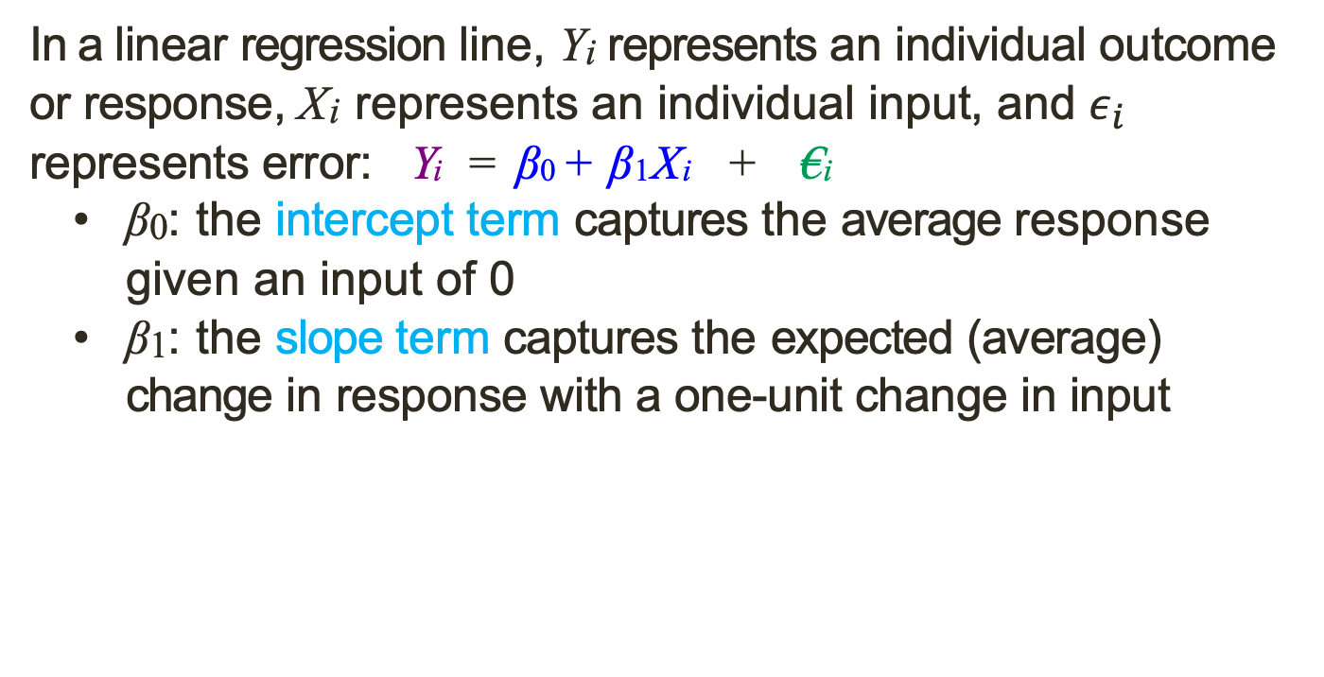
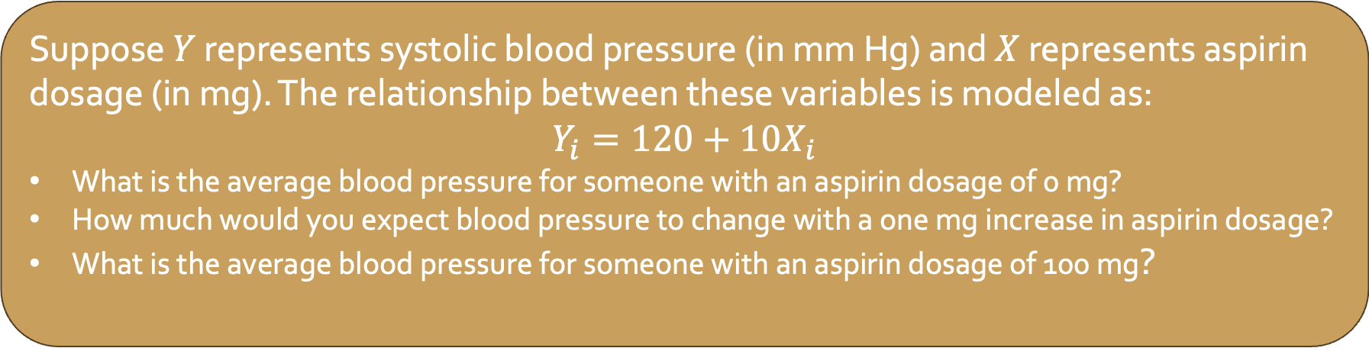
Warm Up: Interpreting the Regression Line
In a linear regression line, Y_{i} represents an individual outcome or response, X_{i} represents an individual input, and $ε_{i}$ represents error: Y_{i} = β₀ + β₁X_{i} + €_{i}
β₀: the intercept term captures the average response given an input of 0
β₁: the slope term captures the expected (average) change in response with a one-unit change in input
Suppose $Y$ represents systolic blood pressure (in mm Hg) and $X$ represents aspirin dosage (in mg). The relationship between these variables is modeled as:
$$Y_{i}=120+10X_{i}$$
What is the average blood pressure for someone with an aspirin dosage of 0 mg?
How much would you expect blood pressure to change with a one mg increase in aspirin dosage?
What is the average blood pressure for someone with an aspirin dosage of 100 mg?

Slide 4
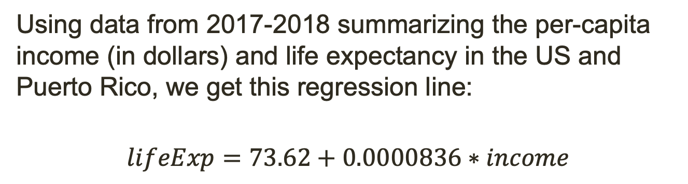
Least Squares Line
Motivating Question
Is there an association between per-capita income and life expectancy in the United States?
Using data from 2017-2018 summarizing the per-capita income (in dollars) and life expectancy in the US and Puerto Rico, we get this regression line:
$$lifeExp=73.62+0.0000836∗income$$

Slide 5
Least Squares Line
Motivating Question
Is there an association between per-capita income and life expectancy in the United States?
Using data from 2017-2018 summarizing the per-capita income (in dollars) and life expectancy in the US and Puerto Rico, we get this regression line:
$$lifeExp=73.62+0.0000836∗income$$
What is the average life expectancy given an income of $0?
What is the average life expectancy given an income of $30,000

Slide 6
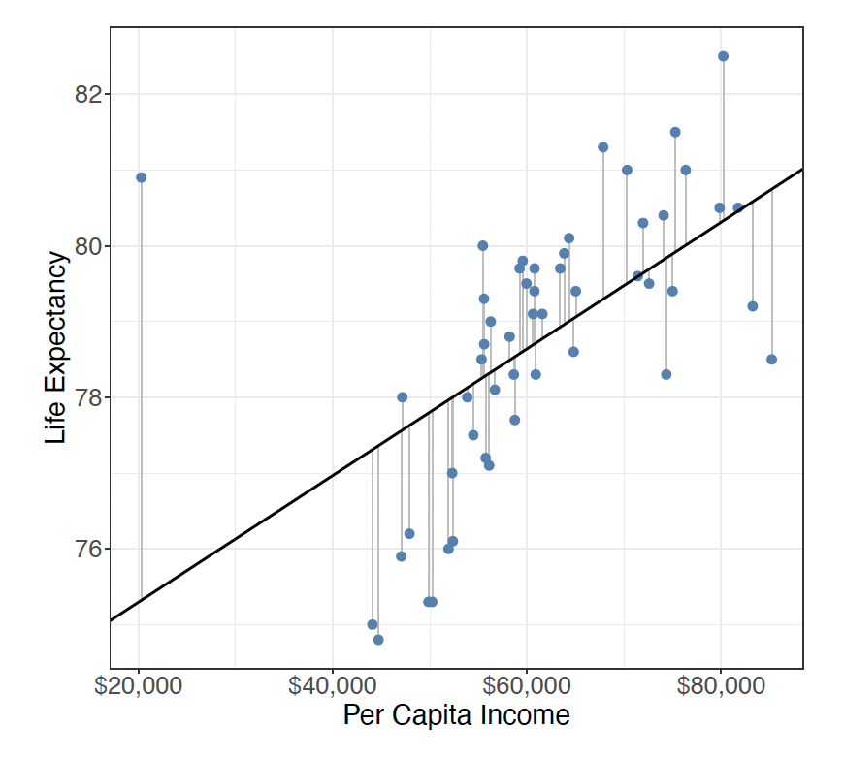

Least Squares Line
Motivating Question
Is there an association between per-capita income and life expectancy in the United States?
$$lifeExp=73.62+0.0000836∗income$$
The line in this plot shows our regression
The points show the actual data

Slide 7
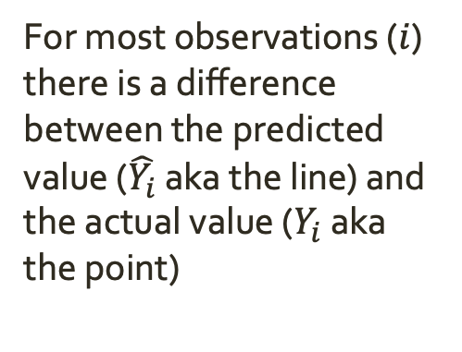
Least Squares Line
Motivating Question
Is there an association between per-capita income and life expectancy in the United States?
$$lifeExp=73.62+0.0000836∗income$$
For most observations ($i$) there is a difference between the predicted value ($\hat{Y_{i}}$ aka the line) and the actual value ($Y_{i}$ aka the point)

Slide 8


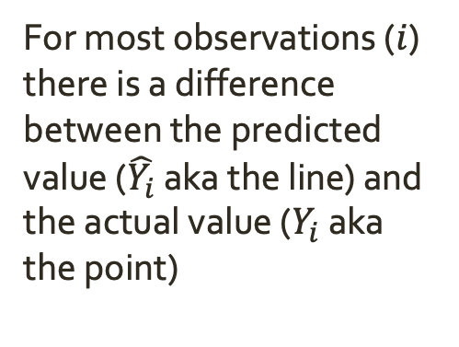
Least Squares Line
Motivating Question
Is there an association between per-capita income and life expectancy in the United States?
$$lifeExp=73.62+0.0000836∗income$$
For most observations ($i$) there is a difference between the predicted value ($\hat{Y_{i}}$ aka the line) and the actual value ($Y_{i}$ aka the point)
$$y_{0}$$
$$\hat{y_{0}}$$

Slide 9

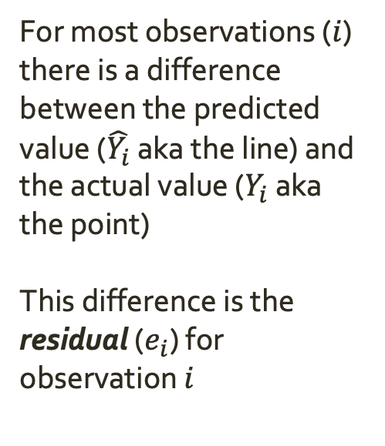
Least Squares Line
Motivating Question
Is there an association between per-capita income and life expectancy in the United States?
$$lifeExp=73.62+0.0000836∗income$$
For most observations ($i$) there is a difference between the predicted value ($\hat{Y_{i}}$ aka the line) and the actual value ($Y_{i}$ aka the point)
This difference is the residual ($e_{i}$) for observation $i$
$$y_{0}$$
$$e_{0}$$
$$\hat{y_{0}}$$

Slide 10




Least Squares Line
Motivating Question
Is there an association between per-capita income and life expectancy in the United States?
$$lifeExp=73.62+0.0000836∗income$$
For most observations ($i$) there is a difference between the predicted value ($\hat{Y_{i}}$ aka the line) and the actual value ($Y_{i}$ aka the point)
This difference is the residual ($e_{i}$) for observation $i$
$$y_{0}$$
$$e_{0}$$
$$\hat{y_{1}}$$
$$e_{1}$$
$$\hat{y_{0}}$$
$$y_{1}$$

Slide 11
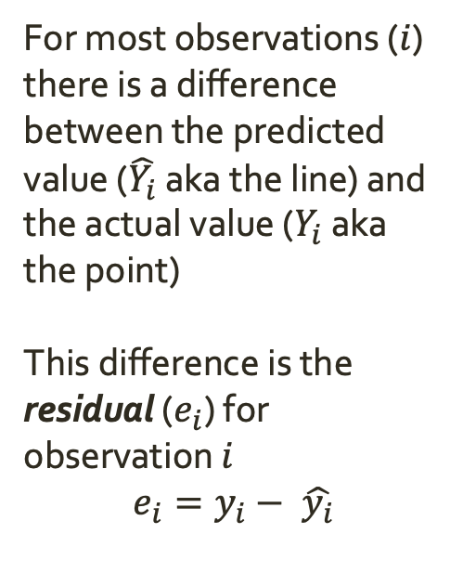
Least Squares Line
Motivating Question
Is there an association between per-capita income and life expectancy in the United States?
$$lifeExp=73.62+0.0000836∗income$$
For most observations ($i$) there is a difference between the predicted value ($\hat{Y_{i}}$ aka the line) and the actual value ($Y_{i}$ aka the point)
This difference is the residual ($e_{i}$) for observation $i$
$$e_{i}=y_{i}− \hat{y_{i}}$$
$$y_{0}$$
$$e_{0}$$
$$\hat{y_{1}}$$
$$e_{1}$$
$$\hat{y_{0}}$$
$$y_{1}$$

Slide 12
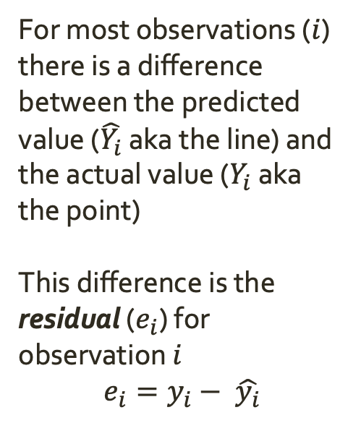
Least Squares Line
Motivating Question
Is there an association between per-capita income and life expectancy in the United States?
$$lifeExp=73.62+0.0000836∗income$$
For most observations ($i$) there is a difference between the predicted value ($\hat{Y_{i}}$ aka the line) and the actual value ($Y_{i}$ aka the point)
This difference is the residual ($e_{i}$) for observation $i$
$$e_{i}=y_{i}− \hat{y_{i}}$$
$$y_{0}$$
$$e_{0}$$
$$\hat{y_{1}}$$
$$e_{1}$$
$$\hat{y_{0}}$$
$$y_{1}$$
residual is the “error” that is unaccounted for by the regression line.

Slide 13
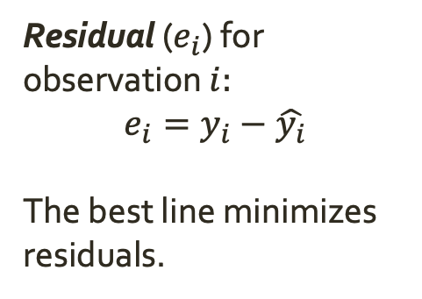
Least Squares Line
Motivating Question
Is there an association between per-capita income and life expectancy in the United States?
$$lifeExp=73.62+0.0000836∗income$$
Residual ($e_{i}$) for observation $i:$
$$e_{i}=y_{i}−\hat{y_{i}}$$
The best line minimizes residuals.
$$y_{0}$$
$$e_{0}$$
$$\hat{y_{1}}$$
Why?
$$e_{1}$$
$$\hat{y_{0}}$$
$$y_{1}$$

Slide 14



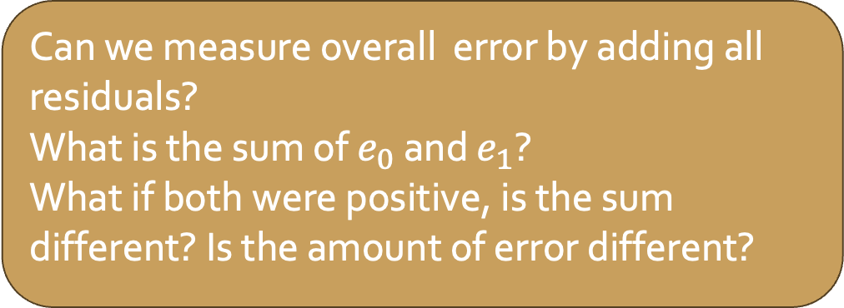




Least Squares Line
Motivating Question
Is there an association between per-capita income and life expectancy in the United States?
$$lifeExp=73.62+0.0000836∗income$$
Residual ($e_{i}$) for observation $i:$
$$e_{i}=y_{i}−\hat{y_{i}}$$
The best line minimizes residuals (i.e. minimizes overall error).
$$y_{0}$$
$e_{0}$ = 6
$$\hat{y_{1}}$$
Can we measure overall error by adding all residuals?
What is the sum of $e_{0}$ and $e_{1}$?
What if both were positive, is the sum different? Is the amount of error different?
$$e_{1}=−3.3$$
$$\hat{y_{0}}$$
$$y_{1}$$

Slide 15
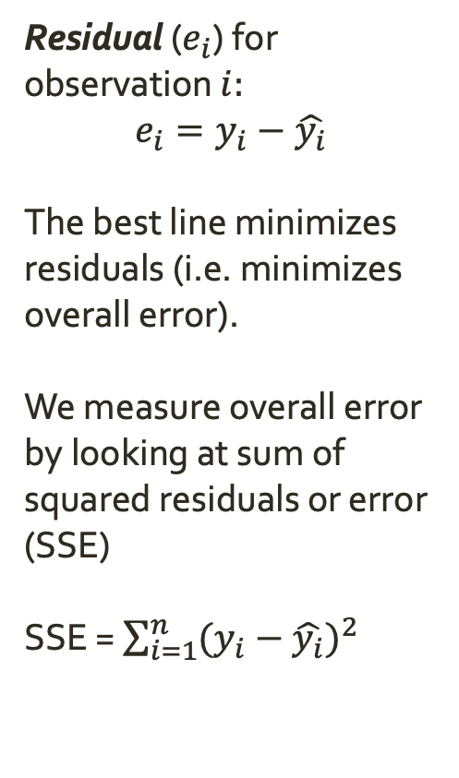
Least Squares Line
Motivating Question
Is there an association between per-capita income and life expectancy in the United States?
$$lifeExp=73.62+0.0000836∗income$$
Residual ($e_{i}$) for observation $i:$
$$e_{i}=y_{i}−\hat{y_{i}}$$
The best line minimizes residuals (i.e. minimizes overall error).
We measure overall error by looking at sum of squared residuals or error (SSE)
SSE = $\sum_{i=1}^{n}{{(y_{i}−\hat{y_{i}})}^{2}}$
$$y_{0}$$
$e_{0}$ = 6
$$\hat{y_{1}}$$
$$e_{1}=−3.3$$
$$\hat{y_{0}}$$
$$y_{1}$$

Slide 16
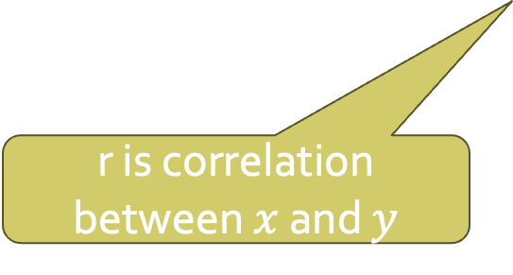
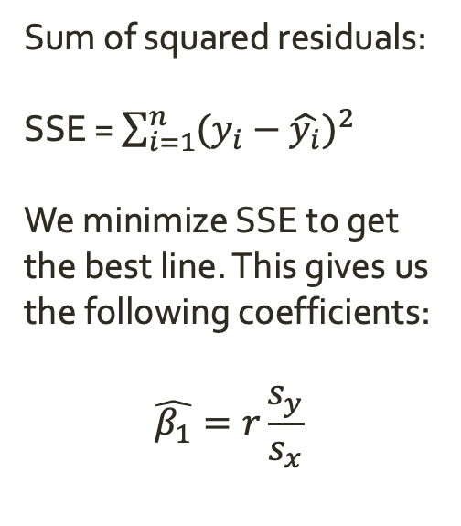
Least Squares Line
Motivating Question
Is there an association between per-capita income and life expectancy in the United States?
$$lifeExp=73.62+0.0000836∗income$$
Sum of squared residuals:
SSE = $\sum_{i=1}^{n}{{(y_{i}−\hat{y_{i}})}^{2}}$
We minimize SSE to get the best line. This gives us the following coefficients:
$$\hat{β_{1}}=r\frac{s_{y}}{s_{x}}$$
$$y_{0}$$
$e_{0}$ = 6
$$\hat{y_{1}}$$
$$e_{1}=−3.3$$
$$\hat{y_{0}}$$
$$y_{1}$$
s is standard deviation
r is correlation between $x$ and $y$

Slide 17
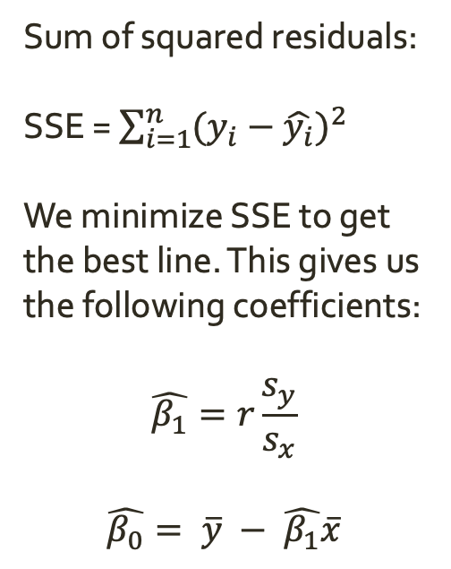
Least Squares Line
Motivating Question
Is there an association between per-capita income and life expectancy in the United States?
$$lifeExp=73.62+0.0000836∗income$$
Sum of squared residuals:
SSE = $\sum_{i=1}^{n}{{(y_{i}−\hat{y_{i}})}^{2}}$
We minimize SSE to get the best line. This gives us the following coefficients:
$$\hat{β_{1}}=r\frac{s_{y}}{s_{x}}$$
$$\hat{β_{0}}= \overline{y} − \hat{β_{1}}\overline{x}$$
$$y_{0}$$
$e_{0}$ = 6
$$\hat{y_{1}}$$
$$e_{1}=−3.3$$
$$\hat{y_{0}}$$
$$y_{1}$$
bar is mean

Slide 18
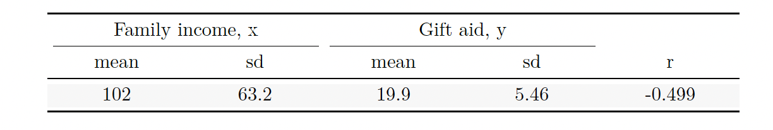


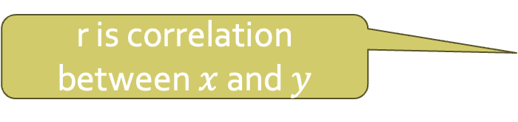
Least Squares Line
Practice: Let’s fit a regression to represent the relationship between family income and gift aid for Elmhurst College in Il.
Use the table below to compute the slope and intercept of the line.
r is correlation between $x$ and $y$
s is standard deviation
$$\hat{β_{1}}=r\frac{s_{y}}{s_{x}}$$
$$\hat{β_{0}}= \overline{y} − \hat{β_{1}}\overline{x}$$
bar is mean
$$\hat{aid}= β_{0}+ β_{1}∗family_income$$

Slide 19
Least Squares Line
Practice: With your regression, what is the average aid for a family with an income of $30,000? How about $100,000?
r is correlation between $x$ and $y$
s is standard deviation
$$\hat{β_{1}}=r\frac{s_{y}}{s_{x}}$$
$$\hat{β_{0}}= \overline{y} − \hat{β_{1}}\overline{x}$$
bar is mean
$$\hat{aid}= β_{0}+ β_{1}∗family_income$$

Slide 20
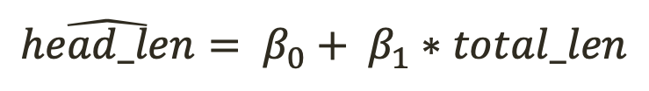
Least Squares Line
Practice: Let’s fit a regression to represent the relationship between possum head length and total length.
Use the table below to compute the slope and intercept of the line.
total_len, x (cm)
head_len, y (mm)
87
15
92
7.5
0.44
r is correlation between $x$ and $y$
s is standard deviation
$$\hat{β_{1}}=r\frac{s_{y}}{s_{x}}$$
$$\hat{β_{0}}= \overline{y} − \hat{β_{1}}\overline{x}$$
bar is mean
$$\hat{head_len}= β_{0}+ β_{1}∗total_len$$

Slide 21
Least Squares Line
Practice: With your regression, what is the average head_len for a raccoon with a total_len of 20cm? How about 100cm?
total_len, x (cm)
head_len, y (mm)
87
15
92
7.5
0.44
r is correlation between $x$ and $y$
s is standard deviation
$$\hat{β_{1}}=r\frac{s_{y}}{s_{x}}$$
$$\hat{β_{0}}= \overline{y} − \hat{β_{1}}\overline{x}$$
bar is mean
$$\hat{head_len}= β_{0}+ β_{1}∗total_len$$

Slide 22
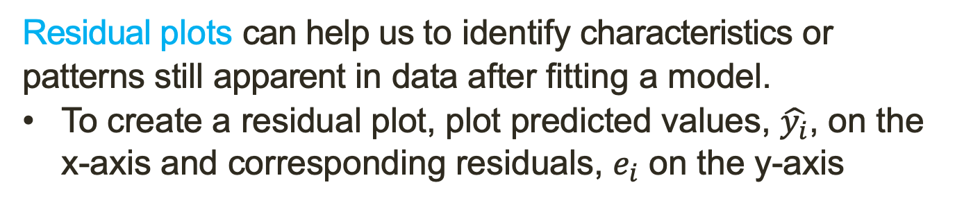
Assessing Fit
Residual plots can help us to identify characteristics or patterns still apparent in data after fitting a model.
To create a residual plot, plot predicted values, $\hat{y_{i}}$, on the x-axis and corresponding residuals, $e_{i}$ on the y-axis

Slide 23
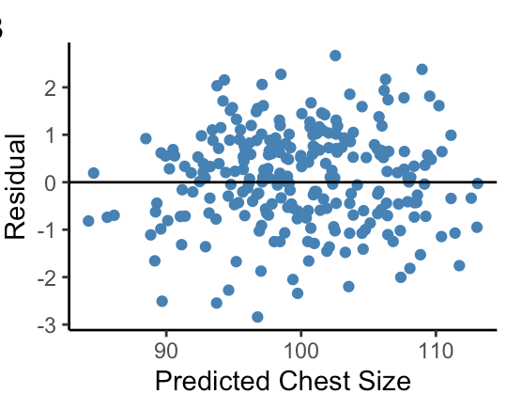
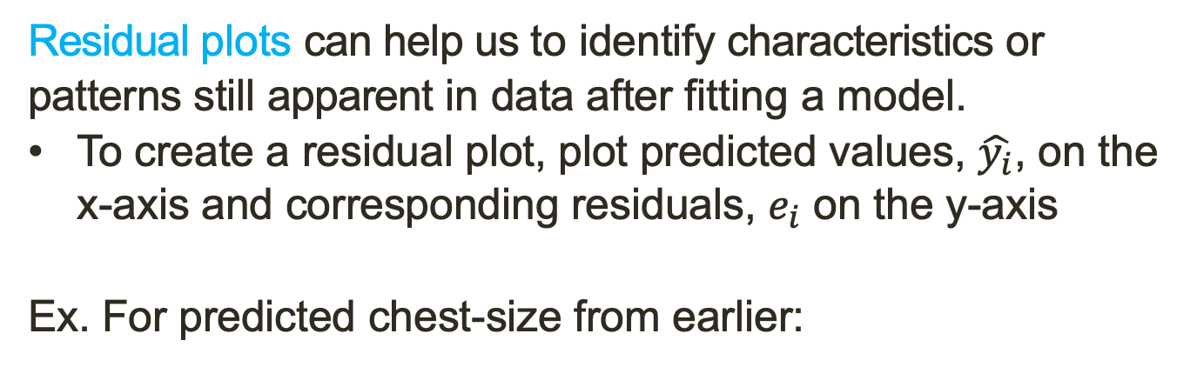
Assessing Fit
Residual plots can help us to identify characteristics or patterns still apparent in data after fitting a model.
To create a residual plot, plot predicted values, $\hat{y_{i}}$, on the x-axis and corresponding residuals, $e_{i}$ on the y-axis
Ex. For predicted chest-size from earlier:
If the fit is good, there will be no discernable pattern.
Why?

Slide 24
Assessing Fit
The coefficient of determination, written as R², measures the proportion of variation in the outcome variable, y, that our model is able to successfully explain.

Slide 25
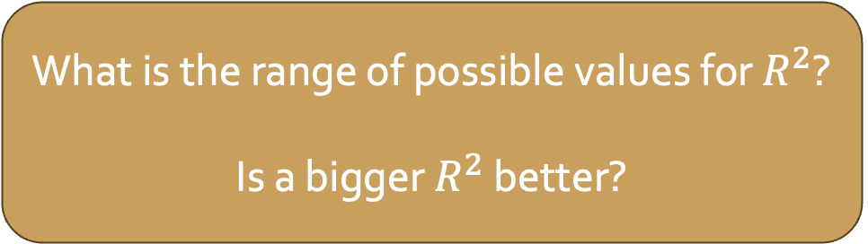
Assessing Fit
The coefficient of determination, written as R², measures the proportion of variation in the outcome variable, y, that our model is able to successfully explain.
What is the range of possible values for $R^{2}$?
Is a bigger $R^{2}$ better?

Slide 26
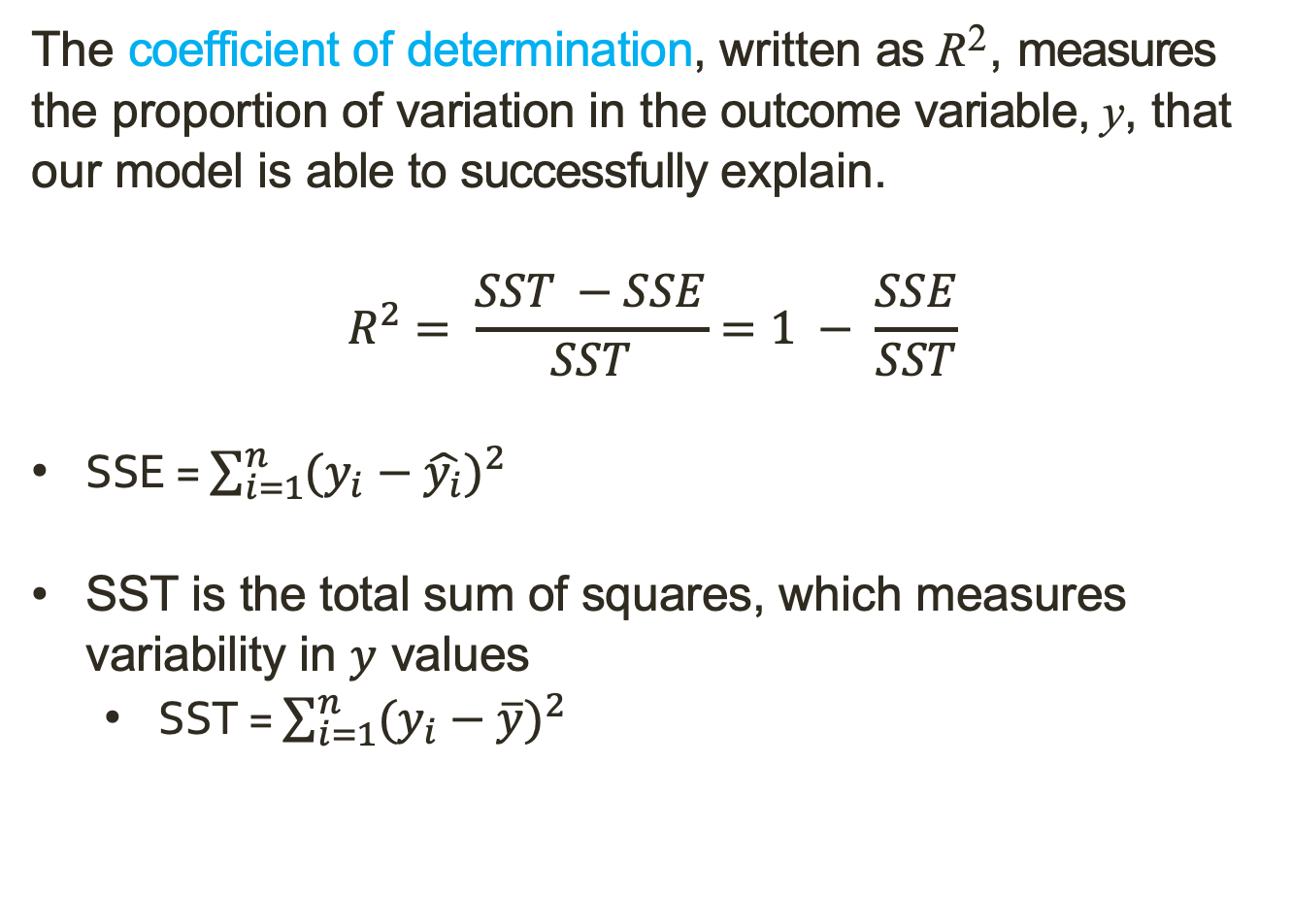
Assessing Fit
The coefficient of determination, written as R², measures the proportion of variation in the outcome variable, y, that our model is able to successfully explain.
$$R^{2}= \frac{SST −SSE}{SST}=1 − \frac{SSE}{SST}$$
SSE = $\sum_{i=1}^{n}{{(y_{i}−\hat{y_{i}})}^{2}}$
SST is the total sum of squares, which measures variability in $y$ values
SST = $\sum_{i=1}^{n}{{(y_{i}−\overline{y})}^{2}}$
this is predicted y for observation i
this is mean observed y

Slide 27

Assessing Fit
The coefficient of determination, written as R², measures the proportion of variation in the outcome variable, y, that our model is able to successfully explain.
$$R^{2}= \frac{SST −SSE}{SST}=1 − \frac{SSE}{SST}$$
SSE = $\sum_{i=1}^{n}{{(y_{i}−\hat{y_{i}})}^{2}}$
SST is the total sum of squares, which measures variability in $y$ values
SST = $\sum_{i=1}^{n}{{(y_{i}−\overline{y})}^{2}}$
Practice: In the Elmhurst dataset SST = 1461, and SSE = 1098. What is $R^{2}$? What does it tell us?

Slide 28
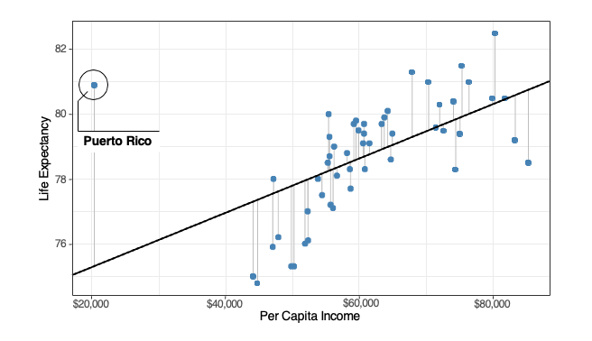
Outliers and Influential Points
The observation on the far left side of the scatter plot lies substantially farther away from the “center” of the plot than any other point...
Should we be worried?

Slide 29
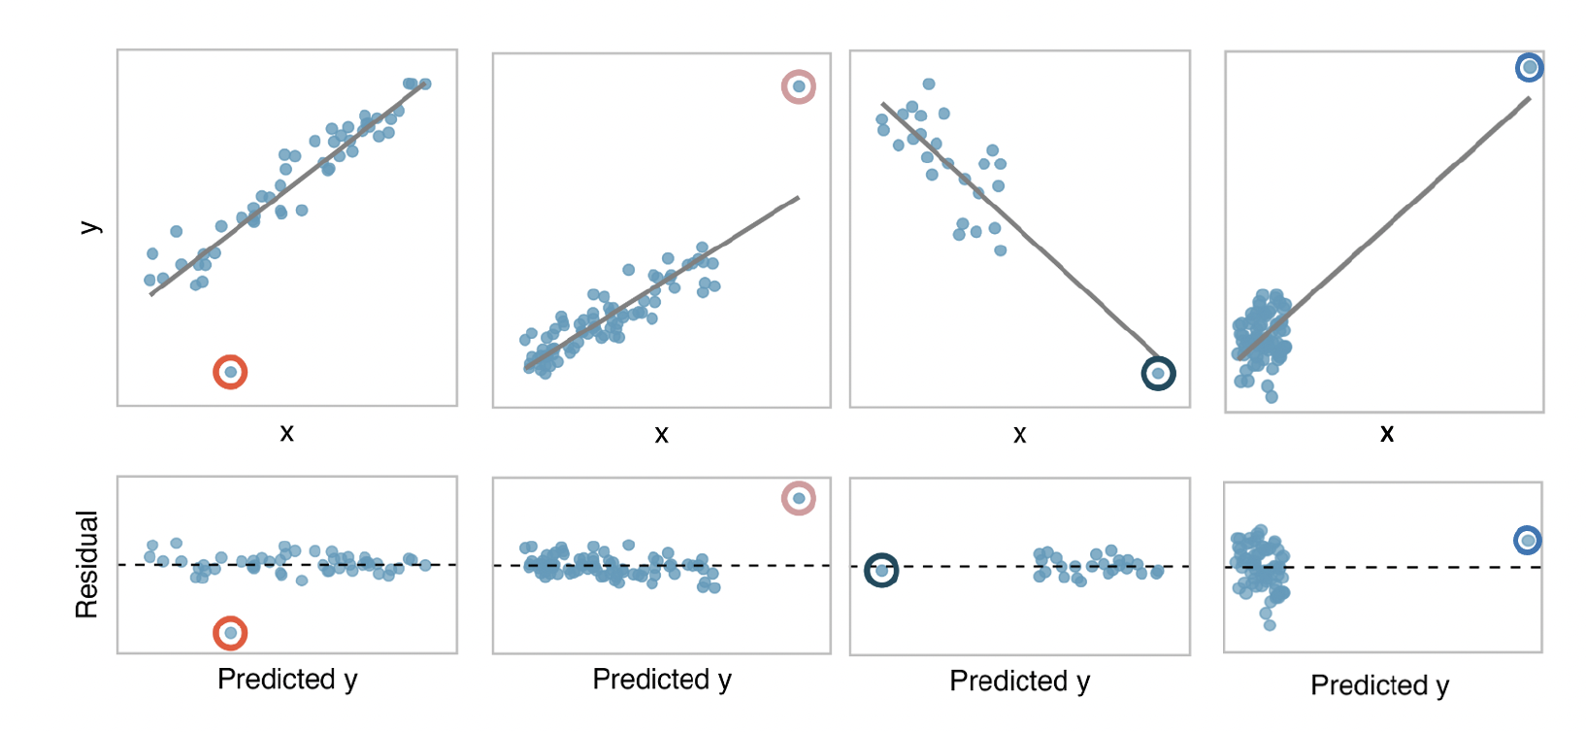
Outliers and Influential Points
Outliers are observations that fall far from the majority of data points. They can have a strong influence on the least squares line!
Leverage: Outliers that fall horizontally away from the center of the cloud of data points are called leverage points.
Influential points: Leverage points that influence the slope of the line.

Slide 30
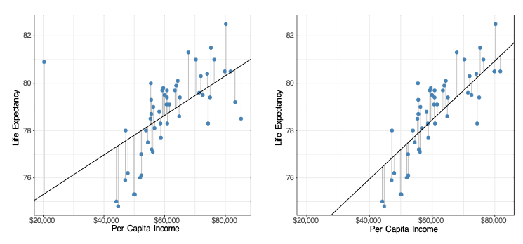
Outliers and Influential Points
Should we exclude Puerto Rico from our analysis? Why or why not? What would you want to check first?
Model Fit With Puerto Rico
Model Fit Without Puerto Rico

Slide 31


Outliers and Influential Points
Should we exclude Puerto Rico from our analysis? Why or why not? What would you want to check first?
Residual Plot With Puerto Rico
Residual Plot Without Puerto Rico
With Puerto Rico
Without Puerto Rico
$$R^{2}=0.32$$
$$R^{2}=0.56$$
What are the implications of removing Puerto Rico on our research question?

Slide 32
Binary Predictors
What if we have a binary predictor, instead of a continuous one?
Ex. Instead of looking at how income effects life expectancy, we want to understand...
Motivating Question
How does the life expectancy in a US state associate with whether or not its average per-capita income is below the poverty threshold?

Slide 33
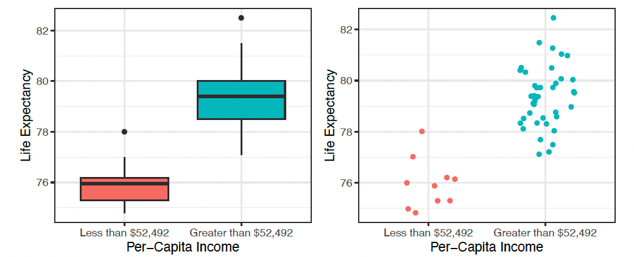
Binary Predictors
Motivating Question
How does the life expectancy in a US state associate with whether or not its average per-capita income is below the poverty threshold?
What is your hypothesis?

Slide 34
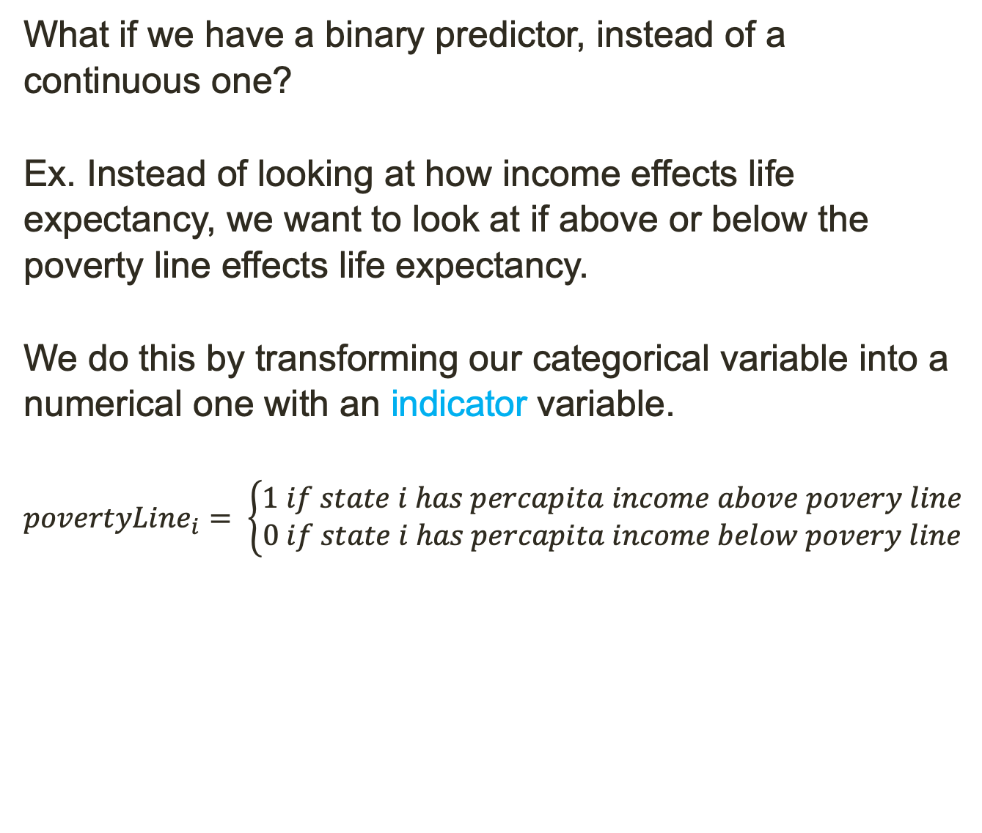
Binary Predictors
What if we have a binary predictor, instead of a continuous one?
Ex. Instead of looking at how income effects life expectancy, we want to look at if above or below the poverty line effects life expectancy.
We do this by transforming our categorical variable into a numerical one with an indicator variable.
$$povertyLine_{i}= \left\{\begin{aligned}1 if state i has percapita income above povery line \\ 0 if state i has percapita income below povery line\end{aligned}\right.$$

Slide 35
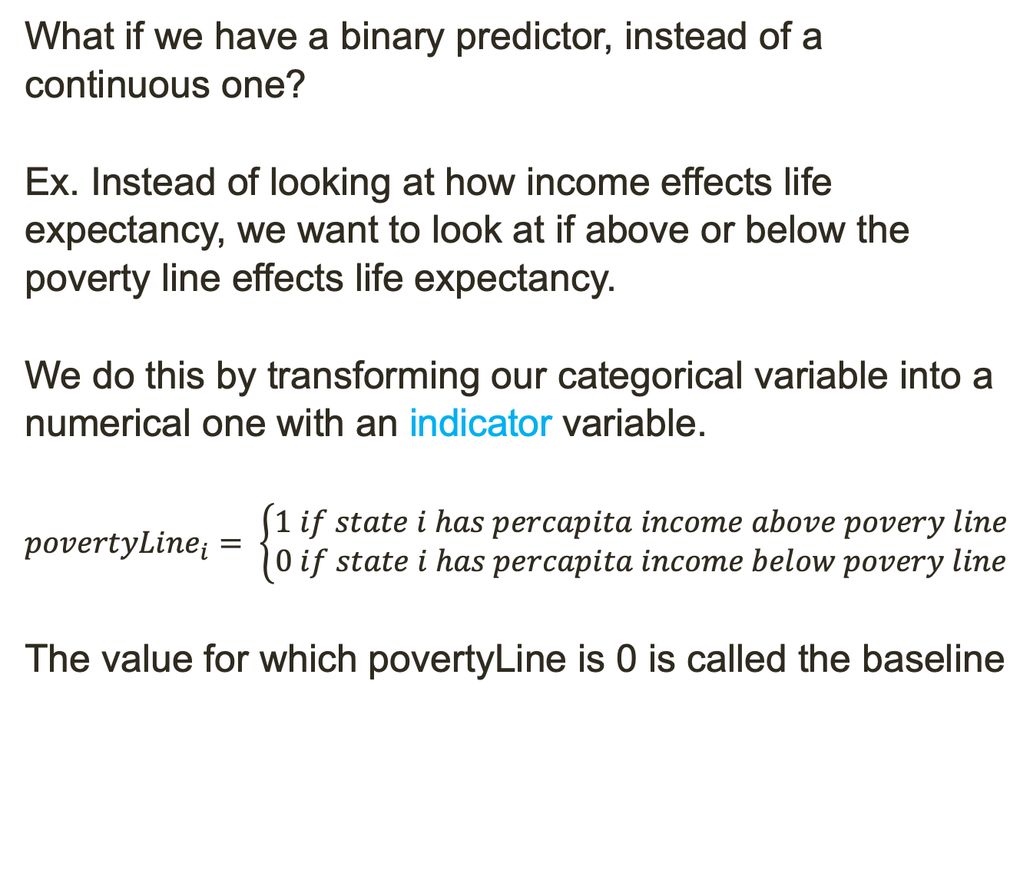
Binary Predictors
What if we have a binary predictor, instead of a continuous one?
Ex. Instead of looking at how income effects life expectancy, we want to look at if above or below the poverty line effects life expectancy.
We do this by transforming our categorical variable into a numerical one with an indicator variable.
$$povertyLine_{i}= \left\{\begin{aligned}1 if state i has percapita income above povery line \\ 0 if state i has percapita income below povery line\end{aligned}\right.$$
The value for which povertyLine is 0 is called the baseline

Slide 36
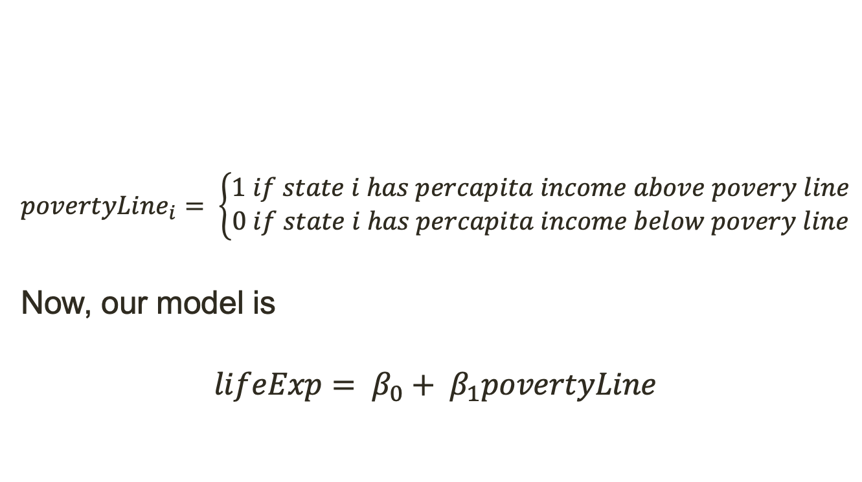
Binary Predictors
$$povertyLine_{i}= \left\{\begin{aligned}1 if state i has percapita income above povery line \\ 0 if state i has percapita income below povery line\end{aligned}\right.$$
Now, our model is
$$lifeExp= β_{0}+ β_{1}povertyLine$$

Slide 37

Binary Predictors
$$povertyLine_{i}= \left\{\begin{aligned}1 if state i has percapita income above povery line \\ 0 if state i has percapita income below povery line\end{aligned}\right.$$
Now, our model is
$$lifeExp= β_{0}+ β_{1}povertyLine$$
What do $β_{0}$ and $β_{1}$ represent in the context of this model?

Slide 38
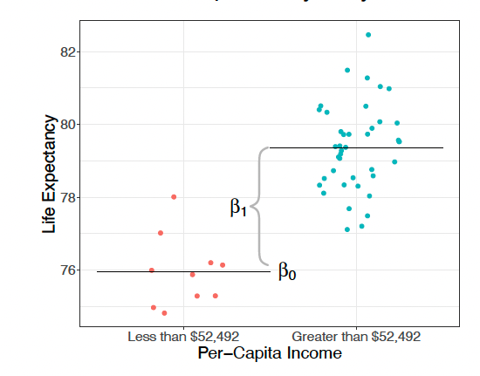
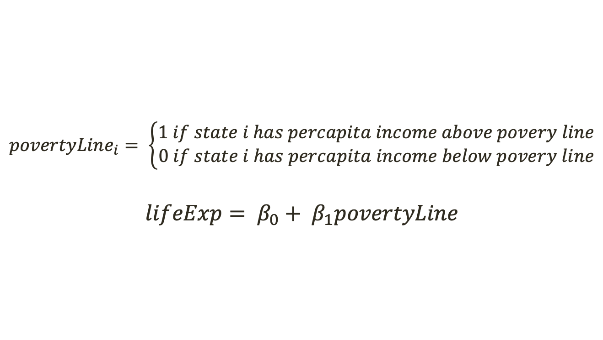
Binary Predictors
$$povertyLine_{i}= \left\{\begin{aligned}1 if state i has percapita income above povery line \\ 0 if state i has percapita income below povery line\end{aligned}\right.$$
$$lifeExp= β_{0}+ β_{1}povertyLine$$
Notes:
b_1 will factor in only for state with poverty line = 1 ie percapita income over poverty line

Slide 39
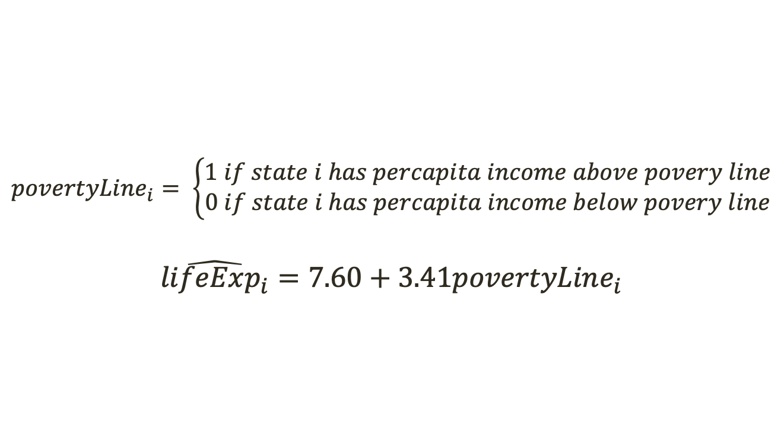
Binary Predictors
$$povertyLine_{i}= \left\{\begin{aligned}1 if state i has percapita income above povery line \\ 0 if state i has percapita income below povery line\end{aligned}\right.$$
$$\hat{lifeExp_{i}}=7.60+3.41povertyLine_{i}$$
What is the predicted life expectancy for a state with percapita income above the poverty line? How about below? What is the difference between these estimates?
Notes:
b_1 will factor in only for state with poverty line = 1 ie percapita income over poverty line

Slide 40
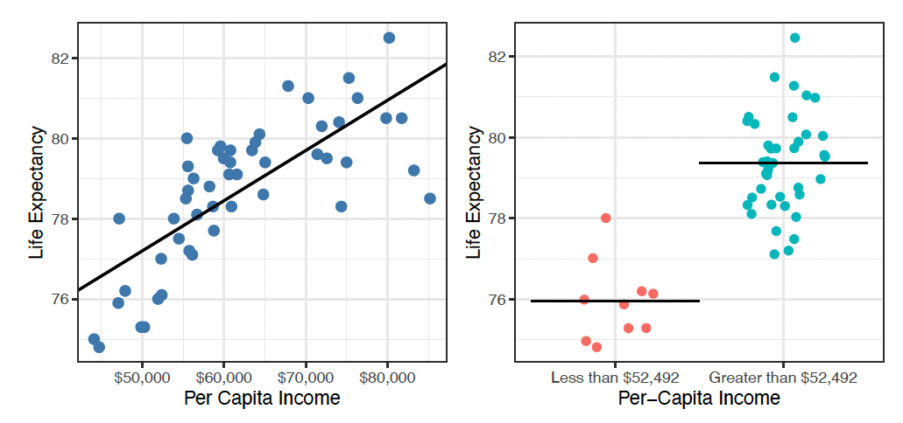
Comparison of Models
We made two models for the same phenomenon. Which is better?
Notes:
b_1 will factor in only for state with poverty line = 1 ie percapita income over poverty line

Slide 41


Comparison of Models
We made two models for the same phenomenon. Which is better?
$$R^{2}=0.557$$
$$R^{2}=0.592$$
Which model explains more of the variance in life expectancy? Is the difference enough to matter?

Slide 42

Comparison of Models
We made two models for the same phenomenon. Which is better?
$$R^{2}=0.557$$
$$R^{2}=0.592$$
Is a smaller $R^{2}$ always better?

