Slide 1
Elementary Statistics – Exploratory Data Analysis (EDA) Pt 2
Dr. Ab Mosca (they/them)
Slides based off slides courtesy of Kaitlyn Cook (https://www.smith.edu/people/kaitlyn-cook)

Slide 2
Reminder!
First quiz is out today! (On PLATO)
Quizzes and homeworks are week long assignments; expect to spend 5-7 hours on them (this is standard for a college class)

Slide 3
Plan for Today
EDA for Two Variables
Categorical & Categorical
Categorical and Numeric
Numeric and Numeric

Slide 4
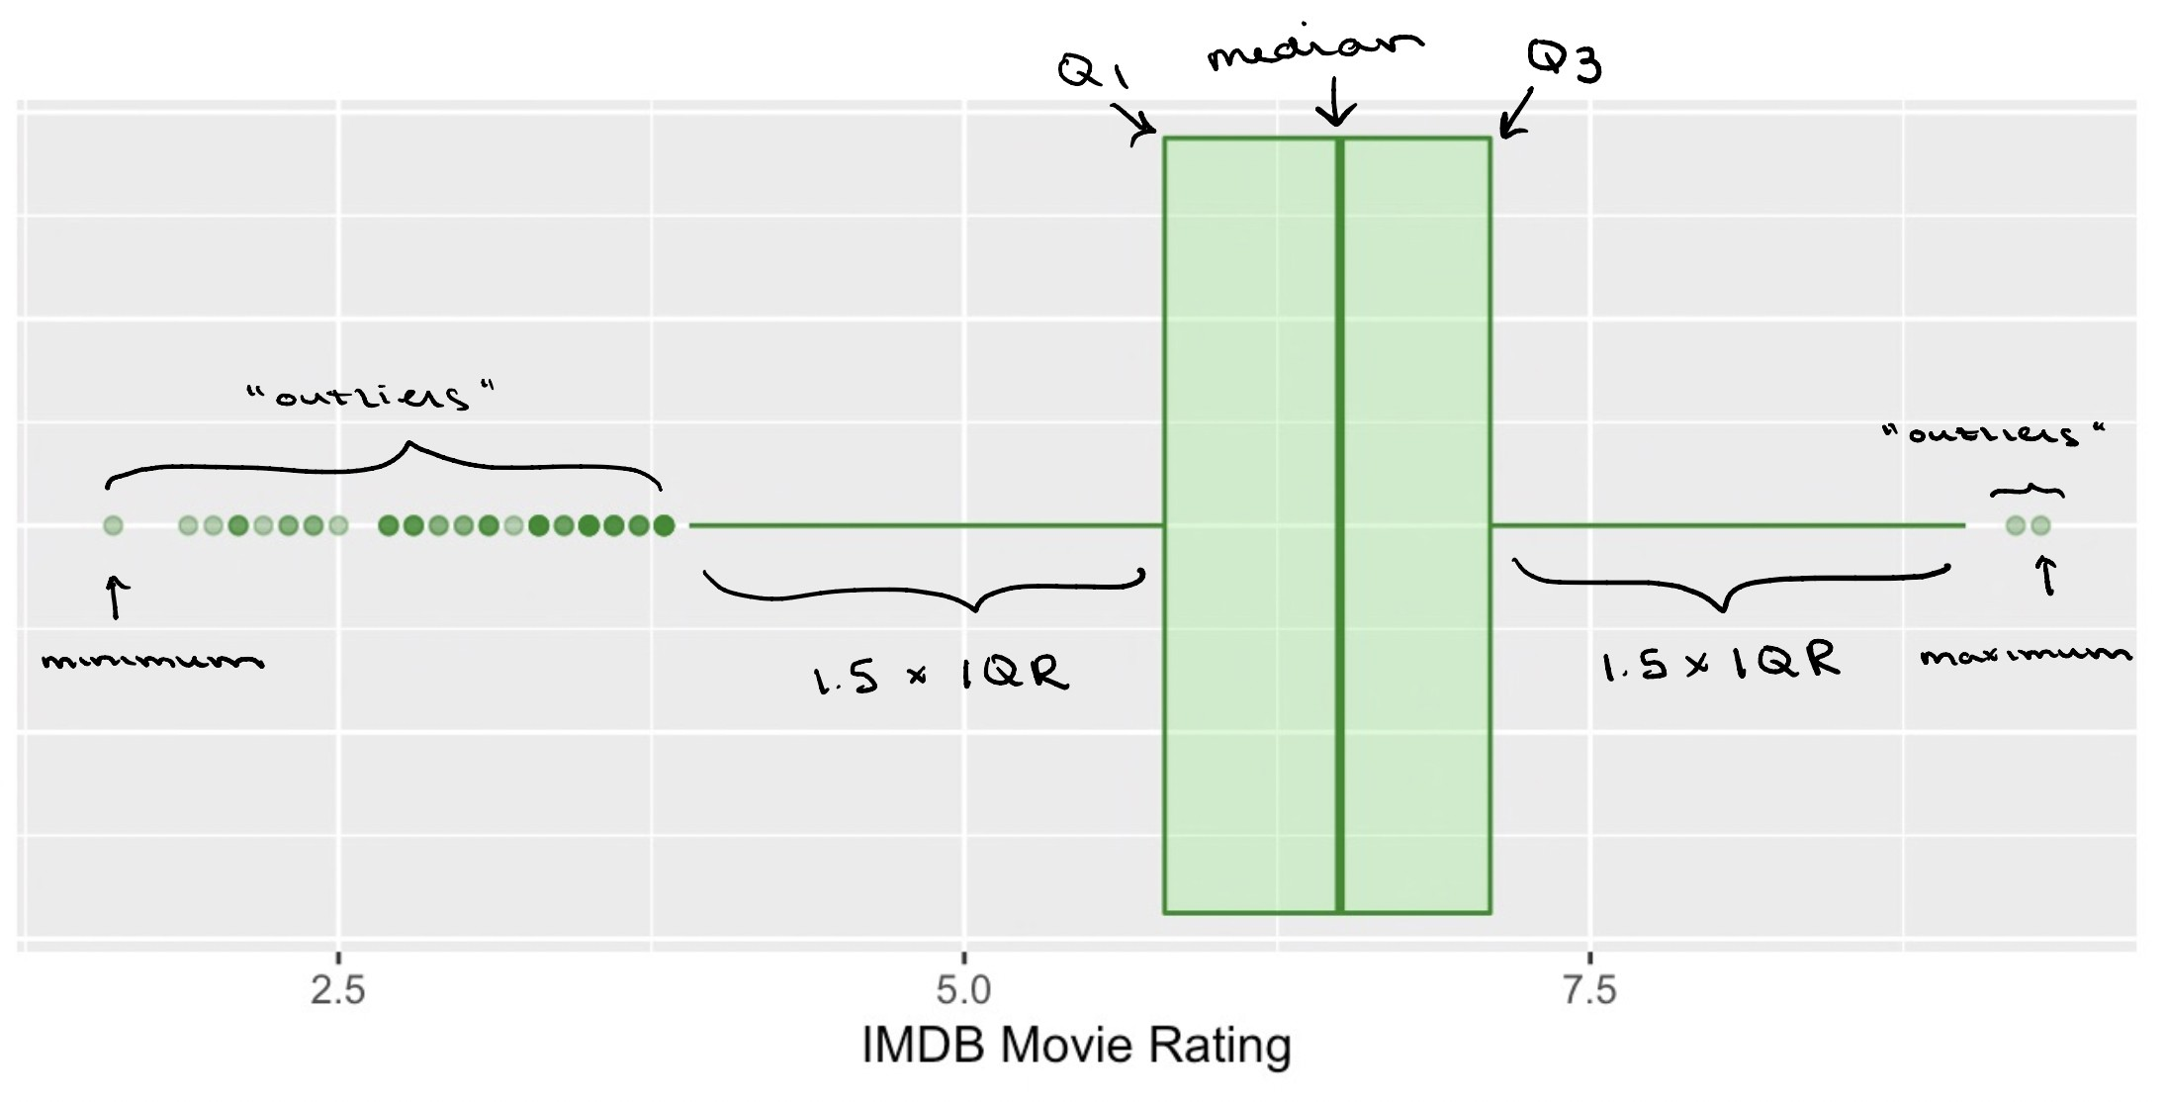
Warm Up / Recap: Describing Distributions for Continuous Variables
When looking at a variable’s distribution, we want to pay attention to and describe the following attributes:
Skewness Modality
Center Spread
Graphical
Summary Statistics
The following five statistics make up the five-number summary, which captures information about both the center and spread of the data:
Minimum / 25th percentile (Q1) / Median / 75th percentile (Q3) / Maximum
We can use a box plot to visualize all of these statistics in one go:

Slide 5
Warm Up / Recap: Describing Distributions for Continuous Variables
When looking at a variable’s distribution, we want to pay attention to and describe the following attributes:
Practice
Skewness Modality
Center Spread
Graphical
Summary Statistics
Generate a box plot to summarize Hours:
The following five statistics make up the five-number summary, which captures information about both the center and spread of the data:
Hours
4.5
4
6.25
9
1.75
8
3
8.33
9.67
0
Minimum / 25th percentile (Q1) / Median / 75th percentile (Q3) / Maximum
We can use a box plot to visualize all of these statistics in one go:

Slide 6
20 Minute Activity: EDA Practice
Open movies.csv (under Demos on the course website) in excel or google sheets.
Work with 1-2 other people.
Choose 1 categorical and 1 numerical variable. For each variable, generate the appropriate summary visualizations and summary statistics.
You in some cases, you will need to manipulate the raw data and use formulas. Helpful tips can be found here:
Excel
https://www.princeton.edu/~otorres/Excel/excelstata.htm
https://statisticsbyjim.com/basics/descriptive-statistics-excel/
Google Sheets
http://www.comfsm.fm/~dleeling/statistics/text6.html#page-031
https://www.groovypost.com/howto/quickly-get-column-statistics-in-google-sheets/

Slide 7
Big Picture
Last time, we discussed how we might use both numbers and visuals to summarize individual variables in our dataset:
Categorical variables
Bar plots and frequency tables
Numerical variables
Histograms and density plots ⇒ the distribution of the variable
Statistics like the mean and standard deviation ⇒ center and spread

Slide 8
Big Picture
Last time, we discussed how we might use both numbers and visuals to summarize individual variables in our dataset:
Categorical variables
Bar plots and frequency tables
Numerical variables
Histograms and density plots ⇒ the distribution of the variable
Statistics like the mean and standard deviation ⇒ center and spread
What if we want to use EDA understand relationships between variables?

Slide 9
Relationships Between Two Categorical Variables

Slide 10
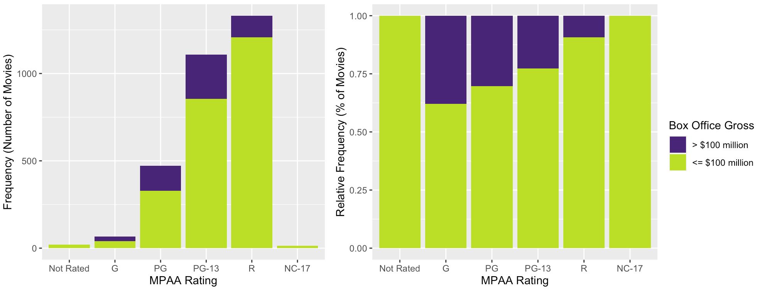
Data Visualizations: Stacked Bar Plots
Suppose we want to understand the relationship between a movie’s MPAA rating and whether it grosses more than $100 million at the box office
→ How does the distribution of movies with large versus small to moderate box office earnings differ based on MPAA rating?
We can use a stacked barplot!
Each bar in a standard barplot is divided into stacked sub-bars, each corresponding to the level of the second categorical variable

Slide 11
Data Visualizations: Stacked Bar Plots
Practice
Suppose we want to understand the relationship between a movie’s MPAA rating and whether it grosses more than $100 million at the box office
→ How does the distribution of movies with large versus small to moderate box office earnings differ based on MPAA rating?
We can use a stacked barplot!
Each bar in a standard barplot is divided into stacked sub-bars, each corresponding to the level of the second categorical variable
Show how the distribution of high versus low hours differs based on activity.
Hours | Activity
low | Exercise
low | Exercise
high | Work
high | Chores
low | Work
high | Work
low | Driving
high | Exercise
high | Work
low | Driving

Slide 12
Summary Statistics: Contingency Tables
Just as a frequency table contains the same information as a univariate barplot, we can use a contingency table to numerically summarize the distribution of two categorical variables!
Displays the number of observations falling into each unique combination of levels for the two variables:
Box Office Gross
Low High
MPAA Rating
Total
Not Rated | 21 | 0 | 21
G | 41 | 25 | 66
PG | 328 | 143 | 471
PG-13 | 856 | 252 | 1108
R | 1207 | 124 | 1331
NC-17 | 13 | 0 | 13
We can use these tables to glean a lot of information about our two variables!
Total
2466
544
3010

Slide 13
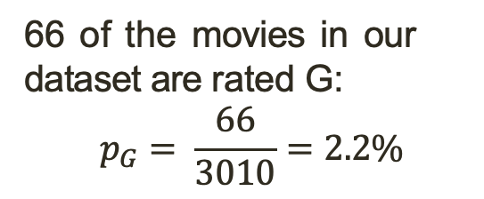
Summary Statistics: Contingency Tables
Just as a frequency table contains the same information as a univariate barplot, we can use a contingency table to numerically summarize the distribution of two categorical variables!
Displays the number of observations falling into each unique combination of levels for the two variables:
Box Office Gross
Low High
MPAA Rating
Total
Marginal Distribution
Not Rated | 21 | 0 | 21
G | 41 | 25 | 66
PG | 328 | 143 | 471
PG-13 | 856 | 252 | 1108
R | 1207 | 124 | 1331
NC-17 | 13 | 0 | 13
66 of the movies in our dataset are rated G:
$$p_{G}= \frac{66}{3010}=2.2\%$$
Total
2466
544
3010

Slide 14

Summary Statistics: Contingency Tables
Just as a frequency table contains the same information as a univariate barplot, we can use a contingency table to numerically summarize the distribution of two categorical variables!
Displays the number of observations falling into each unique combination of levels for the two variables:
Box Office Gross
Low High
MPAA Rating
Total
Marginal Distribution
Not Rated | 21 | 0 | 21
G | 41 | 25 | 66
PG | 328 | 143 | 471
PG-13 | 856 | 252 | 1108
R | 1207 | 124 | 1331
NC-17 | 13 | 0 | 13
544 of the movies in our dataset were high box office earners:
$$p_{high}= \frac{544}{3010}=18\%$$
Total
2466
544
3010

Slide 15

Summary Statistics: Contingency Tables
Just as a frequency table contains the same information as a univariate barplot, we can use a contingency table to numerically summarize the distribution of two categorical variables!
Displays the number of observations falling into each unique combination of levels for the two variables:
Box Office Gross
Low High
MPAA Rating
Total
Joint Distribution
Not Rated | 21 | 0 | 21
G | 41 | 25 | 66
PG | 328 | 143 | 471
PG-13 | 856 | 252 | 1108
R | 1207 | 124 | 1331
NC-17 | 13 | 0 | 13
25 of the movies in our dataset are rated G and were high box office earners:
$$p_{GandHigh}= \frac{25}{3010}=0.08\%$$
Total
2466
544
3010

Slide 16

Summary Statistics: Contingency Tables
Just as a frequency table contains the same information as a univariate barplot, we can use a contingency table to numerically summarize the distribution of two categorical variables!
Displays the number of observations falling into each unique combination of levels for the two variables:
Box Office Gross
Low High
MPAA Rating
Total
Conditional Distribution
Not Rated | 21 | 0 | 21
G | 41 | 25 | 66
PG | 328 | 143 | 471
PG-13 | 856 | 252 | 1108
R | 1207 | 124 | 1331
NC-17 | 13 | 0 | 13
Among the movies that are rated G, 25 were high box of- fice earners:
$$p_{high|G}= \frac{25}{66}=37.9\%$$
Total
2466
544
3010

Slide 17
Start here Tuesday

Slide 18
Summary Statistics: Contingency Tables
Practice: Generate the contingency table that shows the distribution of hours across activities. Then, calculate the
The marginal distribution of Work in the dataset
The marginal distribution of high hours in the dataset
The joint distribution of Work and high hours
The conditional distribution of low hours among Work
Just as a frequency table contains the same information as a univariate barplot, we can use a contingency table to numerically summarize the distribution of two categorical variables!
Displays the number of observations falling into each unique combination of levels for the two variables:
Box Office Gross
Low High
Hours | Activity
low | Exercise
low | Exercise
high | Work
high | Chores
low | Work
high | Work
low | Driving
high | Exercise
high | Work
low | Driving
MPAA Rating
Total
Conditional Distribution
Not Rated | 21 | 0 | 21
G | 41 | 25 | 66
PG | 328 | 143 | 471
PG-13 | 856 | 252 | 1108
R | 1207 | 124 | 1331
NC-17 | 13 | 0 | 13
Among the movies that are rated G, 25 were high box of- fice earners:
$$p_{high|G}= \frac{25}{66}=37.9\%$$
Total
2466
544
3010

Slide 19
Relationships Between One Categorical Variable and One Numerical Variable

Slide 20
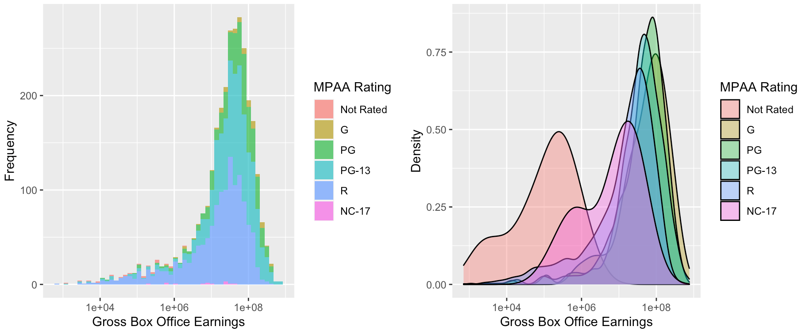
Data Visualizations: Overlaid Histograms / Density Plots
We can visualize the distribution of gross box office earnings within each level of MPAA ratings—and compare these distributions with one another—using overlaid histograms and density plots:
Gross box office earnings is being shown on a log₁₀ scale

Slide 21
Data Visualizations: Overlaid Histograms / Density Plots
These visualizations can be particularly informative if your data appear to be multi-modal, as there may be (and often is) something more going on in the story
For example, consider the following density plot showing the distribution of in-state college tuition costs during the 2018–2019 academic year:

Slide 22
Data Visualizations: Overlaid Histograms / Density Plots
These visualizations can be particularly informative if your data appear to be multi-modal, as there may be (and often is) something more going on in the story
For example, consider the following density plot showing the distribution of in-state college tuition costs during the 2018–2019 academic year:

Slide 23
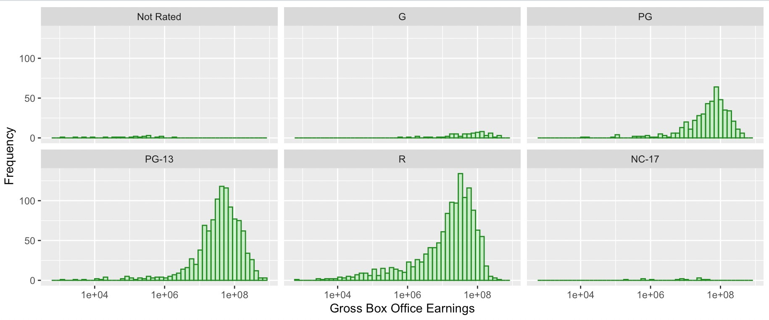
Data Visualizations: Faceted Histograms/ Density Plots
. . . Of course, overlaying all of our histograms or density plots on top of one another can sometimes be a mess, particularly if the categorical variable we’re looking at has a lot of possible levels
→ We can instead display the histograms in side-by-side plots, each with the same x and y axis limits, for easier comparison across levels!

Slide 24
Data Visualizations: Faceted Histograms/ Density Plots
Practice: Generate an overlaid histogram / density plot or faceted histogram / density plot to show the distribution of minutes across each activity.
. . . Of course, overlaying all of our histograms or density plots on top of one another can sometimes be a mess, particularly if the categorical variable we’re looking at has a lot of possible levels
→ We can instead display the histograms in side-by-side plots, each with the same x and y axis limits, for easier comparison across levels!
Minutes | Activity
100 | Exercise
45 | Exercise
60 | Work
35 | Chores
20 | Work
90 | Work
15 | Driving
120 | Exercise
300 | Work
12 | Driving

Slide 25
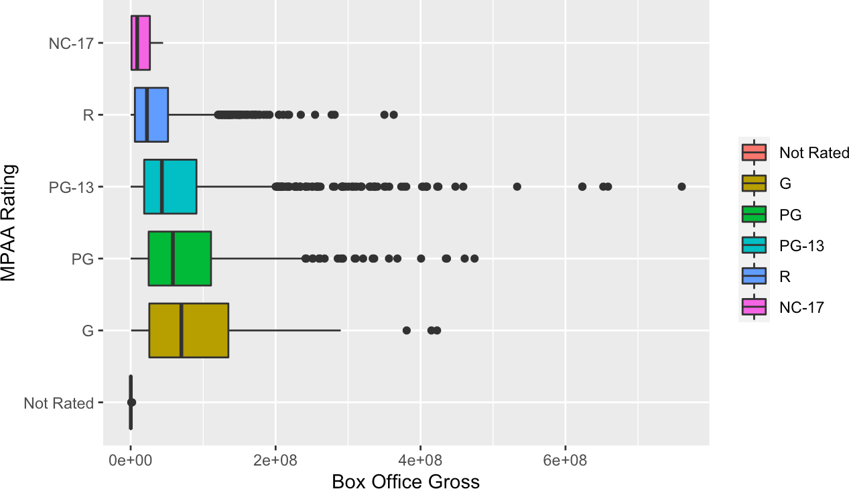
Data Visualizations: Side-by-Side Boxplots
We can also create side-by-side boxplots to visually compare measures of center and spread for the numerical variable across levels of the categorical variable

Slide 26
Data Visualizations: Side-by-Side Boxplots
Practice: Generate side-by-side boxplots to show the distribution of minutes across each activity.
We can also create side-by-side boxplots to visually compare measures of center and spread for the numerical variable across levels of the categorical variable
Minutes | Activity
100 | Exercise
45 | Exercise
60 | Work
35 | Chores
20 | Work
90 | Work
15 | Driving
120 | Exercise
300 | Work
12 | Driving

Slide 27
Relationships Between Two Numerical Variables

Slide 28
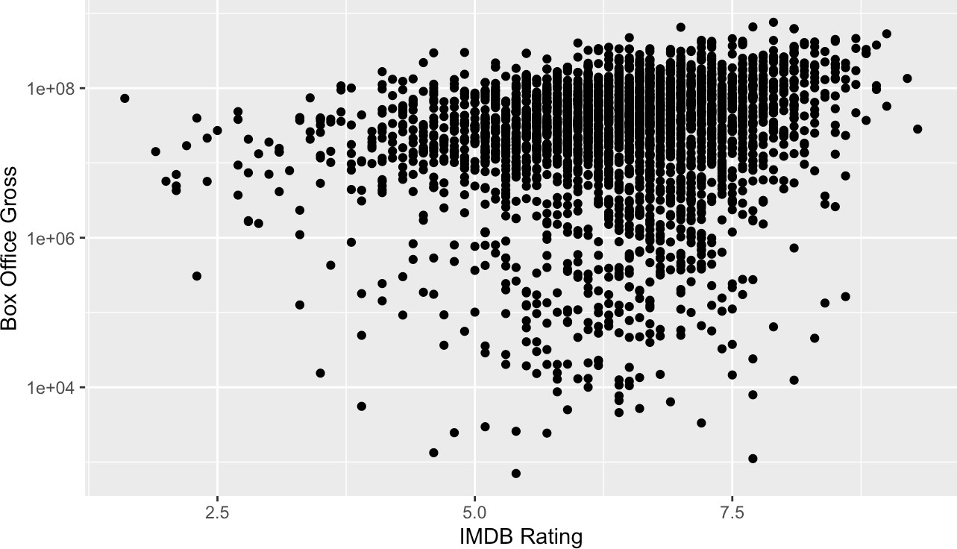
Data Visualizations: Scatterplots
Scatterplots are one of the most common ways of visualizing the relationship between two numerical variables.
For the ith observational unit, let x_{i} be the value of the explanatory variable and y_{i} the value of the response variable.
We plot each (x_{i}, y_{i}) pair for all n observations in our sample.

Slide 29
Data Visualizations: Scatterplots
Practice: Generate a scatterplot show the relationship between minutes and cost.
Scatterplots are one of the most common ways of visualizing the relationship between two numerical variables.
For the ith observational unit, let x_{i} be the value of the explanatory variable and y_{i} the value of the response variable.
We plot each (x_{i}, y_{i}) pair for all n observations in our sample.
Minutes | Cost
100 | $45
45 | $27
60 | $56
35 | $15
20 | $21
90 | $62
15 | $5
120 | $55
300 | $100
12 | $7

Slide 30
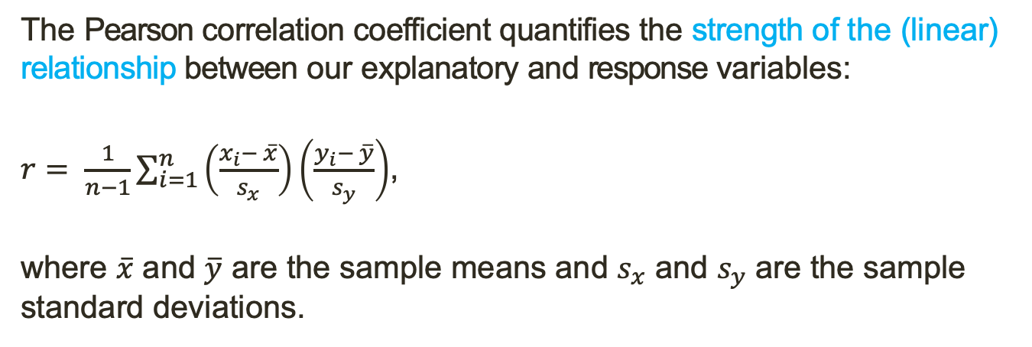
Summary Statistics: Pearson Correlation Coefficient
The Pearson correlation coefficient quantifies the strength of the (linear) relationship between our explanatory and response variables:
$r= \frac{1}{n−1}\sum_{i=1}^{n}{\left(\frac{x_{i}− \overline{x}}{s_{x}}\right)\left(\frac{y_{i}− \overline{y}}{s_{y}}\right)}$,
where $\overline{x}$ and $\overline{y}$ are the sample means and $s_{x}$ and $s_{y}$ are the sample standard deviations.

Slide 31
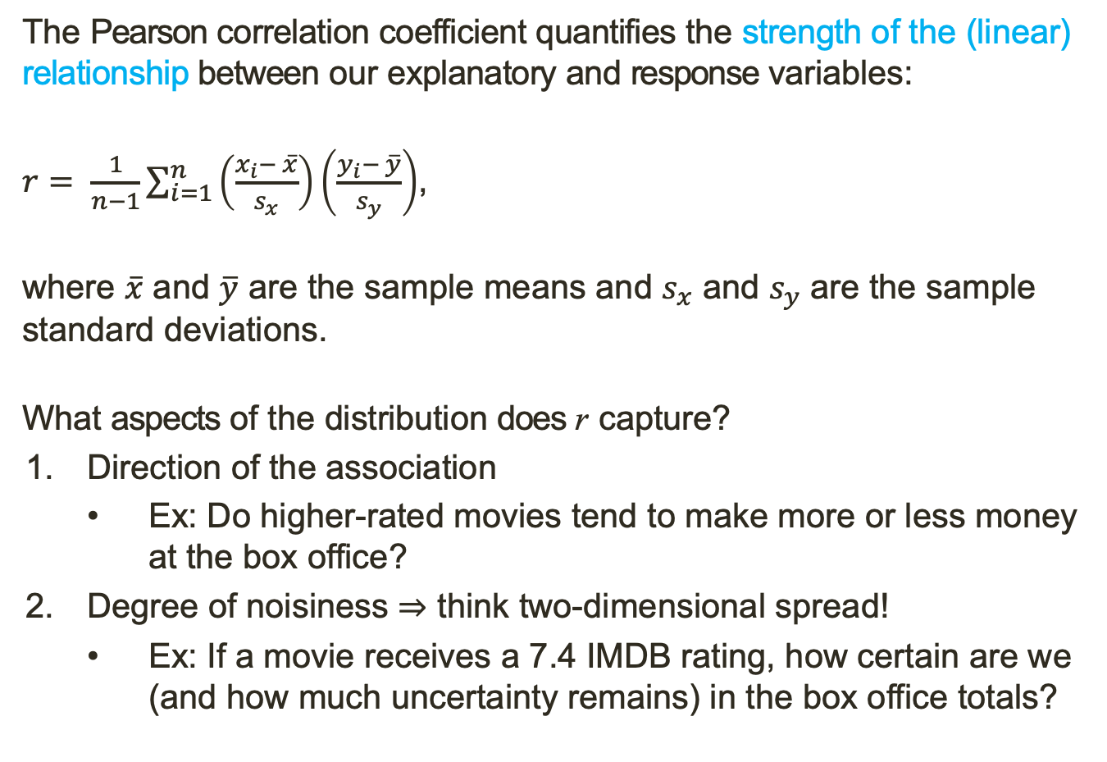
Summary Statistics: Pearson Correlation Coefficient
The Pearson correlation coefficient quantifies the strength of the (linear) relationship between our explanatory and response variables:
$r= \frac{1}{n−1}\sum_{i=1}^{n}{\left(\frac{x_{i}− \overline{x}}{s_{x}}\right)\left(\frac{y_{i}− \overline{y}}{s_{y}}\right)}$,
where $\overline{x}$ and $\overline{y}$ are the sample means and $s_{x}$ and $s_{y}$ are the sample standard deviations.
What aspects of the distribution does r capture?
Direction of the association
Ex: Do higher-rated movies tend to make more or less money at the box office?
Degree of noisiness ⇒ think two-dimensional spread!
Ex: If a movie receives a 7.4 IMDB rating, how certain are we (and how much uncertainty remains) in the box office totals?

Slide 32
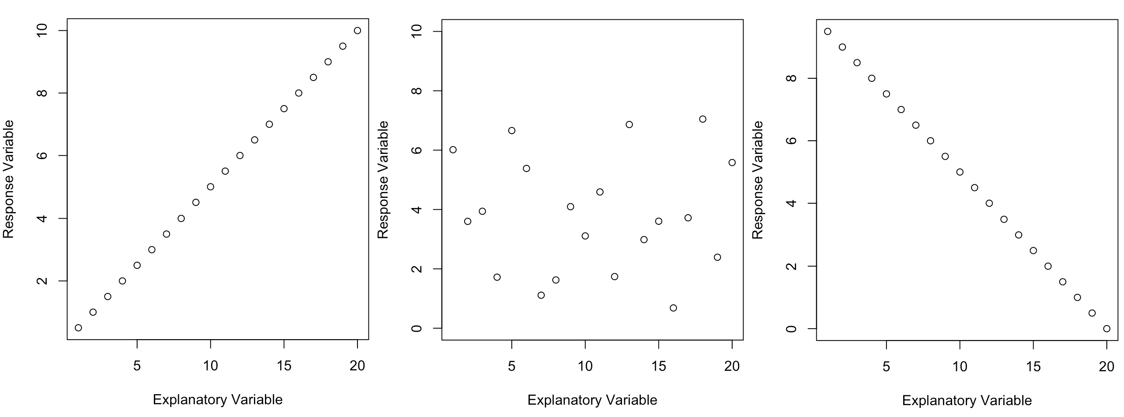
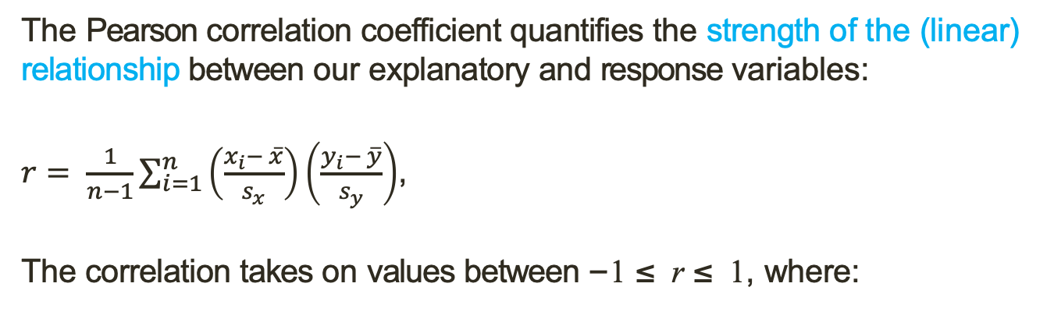
Summary Statistics: Pearson Correlation Coefficient
The Pearson correlation coefficient quantifies the strength of the (linear) relationship between our explanatory and response variables:
$r= \frac{1}{n−1}\sum_{i=1}^{n}{\left(\frac{x_{i}− \overline{x}}{s_{x}}\right)\left(\frac{y_{i}− \overline{y}}{s_{y}}\right)}$,
The correlation takes on values between −1 ≤ r ≤ 1, where:
Perfect positive correlation, r = 1
No correlation, r = 0
Perfect negative correlation, r = −1

Slide 33
Summary Statistics: Pearson Correlation Coefficient
The Pearson correlation coefficient quantifies the strength of the (linear) relationship between our explanatory and response variables:
$r= \frac{1}{n−1}\sum_{i=1}^{n}{\left(\frac{x_{i}− \overline{x}}{s_{x}}\right)\left(\frac{y_{i}− \overline{y}}{s_{y}}\right)}$,
The correlation takes on values between −1 ≤ r ≤ 1, where:
Practice: Based on your scatterplot
what correlation value would you
expect between Minutes and Cost?
Calculate it to check your answer.
Minutes | Cost
100 | $45
45 | $27
60 | $56
35 | $15
20 | $21
90 | $62
15 | $5
120 | $55
300 | $100
12 | $7
Perfect positive correlation, r = 1
No correlation, r = 0
Perfect negative correlation, r = −1

Slide 34
20-30 Minute Activity: EDA Practice
Open movies.csv (under Demos on the course website) in excel or google sheets.
For (a) two categorical, (b) a categorical and numerical, and (c) two numerical variables, generate the appropriate summary visualizations and summary statistics.
You in some cases, you will need to manipulate the raw data and use formulas. Helpful tips can be found here:
Excel
https://www.princeton.edu/~otorres/Excel/excelstata.htm
https://statisticsbyjim.com/basics/descriptive-statistics-excel/
Google Sheets
http://www.comfsm.fm/~dleeling/statistics/text6.html#page-031
https://www.groovypost.com/howto/quickly-get-column-statistics-in-google-sheets/

