Slide 1
Elementary Statistics – Inference for Categorical Data Pt. 2
Dr. Ab Mosca (they/them)
Slides based off slides courtesy of Kaitlyn Cook (https://www.smith.edu/people/kaitlyn-cook)

Slide 2
Plan for Today
Inference for categorical variables

Slide 3
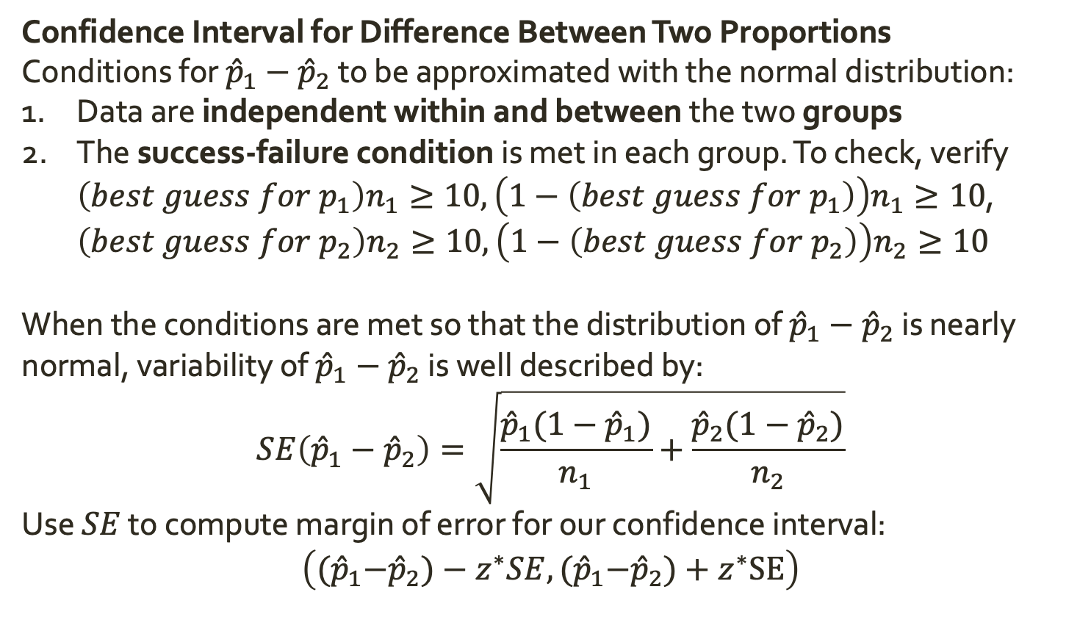
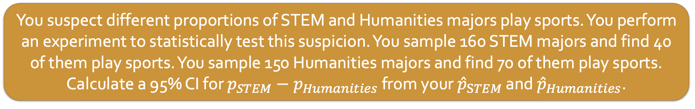
Warm Up: Inference for Two Proportions
Confidence Interval for Difference Between Two Proportions
Conditions for ${\hat{p}}_{1}−{\hat{p}}_{2}$ to be approximated with the normal distribution:
Data are independent within and between the two groups
The success-failure condition is met in each group. To check, verify $\left(best guess for p_{1}\right)n_{1}≥10, \left(1−\left(best guess for p_{1}\right)\right)n_{1}≥10$, $\left(best guess for p_{2}\right)n_{2}≥10, \left(1−\left(best guess for p_{2}\right)\right)n_{2}≥10$
When the conditions are met so that the distribution of ${\hat{p}}_{1}−{\hat{p}}_{2}$ is nearly normal, variability of ${\hat{p}}_{1}−{\hat{p}}_{2}$ is well described by:
$$SE\left({\hat{p}}_{1}−{\hat{p}}_{2}\right)=\sqrt{\frac{{\hat{p}}_{1}(1−{\hat{p}}_{1})}{n_{1}}+\frac{{\hat{p}}_{2}(1−{\hat{p}}_{2})}{n_{2}}}$$
Use $SE$ to compute margin of error for our confidence interval:
$$\left({(\hat{p}}_{1}−{\hat{p}}_{2})−z^{∗}SE,{(\hat{p}}_{1}−{\hat{p}}_{2})+z^{∗}SE\right)$$
You suspect different proportions of STEM and Humanities majors play sports. You perform an experiment to statistically test this suspicion. You sample 160 STEM majors and find 40 of them play sports. You sample 150 Humanities majors and find 70 of them play sports. Calculate a 95% CI for $p_{STEM}−p_{Humanities}$ from your ${\hat{p}}_{STEM}$ and ${\hat{p}}_{Humanities}$.

Slide 4
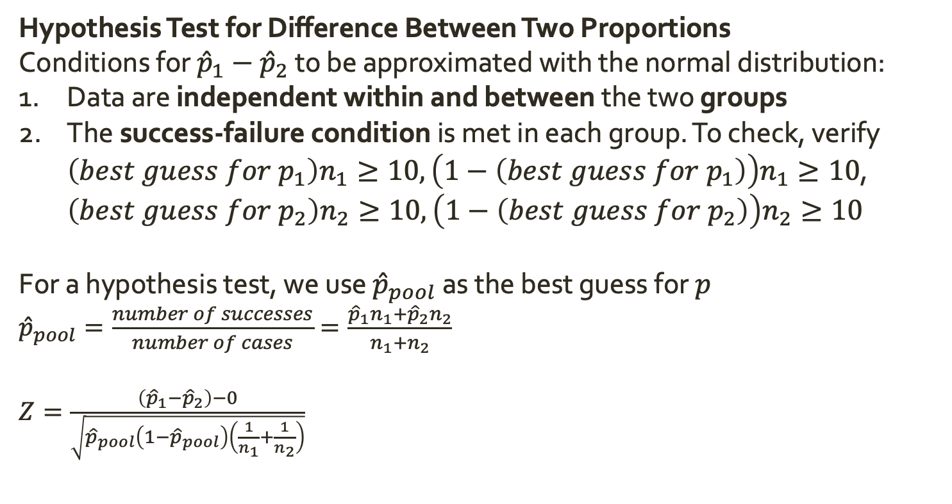
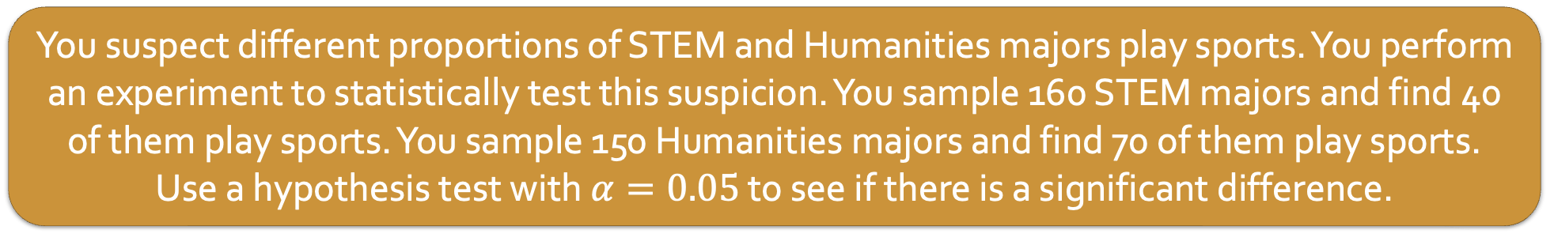
Warm Up: Inference for Two Proportions
Hypothesis Test for Difference Between Two Proportions
Conditions for ${\hat{p}}_{1}−{\hat{p}}_{2}$ to be approximated with the normal distribution:
Data are independent within and between the two groups
The success-failure condition is met in each group. To check, verify $\left(best guess for p_{1}\right)n_{1}≥10, \left(1−\left(best guess for p_{1}\right)\right)n_{1}≥10$, $\left(best guess for p_{2}\right)n_{2}≥10, \left(1−\left(best guess for p_{2}\right)\right)n_{2}≥10$
For a hypothesis test, we use ${\hat{p}}_{pool}$ as the best guess for $p$
${\hat{p}}_{pool}=\frac{number of successes}{number of cases}=\frac{{\hat{p}}_{1}n_{1}+{\hat{p}}_{2}n_{2}}{n_{1}+n_{2}}$
$Z=\frac{\left({\hat{p}}_{1}−{\hat{p}}_{2}\right)−0}{\sqrt{{\hat{p}}_{pool}\left(1−{\hat{p}}_{pool}\right)\left(\frac{1}{n_{1}}+\frac{1}{n_{2}}\right)}}$
You suspect different proportions of STEM and Humanities majors play sports. You perform an experiment to statistically test this suspicion. You sample 160 STEM majors and find 40 of them play sports. You sample 150 Humanities majors and find 70 of them play sports. Use a hypothesis test with $α=0.05$ to see if there is a significant difference.

Slide 5
Inference for Categorical Variables
So far we have focused on questions like
Is the proportion of WSU students who major in math more than 50%?
Is the proportion of WSU students who major in math different than the proportion of Springfield College students who major in math?

Slide 6
Inference for Categorical Variables
So far we have focused on questions like
Is the proportion of WSU students who major in math more than 50%?
Is the proportion of WSU students who major in math different than the proportion of Springfield College students who major in math?
However, many research questions are posed in terms of categorical variables that have more than 2 levels. Ex.
What is the comparative effectiveness of three drug treatments (drug A, drug B, drug C)?
Has the distribution of educational attainment in the US changed since 2000?

Slide 7
Inference for Categorical Variables
Many research questions are posed in terms of categorical variables that have more than 2 levels. Ex.
What is the comparative effectiveness of three drug treatments (drug A, drug B, drug C)?
Has the distribution of educational attainment in the US changed since 2000?
In these cases, we want to understand joint behavior of all possible levels of our categorical variables. There is no longer a single population parameter of interest.

Slide 8
Inference for Categorical Variables
Many research questions are posed in terms of categorical variables that have more than 2 levels. Ex.
What is the comparative effectiveness of three drug treatments (drug A, drug B, drug C)?
Has the distribution of educational attainment in the US changed since 2000?
In these cases, we want to understand joint behavior of all possible levels of our categorical variables. There is no longer a single population parameter of interest.
We typically do not construct CI’s in this context
We can still conduct hypothesis tests

Slide 9
Inference for Categorical Variables
Hypothesis Tests for Categorical Variables with more than 2 levels follow the same recipe as the binary examples we’ve looked at:
Pieces of a Hypothesis test:
Null and Alternative Hypotheses
Test Statistic
Null Distribution
P-value

Slide 10
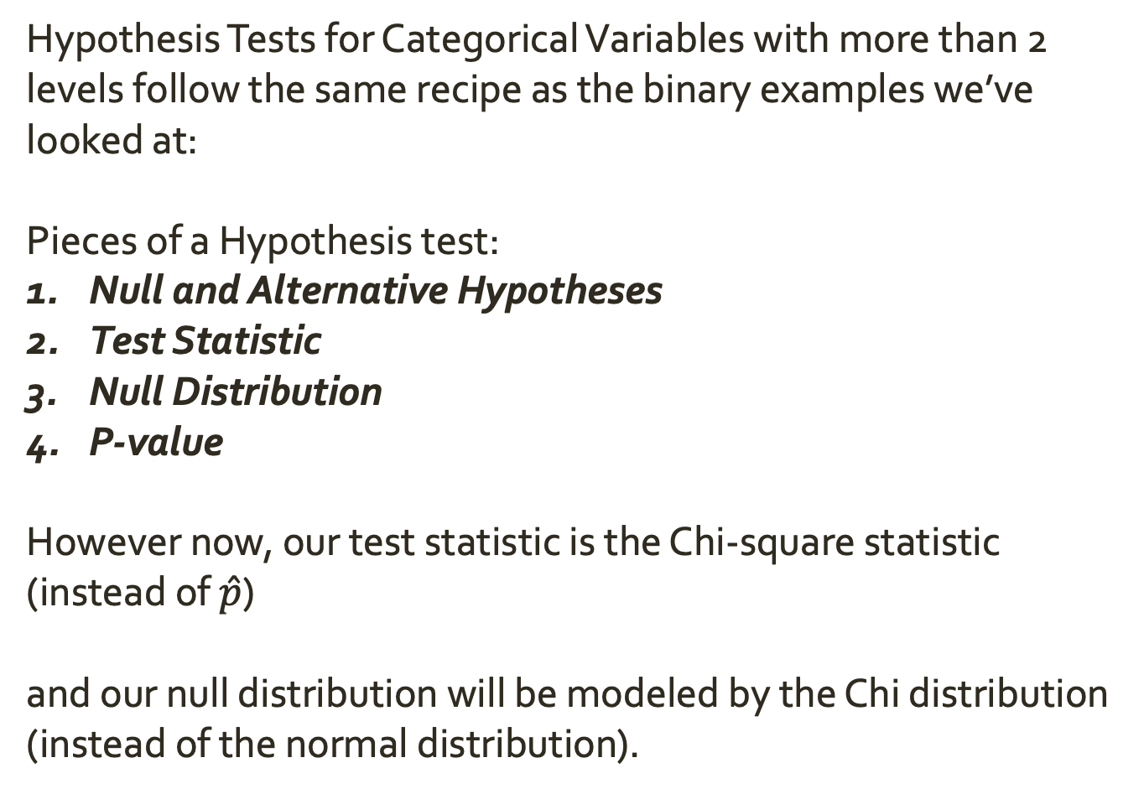
Inference for Categorical Variables
Hypothesis Tests for Categorical Variables with more than 2 levels follow the same recipe as the binary examples we’ve looked at:
Pieces of a Hypothesis test:
Null and Alternative Hypotheses
Test Statistic
Null Distribution
P-value
However now, our test statistic is the Chi-square statistic (instead of $\hat{p}$)
and our null distribution will be modeled by the Chi distribution (instead of the normal distribution).

Slide 11
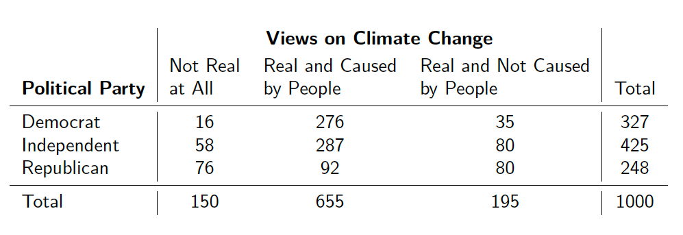
Inference for Categorical Variables
Motivating Example
As part of their 2017 “Pulse of the Nation” project, Cards Against Humanity conducted monthly polls examining American’s social and political views. The following contingency table summarizes the political part affiliation and climate change beliefs of 1000 participants in the September 2017 poll:

Slide 12
Inference for Categorical Variables
Motivating Example
As part of their 2017 “Pulse of the Nation” project, Cards Against Humanity conducted monthly polls examining American’s social and political views. The following contingency table summarizes the political part affiliation and climate change beliefs of 1000 participants in the September 2017 poll:
Observed
Suppose our research question is: Are political affiliation and belief in climate change independent of one another?

Slide 13

Inference for Categorical Variables
Motivating Example
Our hypotheses are:
$H_{0}:$ individuals’ climate change beliefs are independent of their political affiliation
$H_{A}:$ individuals’ climate change beliefs are not independent of their political affiliation.
Observed
Suppose our research question is: Are political affiliation and belief in climate change independent of one another?

Slide 14
Inference for Categorical Variables
Motivating Example
The Test Statistic will capture the degree of discrepancy between observed counts, and the counts we would expect if the null hypothesis (independence between variables) were true.
Observed
Notes:
If H_0 is true, then P(Y=not real | dem) = P(Y=Not real), so expected is total num of dems times proportion of not real

Slide 15

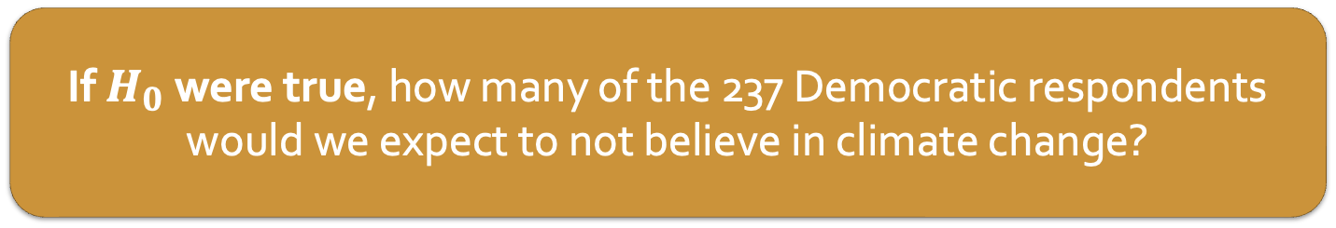
Inference for Categorical Variables
Motivating Example
Our hypotheses are:
$H_{0}:$ individuals’ climate change beliefs are independent of their political affiliation
$H_{A}:$ individuals’ climate change beliefs are not independent of their political affiliation.
Observed
If $H_{0}$ were true, how many of the 237 Democratic respondents would we expect to not believe in climate change?
Suppose our research question is: Are political affiliation and belief in climate change independent of one another?
Notes:
If H_0 is true, then P(Y=not real | dem) = P(Y=Not real), so expected is total num of dems times proportion of not real

Slide 16
Inference for Categorical Variables
Motivating Example
The Test Statistic will capture the degree of discrepancy between observed counts, and the counts we would expect if the null hypothesis (independence between variables) were true.
Observed

Slide 17

Inference for Categorical Variables
Motivating Example
Test Statistic calculation
Generate expected number of observations for each cell of the contingency table if $H_{0}$ is true
$$E_{ij}=\frac{row i total ×column j total}{table total}$$
Expected

Slide 18
Inference for Categorical Variables
Motivating Example
Test Statistic calculation
Generate expected number of observations for each cell of the contingency table if $H_{0}$ is true
$$E_{ij}=\frac{row i total ×column j total}{table total}$$
Expected
Fill in the expected table.

Slide 19
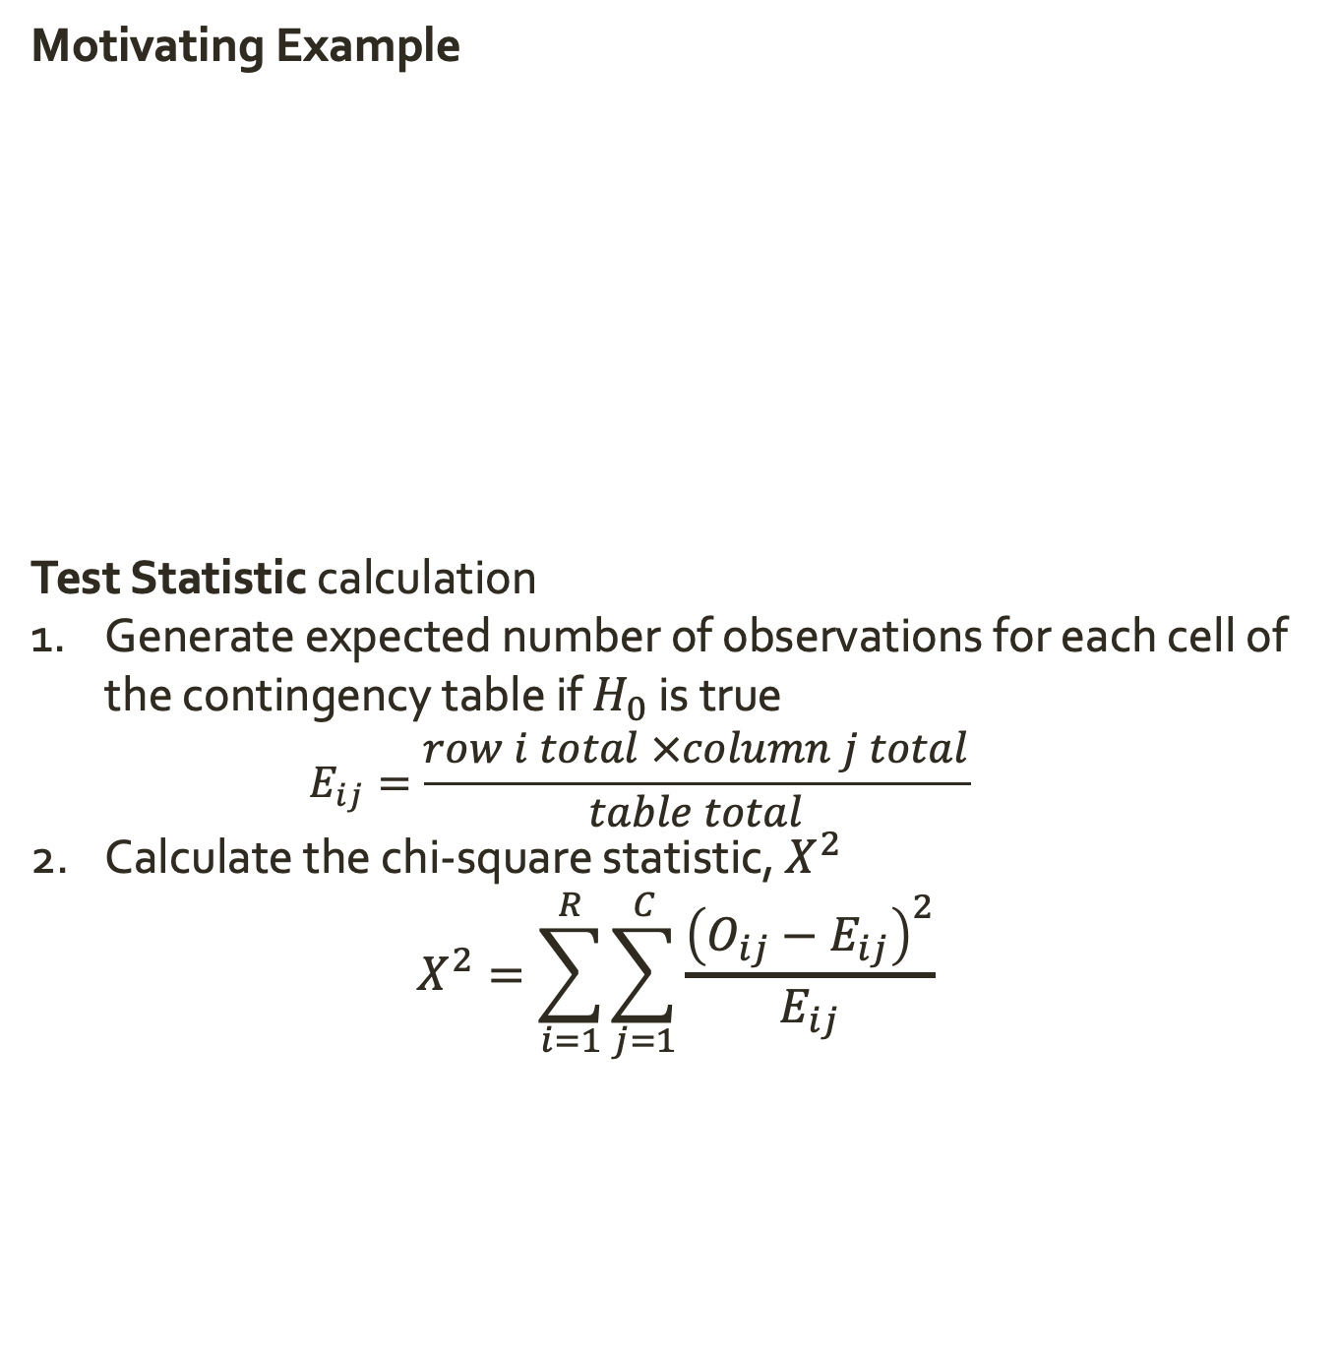
Inference for Categorical Variables
Motivating Example
Test Statistic calculation
Generate expected number of observations for each cell of the contingency table if $H_{0}$ is true
$$E_{ij}=\frac{row i total ×column j total}{table total}$$
Calculate the chi-square statistic, $X^{2}$
$$X^{2}=\sum_{i=1}^{R}{\sum_{j=1}^{C}{\frac{{\left(O_{ij}−E_{ij}\right)}^{2}}{E_{ij}}}}$$
Observed

Slide 20
Inference for Categorical Variables
Motivating Example
Test Statistic calculation
Generate expected number of observations for each cell of the contingency table if $H_{0}$ is true
$$E_{ij}=\frac{row i total ×column j total}{table total}$$
Calculate the chi-square statistic, $X^{2}$
$$X^{2}=\sum_{i=1}^{R}{\sum_{j=1}^{C}{\frac{{\left(O_{ij}−E_{ij}\right)}^{2}}{E_{ij}}}}$$
Observed
Calculate the chi-square statistic

Slide 21

Inference for Categorical Variables
Motivating Example
Null Distribution
If these conditions are met:
Observations are independent
Each cell in the contingency table has an expected count $≥$ 5
Then we use the Chi-square distribution with $(R−1)(C−1)$ degrees of freedom to model the null distribution of $X^{2}$
Observed

Slide 22
Inference for Categorical Variables
Motivating Example
Null Distribution
If these conditions are met:
Observations are independent
Each cell in the contingency table has an expected count $≥$ 5
Then we use the Chi-square distribution with $(R−1)(C−1)$ degrees of freedom to model the null distribution of $X^{2}$
Observed
How many degrees of freedom do we have in this example?

Slide 23
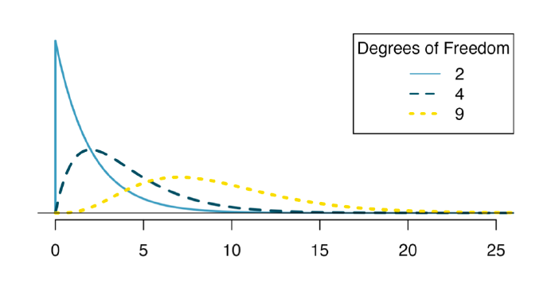
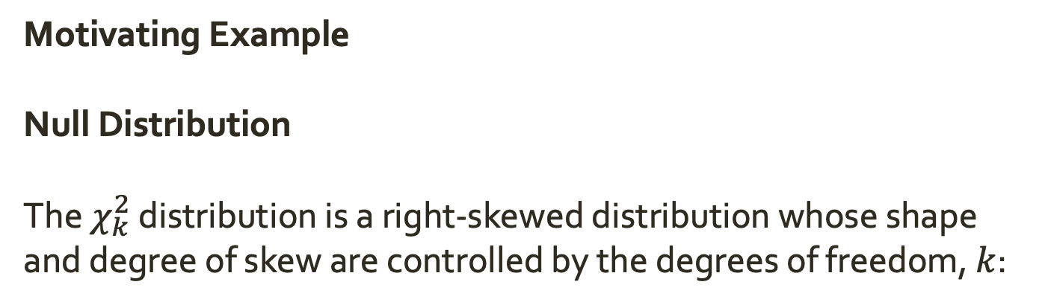
Inference for Categorical Variables
Motivating Example
Null Distribution
The $χ_{k}^{2}$ distribution is a right-skewed distribution whose shape and degree of skew are controlled by the degrees of freedom, $k$:
Notes:
It is closely related to the Normal distribution: it models the sum of k independent squared Z-scores!

Slide 24
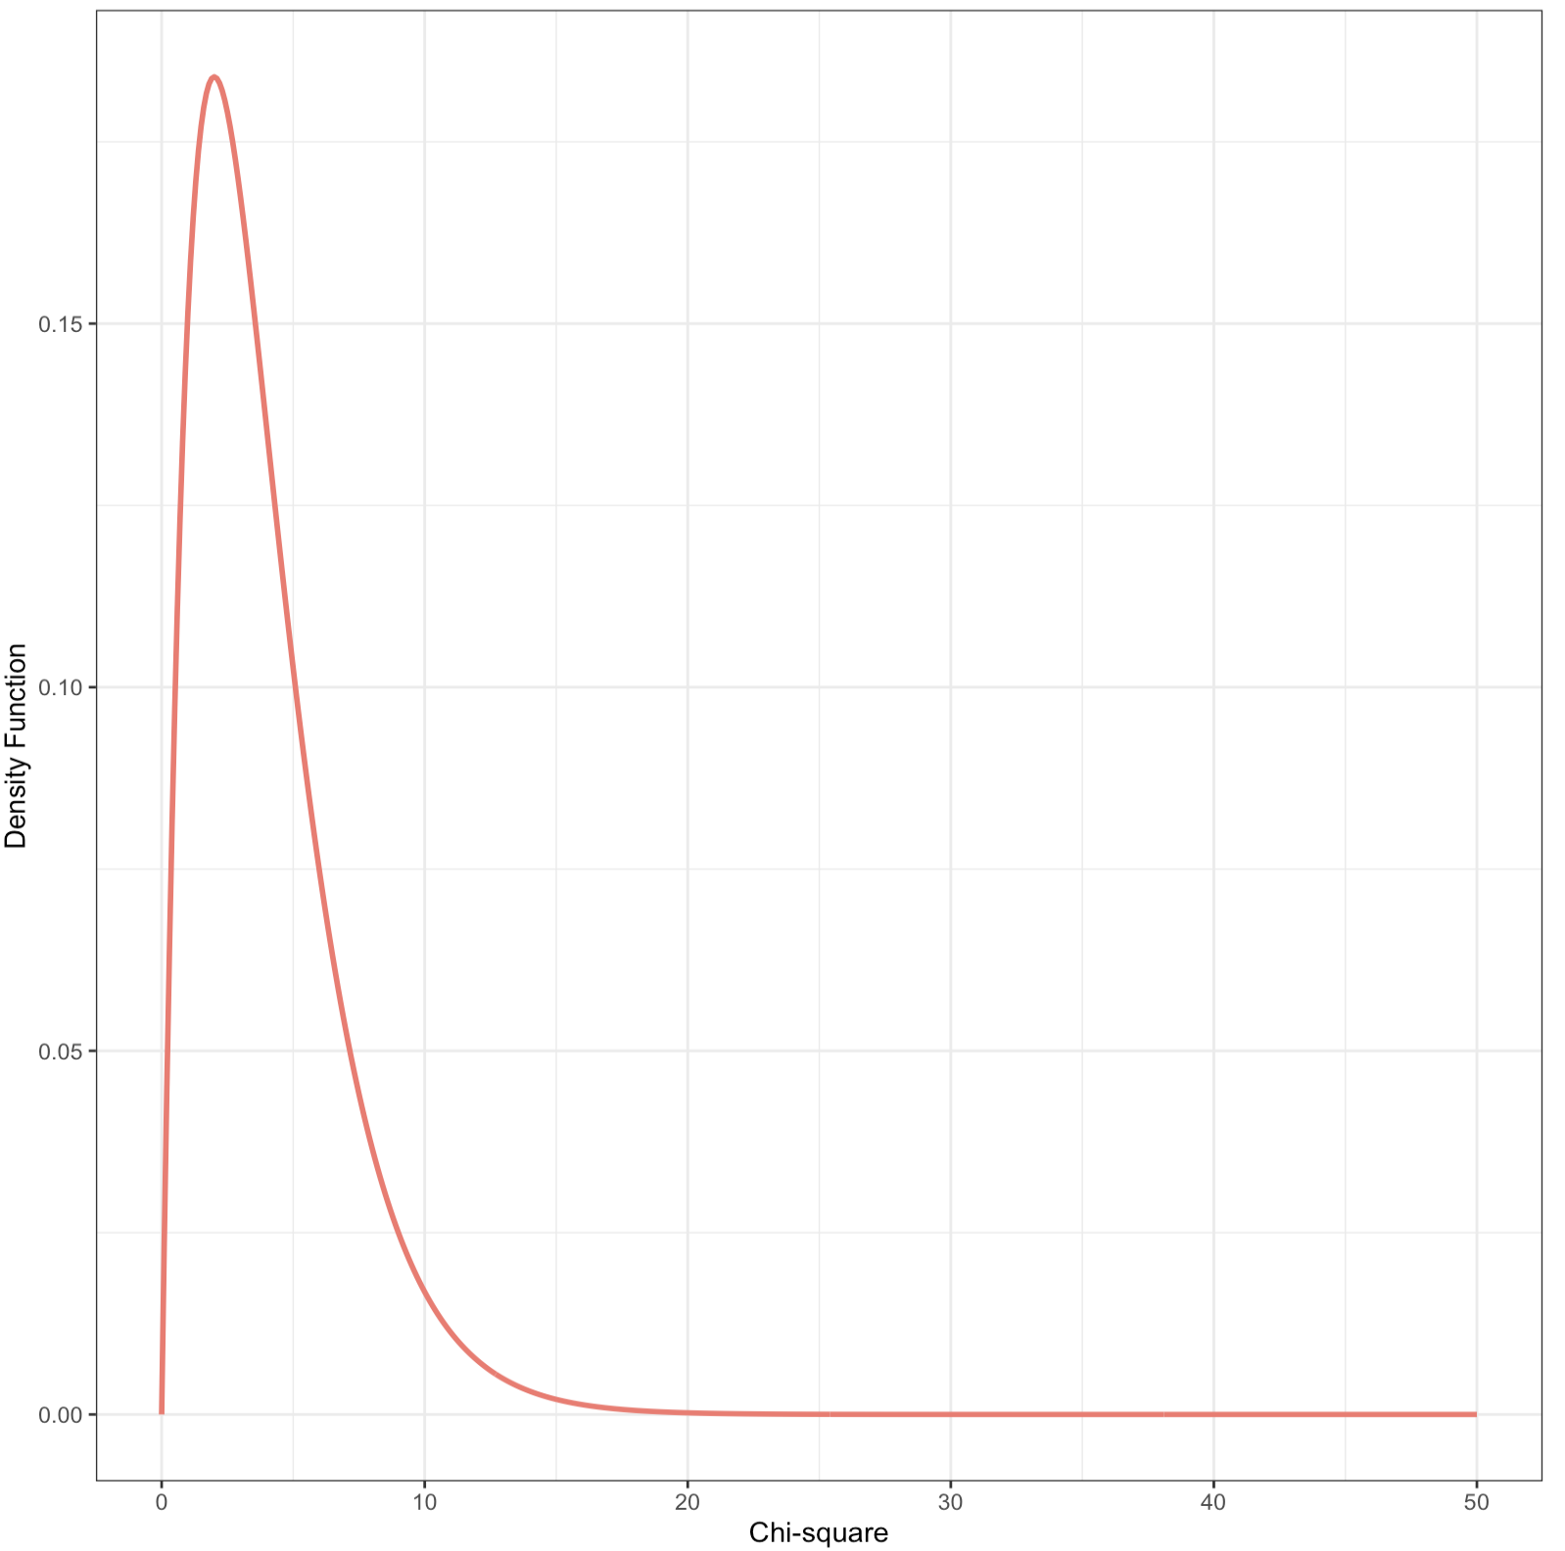
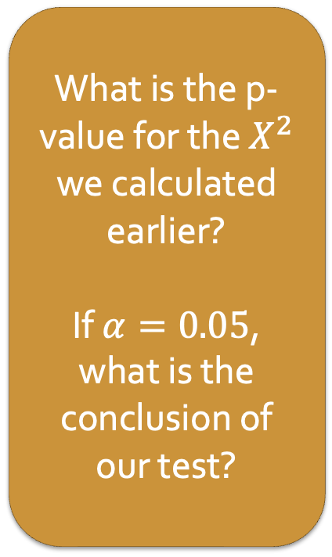
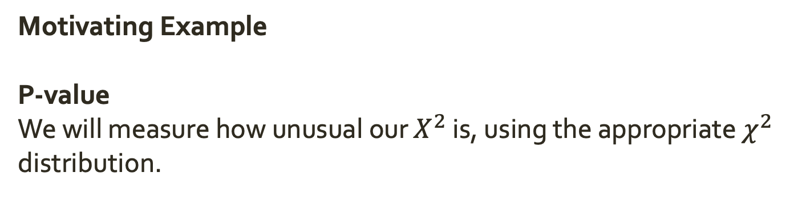

Inference for Categorical Variables
Motivating Example
P-value
We will measure how unusual our $X^{2}$ is, using the appropriate $χ^{2}$ distribution.
What is the p-value for the $X^{2}$ we calculated earlier?
If $α=0.05$, what is the conclusion of our test?
$$X^{2}$$
Notes:
It is closely related to the Normal distribution: it models the sum of k independent squared Z-scores!

Slide 25
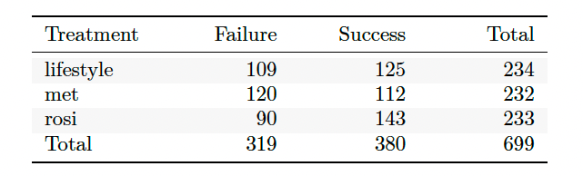
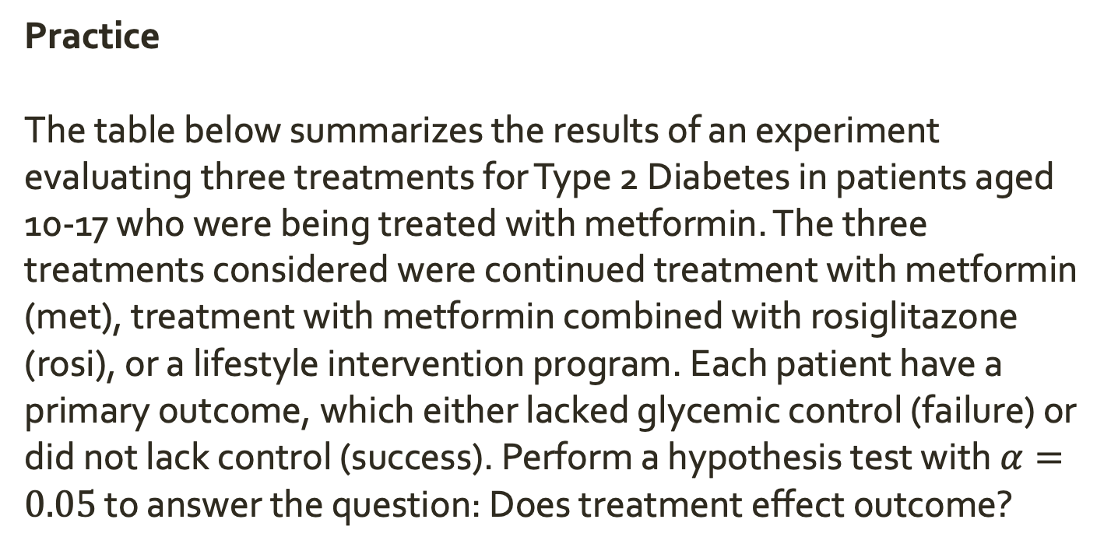
Inference for Categorical Variables
Practice
The table below summarizes the results of an experiment evaluating three treatments for Type 2 Diabetes in patients aged 10-17 who were being treated with metformin. The three treatments considered were continued treatment with metformin (met), treatment with metformin combined with rosiglitazone (rosi), or a lifestyle intervention program. Each patient have a primary outcome, which either lacked glycemic control (failure) or did not lack control (success). Perform a hypothesis test with $α=0.05$ to answer the question: Does treatment effect outcome?
Notes:
hypotheses
test statistic
null distribution (assumptions)
p-value

Slide 26
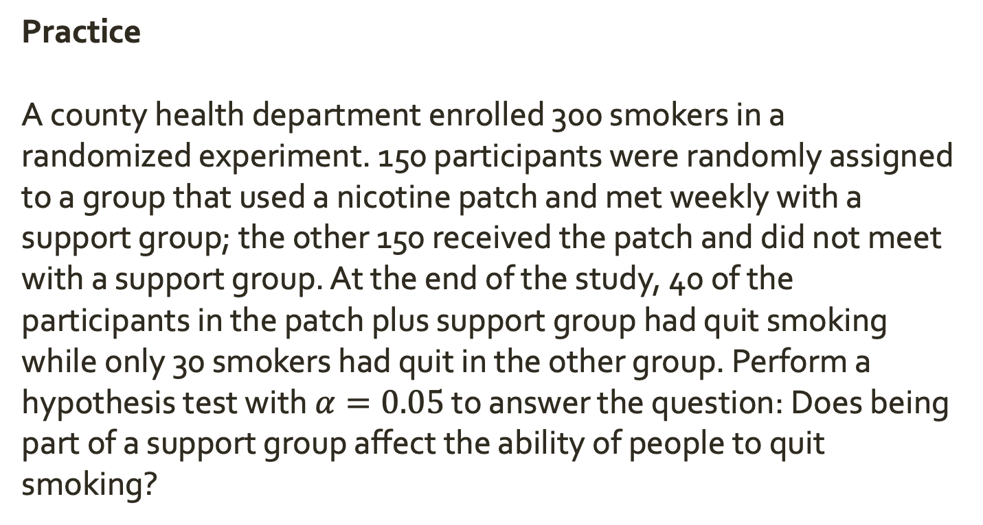
Inference for Categorical Variables
Practice
A county health department enrolled 300 smokers in a randomized experiment. 150 participants were randomly assigned to a group that used a nicotine patch and met weekly with a support group; the other 150 received the patch and did not meet with a support group. At the end of the study, 40 of the participants in the patch plus support group had quit smoking while only 30 smokers had quit in the other group. Perform a hypothesis test with $α=0.05$ to answer the question: Does being part of a support group affect the ability of people to quit smoking?
Notes:
hypotheses
test statistic
null distribution (assumptions)
p-value

