Slide 1
Elementary Statistics – Welcome!
Dr. Ab Mosca (they/them)
Slides based off slides courtesy of Kaitlyn Cook (https://www.smith.edu/people/kaitlyn-cook)

Slide 2
Plan for Today
Who am I?
Who are you?
What will we do in this class?
What are statistics?
Data vocab

Slide 3



Who Am I?

Slide 4


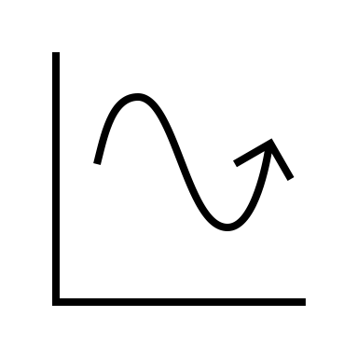
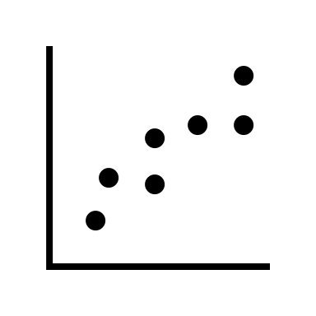

Who Am I?
Dr.

Slide 5



Who Am I?
Dr.

Slide 6
Who Are You?
Form groups of 3
Introduce yourselves (name, pronouns)
Share:
A highlight of your winter break
Find 1 thing that your entire group has in common (favorite color? hometown? left-handed? Be creative!)
After about 5 minutes we will go around, introduce ourselves, and share what each group has in common

Slide 7
Who Are You?
Form new groups of 3 (move around!)
Introduce yourselves (name, pronouns)
Share:
Would you rather only eat sweet foods for the rest of your life OR only eat savory foods for the rest of your life?
After about 5 minutes we will go around, introduce ourselves, and share our would you rather answers

Slide 8
Who Are You?
Form new new groups of 3 (move around!)
Introduce yourselves (name, pronouns)
Share:
Would you rather have a self driving car OR a private jet?
After about 5 minutes we will go around, introduce ourselves, and share our would you rather answers

Slide 9
What You Will Learn & Logistics

Slide 10
What Is This Class?
An introduction to statistics
You will learn to…
formulate well-defined research questions;
explore data using visualizations and summary statistics, and interpret visualizations and summary statistics of a given study;
select and conduct an appropriate analysis for a given research question; and
effectively communicate statistical ideas and results, both verbally and in writing

Slide 11
**Important Info**
Course website (write this down!): https://amosca01.github.io/MATH108-S24/
Office Hours
Wilson Hall 325
Wednesday 09:30 - 11:00
Thursday 14:30 - 16:30
By Appointment

Slide 12
**Important Info**
Textbook: Introduction to Modern Statistics, 1st Edition
See course website for instructions
Assignments:
Turn in on Gradescope – Demo! (https://help.gradescope.com/article/ccbpppziu9-student-submit-work)
Due Dates: As listed on course schedule.
24hr grace period; no late submissions
Lowest homework dropped
See syllabus for revise and resubmit policy

Slide 13
**Important Info**
Assignments
Homework
Pair assignments
Graded largely on effort
Quizzes (on PLATO)
Individual assignments
Can re-take as many times as wanted before deadline
In-class Activities
Graded on effort
Final Project
Small group
Graded on creativity and correctness

Slide 14
**Important Info**
I’m here to help you succeed
Please come to office hours or reach out if you need any additional support

Slide 15
Now the good stuff

Slide 16
What is statistics?
On the next slide is an image accompanied by a statement. Take 10 minutes and. . .
→ Think critically about the image, the statement, and their relationship to one another. What do you notice? What do you wonder?
→ Generate and write down ~10 open-ended questions that you have about the statement.

Slide 17
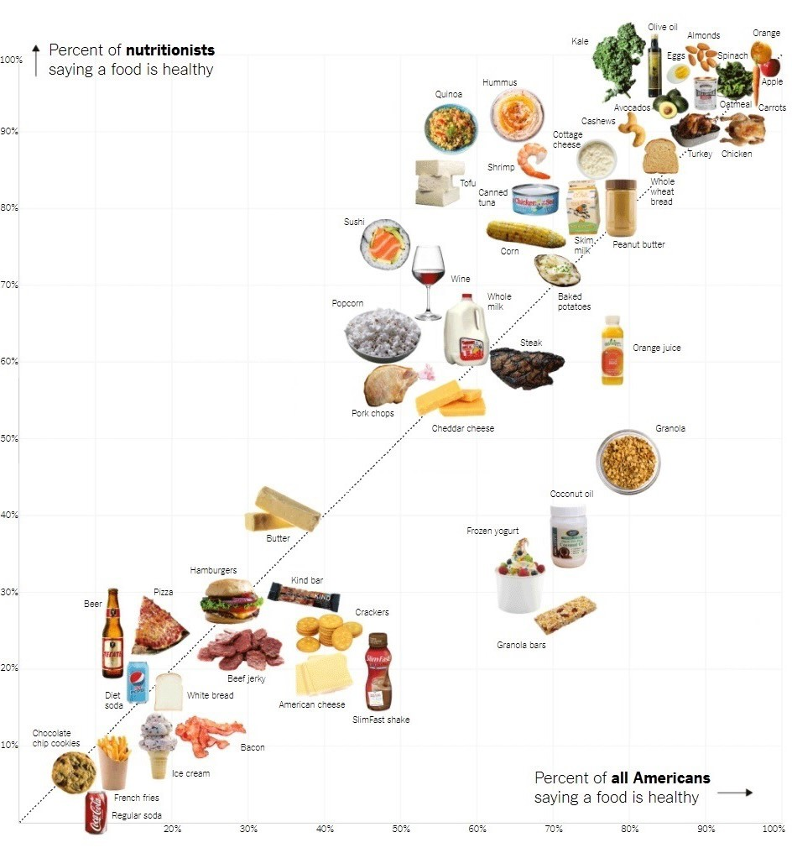
What is statistics?
Americans have a good understanding of which foods are healthy.
Image courtesy of The Upshot – The New York Times

Slide 18


“Statistics: The Art and Science of Learning from Data.” – Alan Agresti and Christine A. Franklin
What is statistics?
Senior Lecture Emeritus in Statistics, University of Georgia
Distinguished Professor Emeritus of Statistics, University of Florida

Slide 19

“Statistics is using data and knowledge about randomness to condense, communicate, and contextualize information and provide insight into the setting from which the data came.” – Jo Hardin
What is statistics?
Professor of Mathematics and Statistics, Pomona College

Slide 20
Course Overview
Given a statistical question. . .
Population |  |  | Parameter
 | Probability
Sample |  |  | Statistics & Visualizations
Population: the target group about which we wish to make claims or predictions
Parameter: numerical summary of the population Sample: the data that we have at hand
Statistic: numerical summary of the sample

Slide 21
Course Overview
Given a statistical question. . .
Population |  |  | Parameter
 | Probability
Sample |  |  | Statistics & Visualizations
Where do our data come from?
→ Weeks 1 and 2

Slide 22
Course Overview
Given a statistical question. . .
Population |  |  | Parameter
 | Probability
Sample |  |  | Statistics & Visualizations
How do we summarize and make sense of all this data (in a way that informs our research question)?
→ Weeks 3, 4, and 5

Slide 23
Course Overview
Given a statistical question. . .
Population |  |  | Parameter
 | Probability
Sample |  |  | Statistics & Visualizations
How can we use ideas from mathematics to relate our sample (and sample statistic) back to the population (and parameter of interest)?
→ Weeks 6, 7, and 9

Slide 24
Course Overview
Given a statistical question. . .
Population |  |  | Parameter
 | Probability
Sample |  |  | Statistics & Visualizations
How do we use these summaries to draw rigorous and reproducible conclusions about the population?
→ Weeks 9–14

Slide 25
Data: Big Picture
Although our statistical questions are framed in terms of populations and parameters, what we have at our disposal to answer those questions is often only a sample

Slide 26
Data: Big Picture
Although our statistical questions are framed in terms of populations and parameters, what we have at our disposal to answer those questions is often only a sample
Population
all likely US voters
all French paintings from the 1800s
humanity
Sample (a.k.a Data)
→ 2000 individuals in a snap political poll
→ French paintings from the 1800s in the Louvre
→ 43,448 individuals in a COVID vaccine trial

Slide 27
Data: Big Picture
Although our statistical questions are framed in terms of populations and parameters, what we have at our disposal to answer those questions is often only a sample
Population
all likely US voters
all French paintings from the 1800s
humanity
Sample (a.k.a Data)
→ 2000 individuals in a snap political poll
→ French paintings from the 1800s in the Louvre
→ 43,448 individuals in a COVID vaccine trial
What does our data look like? Where does our data come from?

Slide 28
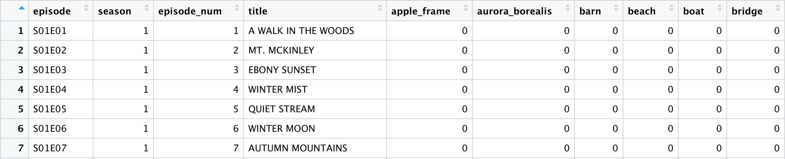
Data: Structure
Observational unit: the person or thing on which measurements are taken
Often represented by a single row in our dataset
Ex: a likely US voter, a single French painting from the 1800s, an individual in a clinical trial

Slide 29
Data: Structure
Observational unit: the person or thing on which measurements are taken
Often represented by a single row in our dataset
Ex: a likely US voter, a single French painting from the 1800s, an individual in a clinical trial
Variable: the characteristic being measured
Often represented by a column in our dataset
Ex: preferred political candidate, whether the painting depicts nature as its subject, COVID infection status after 4 weeks

Slide 30
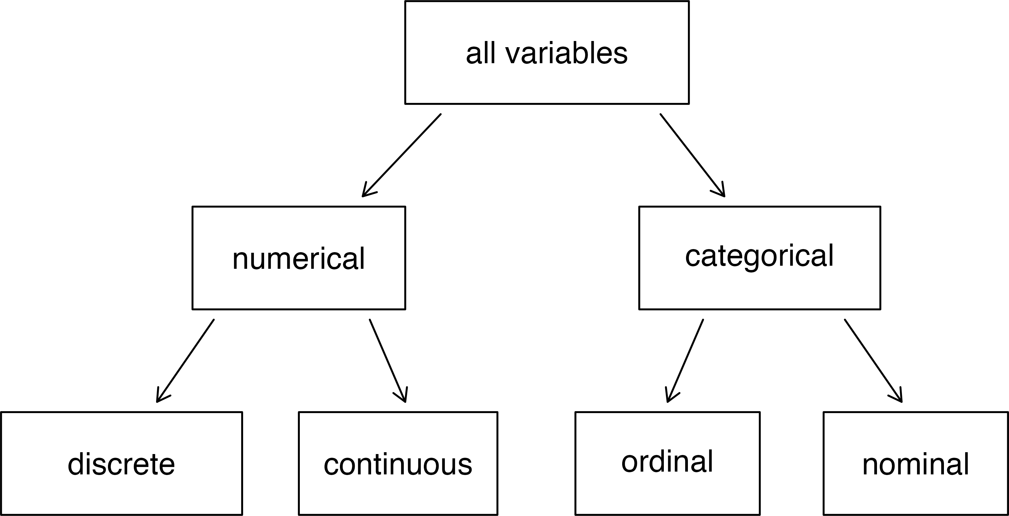
Data: Variable Taxonomy
Fig 1.1 from IMS Ch.1: Breakdown of variables into their respective types

Slide 31
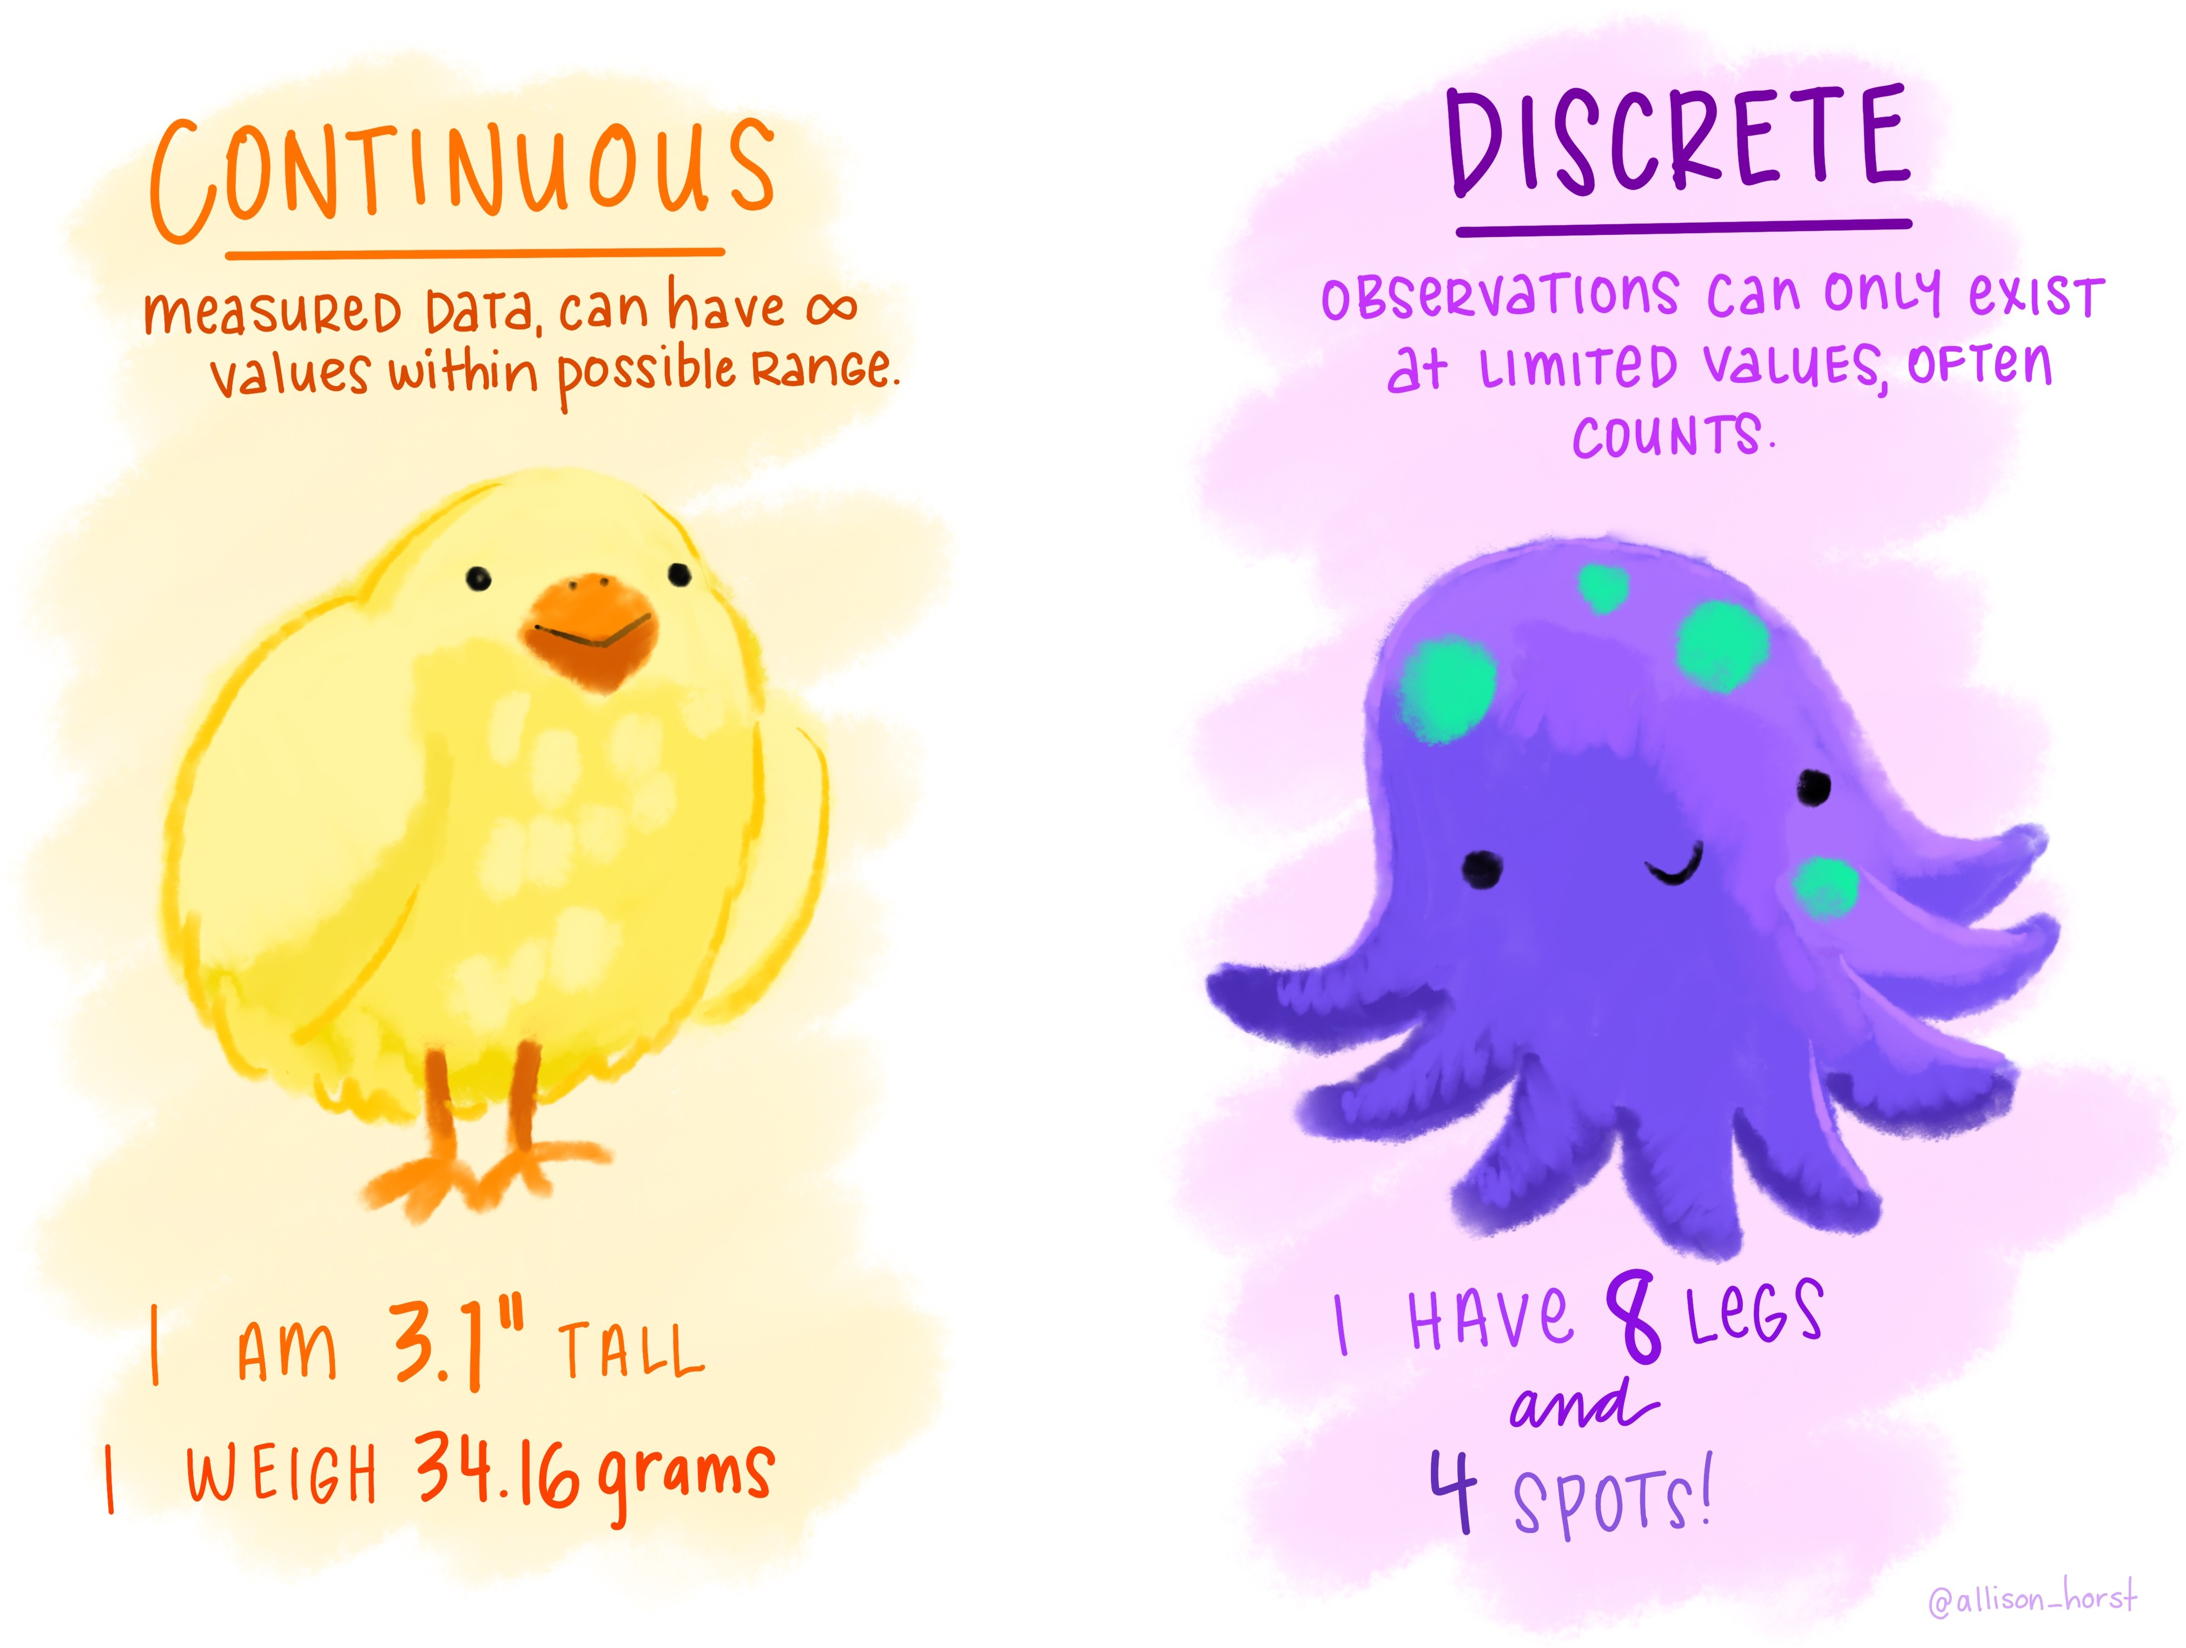
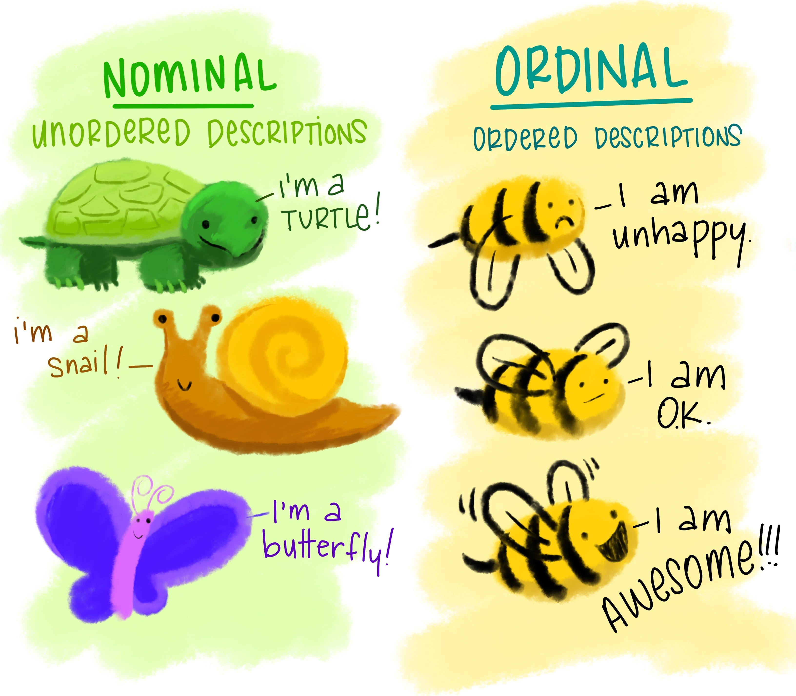
Data: Variable Taxonomy
All Data
Numerical
Categorical

Slide 32
Exercise
Data Collection:
Form a group of three and take turns answering the following questions:
What is your name? What is your class year?
What is your hometown?
Do you have siblings (1 = Yes, 0 = No)?
What is the furthest away from Westfield (in miles) that
you were over winter break?
While one group member answers, the other two will write down the answers. Then open the data collection Google spreadsheet (http://bit.ly/48ceWSa) and start entering the data!

Slide 33
Exercise
Identifying Variable Types:
Take a couple minutes on your own to answer the following:
What is the observational unit in our dataset?
For each variable in the spreadsheet, is it discrete, continuous, ordinal, or nominal?

Slide 34
Exercise
Identifying Variable Types:
Take a couple minutes on your own to answer the following:
What is the observational unit in our dataset?
For each variable in the spreadsheet, is it discrete, continuous, ordinal, or nominal?
Discuss your answers with your neighbor!

Slide 35
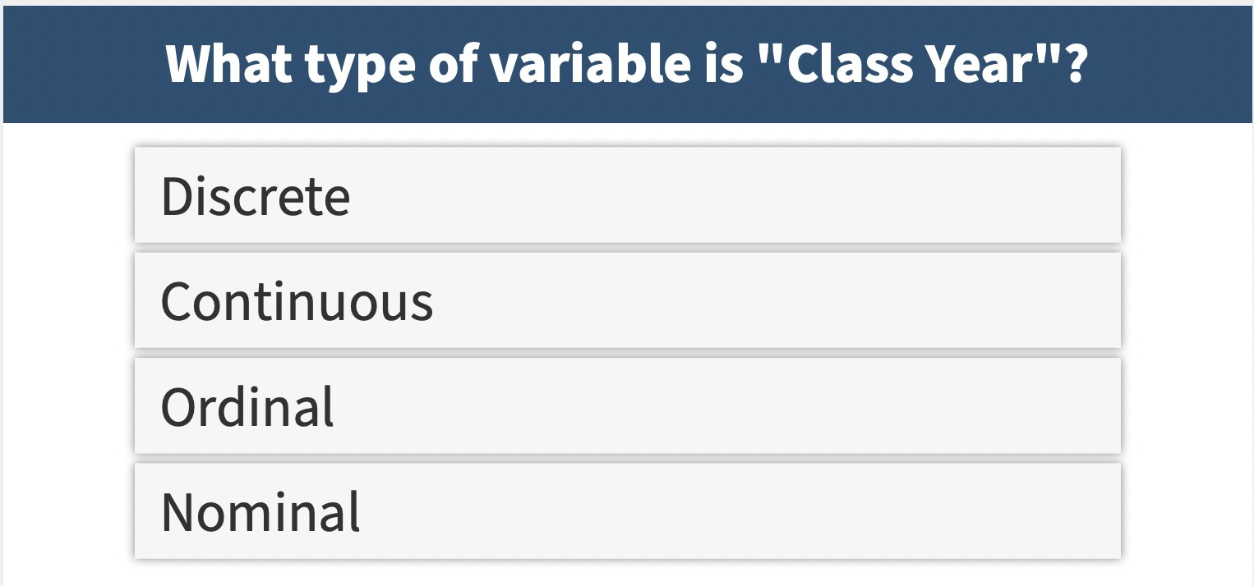
Exercise

Slide 36
Exercise

Slide 37
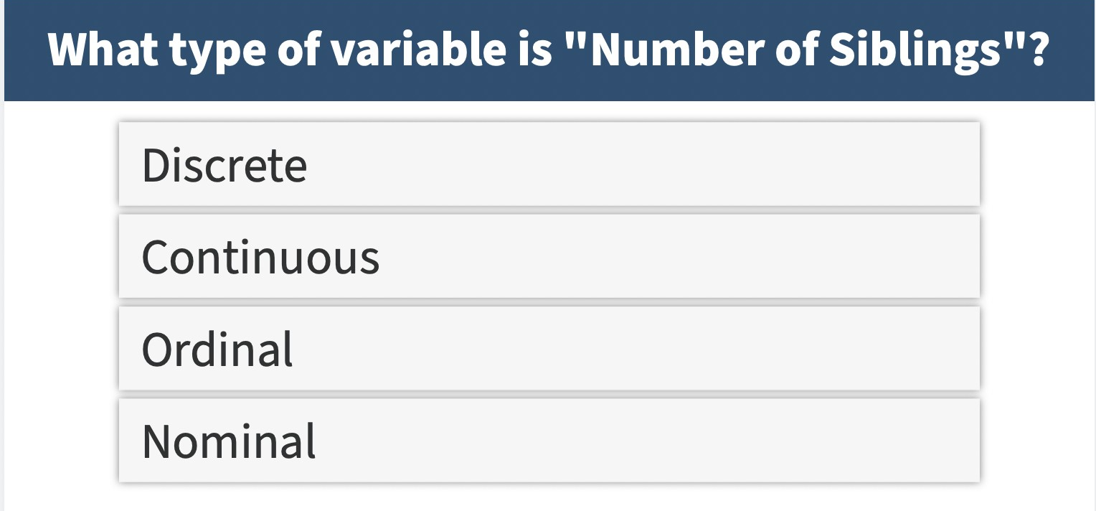
Exercise
What type of variable is ”Siblings”?

Slide 38
Exercise
What type of variable is ”Siblings”?

Slide 39
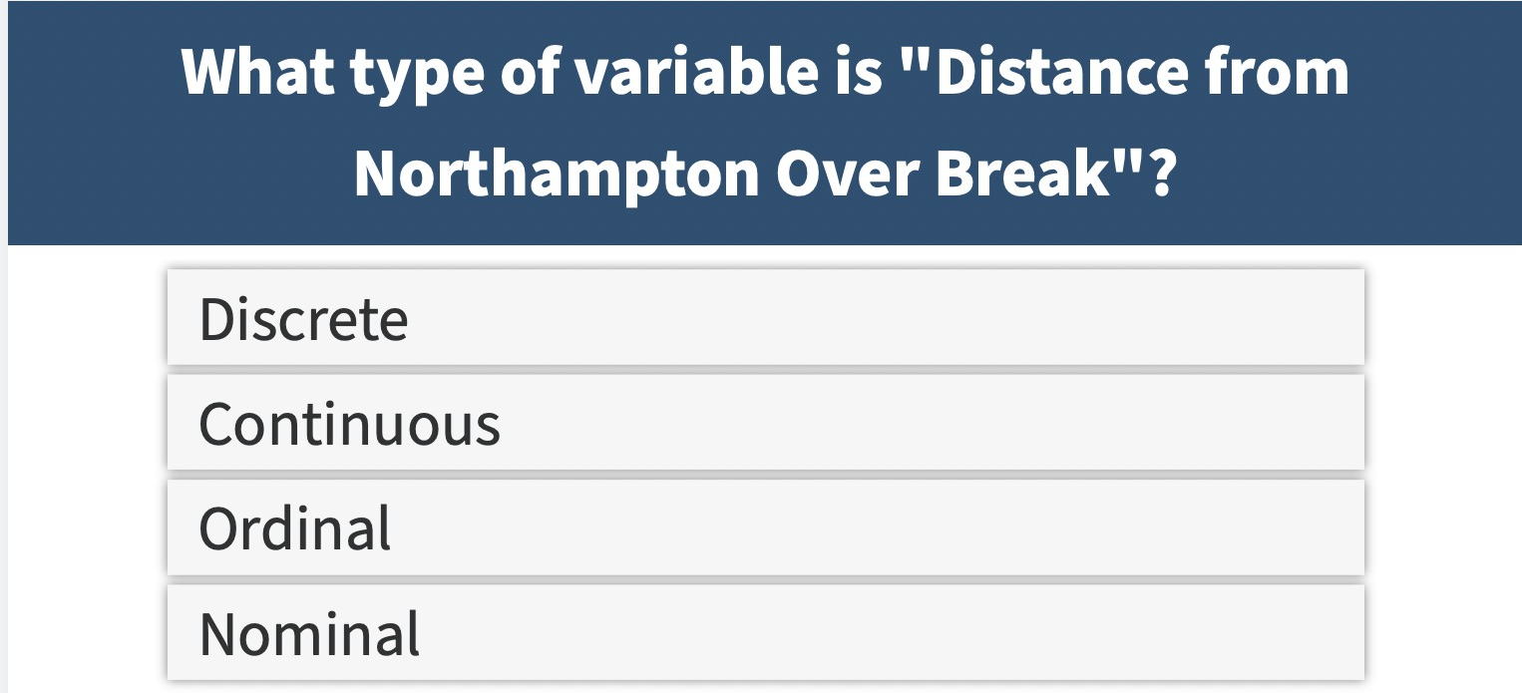
Exercise
What type of variable is “Distance from Westfield over Break” (Miles-Away)?

Slide 40
Exercise
What type of variable is “Distance from Westfield over Break” (Miles-Away)?

