Slide 1
Elementary Statistics – Sampling and Random Experiments
Dr. Ab Mosca (they/them)
Slides based off slides courtesy of Kaitlyn Cook (https://www.smith.edu/people/kaitlyn-cook)

Slide 2
Plan for Today
Sampling
Why
Techniques
Randomized Experiments
Causality
Confounding

Slide 3
Recap: Big Picture
Although our statistical questions are framed in terms of populations and parameters, what we have at our disposal to answer those questions is often only a sample
Population
all likely US voters all French paintings from the 1800s
humanity
Sample (a.k.a Data)
→ 2000 individuals in a snap political poll
→ French paintings from the 1800s in the Louvre
→ 43,448 individuals in a COVID vaccine trial

Slide 4

Recap: Big Picture
Although our statistical questions are framed in terms of populations and parameters, what we have at our disposal to answer those questions is often only a sample
Population
all likely US voters all French paintings from the 1800s
humanity
Sample (a.k.a Data)
→ 2000 individuals in a snap political poll
→ French paintings from the 1800s in the Louvre
→ 43,448 individuals in a COVID vaccine trial
Sometimes we actually are able to collect data on our entire population: this is called a census! In that case, we can calculate the value of the parameter directly. . .
. . . But this happens only rarely and with known issues.

Slide 5
Problems with a Census
Consider the US census, which is supposed to capture data on every person in the US.
Do you know of any issues with the US census?
Brainstorm with a buddy.
Sometimes we actually are able to collect data on our entire population: this is called a census! In that case, we can calculate the value of the parameter directly. . .
. . . But this happens only rarely and with known issues.

Slide 6
Problems with a Census
Consider the US census, which is supposed to capture data on every person in the US.
Issues with the US census:
Does not reach all subpopulations equally
undercounts Hispanic, Black, and Native American residents
overcounts white and Asian American residents
undocumented residents
undercounts residents living in poor urban areas
undercounts unhoused people
Does not collect data in a representative way
sex (only binary options, no intersex option)
gender is not collected
race includes no multiracial option

Slide 7
Problems with a Census
So while a census is nice in theory…
It can be difficult to complete. There always seem to be some individuals who are hard to locate or hard to measure. And these difficult-to-find people may have certain characteristics that distinguish them from the rest of the population.
Populations rarely stand still. Even if you could take a census, the population changes constantly, so it's never possible to get a perfect measure.

Slide 8
Approaches to Data Collection
Anecdotal evidence: evidence based on personal observation, collected in a non-systematic manner and often involving only a few cases
Ex: asking a few of your friends for their opinions
Convenience sample: individuals who are easier to contact or reach are more likely to be included in the sample
Ex: conducting a school-wide survey by stopping WSU students as they exit the Dining Commons
Random (probability) sample: every individual in the population has a known, non-zero probability of being included in the sample and is randomly selected according to this probability
Ex: conducting that same survey by randomly selecting names from the school directory

Slide 9
Approaches to Data Collection
Anecdotal evidence: evidence based on personal observation, collected in a non-systematic manner and often involving only a few cases
Ex: asking a few of your friends for their opinions
Convenience sample: individuals who are easier to contact or reach are more likely to be included in the sample
Ex: conducting a school-wide survey by stopping WSU students as they exit the Dining Commons
Random (probability) sample: every individual in the population has a known, non-zero probability of being included in the sample and is randomly selected according to this probability
Ex: conducting that same survey by randomly selecting names from the school directory
Which approach will produce the best data and insight into the most popular majors at WSU? Why?

Slide 10
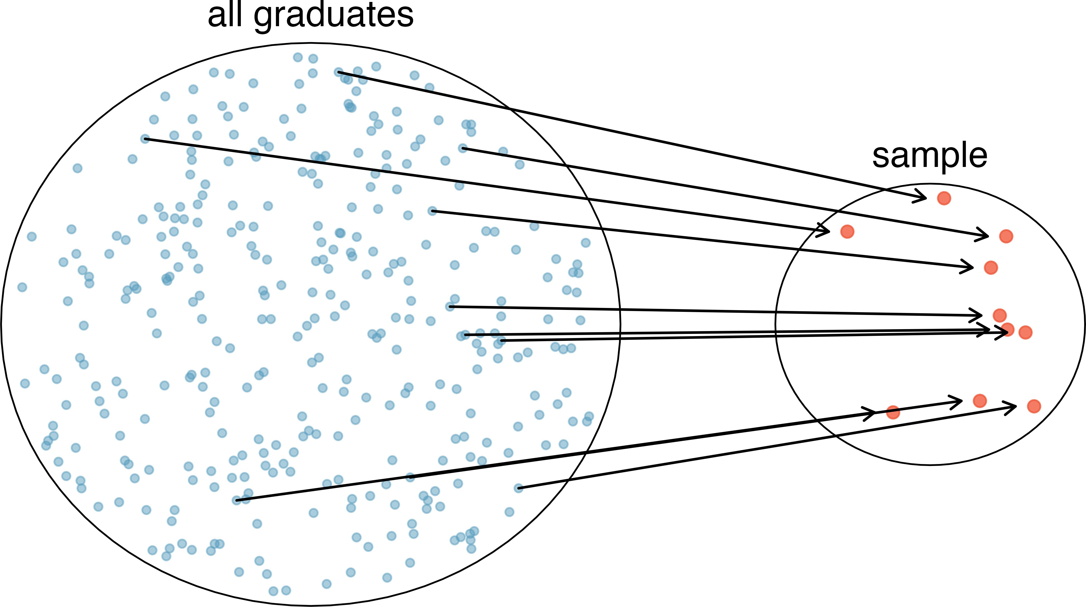
Simple Random Sampling
Analogous to using a raffle to select observations
All members in the population have an equal chance of being included in the final sample
No implied connection between the observations in our sample

Slide 11
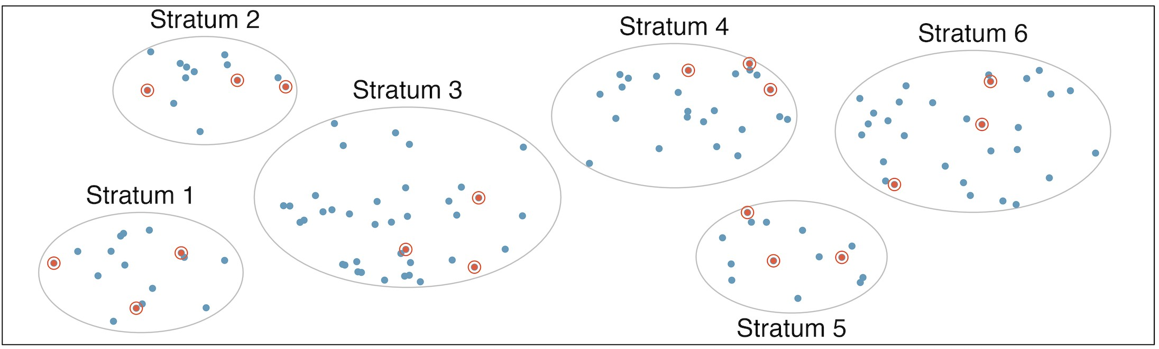
Stratified Random Sampling
Divide-and-conquer sampling strategy that:
Divides the population into “strata” that group similar observations together
Conducts a simple random sample within each stratum
Helps our sample to be more balanced with respect to the grouping/ stratification variable

Slide 12
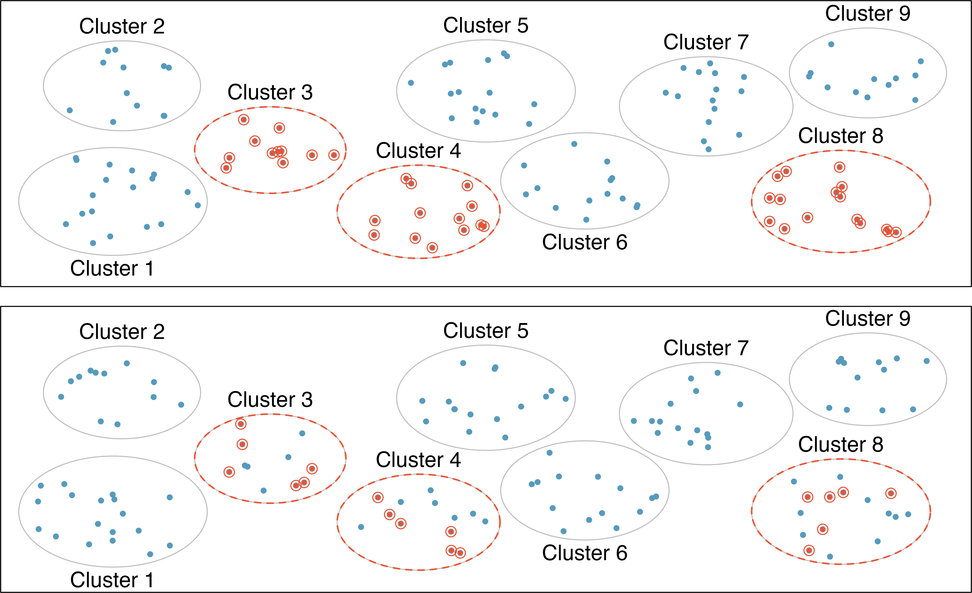
Clustered and Multistage Sampling
Our population may naturally be grouped into clusters (e.g., families, schools, communities)
Cluster sampling: Randomly select clusters and include all members of those clusters
Multistage sampling: Randomly select clusters and include a simple random sample of the cluster members
Often pursued for logistical convenience or economic reasons

Slide 13
What are the pitfalls of non-representative sampling?
Sampling bias refers to systematic error due to non-random sampling, in which some members of the target population are much more likely to be included in the sample than others in ways that we did not intend

Slide 14
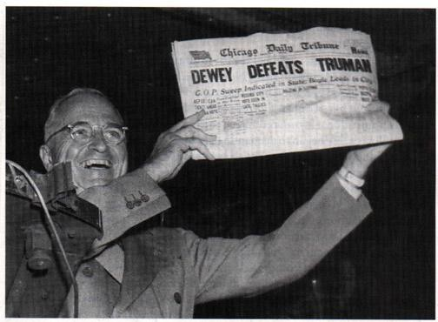
What are the pitfalls of non-representative sampling?
Sampling bias refers to systematic error due to non-random sampling, in which some members of the target population are much more likely to be included in the sample than others in ways that we did not intend
1948 Presidential Election
On the night of the election, the Chicago Tribune mistakenly printed a headline declaring that Dewey had defeated Truman
Conclusion was based on the results of a telephone survey
Individuals with telephones tended to be wealthier and have stable home addresses

Slide 15
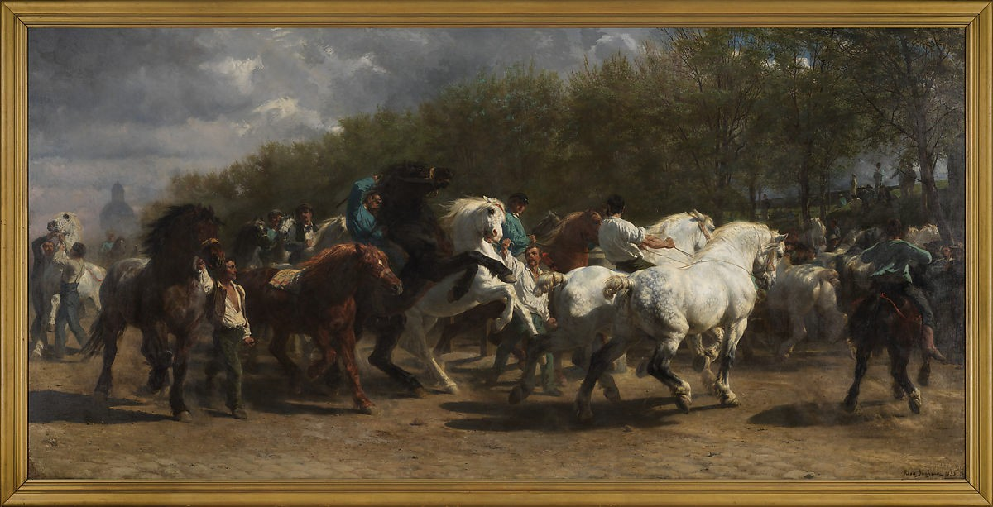
What are the pitfalls of non-representative sampling?
Sampling bias refers to systematic error due to non-random sampling, in which some members of the target population are much more likely to be included in the sample than others in ways that we did not intend
Visual Bias in Art Museums
Art mediums, political agendas, and both artist and art curator identities inform what art is deemed “worthy” of preserving and displaying
Museum collections still vastly overrepresent artists who are white, Western, and male
The Horse Fair, Rosa Bonheur, 1852–55.

Slide 16
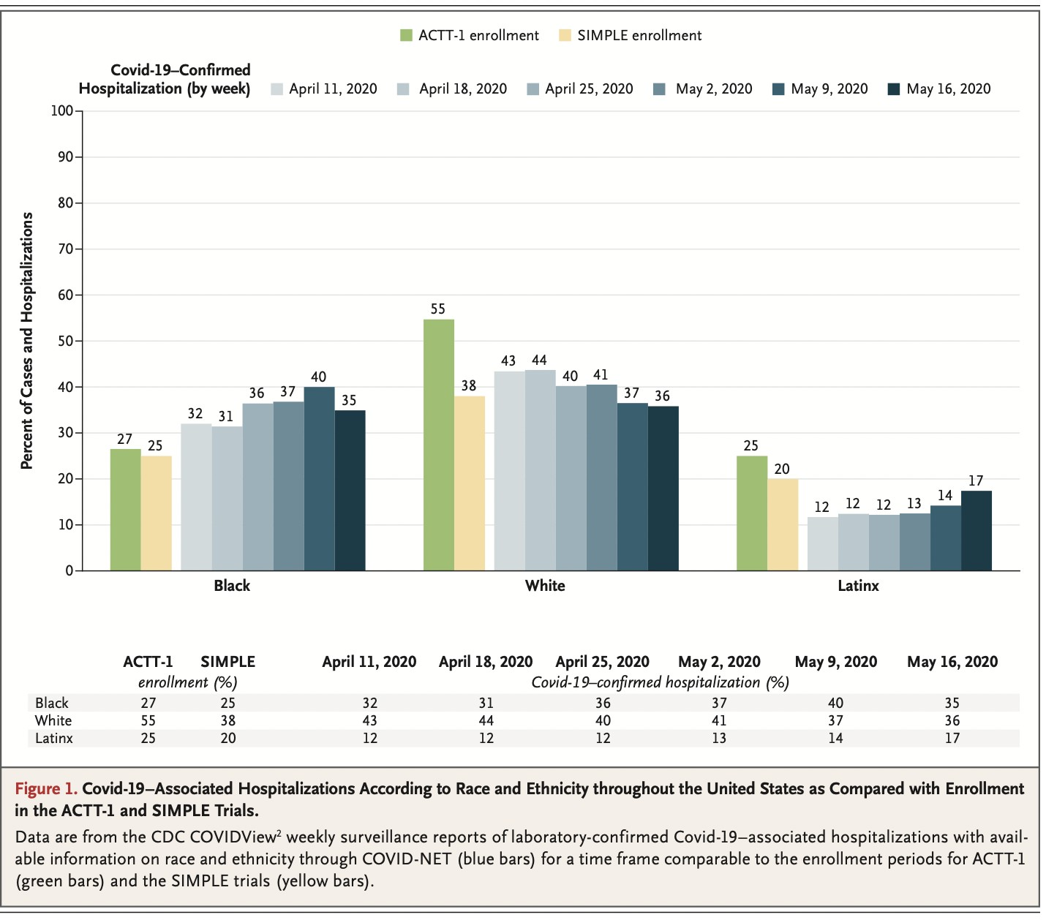
What are the pitfalls of non-representative sampling?
Sampling bias refers to systematic error due to non-random sampling, in which some members of the target population are much more likely to be included in the sample than others in ways that we did not intend
Representation in COVID-19 Studies
Historic mistreatment of people of color as well as ongoing racism and discrimination have bred distrust of the medical field, particularly within racially minoritized communities
Other barriers to participation: language barriers, health literacy, time/cost
From the New England Journal of Medicine.

Slide 17
Practice
A city council has requested a household survey be conducted in a suburban area of their city. The area is broken into many distinct and unique neighborhoods, some including large homes, some with only apartments, and others a diverse mixture of housing structures.
Form 8 groups, each will be assigned a scenario. For your scenario, identify the sampling methods described, and describe the statistical pros and cons of the method in the city’s context. Be prepared to share with the class!
Randomly sample 200 households from the city.
Divide the city into 20 neighborhoods, and sample 10 households from each neighborhood.
Divide the city into 20 neighborhoods, randomly sample 8 neighborhoods, and then randomly sample 50 households from those neighborhoods.
Sample the 200 households closest to the city council offices.

Slide 18
Practice
A city council has requested a household survey be conducted in a suburban area of their city. The area is broken into many distinct and unique neighborhoods, some including large homes, some with only apartments, and others a diverse mixture of housing structures.
Randomly sample 200 households from the city.

Slide 19
Practice
A city council has requested a household survey be conducted in a suburban area of their city. The area is broken into many distinct and unique neighborhoods, some including large homes, some with only apartments, and others a diverse mixture of housing structures.
Divide the city into 20 neighborhoods, and sample 10 households from each neighborhood.

Slide 20
Practice
A city council has requested a household survey be conducted in a suburban area of their city. The area is broken into many distinct and unique neighborhoods, some including large homes, some with only apartments, and others a diverse mixture of housing structures.
Divide the city into 20 neighborhoods, randomly sample 8 neighborhoods, and then randomly sample 50 households from those neighborhoods.

Slide 21
Practice
A city council has requested a household survey be conducted in a suburban area of their city. The area is broken into many distinct and unique neighborhoods, some including large homes, some with only apartments, and others a diverse mixture of housing structures.
Sample the 200 households closest to the city council offices.

Slide 22

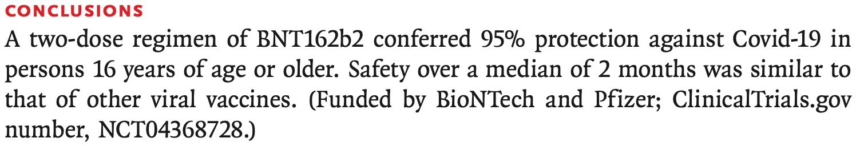
Big Picture
Many research questions are, fundamentally, questions about the relationship between two or more variables of interest:

Slide 23
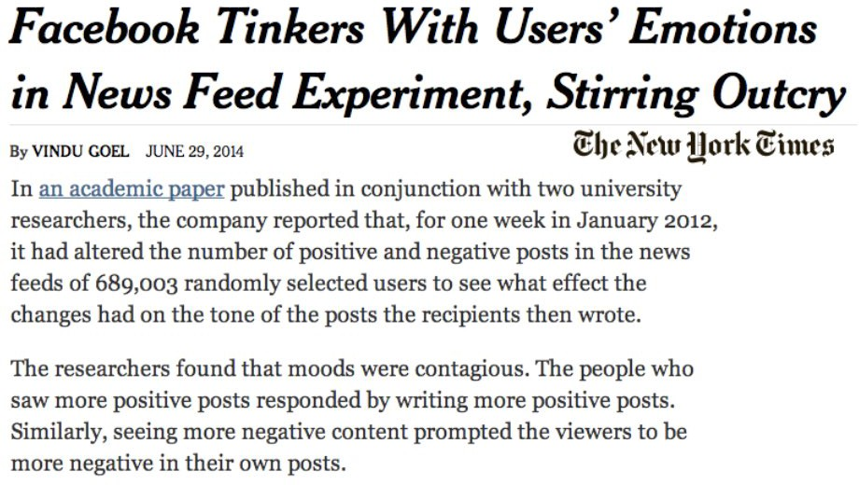
Big Picture
Many research questions are, fundamentally, questions about the relationship between two or more variables of interest:

Slide 24
Big Picture
Many research questions are, fundamentally, questions about the relationship between two or more variables of interest:
How can we design a research study to answer these sorts of questions? And what sorts of conclusions can we draw about these relationships?

Slide 25
Types of Study Designs
We often label these variables according to their hypothesized relationship with one another. . .
Response variable: the measured outcome of interest
Explanatory variable: a variable that potentially explains or predicts changes in the response
. . . and broadly classify study designs into one of two categories:
Observational studies: researchers observe both the explanatory and response variables without interfering in how the data arise
Experiments: researchers intervene and assign treatments (the explanatory variable) to each participant in the study
→ if this assignment involves randomization, then we call the study a
randomized experiment

Slide 26
Types of Study Designs
Handwriting and SAT Scores
An article about handwriting appeared in the October 11, 2006 issue of the Washington Post. The article mentioned that among a sample of students who took the essay portion of the SAT exam in 2005-2006, those who wrote in cursive style scored significantly higher on the essay, on average, than students who used printed block letters.

Slide 27
Types of Study Designs
Handwriting and SAT Scores
An article about handwriting appeared in the October 11, 2006 issue of the Washington Post. The article mentioned that among a sample of students who took the essay portion of the SAT exam in 2005-2006, those who wrote in cursive style scored significantly higher on the essay, on average, than students who used printed block letters.
What are the observational units, variables, types of variables, parameter of interest, and statistic in this study?

Slide 28
Types of Study Designs
Handwriting and SAT Scores
An article about handwriting appeared in the October 11, 2006 issue of the Washington Post. The article mentioned that among a sample of students who took the essay portion of the SAT exam in 2005-2006, those who wrote in cursive style scored significantly higher on the essay, on average, than students who used printed block letters.
What are the observational units, variables, types of variables, parameter of interest, and statistic in this study?
What type of study is this?

Slide 29
Types of Study Designs
Handwriting and SAT Scores
An article about handwriting appeared in the October 11, 2006 issue of the Washington Post. The article mentioned that among a sample of students who took the essay portion of the SAT exam in 2005-2006, those who wrote in cursive style scored significantly higher on the essay, on average, than students who used printed block letters.
What are the observational units, variables, types of variables, parameter of interest, and statistic in this study?
What type of study is this?
Can we conclude that writing in cursive causes higher scores?

Slide 30
Visualizing Causality
We can use Directed Acyclic Graphs (DAGs) to visualize the causal relationships that we assume exist between sets of variables:
Directed: time flows from left to right via directed arrows
Acyclic: no cycles or feedback loops, i.e., a variable cannot cause itself (either directly or through another variable)
Graphs: intuitive way of encoding subject matter knowledge
Deforestation
Increased Greenhouse Gases
Global Warming
School District Funding
Cursive Handwriting
SAT Score
* * * The association flows regardless of the direction of the arrows, but a path is only causal if it follows the direction of the arrows!

Slide 31
Confounding Variables
A confounder is a variable (which may or may not have been measured) that is:
Associated with the explanatory variable Associated with the response variable
Not a downstream consequence of either the explanatory or response variable
1
2
3
It creates a backdoor path (i.e., path of association) between the explanatory and response variables:
School District Funding
Cursive Handwriting
SAT Score

Slide 32
Confounding Variables
A confounder is a variable (which may or may not have been measured) that is:
Associated with the explanatory variable Associated with the response variable
Not a downstream consequence of either the explanatory or response variable
1
2
3
It creates a backdoor path (i.e., path of association) between the explanatory and response variables:
School District Funding
Cursive Handwriting
SAT Score
Failing to adjust for confounders may lead to a spurious or distorted view of the explanatory/response relationship!

Slide 33
Randomization to the Rescue
In an observational study, the presence of confounders generally inhibits our ability to make causal claims.¹ But in randomized experiments, researchers randomly assign participants to one of two (or more) groups:
Treatment Group Control Group
In randomly making this assignment, we ensure that nothing (beyond a coin flip) can be a cause of the explanatory variable!
School District Funding Cursive Handwriting SAT Score
⇒ randomization works to eliminate confounding by both measured and unmeasured variables!
¹Without more advanced statistical techniques!

Slide 34
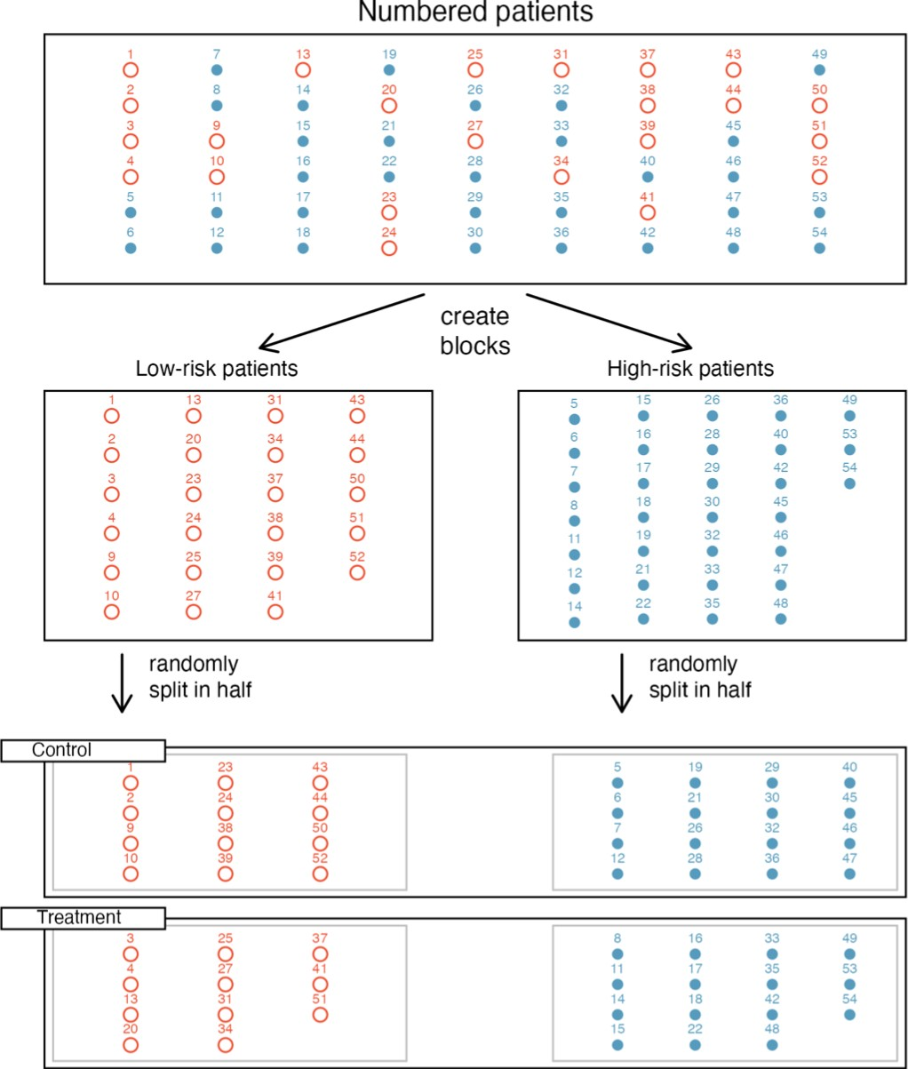
Blocking in Randomized Experiments
If we want to ensure that our treatment and control groups are balanced with respect to a particular variable, we may also employ blocking:

Slide 35
Causality and Experimental Design Practice
Form 6 groups, each will be assigned a scenario below. Work with your group to complete your scenario. Be prepared to share your answer with the class!
For each pair of explanatory and outcome variables below, suppose that someone conducts an observational study and arrives at the stated conclusions. Are these claims warranted? In particular, what is one possible confounder of the exposure/outcome relationship that might alternatively explain the association?
We all scream for ice cream: An investigator decides to look at the relationship between ice cream consumption and public welfare in New England. She finds that higher levels of ice cream consumption are associated with more deaths by drowning and concludes that ice cream represents a clear and present danger to the public.
Nurse Ratched is ready to see you now: A researcher observes that towns with higher numbers of doctors also report higher numbers of crimes. They conclude that doctors must commit crimes at higher rate than the general population does.
Get a move on: A physician notices that heart disease occurs more frequently in patients who are less physically active. On the basis of this observation, she starts recommending that all of her patients engage in at least thirty minutes of exercise every day.

Slide 36
Causality and Experimental Design Practice
Form 6 groups, each will be assigned a scenario below. Work with your group to complete your scenario. Be prepared to share your answer with the class!
For each pair of explanatory and outcome variables below, suppose that someone conducts an observational study and arrives at the stated conclusions. Are these claims warranted? In particular, what is one possible confounder of the exposure/outcome relationship that might alternatively explain the association?
We all scream for ice cream: An investigator decides to look at the relationship between ice cream consumption and public welfare in New England. She finds that higher levels of ice cream consumption are associated with more deaths by drowning and concludes that ice cream represents a clear and present danger to the public.

Slide 37
Causality and Experimental Design Practice
Form 6 groups, each will be assigned a scenario below. Work with your group to complete your scenario. Be prepared to share your answer with the class!
For each pair of explanatory and outcome variables below, suppose that someone conducts an observational study and arrives at the stated conclusions. Are these claims warranted? In particular, what is one possible confounder of the exposure/outcome relationship that might alternatively explain the association?
Nurse Ratched is ready to see you now: A researcher observes that towns with higher numbers of doctors also report higher numbers of crimes. They conclude that doctors must commit crimes at higher rate than the general population does.

Slide 38
Causality and Experimental Design Practice
Form 6 groups, each will be assigned a scenario below. Work with your group to complete your scenario. Be prepared to share your answer with the class!
For each pair of explanatory and outcome variables below, suppose that someone conducts an observational study and arrives at the stated conclusions. Are these claims warranted? In particular, what is one possible confounder of the exposure/outcome relationship that might alternatively explain the association?
Get a move on: A physician notices that heart disease occurs more frequently in patients who are less physically active. On the basis of this observation, she starts recommending that all of her patients engage in at least thirty minutes of exercise every day.

Slide 39
Causality and Experimental Design Practice
Form 6 groups. Work with your group to complete the problem below. Be prepared to share your answer with the class!
A study is designed to test the effect of light level on exam performance of students. The researcher believes that light levels might have different effects on people who wear glasses and people who don’t, so they want to make sure both groups of people are equally represented in each treatment. The treatments are fluorescent overhead lighting, yellow overhead lighting, and no overhead lighting (only desk lamps). In this experiment:
What is the response variable?
What is the explanatory variable? What are its levels?
What is the blocking variable? What are its levels?

