Slide 1
Elementary Statistics – Inference for Numerical Data Pt. 1
Dr. Ab Mosca (they/them)
Slides based off slides courtesy of Kaitlyn Cook (https://www.smith.edu/people/kaitlyn-cook)

Slide 2
Plan for Today
Inference for numerical variables
Single mean
Independent means

Slide 3
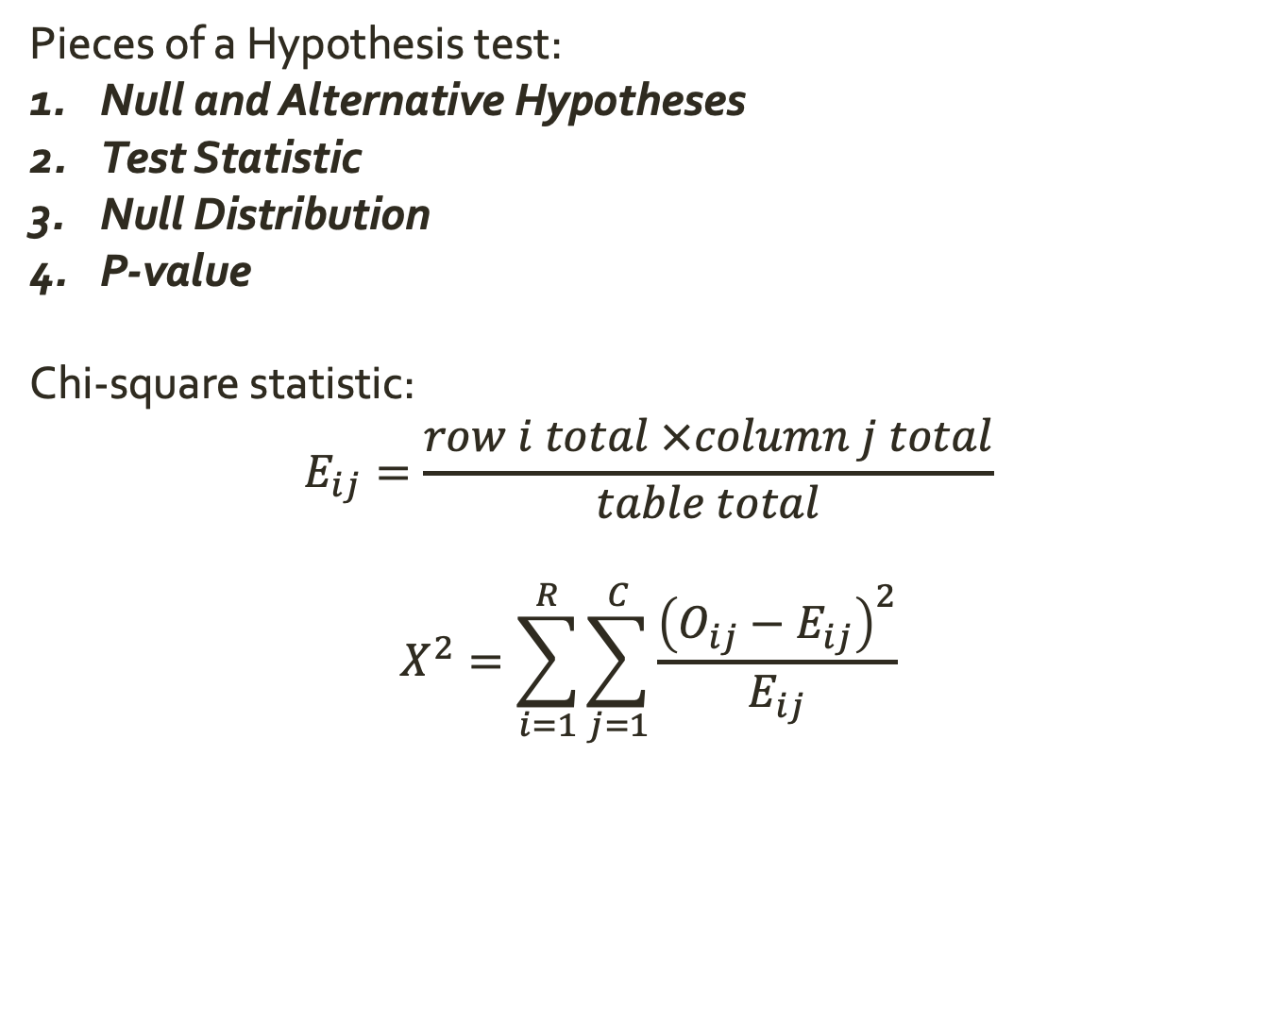
Inference for Categorical Variables
Pieces of a Hypothesis test:
Null and Alternative Hypotheses
Test Statistic
Null Distribution
P-value
Chi-square statistic:
$$E_{ij}=\frac{row i total ×column j total}{table total}$$
$$X^{2}=\sum_{i=1}^{R}{\sum_{j=1}^{C}{\frac{{\left(O_{ij}−E_{ij}\right)}^{2}}{E_{ij}}}}$$

Slide 4
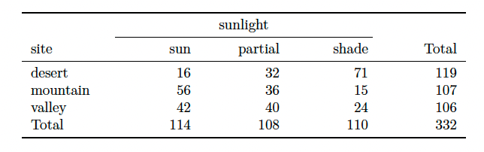
Warm Up: Inference for Categorical Variables
Practice
In order to assess whether habitat conditions are related to the
sunlight choices a lizard makes for resting, Western fence lizards (Sceloporus occidentalis) were observed across three different microhabitats. Perform a hypothesis test with a significance level of 5% to determine if habitat conditions and sunlight choices are related.
Notes:
hypotheses
test statistic
null distribution (assumptions)
p-value

Slide 5
Inference for a Single Mean
So far, we have looked at inference for categorical variables.
Now, we will look at inference for numerical variables, starting with inference for a single mean.
Notes:
hypotheses
test statistic
null distribution (assumptions)
p-value

Slide 6
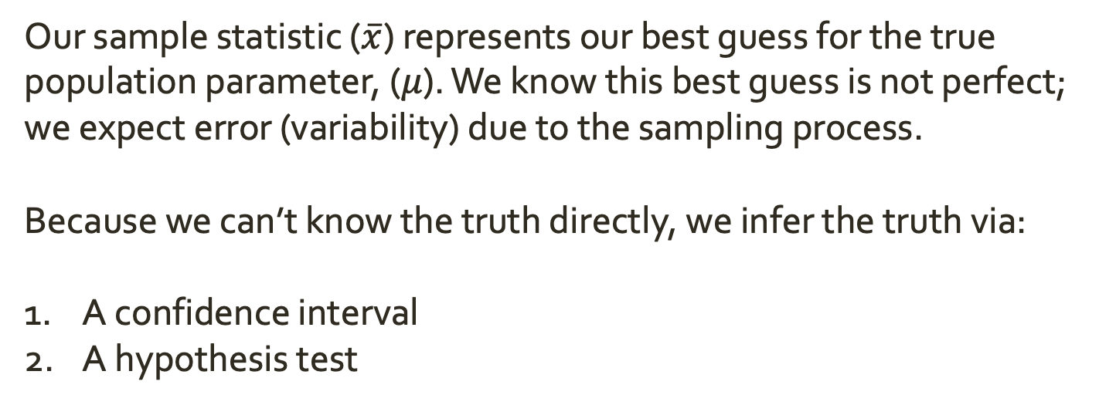
Inference for a Single Mean
Our sample statistic ($\overline{x}$) represents our best guess for the true population parameter, ($μ$). We know this best guess is not perfect; we expect error (variability) due to the sampling process.
Because we can’t know the truth directly, we infer the truth via:
A confidence interval
A hypothesis test
Notes:
hypotheses
test statistic
null distribution (assumptions)
p-value

Slide 7
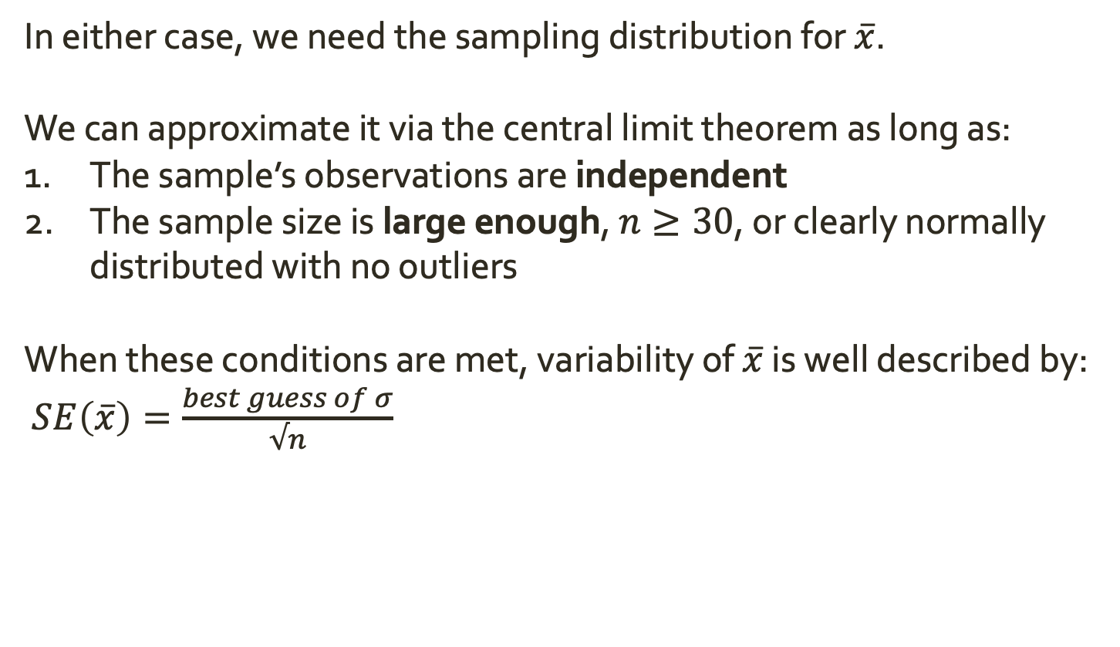
Inference for a Single Mean
In either case, we need the sampling distribution for $\overline{x}$.
We can approximate it via the central limit theorem as long as:
The sample’s observations are independent
The sample size is large enough, $n≥30$, or clearly normally distributed with no outliers
When these conditions are met, variability of $\overline{x}$ is well described by:
$SE\left(\overline{x}\right)=\frac{best guess of σ}{√n}$

Slide 8
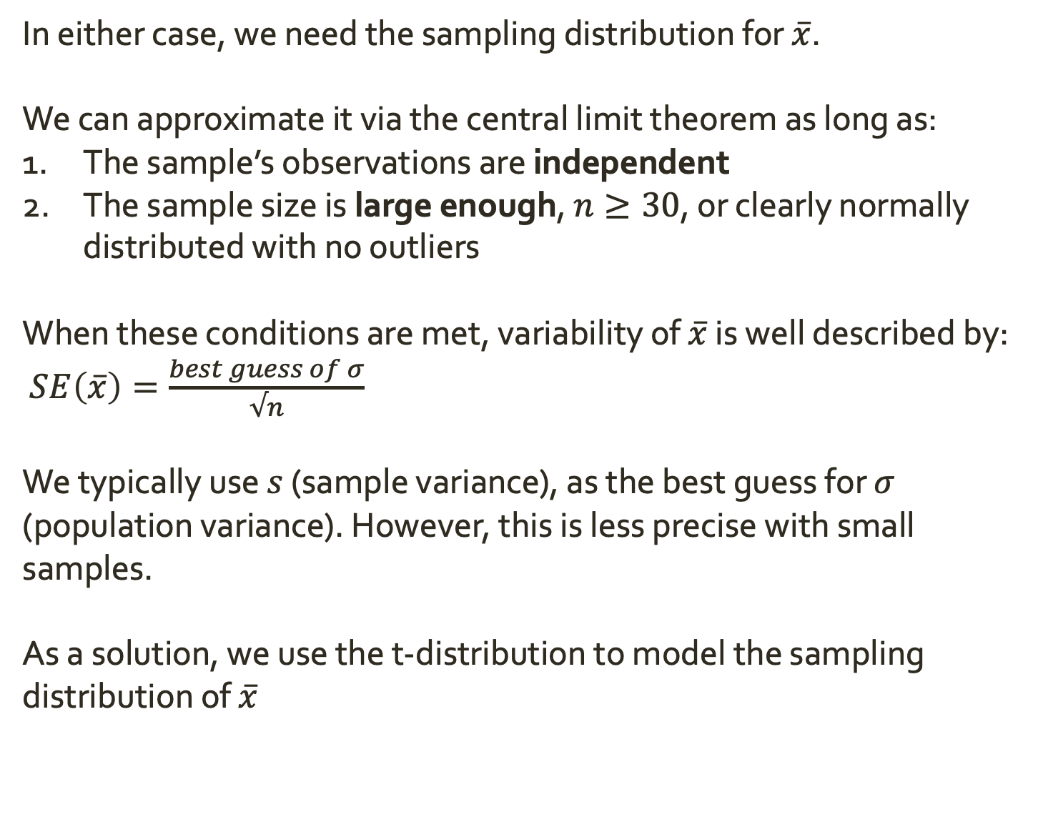
Inference for a Single Mean
In either case, we need the sampling distribution for $\overline{x}$.
We can approximate it via the central limit theorem as long as:
The sample’s observations are independent
The sample size is large enough, $n≥30$, or clearly normally distributed with no outliers
When these conditions are met, variability of $\overline{x}$ is well described by:
$SE\left(\overline{x}\right)=\frac{best guess of σ}{√n}$
We typically use $s$ (sample variance), as the best guess for $σ$ (population variance). However, this is less precise with small samples.
As a solution, we use the t-distribution to model the sampling distribution of $\overline{x}$

Slide 9
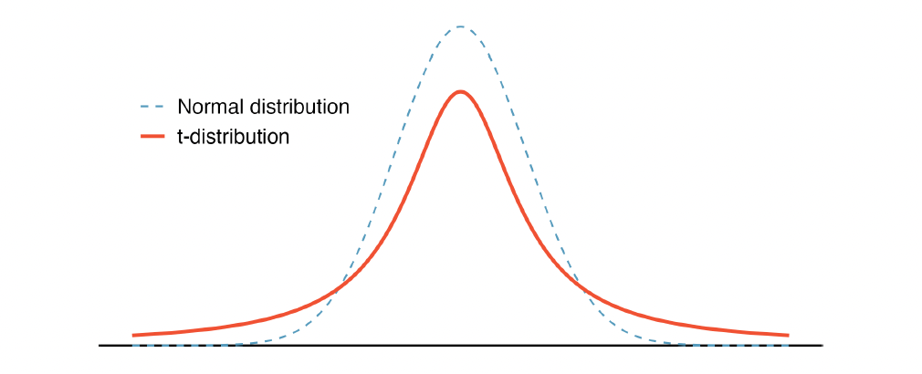
The t-distribution
The t-distribution is similar to the normal distribution, but has thicker tails.
This means observations are more likely to fall more than two standard deviations away from the mean. In other words, it accounts for more variance than the normal distribution.

Slide 10
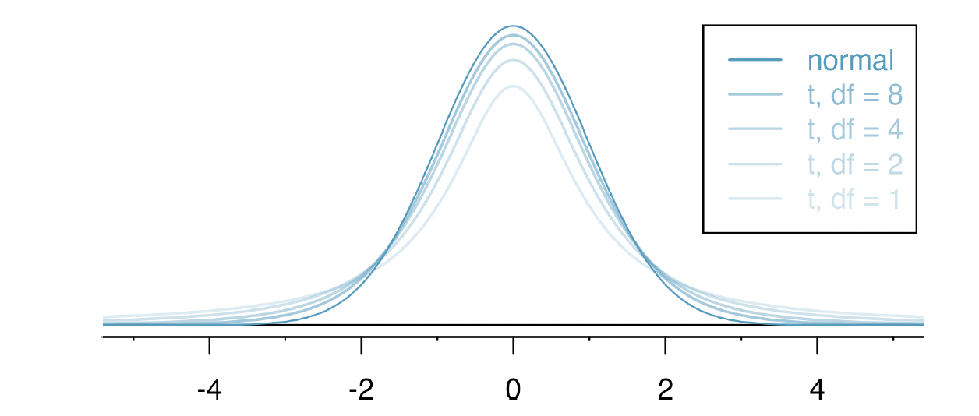
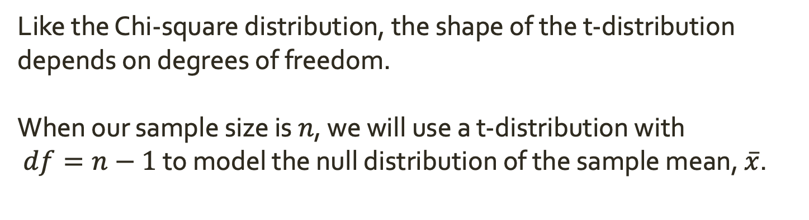
The t-distribution
Like the Chi-square distribution, the shape of the t-distribution depends on degrees of freedom.
When our sample size is $n$, we will use a t-distribution with
$df=n−1$ to model the null distribution of the sample mean, $\overline{x}$.

Slide 11
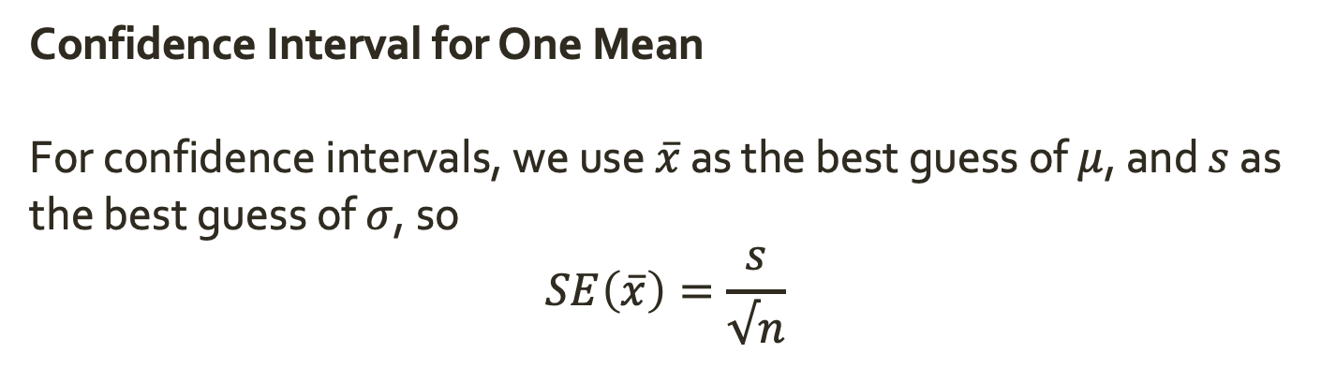
Inference for a Single Mean
Confidence Interval for One Mean
For confidence intervals, we use $\overline{x}$ as the best guess of $μ$, and $s$ as the best guess of $σ$, so
$$SE\left(\overline{x}\right)=\frac{s}{√n}$$

Slide 12
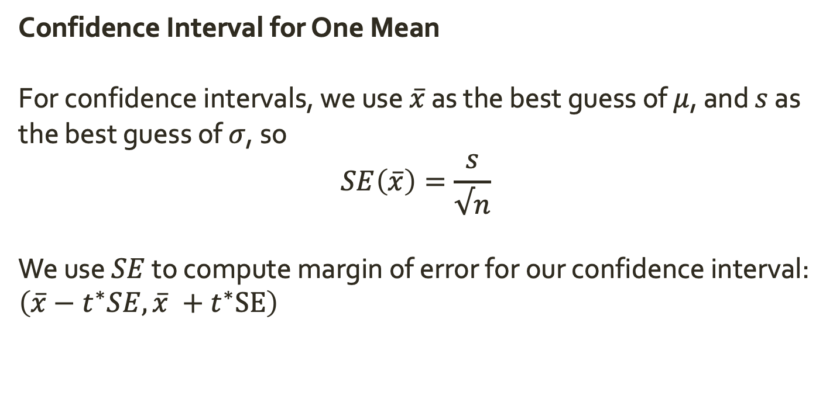
Inference for a Single Mean
Confidence Interval for One Mean
For confidence intervals, we use $\overline{x}$ as the best guess of $μ$, and $s$ as the best guess of $σ$, so
$$SE\left(\overline{x}\right)=\frac{s}{√n}$$
We use $SE$ to compute margin of error for our confidence interval: $\left(\overline{x}−t^{∗}SE,\overline{x} +t^{∗}SE\right)$

Slide 13
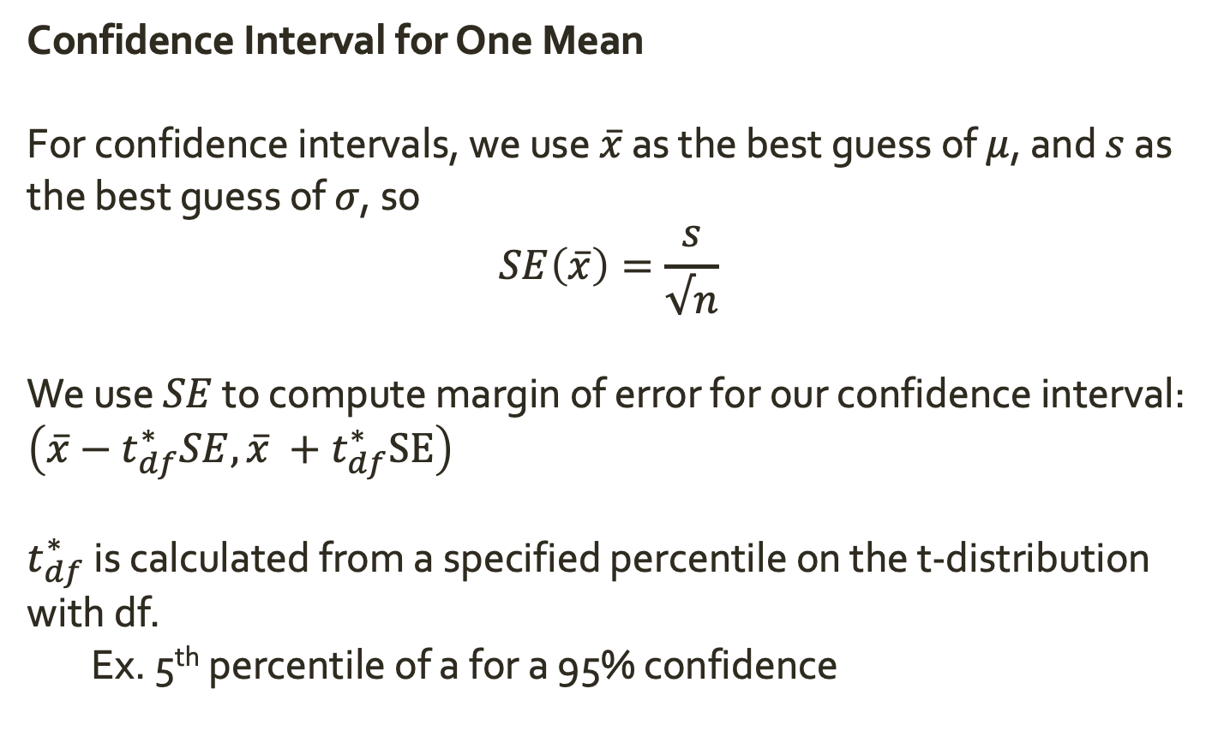
Inference for a Single Mean
Confidence Interval for One Mean
For confidence intervals, we use $\overline{x}$ as the best guess of $μ$, and $s$ as the best guess of $σ$, so
$$SE\left(\overline{x}\right)=\frac{s}{√n}$$
We use $SE$ to compute margin of error for our confidence interval: $\left(\overline{x}−t_{df}^{∗}SE,\overline{x} +t_{df}^{∗}SE\right)$
$t_{df}^{∗}$ is calculated from a specified percentile on the t-distribution with df.
Ex. 5th percentile of a for a 95% confidence

Slide 14
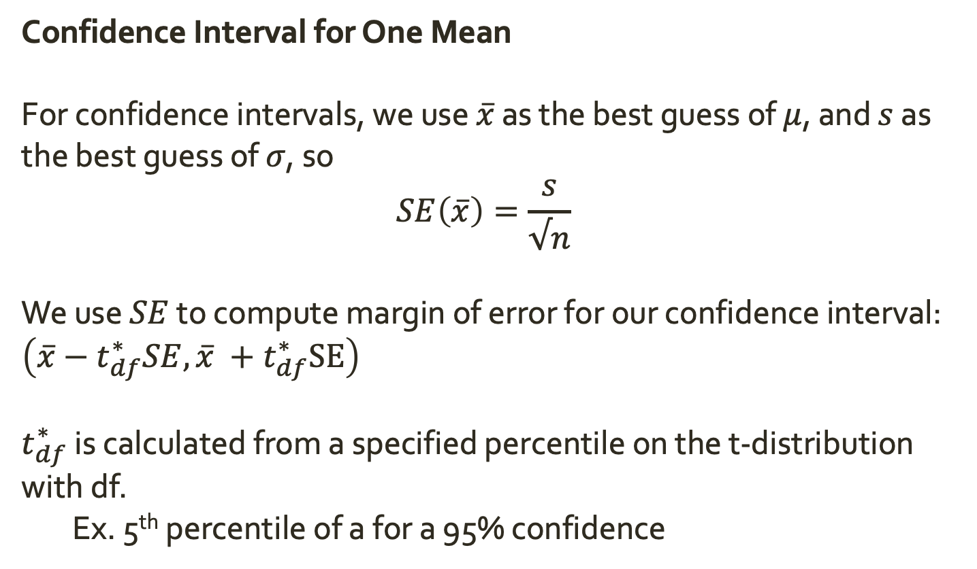

Inference for a Single Mean
Confidence Interval for One Mean
For confidence intervals, we use $\overline{x}$ as the best guess of $μ$, and $s$ as the best guess of $σ$, so
$$SE\left(\overline{x}\right)=\frac{s}{√n}$$
We use $SE$ to compute margin of error for our confidence interval: $\left(\overline{x}−t_{df}^{∗}SE,\overline{x} +t_{df}^{∗}SE\right)$
$t_{df}^{∗}$ is calculated from a specified percentile on the t-distribution with df.
Ex. 5th percentile of a for a 95% confidence
Find $t_{99}^{∗}$ for a 95% CI, a 90% CI, and a 99% CI

Slide 15
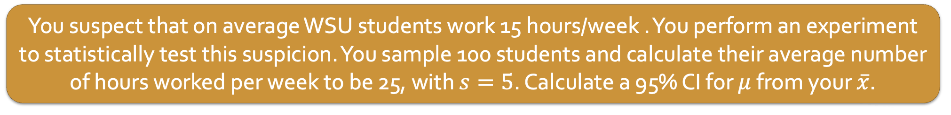
Inference for a Single Mean
Confidence Interval for One Mean
For confidence intervals, we use $\overline{x}$ as the best guess of $μ$, and $s$ as the best guess of $σ$, so
$$SE\left(\overline{x}\right)=\frac{s}{√n}$$
We use $SE$ to compute margin of error for our confidence interval: $\left(\overline{x}−t_{df}^{∗}SE,\overline{x} +t_{df}^{∗}SE\right)$
$t_{df}^{∗}$ is calculated from a specified percentile on the t-distribution with df.
Ex. 5th percentile of a for a 95% confidence
You suspect that on average WSU students work 15 hours/week . You perform an experiment to statistically test this suspicion. You sample 100 students and calculate their average number of hours worked per week to be 25, with $s=5$. Calculate a 95% CI for $μ$ from your $\overline{x}$.

Slide 16
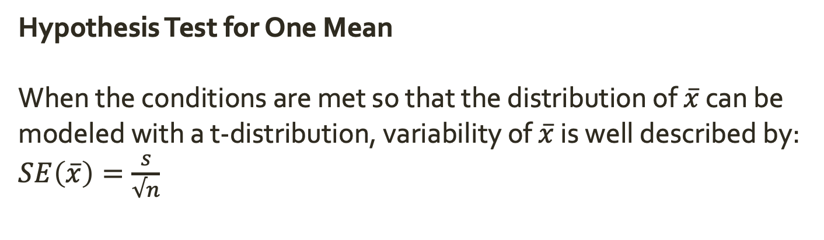
Inference for a Single Mean
Hypothesis Test for One Mean
When the conditions are met so that the distribution of $\overline{x}$ can be modeled with a t-distribution, variability of $\overline{x}$ is well described by:
$SE\left(\overline{x}\right)=\frac{s}{√n}$

Slide 17
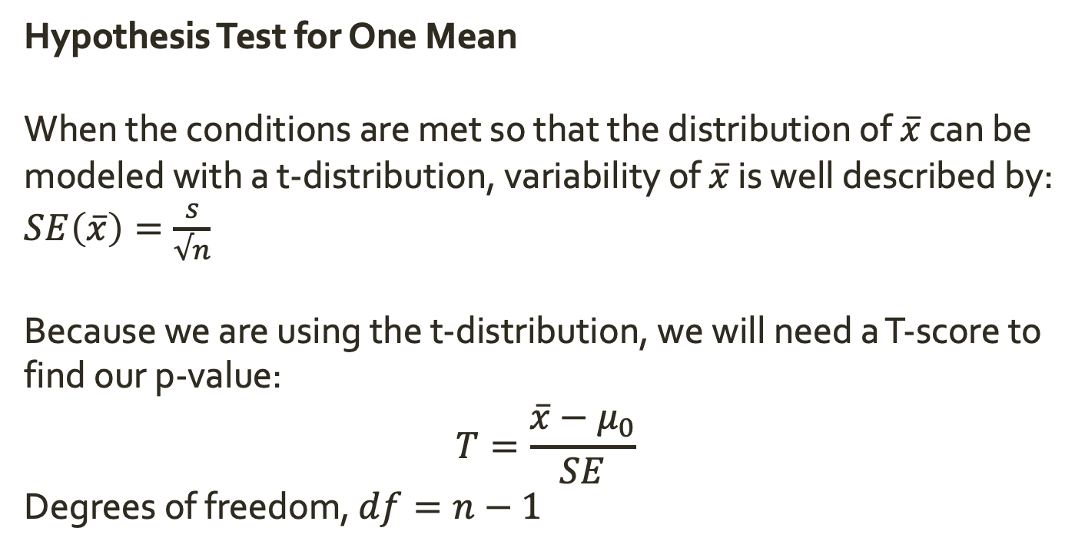
Inference for a Single Mean
Hypothesis Test for One Mean
When the conditions are met so that the distribution of $\overline{x}$ can be modeled with a t-distribution, variability of $\overline{x}$ is well described by:
$SE\left(\overline{x}\right)=\frac{s}{√n}$
Because we are using the t-distribution, we will need a T-score to find our p-value:
$$T=\frac{\overline{x}−μ_{0}}{SE}$$
Degrees of freedom, $df=n−1$

Slide 18
Start here Thursday

Slide 19
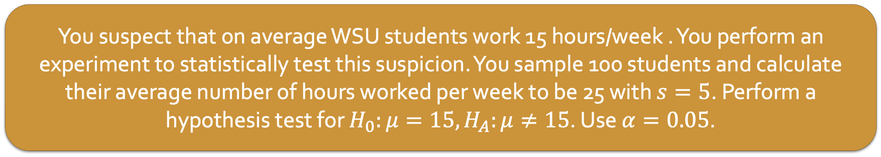
Inference for a Single Mean
Hypothesis Test for One Mean
When the conditions are met so that the distribution of $\overline{x}$ can be modeled with a t-distribution, variability of $\overline{x}$ is well described by:
$SE\left(\overline{x}\right)=\frac{s}{√n}$
Because we are using the t-distribution, we will need a T-score to find our p-value:
$$T=\frac{\overline{x}−μ_{0}}{SE}$$
Degrees of freedom, $df=n−1$
You suspect that on average WSU students work 15 hours/week . You perform an experiment to statistically test this suspicion. You sample 100 students and calculate their average number of hours worked per week to be 25 with $s=5$. Perform a hypothesis test for $H_{0}:μ=15, H_{A}:μ≠15$. Use $α=0.05$.

Slide 20
Inference for Two Independent Means
So far, we’ve done inference to see if our population mean differs from some hypothesized value.
Ex. Is the average number of hours WSU students work per week 15?
Sometimes our research question instead focuses on comparing means from two independent groups.
Ex. Is the average number of hours WSU students work per week different than the average number of hours Springfield College students work per week?

Slide 21
Inference for Two Independent Means
So far, we’ve done inference to see if our population mean differs from some hypothesized value.
Ex. Is the average number of hours WSU students work per week 15?
Sometimes our research question instead focuses on comparing means from two independent groups.
Ex. Is the average number of hours WSU students work per week different than the average number of hours Springfield College students work per week?
Just like with one mean, we can use sample statistics to infer the population level answer to this question with
(a) a confidence interval and/or
(b) a hypothesis test

Slide 22
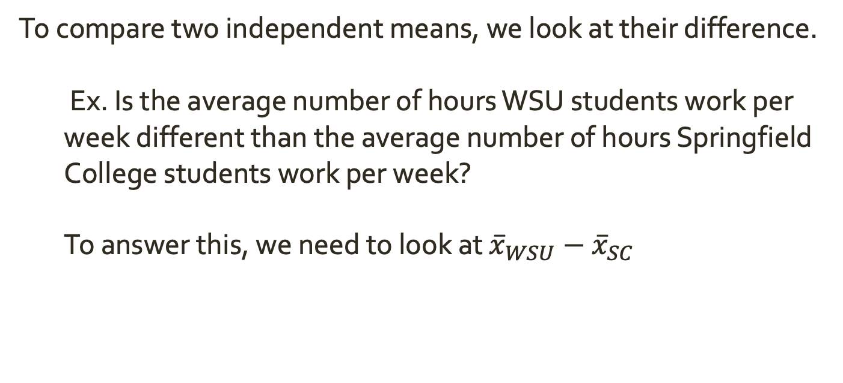
Inference for Two Independent Means
To compare two independent means, we look at their difference.
Ex. Is the average number of hours WSU students work per week different than the average number of hours Springfield College students work per week?
To answer this, we need to look at ${\overline{x}}_{WSU}−{\overline{x}}_{SC}$

Slide 23
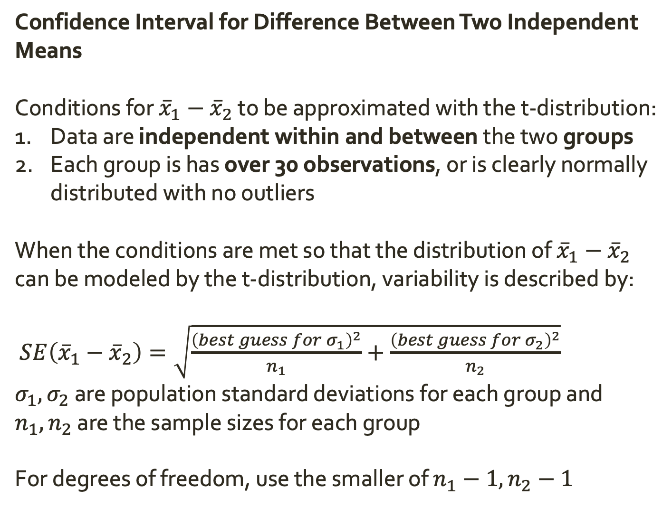
Inference for Two Independent Means
Confidence Interval for Difference Between Two Independent Means
Conditions for ${\overline{x}}_{1}−{\overline{x}}_{2}$ to be approximated with the t-distribution:
Data are independent within and between the two groups
Each group is has over 30 observations, or is clearly normally distributed with no outliers
When the conditions are met so that the distribution of ${\overline{x}}_{1}−{\overline{x}}_{2}$ can be modeled by the t-distribution, variability is described by:
$SE\left({\overline{x}}_{1}−{\overline{x}}_{2}\right)=\sqrt{\frac{{\left(best guess for σ_{1}\right)}^{2}}{n_{1}}+\frac{{\left(best guess for σ_{2}\right)}^{2}}{n_{2}}}$
$σ_{1}, σ_{2}$ are population standard deviations for each group and $n_{1},n_{2}$ are the sample sizes for each group
For degrees of freedom, use the smaller of $n_{1}−1, n_{2}−1$

Slide 24
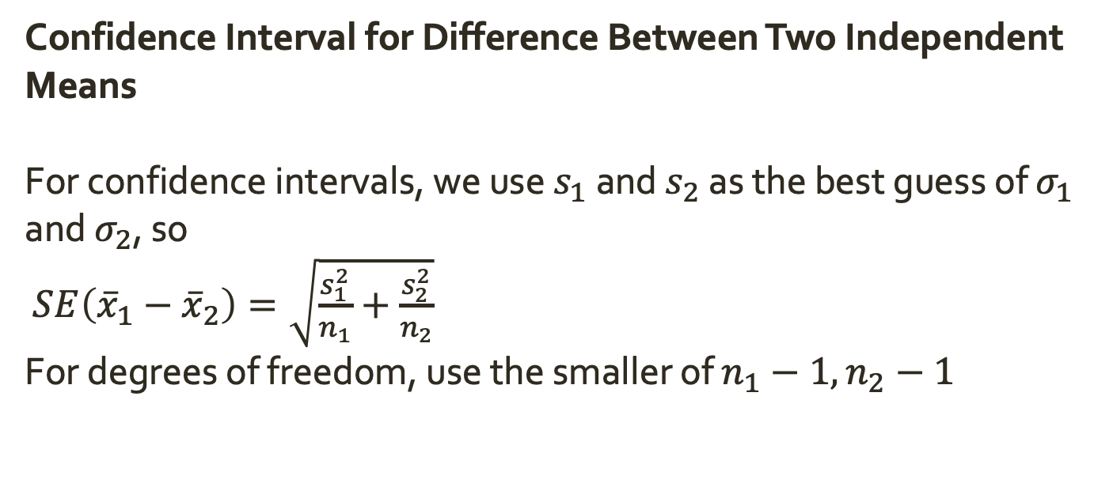
Inference for Two Independent Means
Confidence Interval for Difference Between Two Independent Means
For confidence intervals, we use $s_{1}$ and $s_{2}$ as the best guess of $σ_{1}$ and $σ_{2}$, so
$SE\left({\overline{x}}_{1}−{\overline{x}}_{2}\right)=\sqrt{\frac{s_{1}^{2}}{n_{1}}+\frac{s_{2}^{2}}{n_{2}}}$
For degrees of freedom, use the smaller of $n_{1}−1, n_{2}−1$

Slide 25
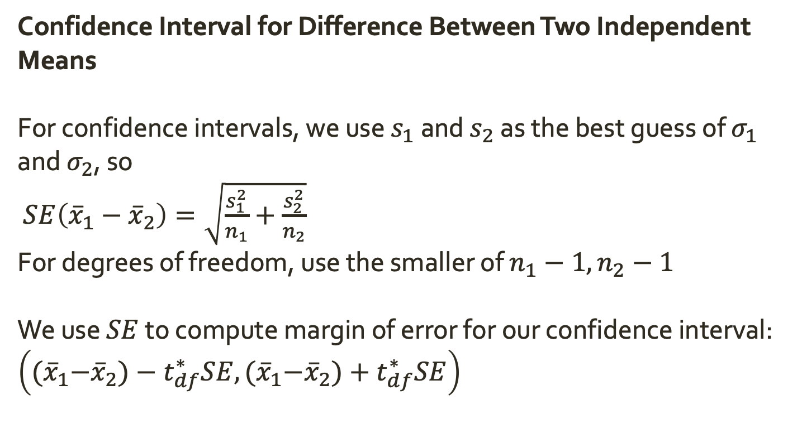
Inference for Two Independent Means
Confidence Interval for Difference Between Two Independent Means
For confidence intervals, we use $s_{1}$ and $s_{2}$ as the best guess of $σ_{1}$ and $σ_{2}$, so
$SE\left({\overline{x}}_{1}−{\overline{x}}_{2}\right)=\sqrt{\frac{s_{1}^{2}}{n_{1}}+\frac{s_{2}^{2}}{n_{2}}}$
For degrees of freedom, use the smaller of $n_{1}−1, n_{2}−1$
We use $SE$ to compute margin of error for our confidence interval: $\left({(\overline{x}}_{1}−{\overline{x}}_{2})−t_{df}^{∗}SE,{(\overline{x}}_{1}−{\overline{x}}_{2})+t_{df}^{∗}SE\right)$

Slide 26
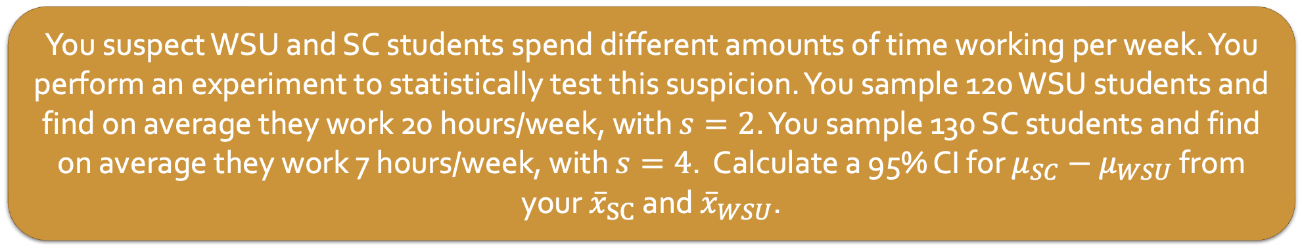
Inference for Two Independent Means
Confidence Interval for Difference Between Two Independent Means
For confidence intervals, we use $s_{1}$ and $s_{2}$ as the best guess of $σ_{1}$ and $σ_{2}$, so
$SE\left({\overline{x}}_{1}−{\overline{x}}_{2}\right)=\sqrt{\frac{s_{1}^{2}}{n_{1}}+\frac{s_{2}^{2}}{n_{2}}}$
For degrees of freedom, use the smaller of $n_{1}−1, n_{2}−1$
We use $SE$ to compute margin of error for our confidence interval: $\left({(\overline{x}}_{1}−{\overline{x}}_{2})−t_{df}^{∗}SE,{(\overline{x}}_{1}−{\overline{x}}_{2})+t_{df}^{∗}SE\right)$
You suspect WSU and SC students spend different amounts of time working per week. You perform an experiment to statistically test this suspicion. You sample 120 WSU students and find on average they work 20 hours/week, with $s=2$. You sample 130 SC students and find on average they work 7 hours/week, with $s=4$. Calculate a 95% CI for $μ_{SC}−μ_{WSU}$ from your ${\overline{x}}_{SC}$ and ${\overline{x}}_{WSU}$.

Slide 27
Inference for Two Independent Means
Hypothesis Test for Difference Between Two Independent Means
For a hypothesis test, our null hypothesis will be that there is no difference between means.

Slide 28
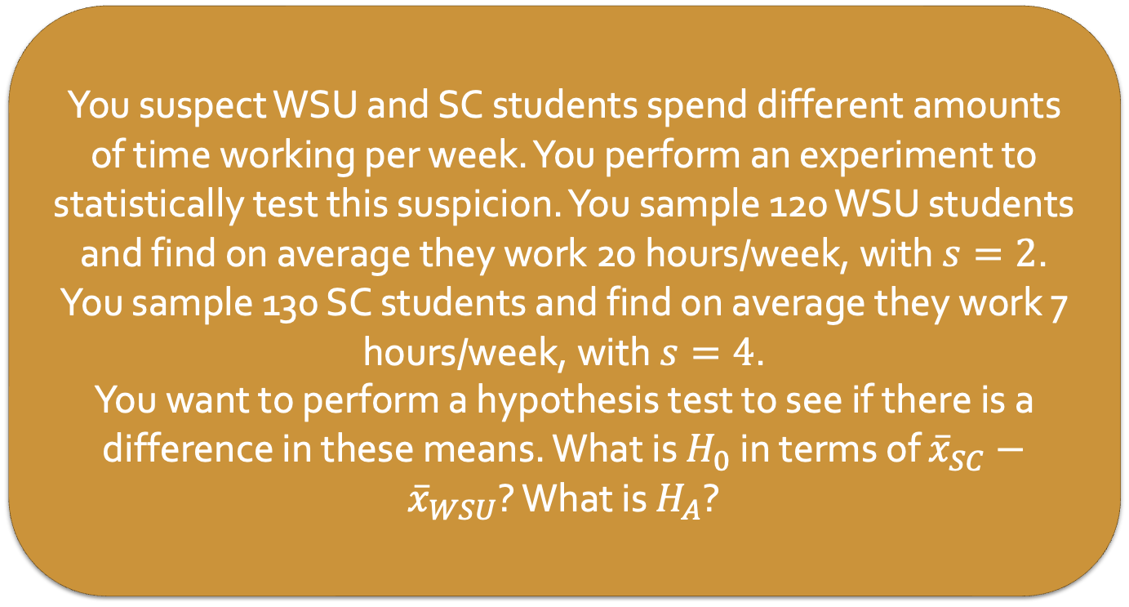
Inference for Two Independent Means
Hypothesis Test for Difference Between Two Independent Means
For a hypothesis test, our null hypothesis will be that there is no difference between means.
You suspect WSU and SC students spend different amounts of time working per week. You perform an experiment to statistically test this suspicion. You sample 120 WSU students and find on average they work 20 hours/week, with $s=2$. You sample 130 SC students and find on average they work 7 hours/week, with $s=4$.
You want to perform a hypothesis test to see if there is a difference in these means. What is $H_{0}$ in terms of ${\overline{x}}_{SC}−{\overline{x}}_{WSU}$? What is $H_{A}$?

Slide 29
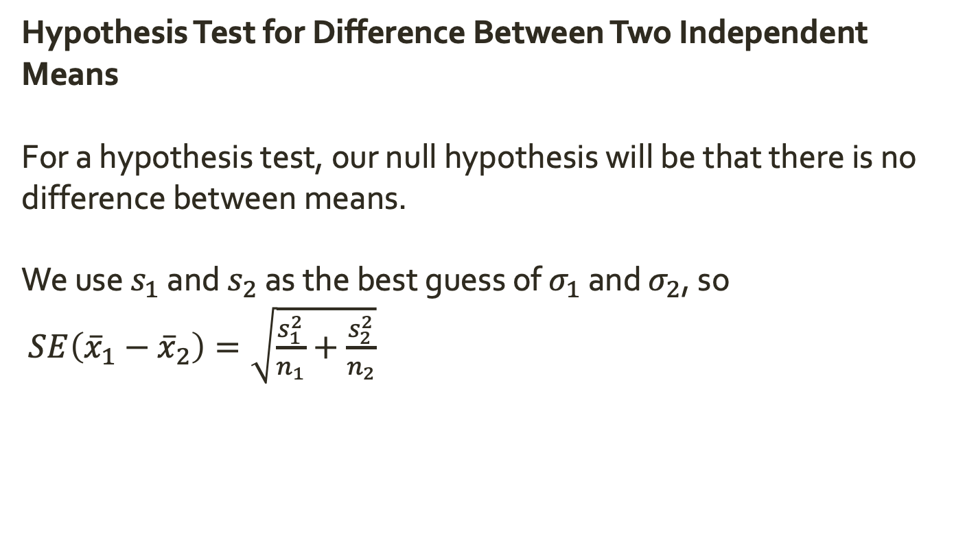
Inference for Two Independent Means
Hypothesis Test for Difference Between Two Independent Means
For a hypothesis test, our null hypothesis will be that there is no difference between means.
We use $s_{1}$ and $s_{2}$ as the best guess of $σ_{1}$ and $σ_{2}$, so
$SE\left({\overline{x}}_{1}−{\overline{x}}_{2}\right)=\sqrt{\frac{s_{1}^{2}}{n_{1}}+\frac{s_{2}^{2}}{n_{2}}}$

Slide 30
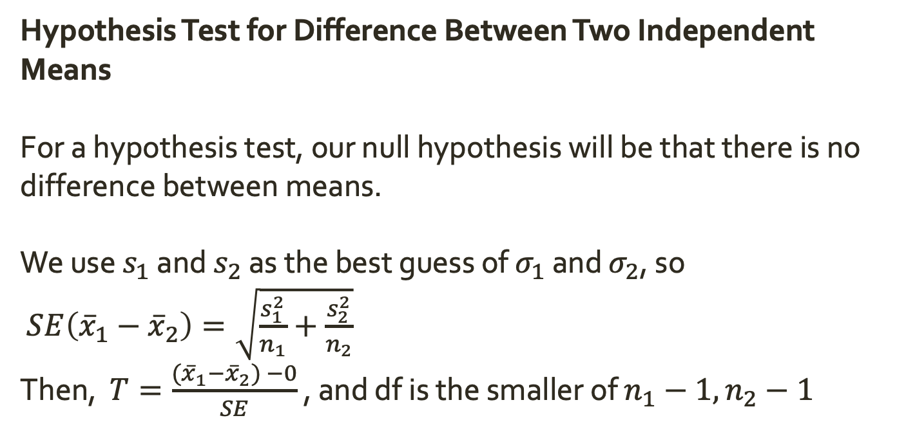
Inference for Two Independent Means
Hypothesis Test for Difference Between Two Independent Means
For a hypothesis test, our null hypothesis will be that there is no difference between means.
We use $s_{1}$ and $s_{2}$ as the best guess of $σ_{1}$ and $σ_{2}$, so
$SE\left({\overline{x}}_{1}−{\overline{x}}_{2}\right)=\sqrt{\frac{s_{1}^{2}}{n_{1}}+\frac{s_{2}^{2}}{n_{2}}}$
Then, $T=\frac{{(\overline{x}}_{1}−{\overline{x}}_{2}) −0}{SE}$ , and df is the smaller of $n_{1}−1, n_{2}−1$

Slide 31
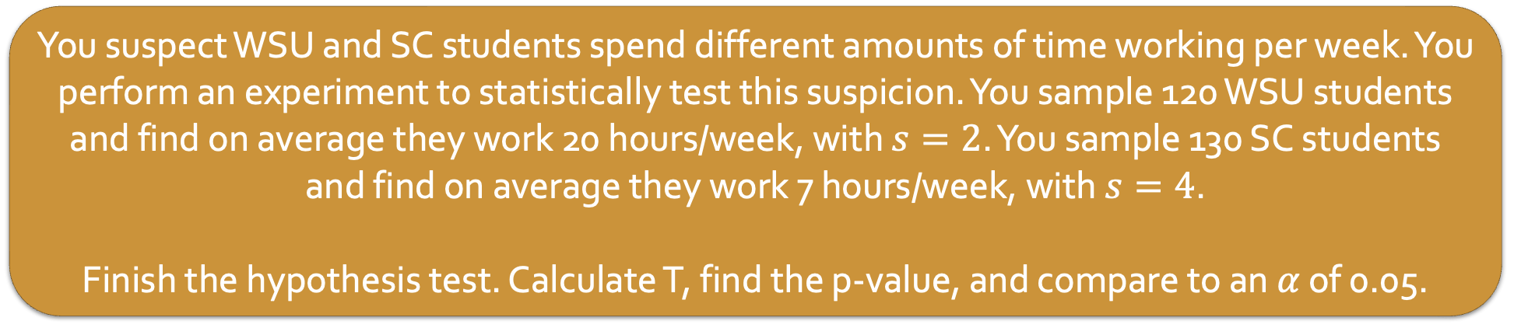
Inference for Two Independent Means
Hypothesis Test for Difference Between Two Independent Means
For a hypothesis test, our null hypothesis will be that there is no difference between means.
We use $s_{1}$ and $s_{2}$ as the best guess of $σ_{1}$ and $σ_{2}$, so
$SE\left({\overline{x}}_{1}−{\overline{x}}_{2}\right)=\sqrt{\frac{s_{1}^{2}}{n_{1}}+\frac{s_{2}^{2}}{n_{2}}}$
Then, $T=\frac{{(\overline{x}}_{1}−{\overline{x}}_{2}) −0}{SE}$ , and df is the smaller of $n_{1}−1, n_{2}−1$
You suspect WSU and SC students spend different amounts of time working per week. You perform an experiment to statistically test this suspicion. You sample 120 WSU students and find on average they work 20 hours/week, with $s=2$. You sample 130 SC students and find on average they work 7 hours/week, with $s=4$.
Finish the hypothesis test. Calculate T, find the p-value, and compare to an $α$ of 0.05.

Slide 32
Inference for Two Independent Means
Hypothesis Test for Difference Between Two Independent Means
For a hypothesis test, our null hypothesis will be that there is no difference between means.
We use $s_{1}$ and $s_{2}$ as the best guess of $σ_{1}$ and $σ_{2}$, so
$SE\left({\overline{x}}_{1}−{\overline{x}}_{2}\right)=\sqrt{\frac{s_{1}^{2}}{n_{1}}+\frac{s_{2}^{2}}{n_{2}}}$
Then, $T=\frac{{(\overline{x}}_{1}−{\overline{x}}_{2}) −0}{SE}$ , and df is the smaller of $n_{1}−1, n_{2}−1$
A group of researchers who are interested in the possible effects of distracting stimuli during eating, such as an increase or decrease in the amount of food consumption, monitored food intake for a group of 44 patients who were randomized into two equal groups. The treatment group ate lunch while playing solitaire, and the control group ate lunch without any added distractions. Patients in the treatment group ate 52.1 grams of biscuits, with a standard deviation of 45.1 grams, and patients in the control group ate 27.1 grams of biscuits, with a standard deviation of 26.4 grams. Do these data provide convincing evidence that the average food intake (measured in amount of biscuits consumed) is different for the patients in the treatment group compared to the control group? Assume that conditions for conducting inference using mathematical models are satisfied.

