Slide 1
Elementary Statistics – Decision Errors and Power
Dr. Ab Mosca (they/them)
Slides based off slides courtesy of Kaitlyn Cook (https://www.smith.edu/people/kaitlyn-cook)

Slide 2
Reminder
It is your responsibility to submit your assignments on Gradescope (and quizzes on PLATO) on time
A lot of people are missing submissions – I will not track you down and I will not accept late assignments

Slide 3
Plan for Today
Hypothesis Testing
Decision Errors
Power

Slide 4
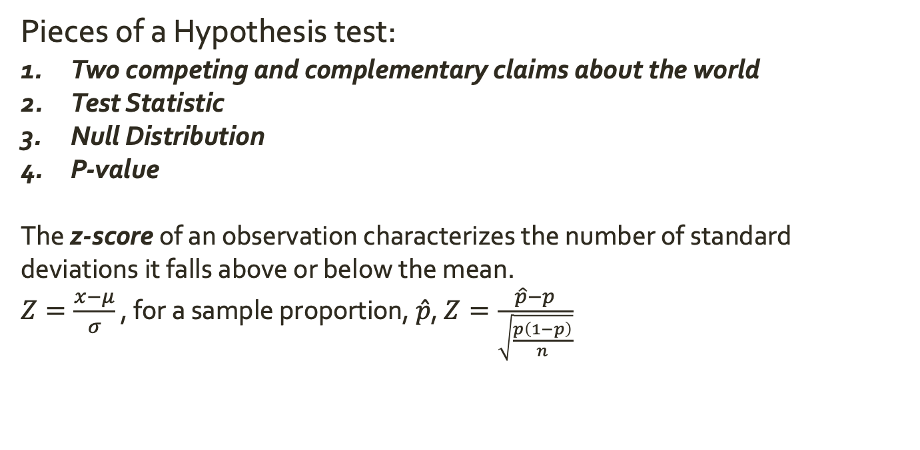
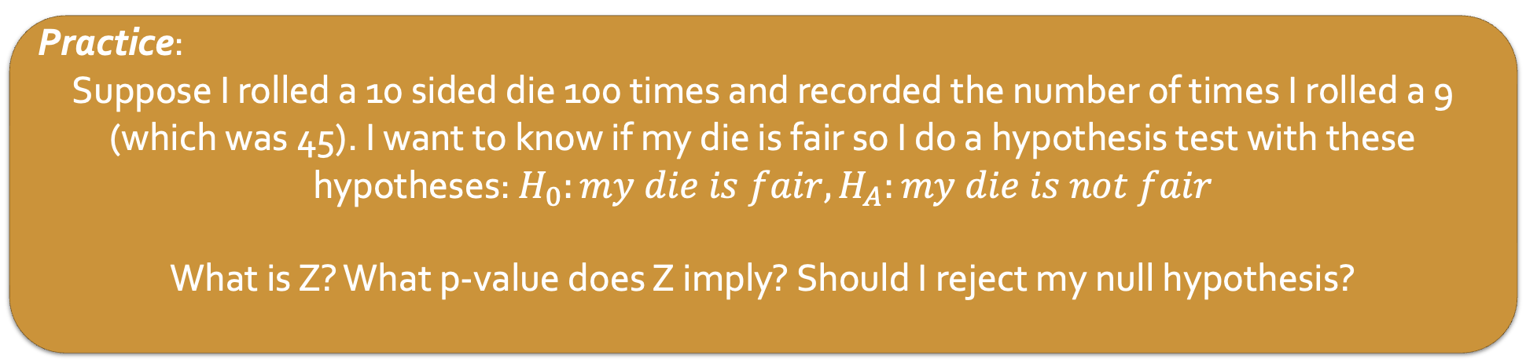
Warm Up: Statistics and CIs
Pieces of a Hypothesis test:
Two competing and complementary claims about the world
Test Statistic
Null Distribution
P-value
The z-score of an observation characterizes the number of standard deviations it falls above or below the mean.
$Z=\frac{x−μ}{σ}$ , for a sample proportion, $\hat{p}$, $Z=\frac{\hat{p}−p}{\sqrt{\frac{p\left(1−p\right)}{n}}}$
Practice:
Suppose I rolled a 10 sided die 100 times and recorded the number of times I rolled a 9 (which was 45). I want to know if my die is fair so I do a hypothesis test with these hypotheses: $H_{0}:my die is fair, H_{A}:my die is not fair$
What is Z? What p-value does Z imply? Should I reject my null hypothesis?

Slide 5
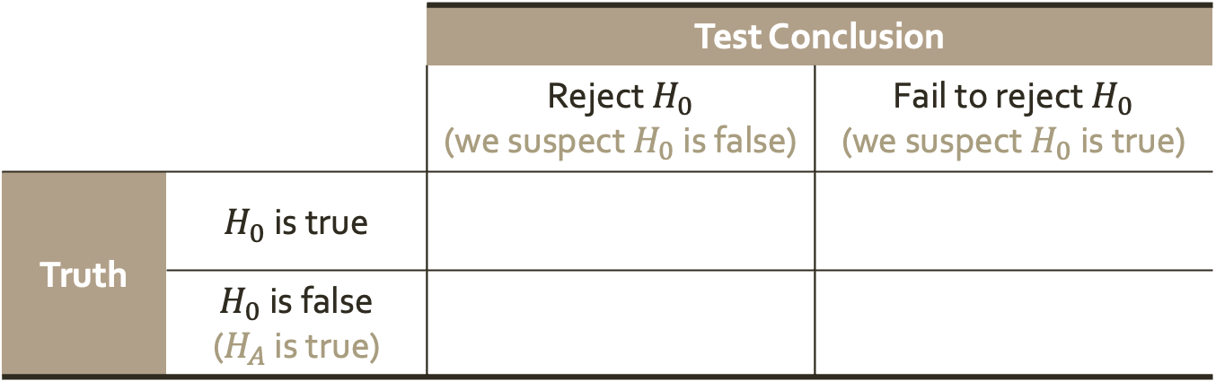
Outcomes of a Hypothesis Test
A hypothesis test has 4 possible outcomes
 |  | Test Conclusion
 |  | Reject $H_{0}$ (we suspect $H_{0}$ is false) | Fail to reject $H_{0}$ (we suspect $H_{0}$ is true)
Truth | $H_{0}$ is true
 | $H_{0}$ is false ($H_{A}$ is true)
A
B
C
D
In which scenario(s) have we made the correct decision? Why?

Slide 6

Outcomes of a Hypothesis Test
A hypothesis test has 4 possible outcomes
 |  | Test Conclusion
 |  | Reject $H_{0}$ (we suspect $H_{0}$ is false) | Fail to reject $H_{0}$ (we suspect $H_{0}$ is true)
Truth | $H_{0}$ is true
 | $H_{0}$ is false ($H_{A}$ is true)
A
D

Slide 7
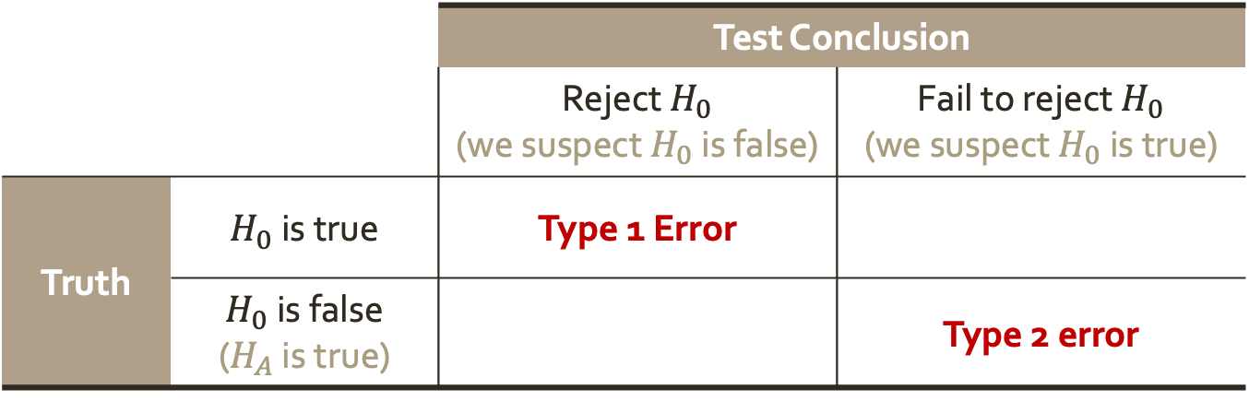
Decision Errors
A hypothesis test has 4 possible outcomes
 |  | Test Conclusion
 |  | Reject $H_{0}$ (we suspect $H_{0}$ is false) | Fail to reject $H_{0}$ (we suspect $H_{0}$ is true)
Truth | $H_{0}$ is true | Type 1 Error
 | $H_{0}$ is false ($H_{A}$ is true) |  | Type 2 error

Slide 8

Decision Errors
A hypothesis test has 4 possible outcomes
Because we reject $H_{0}$ when $p≤α$, the probability of a Type 1 error is $α$
The probability of a Type 2 error is $β$
 |  | Test Conclusion
 |  | Reject $H_{0}$ (we suspect $H_{0}$ is false) | Fail to reject $H_{0}$ (we suspect $H_{0}$ is true)
Truth | $H_{0}$ is true | Type 1 Error
 | $H_{0}$ is false ($H_{A}$ is true) |  | Type 2 error

Slide 9

Decision Errors
A hypothesis test has 4 possible outcomes
Because we reject $H_{0}$ when $p≤α$, the probability of a Type 1 error is $α$
The probability of a Type 2 error is $β$
The power of a statistical test is the probability of correctly rejecting a false $H_{0}$ ($1−β$)
 |  | Test Conclusion
 |  | Reject $H_{0}$ (we suspect $H_{0}$ is false) | Fail to reject $H_{0}$ (we suspect $H_{0}$ is true)
Truth | $H_{0}$ is true | Type 1 Error
 | $H_{0}$ is false ($H_{A}$ is true) |  | Type 2 error

Slide 10


Decision Errors
 |  | Test Conclusion
 |  | Reject $H_{0}$ (we suspect $H_{0}$ is false) | Fail to reject $H_{0}$ (we suspect $H_{0}$ is true)
Truth | $H_{0}$ is true | Type 1 Error
 | $H_{0}$ is false ($H_{A}$ is true) |  | Type 2 error
Because we reject $H_{0}$ when $p≤α$, the probability of a Type 1 error is $α$
The probability of a Type 2 error is $β$
The power of a statistical test is the probability of correctly rejecting a false $H_{0}$ ($1−β$)
Suppose you are the manager of a professional baseball team.
One of the players on your team consistently had a 0.250 batting average (they hit about one out of every four times at the plate).
When you sit down to negotiate, this player claims they have been working hard in the off season and improved to become a 0.333 hitter.
Should you offer this player a raise (at the expense of another players salary)?
What is the parameter of interest in this context?
If you were to conduct a hypothesis test, what would your null and alternative hypotheses be?
What would a Type 1 error be in the context of this problem?
What would a Type 2 error be in the context of this problem?
Who would be most worried about each type of error (you or the player)?

Slide 11
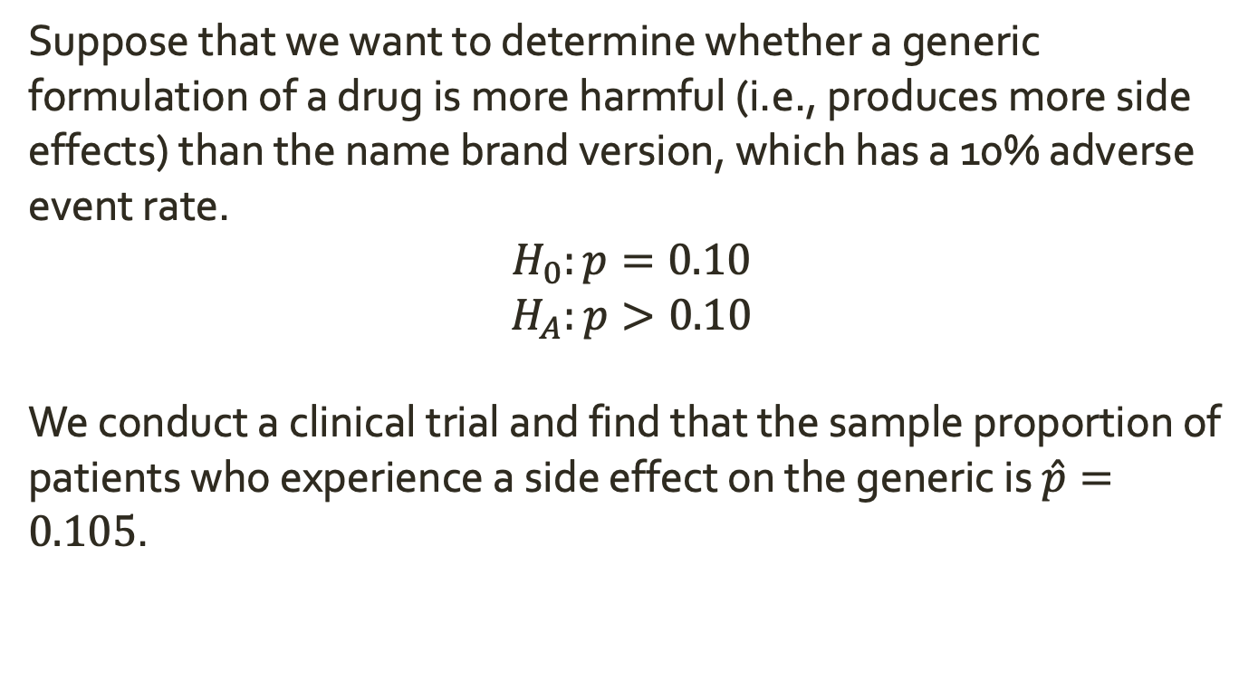
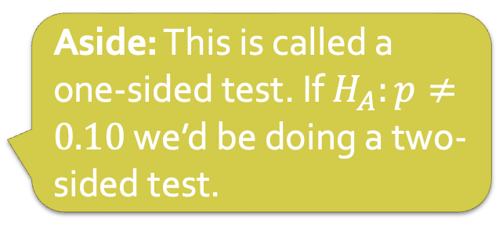
Practical Significance
Suppose that we want to determine whether a generic formulation of a drug is more harmful (i.e., produces more side effects) than the name brand version, which has a 10% adverse event rate.
$$H_{0}:p=0.10$$
$$H_{A}:p>0.10$$
We conduct a clinical trial and find that the sample proportion of patients who experience a side effect on the generic is $\hat{p}=0.105$.
Aside: This is called a one-sided test. If $H_{A}:p≠0.10$ we’d be doing a two-sided test.

Slide 12
Practical Significance
Suppose that we want to determine whether a generic formulation of a drug is more harmful (i.e., produces more side effects) than the name brand version, which has a 10% adverse event rate.
$$H_{0}:p=0.10$$
$$H_{A}:p>0.10$$
We conduct a clinical trial and find that the sample proportion of patients who experience a side effect on the generic is $\hat{p}=0.105$.
What is the corresponding z-score if the sample size for the trial is n = 100?
What is the corresponding z-score if the sample size for the trial is n = 50000?

