Slide 1
Elementary Statistics – Inference for Categorical Data Pt. 1
Dr. Ab Mosca (they/them)
Slides based off slides courtesy of Kaitlyn Cook (https://www.smith.edu/people/kaitlyn-cook)

Slide 2
Plan for Today
Inference for comparing two proportions

Slide 3
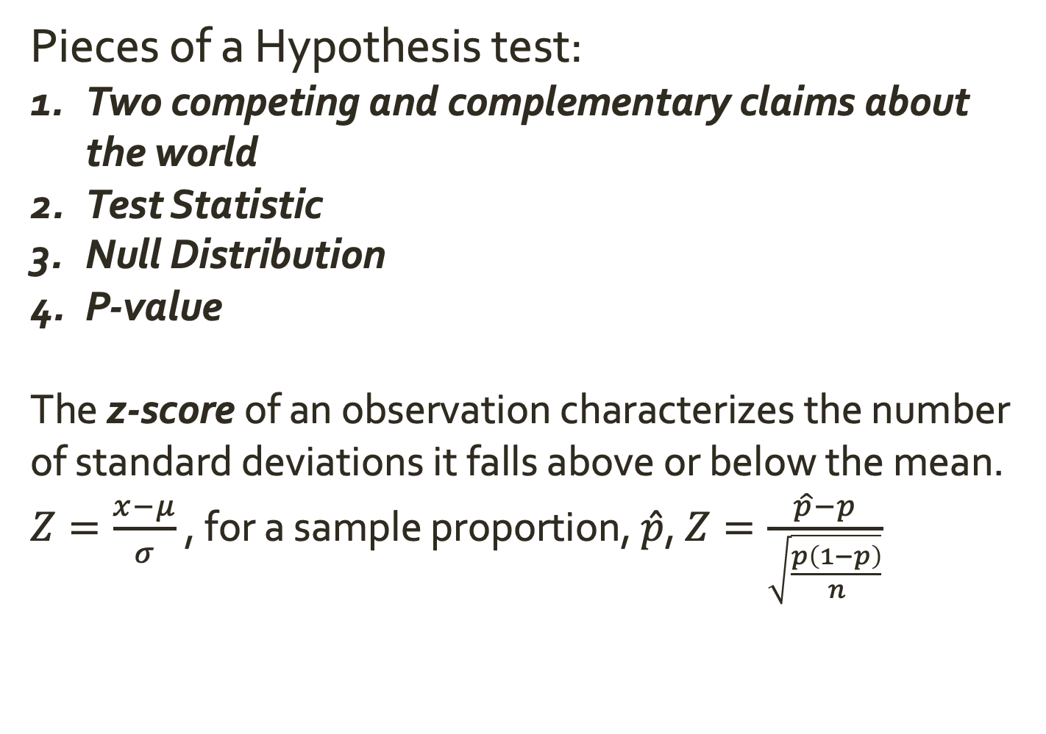
Reminder: Statistics and CIs
Pieces of a Hypothesis test:
Two competing and complementary claims about the world
Test Statistic
Null Distribution
P-value
The z-score of an observation characterizes the number of standard deviations it falls above or below the mean.
$Z=\frac{x−μ}{σ}$ , for a sample proportion, $\hat{p}$, $Z=\frac{\hat{p}−p}{\sqrt{\frac{p\left(1−p\right)}{n}}}$

Slide 4
Reminder: Statistics and CIs
Pieces of a Hypothesis test:
Two competing and complementary claims about the world
Test Statistic
Null Distribution
P-value
The z-score of an observation characterizes the number of standard deviations it falls above or below the mean.
$Z=\frac{x−μ}{σ}$ , for a sample proportion, $\hat{p}$, $Z=\frac{\hat{p}−p}{\sqrt{\frac{p\left(1−p\right)}{n}}}$

