Slide 1
Discrete Structures– Proofs: Sets
Dr. Ab Mosca (they/them)

Slide 2
Plan for Today
Sets
Notation
Relationships
Operations

Slide 3
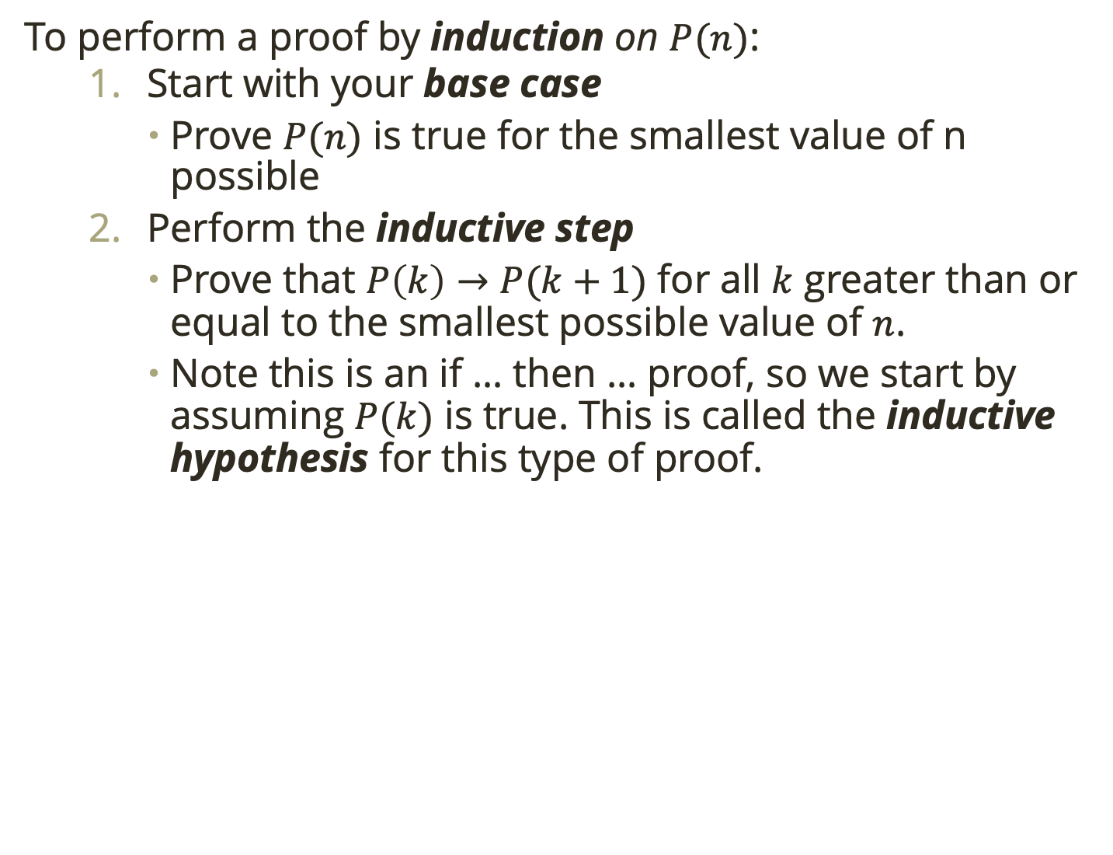
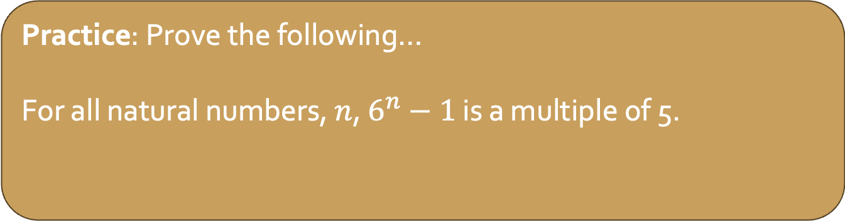
Warm Up: Induction
To perform a proof by induction on $P(n)$:
Start with your base case
Prove $P(n)$ is true for the smallest value of n possible
Perform the inductive step
Prove that $P\left(k\right)→P(k+1)$ for all $k$ greater than or equal to the smallest possible value of $n$.
Note this is an if … then … proof, so we start by assuming $P(k)$ is true. This is called the inductive hypothesis for this type of proof.
Practice: Prove the following…
For all natural numbers, $n$, $6^{n}−1$ is a multiple of 5.
Notes:
Base case = 0,
for ind step start by looking at 6^k – 1 and writing as a mult of 5 (5m)
6^k – 1 = 5m
6^k = 5m + 1
6^(K+1) = 6(5m+1)
6^(k+1) – 1 = 30m + 5 (mult of 5!!)

Slide 4
Set Vocab
A set is an unordered collection of objects.
Ex. Snacks in your pantry
Ex. Natural numbers between 1 and 10 inclusive

Slide 5
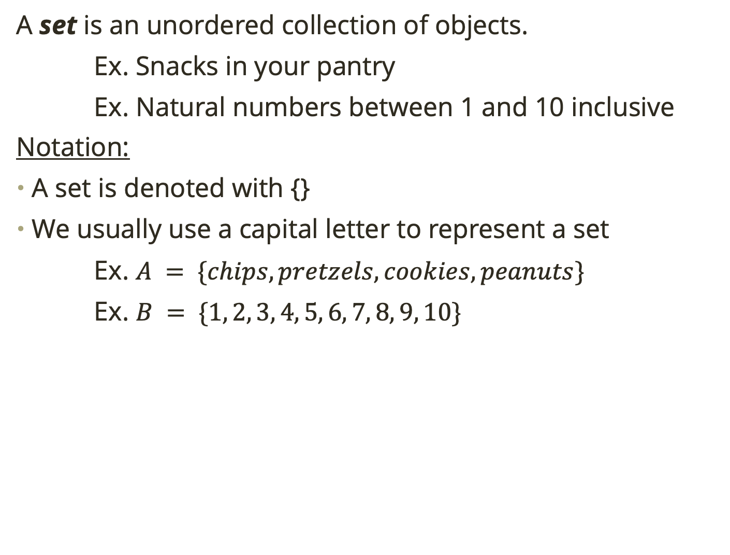
Set Vocab
A set is an unordered collection of objects.
Ex. Snacks in your pantry
Ex. Natural numbers between 1 and 10 inclusive
Notation:
A set is denoted with {}
We usually use a capital letter to represent a set
Ex. $A = \{chips, pretzels, cookies, peanuts\}$
Ex. $B = \{1, 2, 3, 4, 5, 6, 7, 8, 9, 10\}$

Slide 6
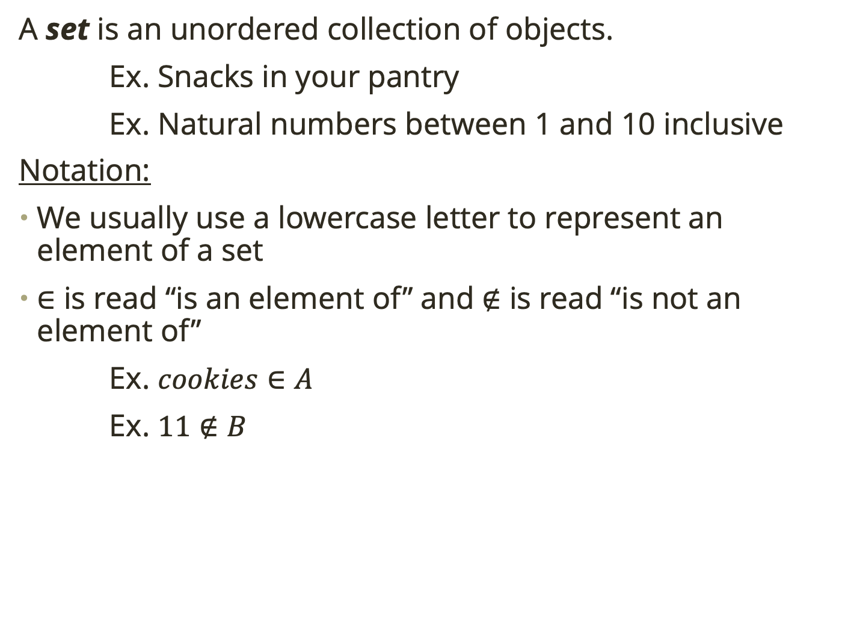
Set Vocab
A set is an unordered collection of objects.
Ex. Snacks in your pantry
Ex. Natural numbers between 1 and 10 inclusive
Notation:
We usually use a lowercase letter to represent an element of a set
$∈$ is read “is an element of” and $∉$ is read “is not an element of”
Ex. $cookies∈A$
Ex. $11∉B$

Slide 7
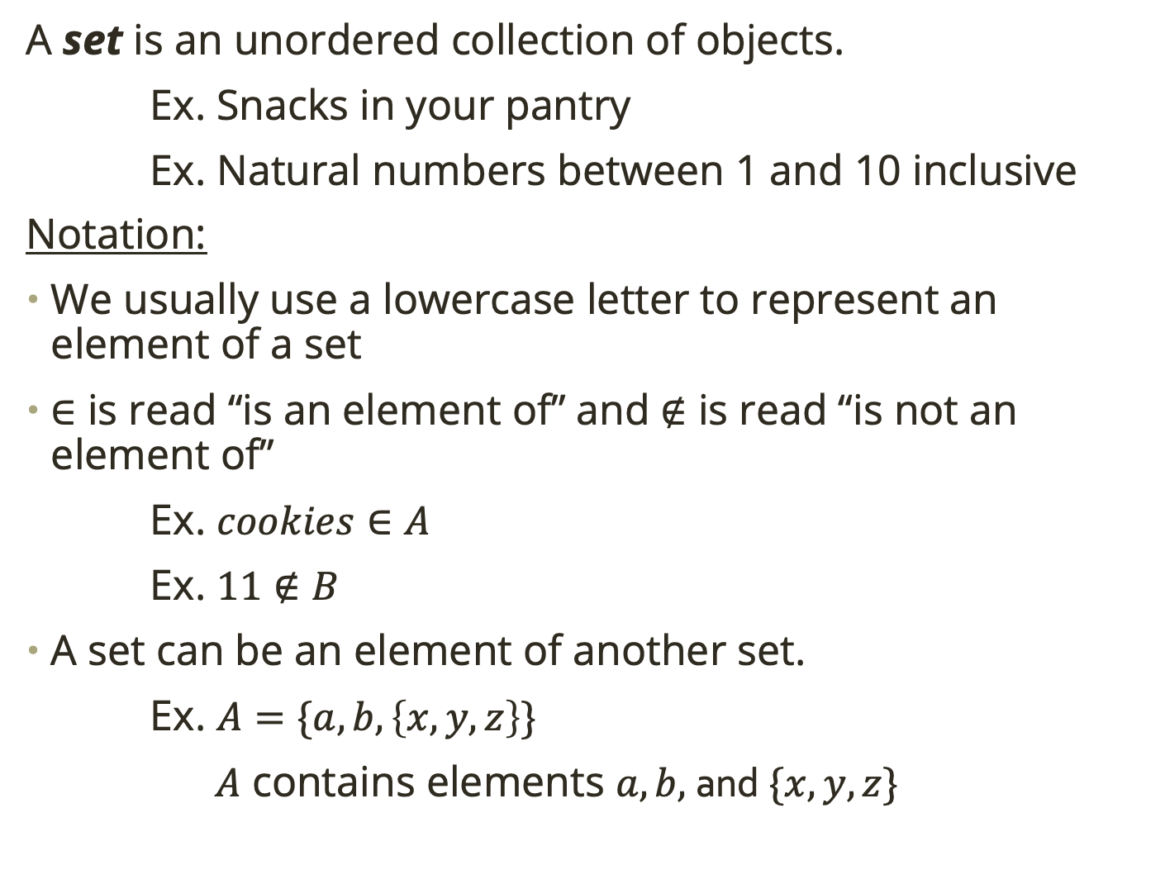
Set Vocab
A set is an unordered collection of objects.
Ex. Snacks in your pantry
Ex. Natural numbers between 1 and 10 inclusive
Notation:
We usually use a lowercase letter to represent an element of a set
$∈$ is read “is an element of” and $∉$ is read “is not an element of”
Ex. $cookies∈A$
Ex. $11∉B$
A set can be an element of another set.
Ex. $A=\{a, b, \left\{x, y, z\right\}\}$
$A$ contains elements $a, b,$ and $\{x, y, z\}$

Slide 8
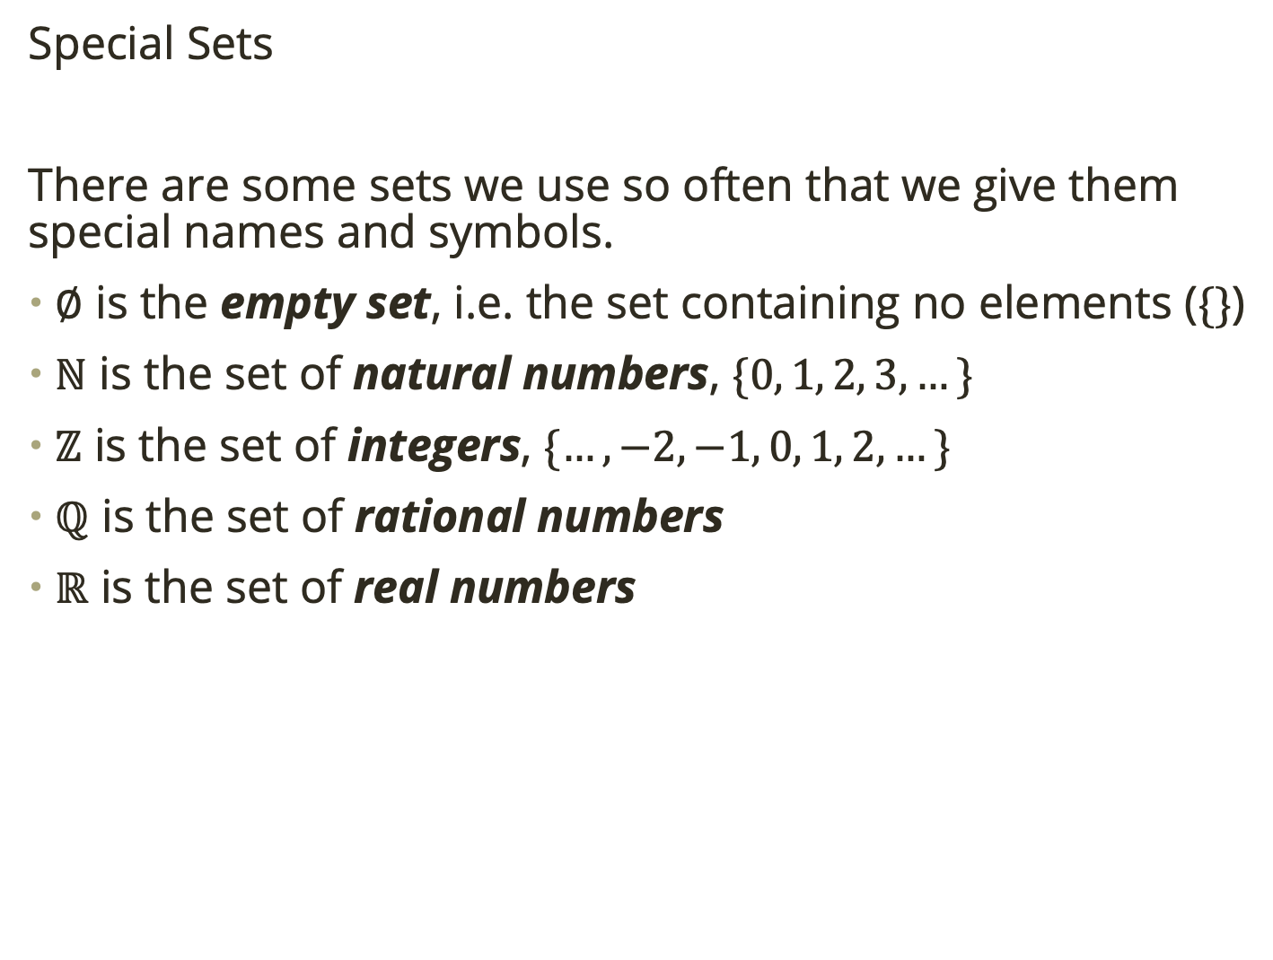
Set Vocab
Special Sets
There are some sets we use so often that we give them special names and symbols.
$∅$ is the empty set, i.e. the set containing no elements ($\{\}$)
$ℕ$ is the set of natural numbers, $\{0, 1, 2, 3, …\}$
$ℤ$ is the set of integers, $\{…, −2, −1, 0, 1, 2, …\}$
$ℚ$ is the set of rational numbers
$ℝ$ is the set of real numbers

Slide 9
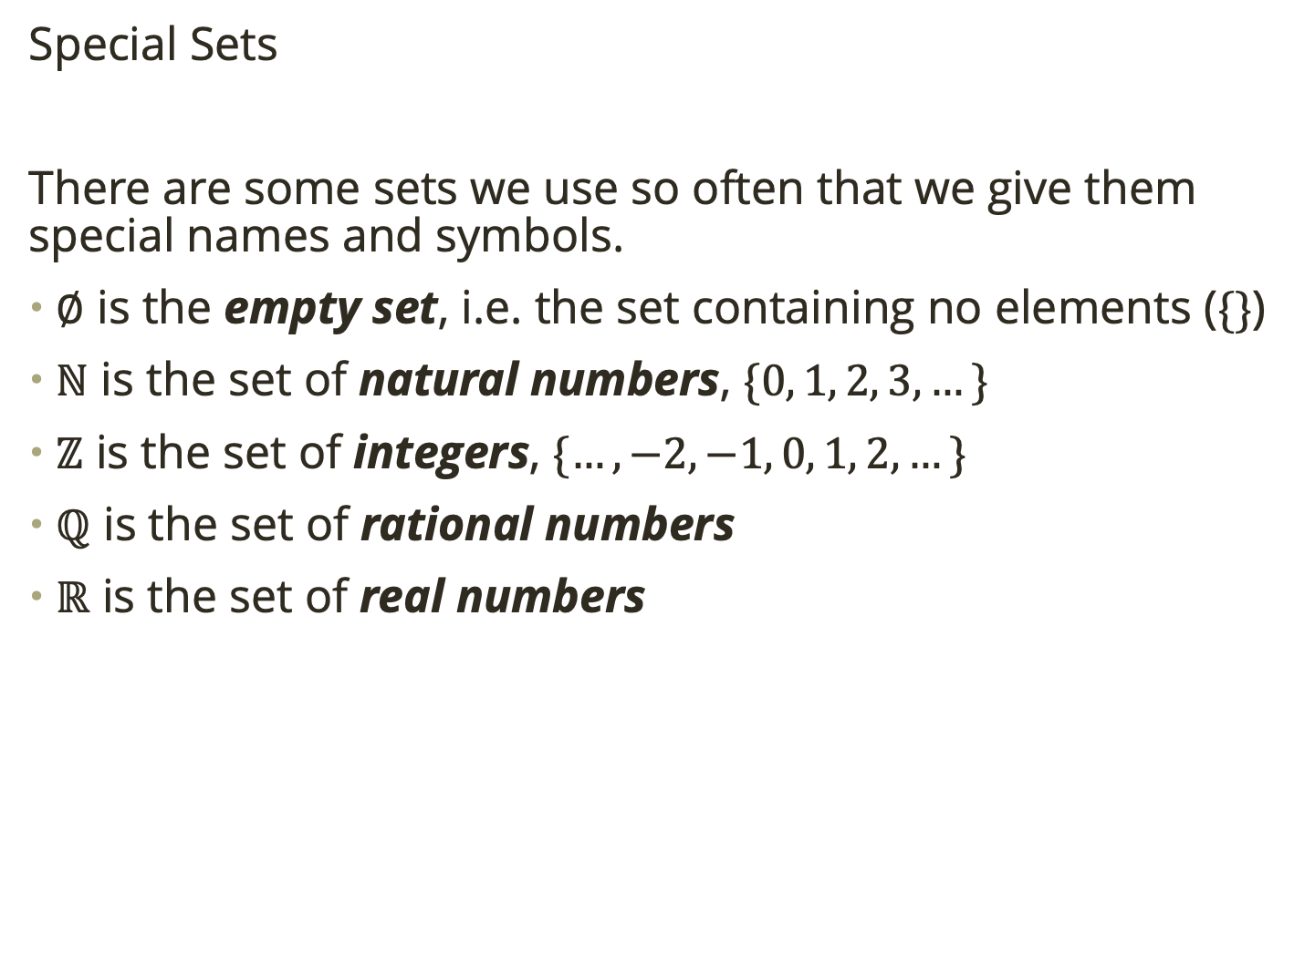
Set Vocab
Special Sets
There are some sets we use so often that we give them special names and symbols.
$∅$ is the empty set, i.e. the set containing no elements ($\{\}$)
$ℕ$ is the set of natural numbers, $\{0, 1, 2, 3, …\}$
$ℤ$ is the set of integers, $\{…, −2, −1, 0, 1, 2, …\}$
$ℚ$ is the set of rational numbers
$ℝ$ is the set of real numbers
Practice: Write the following sets symbolically
The set of classes you are taking this semester
The set of all special sets listed above
The set of even numbers

Slide 10
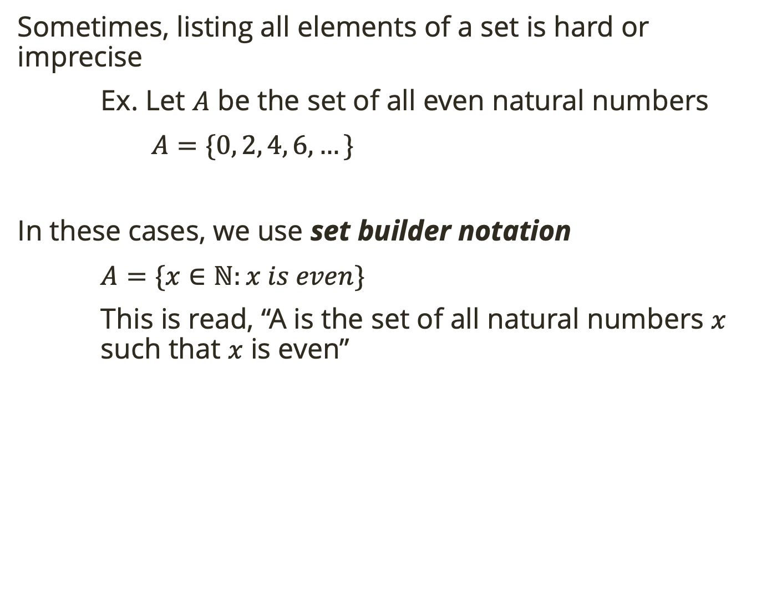
Set Builder Notation
Sometimes, listing all elements of a set is hard or imprecise
Ex. Let $A$ be the set of all even natural numbers
$A=\{0, 2, 4, 6, …\}$
In these cases, we use set builder notation
$A=\{x∈ℕ:x is even\}$
This is read, “A is the set of all natural numbers $x$ such that $x$ is even”

Slide 11

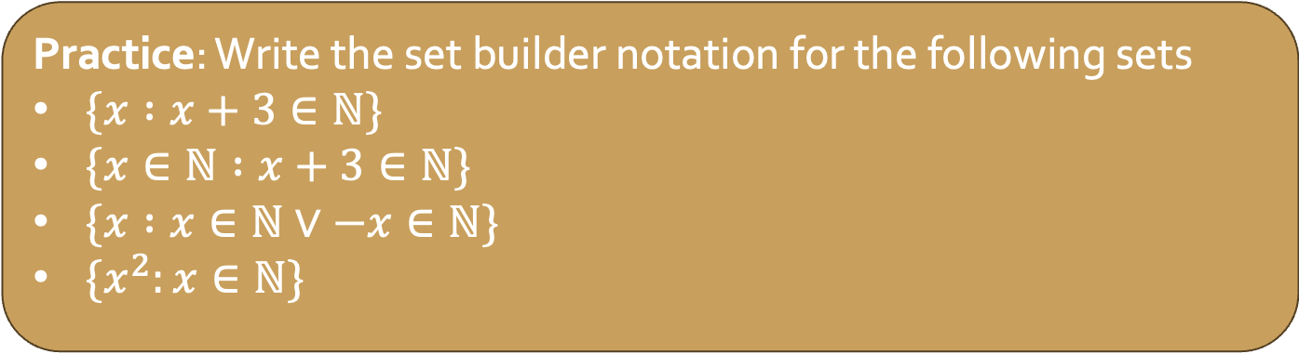
Set Builder Notation
Sometimes, listing all elements of a set is hard or imprecise
Ex. Let $A$ be the set of all even natural numbers
$A=\{0, 2, 4, 6, …\}$
In these cases, we use set builder notation
$A=\{x∈ℕ:x is even\}$
This is read, “A is the set of all natural numbers $x$ such that $x$ is even”
Practice: Write the set builder notation for the following sets
$\{x :x+3∈ℕ\}$
$\{x∈ℕ :x+3∈ℕ\}$
$\{x :x∈ℕ∨−x∈ℕ\}$
$\{x^{2}:x∈ℕ\}$

Slide 12
Set Builder Notation
Sometimes, listing all elements of a set is hard or imprecise
Ex. Let $A$ be the set of all even natural numbers
$A=\{0, 2, 4, 6, …\}$
In these cases, we use set builder notation
$A=\{x∈ℕ:x is even\}$
This is read, “A is the set of all natural numbers $x$ such that $x$ is even”
Practice: List the elements or describe the following sets
The set of natural numbers between 10 and 30 (including 30)
The set of primes
The set of odds
The set of positive odds

Slide 13
Set Builder Notation
Sometimes, listing all elements of a set is hard or imprecise
Ex. Let $A$ be the set of all even natural numbers
$A=\{0, 2, 4, 6, …\}$
In these cases, we use set builder notation
$A=\{x∈ℕ:x is even\}$
This is read, “A is the set of all natural numbers $x$ such that $x$ is even”

Slide 14
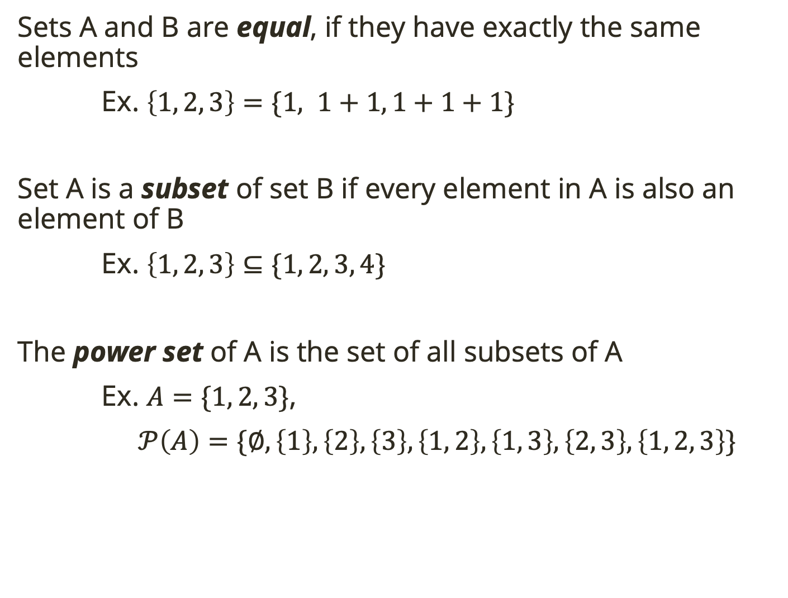
Relationships Between Sets
Sets A and B are equal, if they have exactly the same elements
Ex. $\left\{1, 2, 3\right\}=\{1, 1+1, 1+1+1\}$
Set A is a subset of set B if every element in A is also an element of B
Ex. $\left\{1, 2, 3\right\}⊆\{1, 2, 3, 4\}$
The power set of A is the set of all subsets of A
Ex. $A=\{1, 2, 3\}$,
$𝒫\left(A\right)=\{∅, \left\{1\right\}, \left\{2\right\}, \left\{3\right\}, \left\{1, 2\right\}, \left\{1, 3\right\}, \left\{2, 3\right\}, \left\{1, 2, 3\right\}\}$
empty set is always a subset!

Slide 15
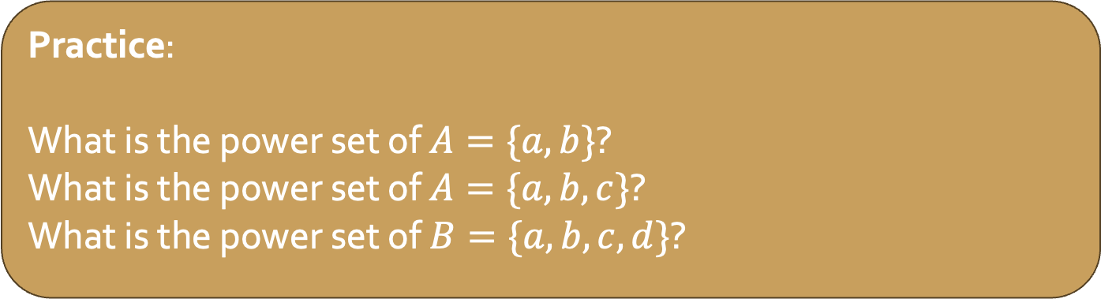
Relationships Between Sets
Sets A and B are equal, if they have exactly the same elements
Ex. $\left\{1, 2, 3\right\}=\{1, 1+1, 1+1+1\}$
Set A is a subset of set B if every element in A is also an element of B
Ex. $\left\{1, 2, 3\right\}⊆\{1, 2, 3, 4\}$
The power set of A is the set of all subsets of A
Ex. $A=\{1, 2, 3\}$,
$𝒫\left(A\right)=\{∅, \left\{1\right\}, \left\{2\right\}, \left\{3\right\}, \left\{1, 2\right\}, \left\{1, 3\right\}, \left\{2, 3\right\}, \left\{1, 2, 3\right\}\}$
Practice:
What is the power set of $A=\{a, b\}$?
What is the power set of $A=\{a, b, c\}$?
What is the power set of $B=\{a, b, c, d\}$?
empty set is always a subset!

Slide 16


Cardinality
The size of a set (i.e. the number of elements in a set) is called it cardinality.
Ex. $A=\left\{a, b\right\}, \left|A\right|=2$
$A=∅, \left|A\right|=0$
Practice: What are the cardinalities of the power sets you found?
power set of $A=\{a, b\}$?
power set of $A=\{a, b, c\}$?
power set of $B=\{a, b, c, d\}$?
Do you notice a pattern?

Slide 17

Cardinality
The size of a set (i.e. the number of elements in a set) is called it cardinality.
Ex. $A=\left\{a, b\right\}, \left|A\right|=2$
$A=∅, \left|A\right|=0$
Let $\left|A\right|=n$, the cardinality of $𝒫\left(A\right)=2^{n}$.

Slide 18



Set Operations
Often, when we deal with sets we have some notion of what “everything” is. We call this the universe, $𝒰$.
We visualize sets within the universe:
$$𝒰$$
$$A$$

Slide 19

Set Operations
Often, when we deal with sets we have some notion of what “everything” is. We call this the universe, $𝒰$.
The complement of $A$ (denoted $\overline{A}$) is the set of all elements in the universe that are not in $A$
$$𝒰$$
$$A$$

Slide 20
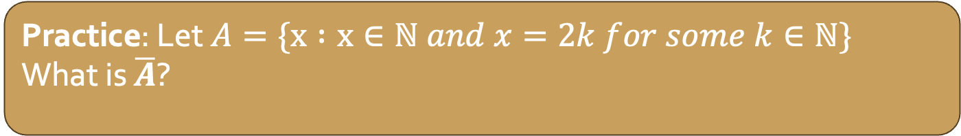
Set Operations
Often, when we deal with sets we have some notion of what “everything” is. We call this the universe, $𝒰$.
The complement of $A$ (denoted $\overline{A}$) is the set of all elements in the universe that are not in $A$
$$𝒰$$
$$A$$
Practice: Let $A=\{x :x∈ℕ and x=2k for some k∈ℕ\}$
What is $\overline{A}$?

Slide 21



Set Operations
Let $A, B$ be sets.
The union of $A$ and $B$ (denoted $A∪B)$ is the set of all elements in $A$, or $B$, or both
$$𝒰$$
$$A$$
$$B$$

Slide 22
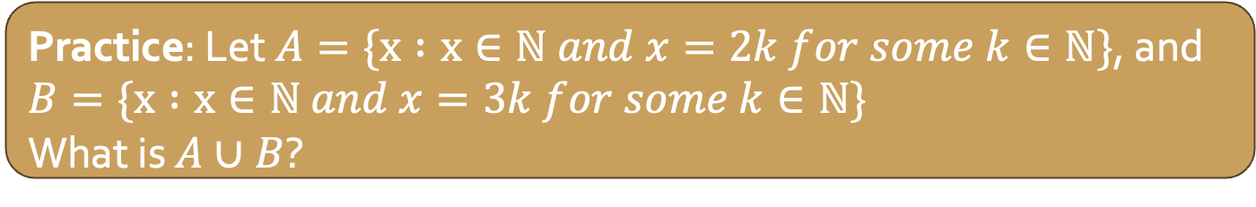
Set Operations
Let $A, B$ be sets.
The union of $A$ and $B$ (denoted $A∪B)$ is the set of all elements in $A$, or $B$, or both
$$𝒰$$
$$A$$
$$B$$
Practice: Let $A=\{x :x∈ℕ and x=2k for some k∈ℕ\}$, and $B=\{x :x∈ℕ and x=3k for some k∈ℕ\}$
What is $A∪B$?

Slide 23

Set Operations
Let $A, B$ be sets.
The intersection of $A$ and $B$ (denoted $A∩B)$ is the set of all elements in $A$ and $B$
$$𝒰$$
$$A$$
$$B$$

Slide 24

Set Operations
Let $A, B$ be sets.
The intersection of $A$ and $B$ (denoted $A∩B)$ is the set of all elements in $A$ and $B$
$$𝒰$$
$$A$$
$$B$$
Practice: Let $A=\{x :x∈ℕ and x=2k for some k∈ℕ\}$, and $B=\{x :x∈ℕ and x=3k for some k∈ℕ\}$
What is $A∩B$?

Slide 25
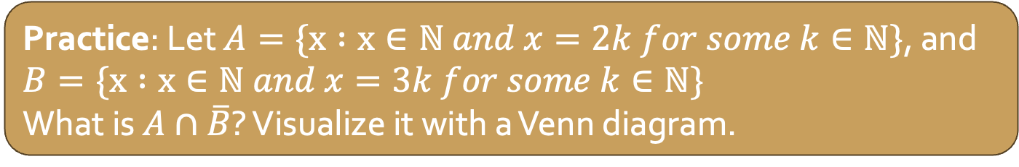
Set Operations
Let $A, B$ be sets.
The intersection of $A$ and $B$ (denoted $A∩B)$ is the set of all elements in $A$ and $B$
$$𝒰$$
$$A$$
$$B$$
Practice: Let $A=\{x :x∈ℕ and x=2k for some k∈ℕ\}$, and $B=\{x :x∈ℕ and x=3k for some k∈ℕ\}$
What is $A∩\overline{B}$? Visualize it with a Venn diagram.

Slide 26

Set Operations
Let $A, B$ be sets.
The set difference of $A$ and $B$ (denoted $A\backslash B)$ is the set of all elements in $A$ that are not in $B$
$$𝒰$$
$$A$$
$$B$$

Slide 27
Set Operations
Let $A, B$ be sets.
The set difference of $A$ and $B$ (denoted $A\backslash B)$ is the set of all elements in $A$ that are not in $B$
$$𝒰$$
$$A$$
$$B$$
Practice: Is set difference of $A$ and $B$ equivalent to $A∩\overline{B}$?

Slide 28
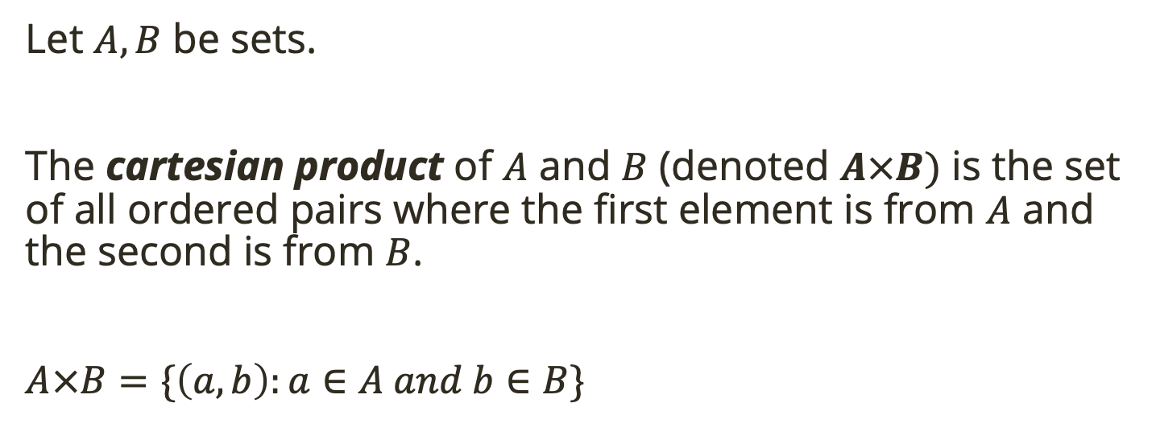
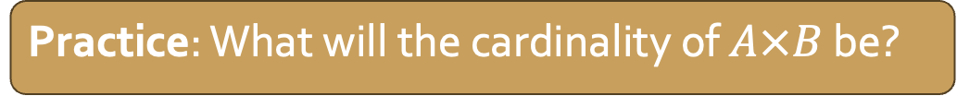
Set Operations
Let $A, B$ be sets.
The cartesian product of $A$ and $B$ (denoted $A×B)$ is the set of all ordered pairs where the first element is from $A$ and the second is from $B$.
$A×B=\{\left(a,b\right):a∈A and b∈B\}$
Practice: What will the cardinality of $A×B$ be?

Slide 29

Set Operations
Practice: Let $A=\left\{1, 2, 3, 4, 5, 6\right\}, B=\left\{2, 4, 6\right\}, C=\left\{1, 2, 3\right\}, D=\left\{7, 8, 9\right\}, 𝒰=\{1, 2, …,10\}$. Find:
$A∪B$
$A∩B$
$B∩C$
$A∩D$
$\overline{B∪C}$
$A\backslash B$
$\left(D∩\overline{C}\right)∪\overline{A∩B}$
$∅∪C$
$∅∩C$
$B×C$
Visualize each with a Venn diagram.
Let $A, B$ be sets.
The set difference of $A$ and $B$ (denoted $A\backslash B)$ is the set of all elements in $A$ that are not in $B$
$$𝒰$$
$$A$$
$$B$$

