Slide 1
Discrete Structures– Proofs: Induction
Dr. Ab Mosca (they/them)

Slide 2
Plan for Today
Proof by induction

Slide 3

Warm Up
To perform a proof by contradiction on P:
Assume $¬P$ is true
Show that this assumption leads to a contradiction
As a result, the only conclusion is that $P$ is true
(i.e. if it impossible for $P$ to be false, we know it must be true)
Practice: Prove the following…
The sum of a rational number and an irrational number is irrational.

Slide 4
Motivation
You need to mail a package, but don't yet know how much postage you will need. You have a large supply of 8-cent stamps and 5-cent stamps. Which amounts of postage can you make exactly using these stamps? Which amounts are impossible to make?

Slide 5
Motivation
You need to mail a package, but don't yet know how much postage you will need. You have a large supply of 8-cent stamps and 5-cent stamps. Which amounts of postage can you make exactly using these stamps? Which amounts are impossible to make?
How did you try to solve this?

Slide 6

Motivation
Let’s let $P(n)$ be the statement: you can make $n$ cents of postage using just 8-cent and 5-cent stamps.
Notes:
P(1), P(2), P(3), P(4)……
F, F, F, F

Slide 7

Motivation
Let’s let $P(n)$ be the statement: you can make $n$ cents of postage using just 8-cent and 5-cent stamps.
If we want to find the value of $P(n)$ for some specific $n$, can we use smaller $n$’s to get it?
i.e. if we know the value of $P(n−1)$ can we get from that value to $P(n)$?
Notes:
P(1), P(2), P(3), P(4)……
F, F, F, F

Slide 8
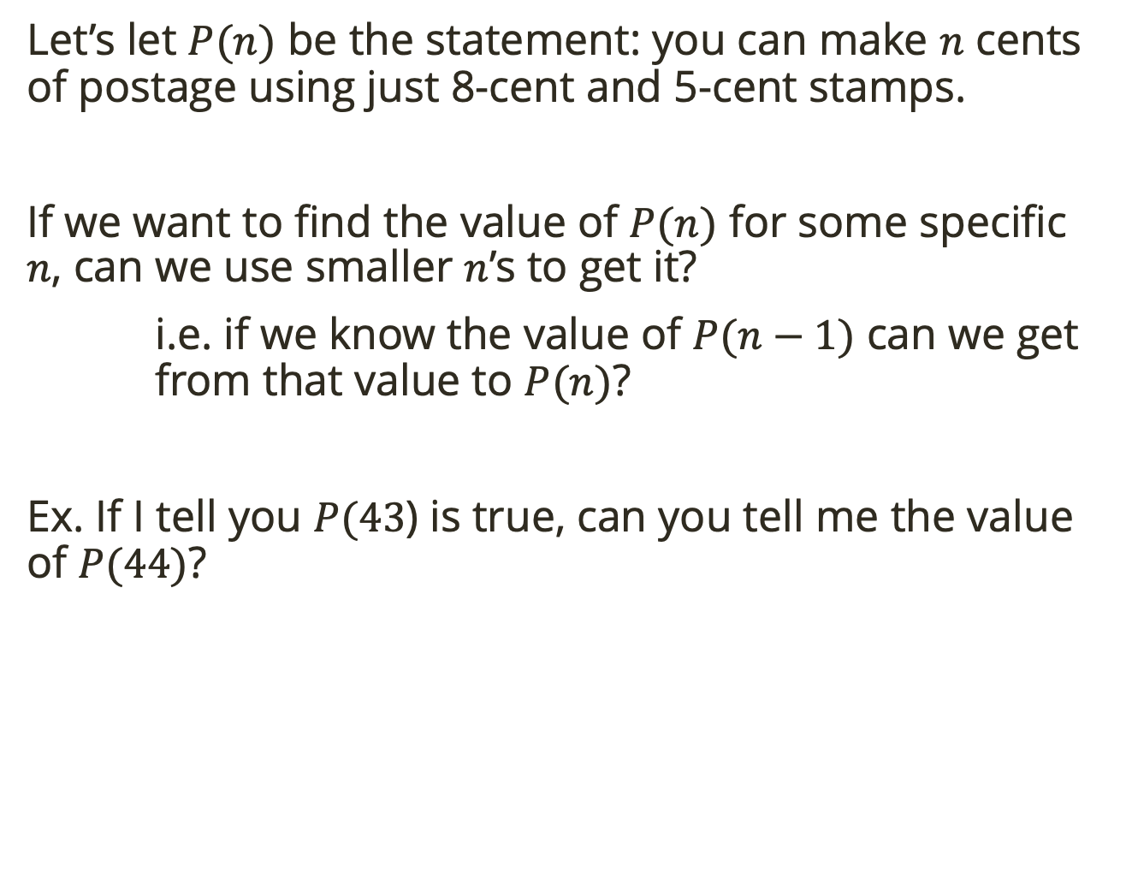
Motivation
Let’s let $P(n)$ be the statement: you can make $n$ cents of postage using just 8-cent and 5-cent stamps.
If we want to find the value of $P(n)$ for some specific $n$, can we use smaller $n$’s to get it?
i.e. if we know the value of $P(n−1)$ can we get from that value to $P(n)$?
Ex. If I tell you $P(43$) is true, can you tell me the value of $P(44)$?
Notes:
P(44)

Slide 9
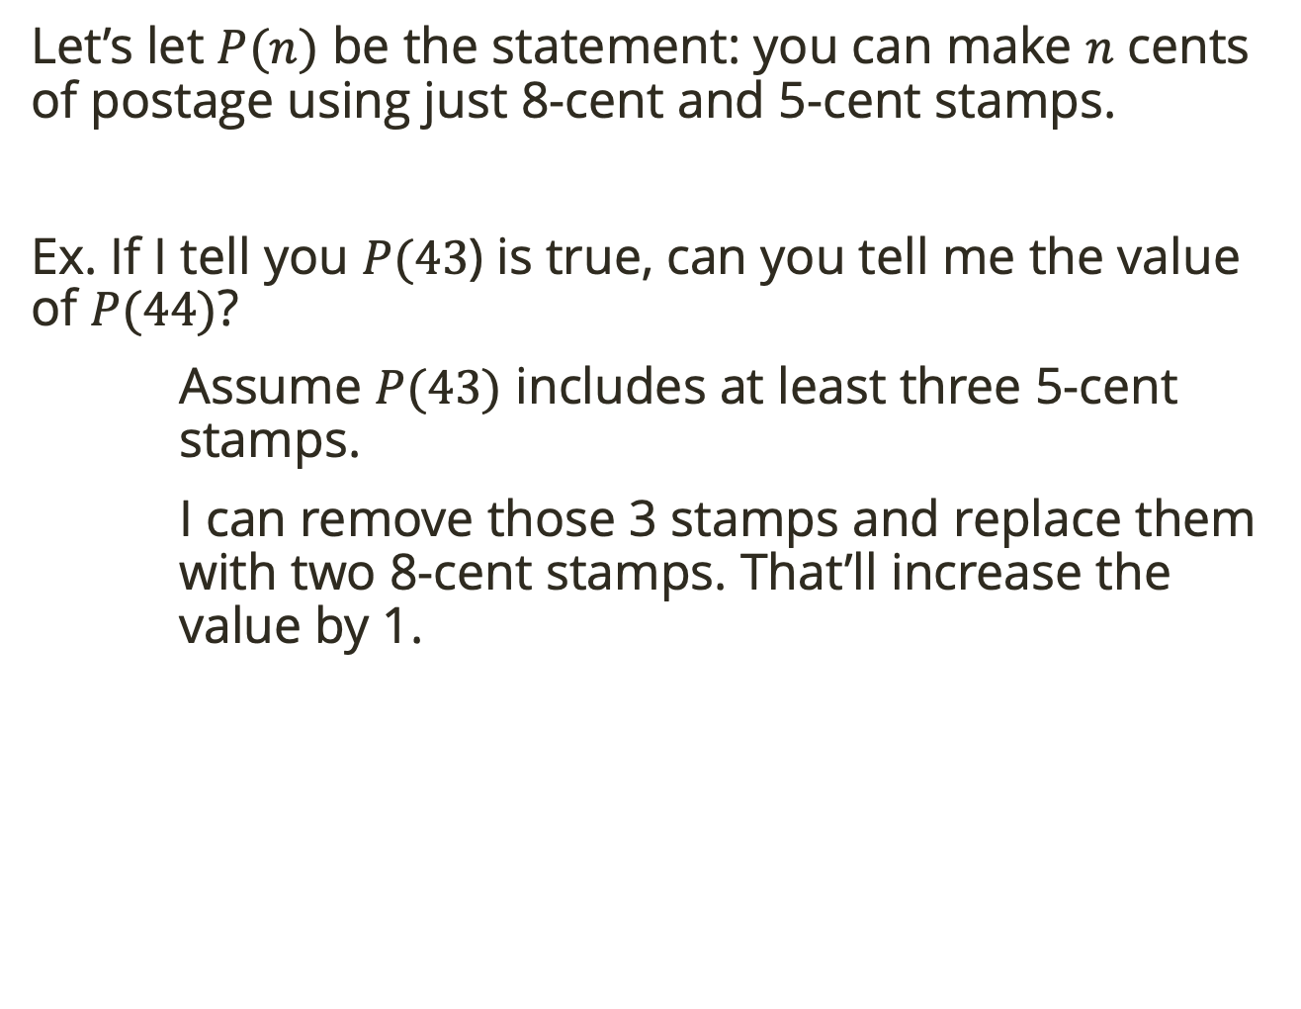
Motivation
Let’s let $P(n)$ be the statement: you can make $n$ cents of postage using just 8-cent and 5-cent stamps.
Ex. If I tell you $P(43$) is true, can you tell me the value of $P(44)$?
Assume $P(43)$ includes at least three 5-cent stamps.
I can remove those 3 stamps and replace them with two 8-cent stamps. That’ll increase the value by 1.
Notes:
P(44)

Slide 10
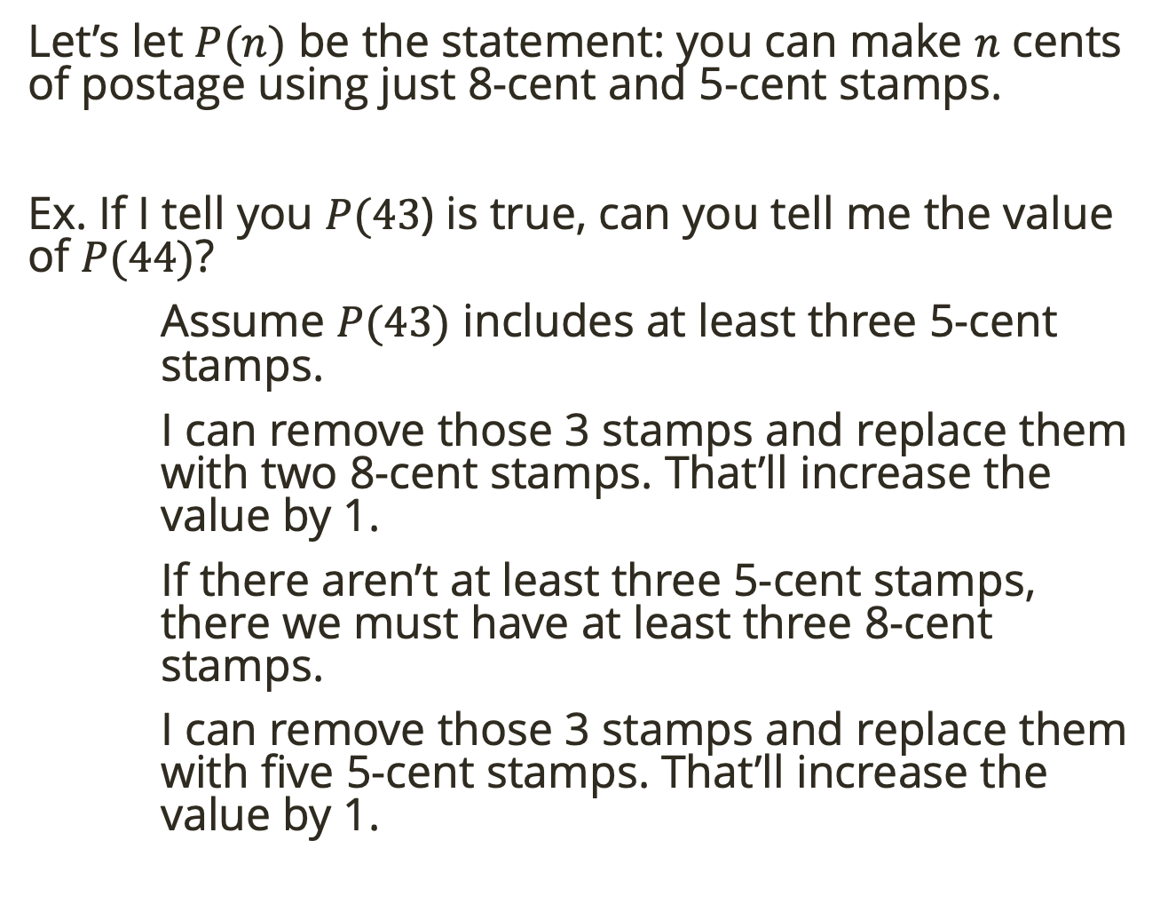
Motivation
Let’s let $P(n)$ be the statement: you can make $n$ cents of postage using just 8-cent and 5-cent stamps.
Ex. If I tell you $P(43$) is true, can you tell me the value of $P(44)$?
Assume $P(43)$ includes at least three 5-cent stamps.
I can remove those 3 stamps and replace them with two 8-cent stamps. That’ll increase the value by 1.
If there aren’t at least three 5-cent stamps, there we must have at least three 8-cent stamps.
I can remove those 3 stamps and replace them with five 5-cent stamps. That’ll increase the value by 1.
Notes:
7X5 = 35 + 8

Slide 11
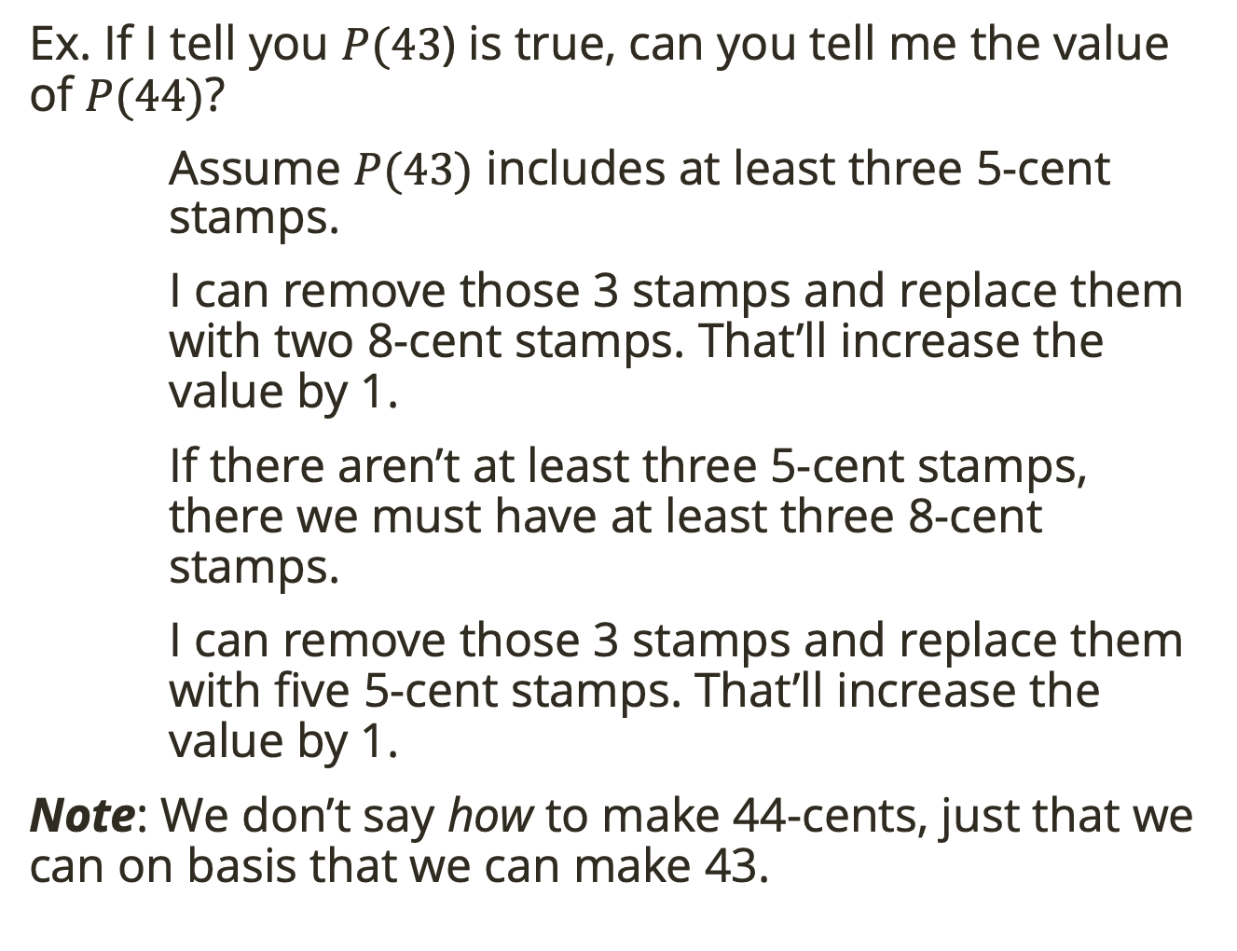
Motivation
Ex. If I tell you $P(43$) is true, can you tell me the value of $P(44)$?
Assume $P(43)$ includes at least three 5-cent stamps.
I can remove those 3 stamps and replace them with two 8-cent stamps. That’ll increase the value by 1.
If there aren’t at least three 5-cent stamps, there we must have at least three 8-cent stamps.
I can remove those 3 stamps and replace them with five 5-cent stamps. That’ll increase the value by 1.
Note: We don’t say how to make 44-cents, just that we can on basis that we can make 43.
Notes:
7X5 = 35 + 8

Slide 12
Motivation
Note: We don’t say how to make 44-cents, just that we can on basis that we can make 43.
How do we know we can make 43? Because we know we can make 42, which we know because we can make 41, etc.
Notes:
7X5 = 35 + 8

Slide 13
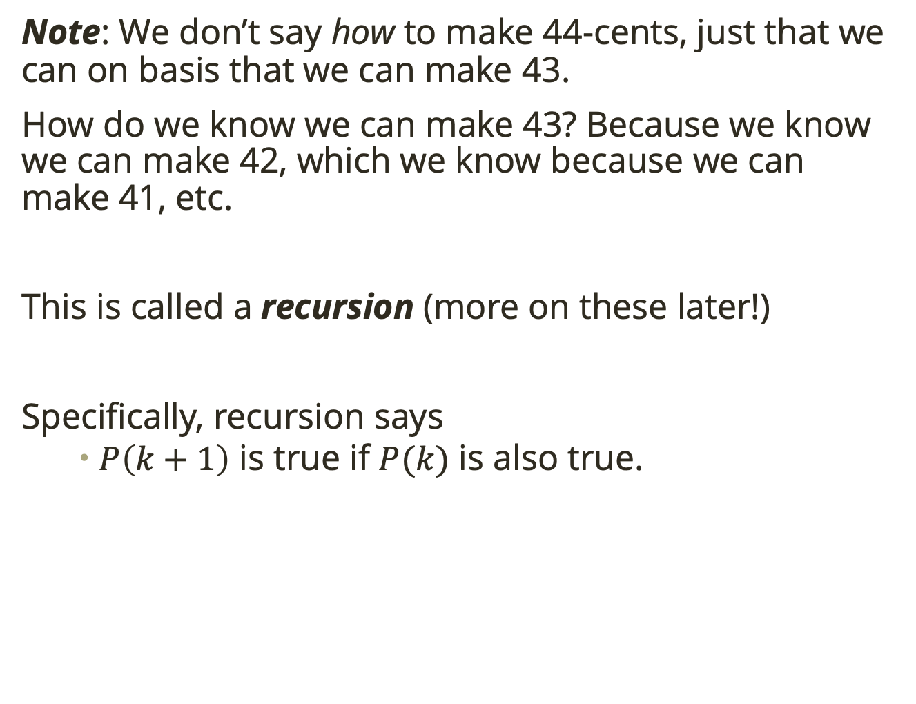
Motivation
Note: We don’t say how to make 44-cents, just that we can on basis that we can make 43.
How do we know we can make 43? Because we know we can make 42, which we know because we can make 41, etc.
This is called a recursion (more on these later!)
Specifically, recursion says
$P\left(k+1\right)$ is true if $P(k)$ is also true.
Notes:
7X5 = 35 + 8

Slide 14
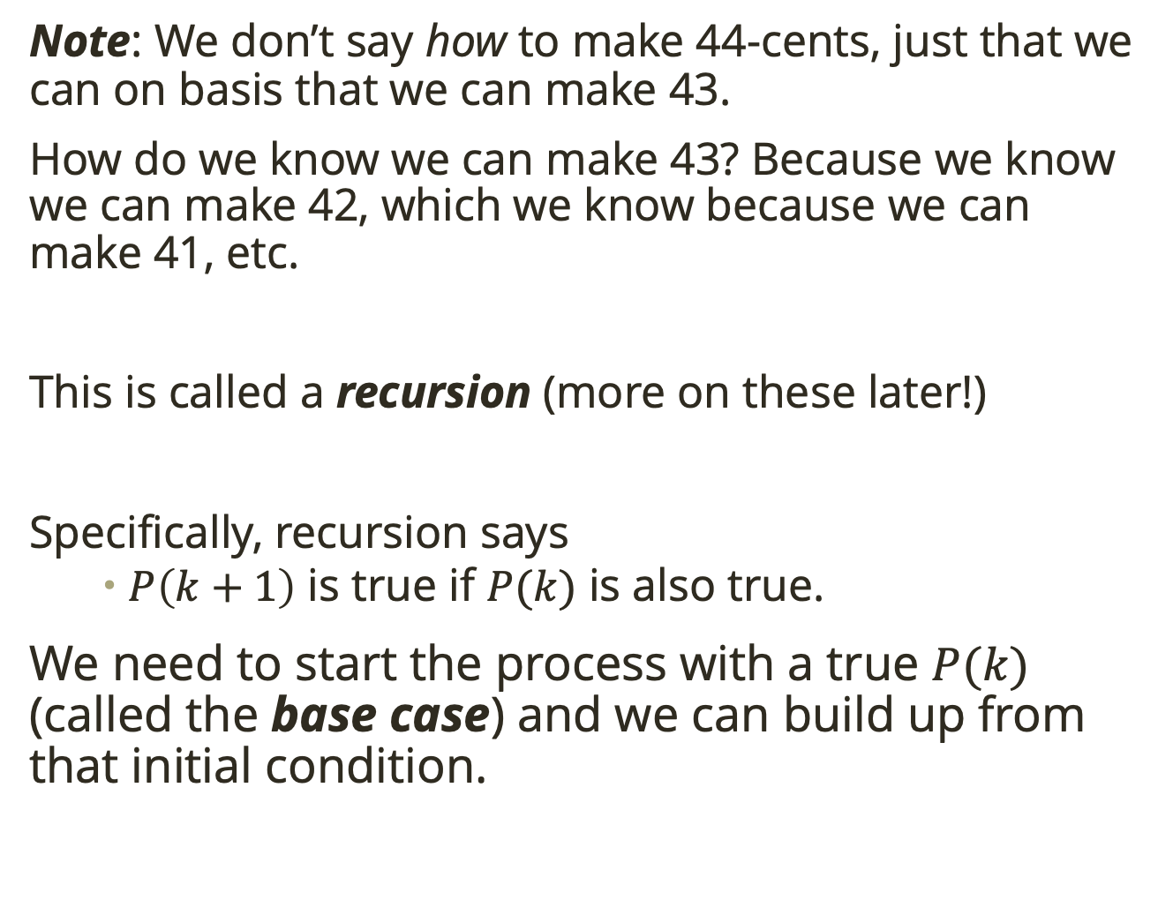
Motivation
Note: We don’t say how to make 44-cents, just that we can on basis that we can make 43.
How do we know we can make 43? Because we know we can make 42, which we know because we can make 41, etc.
This is called a recursion (more on these later!)
Specifically, recursion says
$P\left(k+1\right)$ is true if $P(k)$ is also true.
We need to start the process with a true $P(k)$ (called the base case) and we can build up from that initial condition.
Notes:
7X5 = 35 + 8

Slide 15

Motivation
We know not all $P(n)$ are true.
But what if I told you that $P(n)$ is true for all $n≥28$?
Notes:
7X5 = 35 + 8

Slide 16

Motivation
We know not all $P(n)$ are true.
But what if I told you that $P(n)$ is true for all $n≥28$?
I can make 28 cents with four 5-cent stamps and one 8-cent stamp.
Notes:
7X5 = 35 + 8

Slide 17
Motivation
We know not all $P(n)$ are true.
But what if I told you that $P(n)$ is true for all $n≥28$?
I can make 28 cents with four 5-cent stamps and one 8-cent stamp.
Does the trick we used before (swapping three 5-cent stamps for two 8-cent stamps, or three 8-cent stamps for five 5-cent stamps) work for all numbers greater than 28?
Convince me.
Hint: Are you sure you have at least three 5-cent stamps and 8-cent stamps to make 28 cents?
Notes:
We must have at least 3 five cents and 8 cents otherwise we only get to 26 cents.
So I can use the trick for 15 -> 16, or for 24→ 25.
Therefore, if I know P(k+1) is true if P(k) is true for any k>= 28

Slide 18

Induction
The proof we just did was an inductive proof.
We showed that $P(28)$ is true.
Then we showed that for any $k$ greater than 28, if $P(k)$ is true then $P\left(k+1\right)$ is also true.

Slide 19
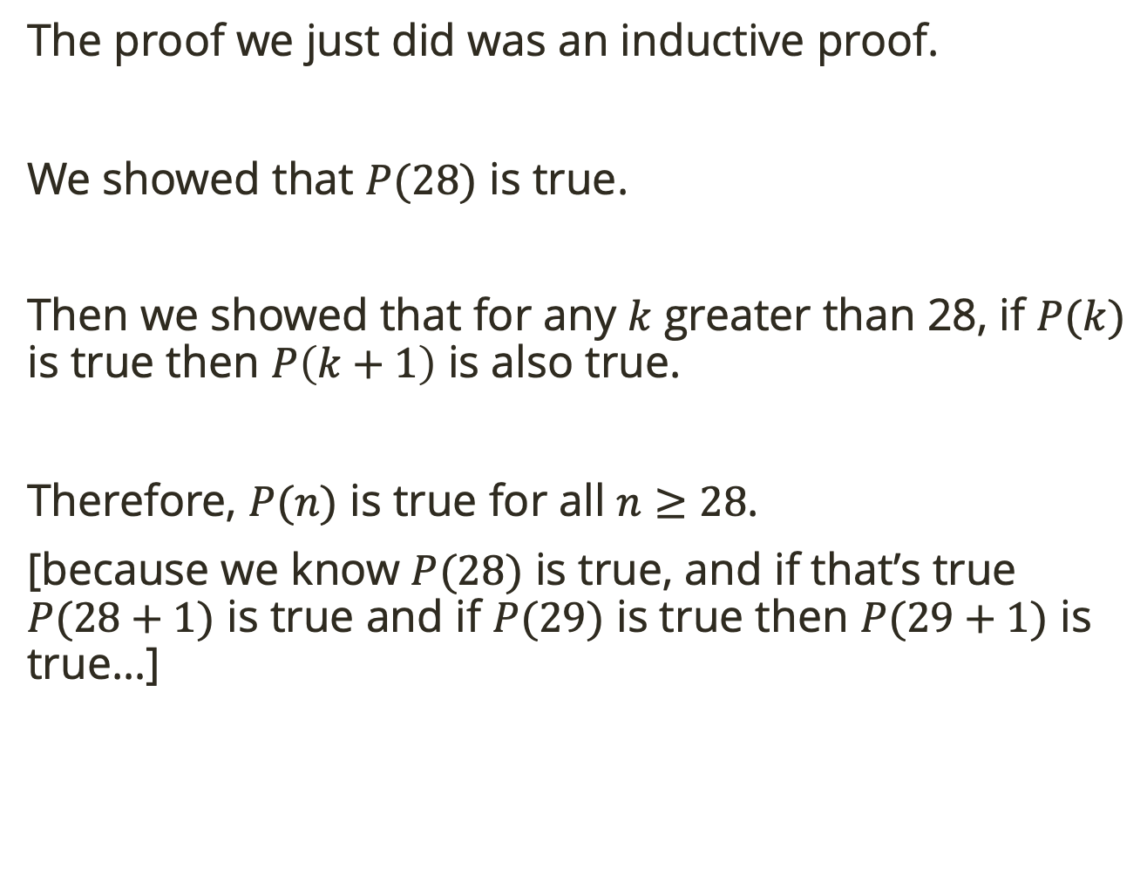
Induction
The proof we just did was an inductive proof.
We showed that $P(28)$ is true.
Then we showed that for any $k$ greater than 28, if $P(k)$ is true then $P\left(k+1\right)$ is also true.
Therefore, $P(n)$ is true for all $n≥28$.
[because we know $P(28)$ is true, and if that’s true $P(28+1)$ is true and if $P(29)$ is true then $P(29+1)$ is true…]

Slide 20
Induction
The proof we just did was an inductive proof.
We showed that $P(28)$ is true.
Then we showed that for any $k$ greater than 28, if $P(k)$ is true then $P\left(k+1\right)$ is also true.
Therefore, $P(n)$ is true for all $n≥28$.
[because we know $P(28)$ is true, and if that’s true $P(28+1)$ is true and if $P(29)$ is true then $P(29+1)$ is true…]
This is called our base case
This is called the inductive step.

Slide 21
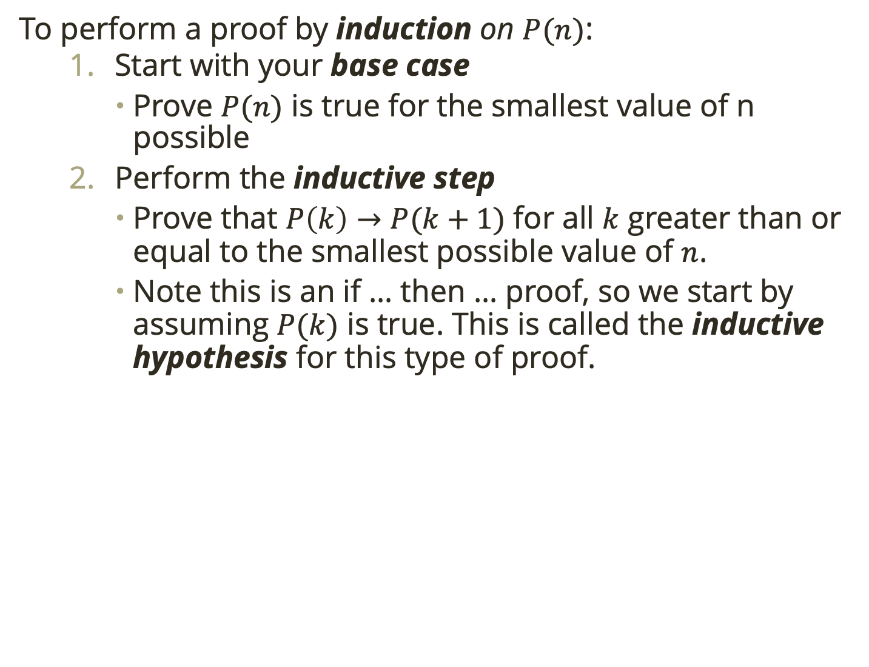
Induction
To perform a proof by induction on $P(n)$:
Start with your base case
Prove $P(n)$ is true for the smallest value of n possible
Perform the inductive step
Prove that $P\left(k\right)→P(k+1)$ for all $k$ greater than or equal to the smallest possible value of $n$.
Note this is an if … then … proof, so we start by assuming $P(k)$ is true. This is called the inductive hypothesis for this type of proof.

Slide 22
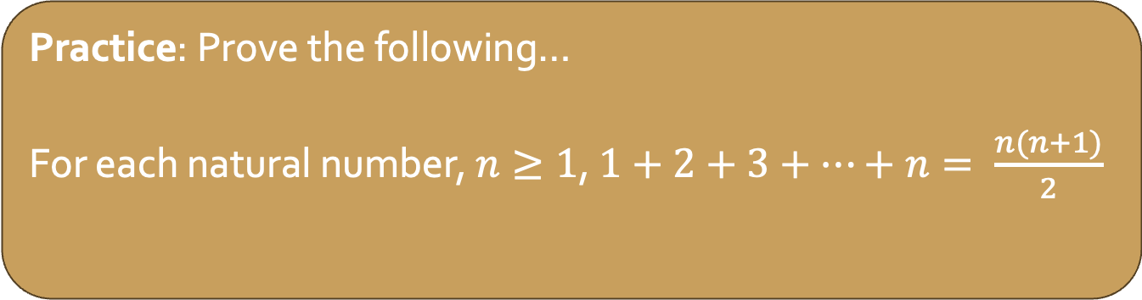
Induction
To perform a proof by induction on $P(n)$:
Start with your base case
Prove $P(n)$ is true for the smallest value of n possible
Perform the inductive step
Prove that $P\left(k\right)→P(k+1)$ for all $k$ greater than or equal to the smallest possible value of $n$.
Note this is an if … then … proof, so we start by assuming $P(k)$ is true. This is called the inductive hypothesis for this type of proof.
Practice: Prove the following…
For each natural number, $n≥1$, $1+2+3+…+n= \frac{n(n+1)}{2}$

Slide 23
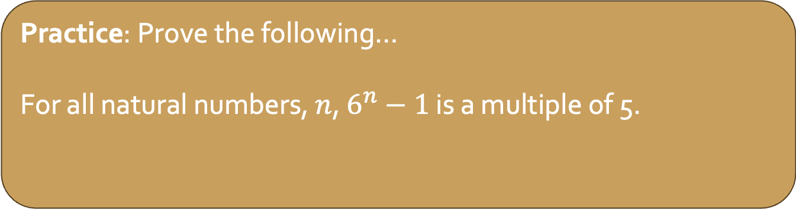
Induction
To perform a proof by induction on $P(n)$:
Start with your base case
Prove $P(n)$ is true for the smallest value of n possible
Perform the inductive step
Prove that $P\left(k\right)→P(k+1)$ for all $k$ greater than or equal to the smallest possible value of $n$.
Note this is an if … then … proof, so we start by assuming $P(k)$ is true. This is called the inductive hypothesis for this type of proof.
Practice: Prove the following…
For all natural numbers, $n$, $6^{n}−1$ is a multiple of 5.
Notes:
Let �(�) be the statement, “6�−1 is a multiple of 5.” We will prove that �(�) is true for all .�∈�.
Base case: �(0) is true: 60−1=0 which is a multiple of 5.
Inductive case: Let � be an arbitrary natural number. Assume, for induction, that �(�) is true. That is, 6�−1 is a multiple of .5. Then 6�−1=5� for some integer .�. This means that .6�=5�+1. Multiply both sides by :6:
.6�+1=6(5�+1)=30�+6.
But we want to know about ,6�+1−1, so subtract 1 from both sides:
.6�+1−1=30�+5.
Of course ,30�+5=5(6�+1), so is a multiple of 5.
Therefore 6�+1−1 is a multiple of 5, or in other words, �(�+1) is true. Thus, by the principle of mathematical induction �(�) is true for all .

Slide 24
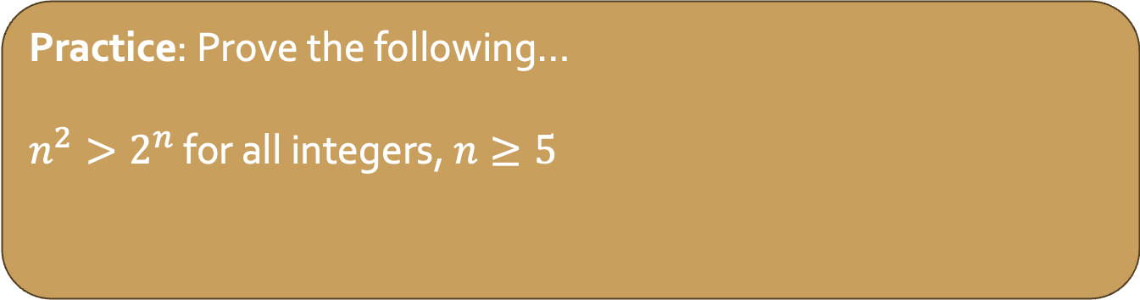
Induction
To perform a proof by induction on $P(n)$:
Start with your base case
Prove $P(n)$ is true for the smallest value of n possible
Perform the inductive step
Prove that $P\left(k\right)→P(k+1)$ for all $k$ greater than or equal to the smallest possible value of $n$.
Note this is an if … then … proof, so we start by assuming $P(k)$ is true. This is called the inductive hypothesis for this type of proof.
Practice: Prove the following…
$n^{2}>2^{n}$ for all integers, $n≥5$
Notes:
Inductive case: Let �≥5 be an arbitrary integer. Assume, for induction, that �(�) is true. That is, assume .�2<2�. We will prove that �(�+1) is true, i.e., .(�+1)2<2�+1. To prove such an inequality, start with the left-hand side and work towards the right-hand side:
by the inductive hypothesis. since for (�+1)2=�2+2�+1<2�+2�+1…by the inductive hypothesis.<2�+2�… since 2�+1<2� for �≥5.=2�+1.
Following the equalities and inequalities through, we get ,(�+1)2<2�+1, in other words, .�(�+1). Therefore by the principle of mathematical induction, �(�) is true for all .

Slide 25
Logic Wrap Up
Take a look at in-class activity 1 (ic-01) on the course website. We’ll work on this project in class for the rest of today, and Thursday.

