Slide 1
Discrete Structures– Proofs: Direct and Contrapositive
Dr. Ab Mosca (they/them)

Slide 2
Reminder!
First homework is out today!
Homeworks (and quizzes) are week long assignments; expect to spend 5-7 hours on them (this is standard for a college class)

Slide 3
Plan for Today
What is a proof?
Direct proofs
Proof by contrapositive

Slide 4
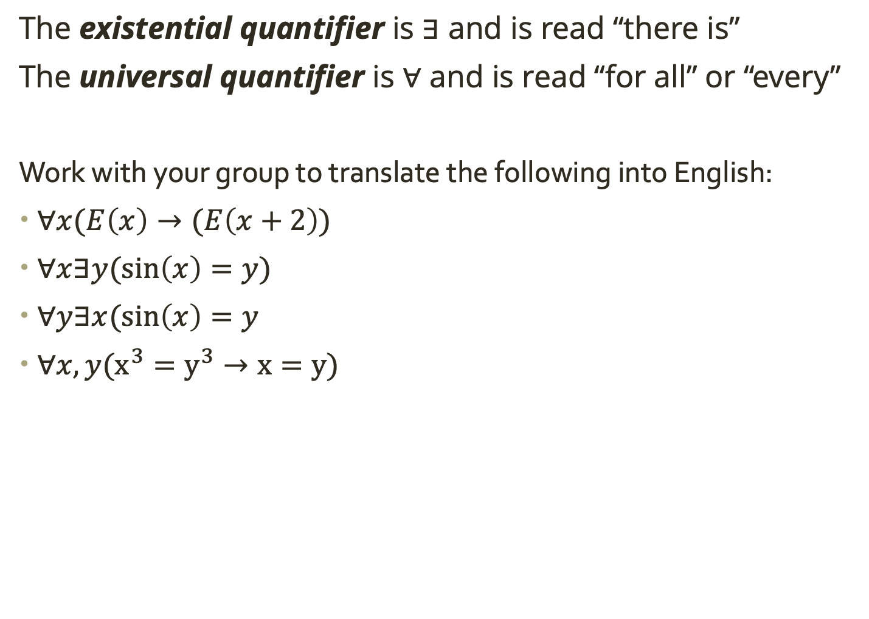
Warm Up
The existential quantifier is $∃$ and is read “there is”
The universal quantifier is $∀$ and is read “for all” or “every”
Work with your group to translate the following into English:
$∀x(E\left(x\right)→(E\left(x+2\right))$
$∀x∃y(\sin\left(x\right)=y)$
$∀y∃x(\sin\left(x\right)=y$
$∀x,y(x^{3}=y^{3}→x=y)$
Notes:
Any even number plus 2 is an even number.
For any � there is a � such that .sin⁡(�)=�. In other words, every number � is in the domain of sine.
For every � there is an � such that .sin⁡(�)=�. In other words, every number � is in the range of sine (which is false).
For any numbers, if the cubes of two numbers are equal, then the numbers are equal.

Slide 5
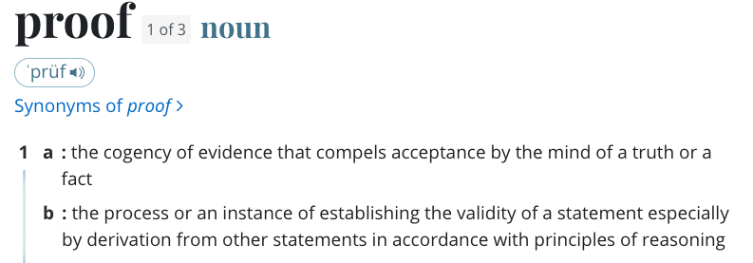
Defn: Proof
https://www.merriam-webster.com/dictionary/proof

Slide 6
Defn: Proof
https://www.merriam-webster.com/dictionary/proof

Slide 7
Defn: Proof
Proofs are simply the process of using what we know to be true to logically show that something new is also true.
https://www.merriam-webster.com/dictionary/proof

Slide 8
Proof Structure
Proofs are a form of communication. You need to write them with the understanding that they are primarily for other people. (Remember, the objective is to convincingly argue to someone that something is true.)

Slide 9
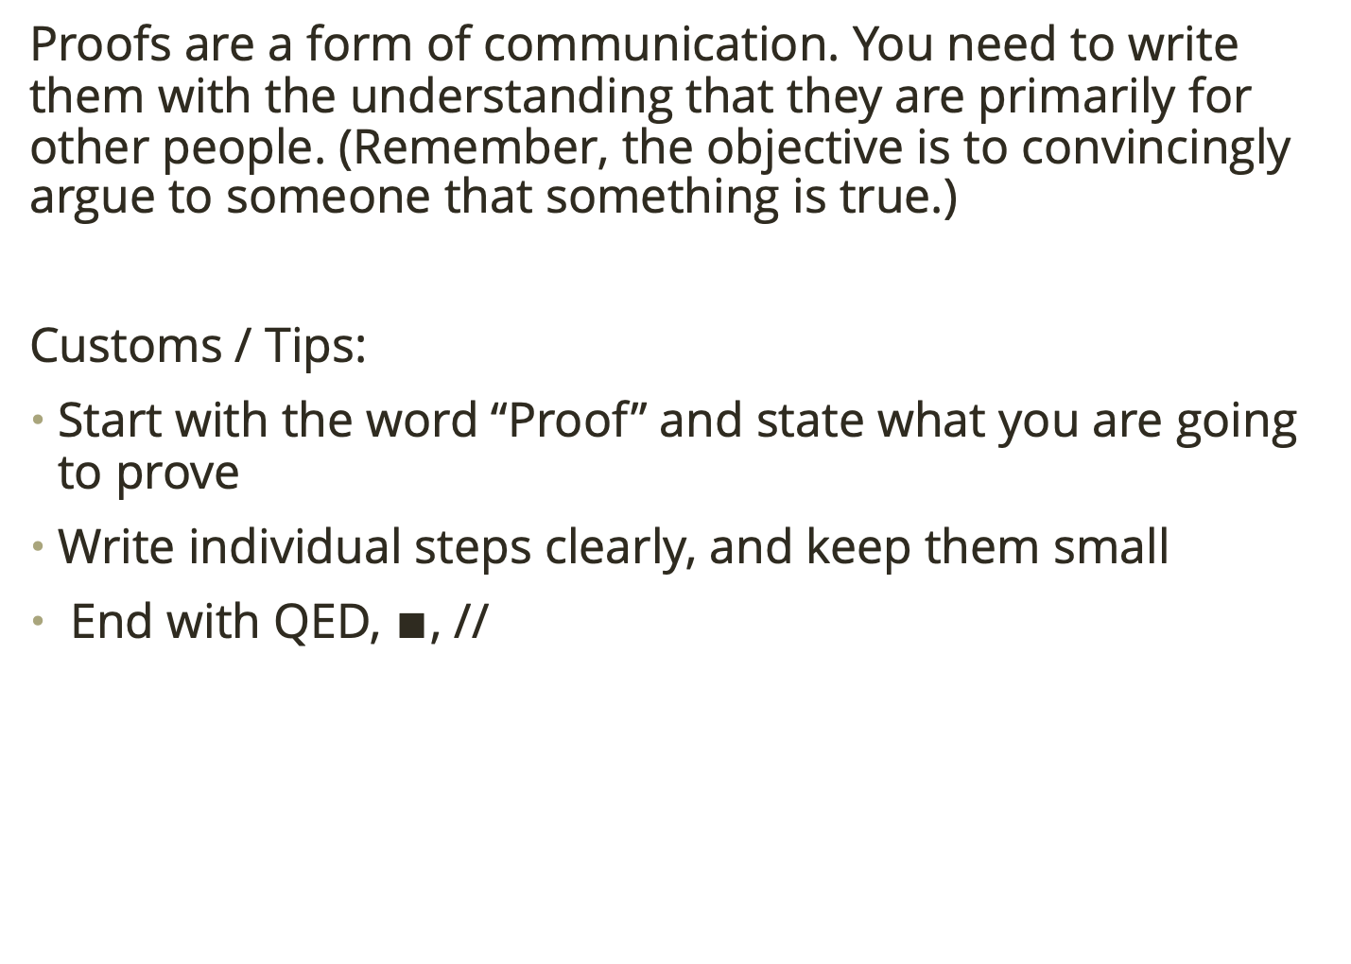
Proof Structure
Proofs are a form of communication. You need to write them with the understanding that they are primarily for other people. (Remember, the objective is to convincingly argue to someone that something is true.)
Customs / Tips:
Start with the word “Proof” and state what you are going to prove
Write individual steps clearly, and keep them small
End with QED, $∎$, //

Slide 10
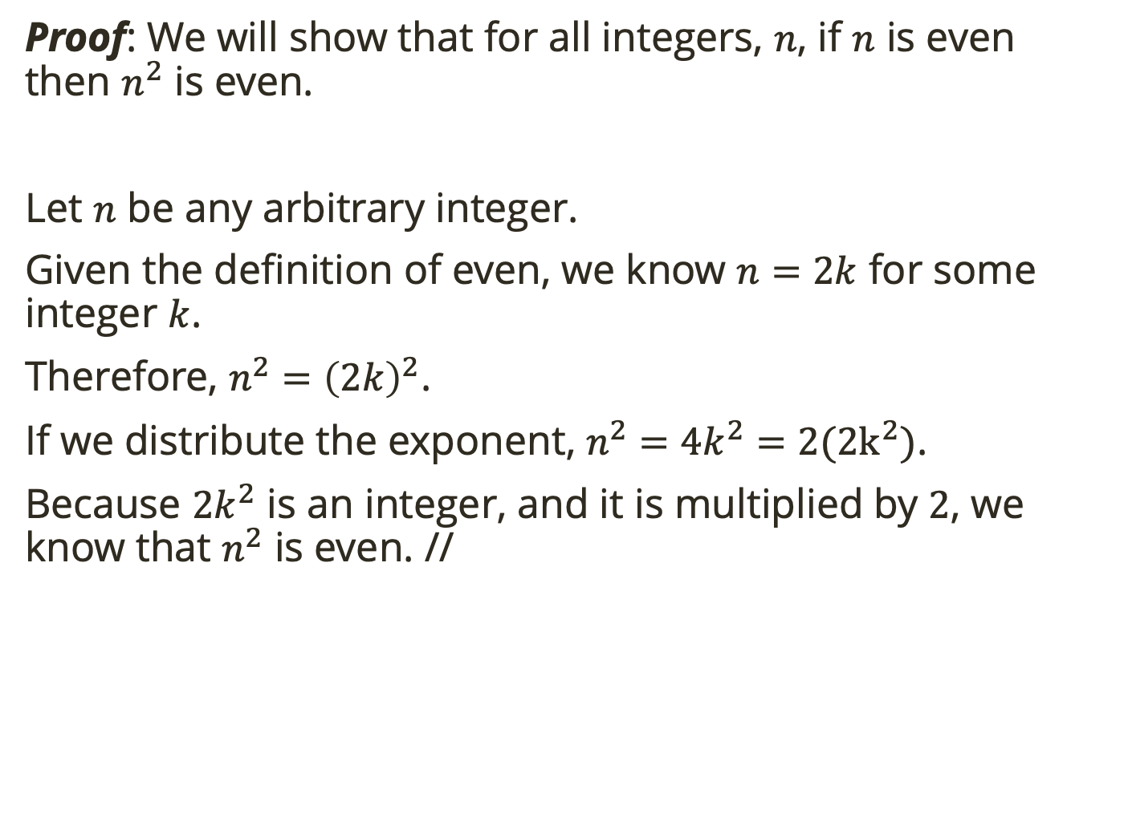
Example Proof
Proof: We will show that for all integers, $n$, if $n$ is even then $n^{2}$ is even.
Let $n$ be any arbitrary integer.
Given the definition of even, we know $n=2k$ for some integer $k$.
Therefore, $n^{2}={\left(2k\right)}^{2}$.
If we distribute the exponent, $n^{2}=4k^{2}=2(2k^{2})$.
Because $2k^{2}$ is an integer, and it is multiplied by $2$, we know that $n^{2}$ is even. //

Slide 11
Example Proof
Proof: We will show that for all integers, $n$, if $n$ is even then $n^{2}$ is even.
Let $n$ be any arbitrary integer.
Given the definition of even, we know $n=2k$ for some integer $k$.
Therefore, $n^{2}={\left(2k\right)}^{2}$.
If we distribute the exponent, $n^{2}=4k^{2}=2(2k^{2})$.
Because $2k^{2}$ is an integer, and it is multiplied by $2$, we know that $n^{2}$ is even. //
Start by stating what you will show.

Slide 12
Example Proof
Proof: We will show that for all integers, $n$, if $n$ is even then $n^{2}$ is even.
Let $n$ be any arbitrary integer.
Given the definition of even, we know $n=2k$ for some integer $k$.
Therefore, $n^{2}={\left(2k\right)}^{2}$.
If we distribute the exponent, $n^{2}=4k^{2}=2(2k^{2})$.
Because $2k^{2}$ is an integer, and it is multiplied by $2$, we know that $n^{2}$ is even. //
Start by stating what you will show.
Take SMALL, justified steps.

Slide 13
Example Proof
Proof: We will show that for all integers, $n$, if $n$ is even then $n^{2}$ is even.
Let $n$ be any arbitrary integer.
Given the definition of even, we know $n=2k$ for some integer $k$.
Therefore, $n^{2}={\left(2k\right)}^{2}$.
If we distribute the exponent, $n^{2}=4k^{2}=2(2k^{2})$.
Because $2k^{2}$ is an integer, and it is multiplied by $2$, we know that $n^{2}$ is even. //
Start by stating what you will show.
End proof.
Take SMALL, justified steps.

Slide 14
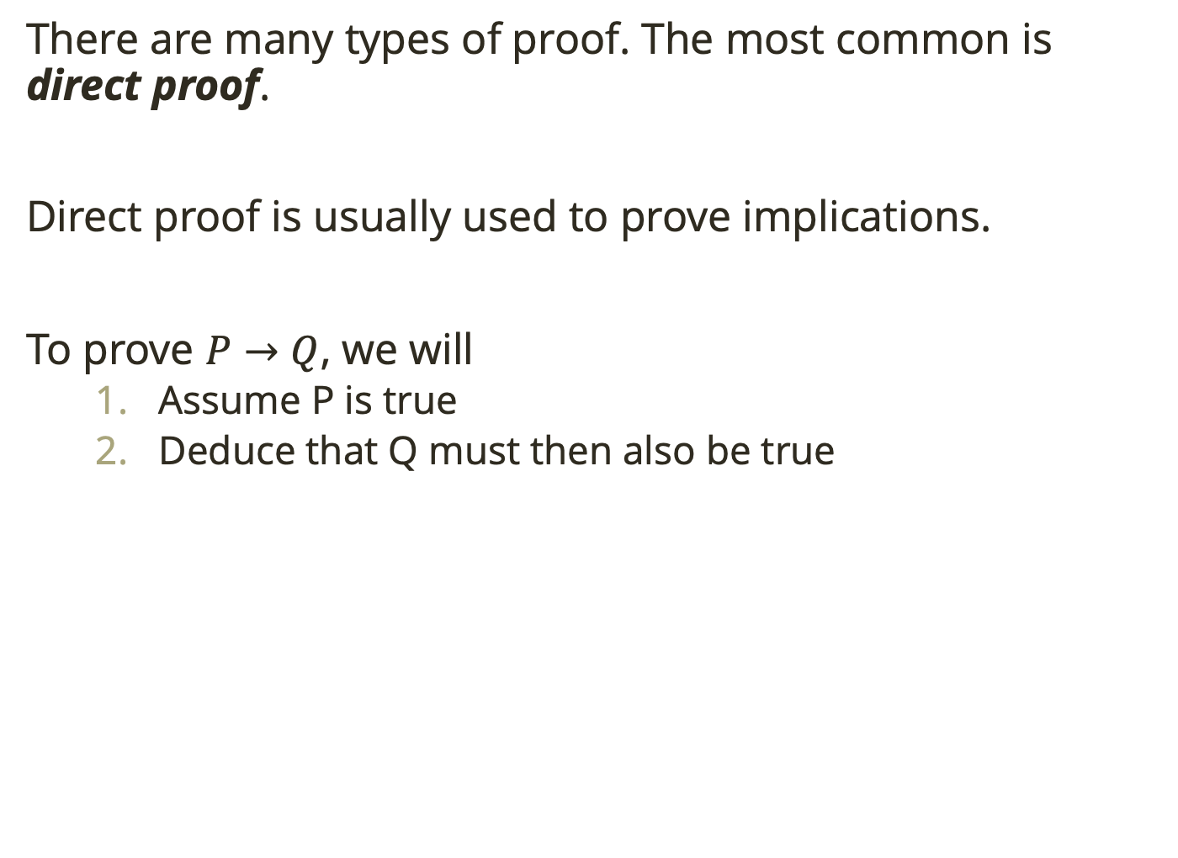
Direct Proof
There are many types of proof. The most common is direct proof.
Direct proof is usually used to prove implications.
To prove $P→Q$, we will
Assume P is true
Deduce that Q must then also be true

Slide 15
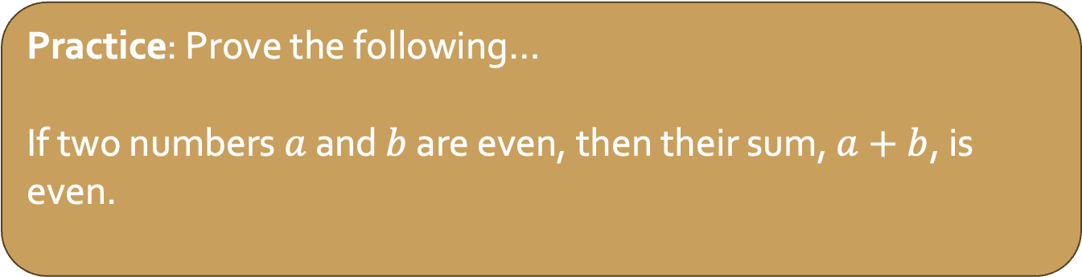
Direct Proof
There are many types of proof. The most common is direct proof.
Direct proof is usually used to prove implications.
To prove $P→Q$, we will
Assume P is true
Deduce that Q must then also be true
Practice: Prove the following…
If two numbers $a$ and $b$ are even, then their sum, $a+b$, is even.
Notes:
Let ,�, ,�, and � be integers. Assume that �|� and .�|�. In other words, � is a multiple of � and � is a multiple of .�. So there are integers � and � such that �=�� and .�=��. Combining these (through substitution) we get that .�=���. But �� is an integer, so this says that � is a multiple of .�. Therefore .

Slide 16
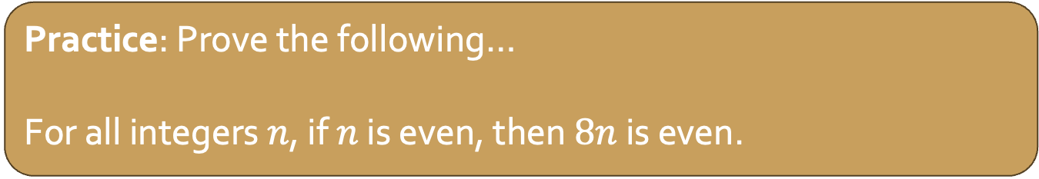
Direct Proof
There are many types of proof. The most common is direct proof.
Direct proof is usually used to prove implications.
To prove $P→Q$, we will
Assume P is true
Deduce that Q must then also be true
Practice: Prove the following…
For all integers $n$, if $n$ is even, then $8n$ is even.

Slide 17
Start here next week!

Slide 18
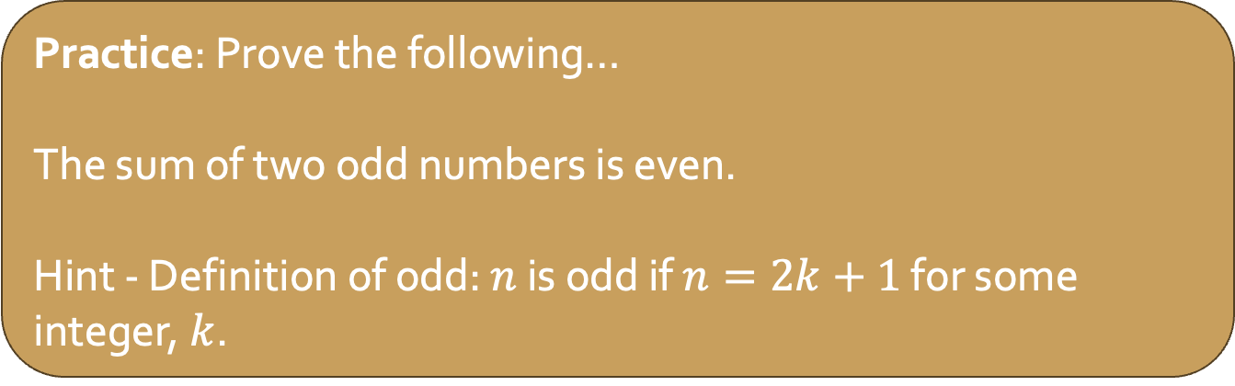
Direct Proof
There are many types of proof. The most common is direct proof.
Direct proof is usually used to prove implications.
To prove $P→Q$, we will
Assume P is true
Deduce that Q must then also be true
Practice: Prove the following…
The sum of two odd numbers is even.
Hint - Definition of odd: $n$ is odd if $n=2k+1$ for some integer, $k$.

Slide 19
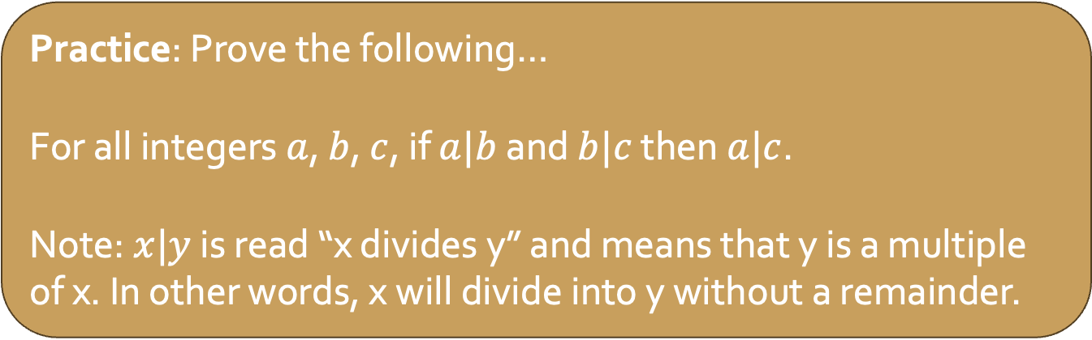
Direct Proof
There are many types of proof. The most common is direct proof.
Direct proof is usually used to prove implications.
To prove $P→Q$, we will
Assume P is true
Deduce that Q must then also be true
Practice: Prove the following…
For all integers $a$, $b$, $c$, if $a|b$ and $b|c$ then $a|c$.
Note: $x|y$ is read “x divides y” and means that y is a multiple of x. In other words, x will divide into y without a remainder.
Notes:
Let ,�, ,�, and � be integers. Assume that �|� and .�|�. In other words, � is a multiple of � and � is a multiple of .�. So there are integers � and � such that �=�� and .�=��. Combining these (through substitution) we get that .�=���. But �� is an integer, so this says that � is a multiple of .�. Therefore .

Slide 20
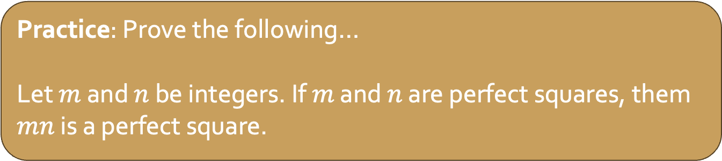
Direct Proof
There are many types of proof. The most common is direct proof.
Direct proof is usually used to prove implications.
To prove $P→Q$, we will
Assume P is true
Deduce that Q must then also be true
Practice: Prove the following…
Let $m$ and $n$ be integers. If $m$ and $n$ are perfect squares, them $mn$ is a perfect square.

Slide 21
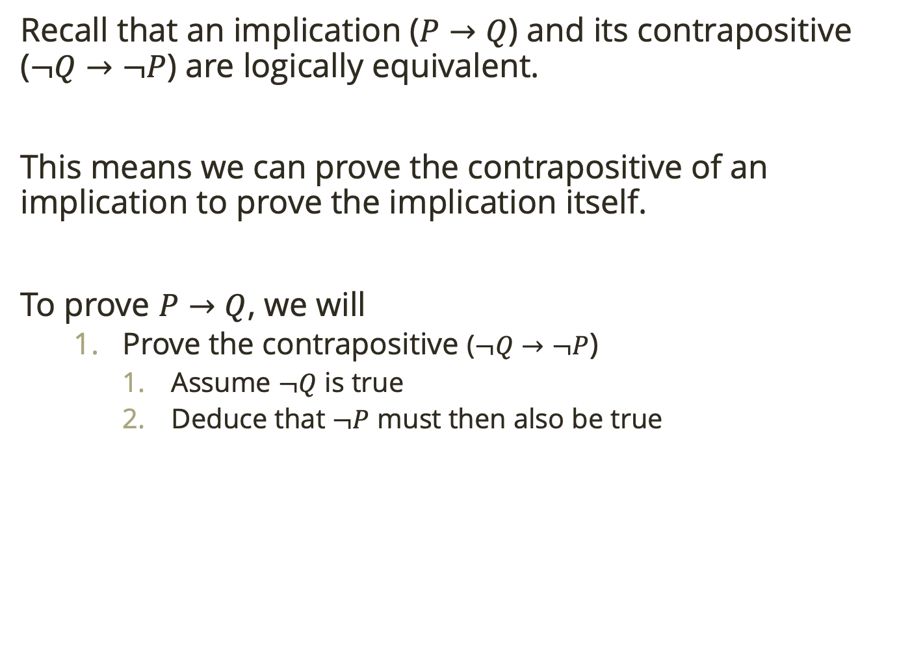
Proof by Contrapositive
Recall that an implication ($P→Q$) and its contrapositive ($¬Q→¬P$) are logically equivalent.
This means we can prove the contrapositive of an implication to prove the implication itself.
To prove $P→Q$, we will
Prove the contrapositive ($¬Q→¬P$)
Assume $¬Q$ is true
Deduce that $¬P$ must then also be true

Slide 22
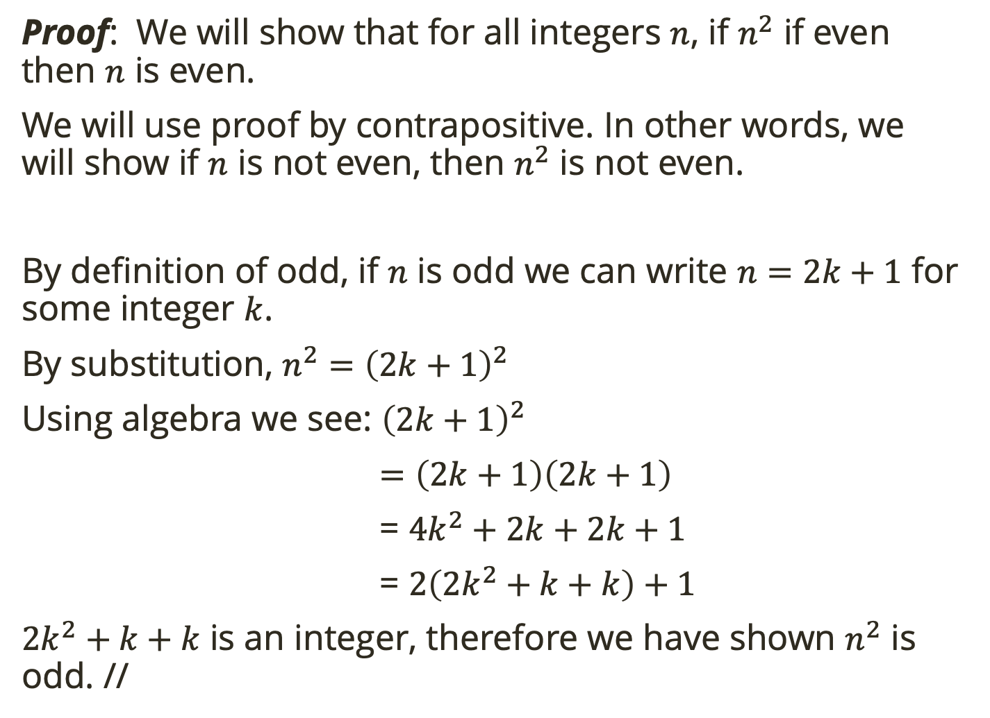
Proof by Contrapositive
Proof: We will show that for all integers $n$, if $n^{2}$ if even then $n$ is even.
We will use proof by contrapositive. In other words, we will show if $n$ is not even, then $n^{2}$ is not even.
By definition of odd, if $n$ is odd we can write $n=2k+1$ for some integer $k$.
By substitution, $n^{2}={\left(2k+1\right)}^{2}$
Using algebra we see: ${\left(2k+1\right)}^{2}$
$=\left(2k+1\right)\left(2k+1\right)$
= $4k^{2}+2k+2k+1$
= $2\left(2k^{2}+k+k\right)+1$
$2k^{2}+k+k$ is an integer, therefore we have shown $n^{2}$ is odd. //

Slide 23
Proof by Contrapositive
Proof: We will show that for all integers $n$, if $n^{2}$ if even then $n$ is even.
We will use proof by contrapositive. In other words, we will show if $n$ is not even, then $n^{2}$ is not even.
By definition of odd, if $n$ is odd we can write $n=2k+1$ for some integer $k$.
By substitution, $n^{2}={\left(2k+1\right)}^{2}$
Using algebra we see: ${\left(2k+1\right)}^{2}$
$=\left(2k+1\right)\left(2k+1\right)$
= $4k^{2}+2k+2k+1$
= $2\left(2k^{2}+k+k\right)+1$
$2k^{2}+k+k$ is an integer, therefore we have shown $n^{2}$ is odd. //
Start by stating what you will show.
Take SMALL, justified steps.
For proofs other than direct, say what technique you will use
End proof.

Slide 24
Proof by Contrapositive
Recall that an implication ($P→Q$) and its contrapositive ($¬Q→¬P$) are logically equivalent.
This means we can prove the contrapositive of an implication to prove the implication itself.
To prove $P→Q$, we will
Prove the contrapositive ($¬Q→¬P$)
Assume $¬Q$ is true
Deduce that $¬P$ must then also be true

Slide 25
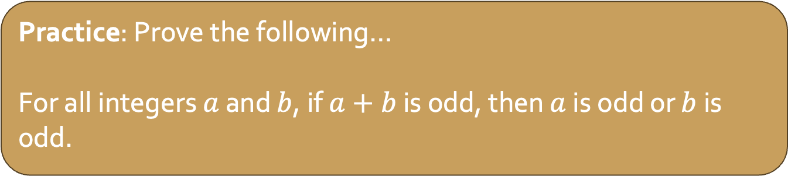
Proof by Contrapositive
Recall that an implication ($P→Q$) and its contrapositive ($¬Q→¬P$) are logically equivalent.
This means we can prove the contrapositive of an implication to prove the implication itself.
To prove $P→Q$, we will
Prove the contrapositive ($¬Q→¬P$)
Assume $¬Q$ is true
Deduce that $¬P$ must then also be true
Practice: Prove the following…
For all integers $a$ and $b$, if $a+b$ is odd, then $a$ is odd or $b$ is odd.
Notes:
Assume that � and � are both even. la la la. Therefore �+� is even.
Proof.
Let � and � be integers. Assume that � and � are even. Then �=2� and �=2� for some integers � and .�. Now .�+�=2�+2�=2(�+�). Since �+� is an integer, we see that �+� is even, completing the proof.
Note that our assumption that � and � are even is really the negation of � or � is odd. We used De Morgan's law here.

Slide 26
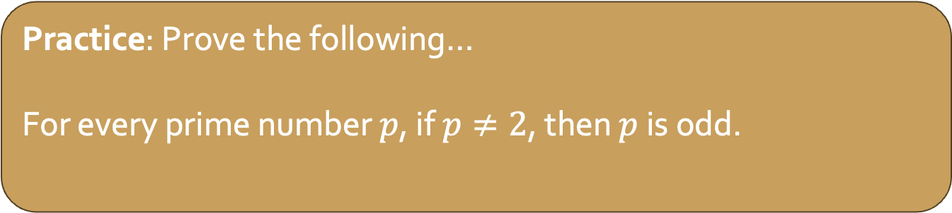
Proof by Contrapositive
Recall that an implication ($P→Q$) and its contrapositive ($¬Q→¬P$) are logically equivalent.
This means we can prove the contrapositive of an implication to prove the implication itself.
To prove $P→Q$, we will
Prove the contrapositive ($¬Q→¬P$)
Assume $¬Q$ is true
Deduce that $¬P$ must then also be true
Practice: Prove the following…
For every prime number $p$, if $p≠2$, then $p$ is odd.
Notes:
Let � be an arbitrary prime number. Assume � is not odd. So � is divisible by 2. Since � is prime, it must have exactly two divisors, and it has 2 as a divisor, so � must be divisible by only 1 and 2. Therefore .�=2. This completes the proof (by contrapositive).

Slide 27
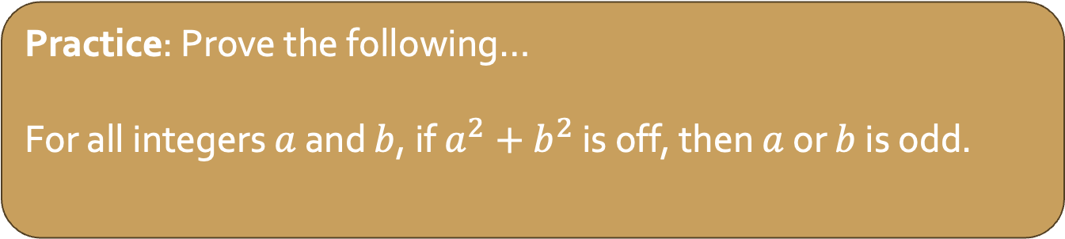
Proof by Contrapositive
Recall that an implication ($P→Q$) and its contrapositive ($¬Q→¬P$) are logically equivalent.
This means we can prove the contrapositive of an implication to prove the implication itself.
To prove $P→Q$, we will
Prove the contrapositive ($¬Q→¬P$)
Assume $¬Q$ is true
Deduce that $¬P$ must then also be true
Practice: Prove the following…
For all integers $a$ and $b$, if $a^{2}+b^{2}$ is off, then $a$ or $b$ is odd.

Slide 28
Proof by Contrapositive
Recall that an implication ($P→Q$) and its contrapositive ($¬Q→¬P$) are logically equivalent.
This means we can prove the contrapositive of an implication to prove the implication itself.
To prove $P→Q$, we will
Prove the contrapositive ($¬Q→¬P$)
Assume $¬Q$ is true
Deduce that $¬P$ must then also be true
Practice: Prove the following…
The game TENZI comes with 40 six-sided dice. Suppose you roll all 40 dice. Prove that there will be at least seven dice that land on the same number.
Notes:
Suppose that each number only came up 6 or fewer times. So there are at most six 1's, six 2's, and so on. That's a total of 36 dice, so you must not have rolled all 40 dice.

Slide 29
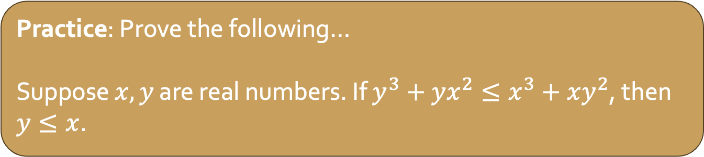
Proof by Contrapositive
Recall that an implication ($P→Q$) and its contrapositive ($¬Q→¬P$) are logically equivalent.
This means we can prove the contrapositive of an implication to prove the implication itself.
To prove $P→Q$, we will
Prove the contrapositive ($¬Q→¬P$)
Assume $¬Q$ is true
Deduce that $¬P$ must then also be true
Practice: Prove the following…
Suppose $x, y$ are real numbers. If $y^{3}+yx^{2}≤x^{3}+xy^{2}$, then $y≤x$.
Notes:
Suppose it is not true that y≤x, so y>x. Then y−x>0. Multiply both sides of y−x>0 by the positive value x^2+y^2.
(y−x)(x^2+y2^) > 0(x^2+y^2)
yx^2+y3−x3−xy^2 > 0
y^3+yx^2 > x^3+xy^2
Therefore y^^3+yx^2>x^3+xy^2, so it is not true that
y^3+yx^2≤x^3+xy^2.

Slide 30
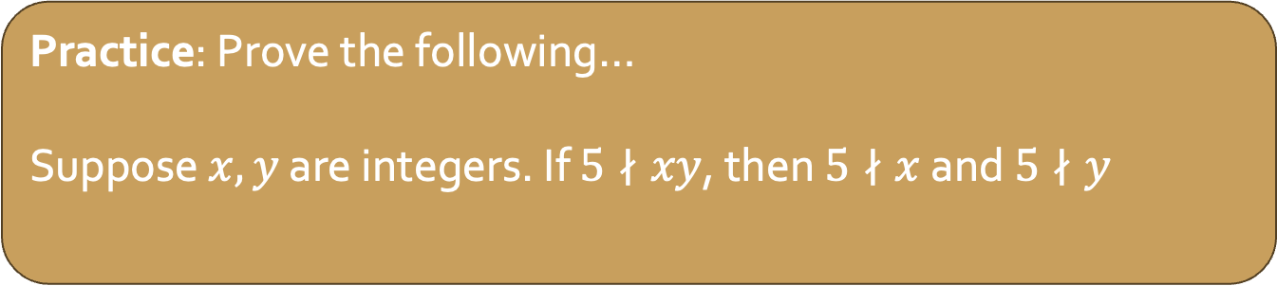
Proof
Part of proof is choosing the technique.
Practice: Prove the following…
Suppose $x,y$ are integers. If $5∤xy$, then $5∤x$ and $5∤y$
Notes:
Suppose it is not true that 5 x and 5 y.
By DeMorgan’s law, it is not true that 5 x or it is not true that 5 y. Therefore 5|x or 5|y. We consider these possibilities separately. Case1. Suppose 5|x. Then x=5a for some a∈Z. From this we get xy=5(ay), and that means 5|xy. Case2. Suppose 5|y. Then y=5a for some a∈Z. From this we get xy=5(ax), and that means 5|xy. The above cases show that 5|xy, so it is not true that 5 xy.

