Slide 1
Discrete Structures– Graphs: Definitions
Dr. Ab Mosca (they/them)

Slide 2
Plan for Today
Graph definitions

Slide 3
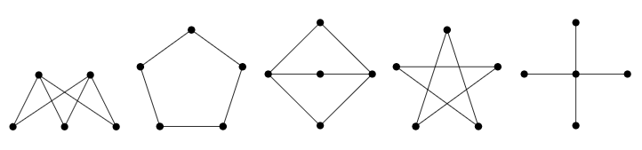
Warm Up: Visualizing
Are any of the graphs below the same? If you said yes, which ones and why?
Notes:
a_0 = 8, d = 6

Slide 4
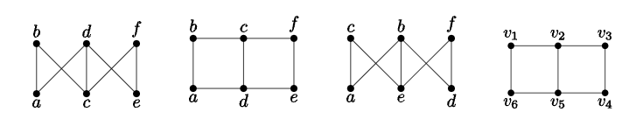
Warm Up: Visualizing
How about these with labels?
Are any of the graphs below the same? If you said yes, which ones and why?
Notes:
a_0 = 8, d = 6

Slide 5

Definition
These examples are drawings of graphs.
Mathematically, a graph is an ordered pair, $G=(V,E)$, consisting of a nonempty set, $V$ (called vertices), and a set $E$ (called edges) of two-elements subsets of $V$.
Notes:
a_0 = 8, d = 6

Slide 6

Definition
These examples are drawings of graphs.
Mathematically, a graph is an ordered pair, $G=(V,E)$, consisting of a nonempty set, $V$ (called vertices), and a set $E$ (called edges) of two-elements subsets of $V$.
Note: you may also hear vertices called nodes.
Notes:
a_0 = 8, d = 6

Slide 7

Definition
Mathematically, a graph is an ordered pair, $G=(V,E)$, consisting of a nonempty set, $V$ (called vertices), and a set $E$ (called edges) of two-elements subsets of $V$.
Ex. Graph 1:
$V=\left\{a, b, c, d, e\right\},$
$E=\{\left\{a, b\right\}, \left\{a, c\right\}, \left\{a, d\right\}, \left\{a, e\right\}, \left\{b, c\right\}, \left\{d, e\right\}\}$
Notes:
a_0 = 8, d = 6

Slide 8
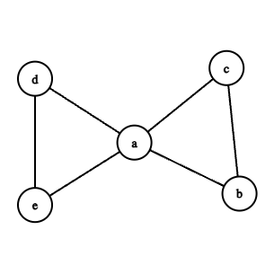
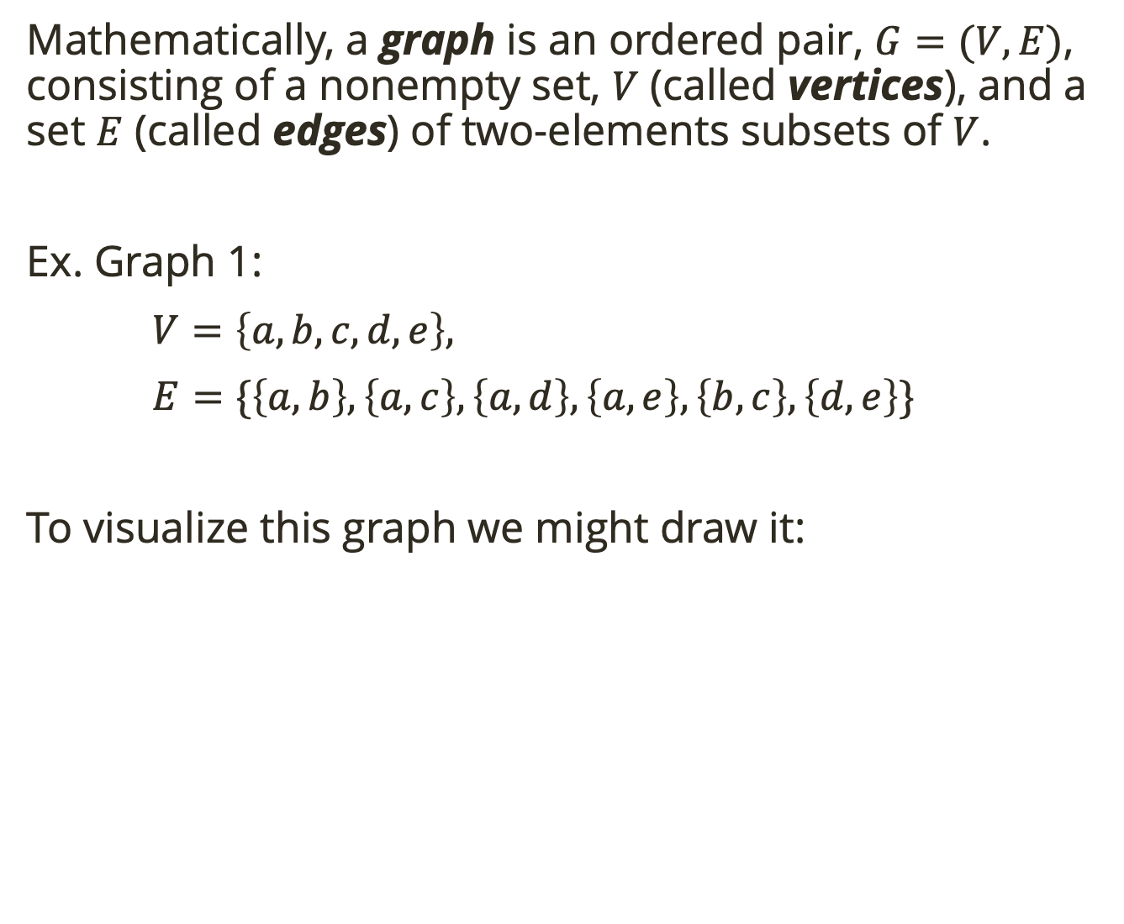
Definition
Mathematically, a graph is an ordered pair, $G=(V,E)$, consisting of a nonempty set, $V$ (called vertices), and a set $E$ (called edges) of two-elements subsets of $V$.
Ex. Graph 1:
$V=\left\{a, b, c, d, e\right\},$
$E=\{\left\{a, b\right\}, \left\{a, c\right\}, \left\{a, d\right\}, \left\{a, e\right\}, \left\{b, c\right\}, \left\{d, e\right\}\}$
To visualize this graph we might draw it:
Notes:
a_0 = 8, d = 6

Slide 9

Definition
Mathematically, a graph is an ordered pair, $G=(V,E)$, consisting of a nonempty set, $V$ (called vertices), and a set $E$ (called edges) of two-elements subsets of $V$.
Ex. Graph 1:
$V=\left\{a, b, c, d, e\right\},$
$E=\{\left\{a, b\right\}, \left\{a, c\right\}, \left\{a, d\right\}, \left\{a, e\right\}, \left\{b, c\right\}, \left\{d, e\right\}\}$
To visualize this graph we might draw it:
Draw this graph:
$$V=\left\{v_{1},v_{2},v_{3},v_{4},v_{5}\right\}$$
$$E=\{\left\{v_{1},v_{3}\right\}, \left\{v_{1},v_{5}\right\}, \left\{v_{2}, v_{4}\right\},$$
$\left\{v_{2}, v_{5}\right\}, \left\{v_{3}, v_{5}\right\}, \left\{v_{4}, v_{5}\right\}\}$
Notes:
a_0 = 8, d = 6

Slide 10
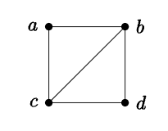
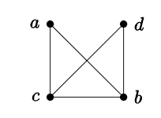
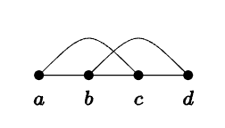

Relationships Between Graphs
Two graphs are equal if their sets of vertices and edges are equal.
Drawings of the same graph can differ.
Ex. $(\left\{a, b, c, d, e\right\}, \left\{\left\{a, b\right\}, \left\{a, c\right\}, \left\{b, c\right\}, \left\{b,d\right\}, \left\{c,d\right\}\right\})$
To visualize this graph we might draw it:
Notes:
a_0 = 8, d = 6

Slide 11

Relationships Between Graphs
Two graphs are equal if their sets of vertices and edges are equal.
Drawings of the same graph can differ.
Ex. $(\left\{a, b, c, d, e\right\}, \left\{\left\{a, b\right\}, \left\{a, c\right\}, \left\{b, c\right\}, \left\{b,d\right\}, \left\{c,d\right\}\right\})$
To visualize this graph we might draw it:
Are these graphs equal?
$$G_{1}=\left(\left\{a, b,c\right\}, \left\{\left\{a,b\right\}, \left\{b,c\right\}\right\}\right)$$
$$G_{2}=\left(\left\{a, b,c\right\}, \left\{\left\{a,c\right\}, \left\{c,b\right\}\right\}\right)$$
Notes:
a_0 = 8, d = 6

Slide 12
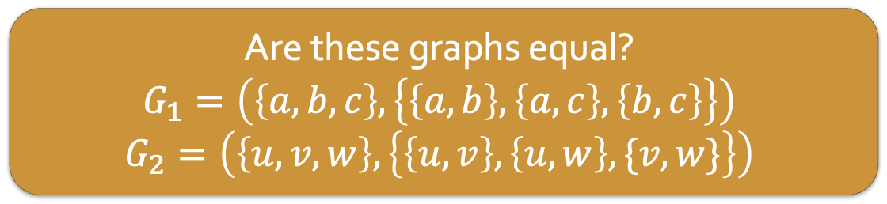
Relationships Between Graphs
Two graphs are equal if their sets of vertices and edges are equal.
Drawings of the same graph can differ.
Ex. $(\left\{a, b, c, d, e\right\}, \left\{\left\{a, b\right\}, \left\{a, c\right\}, \left\{b, c\right\}, \left\{b,d\right\}, \left\{c,d\right\}\right\})$
To visualize this graph we might draw it:
Are these graphs equal?
$$G_{1}=\left(\left\{a, b,c\right\}, \left\{\left\{a,b\right\}, \left\{a,c\right\},\left\{b,c\right\}\right\}\right)$$
$$G_{2}=\left(\left\{u, v,w\right\}, \left\{\left\{u,v\right\}, \left\{u,w\right\}, \{v,w\}\right\}\right)$$
Notes:
a_0 = 8, d = 6

Slide 13
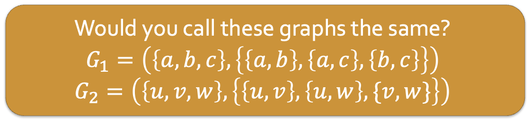
Relationships Between Graphs
Two graphs are equal if their sets of vertices and edges are equal.
Drawings of the same graph can differ.
Ex. $(\left\{a, b, c, d, e\right\}, \left\{\left\{a, b\right\}, \left\{a, c\right\}, \left\{b, c\right\}, \left\{b,d\right\}, \left\{c,d\right\}\right\})$
To visualize this graph we might draw it:
Would you call these graphs the same?
$$G_{1}=\left(\left\{a, b,c\right\}, \left\{\left\{a,b\right\}, \left\{a,c\right\},\left\{b,c\right\}\right\}\right)$$
$$G_{2}=\left(\left\{u, v,w\right\}, \left\{\left\{u,v\right\}, \left\{u,w\right\}, \{v,w\}\right\}\right)$$
Notes:
a_0 = 8, d = 6

Slide 14

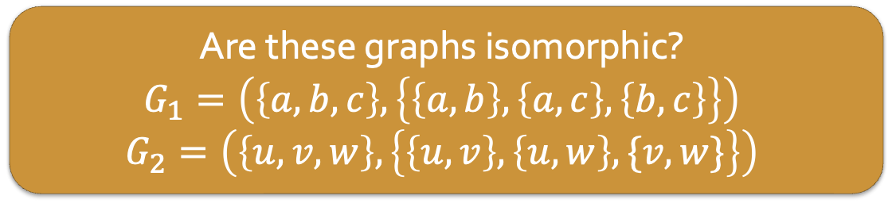
Relationships Between Graphs
An isomorphism between two graphs $G_{1}$ and $G_{2}$ is a bijection $f:V_{1}→V_{2}$ between the vertices of the graphs such that $\{a,b\}$ is an edge in $G_{1}$ if and only if $\{f\left(a\right), f\left(b\right)\}$ is an edge in $G_{2}$.
Two graphs are isomorphic if there is an isomorphism between them. In this case we write $G_{1}≅G_{2}$.
Are these graphs isomorphic?
$$G_{1}=\left(\left\{a, b,c\right\}, \left\{\left\{a,b\right\}, \left\{a,c\right\},\left\{b,c\right\}\right\}\right)$$
$$G_{2}=\left(\left\{u, v,w\right\}, \left\{\left\{u,v\right\}, \left\{u,w\right\}, \{v,w\}\right\}\right)$$
Notes:
a_0 = 8, d = 6

Slide 15
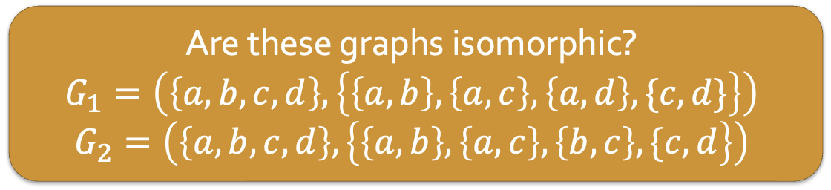
Relationships Between Graphs
An isomorphism between two graphs $G_{1}$ and $G_{2}$ is a bijection $f:V_{1}→V_{2}$ between the vertices of the graphs such that $\{a,b\}$ is an edge in $G_{1}$ if and only if $\{f\left(a\right), f\left(b\right)\}$ is an edge in $G_{2}$.
Two graphs are isomorphic if there is an isomorphism between them. In this case we write $G_{1}≅G_{2}$.
Are these graphs isomorphic?
$$G_{1}=\left(\left\{a, b,c,d\right\}, \left\{\left\{a,b\right\}, \left\{a,c\right\},\left\{a,d\right\}, \{c,d\}\right\}\right)$$
$$G_{2}=\left(\left\{a,b,c,d\right\}, \left\{\left\{a,b\right\}, \left\{a,c\right\}, \left\{b,c\right\}, \{c,d\right\}\right)$$
Notes:
Yes!
Draw
See how to map vertices in G_1 to G_2 (define each g(x) = y
Then check that it’s a bijection and isomorphism

Slide 16
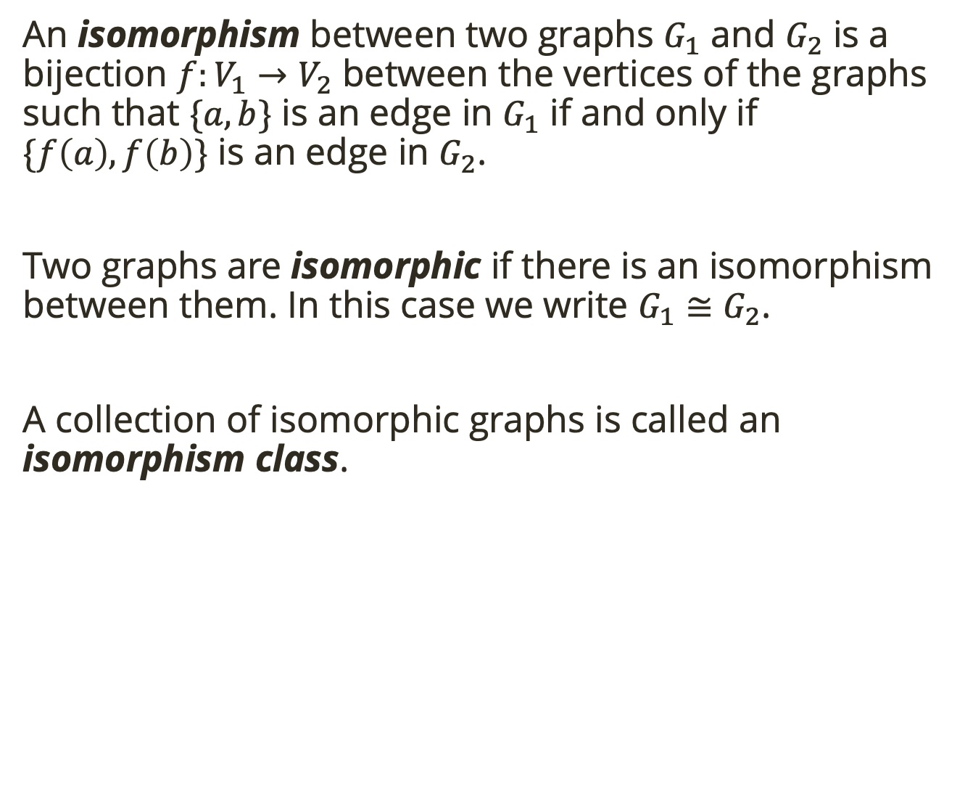
Relationships Between Graphs
An isomorphism between two graphs $G_{1}$ and $G_{2}$ is a bijection $f:V_{1}→V_{2}$ between the vertices of the graphs such that $\{a,b\}$ is an edge in $G_{1}$ if and only if $\{f\left(a\right), f\left(b\right)\}$ is an edge in $G_{2}$.
Two graphs are isomorphic if there is an isomorphism between them. In this case we write $G_{1}≅G_{2}$.
A collection of isomorphic graphs is called an isomorphism class.

Slide 17
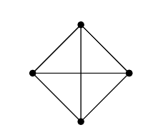
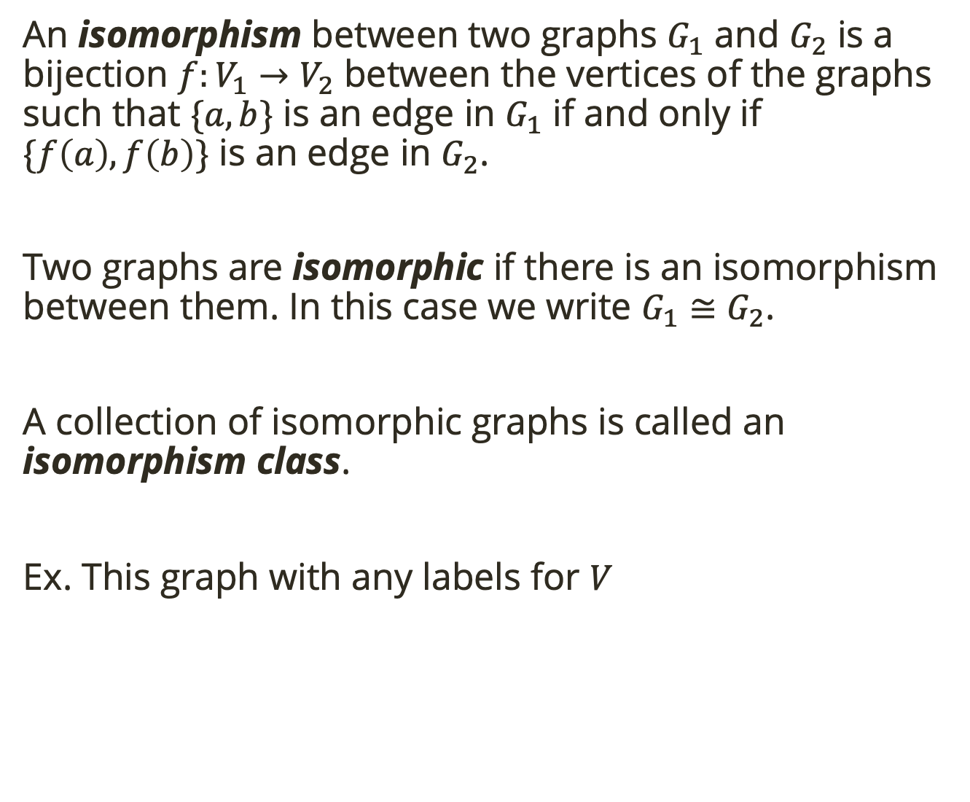
Relationships Between Graphs
An isomorphism between two graphs $G_{1}$ and $G_{2}$ is a bijection $f:V_{1}→V_{2}$ between the vertices of the graphs such that $\{a,b\}$ is an edge in $G_{1}$ if and only if $\{f\left(a\right), f\left(b\right)\}$ is an edge in $G_{2}$.
Two graphs are isomorphic if there is an isomorphism between them. In this case we write $G_{1}≅G_{2}$.
A collection of isomorphic graphs is called an isomorphism class.
Ex. This graph with any labels for $V$

Slide 18
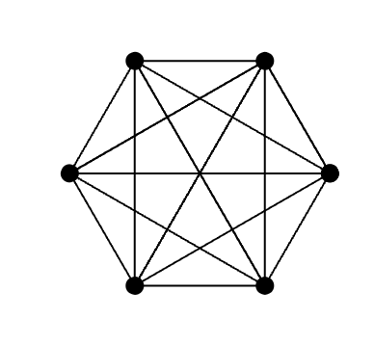
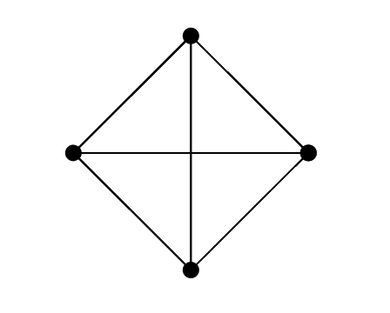
Relationships Between Graphs
Do you think these graphs are related? If so, how?

Slide 19
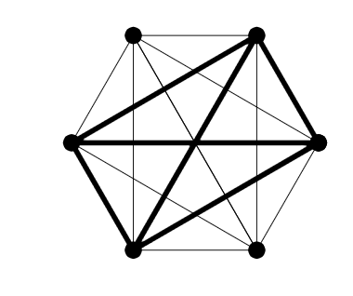

Relationships Between Graphs
We say that $G^{′}=(V^{′},E^{′})$ is a subgraph of $G=(V,E)$, and write $G^{′}⊆G$, provided $V^{′}⊆V$ and $E^{′}⊆E$.
We say that $G^{′}=(V^{′},E^{′})$ is an induced subgraph of $G=(V,E)$ provided $V^{′}⊆V$ and every edge in $E$ whose vertices are still in $V^{′}$ is also an edge in $E′$.
Notes:
A subgraph 𝐻 of 𝐺 is called INDUCED, if for any two vertices 𝑢,𝑣,in 𝐻, 𝑢 and 𝑣 are adjacent in 𝐻 if and only if they are adjacent in 𝐺.
In other words, 𝐻 has the same edges as 𝐺 between the vertices in 𝐻.
A general subgraph can have less edges between the same vertices than the original one.
So, an induced subgraph can be constructed by deleting vertices (and with them all the incident edges), but no more edges. If additional edges are deleted, the subgraph is not induced.

Slide 20
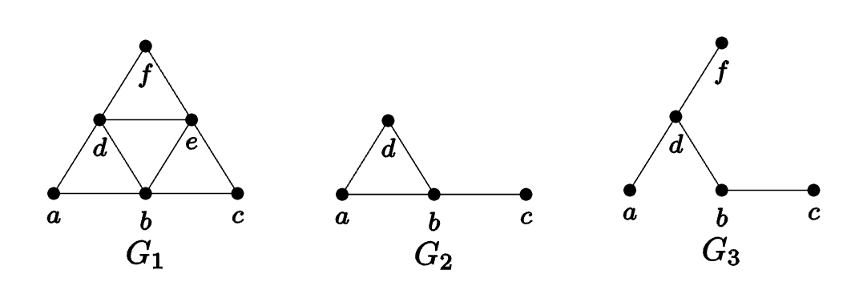

Relationships Between Graphs
We say that $G^{′}=(V^{′},E^{′})$ is a subgraph of $G=(V,E)$, and write $G^{′}⊆G$, provided $V^{′}⊆V$ and $E^{′}⊆E$.
We say that $G^{′}=(V^{′},E^{′})$ is an induced subgraph of $G=(V,E)$ provided $V^{′}⊆V$ and every edge in $E$ whose vertices are still in $V^{′}$ is also an edge in $E′$.
Notes:
G_1 and G_3 are subgraphs of G_1
Only G_2 is an induced subgraph
Every edge in G_1 that connects vertices in G_2 is also an edge in G_2
In G_3, the edge {a,b} is in E_1 but not E_3, even though vertices a and b are in V_3

Slide 21
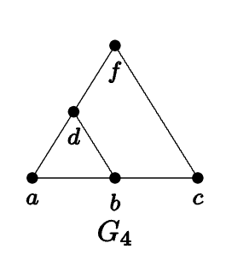

Relationships Between Graphs
We say that $G^{′}=(V^{′},E^{′})$ is a subgraph of $G=(V,E)$, and write $G^{′}⊆G$, provided $V^{′}⊆V$ and $E^{′}⊆E$.
We say that $G^{′}=(V^{′},E^{′})$ is an induced subgraph of $G=(V,E)$ provided $V^{′}⊆V$ and every edge in $E$ whose vertices are still in $V^{′}$ is also an edge in $E′$.
Is $G_{4}$ a subgraph of $G_{1}$?
Notes:
No!
in E_4 we have the edge {c, f} but this is not an element of E_1, so we don’t have the required E_4 is a subset of E_1

Slide 22
Special Graphs
With our current definition no pair of vertices can be connected by an edge more than once, and no vertex can be connected to itself.

Slide 23
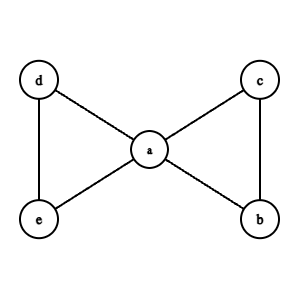
Special Graphs
With our current definition no pair of vertices can be connected by an edge more than once, and no vertex can be connected to itself.
A multigraph, is a graph that allows double (or more) edges, and for a vertex to be connected to itself.

Slide 24
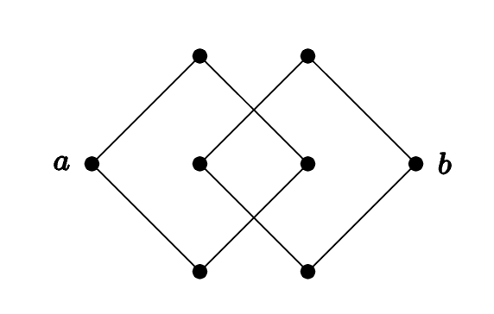
Special Graphs
A connected graph is a graph where you can get from any vertex to any other vertex by following some path of edges.
Is this graph connected?

Slide 25

Special Graphs
A graph that includes all possible edges is called complete. In other words, a graph is complete if every pair of vertices is connected by an edge.
$K_{n}$ is the complete graph on $n$ vertices.

Slide 26

Special Graphs
A graph that includes all possible edges is called complete. In other words, a graph is complete if every pair of vertices is connected by an edge.
$K_{n}$ is the complete graph on $n$ vertices.
We call the number of edges emanating from a given vertex the degree of that vertex.

Slide 27
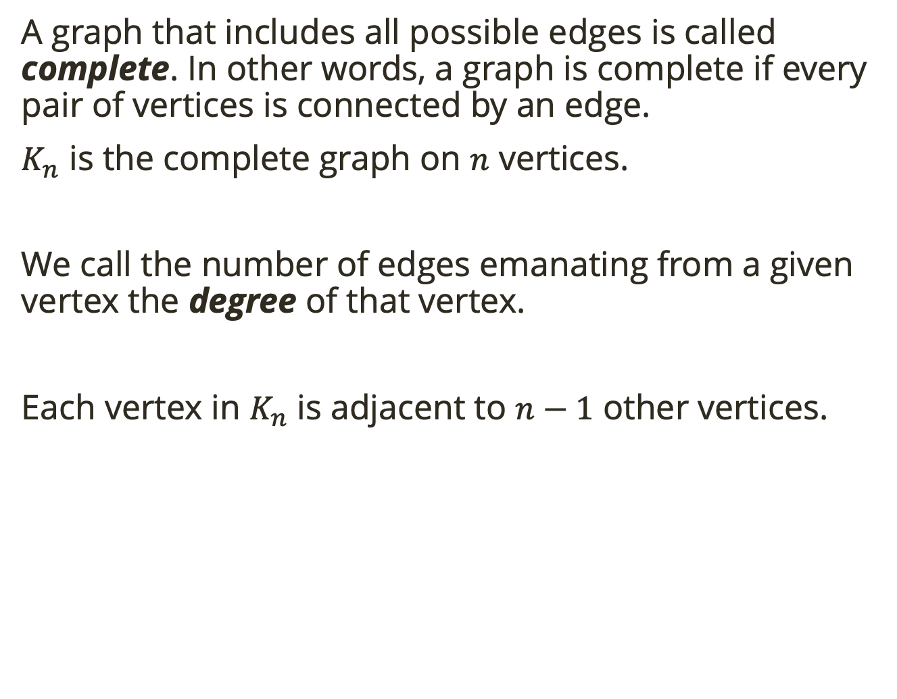
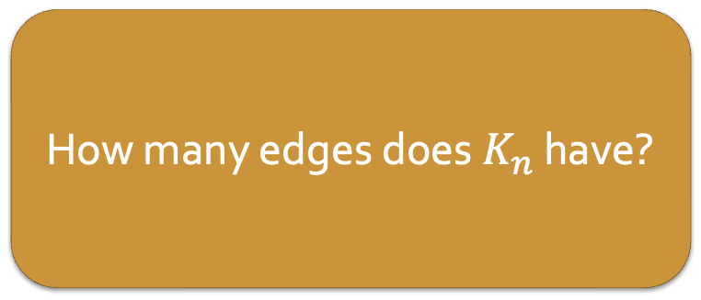
Special Graphs
A graph that includes all possible edges is called complete. In other words, a graph is complete if every pair of vertices is connected by an edge.
$K_{n}$ is the complete graph on $n$ vertices.
We call the number of edges emanating from a given vertex the degree of that vertex.
Each vertex in $K_{n}$ is adjacent to $n−1$ other vertices.
How many edges does $K_{n}$ have?
Notes:
n(n-1)/2
OR n choose 2 because to draw an edge we must choose 2 of the n vertices

Slide 28

Handshake Lemma
In any graph, the sum of the degrees of vertices in the graph is always twice the number of edges.
This can be written symbolically as: $\sum_{v∈V}{d(v)}=2e$
Notes:
n(n-1)/2
OR n choose 2 because to draw an edge we must choose 2 of the n vertices

Slide 29
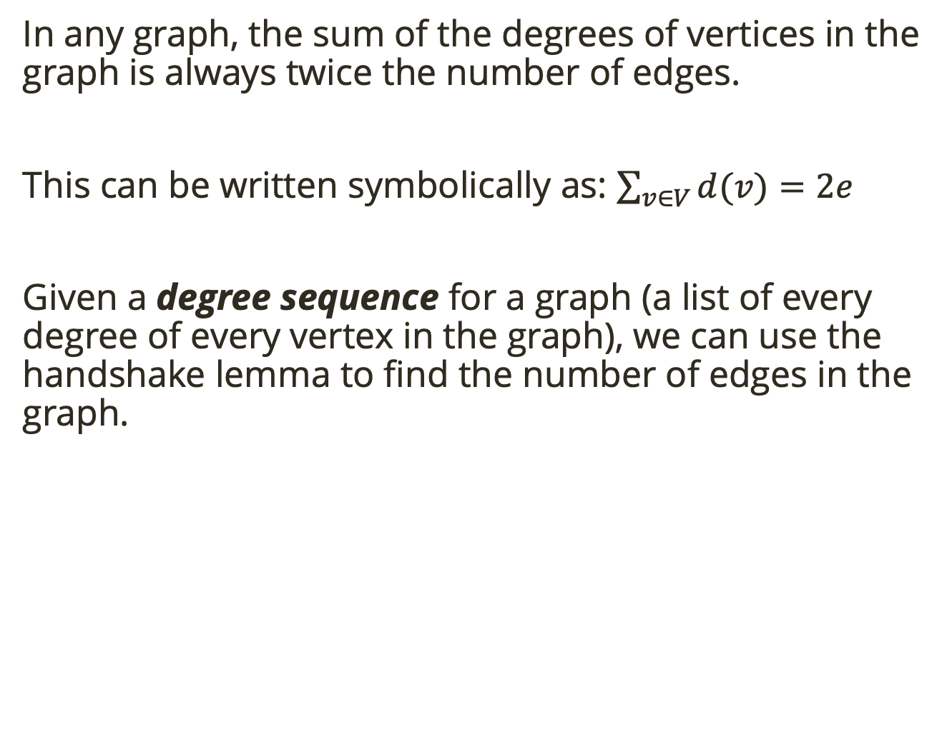
Handshake Lemma
In any graph, the sum of the degrees of vertices in the graph is always twice the number of edges.
This can be written symbolically as: $\sum_{v∈V}{d(v)}=2e$
Given a degree sequence for a graph (a list of every degree of every vertex in the graph), we can use the handshake lemma to find the number of edges in the graph.
How many vertices and edges must the graph with the degree sequence (4, 4, 3, 3, 3, 2, 1) have?
Notes:
vertices = number of degrees in the sequence
Edges is degree sum / 2 → 10

Slide 30
Handshake Lemma
In any graph, the sum of the degrees of vertices in the graph is always twice the number of edges.
This can be written symbolically as: $\sum_{v∈V}{d(v)}=2e$
Given a degree sequence for a graph (a list of every degree of every vertex in the graph), we can use the handshake lemma to find the number of edges in the graph.
At a recent math seminar, 9 mathematicians greeted each other by shaking hands. Is it possible that each mathematician shook hands with exactly 7 people at the seminar?
Notes:
It seems like this should be possible. Each mathematician chooses one person to not shake hands with. But this cannot happen. We are asking whether a graph with 9 vertices can have each vertex have degree 7. If such a graph existed, the sum of the degrees of the vertices would be 9⋅7=63. This would be twice the number of edges (handshakes) resulting in a graph with 31.5 edges. That is impossible. Thus at least one (in fact an odd number) of the mathematicians must have shaken hands with an even number of people at the seminar.

Slide 31
Proposition
We can generalize the previous example into a proposition:
In any graph, the number of vertices with odd degree must be even.
Prove this proposition.
Notes:
Suppose there were a graph with an odd number of vertices with odd degree. Then the sum of the degrees in the graph would be odd, which is impossible, by the handshake lemma.

Slide 32
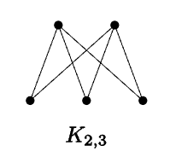
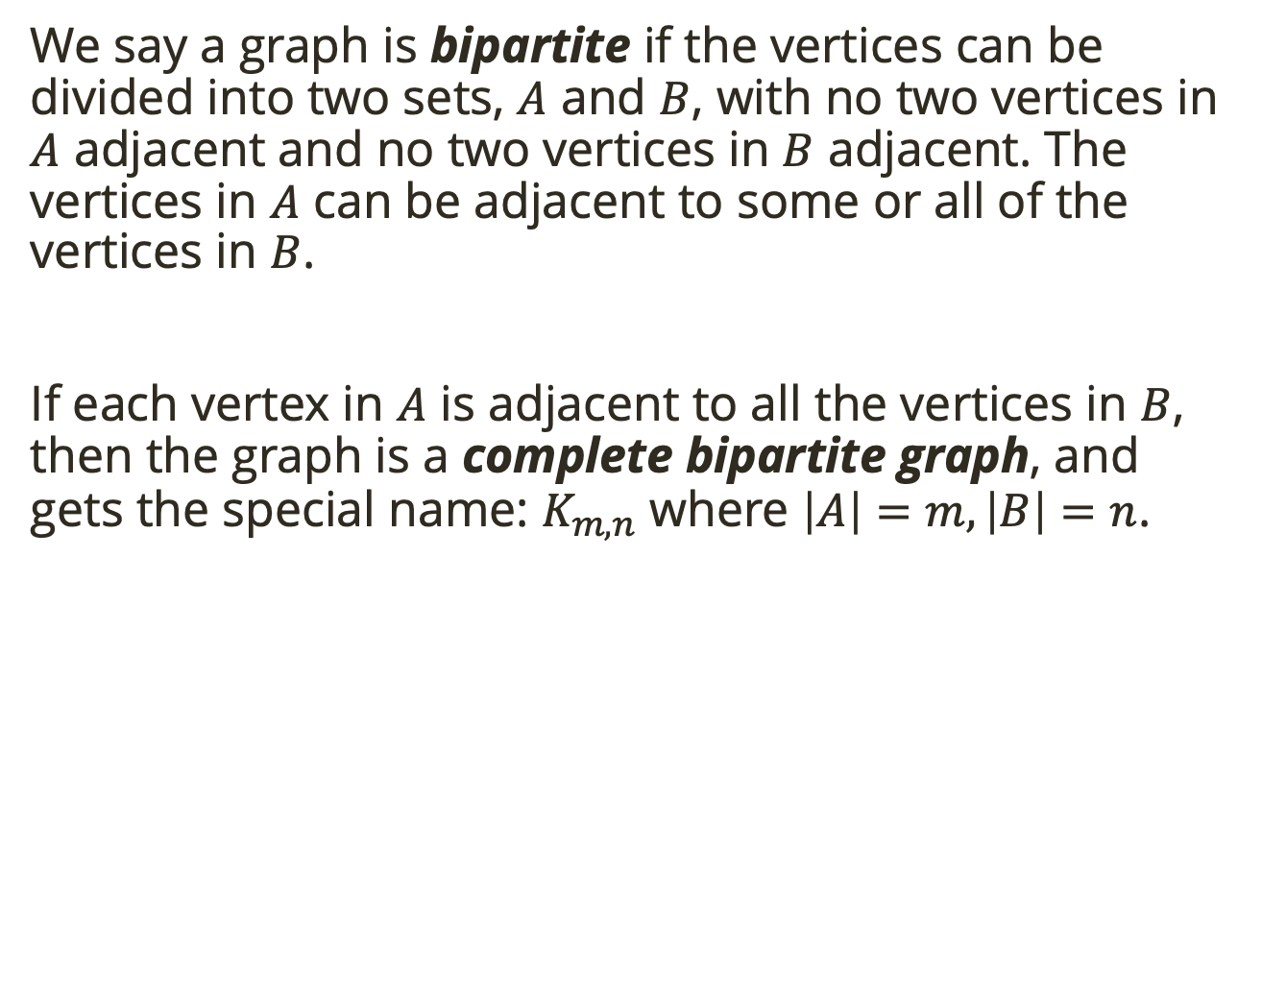
Bipartite
We say a graph is bipartite if the vertices can be divided into two sets, $A$ and $B$, with no two vertices in $A$ adjacent and no two vertices in $B$ adjacent. The vertices in $A$ can be adjacent to some or all of the vertices in $B$.
If each vertex in $A$ is adjacent to all the vertices in $B$, then the graph is a complete bipartite graph, and gets the special name: $K_{m,n}$ where $\left|A\right|=m, \left|B\right|=n$.

Slide 33
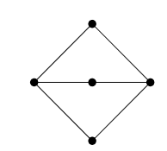
Bipartite
We say a graph is bipartite if the vertices can be divided into two sets, $A$ and $B$, with no two vertices in $A$ adjacent and no two vertices in $B$ adjacent. The vertices in $A$ can be adjacent to some or all of the vertices in $B$.
If each vertex in $A$ is adjacent to all the vertices in $B$, then the graph is a complete bipartite graph, and gets the special name: $K_{m,n}$ where $\left|A\right|=m, \left|B\right|=n$.
Is this graph bipartite?
Notes:
Yes! label middle nodes B and outer two A

Slide 34
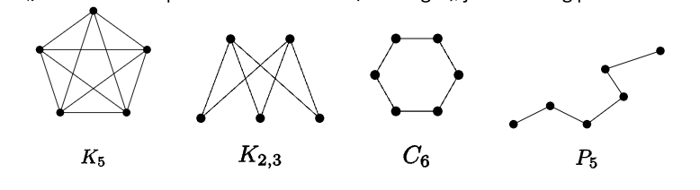
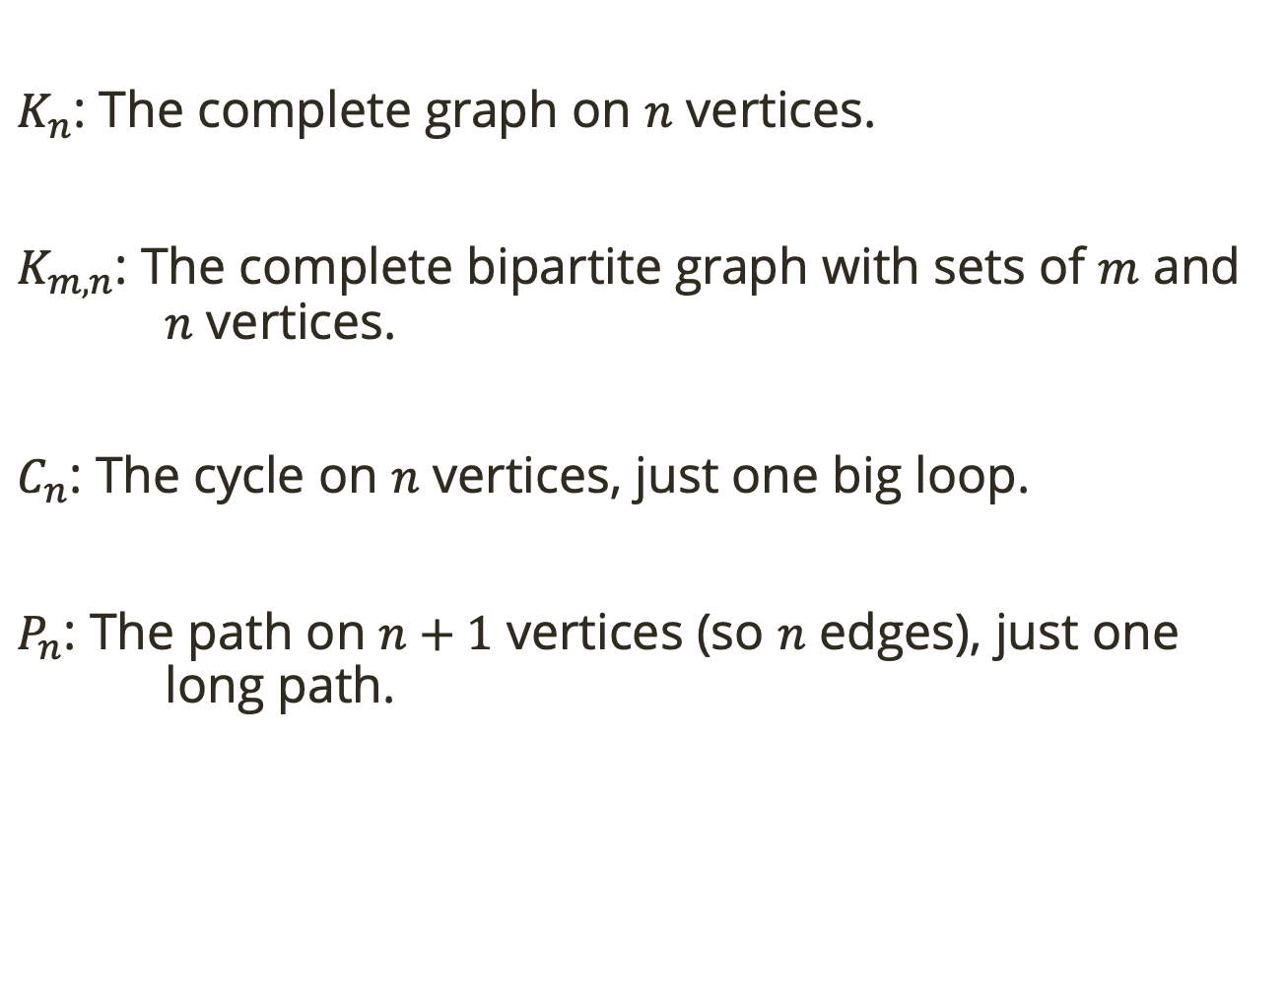
Named Graphs
$K_{n}$: The complete graph on $n$ vertices.
$K_{m,n}$: The complete bipartite graph with sets of $m$ and $n$ vertices.
$C_{n}$: The cycle on $n$ vertices, just one big loop.
$P_{n}$: The path on $n+1$ vertices (so $n$ edges), just one long path.

