Slide 1
Discrete Structures– Sequences
Dr. Ab Mosca (they/them)

Slide 2
Plan for Today
Sequences
Describing
Arithmetic
Geometric

Slide 3
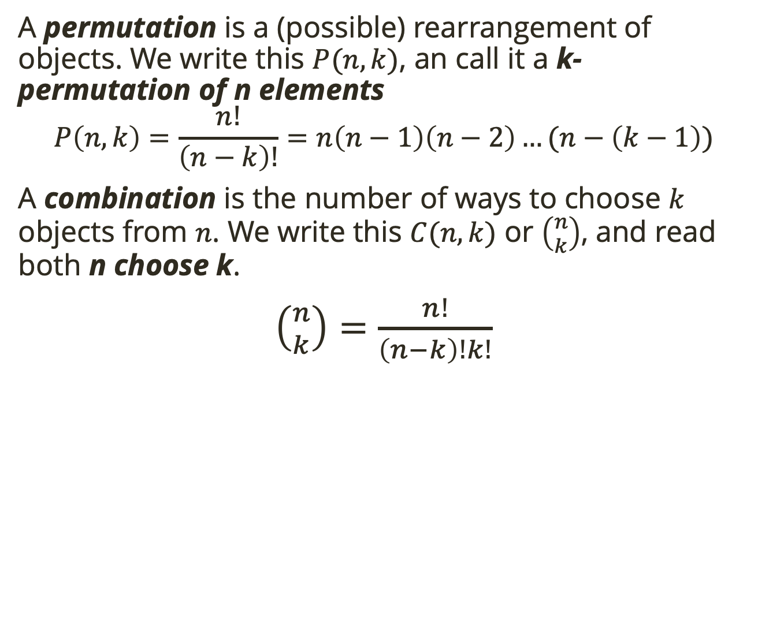

Warm Up: Counting and Proofs
A permutation is a (possible) rearrangement of objects. We write this $P(n,k)$, an call it a k-permutation of n elements
$$P\left(n, k\right)=\frac{n!}{\left(n−k\right)!}=n\left(n−1\right)\left(n−2\right)…(n−\left(k−1\right))$$
A combination is the number of ways to choose $k$ objects from $n$. We write this $C(n, k)$ or $\left({n \atop k}\right)$, and read both n choose k.
$\left({n \atop k}\right)=\frac{n!}{\left(n−k\right)!k!}$
Consider the identity: $k \left({n \atop k}\right)=n\left({n−1 \atop k−1}\right)$. Prove that this identity is true.

Slide 4
Motivation
You have a collection of 1X1 squares and 1X2 squares. You want to arrange these to. make a 1X15 strip.
How many length 1X1 strips can you make? How many 1X2 strips? How many 1X3 strips? How many 1X4? Etc

Slide 5
Motivation
You have a collection of 1X1 squares and 1X2 squares. You want to arrange these to. make a 1X15 strip.
How many length 1X1 strips can you make? How many 1X2 strips? How many 1X3 strips? How many 1X4? Etc
How are the 1X3 and 1X4 strips related to the 1X5 strips?

Slide 6
Motivation
You have a collection of 1X1 squares and 1X2 squares. You want to arrange these to. make a 1X15 strip.
How many length 1X1 strips can you make? How many 1X2 strips? How many 1X3 strips? How many 1X4? Etc.
How are the 1X3 and 1X4 strips related to the 1X5 strips?
How many 1X15 strips can you make?

Slide 7
Motivation
You have a collection of 1X1 squares and 1X2 squares. You want to arrange these to. make a 1X15 strip.
How many length 1X1 strips can you make? How many 1X2 strips? How many 1X3 strips? How many 1X4? Etc.
How are the 1X3 and 1X4 strips related to the 1X5 strips?
How many 1X15 strips can you make?
What if I asked you to find the number of 1X1000 strips? Would the method you used to calculate the number of 1X15 strips be helpful?

Slide 8

Definition
A sequence is an ordered list of numbers (think array!)
When we use variables to represent a sequence, we number them because order matters:
$$a_{0},a_{1},a_{2},a_{3}, …$$

Slide 9
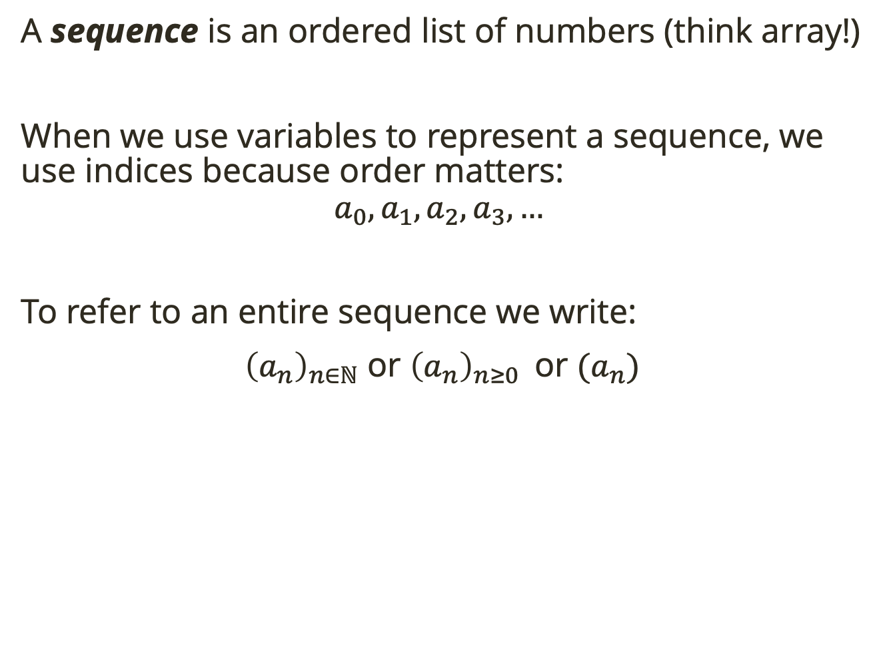
Definition
A sequence is an ordered list of numbers (think array!)
When we use variables to represent a sequence, we use indices because order matters:
$$a_{0},a_{1},a_{2},a_{3}, …$$
To refer to an entire sequence we write:
${\left(a_{n}\right)}_{n∈ℕ}$ or ${\left(a_{n}\right)}_{n≥0 }$ or $(a_{n})$

Slide 10
Definition
A sequence is an ordered list of numbers (think array!)
When we use variables to represent a sequence, we use indices because order matters:
$$a_{0},a_{1},a_{2},a_{3}, …$$
To refer to an entire sequence we write:
${\left(a_{n}\right)}_{n∈ℕ}$ or ${\left(a_{n}\right)}_{n≥0 }$ or $(a_{n})$
Guess the next term in these sequences:
3, -3, 3, -3, 3, …
1, 5, 2, 10, 3, 15, …
1, 2, 4, 8, 16, …
1, 4, 9, 16, 25, 36, …

Slide 11

Definition
Guessing sequences from a few terms is imperfect, instead we need exact definitions.
A closed formula for a sequence ${\left(a_{n}\right)}_{n∈ℕ}$ is a formula for $a_{n}$ using a fixed finite number of operations on $n$.

Slide 12
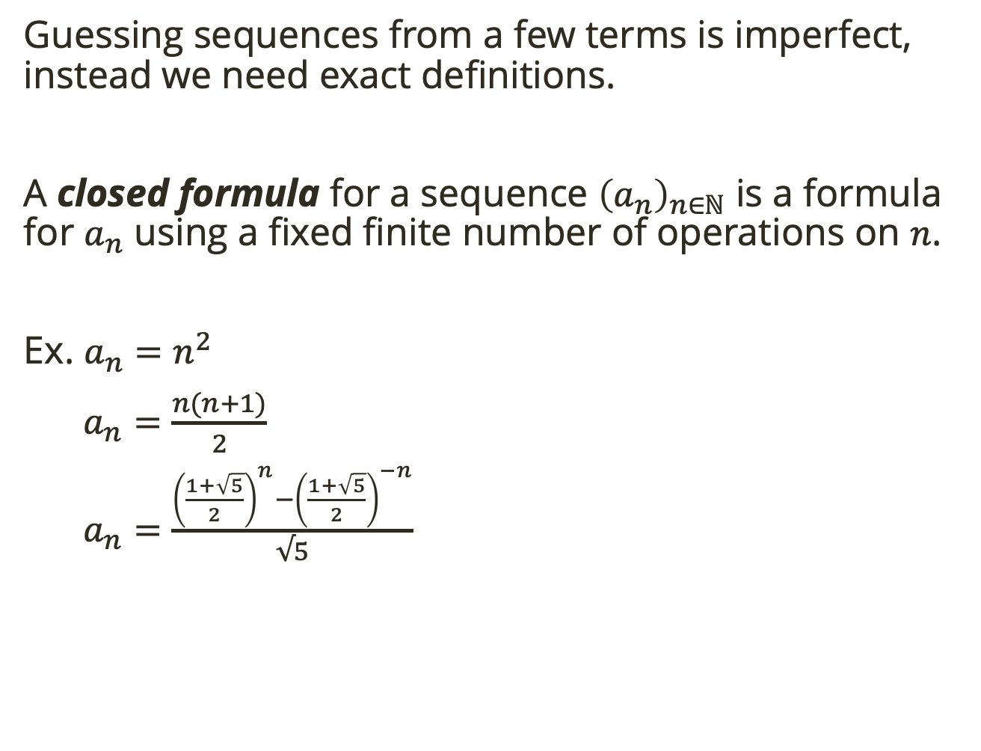
Definition
Guessing sequences from a few terms is imperfect, instead we need exact definitions.
A closed formula for a sequence ${\left(a_{n}\right)}_{n∈ℕ}$ is a formula for $a_{n}$ using a fixed finite number of operations on $n$.
Ex. $a_{n}=n^{2}$
$a_{n}=\frac{n(n+1)}{2}$
$a_{n}=\frac{{\left(\frac{1+\sqrt{5}}{2}\right)}^{n}−{\left(\frac{1+\sqrt{5}}{2}\right)}^{−n}}{√5}$
Find the 0th, 1st, and 5th terms for each sequence

Slide 13
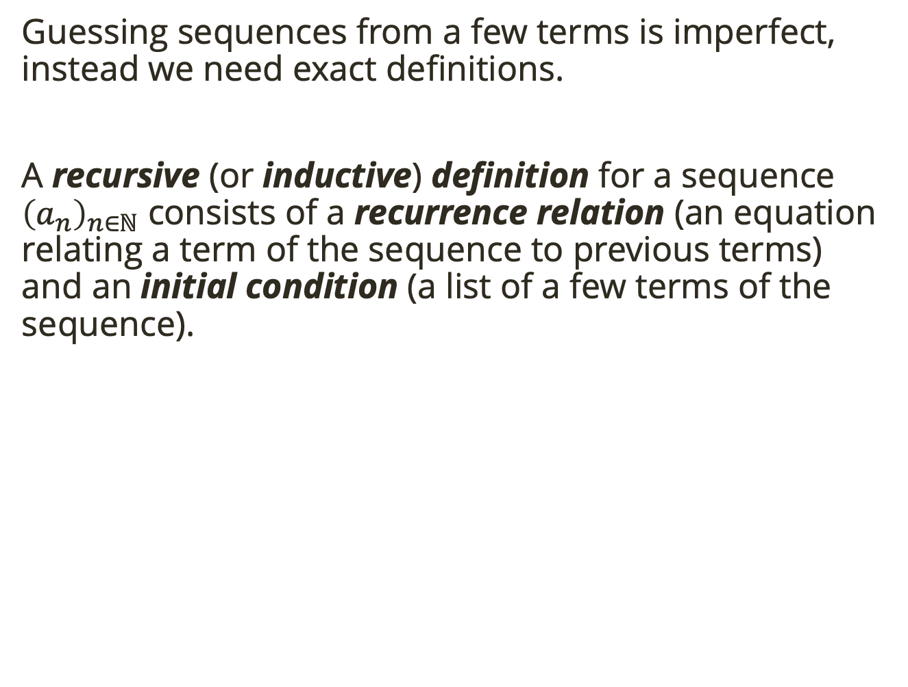
Definition
Guessing sequences from a few terms is imperfect, instead we need exact definitions.
A recursive (or inductive) definition for a sequence ${\left(a_{n}\right)}_{n∈ℕ}$ consists of a recurrence relation (an equation relating a term of the sequence to previous terms) and an initial condition (a list of a few terms of the sequence).

Slide 14
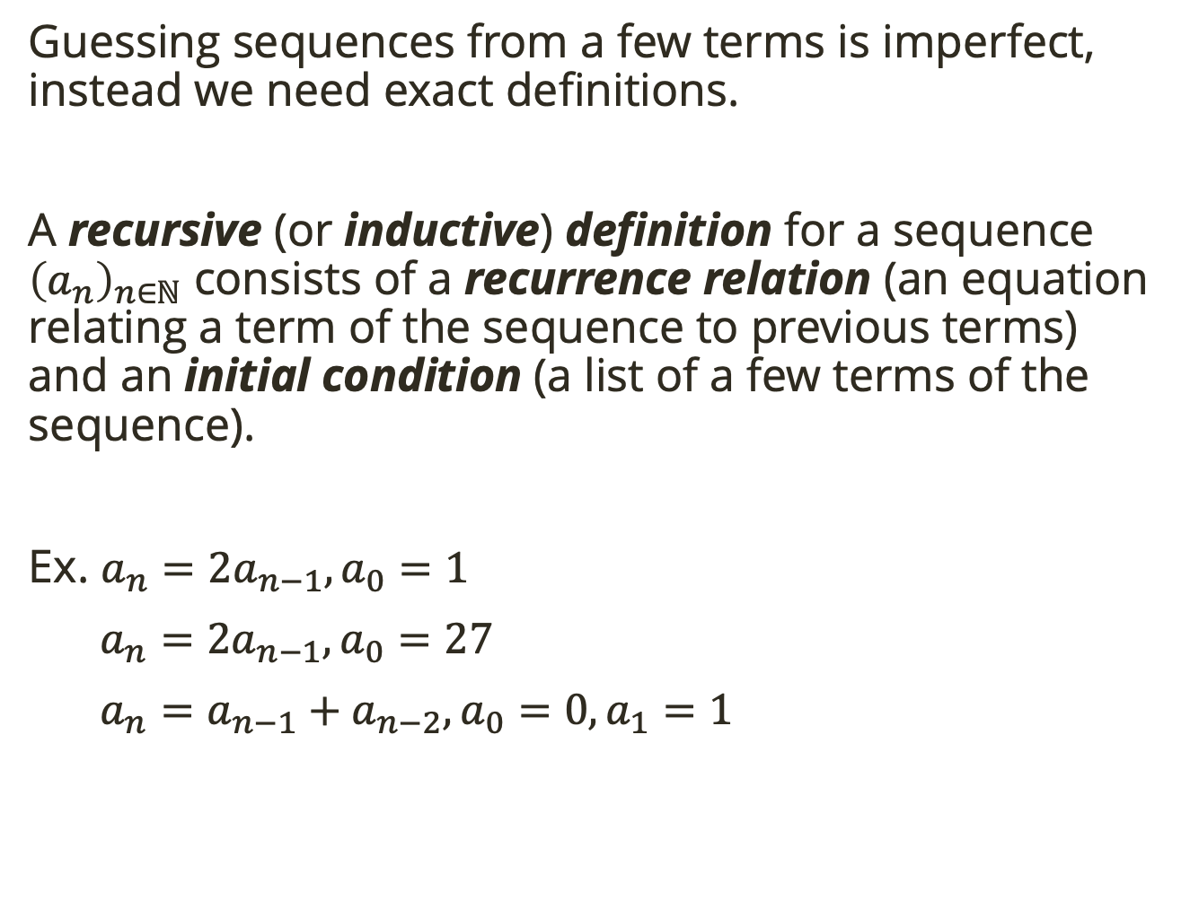
Definition
Guessing sequences from a few terms is imperfect, instead we need exact definitions.
A recursive (or inductive) definition for a sequence ${\left(a_{n}\right)}_{n∈ℕ}$ consists of a recurrence relation (an equation relating a term of the sequence to previous terms) and an initial condition (a list of a few terms of the sequence).
Ex. $a_{n}=2a_{n−1}, a_{0}=1$
$a_{n}=2a_{n−1}, a_{0}=27$
$a_{n}=a_{n−1}+a_{n−2}, {a_{0}=0, a}_{1}=1$
Find the 0th, 1st, and 5th terms for each sequence

Slide 15
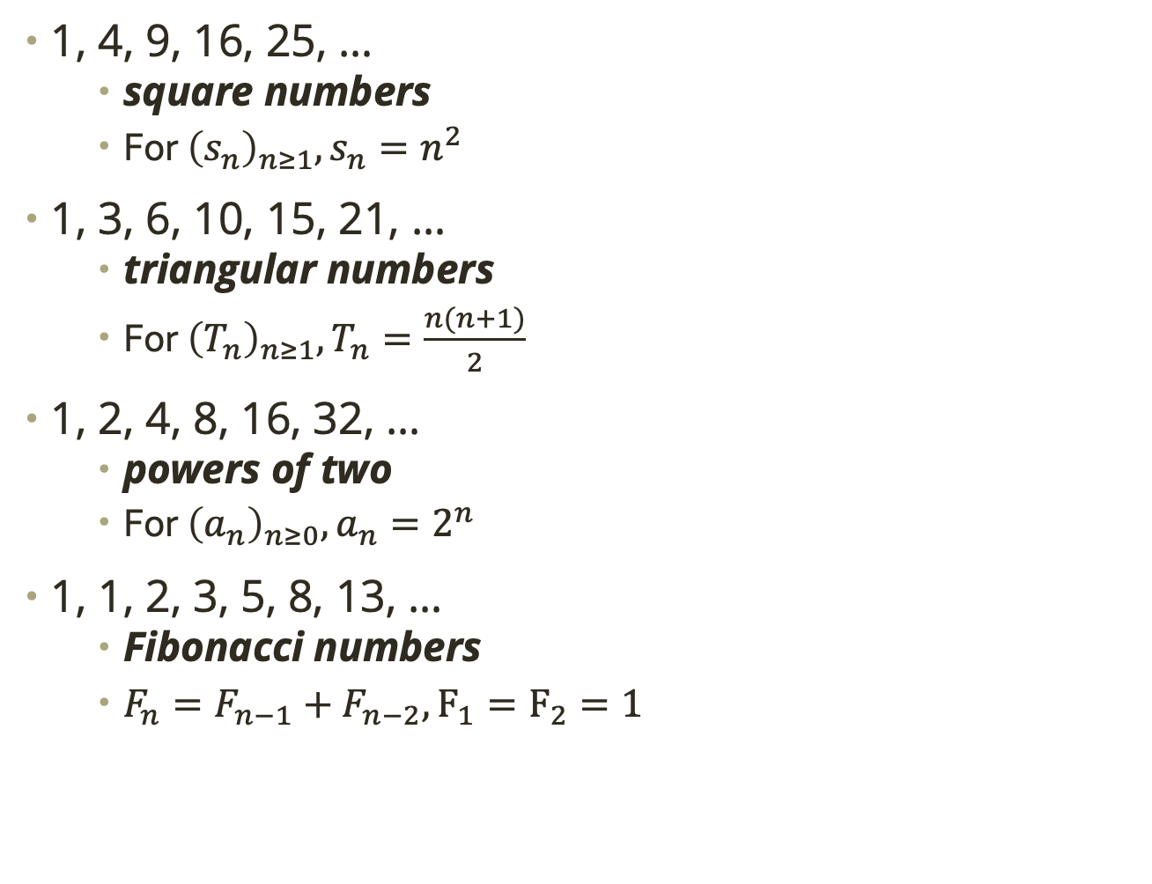
Common Sequences
1, 4, 9, 16, 25, …
square numbers
For ${\left(s_{n}\right)}_{n≥1},s_{n}=n^{2}$
1, 3, 6, 10, 15, 21, …
triangular numbers
For ${\left(T_{n}\right)}_{n≥1},T_{n}=\frac{n(n+1)}{2}$
1, 2, 4, 8, 16, 32, …
powers of two
For ${\left(a_{n}\right)}_{n≥0},a_{n}=2^{n}$
1, 1, 2, 3, 5, 8, 13, …
Fibonacci numbers
$F_{n}=F_{n−1}+F_{n−2}, F_{1}=F_{2}=1$

Slide 16

Describing Sequences
Finding the closed formula for a sequence is not always straightforward. There are many approaches.
One option: Try to relate the sequence to a common sequence
Use $T_{n}=\frac{n(n+1)}{2}$ and $a_{n}=2^{n}$ to find closed formulas for the following sequences. Assume each first term corresponds to $n=0$.
$\left(b_{n}\right):1, 2, 4, 7, 11, 16, 22, …$
$\left(c_{n}\right):3, 5, 9, 17, 33$
$\left(d_{n}\right):0, 2, 6, 12, 20, 30, 42,…$
$\left(f_{n}\right):0, 1, 3, 7, 15, 31$
Notes:
T_n + 1
c_n = a_(n+1) + 1
Tn*2
2^n – 1

Slide 17
Describing Sequences
Finding the closed formula for a sequence is not always straightforward. There are many approaches.
Some sequences naturally arise as the sum of terms of another sequence
Notes:
T_n + 1
c_n = a_(n+1) + 1
Tn*2
2^n – 1

Slide 18

Describing Sequences
Finding the closed formula for a sequence is not always straightforward. There are many approaches.
Some sequences naturally arise as the sum of terms of another sequence
Sam keeps track of how many push-ups she does each day of her “do lots of push-ups challenge.” Let ${\left(a_{n}\right)}_{n≥1}$ be the sequence that describes the number of push-ups done on the n^{th} day of the challenge. The sequence starts
3, 5, 6, 10, 9, 0, 12
Describe the sequence ${\left(b_{n}\right)}_{n≥1 }$that describes the total number of pushups done by Sam after the n^{th} day.
Notes:
b_1 = a_1
b_2 = a_1 + a_2
b_3 = a_1 + a_2 + a_3
Recursive: b_n = b_(n-1)+a_n
Closed: b_n = a_1 + a_2 + … + a_n

Slide 19
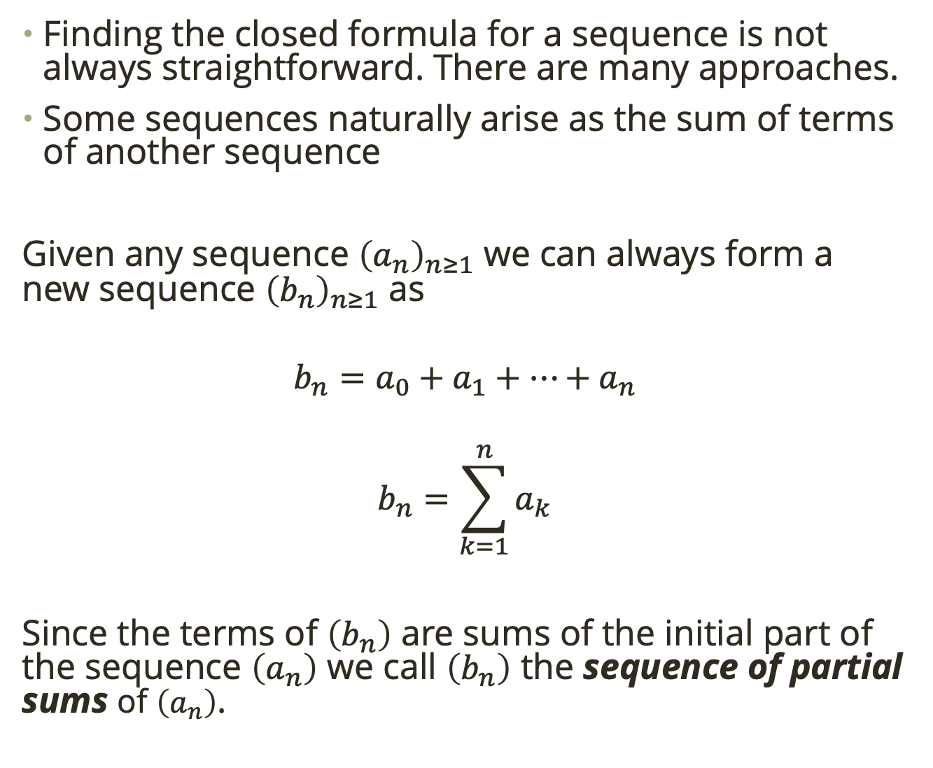
Describing Sequences
Finding the closed formula for a sequence is not always straightforward. There are many approaches.
Some sequences naturally arise as the sum of terms of another sequence
Given any sequence ${\left(a_{n}\right)}_{n≥1}$ we can always form a new sequence ${\left(b_{n}\right)}_{n≥1}$ as
$$b_{n}=a_{0}+a_{1}+…+a_{n}$$
$$b_{n}=\sum_{k=1}^{n}{a_{k}}$$
Since the terms of $\left(b_{n}\right)$ are sums of the initial part of the sequence $\left(a_{n}\right)$ we call $\left(b_{n}\right)$ the sequence of partial sums of $\left(a_{n}\right)$.
Notes:
b_1 = a_1
b_2 = a_1 + a_2
b_3 = a_1 + a_2 + a_3
Recursive: b_n = b_(n-1)+a_n
Closed: b_n = a_1 + a_2 + … + a_n

Slide 20
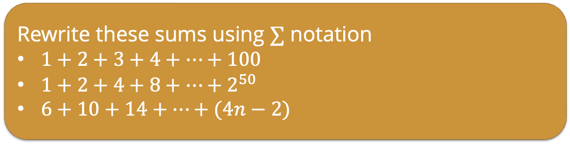
Describing Sequences
Rewrite these sums using $∑$ notation
$1+2+3+4+…+100$
$1+2+4+8+…+2^{50}$
$6+10+14+…+(4n−2)$
Finding the closed formula for a sequence is not always straightforward. There are many approaches.
Some sequences naturally arise as the sum of terms of another sequence
Given any sequence ${\left(a_{n}\right)}_{n≥1}$ we can always form a new sequence ${\left(b_{n}\right)}_{n≥1}$ as
$$b_{n}=a_{0}+a_{1}+…+a_{n}$$
$$b_{n}=\sum_{k=1}^{n}{a_{k}}$$
Since the terms of $\left(b_{n}\right)$ are sums of the initial part of the sequence $\left(a_{n}\right)$ we call $\left(b_{n}\right)$ the sequence of partial sums of $\left(a_{n}\right)$.
Notes:
sum 1 to 100 k
sum 0 to 50 2^k
sum 2 to n 4k-2

Slide 21
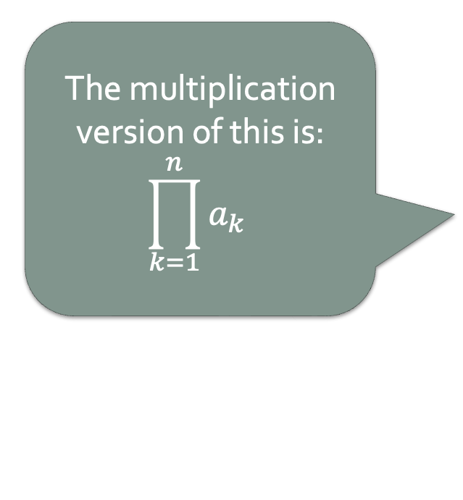
Describing Sequences
Finding the closed formula for a sequence is not always straightforward. There are many approaches.
Some sequences naturally arise as the sum of terms of another sequence
Given any sequence ${\left(a_{n}\right)}_{n≥1}$ we can always form a new sequence ${\left(b_{n}\right)}_{n≥1}$ as
$$b_{n}=a_{0}+a_{1}+…+a_{n}$$
$$b_{n}=\sum_{k=1}^{n}{a_{k}}$$
Since the terms of $\left(b_{n}\right)$ are sums of the initial part of the sequence $\left(a_{n}\right)$ we call $\left(b_{n}\right)$ the sequence of partial sums of $\left(a_{n}\right)$.
The multiplication version of this is:
$$\prod_{k=1}^{n}{a_{k}}$$
Notes:
sum 1 to 100 k
sum 0 to 50 2^k
sum 2 to n 4k-2

Slide 22
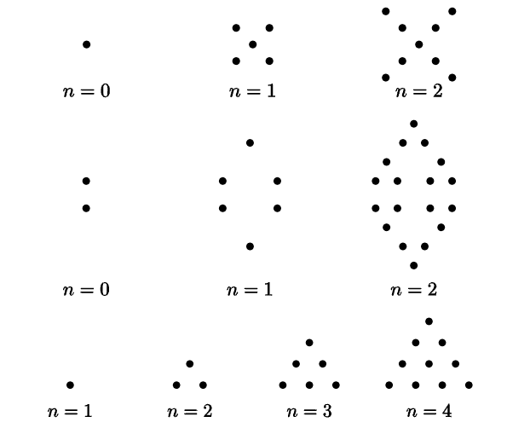
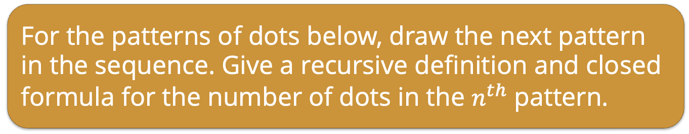
Closed Formulas
For the patterns of dots below, draw the next pattern in the sequence. Give a recursive definition and closed formula for the number of dots in the $n^{th}$ pattern.

Slide 23
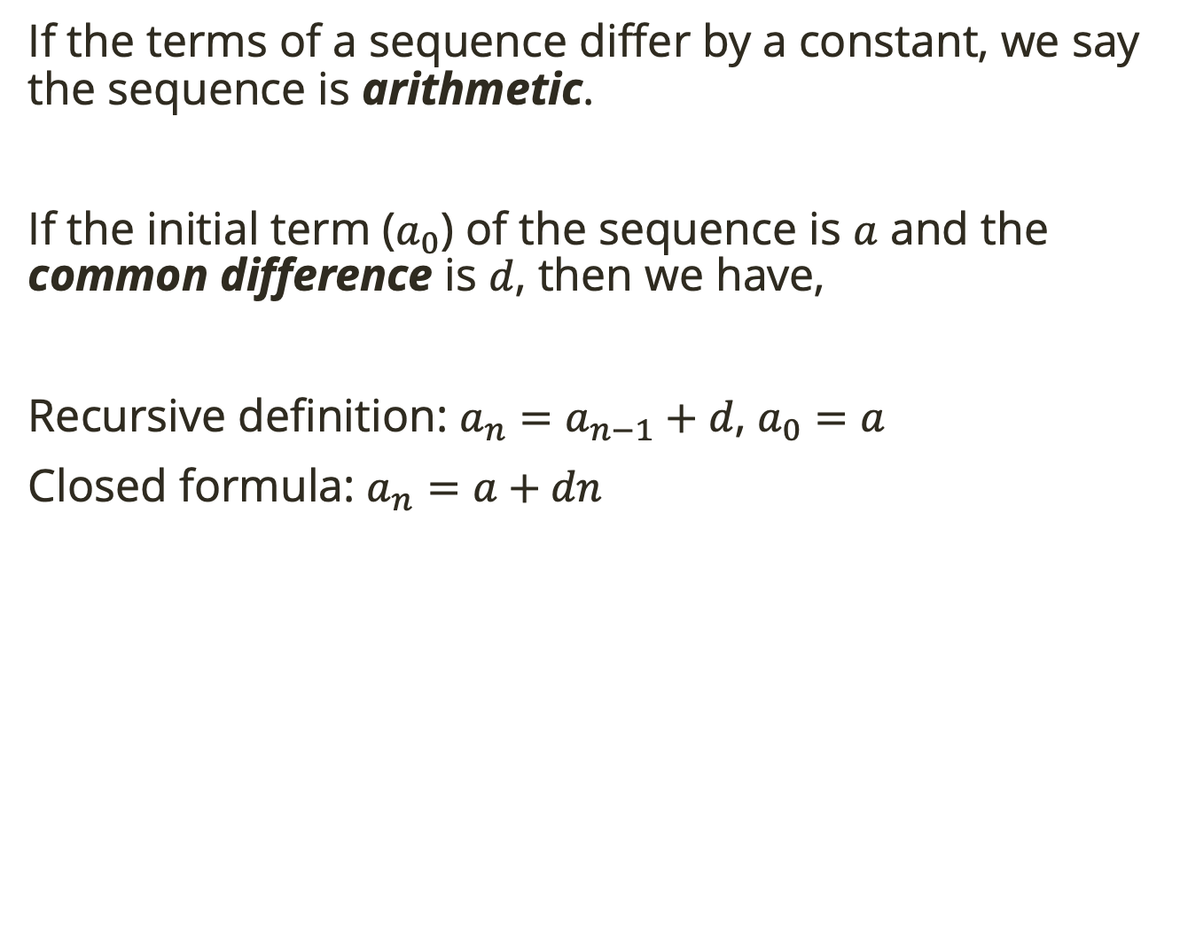
Arithmetic Sequences
If the terms of a sequence differ by a constant, we say the sequence is arithmetic.
If the initial term ($a_{0}$) of the sequence is $a$ and the common difference is $d$, then we have,
Recursive definition: $a_{n}=a_{n−1}+d$, $a_{0}=a$
Closed formula: $a_{n}=a+dn$

Slide 24
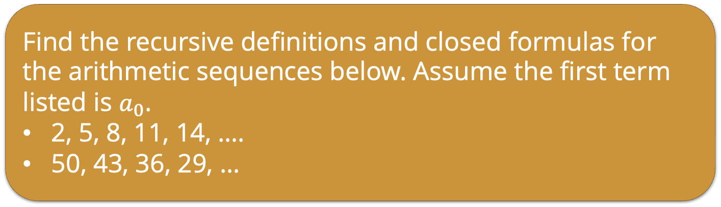
Arithmetic Sequences
If the terms of a sequence differ by a constant, we say the sequence is arithmetic.
If the initial term ($a_{0}$) of the sequence is $a$ and the common difference is $d$, then we have,
Recursive definition: $a_{n}=a_{n−1}+d$, $a_{0}=a$
Closed formula: $a_{n}=a+dn$
Find the recursive definitions and closed formulas for the arithmetic sequences below. Assume the first term listed is $a_{0}$.
2, 5, 8, 11, 14, ….
50, 43, 36, 29, …
Notes:
Find d
first term is a

Slide 25
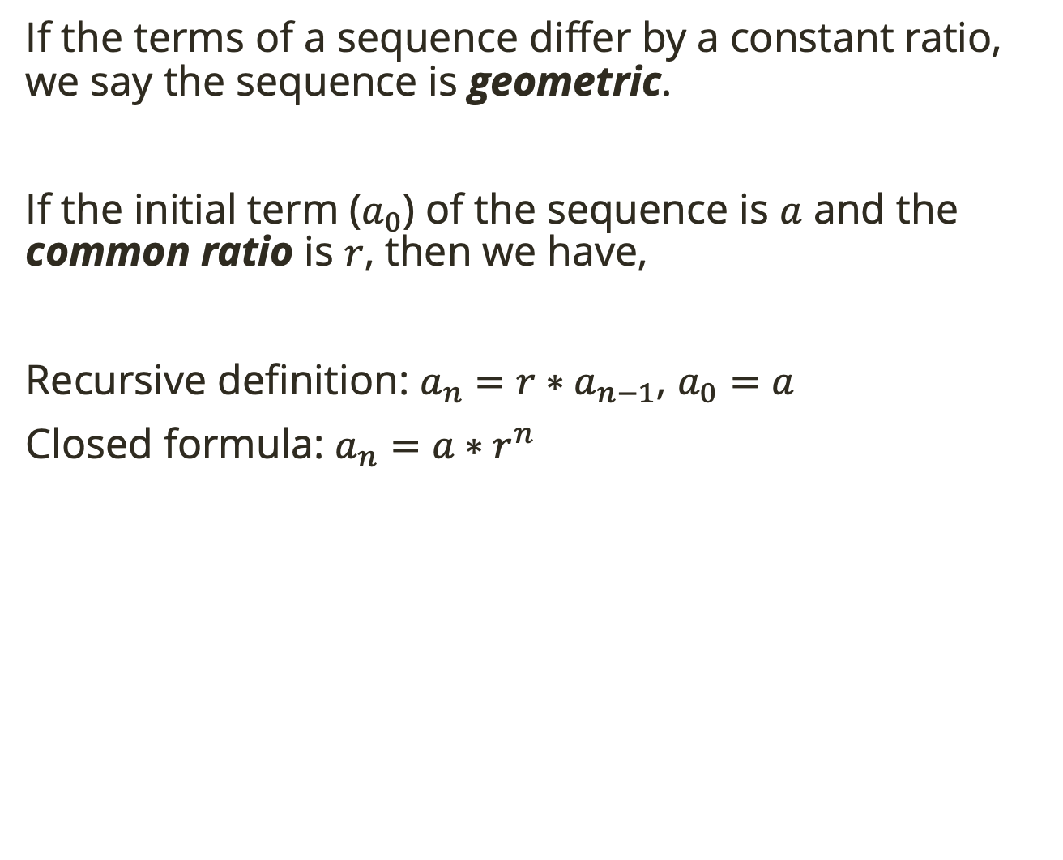
Geometric Sequences
If the terms of a sequence differ by a constant ratio, we say the sequence is geometric.
If the initial term ($a_{0}$) of the sequence is $a$ and the common ratio is $r$, then we have,
Recursive definition: $a_{n}={r∗a}_{n−1}$, $a_{0}=a$
Closed formula: $a_{n}=a∗r^{n}$
Notes:
Find d
first term is a

Slide 26
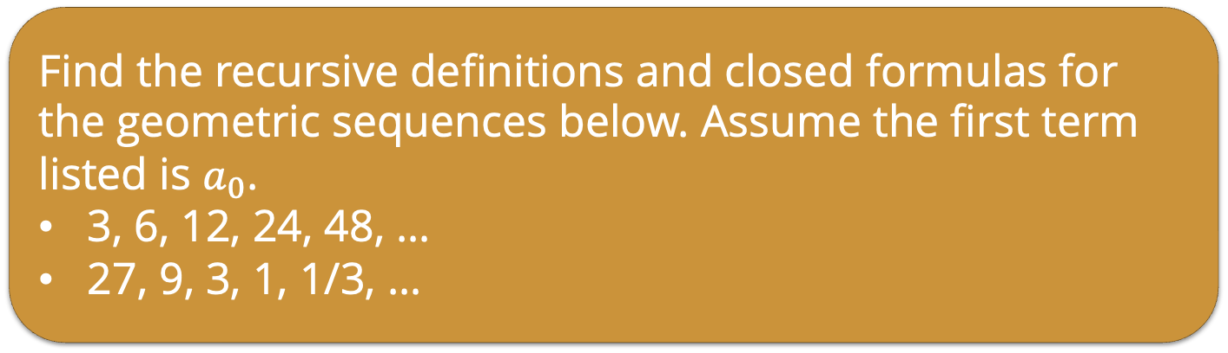
Geometric Sequences
If the terms of a sequence differ by a constant ratio, we say the sequence is geometric.
If the initial term ($a_{0}$) of the sequence is $a$ and the common ratio is $r$, then we have,
Recursive definition: $a_{n}={r∗a}_{n−1}$, $a_{0}=a$
Closed formula: $a_{n}=a∗r^{n}$
Find the recursive definitions and closed formulas for the geometric sequences below. Assume the first term listed is $a_{0}$.
3, 6, 12, 24, 48, …
27, 9, 3, 1, 1/3, …
Notes:
Find r
first term is a

