Slide 1
Discrete Structures– Graphs: Trees
Dr. Ab Mosca (they/them)

Slide 2
Plan for Today
Trees
Definition
Properties
Rooted
Spanning

Slide 3
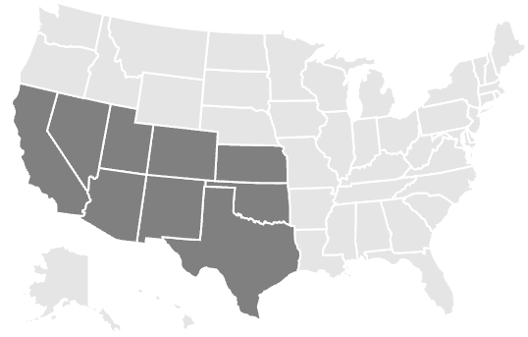
Warm Up: Euler Paths & Circuits
An Euler path, in a graph or multigraph, is a path through the graph which uses every edge exactly once.
An Euler circuit is a Euler path which stops and starts at the same vertex.
You and your friends want to tour the southwest by car. You will visit the nine states highlighted, with the following rather odd rule: you must cross each border between neighboring states exactly once (so, for example, you must cross the Colorado-Utah border exactly once). Can you do it? If so, does it matter where you start your road trip?
Notes:
A graph has an Euler circuit if and only if the degree of every vertex is even.
A graph has an Euler path if and only if there are at most two vertices with an odd degree.
This is a question about finding Euler paths. Draw a graph with a vertex in each state, and connect vertices if their states share a border. Exactly two vertices will have odd degree: the vertices for Nevada and Utah. Thus you must start your road trip at in one of those states and end it in the other.

Slide 4
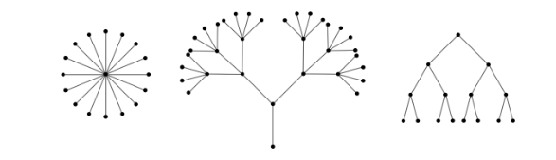
Definition: Tree
A tree is a connected graph containing no cycles.
A forest is a graph containing no cycles.
Note: this means a connected forest is a tree.
https://ptwiddle.github.io/Graph-Theory-Notes/s_intro_trees.html

Slide 5

Tree Properties
Proposition: A graph, $T$, is a tree if and only if between every pair of distinct vertices of $T$ there is a unique path.
Corollary: A graph, $F$, is a forest if and only if between any pair of vertices in $F$ there is as most one path.

Slide 6
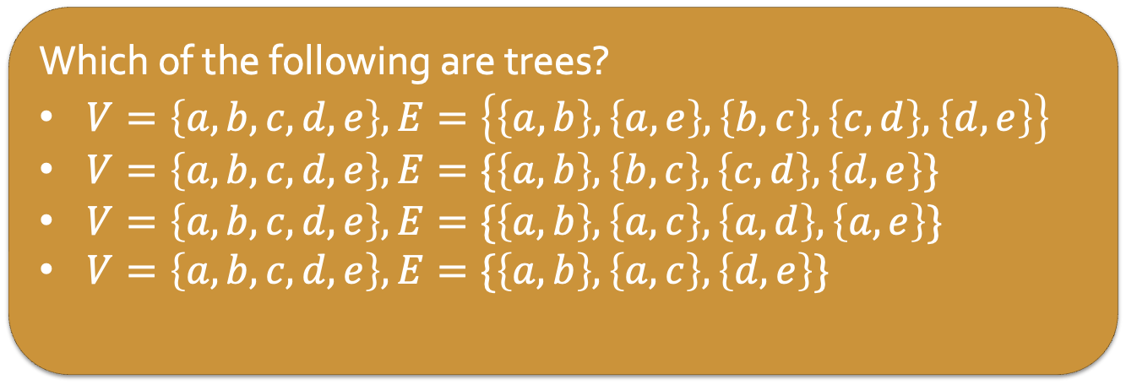
Tree Properties
Proposition: A graph, $T$, is a tree if and only if between every pair of distinct vertices of $T$ there is a unique path.
Corollary: A graph, $F$, is a forest if and only if between any pair of vertices in $F$ there is as most one path.
Which of the following are trees?
$V=\left\{a, b, c, d, e\right\}, E=\left\{\left\{a,b\right\},\left\{a,e\right\}, \left\{b,c\right\}, \left\{c,d\right\}, \left\{d,e\right\}\right\}$
$V=\left\{a, b, c, d, e\right\}, E=\{\left\{a,b\right\}, \left\{b,c\right\}, \left\{c,d\right\}, \left\{d,e\right\}\}$
$V=\left\{a, b, c, d, e\right\}, E=\{\left\{a,b\right\}, \left\{a,c\right\}, \left\{a,d\right\}, \left\{a,e\right\}\}$
$V=\left\{a, b, c, d, e\right\}, E=\{\left\{a,b\right\}, \left\{a,c\right\}, \left\{d,e\right\}\}$
Notes:
No – contains a cycle
Yes - connected, no cycles
Yes - connected, no cycles
No - not a tree, not connected, not enough edges

Slide 7
Tree Properties
In a tree, vertices of degree one are called leaves.
Which vertices in these trees are leaves?

Slide 8

Tree Properties
Proposition: Any tree with at least two vertices has at least two vertices of degree one.
Proposition: Let $T$ be a tree with $v$ vertices and $e$ edges. Then $e=v−1$.

Slide 9
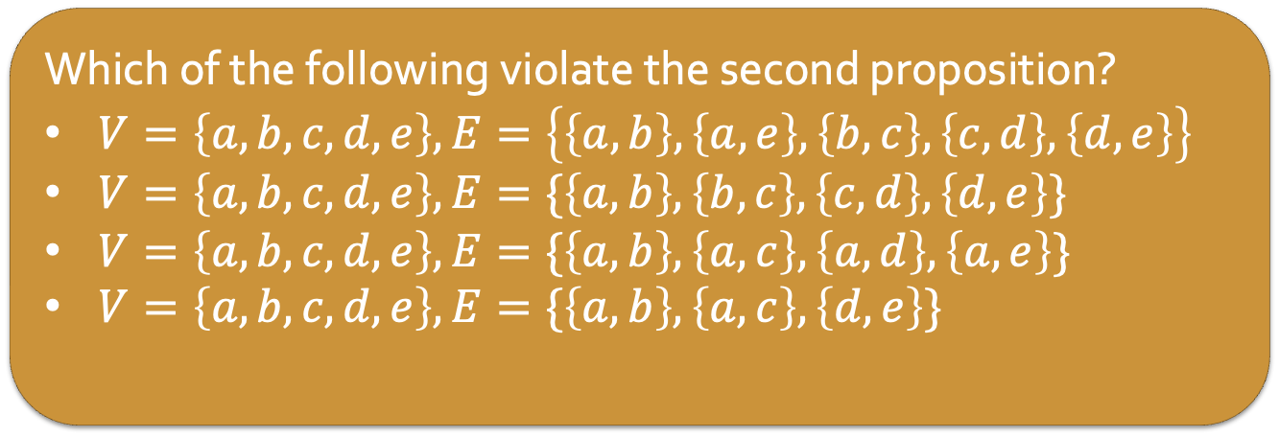
Tree Properties
Proposition: Any tree with at least two vertices has at least two vertices of degree one.
Proposition: Let $T$ be a tree with $v$ vertices and $e$ edges. Then $e=v−1$.
Which of the following violate the second proposition?
$V=\left\{a, b, c, d, e\right\}, E=\left\{\left\{a,b\right\},\left\{a,e\right\}, \left\{b,c\right\}, \left\{c,d\right\}, \left\{d,e\right\}\right\}$
$V=\left\{a, b, c, d, e\right\}, E=\{\left\{a,b\right\}, \left\{b,c\right\}, \left\{c,d\right\}, \left\{d,e\right\}\}$
$V=\left\{a, b, c, d, e\right\}, E=\{\left\{a,b\right\}, \left\{a,c\right\}, \left\{a,d\right\}, \left\{a,e\right\}\}$
$V=\left\{a, b, c, d, e\right\}, E=\{\left\{a,b\right\}, \left\{a,c\right\}, \left\{d,e\right\}\}$

Slide 10
Rooted Trees
We can identify one vertex in a tree as the root. Then, every other vertex on the tree can be characterized by its position relative to the root.
Root

Slide 11
Rooted Trees
We can identify one vertex in a tree as the root. Then, every other vertex on the tree can be characterized by its position relative to the root.
If two vertices are adjacent, we say the one closer to the root is the parent, and the other is the child.
The root of a tree is a parent, but not a child of any vertex. All non-root vertices have exactly one parent.
parent
child

Slide 12
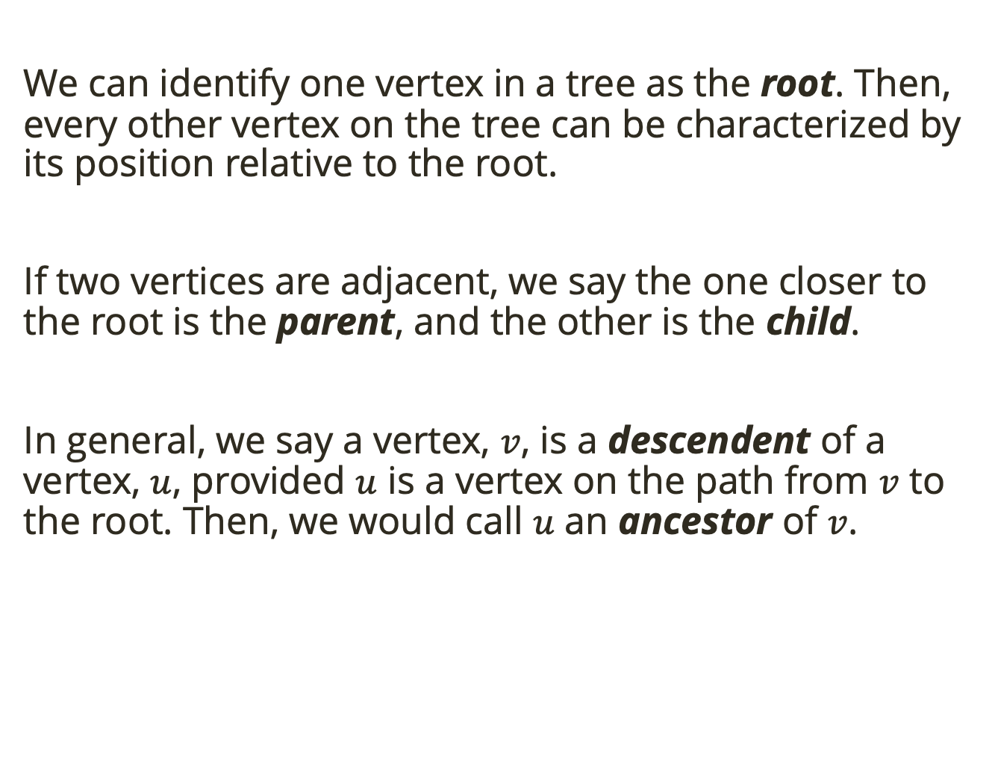
Rooted Trees
We can identify one vertex in a tree as the root. Then, every other vertex on the tree can be characterized by its position relative to the root.
If two vertices are adjacent, we say the one closer to the root is the parent, and the other is the child.
In general, we say a vertex, $v$, is a descendent of a vertex, $u$, provided $u$ is a vertex on the path from $v$ to the root. Then, we would call $u$ an ancestor of $v$.
ancestor
descendent

Slide 13
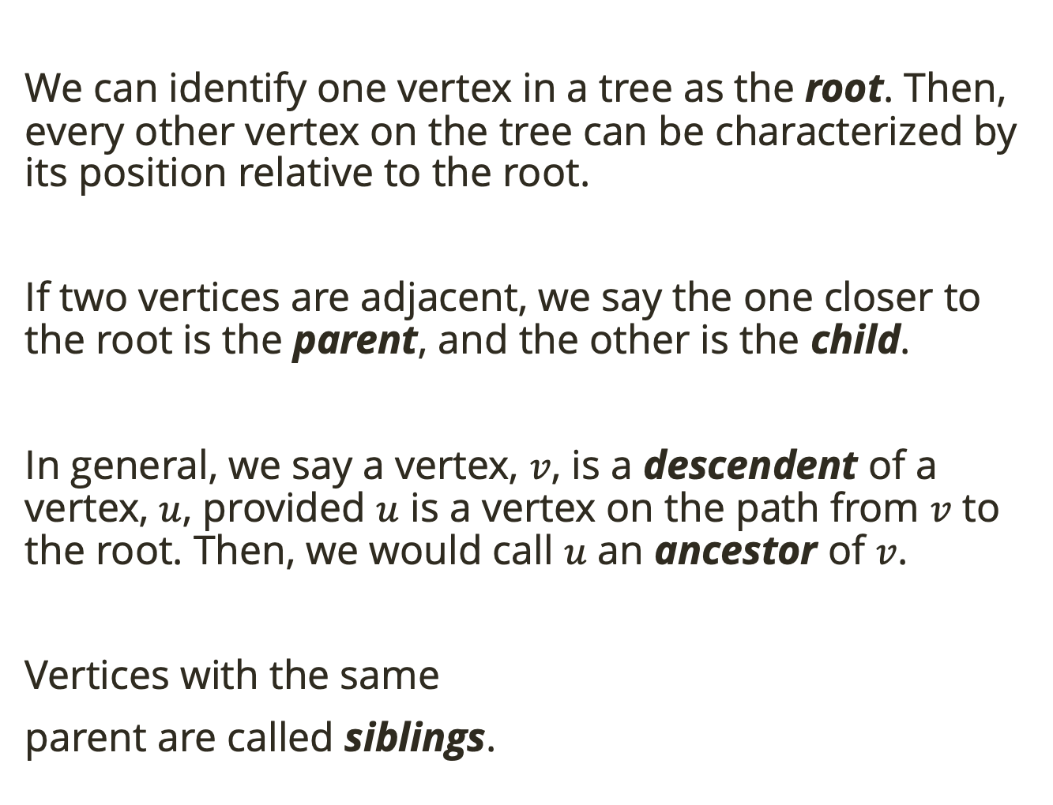
Rooted Trees
We can identify one vertex in a tree as the root. Then, every other vertex on the tree can be characterized by its position relative to the root.
If two vertices are adjacent, we say the one closer to the root is the parent, and the other is the child.
In general, we say a vertex, $v$, is a descendent of a vertex, $u$, provided $u$ is a vertex on the path from $v$ to the root. Then, we would call $u$ an ancestor of $v$.
Vertices with the same
parent are called siblings.
siblings

Slide 14
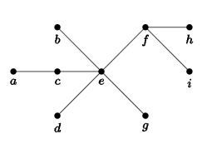

Rooted Trees
We can identify one vertex in a tree as the root. Then, every other vertex on the tree can be characterized by its position relative to the root.
If two vertices are adjacent, we say the one closer to the root is the parent, and the other is the child.
In general, we say a vertex, $v$, is a descendent of a vertex, $u$, provided $u$ is a vertex on the path from $v$ to the root. Then, we would call $u$ an ancestor of $v$.
Vertices with the same
parent are called siblings.
Let $f$ be the root. Label the other vertices.

Slide 15
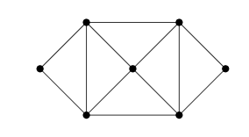

Spanning Trees
Given a graph, $G$, a spanning tree of $G$ is a subgraph of $G$ which is a tree and includes all the vertices of $G$.
Find two different spanning trees of this graph.

Slide 16

Spanning Trees
Given a graph, $G$, a spanning tree of $G$ is a subgraph of $G$ which is a tree and includes all the vertices of $G$.
Every connected graph has a spanning tree.
Prove this claim.
Notes:
Start with a connected graph G.
If there is no cycle, then G is already a tree and we are done.
If there is a cycle, let e be any edge in that cycle and consider the new graph G_1=G – e (i.e., the graph you get by deleting e). T
his tree is still connected since e belonged to a cycle, there were at least two paths between its incident vertices.
Now repeat: if G_1 has no cycles, we are done, otherwise define G_2 to be ,G_1−e_1, where e_1 is an edge in a cycle in G_1. Keep going.
This process must eventually stop, since there are only a finite number of edges to remove. The result will be a tree, and since we never removed any vertex, a spanning tree.

