Slide 1
Discrete Structures– Counting Pt. 1
Dr. Ab Mosca (they/them)

Slide 2
Plan for Today
Counting
Additive and Multiplicative Principles
Sets
Inclusion/Exclusion Principles

Slide 3
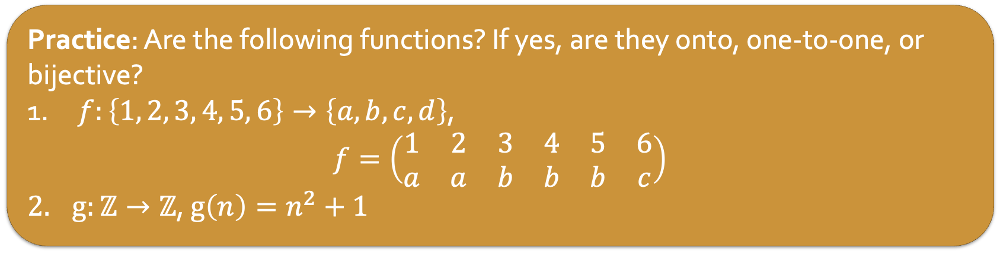
Warm Up: Functions
A function is a rule that assigns each input exactly one output.
When a function maps the domain to everything in the codomain (i.e the codomain is the range) we say it is onto.
When a function is such that each element of the codomain is the image of at most one element of the domain, we say it is one-to-one.
An onto and one-to-one function is a bijective function.
Practice: Are the following functions? If yes, are they onto, one-to-one, or bijective?
$f:\left\{1, 2, 3, 4, 5, 6\right\}→\left\{a, b, c, d\right\}\text{, }$
$$f=\left(\begin{matrix}1 & 2 & 3 & 4 & 5 & 6 \\ a & a & b & b & b & c\end{matrix}\right)$$
$g:ℤ→ℤ$, $g\left(n\right)=n^{2}+1$

Slide 4
Motivation
A restaurant offers 8 appetizers and 14 entrées. How many choices do you have if:
You will eat one dish, either an appetizer or entrée?
You will each two dishes, one appetizer and one entrée?
Answer these questions then think about what rules you used to answer them. Write down the rules you have.

Slide 5
Motivation
Answer these questions using the rules you developed. Do they work?
A standard deck of playing cards has 26 red cards and 12 face cards.
How many ways can you select a card that is either red or a face?
How many ways can you select a card which is red and a face?
How many ways can you select two cards so that the first one is red and the second is a face?

Slide 6
Additive Principle
The additive principle states that if event A can occur in m ways and event B can occur in n disjoint ways, then the event “A or B” can occur in m+n ways.
Notes:
disjoin = A and B cannot happen at the same time

Slide 7
Additive Principle
The additive principle states that if event A can occur in m ways and event B can occur in n disjoint ways, then the event “A or B” can occur in m+n ways.
A standard deck of playing cards has 26 red cards and 12 face cards.
How many ways can you select a card that is either red or a face?
Red and face are not disjoint which is why the answer to this question is not 26 + 12 = 38
Notes:
disjoin = A and B cannot happen at the same time

Slide 8
Additive Principle
The additive principle states that if event A can occur in m ways and event B can occur in n disjoint ways, then the event “A or B” can occur in m+n ways.
A standard deck of playing cards has 26 red cards and 12 face cards.
How many ways can you select a card that is either red or a face?
Red and face are not disjoint which is why the answer to this question is not 26 + 12 = 38
How many ways can you select a card that is either a Jack or a Queen?
Jack and queen are disjoint which is why the answer to this question is 4 + 4 = 8
Notes:
disjoin = A and B cannot happen at the same time

Slide 9
Additive Principle
The additive principle states that if event A can occur in m ways and event B can occur in n disjoint ways, then the event “A or B” can occur in m+n ways.
Practice: How many two letter, alphabetical, lower-case strings start with either A or B?
Notes:
How many start with A? 26
How many start with B? 26
52 total

Slide 10
Additive Principle
The additive principle states that if event A can occur in m ways and event B can occur in n disjoint ways, then the event “A or B” can occur in m+n ways.
Practice: How many two letter, alphabetical, lower-case strings start with one of the 5 vowels?
Notes:
5*26

Slide 11
Additive Principle
The additive principle states that if event A can occur in m ways and event B can occur in n disjoint ways, then the event “A or B” can occur in m+n ways.
Practice: Suppose you are going out for ice cream. There are 6 ice cream flavors and 4 toppings. How many choices do you have if you must choose an ice cream and a topping?
Notes:
6 + 6 + 6 +6 = 24

Slide 12
Multiplicative Principle
The multiplicative principle states that if event A can occur in m ways and each possibility for A allows for exactly n ways for event B, then the event “A and B” can occur in m*n ways.
Notes:
6 + 6 + 6 +6 = 24

Slide 13
Multiplicative Principle
The multiplicative principle states that if event A can occur in m ways and each possibility for A allows for exactly n ways for event B, then the event “A and B” can occur in m*n ways.
How many two letter, alphabetical, lower-case strings start with one of the 5 vowels?
5 * 26 = 130
Notes:
6 + 6 + 6 +6 = 24

Slide 14
Multiplicative Principle
The multiplicative principle states that if event A can occur in m ways and each possibility for A allows for exactly n ways for event B, then the event “A and B” can occur in m*n ways.
Practice: How many license plates can you make out of three letters followed by 3 numerical digits?
Notes:
6 events (each letter)
first 3 can happen 26 ways
last 3 can happen 10 ways

Slide 15
Multiplicative Principle
The multiplicative principle states that if event A can occur in m ways and each possibility for A allows for exactly n ways for event B, then the event “A and B” can occur in m*n ways.
Practice: How many passwords can you make out of four letters followed by four numerical digits followed by two punctuation (. , ? ; : ! )?
Notes:
6 events (each letter)
first 3 can happen 26 ways
last 3 can happen 10 ways

Slide 16
Sets & Counting
We will represent events as sets of possible outcomes.
Ex. Let A = {set of 9 shirts}, B = {set of 5 pants}
To make an outfit we need 1 shirt and one pant, how many outfits can we make?
9*5

Slide 17
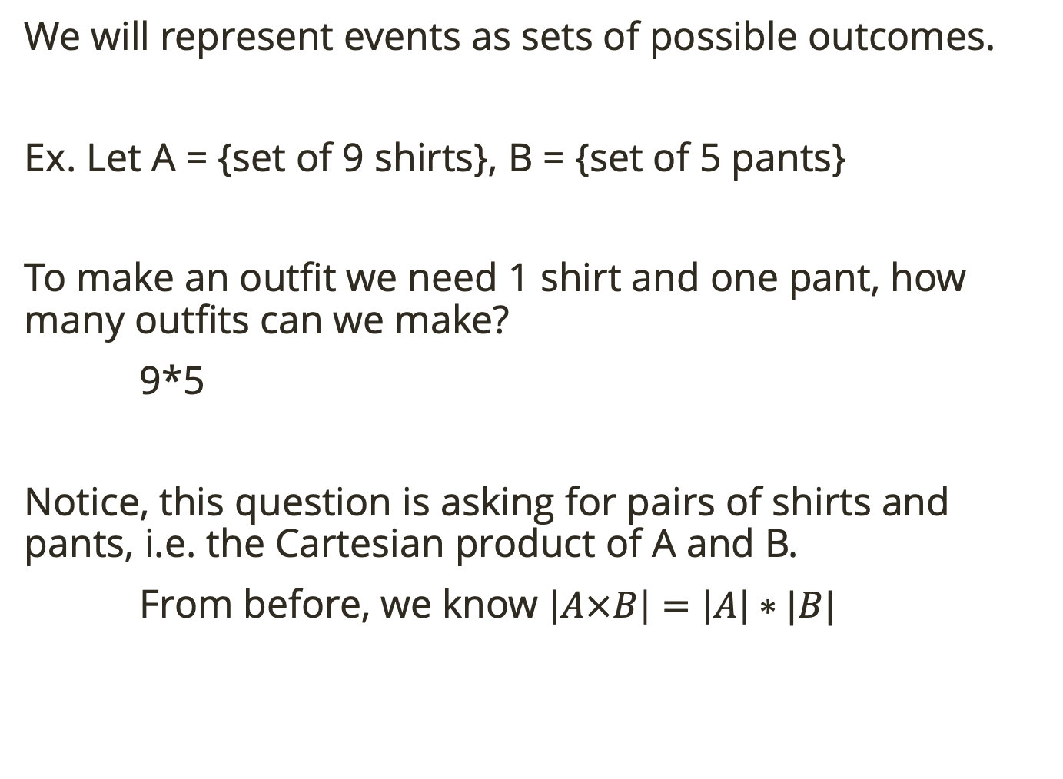
Sets & Counting
We will represent events as sets of possible outcomes.
Ex. Let A = {set of 9 shirts}, B = {set of 5 pants}
To make an outfit we need 1 shirt and one pant, how many outfits can we make?
9*5
Notice, this question is asking for pairs of shirts and pants, i.e. the Cartesian product of A and B.
From before, we know $\left|A×B\right|=\left|A\right|∗|B|$

Slide 18
Sets & Counting
We will represent events as sets of possible outcomes.
Ex. Let A = {set of 9 shirts}, B = {set of 5 pants}
Let’s say you’re staying in and want to wear a shirt or pants (only one). How many outfits can you make?
9 + 5

Slide 19
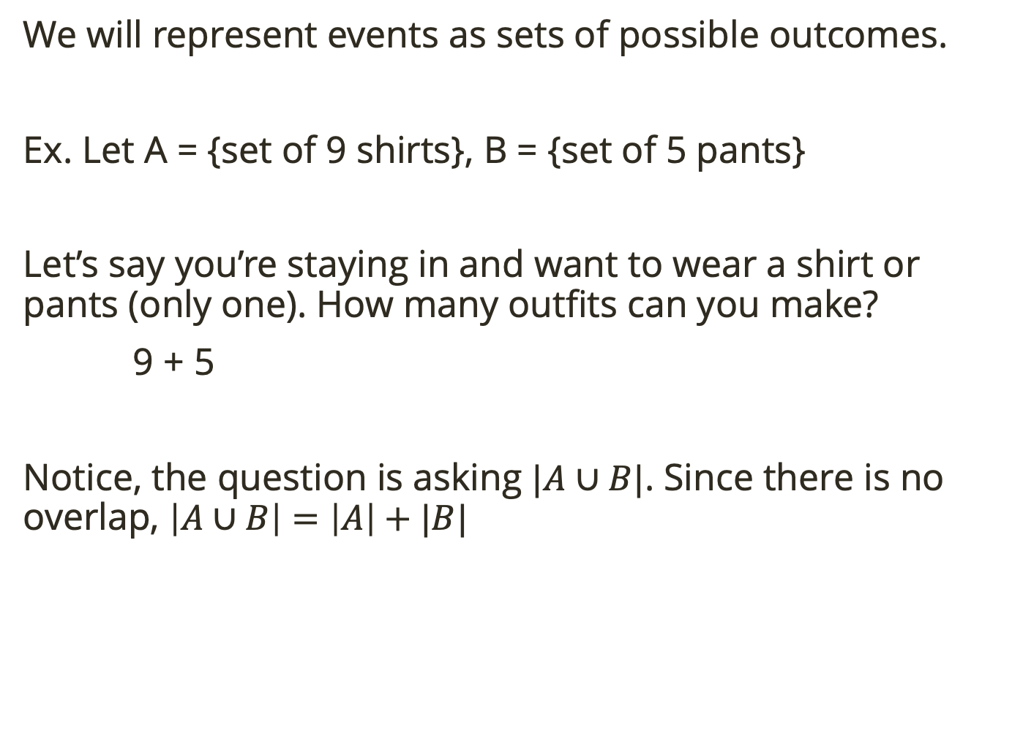
Sets & Counting
We will represent events as sets of possible outcomes.
Ex. Let A = {set of 9 shirts}, B = {set of 5 pants}
Let’s say you’re staying in and want to wear a shirt or pants (only one). How many outfits can you make?
9 + 5
Notice, the question is asking $|A∪B|$. Since there is no overlap, $\left|A∪B\right|=\left|A\right|+|B|$

Slide 20
Sets & Counting
We will represent events as sets of possible outcomes.
Practice: Conceptualize the following as set problems.
How many two letter, alphabetical, lower-case strings start with one of the 5 vowels?
Suppose you are going out for ice cream. There are 6 ice cream flavors and 4 toppings. How many choices do you have if you must choose an ice cream and a topping?
How many license plates can you make out of three letters followed by 3 numerical digits?
How many passwords can you make out of four letters followed by four numerical digits followed by two punctuation (. , ? ; : ! )?

Slide 21

Inclusion/ Exclusion
A recent buzz marketing campaign for Village Inn surveyed patrons on their pie preferences. People were asked whether they enjoyed (A) Apple, (B) Blueberry or (C) Cherry pie (respondents answered yes or no to each type of pie, and could say yes to more than one type). The following table shows the results of the survey.
Represent these results with a Venn Diagram

Slide 22
Inclusion/ Exclusion
A recent buzz marketing campaign for Village Inn surveyed patrons on their pie preferences. People were asked whether they enjoyed (A) Apple, (B) Blueberry or (C) Cherry pie (respondents answered yes or no to each type of pie, and could say yes to more than one type). The following table shows the results of the survey.
How many people enjoy at least one of the kinds of pie?
Notes:
not 95, because that double counts
have to subtract the doubles from the singles

Slide 23

Inclusion/ Exclusion
An examination in three subjects, Algebra, Biology, and Chemistry, was taken by 41 students. The following table shows how many students failed in each single subject and in their various combinations:
How many students failed at least one subject?
Represent these results with a Venn Diagram
Notes:
not 95, because that double counts
have to subtract the doubles from the singles

Slide 24
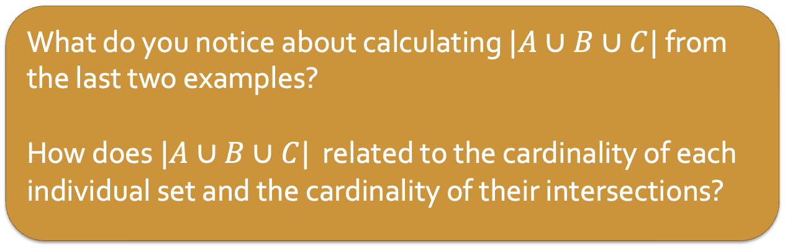
Inclusion/ Exclusion
What do you notice about calculating $|A∪B∪C|$ from the last two examples?
How does $|A∪B∪C|$ related to the cardinality of each individual set and the cardinality of their intersections?
Notes:
not 95, because that double counts
have to subtract the doubles from the singles

Slide 25

Inclusion/ Exclusion
What do you notice about calculating $|A∪B∪C|$ from the last two examples?
How does $|A∪B∪C|$ related to the cardinality of each individual set and the cardinality of their intersections?
For finite sets, $A, B, C$
$\left|A∪B∪C\right|=\left|A\right|+\left|B\right|+\left|C\right|−\left|A∩B\right|−\left|A∩C\right|−\left|B∩C\right|+|A∩B∩C|$
Add back anything removed in all 3 double count subtractions
Count all elements in each set
Remove double counts
Notes:
not 95, because that double counts
have to subtract the doubles from the singles

Slide 26
Inclusion/ Exclusion
Practice: A group of college students were asked about their TV watching habits. Of those surveyed, 28 students watch The Walking Dead, 19 watch The Blacklist, and 24 watch Game of Thrones. Additionally, 16 watch The Walking Dead and The Blacklist, 14 watch The Walking Dead and Game of Thrones, and 10 watch The Blacklist and Game of Thrones. There are 8 students who watch all three shows. How many students surveyed watched at least one of the shows?
For finite sets, $A, B, C$
$\left|A∪B∪C\right|=\left|A\right|+\left|B\right|+\left|C\right|−\left|A∩B\right|−\left|A∩C\right|−\left|B∩C\right|+|A∩B∩C|$
Add back anything removed in all 3 double count subtractions
Count all elements in each set
Remove double counts
Notes:
not 95, because that double counts
have to subtract the doubles from the singles

Slide 27
Putting it all together
Practice: Consider all 5 character strings made from letters a – h.
How many of these strings are there total?
How many of these strings contain no repeated letters?
How many of these strings start with the substring “aha”?
How many of these strings either start with “aha” or end with “bah” or both?
How many of the strings containing no repeats also do not contain the substring “bad”?
Notes:
8^5
8*7*6*5*4
8*8
64+64-0
(8*7*6*5*4)-3*(4*4)

