Slide 1
Discrete Structures– Propositional Logic Pt. 1
Dr. Ab Mosca (they/them)

Slide 2
Plan for Today
Truth conditions for connectives
Truth Tables
Logical Equivalence

Slide 3
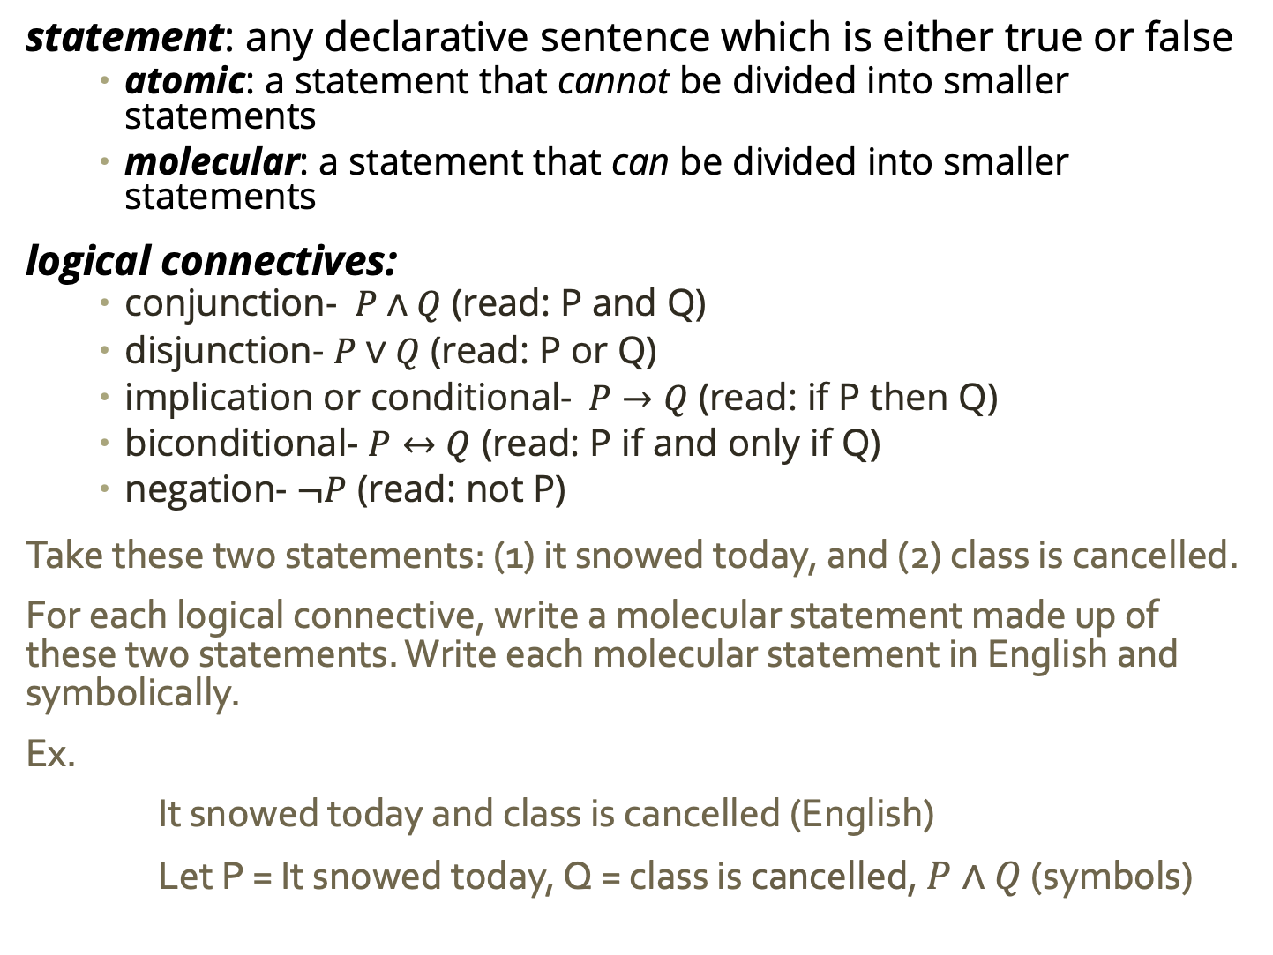
Warm Up
statement: any declarative sentence which is either true or false
atomic: a statement that cannot be divided into smaller statements
molecular: a statement that can be divided into smaller statements
logical connectives:
conjunction- $P∧Q$ (read: P and Q)
disjunction- $P∨Q$ (read: P or Q)
implication or conditional-$P→Q$ (read: if P then Q)
biconditional- $P↔Q$ (read: P if and only if Q)
negation- $¬P$ (read: not P)
Take these two statements: (1) it snowed today, and (2) class is cancelled.
For each logical connective, write a molecular statement made up of these two statements. Write each molecular statement in English and symbolically.
Ex.
It snowed today and class is cancelled (English)
Let P = It snowed today, Q = class is cancelled, $P∧Q$ (symbols)

Slide 4
Truth Conditions
All statements have a truth value: true (T or 1) or false (F or 0)

Slide 5
Truth Conditions
All statements have a truth value: true (T or 1) or false (F or 0)
The truth value of a statement depends on
(1) the truth values of its parts and
(2) its connectives

Slide 6
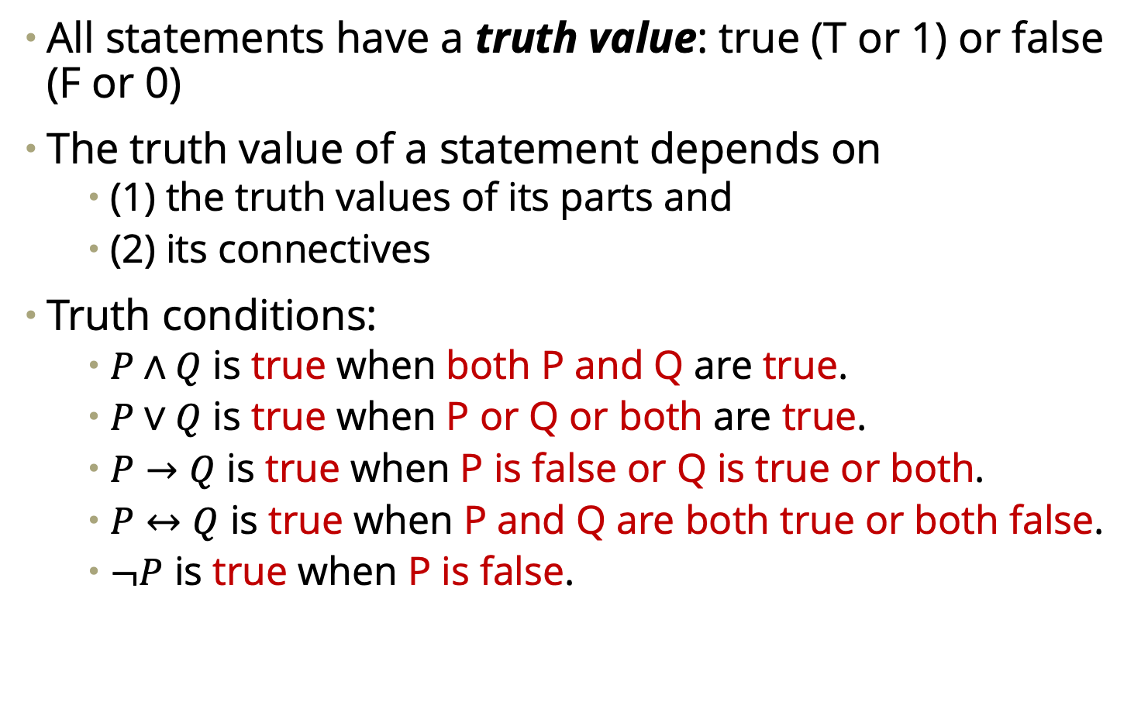
Truth Conditions
All statements have a truth value: true (T or 1) or false (F or 0)
The truth value of a statement depends on
(1) the truth values of its parts and
(2) its connectives
Truth conditions:
$P∧Q$ is true when both P and Q are true.
$P∨Q$ is true when P or Q or both are true.
$P→Q$ is true when P is false or Q is true or both.
$P↔Q$ is true when P and Q are both true or both false.
$¬P$ is true when P is false.

Slide 7
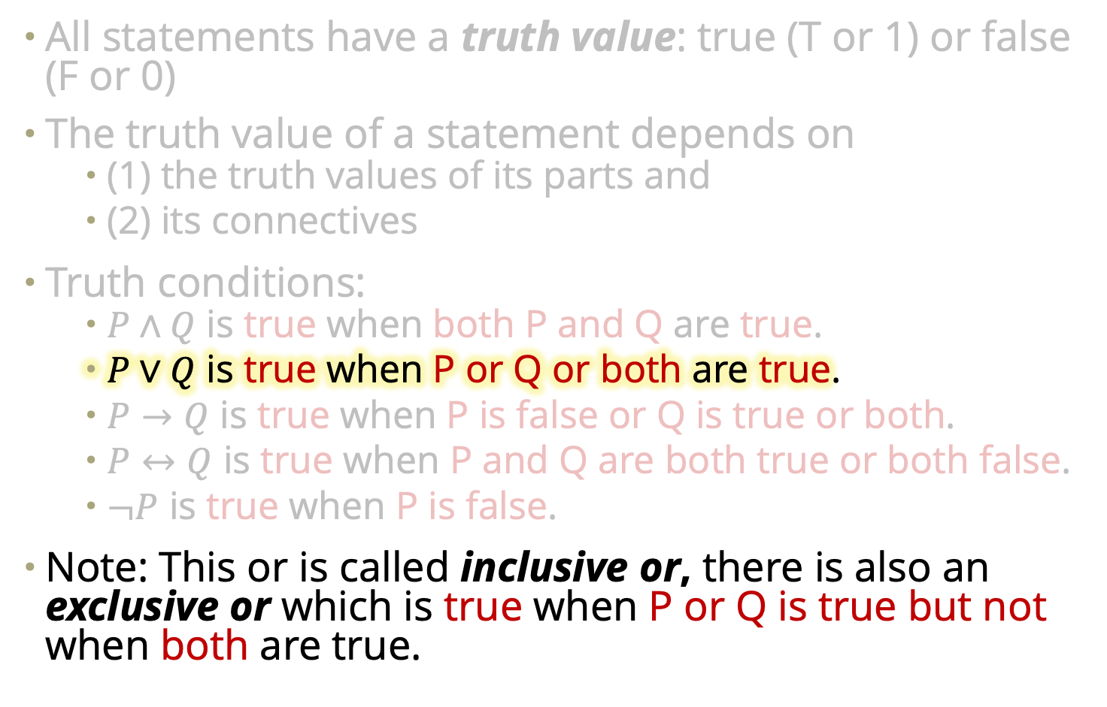
Truth Conditions
All statements have a truth value: true (T or 1) or false (F or 0)
The truth value of a statement depends on
(1) the truth values of its parts and
(2) its connectives
Truth conditions:
$P∧Q$ is true when both P and Q are true.
$P∨Q$ is true when P or Q or both are true.
$P→Q$ is true when P is false or Q is true or both.
$P↔Q$ is true when P and Q are both true or both false.
$¬P$ is true when P is false.
Note: This or is called inclusive or, there is also an exclusive or which is true when P or Q is true but not when both are true.

Slide 8
Truth Conditions
All statements have a truth value: true (T or 1) or false (F or 0)
The truth value of a statement depends on
(1) the truth values of its parts and
(2) its connectives
Truth conditions:
$P∧Q$ is true when both P and Q are true.
$P∨Q$ is true when P or Q or both are true.
$P→Q$ is true when P is false or Q is true or both.
$P↔Q$ is true when P and Q are both true or both false.
$¬P$ is true when P is false.
Practice: Let P = It snowed today, Q = class is cancelled, what is the truth value for each of the statements you wrote earlier based on the truth of P and Q today.

Slide 9
Truth Conditions
All statements have a truth value: true (T or 1) or false (F or 0)
The truth value of a statement depends on
(1) the truth values of its parts and
(2) its connectives

Slide 10
Truth Conditions
All statements have a truth value: true (T or 1) or false (F or 0)
The truth value of a statement depends on
(1) the truth values of its parts and
(2) its connectives
For any atomic statement there are only two possible truth values, that means when we string statements together with connectives there is a finite number of possible combinations of truth values

Slide 11
Truth Conditions
All statements have a truth value: true (T or 1) or false (F or 0)
The truth value of a statement depends on
(1) the truth values of its parts and
(2) its connectives
For any atomic statement there are only two possible truth values, that means when we string statements together with connectives there is a finite number of possible combinations of truth values
One way we model possible truth values is with truth tables

Slide 12
Truth Tables
One way we model possible truth values is with truth tables
Let P be a statement. The truth table for P is:
P
T
F

Slide 13
Truth Tables
One way we model possible truth values is with truth tables
Let P be a statement. The truth table for P is:
Let Q be a statement. The truth table for Q is:
P
T
F
Q
T
F

Slide 14
Truth Tables
One way we model possible truth values is with truth tables
When we combine statements with conjunctives, there is a finite number of truth value combinations:
Let P and Q be statements. One of these must be the case:
P is true and Q is true
P is true and Q is false
P is false and Q is true
P is false and Q is false

Slide 15
Truth Tables
One way we model possible truth values is with truth tables
When we combine statements with conjunctives, there is a finite number of truth value combinations:
Let P and Q be statements. One of these must be the case:
P is true and Q is true
P is true and Q is false
P is false and Q is true
P is false and Q is false
When we use connectives, the truth value of the resulting statement depends on the true values of its parts and the connective. We use truth tables to model this.

Slide 16

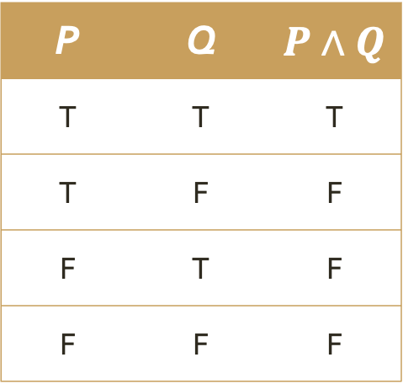
Truth Tables
When we use connectives, the truth value of the resulting statement depends on the true values of its parts and the connective. We use truth tables to model this.
Conjunction: $P∧Q$ is true when both P and Q are true.
P | Q | $P∧Q$
T | T | T
T | F | F
F | T | F
F | F | F

Slide 17

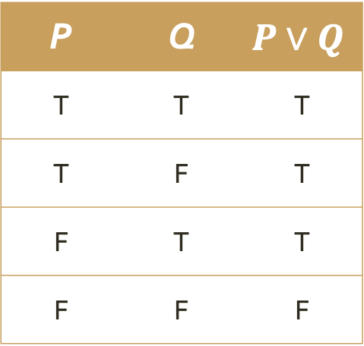
Truth Tables
When we use connectives, the truth value of the resulting statement depends on the true values of its parts and the connective. We use truth tables to model this.
Disjunction: $P∨Q$ is true when P or Q or both are true.
P | Q | $$P∨Q$$
T | T | T
T | F | T
F | T | T
F | F | F

Slide 18

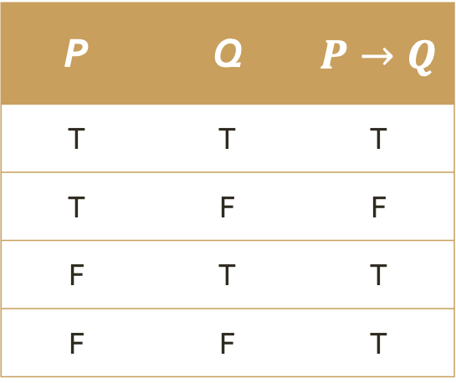
Truth Tables
When we use connectives, the truth value of the resulting statement depends on the true values of its parts and the connective. We use truth tables to model this.
Implication: $P→Q$ is true when P is false or Q is true or both.
P | Q | $P→Q$
T | T | T
T | F | F
F | T | T
F | F | T

Slide 19

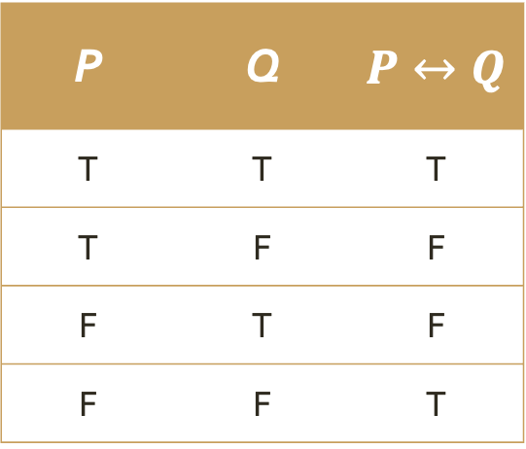
Truth Tables
When we use connectives, the truth value of the resulting statement depends on the true values of its parts and the connective. We use truth tables to model this.
Biconditional: $P↔Q$ is true when P and Q are both true or both false.
P | Q | $P↔Q$
T | T | T
T | F | F
F | T | F
F | F | T

Slide 20

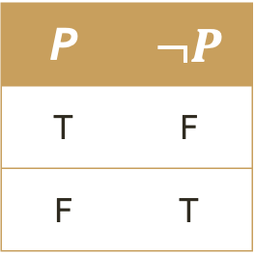
Truth Tables
When we use connectives, the truth value of the resulting statement depends on the true values of its parts and the connective. We use truth tables to model this.
Negation: $¬P$ is true when P is false.
P | $¬P$
T | F
F | T

Slide 21
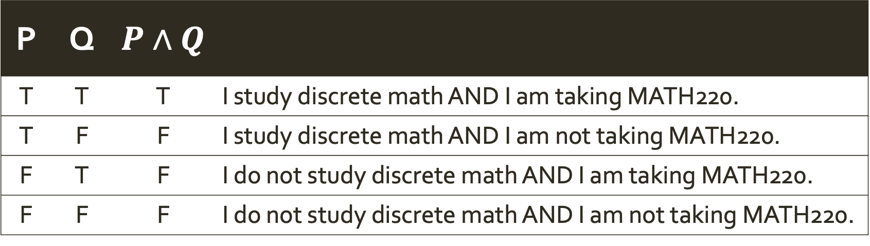
Truth Tables
Practice: Form five groups. Each will be assigned a conjunction. Come up with a real world scenario that your conjunction accurately represents. Be ready to share your answers!
Ex. If I had conjunction and were one of you, I might say: Let P = I study discrete math, and Q = I am taking MATH220
The truth table and real work scenarios are:
P | Q | $P∧Q$
T | T | T | I study discrete math AND I am taking MATH220.
T | F | F | I study discrete math AND I am not taking MATH220.
F | T | F | I do not study discrete math AND I am taking MATH220.
F | F | F | I do not study discrete math AND I am not taking MATH220.

Slide 22

Truth Tables
Larger statements can be made up of more than two smaller parts and/or more than one conjunction.
Truth tables are helpful for deducing when these larger statements are true and false.
Ex. When is $¬P∨Q$ true?

Slide 23
Truth Tables
Larger statements can be made up of more than two smaller parts and/or more than one conjunction.
Truth tables are helpful for deducing when these larger statements are true and false.
Ex. When is $¬P∨Q$ true?
P | Q
T | T
T | F
F | T
F | F
Start the table with all possible combinations of T/F for smallest statements

Slide 24
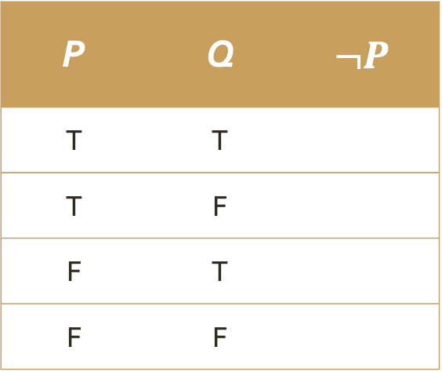
Truth Tables
Larger statements can be made up of more than two smaller parts and/or more than one conjunction.
Truth tables are helpful for deducing when these larger statements are true and false.
Ex. When is $¬P∨Q$ true?
P | Q | $$¬P$$
T | T
T | F
F | T
F | F
Build up the truth table with additional columns for slightly larger statements

Slide 25
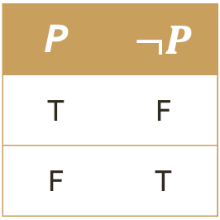
Truth Tables
Larger statements can be made up of more than two smaller parts and/or more than one conjunction.
Truth tables are helpful for deducing when these larger statements are true and false.
Ex. When is $¬P∨Q$ true?
We know the truth values for NOT something from earlier
P | Q | $$¬P$$
T | T
T | F
F | T
F | F
P | $¬P$
T | F
F | T

Slide 26
Truth Tables
Larger statements can be made up of more than two smaller parts and/or more than one conjunction.
Truth tables are helpful for deducing when these larger statements are true and false.
Ex. When is $¬P∨Q$ true?
We know the truth values for NOT something from earlier
P | Q | $$¬P$$
T | T
T | F
F | T
F | F
P | $¬P$
T | F
F | T

Slide 27
Truth Tables
Larger statements can be made up of more than two smaller parts and/or more than one conjunction.
Truth tables are helpful for deducing when these larger statements are true and false.
Ex. When is $¬P∨Q$ true?
We know the truth values for NOT something from earlier
P | Q | $$¬P$$
T | T
T | F
F | T
F | F
P | $¬P$
T | F
F | T

Slide 28
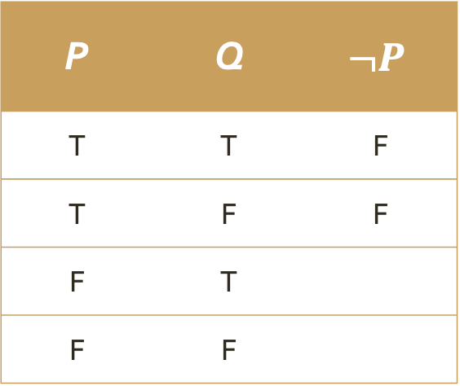
Truth Tables
Larger statements can be made up of more than two smaller parts and/or more than one conjunction.
Truth tables are helpful for deducing when these larger statements are true and false.
Ex. When is $¬P∨Q$ true?
We know the truth values for NOT something from earlier
P | Q | $$¬P$$
T | T | F
T | F | F
F | T
F | F
P | $¬P$
T | F
F | T

Slide 29
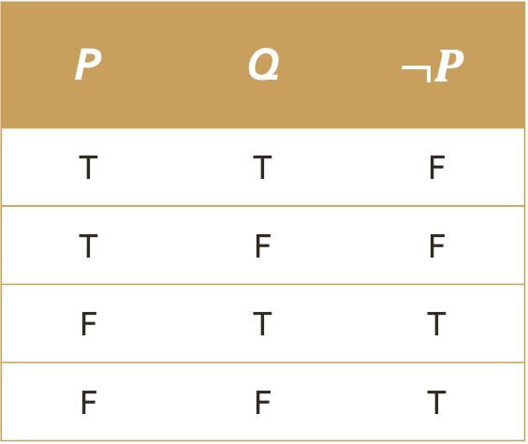
Truth Tables
Larger statements can be made up of more than two smaller parts and/or more than one conjunction.
Truth tables are helpful for deducing when these larger statements are true and false.
Ex. When is $¬P∨Q$ true?
We know the truth values for NOT something from earlier
P | Q | $$¬P$$
T | T | F
T | F | F
F | T | T
F | F | T
P | $¬P$
T | F
F | T

Slide 30
Truth Tables
Larger statements can be made up of more than two smaller parts and/or more than one conjunction.
Truth tables are helpful for deducing when these larger statements are true and false.
Ex. When is $¬P∨Q$ true?
P | Q | $$¬P$$
T | T | F
T | F | F
F | T | T
F | F | T

Slide 31
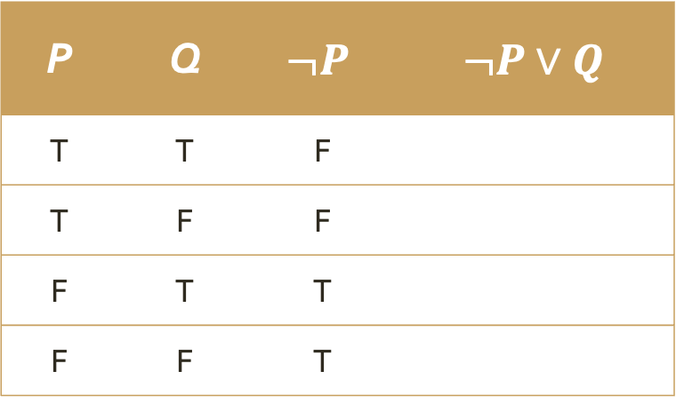
Truth Tables
Larger statements can be made up of more than two smaller parts and/or more than one conjunction.
Truth tables are helpful for deducing when these larger statements are true and false.
Ex. When is $¬P∨Q$ true?
Build up the truth table with additional columns for larger statements
P | Q | $$¬P$$ | $¬P∨Q$
T | T | F
T | F | F
F | T | T
F | F | T

Slide 32
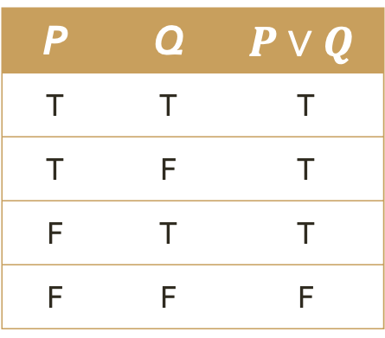
Truth Tables
Larger statements can be made up of more than two smaller parts and/or more than one conjunction.
Truth tables are helpful for deducing when these larger statements are true and false.
Ex. When is $¬P∨Q$ true?
We know the truth values for something OR something from earlier
P | Q | $$¬P$$ | $¬P∨Q$
T | T | F
T | F | F
F | T | T
F | F | T
P | Q | $$P∨Q$$
T | T | T
T | F | T
F | T | T
F | F | F

Slide 33
Truth Tables
Larger statements can be made up of more than two smaller parts and/or more than one conjunction.
Truth tables are helpful for deducing when these larger statements are true and false.
Ex. When is $¬P∨Q$ true?
We know the truth values for something OR something from earlier
P | Q | $$¬P$$ | $¬P∨Q$
T | T | F
T | F | F
F | T | T
F | F | T
P | Q | $$P∨Q$$
T | T | T
T | F | T
F | T | T
F | F | F

Slide 34
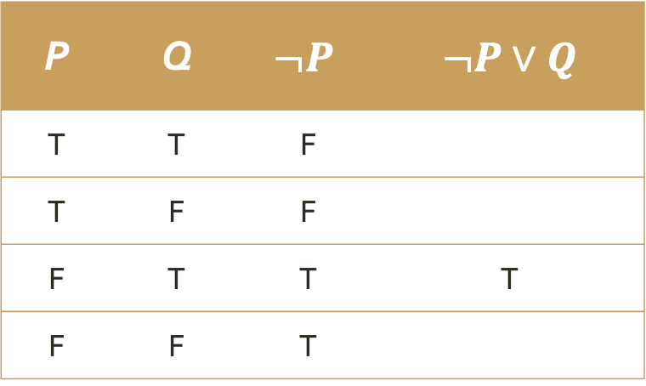
Truth Tables
Larger statements can be made up of more than two smaller parts and/or more than one conjunction.
Truth tables are helpful for deducing when these larger statements are true and false.
Ex. When is $¬P∨Q$ true?
We know the truth values for something OR something from earlier
P | Q | $$¬P$$ | $¬P∨Q$
T | T | F
T | F | F
F | T | T | T
F | F | T
P | Q | $$P∨Q$$
T | T | T
T | F | T
F | T | T
F | F | F

Slide 35
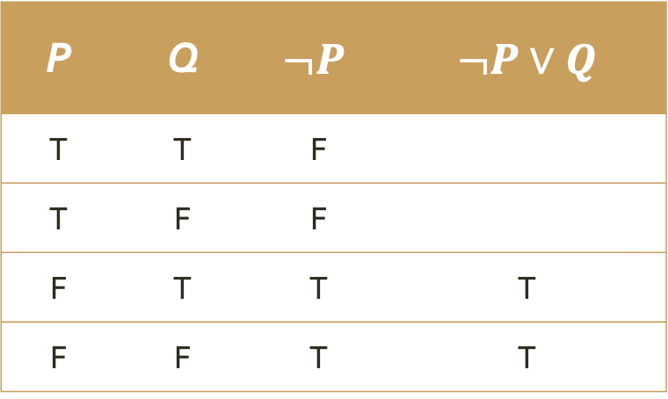
Truth Tables
Larger statements can be made up of more than two smaller parts and/or more than one conjunction.
Truth tables are helpful for deducing when these larger statements are true and false.
Ex. When is $¬P∨Q$ true?
We know the truth values for something OR something from earlier
P | Q | $$¬P$$ | $¬P∨Q$
T | T | F
T | F | F
F | T | T | T
F | F | T | T
P | Q | $$P∨Q$$
T | T | T
T | F | T
F | T | T
F | F | F

Slide 36
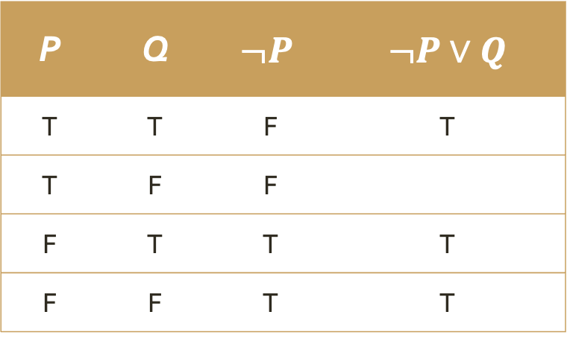
Truth Tables
Larger statements can be made up of more than two smaller parts and/or more than one conjunction.
Truth tables are helpful for deducing when these larger statements are true and false.
Ex. When is $¬P∨Q$ true?
We know the truth values for something OR something from earlier
P | Q | $$¬P$$ | $¬P∨Q$
T | T | F | T
T | F | F
F | T | T | T
F | F | T | T
P | Q | $$P∨Q$$
T | T | T
T | F | T
F | T | T
F | F | F

Slide 37
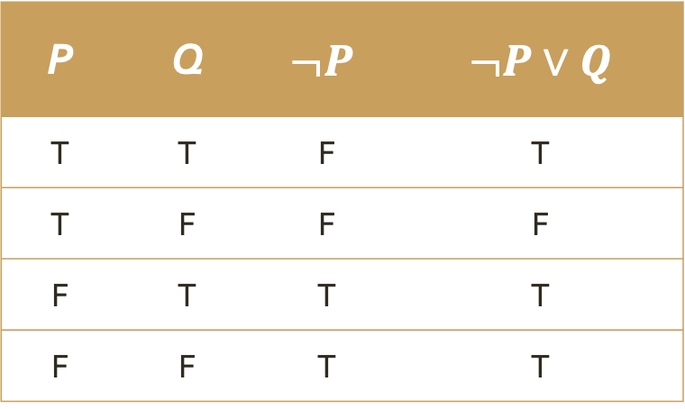
Truth Tables
Larger statements can be made up of more than two smaller parts and/or more than one conjunction.
Truth tables are helpful for deducing when these larger statements are true and false.
Ex. When is $¬P∨Q$ true?
We know the truth values for something OR something from earlier
P | Q | $$¬P$$ | $¬P∨Q$
T | T | F | T
T | F | F | F
F | T | T | T
F | F | T | T
P | Q | $$P∨Q$$
T | T | T
T | F | T
F | T | T
F | F | F

Slide 38
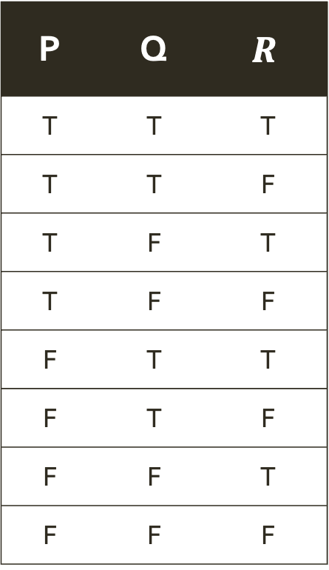

Truth Tables
Practice: Finish the truth table for the statement $\left(P→Q\right)∨(Q→R)$
Larger statements can be made up of more than two smaller parts and/or more than one conjunction.
Truth tables are helpful for deducing when these larger statements are true and false.
Ex. When is $¬P∨Q$ true?
P | Q | $$R$$
T | T | T
T | T | F
T | F | T
T | F | F
F | T | T
F | T | F
F | F | T
F | F | F
We know the truth values for something OR something from earlier
P | Q | $$¬P$$ | $¬P∨Q$
T | T | F | T
T | F | F
F | T | T | T
F | F | T | T
P | Q | $$P∨Q$$
T | T | T
T | F | T
F | T | T
F | F | F

Slide 39

Truth Tables
Practice: Finish the truth table for the statement $\left(P→Q\right)∨(Q→R)$
Note: $\left(P→Q\right)∨(Q→R)$ is a tautology, a statement that is always true.
Larger statements can be made up of more than two smaller parts and/or more than one conjunction.
Truth tables are helpful for deducing when these larger statements are true and false.
Ex. When is $¬P∨Q$ true?
P | Q | $$R$$
T | T | T
T | T | F
T | F | T
T | F | F
F | T | T
F | T | F
F | F | T
F | F | F
We know the truth values for something OR something from earlier
P | Q | $$¬P$$ | $¬P∨Q$
T | T | F | T
T | F | F
F | T | T | T
F | F | T | T
P | Q | $$P∨Q$$
T | T | T
T | F | T
F | T | T
F | F | F

Slide 40
Logical Equivalence
Two molecular statements P and Q are logically equivalent provided P is true precisely when Q is true.
In other words, P and Q are logically equivalent if they have the same truth value for any assignment of truth values to their atomic parts.

Slide 41

Logical Equivalence
Two molecular statements P and Q are logically equivalent provided P is true precisely when Q is true.
In other words, P and Q are logically equivalent if they have the same truth value for any assignment of truth values to their atomic parts.
Ex. We can use truth tables to show $¬P∨Q$ and $P→Q$ are logically equivalent.

Slide 42
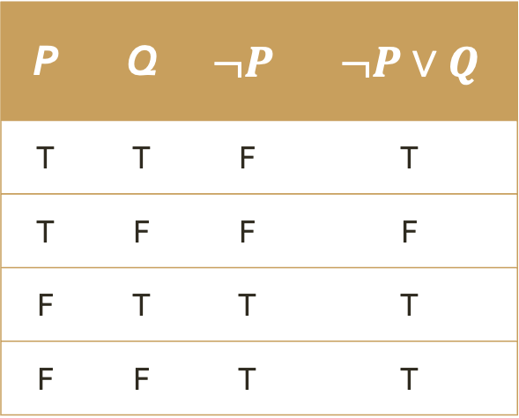
Logical Equivalence
Two molecular statements P and Q are logically equivalent provided P is true precisely when Q is true.
In other words, P and Q are logically equivalent if they have the same truth value for any assignment of truth values to their atomic parts.
Ex. We can use truth tables to show $¬P∨Q$ and $P→Q$ are logically equivalent.
P | Q | $$¬P$$ | $¬P∨Q$
T | T | F | T
T | F | F | F
F | T | T | T
F | F | T | T

Slide 43
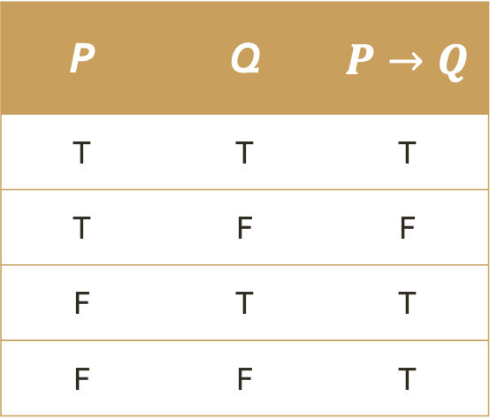
Logical Equivalence
Two molecular statements P and Q are logically equivalent provided P is true precisely when Q is true.
In other words, P and Q are logically equivalent if they have the same truth value for any assignment of truth values to their atomic parts.
Ex. We can use truth tables to show $¬P∨Q$ and $P→Q$ are logically equivalent.
P | Q | $$¬P$$ | $¬P∨Q$
T | T | F | T
T | F | F | F
F | T | T | T
F | F | T | T
P | Q | $P→Q$
T | T | T
T | F | F
F | T | T
F | F | T

Slide 44
Logical Equivalence
Two molecular statements P and Q are logically equivalent provided P is true precisely when Q is true.
In other words, P and Q are logically equivalent if they have the same truth value for any assignment of truth values to their atomic parts.
Ex. We can use truth tables to show $¬P∨Q$ and $P→Q$ are logically equivalent.
P | Q | $$¬P$$ | $¬P∨Q$
T | T | F | T
T | F | F | F
F | T | T | T
F | F | T | T
P | Q | $P→Q$
T | T | T
T | F | F
F | T | T
F | F | T

Slide 45
Logical Equivalence
Two molecular statements P and Q are logically equivalent provided P is true precisely when Q is true.
In other words, P and Q are logically equivalent if they have the same truth value for any assignment of truth values to their atomic parts.
Ex. We can use truth tables to show $¬P∨Q$ and $P→Q$ are logically equivalent.
P | Q | $$¬P$$ | $¬P∨Q$
T | T | F | T
T | F | F | F
F | T | T | T
F | F | T | T
P | Q | $P→Q$
T | T | T
T | F | F
F | T | T
F | F | T

Slide 46
Logical Equivalence
Two molecular statements P and Q are logically equivalent provided P is true precisely when Q is true.
In other words, P and Q are logically equivalent if they have the same truth value for any assignment of truth values to their atomic parts.
Ex. We can use truth tables to show $¬P∨Q$ and $P→Q$ are logically equivalent.
P | Q | $$¬P$$ | $¬P∨Q$
T | T | F | T
T | F | F | F
F | T | T | T
F | F | T | T
P | Q | $P→Q$
T | T | T
T | F | F
F | T | T
F | F | T

Slide 47
Logical Equivalence
Two molecular statements P and Q are logically equivalent provided P is true precisely when Q is true.
In other words, P and Q are logically equivalent if they have the same truth value for any assignment of truth values to their atomic parts.
Ex. We can use truth tables to show $¬P∨Q$ and $P→Q$ are logically equivalent.
P | Q | $$¬P$$ | $¬P∨Q$
T | T | F | T
T | F | F | F
F | T | T | T
F | F | T | T
P | Q | $P→Q$
T | T | T
T | F | F
F | T | T
F | F | T

Slide 48
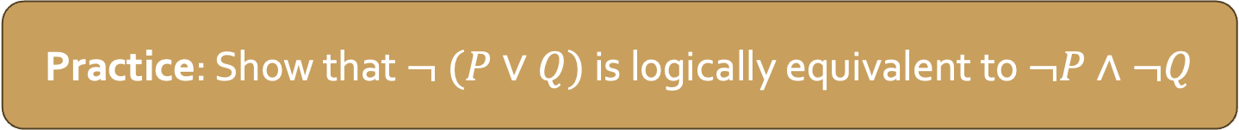
Logical Equivalence
Practice: Show that $¬ (P∨Q)$ is logically equivalent to $¬P∧¬Q$
Two molecular statements P and Q are logically equivalent provided P is true precisely when Q is true.
In other words, P and Q are logically equivalent if they have the same truth value for any assignment of truth values to their atomic parts.
Ex. We can use truth tables to show $¬P∨Q$ and $P→Q$ are logically equivalent.
P | Q | $$¬P$$ | $¬P∨Q$
T | T | F | T
T | F | F | F
F | T | T | T
F | F | T | T
P | Q | $P→Q$
T | T | T
T | F | F
F | T | T
F | F | T

