Slide 1
Discrete Structures– Propositional Logic Pt. 2
Dr. Ab Mosca (they/them)

Slide 2
Plan for Today
Boolean Algebra
Propositions
Quantifiers

Slide 3
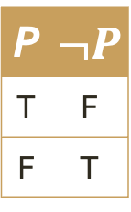
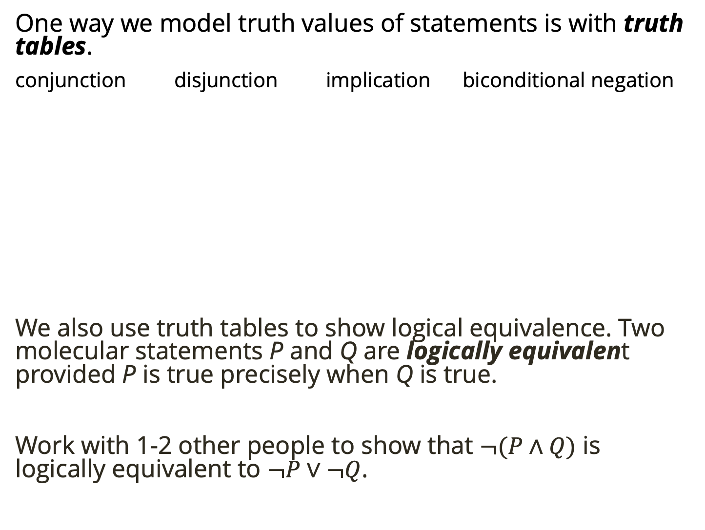
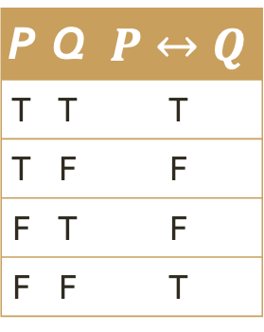
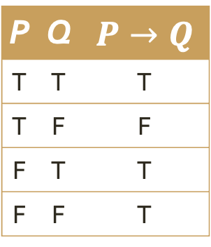
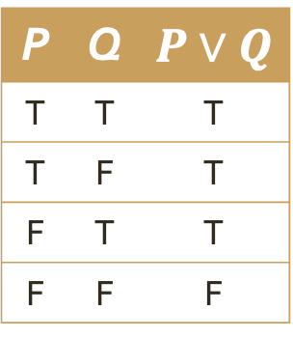
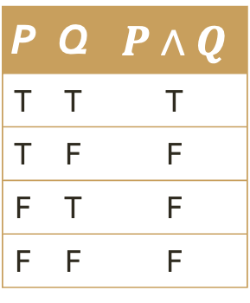
Warm Up
One way we model truth values of statements is with truth tables.
conjunction disjunction implication biconditional negation
We also use truth tables to show logical equivalence. Two molecular statements P and Q are logically equivalent provided P is true precisely when Q is true.
Work with 1-2 other people to show that $¬(P∧Q)$ is logically equivalent to $¬P∨¬Q$.
P | Q | $P∧Q$
T | T | T
T | F | F
F | T | F
F | F | F
P | Q | $P∨Q$
T | T | T
T | F | T
F | T | T
F | F | F
P | Q | $P→Q$
T | T | T
T | F | F
F | T | T
F | F | T
P | Q | $P↔Q$
T | T | T
T | F | F
F | T | F
F | F | T
P | $¬P$
T | F
F | T

Slide 4

De Morgan’s Laws
Last time we showed
$¬(P∨Q)$ is logically equivalent to $¬P∧¬Q$.
You just showed
$¬(P∧Q)$ is logically equivalent to $¬P∨¬Q$.

Slide 5

De Morgan’s Laws
$¬(P∨Q)$ is logically equivalent to $¬P∧¬Q$.
$¬(P∧Q)$ is logically equivalent to $¬P∨¬Q$.
These equivalences are called De Morgan’s Laws.

Slide 6
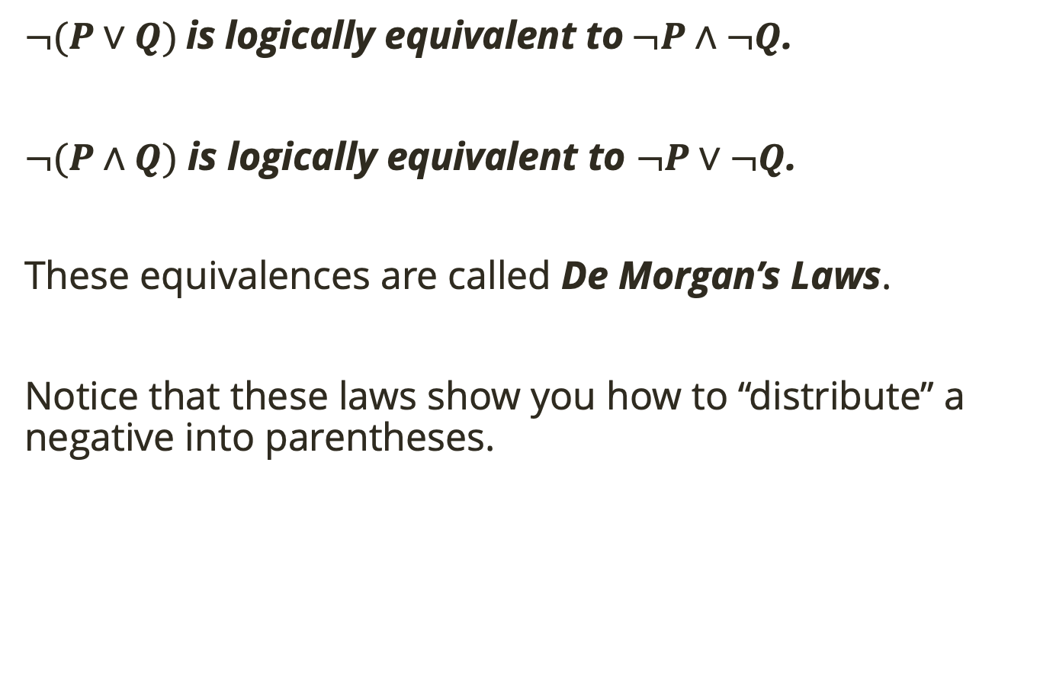
De Morgan’s Laws
$¬(P∨Q)$ is logically equivalent to $¬P∧¬Q$.
$¬(P∧Q)$ is logically equivalent to $¬P∨¬Q$.
These equivalences are called De Morgan’s Laws.
Notice that these laws show you how to “distribute” a negative into parentheses.

Slide 7

Implications are Disjunctions
Last time we also showed that the implication $P→Q$ is logically equivalent to the disjunction $¬P∨Q$.

Slide 8

Implications are Disjunctions
Last time we also showed that the implication $P→Q$ is logically equivalent to the disjunction $¬P∨Q$.
That means at any time we see $P→Q$ in a statement we can replace it with $¬P∨Q$ without changing the truth values of the statement. And vice versa.

Slide 9
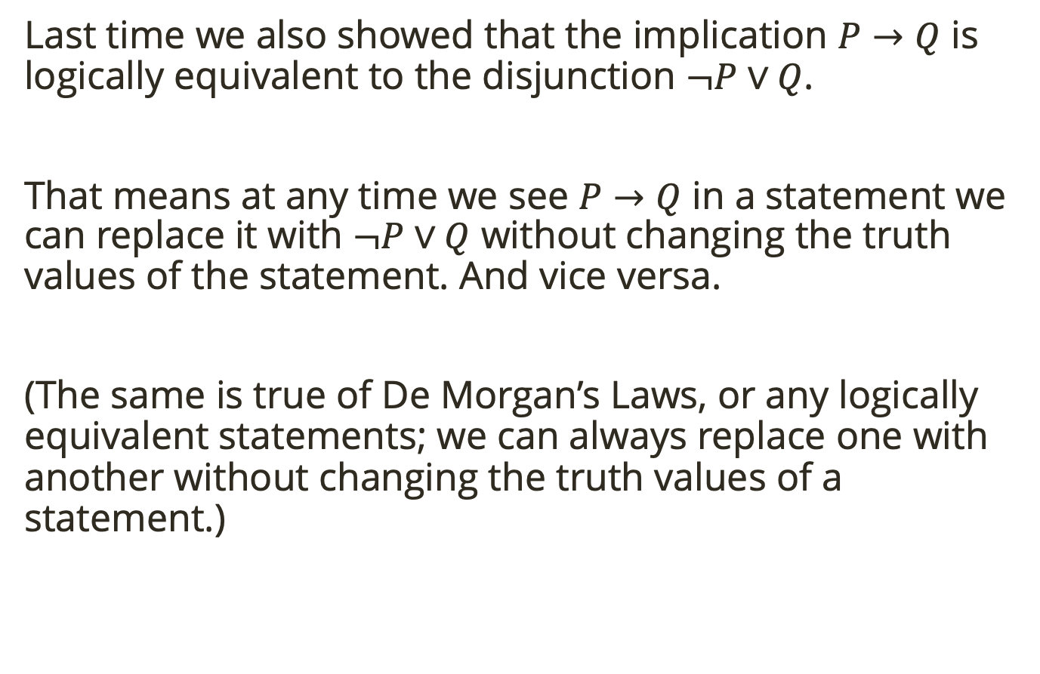
Implications are Disjunctions
Last time we also showed that the implication $P→Q$ is logically equivalent to the disjunction $¬P∨Q$.
That means at any time we see $P→Q$ in a statement we can replace it with $¬P∨Q$ without changing the truth values of the statement. And vice versa.
(The same is true of De Morgan’s Laws, or any logically equivalent statements; we can always replace one with another without changing the truth values of a statement.)
Notes:
Like how we can write x + y = 7, or x = 7 – y

Slide 10

Double Negation
A double negation cancels itself out.
In other words, $¬¬P$ is logically equivalent to $P$.

Slide 11
Boolean Algebra
Boolean Algebra is the set of rules dictating how to transform one statement into another.

Slide 12
Boolean Algebra
Boolean Algebra is the set of rules dictating how to transform one statement into another.
Another way to show logical equivalence (besides truth tables) is with Boolean Algebra.

Slide 13
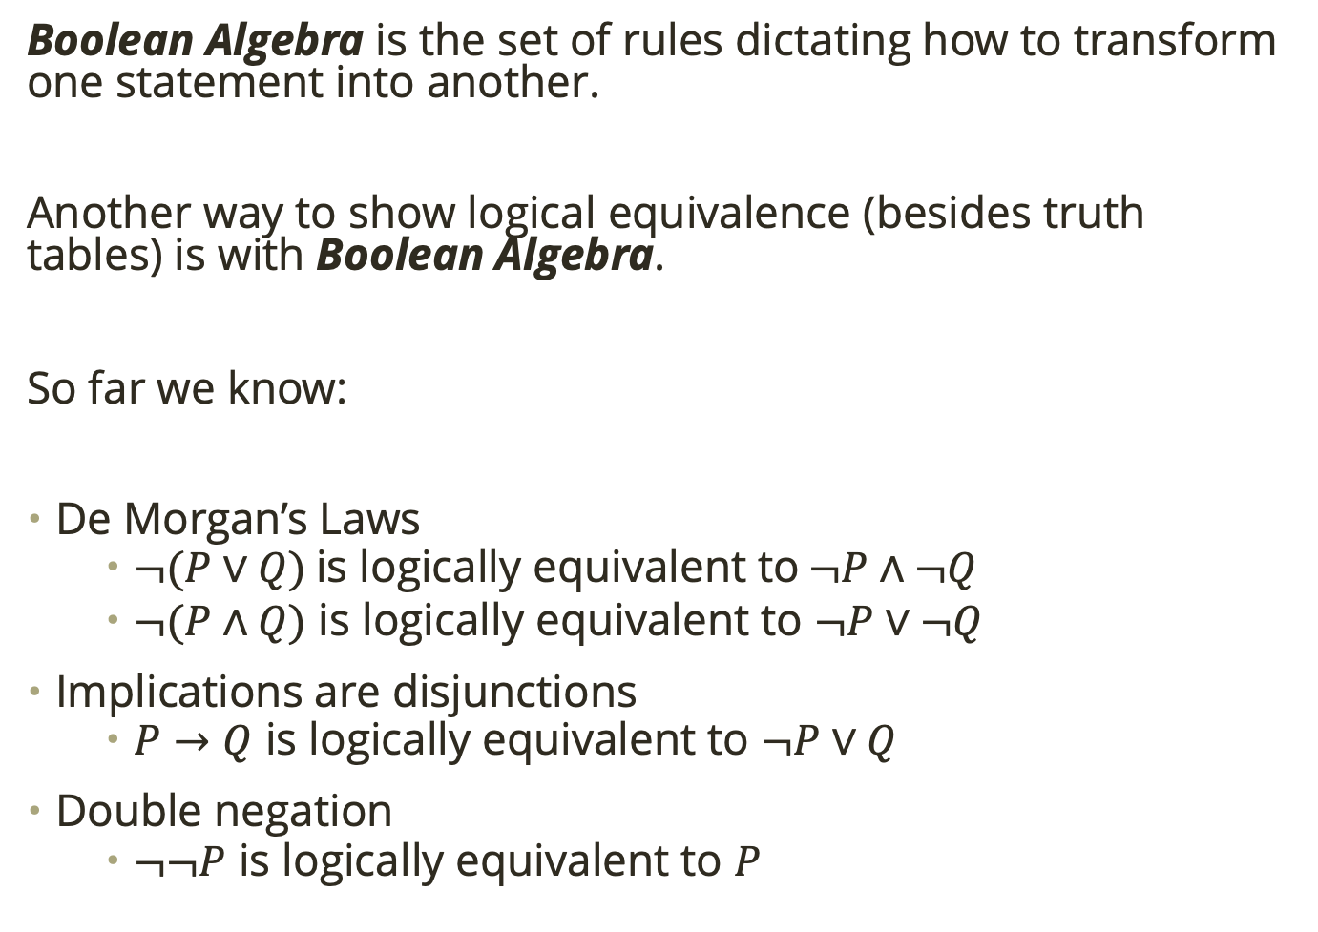
Boolean Algebra
Boolean Algebra is the set of rules dictating how to transform one statement into another.
Another way to show logical equivalence (besides truth tables) is with Boolean Algebra.
So far we know:
De Morgan’s Laws
$¬(P∨Q)$ is logically equivalent to $¬P∧¬Q$
$¬(P∧Q)$ is logically equivalent to $¬P∨¬Q$
Implications are disjunctions
$P→Q$ is logically equivalent to $¬P∨Q$
Double negation
$¬¬P$ is logically equivalent to $P$

Slide 14

Boolean Algebra
Boolean Algebra is the set of rules dictating how to transform one statement into another.
Another way to show logical equivalence (besides truth tables) is with Boolean Algebra.
So far we know:
De Morgan’s Laws
$¬(P∨Q)$ is logically equivalent to $¬P∧¬Q$
$¬(P∧Q)$ is logically equivalent to $¬P∨¬Q$
Implications are disjunctions
$P→Q$ is logically equivalent to $¬P∨Q$
Double negation
$¬¬P$ is logically equivalent to $P$
Practice: Use Boolean Algebra to show $¬(P→Q)$ and $P∧¬Q$ are logically equivalent.

Slide 15
Boolean Algebra
Boolean Algebra is the set of rules dictating how to transform one statement into another.
Another way to show logical equivalence (besides truth tables) is with Boolean Algebra.
So far we know:
De Morgan’s Laws
$¬(P∨Q)$ is logically equivalent to $¬P∧¬Q$
$¬(P∧Q)$ is logically equivalent to $¬P∨¬Q$
Implications are disjunctions
$P→Q$ is logically equivalent to $¬P∨Q$
Double negation
$¬¬P$ is logically equivalent to $P$
Practice: Use Boolean Algebra to show $¬(\left(¬P∧Q\right)∨¬\left(R∨¬S\right))$ and $(Q→P)∧(S→R)$ are logically equivalent.

Slide 16
Variables and Statements
Often we want to use variables in our mathematical sentences.
For example, suppose we want to represent the following as a mathematical statement:
If n is prime, then n + 7 is not prime.

Slide 17
Variables and Statements
Often we want to use variables in our mathematical sentences.
For example, suppose we want to represent the following as a mathematical statement:
If n is prime, then n + 7 is not prime.
Hmm… this looks like an implication (if … then …), but n could be anything; it’s not limited to one value.

Slide 18
Variables and Statements
Often we want to use variables in our mathematical sentences.
For example, suppose we want to represent the following as a mathematical statement:
If n is prime, then n + 7 is not prime.
Hmm… this looks like an implication (if … then …), but n could be anything; it’s not limited to one value.
We need a way to symbolically write this statement for different values of n.

Slide 19
Variables and Statements
Often we want to use variables in our mathematical sentences.
For example, suppose we want to represent the following as a mathematical statement:
If n is prime, then n + 7 is not prime.
Hmm… this looks like an implication (if … then …), but n could be anything; it’s not limited to one value.
We need a way to symbolically write this statement for different values of n.
Let’s let P(n) = n is prime

Slide 20
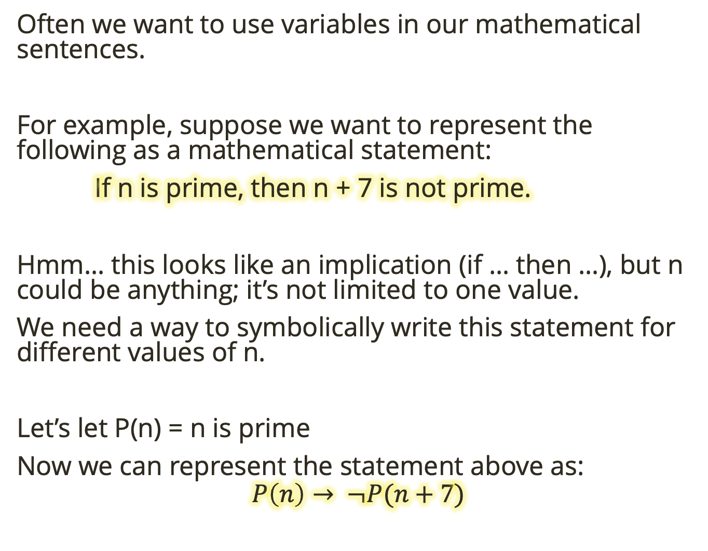
Variables and Statements
Often we want to use variables in our mathematical sentences.
For example, suppose we want to represent the following as a mathematical statement:
If n is prime, then n + 7 is not prime.
Hmm… this looks like an implication (if … then …), but n could be anything; it’s not limited to one value.
We need a way to symbolically write this statement for different values of n.
Let’s let P(n) = n is prime
Now we can represent the statement above as:
$$P\left(n\right)→ ¬P(n+7)$$

Slide 21
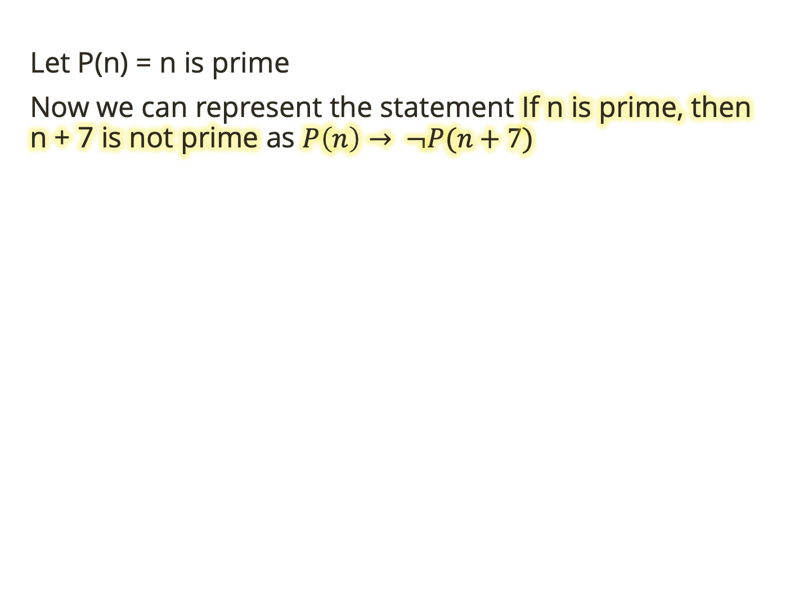
Variables and Statements
Let P(n) = n is prime
Now we can represent the statement If n is prime, then n + 7 is not prime as $P\left(n\right)→ ¬P(n+7)$

Slide 22
Variables and Statements
Let P(n) = n is prime
Now we can represent the statement If n is prime, then n + 7 is not prime as $P\left(n\right)→ ¬P(n+7)$
Practice: Write the sentence “Primes greater than 2 are odd” symbolically.

Slide 23
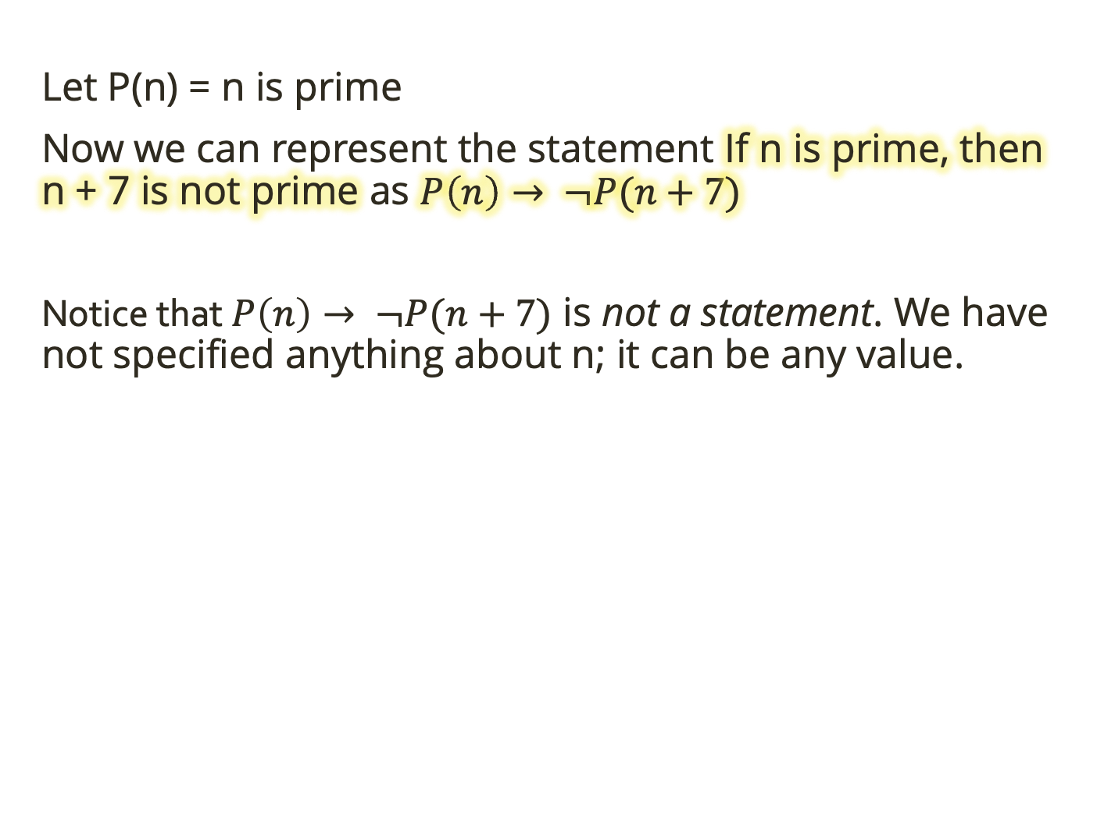
Variables and Statements
Let P(n) = n is prime
Now we can represent the statement If n is prime, then n + 7 is not prime as $P\left(n\right)→ ¬P(n+7)$
Notice that $P\left(n\right)→ ¬P(n+7)$ is not a statement. We have not specified anything about n; it can be any value.

Slide 24
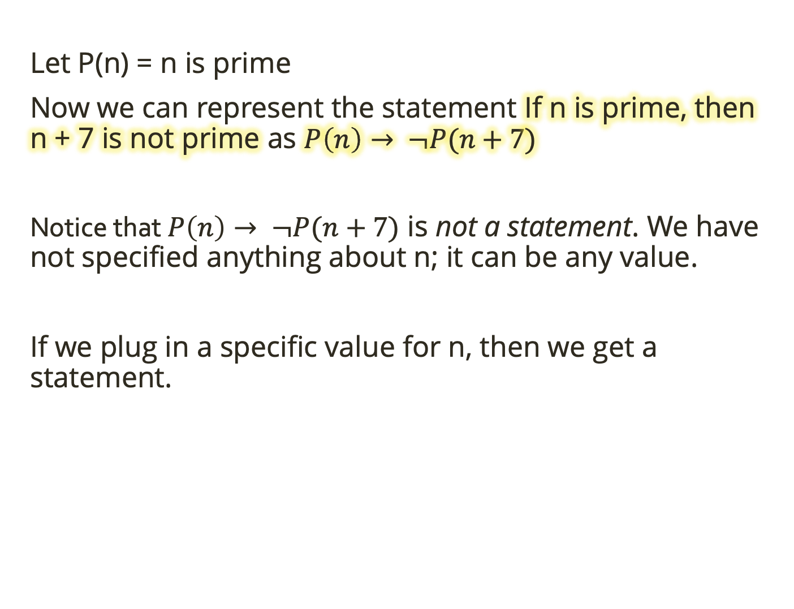
Variables and Statements
Let P(n) = n is prime
Now we can represent the statement If n is prime, then n + 7 is not prime as $P\left(n\right)→ ¬P(n+7)$
Notice that $P\left(n\right)→ ¬P(n+7)$ is not a statement. We have not specified anything about n; it can be any value.
If we plug in a specific value for n, then we get a statement.

Slide 25

Variables and Statements
Let P(n) = n is prime
Now we can represent the statement If n is prime, then n + 7 is not prime as $P\left(n\right)→ ¬P(n+7)$
Notice that $P\left(n\right)→ ¬P(n+7)$ is not a statement. We have not specified anything about n; it can be any value.
If we plug in a specific value for n, then we get a statement.
A sentence that contains variables is called a predicate.

Slide 26
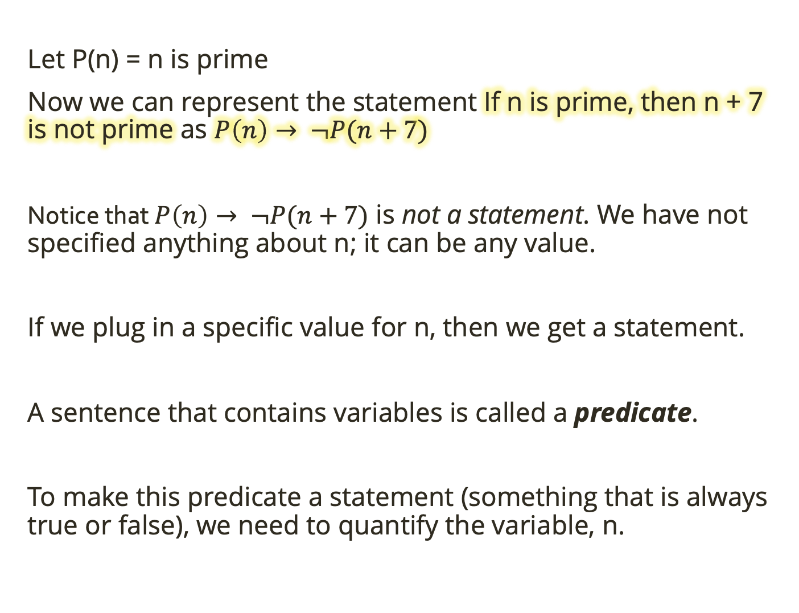
Variables and Statements
Let P(n) = n is prime
Now we can represent the statement If n is prime, then n + 7 is not prime as $P\left(n\right)→ ¬P(n+7)$
Notice that $P\left(n\right)→ ¬P(n+7)$ is not a statement. We have not specified anything about n; it can be any value.
If we plug in a specific value for n, then we get a statement.
A sentence that contains variables is called a predicate.
To make this predicate a statement (something that is always true or false), we need to quantify the variable, n.

Slide 27
Quantifiers
In mathematics we use two quantifiers: existential and universal.

Slide 28
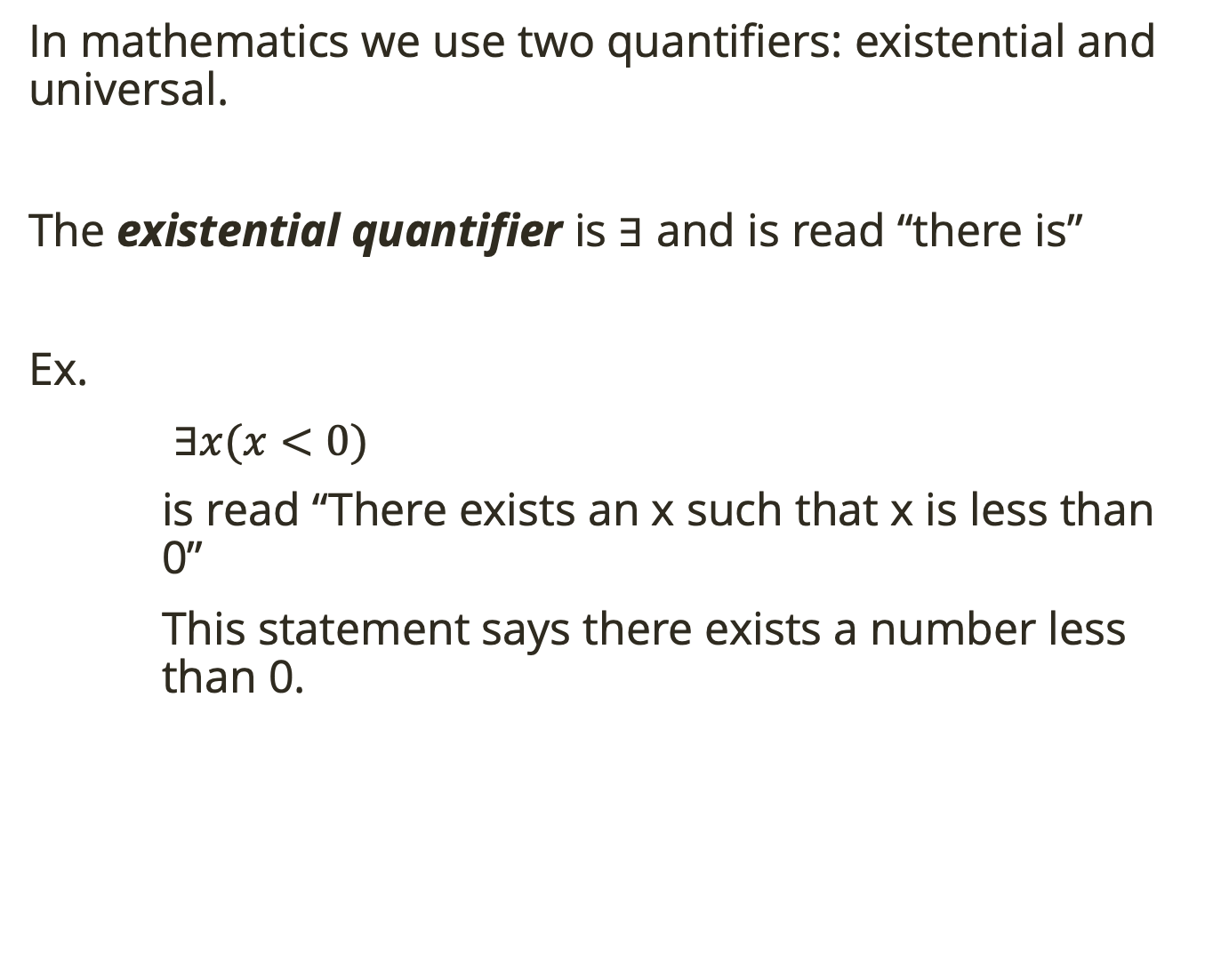
Quantifiers
In mathematics we use two quantifiers: existential and universal.
The existential quantifier is $∃$ and is read “there is”
Ex.
$∃x(x<0)$
is read “There exists an x such that x is less than 0”
This statement says there exists a number less than 0.

Slide 29
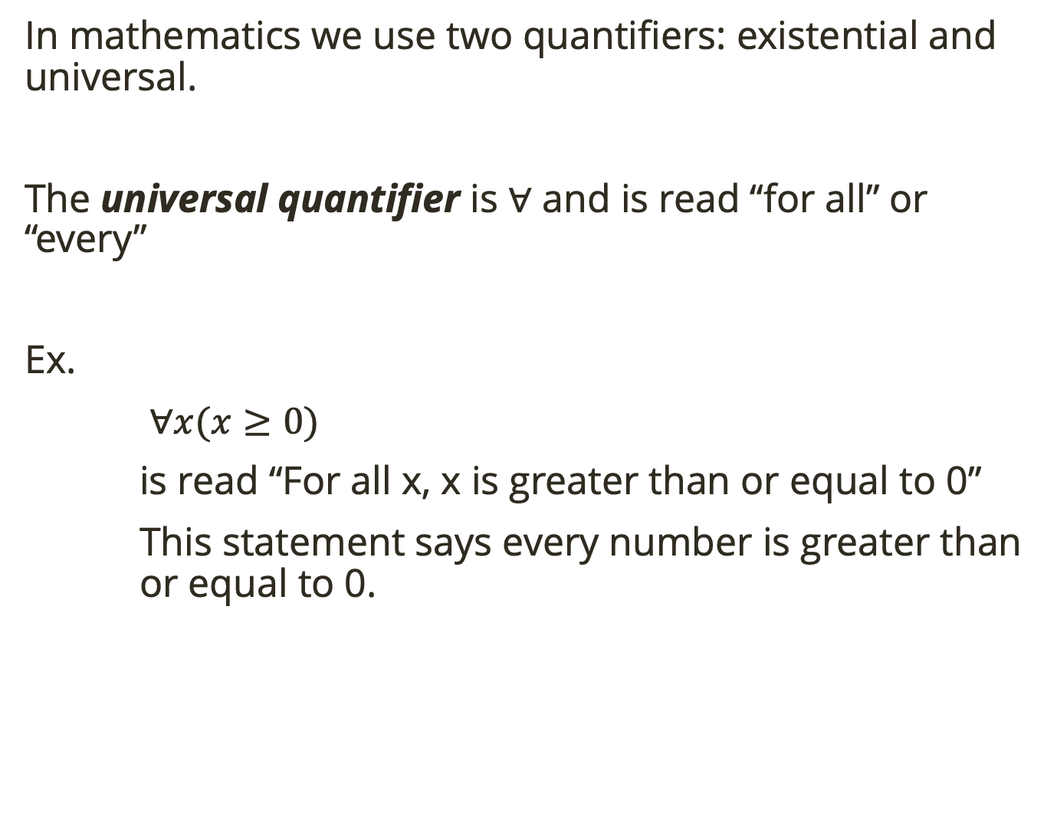
Quantifiers
In mathematics we use two quantifiers: existential and universal.
The universal quantifier is $∀$ and is read “for all” or “every”
Ex.
$∀x(x≥0)$
is read “For all x, x is greater than or equal to 0”
This statement says every number is greater than or equal to 0.

Slide 30

Quantifiers
The existential quantifier is $∃$ and is read “there is”
The universal quantifier is $∀$ and is read “for all” or “every”
Practice: Write the sentence “All primes greater than 2 are odd” symbolically.

Slide 31
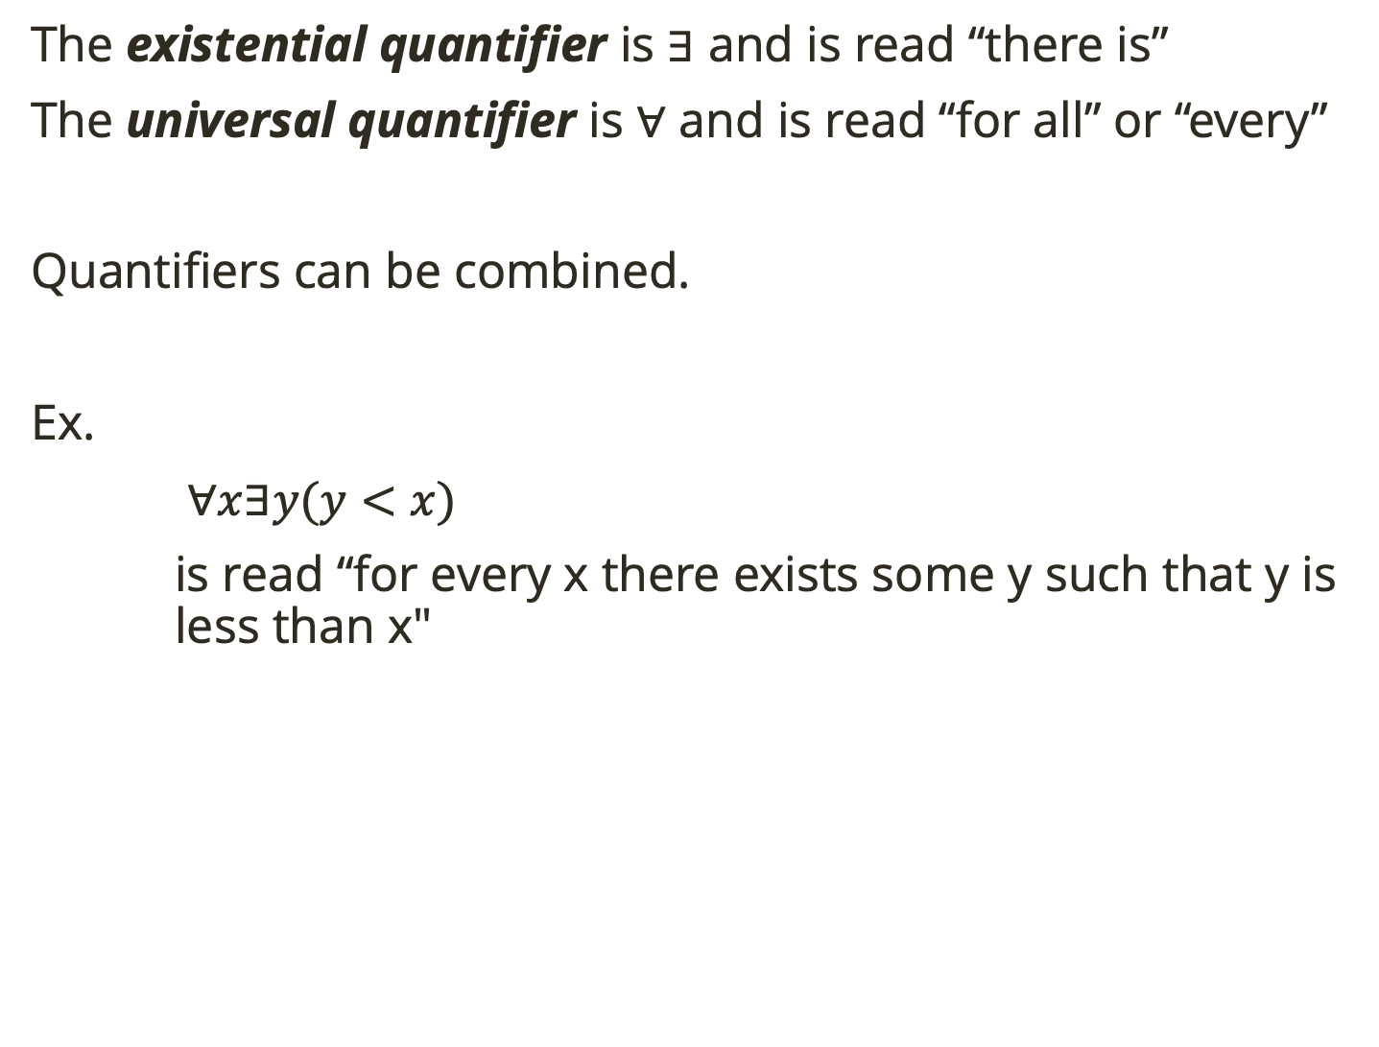
Quantifiers
The existential quantifier is $∃$ and is read “there is”
The universal quantifier is $∀$ and is read “for all” or “every”
Quantifiers can be combined.
Ex.
$∀x∃y(y<x)$
is read “for every x there exists some y such that y is less than x"

Slide 32
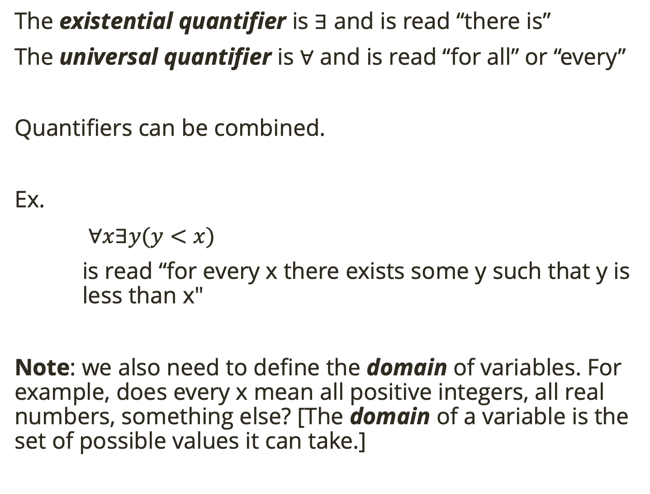
Quantifiers
The existential quantifier is $∃$ and is read “there is”
The universal quantifier is $∀$ and is read “for all” or “every”
Quantifiers can be combined.
Ex.
$∀x∃y(y<x)$
is read “for every x there exists some y such that y is less than x"
Note: we also need to define the domain of variables. For example, does every x mean all positive integers, all real numbers, something else? [The domain of a variable is the set of possible values it can take.]

Slide 33

Quantifiers
The existential quantifier is $∃$ and is read “there is”
The universal quantifier is $∀$ and is read “for all” or “every”
Quantifiers can be combined.
Ex.
$∀x∃y(y<x)$
is read “for every x there exists some y such that y is less than x"
Note: we also need to define the domain of variables. For example, does every x mean all positive integers, all real numbers, something else? [The domain of a variable is the set of possible values it can take.]
Practice: Once we have defined the domain and quantified variables in a predicate, we have a statement!
Consider this statement: $∀x∃y(y<x)$
Let the domain of x, y be the natural numbers (0, 1, 2, …)
What is the truth value of the statement?

Slide 34

Quantifiers
The existential quantifier is $∃$ and is read “there is”
The universal quantifier is $∀$ and is read “for all” or “every”
Quantifiers can be combined.
Ex.
$∀x∃y(y<x)$
is read “for every x there exists some y such that y is less than x"
Note: we also need to define the domain of variables. For example, does every x mean all positive integers, all real numbers, something else? [The domain of a variable is the set of possible values it can take.]
Practice: Once we have defined the domain and quantified variables in a predicate, we have a statement!
Consider this statement: $∃x∀y(y≥x)$
Let the domain of x, y be the natural numbers (0, 1, 2, …)
What is this statement in English?
What is the truth value of the statement?

Slide 35
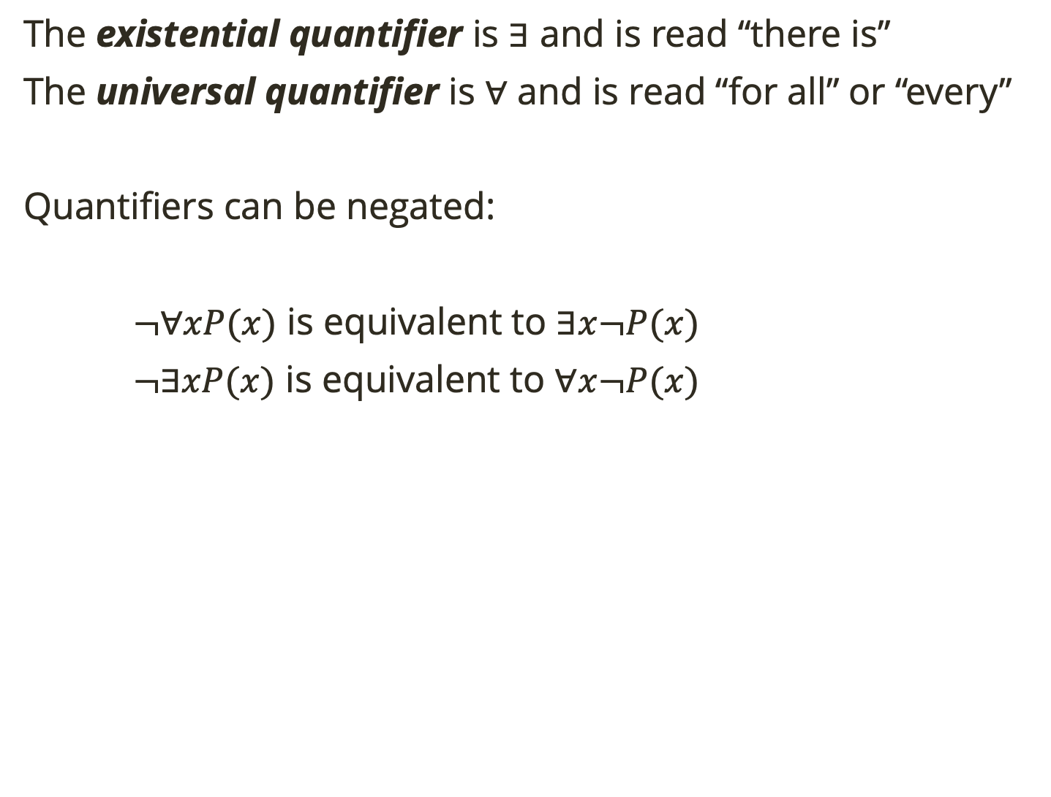
Negation of Quantifiers
The existential quantifier is $∃$ and is read “there is”
The universal quantifier is $∀$ and is read “for all” or “every”
Quantifiers can be negated:
$¬∀xP(x)$ is equivalent to $∃x¬P(x)$
$¬∃xP(x)$ is equivalent to $∀x¬P(x)$
Notes:
f not everything has a property, then something doesn't have that property. And if there is not something with a property, then everything doesn't have that property.

Slide 36
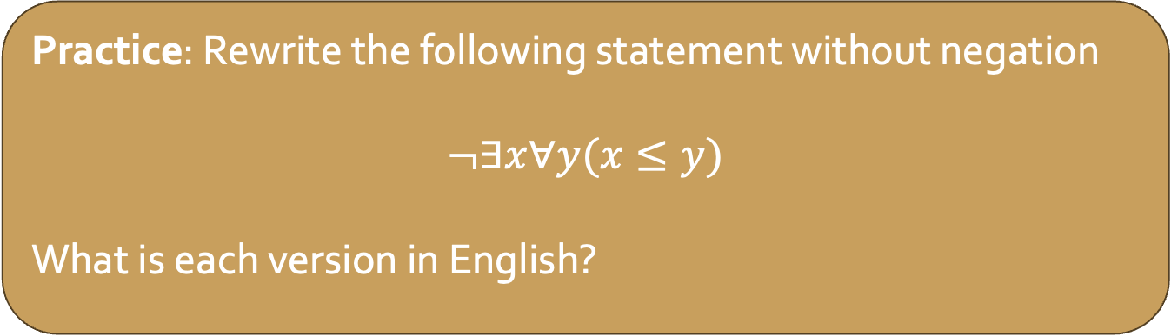
Negation of Quantifiers
The existential quantifier is $∃$ and is read “there is”
The universal quantifier is $∀$ and is read “for all” or “every”
Quantifiers can be negated:
$¬∀xP(x)$ is equivalent to $∃x¬P(x)$
$¬∃xP(x)$ is equivalent to $∀x¬P(x)$
Practice: Rewrite the following statement without negation
$$¬∃x∀y(x≤y)$$
What is each version in English?
Notes:
for all x there exists a y (y < x)

