Slide 1
Discrete Structures– Proofs: Contradiction and Counter Example
Dr. Ab Mosca (they/them)

Slide 2
Plan for Today
Proof by contradiction
Proof by counter example

Slide 3
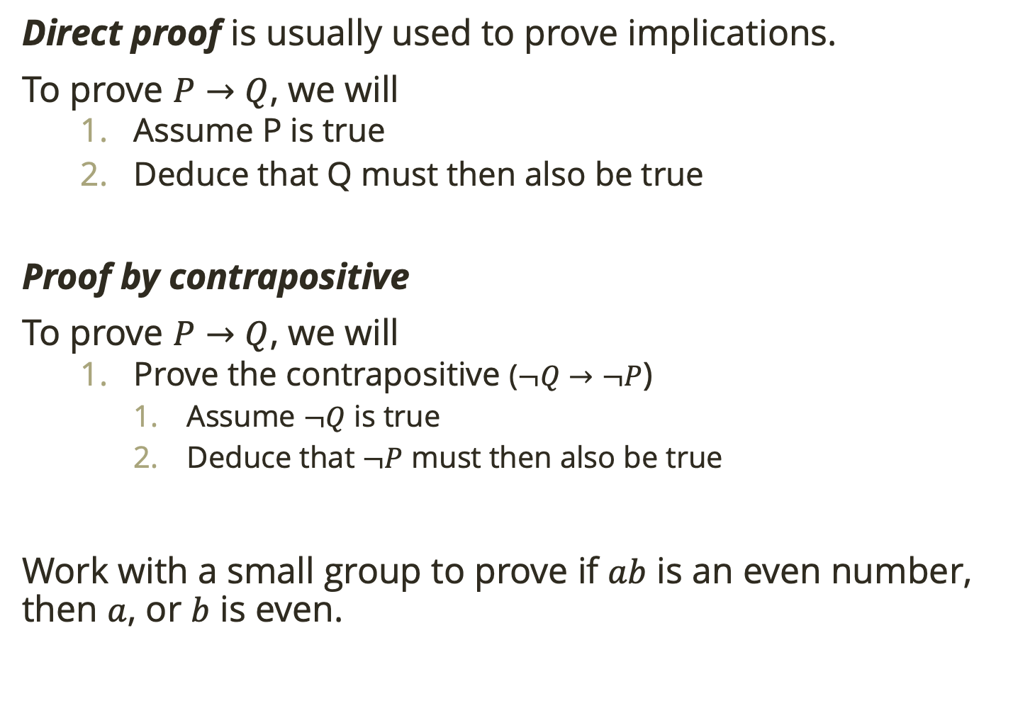
Warm Up
Direct proof is usually used to prove implications.
To prove $P→Q$, we will
Assume P is true
Deduce that Q must then also be true
Proof by contrapositive
To prove $P→Q$, we will
Prove the contrapositive ($¬Q→¬P$)
Assume $¬Q$ is true
Deduce that $¬P$ must then also be true
Work with a small group to prove if $ab$ is an even number, then $a$, or $b$ is even.
Notes:
let ab = 2n, and a be an odd number, a = 2k + 1
2n = (2k+1)*b
2n = 2kb + b
2n – 2kb = b
2(n-kb) = b, therefore b is an even integer.

Slide 4

Proof by Contradiction
Consider the implication $¬P→Q$
If this implication is true, and $Q$ is false, what does that tell us about $¬P$?

Slide 5

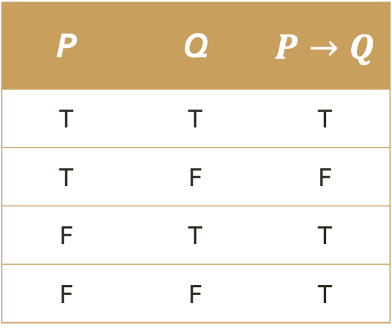
Proof by Contradiction
Consider the implication $¬P→Q$
If this implication is true, and $Q$ is false, what does that tell us about $¬P$?
It tells us that $¬P$ must be false!
P | Q | $P→Q$
T | T | T
T | F | F
F | T | T
F | F | T

Slide 6
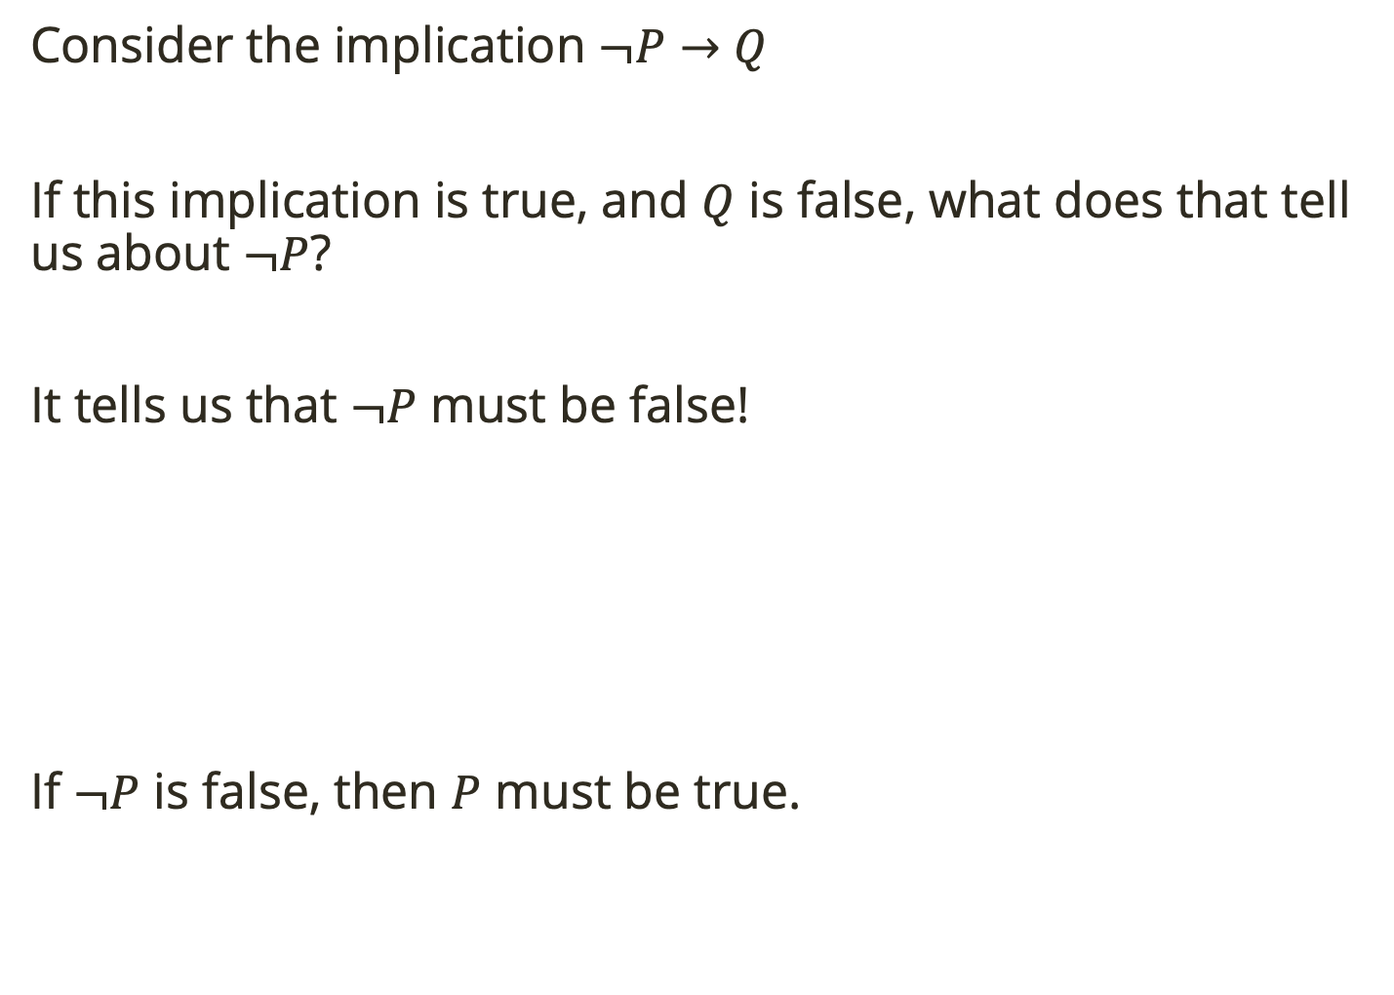
Proof by Contradiction
Consider the implication $¬P→Q$
If this implication is true, and $Q$ is false, what does that tell us about $¬P$?
It tells us that $¬P$ must be false!
If $¬P$ is false, then $P$ must be true.
P | Q | $P→Q$
T | T | T
T | F | F
F | T | T
F | F | T

Slide 7
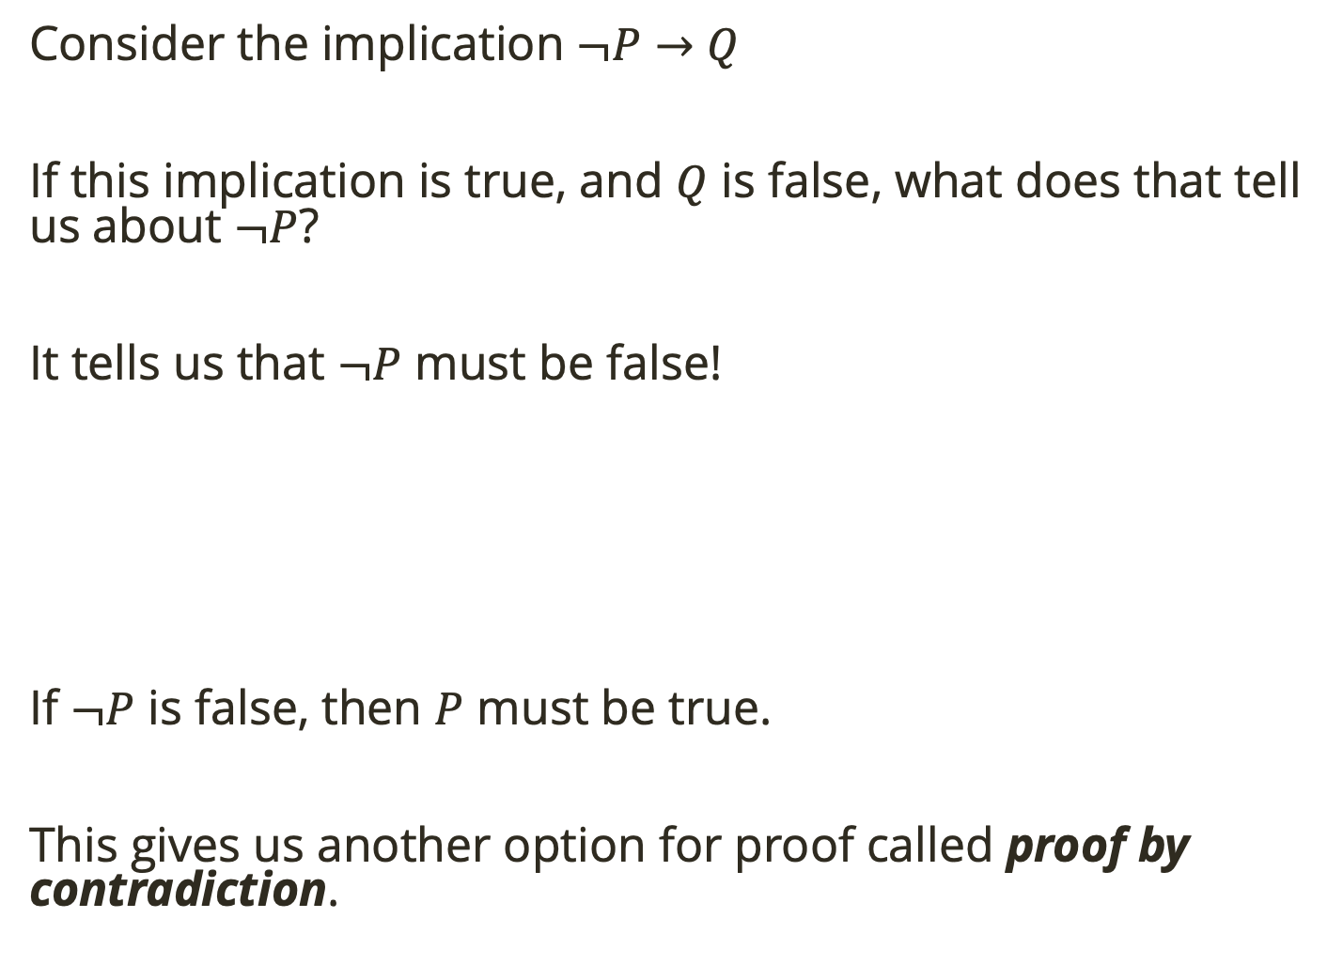
Proof by Contradiction
Consider the implication $¬P→Q$
If this implication is true, and $Q$ is false, what does that tell us about $¬P$?
It tells us that $¬P$ must be false!
If $¬P$ is false, then $P$ must be true.
This gives us another option for proof called proof by contradiction.
P | Q | $P→Q$
T | T | T
T | F | F
F | T | T
F | F | T

Slide 8

Proof by Contradiction
To perform a proof by contradiction (on P):
Assume $¬P$ is true
Show that this assumption leads to a contradiction
As a result, the only conclusion is that $P$ is true
(i.e. if it impossible for $P$ to be false, we know it must be true)

Slide 9

Proof by Contradiction
Proof: We will show that $\sqrt{2}$ is irrational using proof by contradiction.

Slide 10

Proof by Contradiction
Proof: We will show that $\sqrt{2}$ is irrational using proof by contradiction.
Assume $\sqrt{2}$ is rational. This means that we can write it as a fraction, $\frac{a}{b}$, where $a$ and $b$ are integers. We will assume $\frac{a}{b}$ is in lowest terms.

Slide 11

Proof by Contradiction
Proof: We will show that $\sqrt{2}$ is irrational using proof by contradiction.
Assume $\sqrt{2}$ is rational. This means that we can write it as a fraction, $\frac{a}{b}$, where $a$ and $b$ are integers. We will assume $\frac{a}{b}$ is in lowest terms.
Now consider ${\left(\sqrt{2}\right)}^{2}={\left(\frac{a}{b}\right)}^{2}$

Slide 12
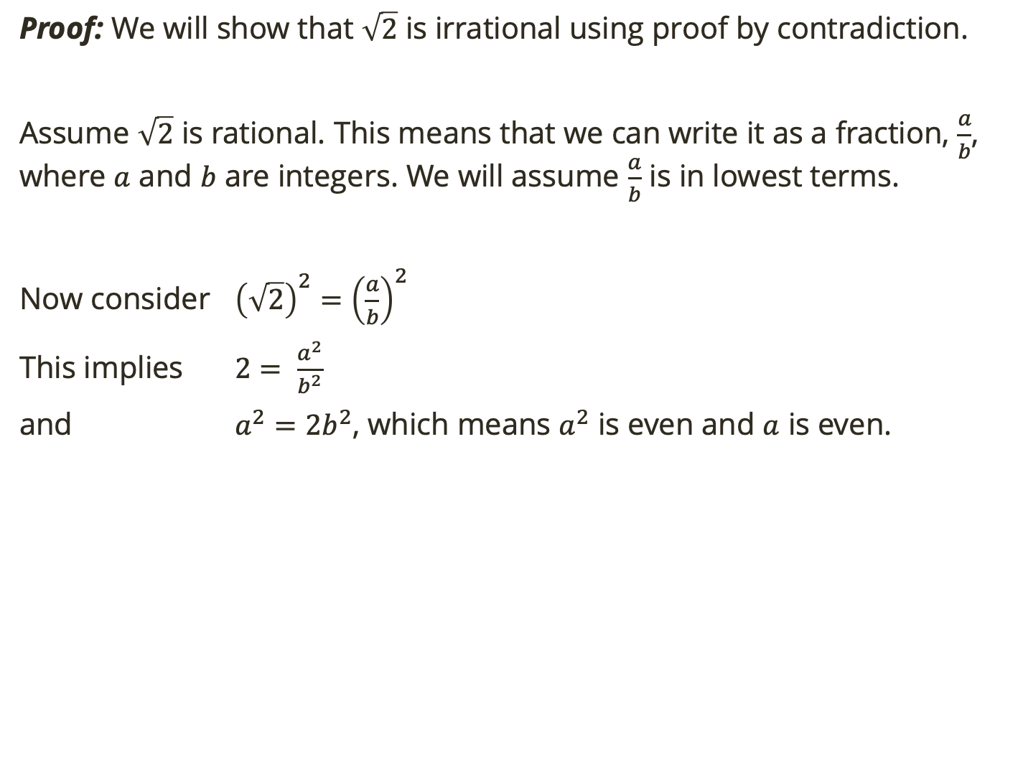
Proof by Contradiction
Proof: We will show that $\sqrt{2}$ is irrational using proof by contradiction.
Assume $\sqrt{2}$ is rational. This means that we can write it as a fraction, $\frac{a}{b}$, where $a$ and $b$ are integers. We will assume $\frac{a}{b}$ is in lowest terms.
Now consider ${\left(\sqrt{2}\right)}^{2}={\left(\frac{a}{b}\right)}^{2}$
This implies $2= \frac{a^{2}}{b^{2}}$
and $a^{2}=2b^{2}$, which means $a^{2}$ is even and $a$ is even.

Slide 13
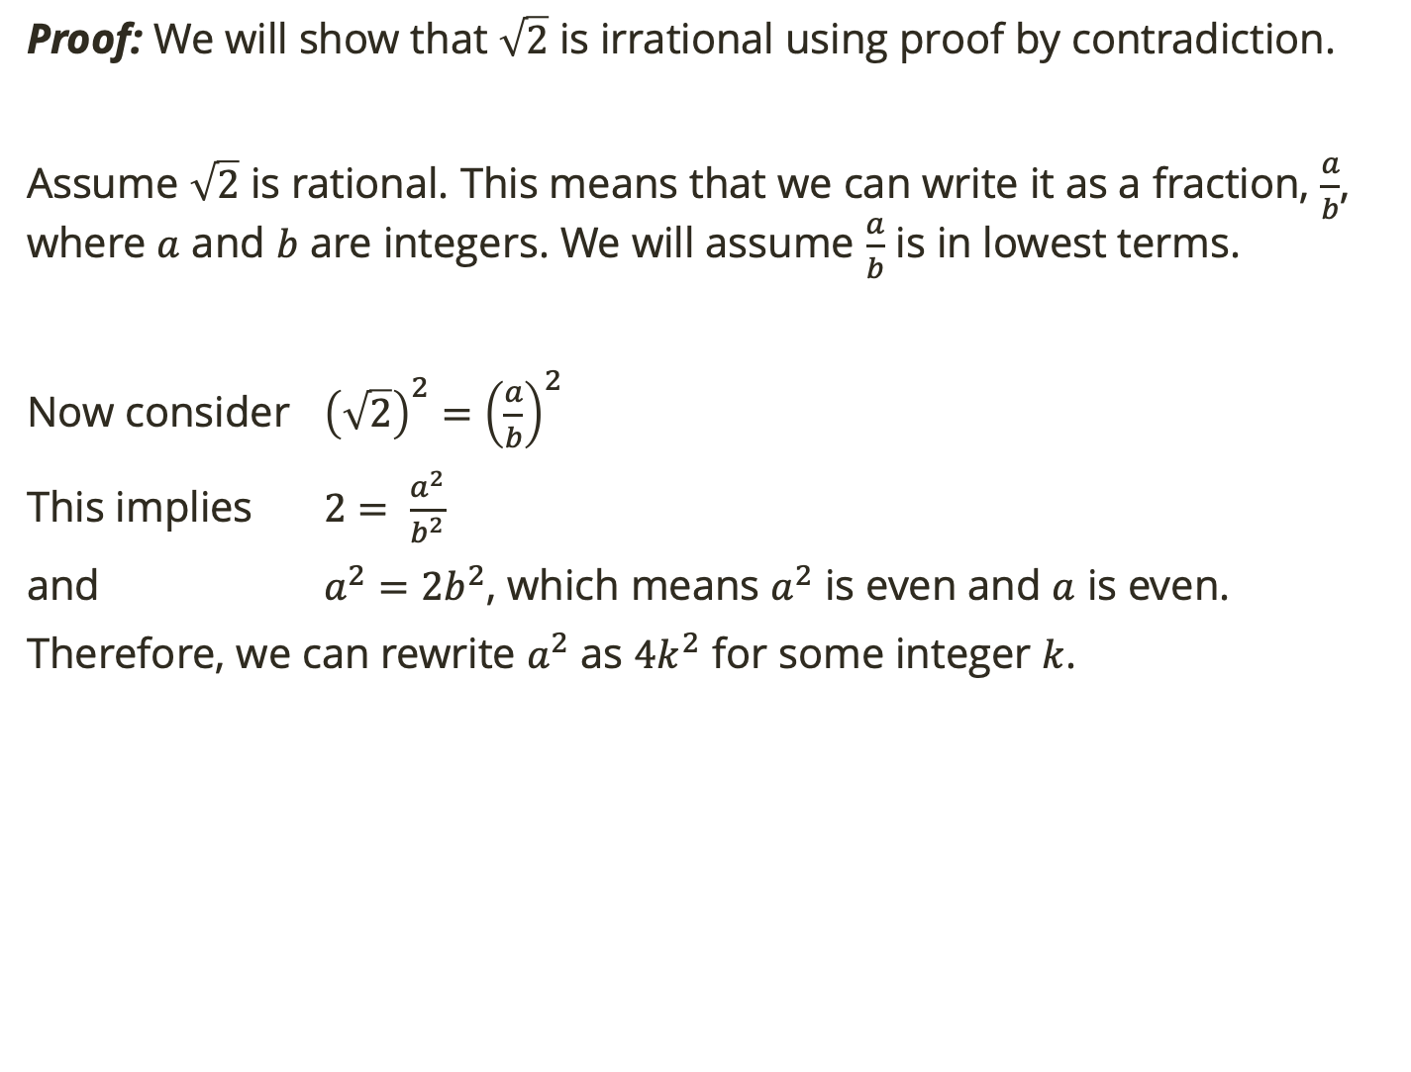
Proof by Contradiction
Proof: We will show that $\sqrt{2}$ is irrational using proof by contradiction.
Assume $\sqrt{2}$ is rational. This means that we can write it as a fraction, $\frac{a}{b}$, where $a$ and $b$ are integers. We will assume $\frac{a}{b}$ is in lowest terms.
Now consider ${\left(\sqrt{2}\right)}^{2}={\left(\frac{a}{b}\right)}^{2}$
This implies $2= \frac{a^{2}}{b^{2}}$
and $a^{2}=2b^{2}$, which means $a^{2}$ is even and $a$ is even.
Therefore, we can rewrite $a^{2}$ as $4k^{2}$ for some integer $k$.

Slide 14
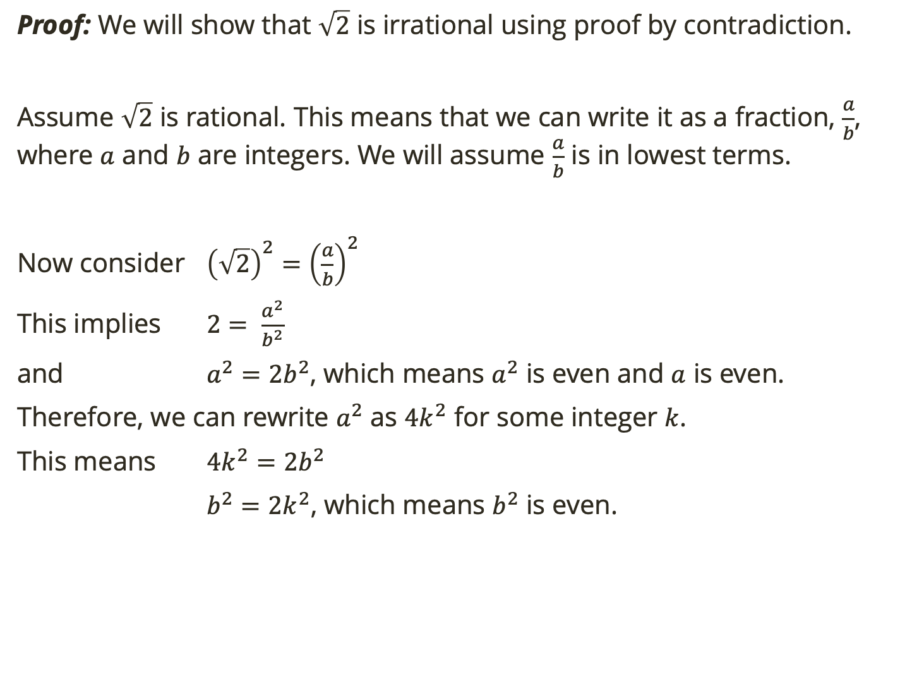
Proof by Contradiction
Proof: We will show that $\sqrt{2}$ is irrational using proof by contradiction.
Assume $\sqrt{2}$ is rational. This means that we can write it as a fraction, $\frac{a}{b}$, where $a$ and $b$ are integers. We will assume $\frac{a}{b}$ is in lowest terms.
Now consider ${\left(\sqrt{2}\right)}^{2}={\left(\frac{a}{b}\right)}^{2}$
This implies $2= \frac{a^{2}}{b^{2}}$
and $a^{2}=2b^{2}$, which means $a^{2}$ is even and $a$ is even.
Therefore, we can rewrite $a^{2}$ as $4k^{2}$ for some integer $k$.
This means $4k^{2}=2b^{2}$
$b^{2}=2k^{2}$, which means $b^{2}$ is even.

Slide 15
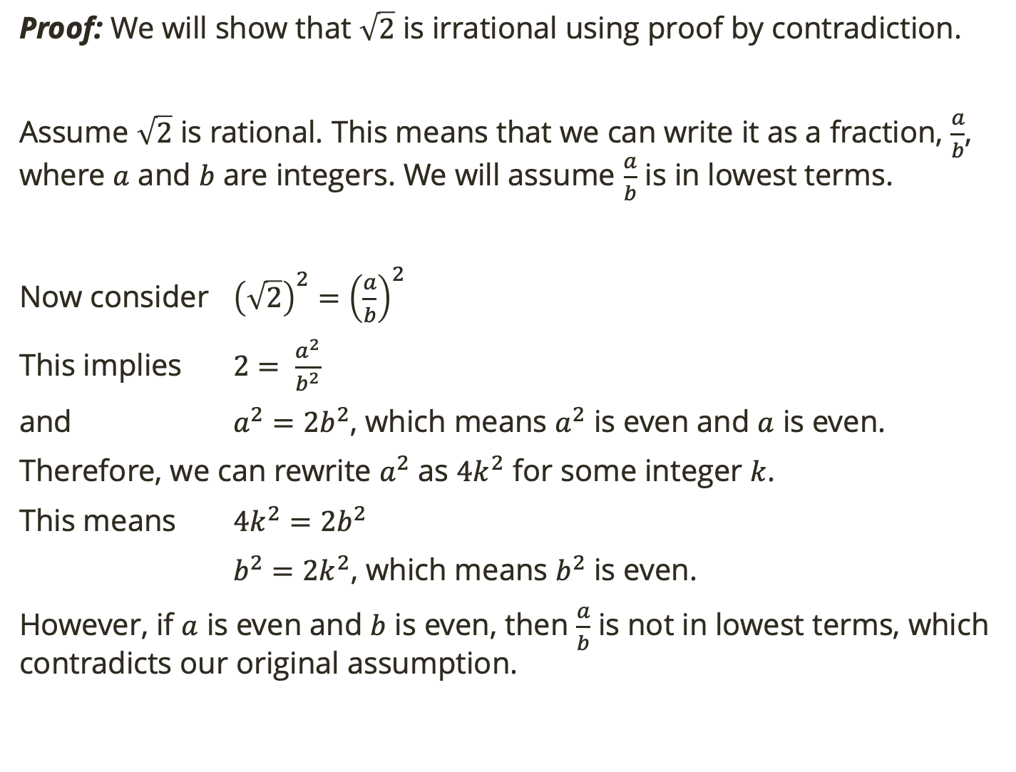
Proof by Contradiction
Proof: We will show that $\sqrt{2}$ is irrational using proof by contradiction.
Assume $\sqrt{2}$ is rational. This means that we can write it as a fraction, $\frac{a}{b}$, where $a$ and $b$ are integers. We will assume $\frac{a}{b}$ is in lowest terms.
Now consider ${\left(\sqrt{2}\right)}^{2}={\left(\frac{a}{b}\right)}^{2}$
This implies $2= \frac{a^{2}}{b^{2}}$
and $a^{2}=2b^{2}$, which means $a^{2}$ is even and $a$ is even.
Therefore, we can rewrite $a^{2}$ as $4k^{2}$ for some integer $k$.
This means $4k^{2}=2b^{2}$
$b^{2}=2k^{2}$, which means $b^{2}$ is even.
However, if $a$ is even and $b$ is even, then $\frac{a}{b}$ is not in lowest terms, which contradicts our original assumption.

Slide 16
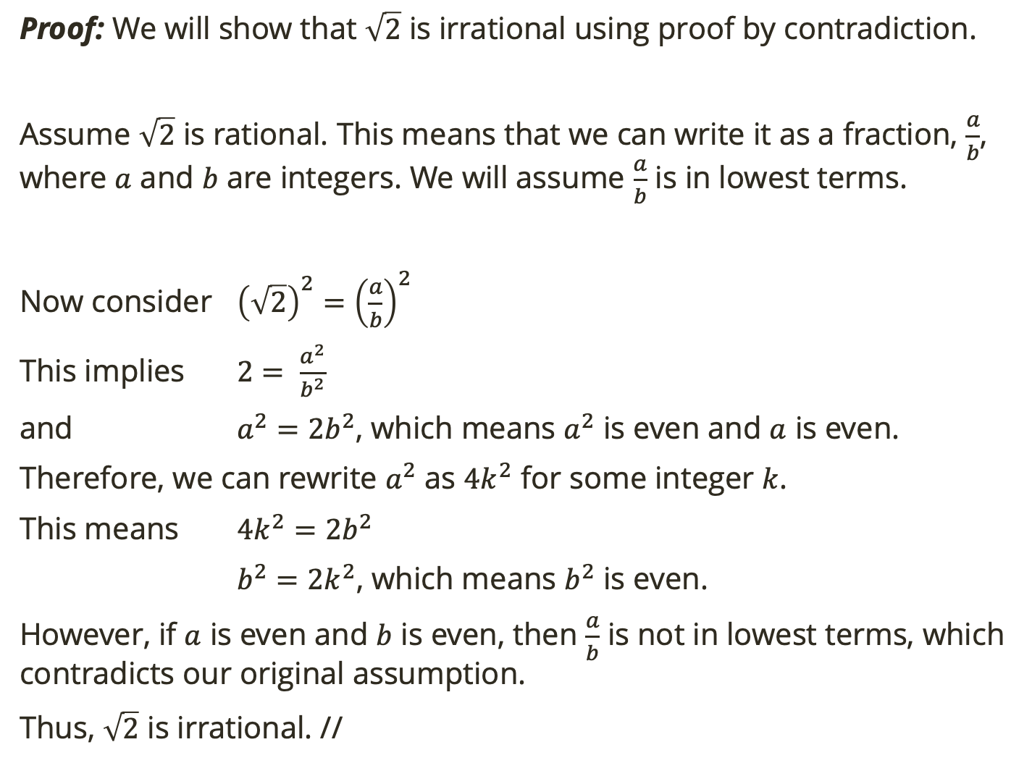
Proof by Contradiction
Proof: We will show that $\sqrt{2}$ is irrational using proof by contradiction.
Assume $\sqrt{2}$ is rational. This means that we can write it as a fraction, $\frac{a}{b}$, where $a$ and $b$ are integers. We will assume $\frac{a}{b}$ is in lowest terms.
Now consider ${\left(\sqrt{2}\right)}^{2}={\left(\frac{a}{b}\right)}^{2}$
This implies $2= \frac{a^{2}}{b^{2}}$
and $a^{2}=2b^{2}$, which means $a^{2}$ is even and $a$ is even.
Therefore, we can rewrite $a^{2}$ as $4k^{2}$ for some integer $k$.
This means $4k^{2}=2b^{2}$
$b^{2}=2k^{2}$, which means $b^{2}$ is even.
However, if $a$ is even and $b$ is even, then $\frac{a}{b}$ is not in lowest terms, which contradicts our original assumption.
Thus, $\sqrt{2}$ is irrational. //

Slide 17
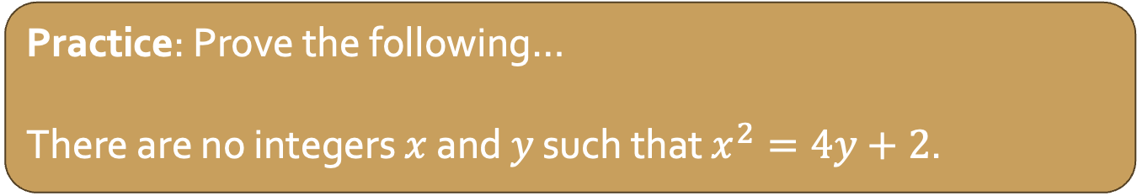
Proof by Contradiction
To perform a proof by contradiction (on P):
Assume $¬P$ is true
Show that this assumption leads to a contradiction
As a result, the only conclusion is that $P$ is true
(i.e. if it impossible for $P$ to be false, we know it must be true)
Practice: Prove the following…
There are no integers $x$ and $y$ such that $x^{2}=4y+2$.

Slide 18
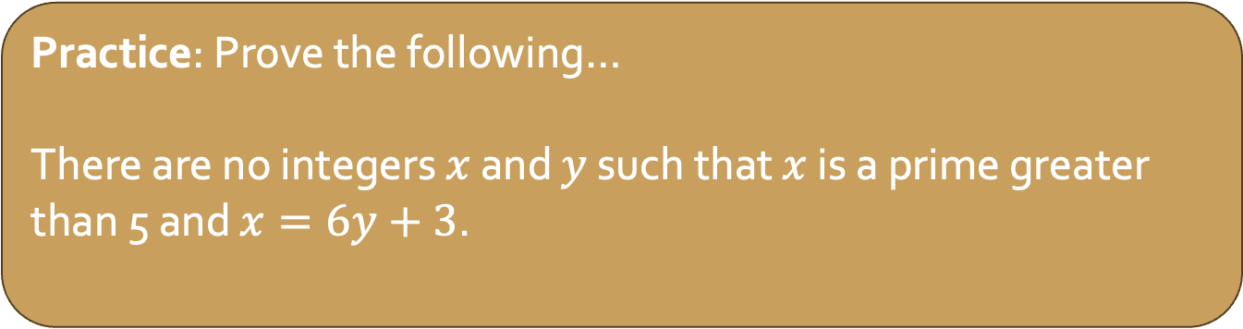
Proof by Contradiction
To perform a proof by contradiction (on P):
Assume $¬P$ is true
Show that this assumption leads to a contradiction
As a result, the only conclusion is that $P$ is true
(i.e. if it impossible for $P$ to be false, we know it must be true)
Practice: Prove the following…
There are no integers $x$ and $y$ such that $x$ is a prime greater than 5 and $x=6y+3$.
Notes:
Start of proof: Assume, for the sake of contradiction, that there are integers � and � such that � is a prime greater than 5 and .�=6�+3. End of proof: … this is a contradiction, so there are no such integers.

Slide 19

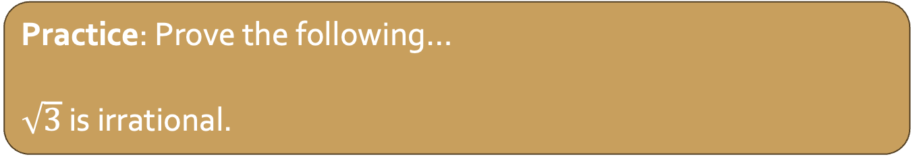
Proof by Contradiction
To perform a proof by contradiction (on P):
Assume $¬P$ is true
Show that this assumption leads to a contradiction
As a result, the only conclusion is that $P$ is true
(i.e. if it impossible for $P$ to be false, we know it must be true)
Practice: Prove the following…
$\sqrt{3}$ is irrational.

Slide 20
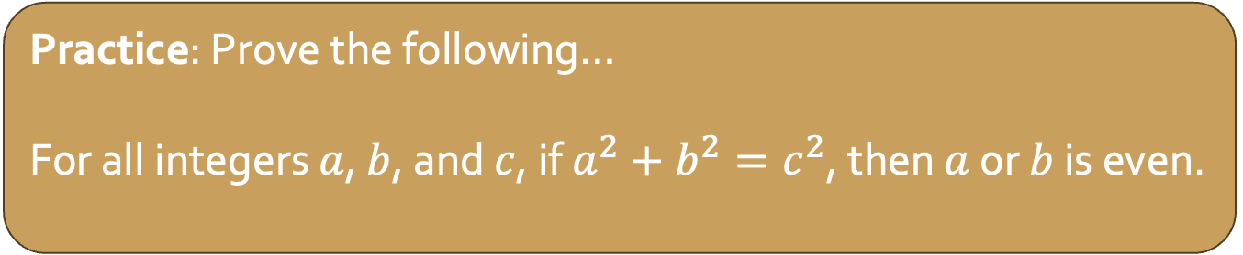
Proof by Contradiction
To perform a proof by contradiction (on P):
Assume $¬P$ is true
Show that this assumption leads to a contradiction
As a result, the only conclusion is that $P$ is true
(i.e. if it impossible for $P$ to be false, we know it must be true)
Practice: Prove the following…
For all integers $a$, $b$, and $c$, if $a^{2}+b^{2}=c^{2}$, then $a$ or $b$ is even.
Notes:
A proof by contradiction would be reasonable here, because then you get to assume that both � and � are odd. Deduce that �2 is even, and therefore a multiple of 4 (why? and why is that a contradiction?).

Slide 21
Start here on Tuesday

Slide 22
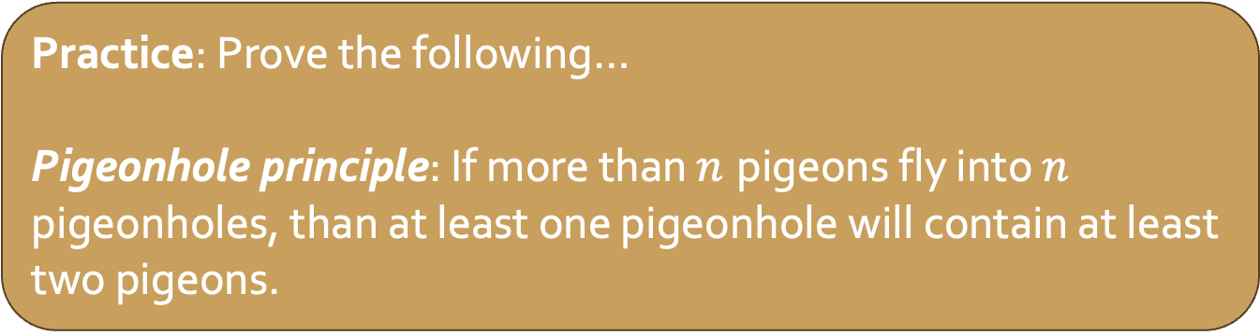
Proof by Contradiction
To perform a proof by contradiction (on P):
Assume $¬P$ is true
Show that this assumption leads to a contradiction
As a result, the only conclusion is that $P$ is true
(i.e. if it impossible for $P$ to be false, we know it must be true)
Practice: Prove the following…
Pigeonhole principle: If more than $n$ pigeons fly into $n$ pigeonholes, than at least one pigeonhole will contain at least two pigeons.
Notes:
Suppose, contrary to stipulation, that each of the pigeon holes contain at most one pigeon. Then at most, there will be � pigeons. But we assumed that there are more than � pigeons, so this is impossible. Thus there must be a pigeonhole with more than one pigeon.

Slide 23

Pigeonhole Principle
If more than $n$ pigeons fly into $n$ pigeonholes, than at least one pigeonhole will contain at least two pigeons.
This principle comes up often in proofs. Now that you’ve proven it, you can use it as justification in other proofs.

Slide 24
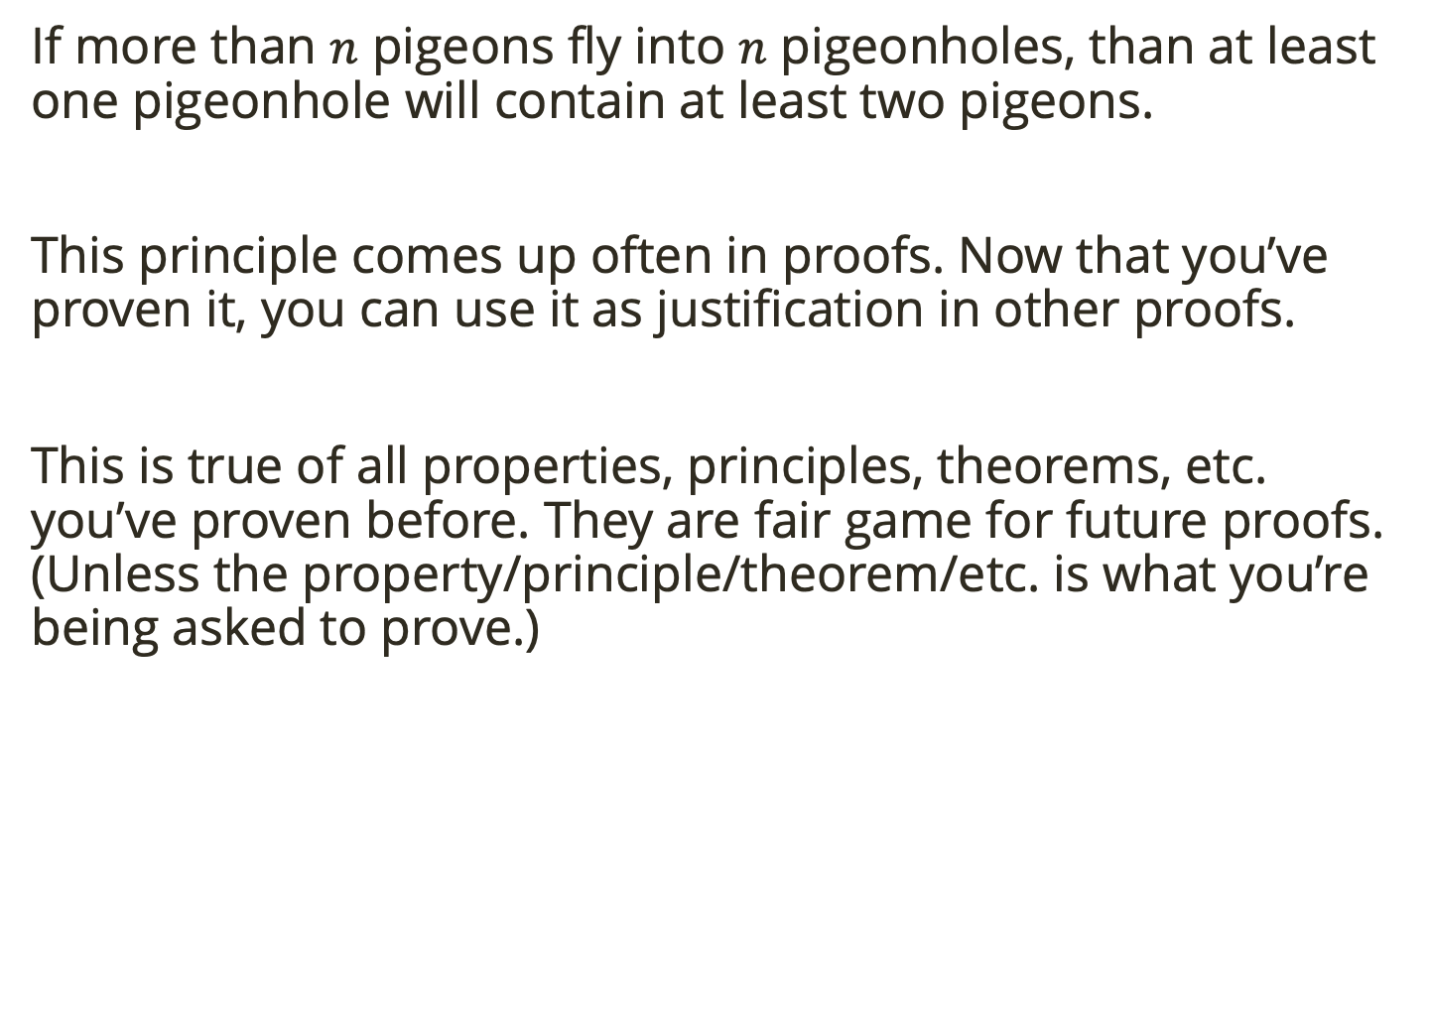
Pigeonhole Principle
If more than $n$ pigeons fly into $n$ pigeonholes, than at least one pigeonhole will contain at least two pigeons.
This principle comes up often in proofs. Now that you’ve proven it, you can use it as justification in other proofs.
This is true of all properties, principles, theorems, etc. you’ve proven before. They are fair game for future proofs. (Unless the property/principle/theorem/etc. is what you’re being asked to prove.)

Slide 25
Proof by Counter Example
Proof by counter example is a useful method for showing something is false.

Slide 26

Proof by Counter Example
Proof by counter example is a useful method for showing something is false.
You CANNOT show a statement of the form $∀x P(x)$ is true with only one example.

Slide 27
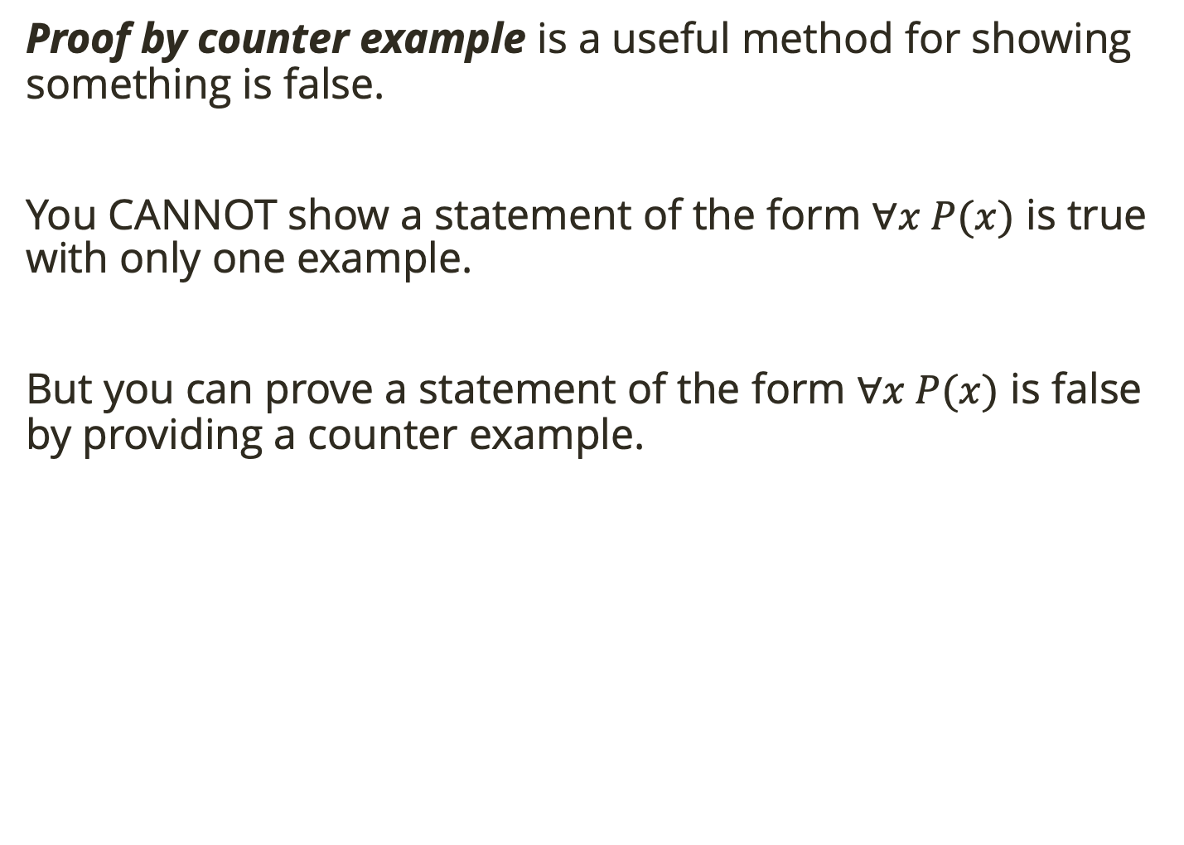
Proof by Counter Example
Proof by counter example is a useful method for showing something is false.
You CANNOT show a statement of the form $∀x P(x)$ is true with only one example.
But you can prove a statement of the form $∀x P(x)$ is false by providing a counter example.

Slide 28
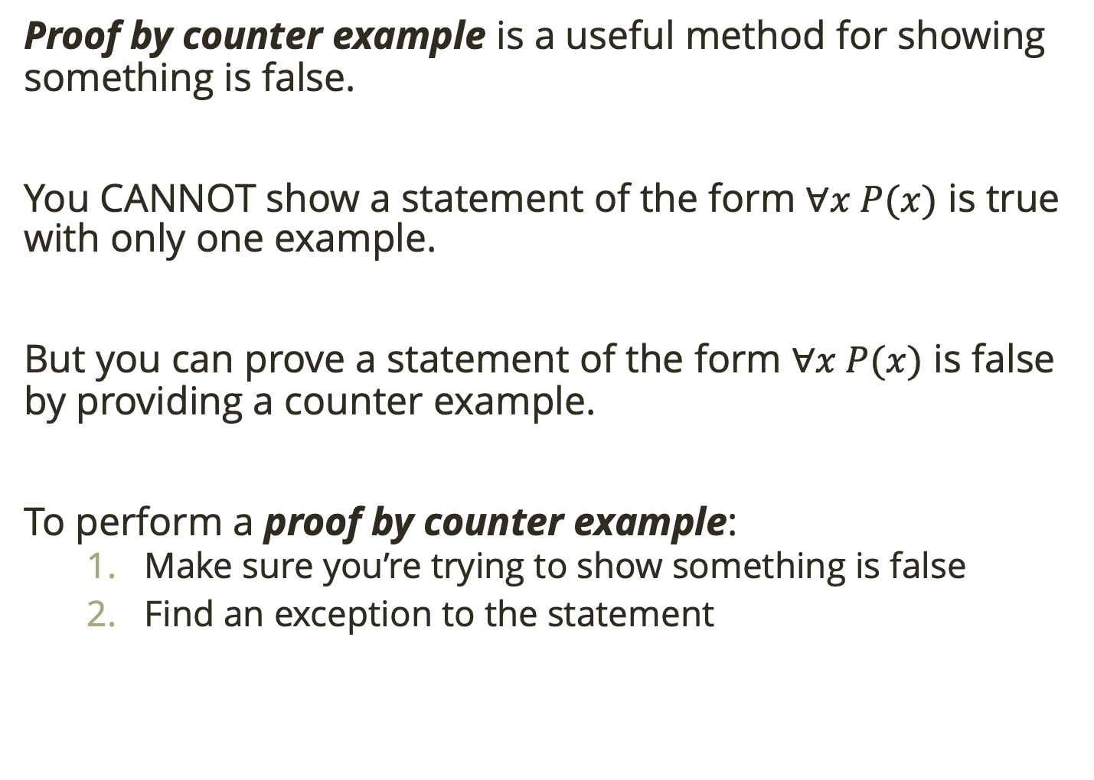
Proof by Counter Example
Proof by counter example is a useful method for showing something is false.
You CANNOT show a statement of the form $∀x P(x)$ is true with only one example.
But you can prove a statement of the form $∀x P(x)$ is false by providing a counter example.
To perform a proof by counter example:
Make sure you’re trying to show something is false
Find an exception to the statement

Slide 29
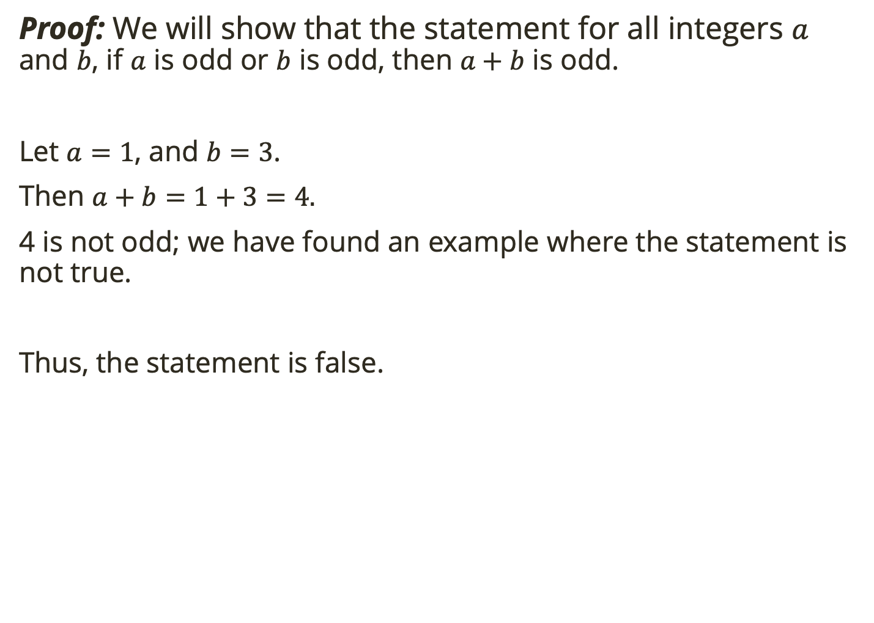
Proof by Counter Example
Proof: We will show that the statement for all integers $a$ and $b$, if $a$ is odd or $b$ is odd, then $a+b$ is odd.
Let $a=1$, and $b=3$.
Then $a+b=1+3=4.$
4 is not odd; we have found an example where the statement is not true.
Thus, the statement is false.

Slide 30
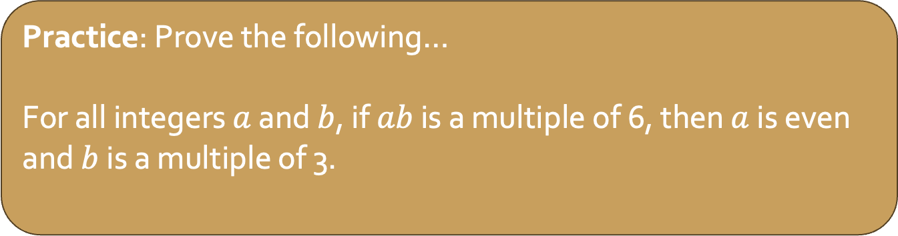
Proof by Counter Example
To perform a proof by counter example:
Make sure you’re trying to show something is false
Find an exception to the statement
Practice: Prove the following…
For all integers $a$ and $b$, if $ab$ is a multiple of 6, then $a$ is even and $b$ is a multiple of 3.

Slide 31

Notes about proofs
Sometimes you will need to break a proof into cases.
For example, if you were to prove this:
For any integer $n$, the number $(n^{3}−n)$ is even.
You might look at a case where $n$ is even and a care where $n$ is odd.

Slide 32
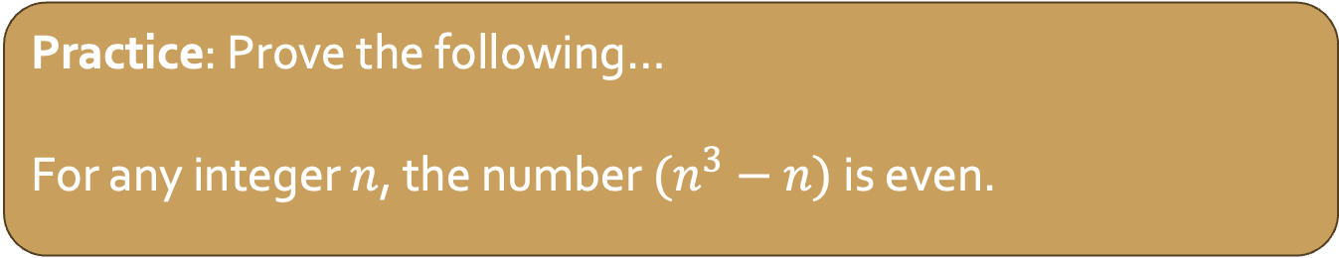
Notes about proofs
Sometimes you will need to break a proof into cases.
For example, if you were to prove this:
For any integer $n$, the number $(n^{3}−n)$ is even.
You might look at a case where $n$ is even and a care where $n$ is odd.
Practice: Prove the following…
For any integer $n$, the number $(n^{3}−n)$ is even.

Slide 33

Notes about proofs
To prove a biconditional, you must prove both implications.
For example, if you were to prove this:
For all integers $n$, it is the case that $n$ is even if and only if $3n$ is even.

Slide 34
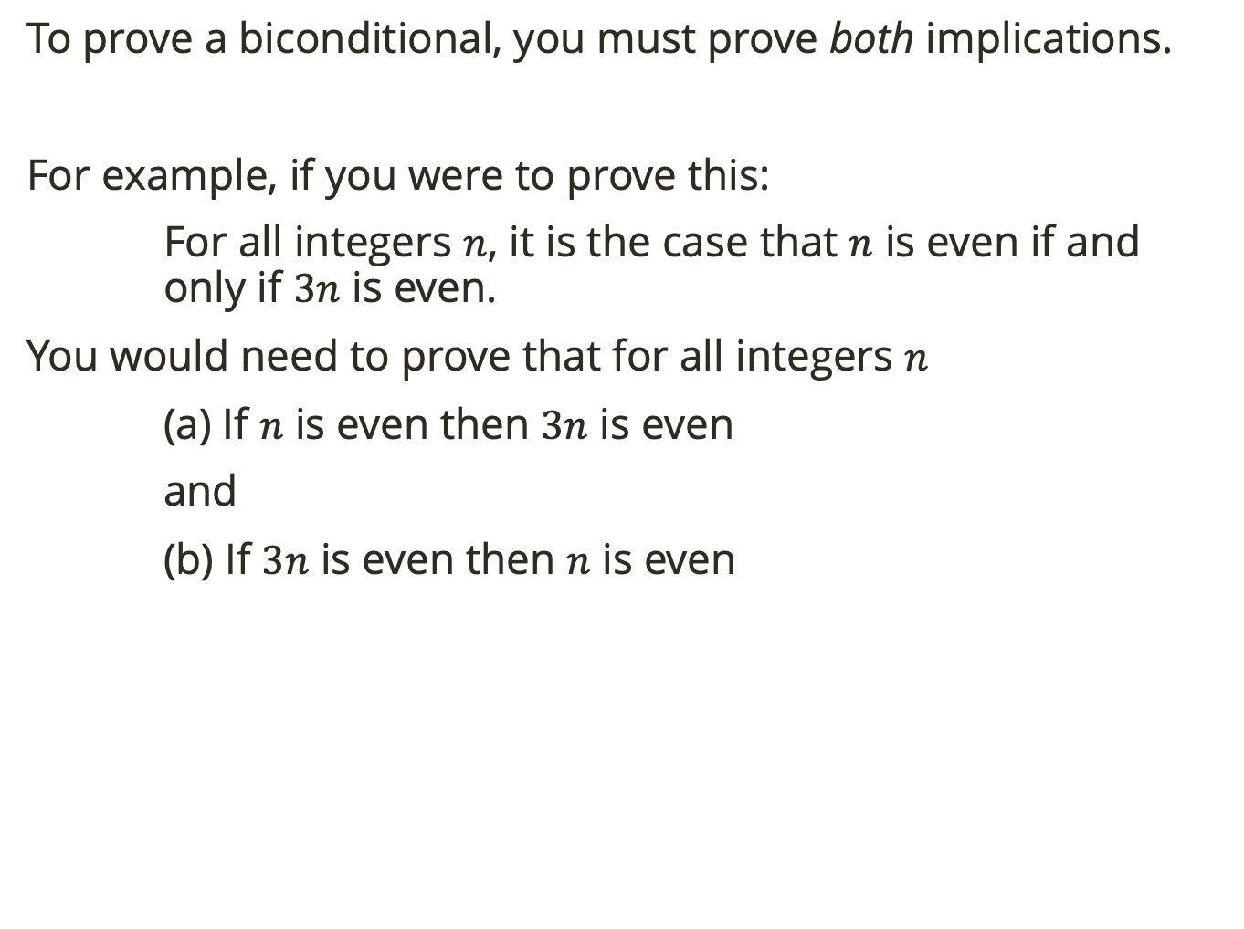
Notes about proofs
To prove a biconditional, you must prove both implications.
For example, if you were to prove this:
For all integers $n$, it is the case that $n$ is even if and only if $3n$ is even.
You would need to prove that for all integers $n$
(a) If $n$ is even then $3n$ is even
and
(b) If $3n$ is even then $n$ is even

Slide 35
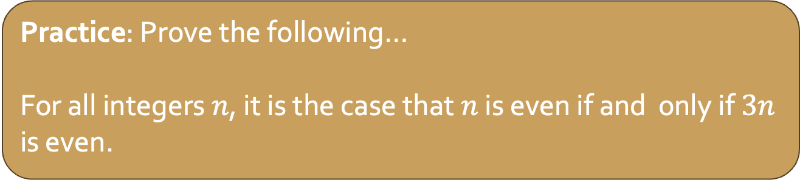
Notes about proofs
To prove a biconditional, you must prove both implications.
For example, if you were to prove this:
For all integers $n$, it is the case that $n$ is even if and only if $3n$ is even.
You would need to prove that for all integers $n$
(a) If $n$ is even then $3n$ is even
and
(b) If $3n$ is even then $n$ is even
Practice: Prove the following…
For all integers $n$, it is the case that $n$ is even if and only if $3n$ is even.

