Slide 1
Discrete Structures– Counting Pt. 2
Dr. Ab Mosca (they/them)

Slide 2
Reminder
It is your responsibility to submit your assignments on Gradescope (and quizzes on PLATO) on time
A lot of people are missing submissions – I will not track you down and I will not accept late assignments

Slide 3
Plan for Today
Counting
Combinations
Permutations

Slide 4
Warm Up: Counting
The additive principle states that if event A can occur in m ways and event B can occur in n disjoint ways, then the event “A or B” can occur in m+n ways.
The multiplicative principle states that if event A can occur in m ways and each possibility for A allows for exactly n ways for event B, then the event “A and B” can occur in m*n ways.
You have a bunch of chips which come in five different colors: blue, black, purple, white, and green.
How many different two-chip stacks can you make if the bottom chip must be blue or black? Explain your answer using both the additive and multiplicative principles.

Slide 5
Warm Up: Counting
The additive principle states that if event A can occur in m ways and event B can occur in n disjoint ways, then the event “A or B” can occur in m+n ways.
The multiplicative principle states that if event A can occur in m ways and each possibility for A allows for exactly n ways for event B, then the event “A and B” can occur in m*n ways.
You have a bunch of chips which come in five different colors: blue, black, purple, white, and green.
How many different three-chip stacks can you make if the bottom chip must be blue or black and the top chip must be purple, white, or green? How does this problem relate to the previous one?

Slide 6
Warm Up: Counting
The additive principle states that if event A can occur in m ways and event B can occur in n disjoint ways, then the event “A or B” can occur in m+n ways.
The multiplicative principle states that if event A can occur in m ways and each possibility for A allows for exactly n ways for event B, then the event “A and B” can occur in m*n ways.
You have a bunch of chips which come in five different colors: blue, black, purple, white, and green.
How many different three-chip stacks are there in which no color is repeated? What about four-chip stacks?

Slide 7
Warm Up: Counting
The additive principle states that if event A can occur in m ways and event B can occur in n disjoint ways, then the event “A or B” can occur in m+n ways.
The multiplicative principle states that if event A can occur in m ways and each possibility for A allows for exactly n ways for event B, then the event “A and B” can occur in m*n ways.
You have a bunch of chips which come in five different colors: blue, black, purple, white, and green.
Suppose you wanted to take three different colored chips and put them in your pocket. How many different choices do you have? What if you wanted four different colored chips? How do these problems relate to the previous one?

Slide 8
Permutations
A permutation is a (possible) rearrangement of objects.
Ex. consider the letters a, b, c
There are 6 permutations of these letters:
abc, acb, bac, bca, cab, cba
3 choices for the 1st letter, 2 for the second, 1 for the third: 3*2*1 = 6

Slide 9
Permutations
A permutation is a (possible) rearrangement of objects.
Ex. consider the letters a, b, c
There are 6 permutations of these letters:
abc, acb, bac, bca, cab, cba
3 choices for the 1st letter, 2 for the second, 1 for the third: 3*2*1 = 6
How many permutations are there of a, b, c, d, e, f?
Do you notice a pattern?

Slide 10

Permutations
A permutation is a (possible) rearrangement of objects.
There are $n!=n∗\left(n−1\right)∗\left(n−2\right)∗…∗2∗1$ permutations of $n$ distinct elements.

Slide 11
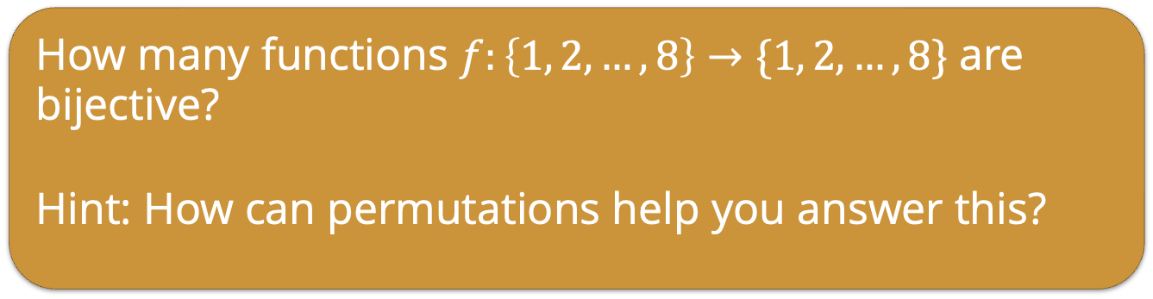
Permutations
A permutation is a (possible) rearrangement of objects.
There are $n!=n∗\left(n−1\right)∗\left(n−2\right)∗…∗2∗1$ permutations of $n$ distinct elements.
How many functions $f:\left\{1, 2, …, 8\right\}→\{1, 2, …, 8\}$ are bijective?
Hint: How can permutations help you answer this?
Notes:
injection = one to one = maps distinct elements to distinct elements
surjection = onto = maps to all elements of codomain
What we are really doing is just rearranging the elements of the codomain, so we are creating a permutation of 8 elements. In fact, “permutation” is another term used to describe bijective functions from a finite set to itself.
If you believe this, then you see the answer must be 8!=8⋅7⋅⋯⋅1=40320.
You can see this directly as well: for each element of the domain, we must pick a distinct element of the codomain to map to. There are 8 choices for where to send 1, then 7 choices for where to send 2, and so on. We multiply using the multiplicative principle.

Slide 12
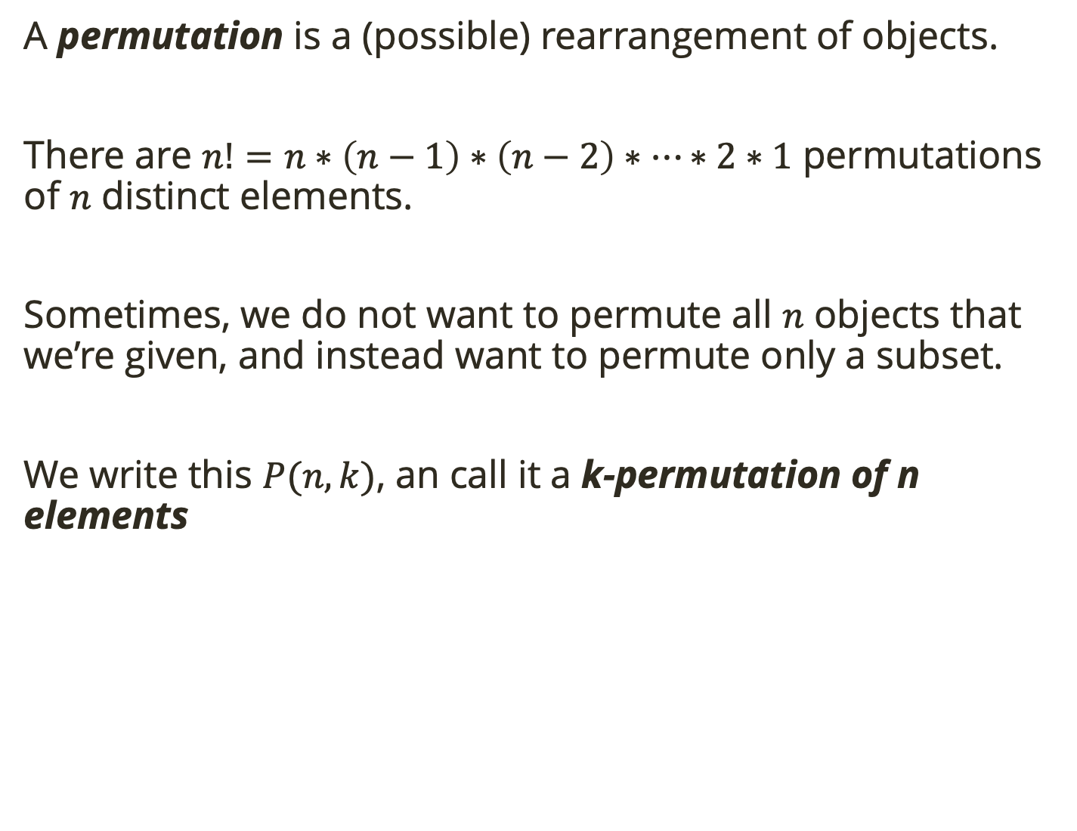
Permutations
A permutation is a (possible) rearrangement of objects.
There are $n!=n∗\left(n−1\right)∗\left(n−2\right)∗…∗2∗1$ permutations of $n$ distinct elements.
Sometimes, we do not want to permute all $n$ objects that we’re given, and instead want to permute only a subset.
We write this $P(n,k)$, an call it a k-permutation of n elements
Notes:
What we are really doing is just rearranging the elements of the codomain, so we are creating a permutation of 8 elements. In fact, “permutation” is another term used to describe bijective functions from a finite set to itself.
If you believe this, then you see the answer must be 8!=8⋅7⋅⋯⋅1=40320.
You can see this directly as well: for each element of the domain, we must pick a distinct element of the codomain to map to. There are 8 choices for where to send 1, then 7 choices for where to send 2, and so on. We multiply using the multiplicative principle.

Slide 13
Permutations
A permutation is a (possible) rearrangement of objects.
There are $n!=n∗\left(n−1\right)∗\left(n−2\right)∗…∗2∗1$ permutations of $n$ distinct elements.
Sometimes, we do not want to permute all $n$ objects that we’re given, and instead want to permute only a subset.
We write this $P(n,k)$, an call it a k-permutation of n elements
How many four letter strings can you make from the characters a, b, c, d, e, f with no repeated characters?
Notes:
This is just like the problem of permuting 4 letters, only now we have more choices for each letter.
For the first letter, there are 6 choices.
For each of those, there are 5 choices for the second letter.
Then there are 4 choices for the third letter,
and 3 choices for the last letter.
The total number of words is .6⋅5⋅4⋅3=360. This is not 6! because we never multiplied by 2 and 1

Slide 14
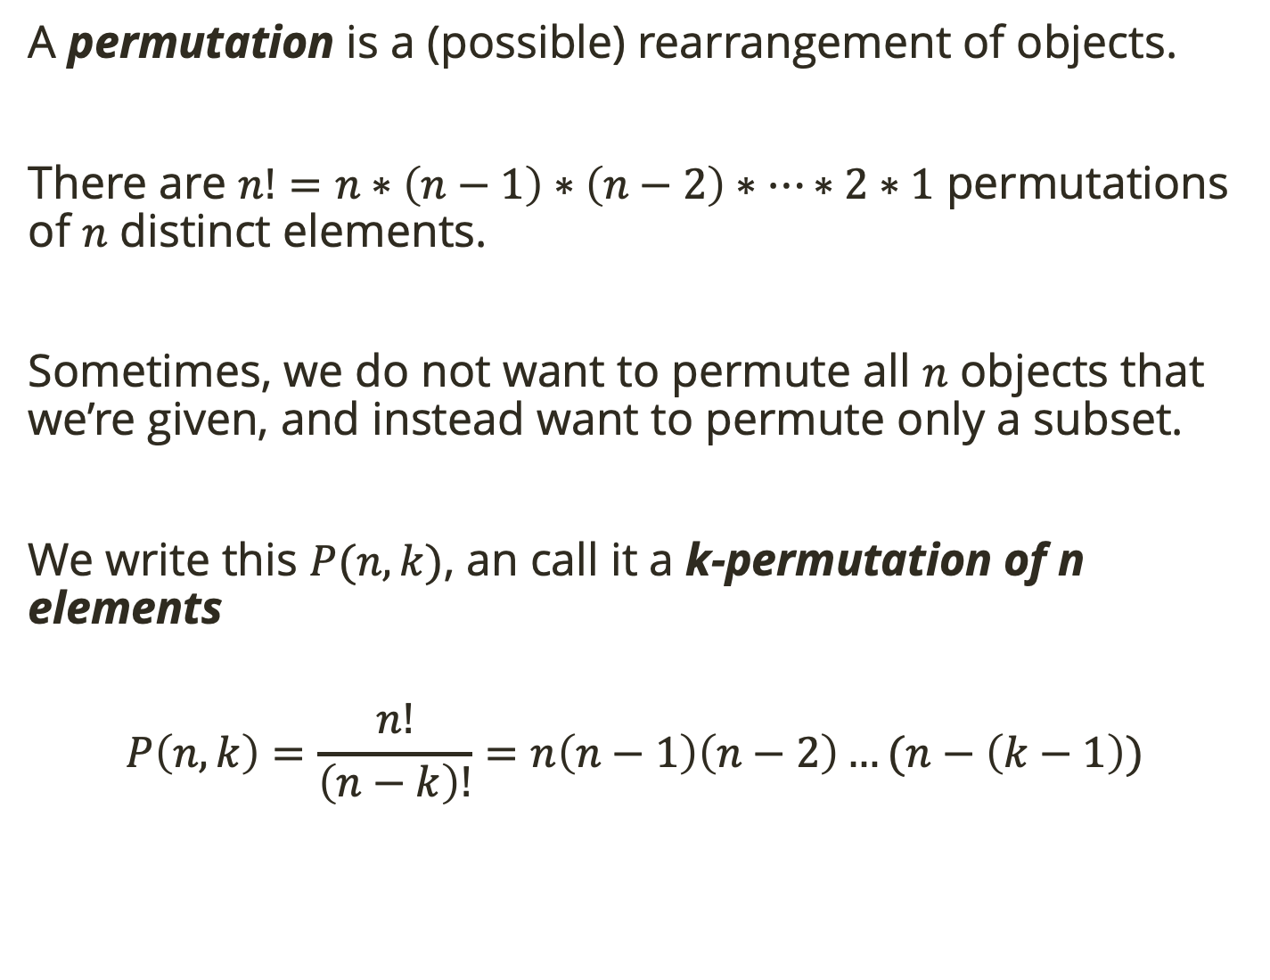
Permutations
A permutation is a (possible) rearrangement of objects.
There are $n!=n∗\left(n−1\right)∗\left(n−2\right)∗…∗2∗1$ permutations of $n$ distinct elements.
Sometimes, we do not want to permute all $n$ objects that we’re given, and instead want to permute only a subset.
We write this $P(n,k)$, an call it a k-permutation of n elements
$$P\left(n, k\right)=\frac{n!}{\left(n−k\right)!}=n\left(n−1\right)\left(n−2\right)…(n−\left(k−1\right))$$
Notes:
This is just like the problem of permuting 4 letters, only now we have more choices for each letter.
For the first letter, there are 6 choices.
For each of those, there are 5 choices for the second letter.
Then there are 4 choices for the third letter,
and 3 choices for the last letter.
The total number of words is .6⋅5⋅4⋅3=360. This is not 6! because we never multiplied by 2 and 1

Slide 15
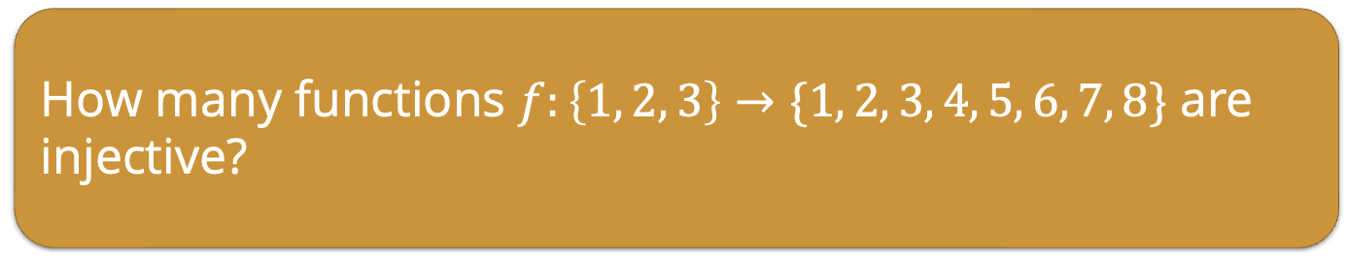
Permutations
A permutation is a (possible) rearrangement of objects.
There are $n!=n∗\left(n−1\right)∗\left(n−2\right)∗…∗2∗1$ permutations of $n$ distinct elements.
Sometimes, we do not want to permute all $n$ objects that we’re given, and instead want to permute only a subset.
We write this $P(n,k)$, an call it a k-permutation of n elements
$$P\left(n, k\right)=\frac{n!}{\left(n−k\right)!}=n\left(n−1\right)\left(n−2\right)…(n−\left(k−1\right))$$
How many functions $f:\left\{1, 2, 3\right\}→\{1, 2, 3, 4, 5, 6, 7, 8\}$ are injective?
Notes:
injection = one to one = maps distinct elements to distinct elements
We need to pick an element from the codomain to be the image of 1.
There are 8 choices.
Then we need to pick one of the remaining 7 elements to be the image of 2.
Finally, one of the remaining 6 elements must be the image of 3.
So the total number of functions is P(8,3)

Slide 16
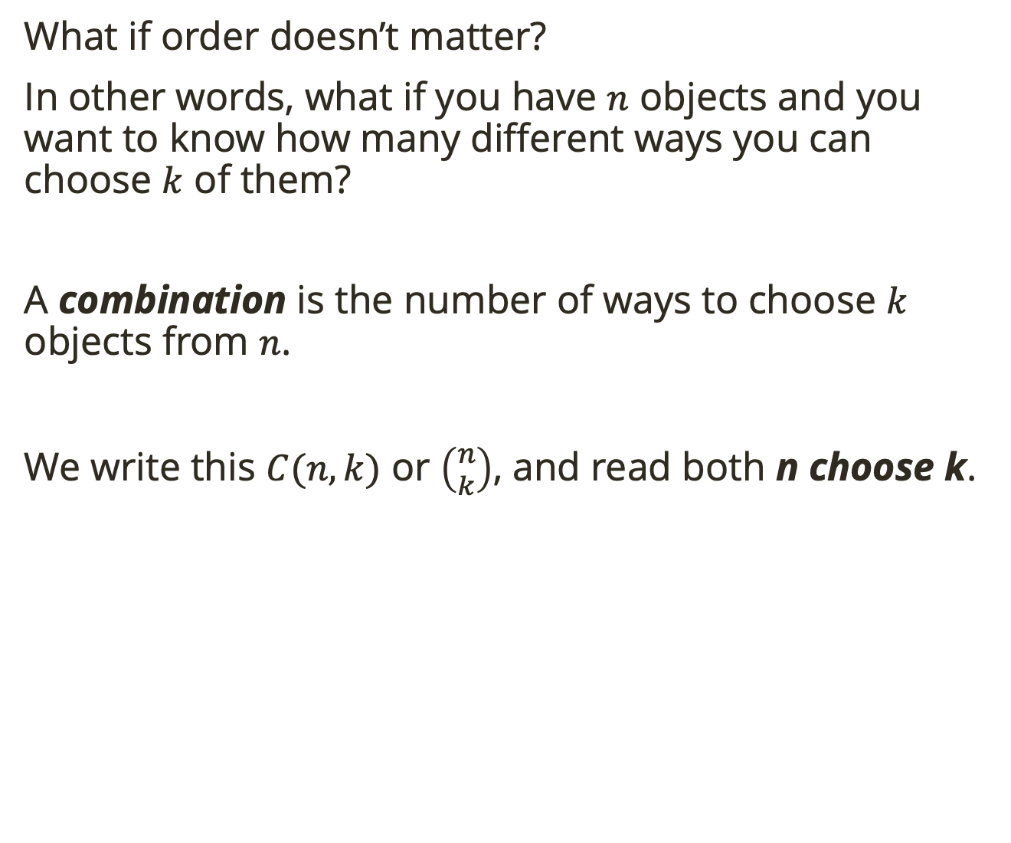
Combinations
What if order doesn’t matter?
In other words, what if you have $n$ objects and you want to know how many different ways you can choose $k$ of them?
A combination is the number of ways to choose $k$ objects from $n$.
We write this $C(n, k)$ or $\left({n \atop k}\right)$, and read both n choose k.

Slide 17
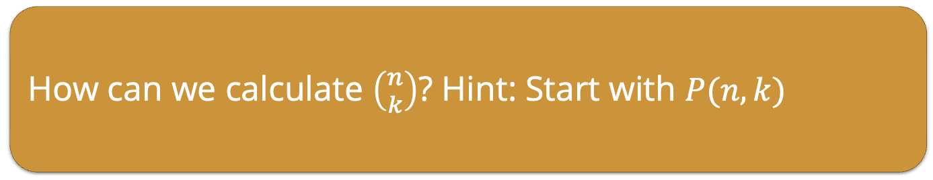
Combinations
What if order doesn’t matter?
In other words, what if you have $n$ objects and you want to know how many different ways you can choose $k$ of them?
A combination is the number of ways to choose $k$ objects from $n$.
We write this $C(n, k)$ or $\left({n \atop k}\right)$, and read both n choose k.
How can we calculate $\left({n \atop k}\right)$? Hint: Start with $P(n,k)$

Slide 18
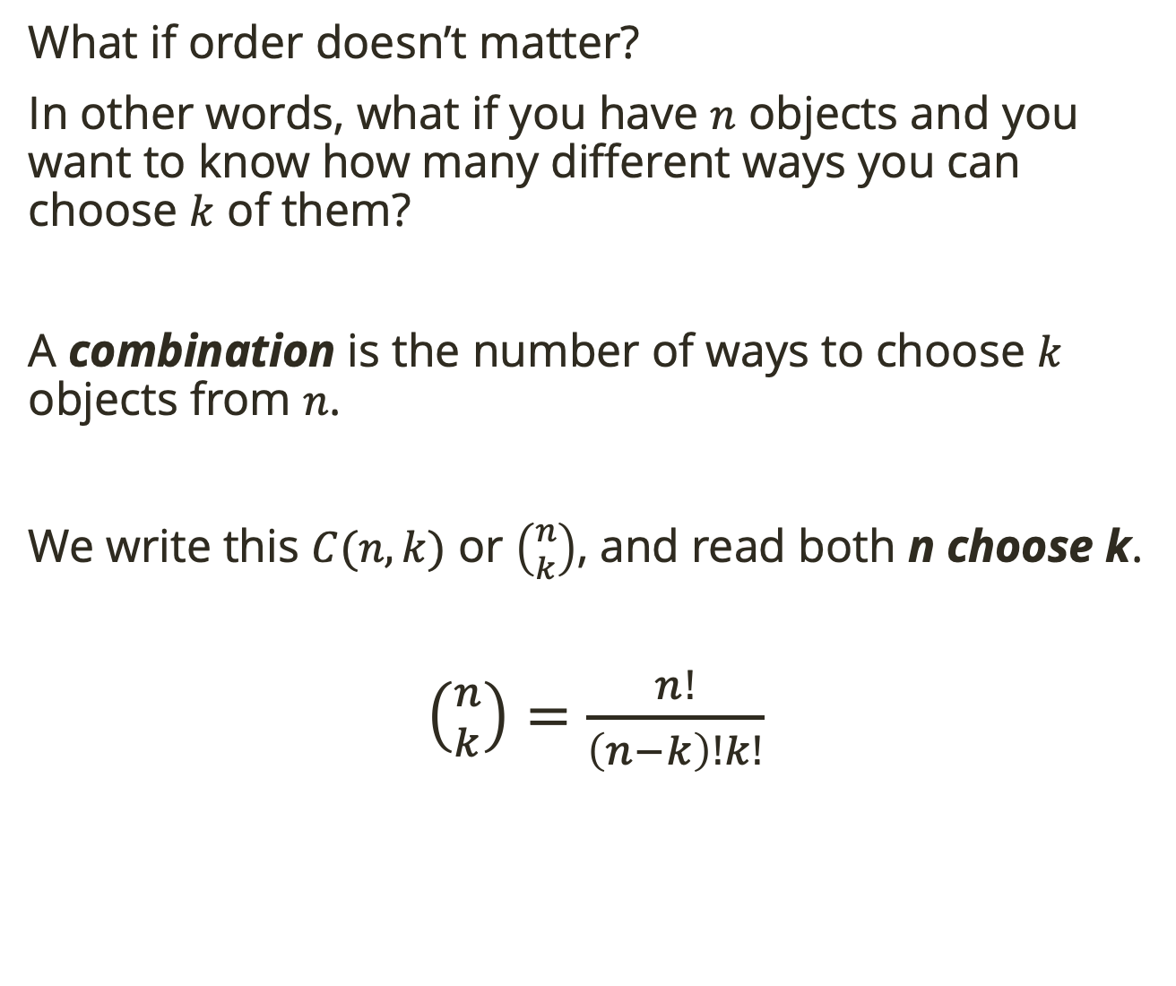
Combinations
What if order doesn’t matter?
In other words, what if you have $n$ objects and you want to know how many different ways you can choose $k$ of them?
A combination is the number of ways to choose $k$ objects from $n$.
We write this $C(n, k)$ or $\left({n \atop k}\right)$, and read both n choose k.
$\left({n \atop k}\right)=\frac{n!}{\left(n−k\right)!k!}$
Notes:
We take permutation and then divide out the different orderings for k objects

Slide 19
Combinations
What if order doesn’t matter?
In other words, what if you have $n$ objects and you want to know how many different ways you can choose $k$ of them?
A combination is the number of ways to choose $k$ objects from $n$.
We write this $C(n, k)$ or $\left({n \atop k}\right)$, and read both n choose k.
$\left({n \atop k}\right)=\frac{n!}{\left(n−k\right)!k!}$
A pizza parlor offers 10 toppings. how many 3-topping pizzas could the put on their menu? (The toppings must all be different, no repeats.)
Notes:
10 C 3 = 120

