Slide 1
Discrete Structures– Welcome!
Dr. Ab Mosca (they/them)

Slide 2
Plan for Today
Who am I?
Who are you?
What will we do in this class?
What is discrete math?
Mathematical Statements

Slide 3



Who Am I?

Slide 4


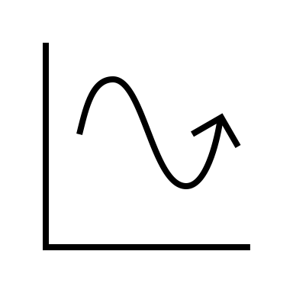
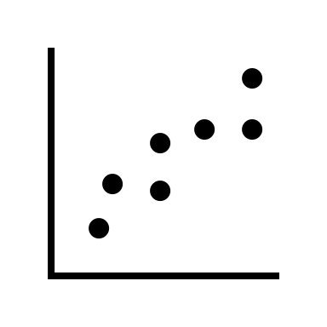

Who Am I?
Dr.

Slide 5



Who Am I?
Dr.

Slide 6
Who Are You?
Form groups of 3
Introduce yourselves (name, pronouns)
Share:
A highlight of your winter break
Find 1 thing that your entire group has in common (favorite color? hometown? left-handed? Be creative!)
After about 5 minutes we will go around, introduce ourselves, and share what each group has in common

Slide 7
Who Are You?
Form new groups of 3 (move around!)
Introduce yourselves (name, pronouns)
Share:
Would you rather have telekinesis (the ability to move things with your mind) OR telepathy (the ability to read minds)?
After about 5 minutes we will go around, introduce ourselves, and share our would you rather answers

Slide 8
Who Are You?
Form new new groups of 3 (move around!)
Introduce yourselves (name, pronouns)
Share:
Would you rather take amazing selfies but look terrible in all other photos OR take terrible selfies but look amazing in all other photos?
After about 5 minutes we will go around, introduce ourselves, and share our would you rather answers

Slide 9
Who Are You?
Name tags!

Slide 10
What You Will Learn & Logistics

Slide 11
What Is This Class?
An introduction to discrete mathematics
You will learn to…
Logically prove mathematical statements
Model scenarios combinatorically
Describe functions, relations, and sequences
Model scenarios graphically

Slide 12
**Important Info**
Course website (write this down!): https://amosca01.github.io/MATH220-S24/
Office Hours
Wilson Hall 325
Wednesday 09:30 - 11:00
Thursday 14:30 - 16:30
By Appointment

Slide 13
**Important Info**
Textbook: Discrete Mathematics: An Open Introduction, 3rd Edition
See course website for instructions
Assignments:
Turn in on Gradescope – Demo! (https://help.gradescope.com/article/ccbpppziu9-student-submit-work)
Due Dates: As listed on course schedule.
24hr grace period; no late submissions
Lowest homework dropped
See syllabus for revise and resubmit policy

Slide 14
**Important Info**
Assignments
Homework
Pair assignments
Graded on effort and correctness
Quizzes (on PLATO)
Individual assignments
Can re-take as many times as wanted before deadline
In-class Activities
Graded on effort
Final Project
Small group
Graded on creativity and correctness

Slide 15
**Important Info**
I’m here to help you succeed
Please come to office hours or reach out if you need any additional support

Slide 16
Now the good stuff

Slide 17
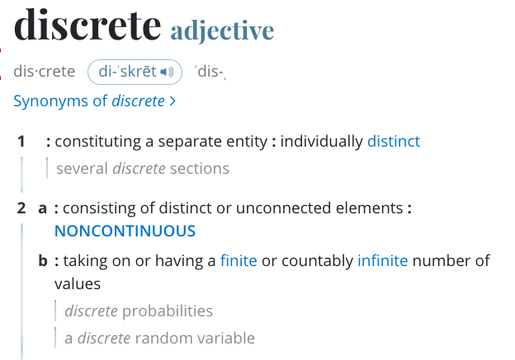
What is Discrete Math?
https://www.merriam-webster.com/dictionary/discrete
Notes:
Boolean algebra and logic, proof techniques, sets, relations and functions, counting, sequences, and graph theory
Math that computer science relies heavily on

Slide 18
What is Discrete Math?
In this class we’ll cove four main topics:
Logic
Combinatorics (counting)
Sequences
Graphs
Notes:
Boolean algebra and logic, proof techniques, sets, relations and functions, counting, sequences, and graph theory
Math that computer science relies heavily on

Slide 19
Warm Up
While walking through a fictional forest, you encounter three trolls guarding a bridge. Each is either a knight, who always tells the truth, or a knave, who always lies. The trolls will not let you pass until you correctly identify each as either a knight or a knave. Each troll makes a single statement:
Troll 1: If I am a knave, then there are exactly two knights here.
Troll 2: Troll 1 is lying.
Troll 3: Either we are all knaves or at least one of us is a knight.
Which troll is which?

Slide 20
Vocab
statement: any declarative sentence which is either true or false

Slide 21
Vocab
statement: any declarative sentence which is either true or false
Example Statements:
- Telephone numbers in the US have 10 digits.
- The moon is made of cheese.
Example non-Statements:
- Would you like some cake?
- The sum of two squares.

Slide 22
Vocab
statement: any declarative sentence which is either true or false
Which are statements and which are not?
- 42 is a perfect square.
- 1 + 3 + 5 + 7
- Go to your room!
- 3 + 7 = 12
- 3 + x = 12
Notes:
statement
not
not
statement
not

Slide 23
Vocab: Types of Statements
statement: any declarative sentence which is either true or false
atomic: a statement that cannot be divided into smaller statements
molecular: a statement that can be divided into smaller statements

Slide 24
Vocab: Types of Statements
statement: any declarative sentence which is either true or false
atomic: a statement that cannot be divided into smaller statements
molecular: a statement that can be divided into smaller statements
Example atomic statement:
- Telephone numbers in the US have 10 digits.

Slide 25
Vocab: Types of Statements
statement: any declarative sentence which is either true or false
atomic: a statement that cannot be divided into smaller statements
molecular: a statement that can be divided into smaller statements
Example atomic statement:
- Telephone numbers in the US have 10 digits.
Example of molecular statement:
- Telephone numbers in the US have 10 digits and 42 is a perfect square.

Slide 26
Vocab: Types of Statements
statement: any declarative sentence which is either true or false
atomic: a statement that cannot be divided into smaller statements
molecular: a statement that can be divided into smaller statements
Example atomic statement:
- Telephone numbers in the US have 10 digits.
Example of molecular statement:
- Telephone numbers in the US have 10 digits and 42 is a perfect square.
atomic statement
atomic statement

Slide 27
Vocab: Types of Statements
statement: any declarative sentence which is either true or false
atomic: a statement that cannot be divided into smaller statements
molecular: a statement that can be divided into smaller statements
Example atomic statement:
- Telephone numbers in the US have 10 digits.
Example of molecular statement:
- Telephone numbers in the US have 10 digits and 42 is a perfect square.
atomic statement
logical connective
atomic statement

Slide 28
Vocab: Logical Connectives
logical connectives: connect or modify statements

Slide 29
Vocab: Logical Connectives
logical connectives: connect or modify statements
binary connectives: connect two statements
- and
- or
- if … then …
- if and only if

Slide 30
Vocab: Logical Connectives
logical connectives: connect or modify statements
binary connectives: connect two statements
- and
- or
- if … then …
- if and only if
unary connectives: applies to a single statement
- not

Slide 31
Vocab: Logical Connectives
logical connectives: connect or modify statements
binary connectives: connect two statements
- and
- or
- if … then …
- if and only if
unary connectives: applies to a single statement
- not
Practice: Form 5 groups. Each will be assigned a connective. Come up with two examples of statements using your connective. For each example, identify molecular statements, atomic statements, and connective.

Slide 32
Symbolic Representation
Writing out entire statements is a pain

Slide 33
Symbolic Representation
Writing out entire statements is a pain
To save time, we represent statements (usually atomic) with variables

Slide 34
Symbolic Representation
Writing out entire statements is a pain
To save time, we represent statements (usually atomic) with variables
It is custom to use capital letters in the middle of the alphabet for statement variables
Ex. P, Q, R, S

Slide 35
Symbolic Representation
Writing out entire statements is a pain
To save time, we represent statements (usually atomic) with variables
It is custom to use capital letters in the middle of the alphabet for statement variables
Ex. P, Q, R, S
Note: In this context, a variable only has 2 possible values – True (written T or 1) or False (written F or 0)

Slide 36
Symbolic Representation
Writing out entire statements is a pain
To save time, we represent statements (usually atomic) with variables
It is custom to use capital letters in the middle of the alphabet for statement variables
Ex. P, Q, R, S
Note: In this context, a variable only has 2 possible values – True (written T or 1) or False (written F or 0)
Practice: Return to your groups. Re-write your statements from the previous exercise using variables.

Slide 37
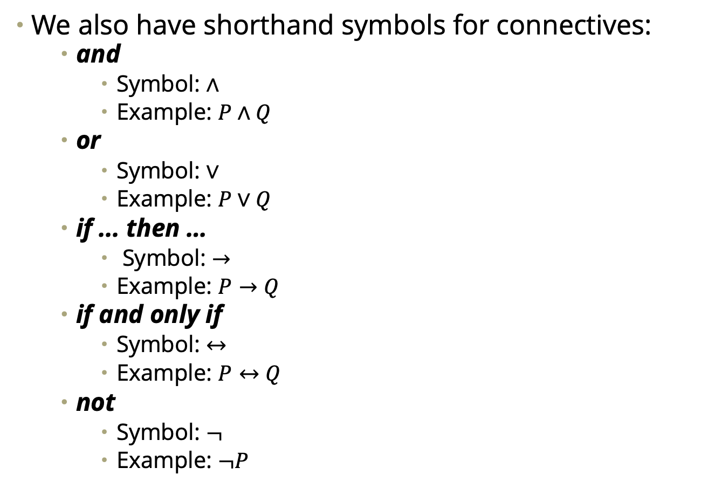
Symbolic Representation
We also have shorthand symbols for connectives:
and
Symbol: $∧$
Example: $P∧Q$
or
Symbol: $∨$
Example: $P∨Q$
if ... then …
Symbol: $→$
Example: $P→Q$
if and only if
Symbol: $↔$
Example: $P↔Q$
not
Symbol: $¬$
Example: $¬P$

Slide 38
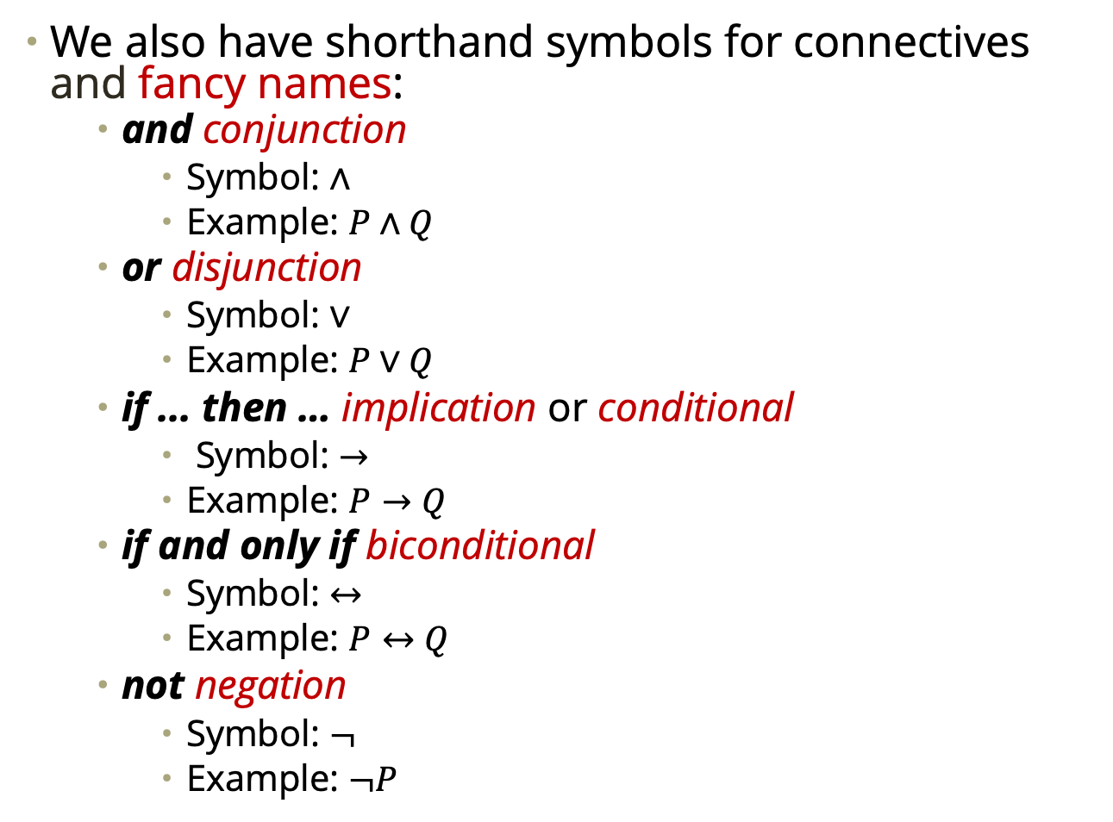
Symbolic Representation
We also have shorthand symbols for connectives and fancy names:
and conjunction
Symbol: $∧$
Example: $P∧Q$
or disjunction
Symbol: $∨$
Example: $P∨Q$
if ... then … implication or conditional
Symbol: $→$
Example: $P→Q$
if and only if biconditional
Symbol: $↔$
Example: $P↔Q$
not negation
Symbol: $¬$
Example: $¬P$

Slide 39
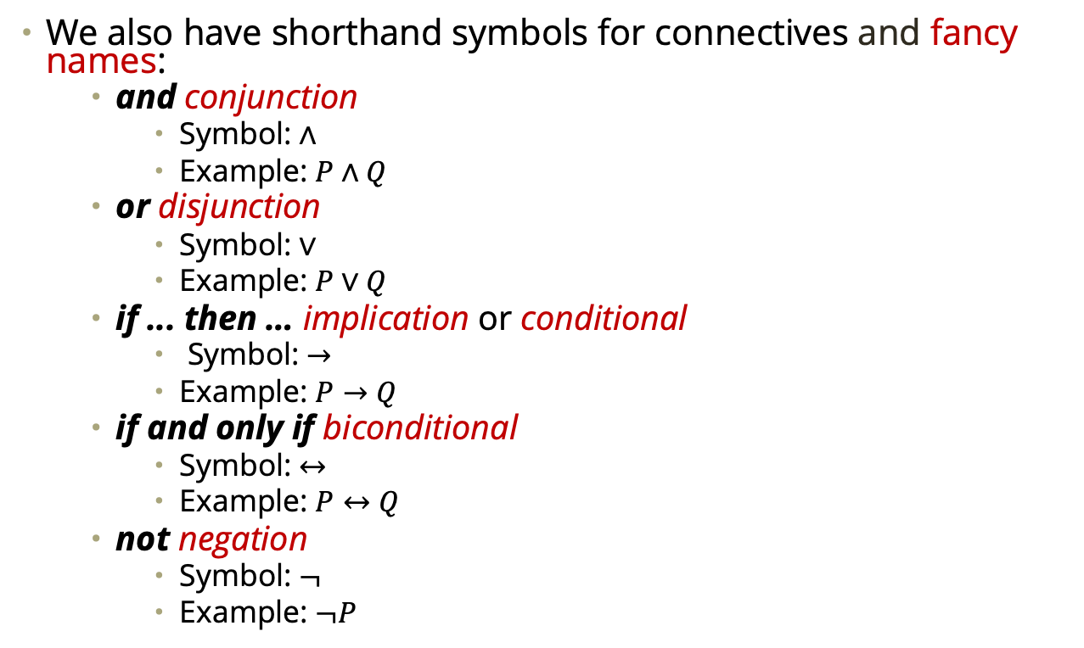
Symbolic Representation
We also have shorthand symbols for connectives and fancy names:
and conjunction
Symbol: $∧$
Example: $P∧Q$
or disjunction
Symbol: $∨$
Example: $P∨Q$
if ... then … implication or conditional
Symbol: $→$
Example: $P→Q$
if and only if biconditional
Symbol: $↔$
Example: $P↔Q$
not negation
Symbol: $¬$
Example: $¬P$
Practice: Return to your groups. Add the appropriate connective to your statements from the previous exercise.

