Slide 1
Discrete Structures– Graphs: Euler Paths and Circuits
Dr. Ab Mosca (they/them)

Slide 2
Plan for Today
Trees
Definition
Properties
Rooted
Spanning

Slide 3
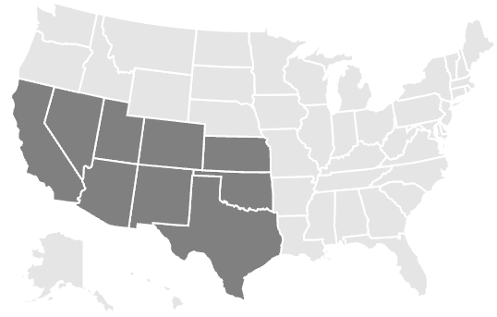
Warm Up: Euler Paths & Circuits
An Euler path, in a graph or multigraph, is a path through the graph which uses every edge exactly once.
An Euler circuit is a Euler path which stops and starts at the same vertex.
You and your friends want to tour the southwest by car. You will visit the nine states highlighted, with the following rather odd rule: you must cross each border between neighboring states exactly once (so, for example, you must cross the Colorado-Utah border exactly once). Can you do it? If so, does it matter where you start your road trip?
Notes:
A graph has an Euler circuit if and only if the degree of every vertex is even.
A graph has an Euler path if and only if there are at most two vertices with an odd degree.
This is a question about finding Euler paths. Draw a graph with a vertex in each state, and connect vertices if their states share a border. Exactly two vertices will have odd degree: the vertices for Nevada and Utah. Thus you must start your road trip at in one of those states and end it in the other.

Slide 4
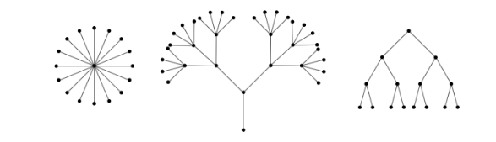
Definition: Tree
A tree is a connected graph containing no cycles.
A forest is a graph containing no cycles.
Note: this means a connected forest is a tree.
https://ptwiddle.github.io/Graph-Theory-Notes/s_intro_trees.html

Slide 5

Tree Properties
Proposition: A graph, $T$, is a tree if and only if between every pair of distinct vertices of $T$ there is a unique path.
Corollary: A graph, $F$, is a forest if and only if between any pair of vertices in $F$ there is as most one path.

Slide 6
Tree Properties
In a tree, vertices of degree one are called leaves.
Which vertices in these trees are leaves?

Slide 7

Tree Properties
Proposition: Any tree with at least two vertices has at least two vertices of degree one.
Proposition: Let $T$ be a tree with $v$ vertices and $e$ edges. Then $e=v−1$.

Slide 8
Rooted Trees
We can identify one vertex in a tree as the root. Then, every other vertex on the tree can e characterized by its position relative to the root.
If two vertices are adjacent, we say the one closer to the root is the parent, and the other is the child.
The root of a tree is a parent, but not a child of any vertex. All non-root vertices have exactly one parent.

