Slide 1
Discrete Structures– Functions
Dr. Ab Mosca (they/them)

Slide 2
Plan for Today
Functions
Describing
Properties
Image and Inverse Image

Slide 3

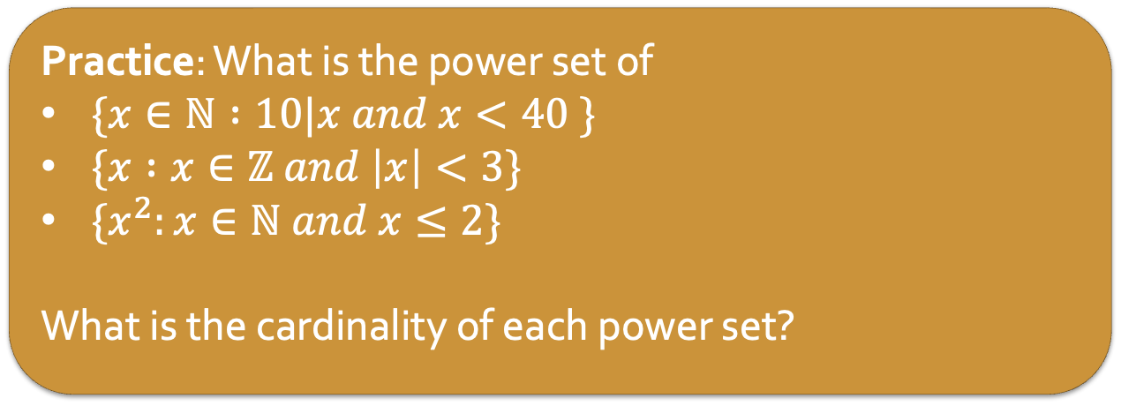
Warm Up: Sets
A set is an unordered collection of objects
The power set of A is the set of all subsets of A
Ex. $A=\{1, 2, 3\}$,
$𝒫\left(A\right)=\{∅, \left\{1\right\}, \left\{2\right\}, \left\{3\right\}, \left\{1, 2\right\}, \left\{1, 3\right\}, \left\{2, 3\right\}, \left\{1, 2, 3\right\}\}$
Practice: What is the power set of
$\{x∈ℕ :10|x and x<40 \}$
$\{x :x∈ℤ and \left|x\right|<3\}$
$\{x^{2}:x∈ℕ and x≤2\}$
What is the cardinality of each power set?

Slide 4
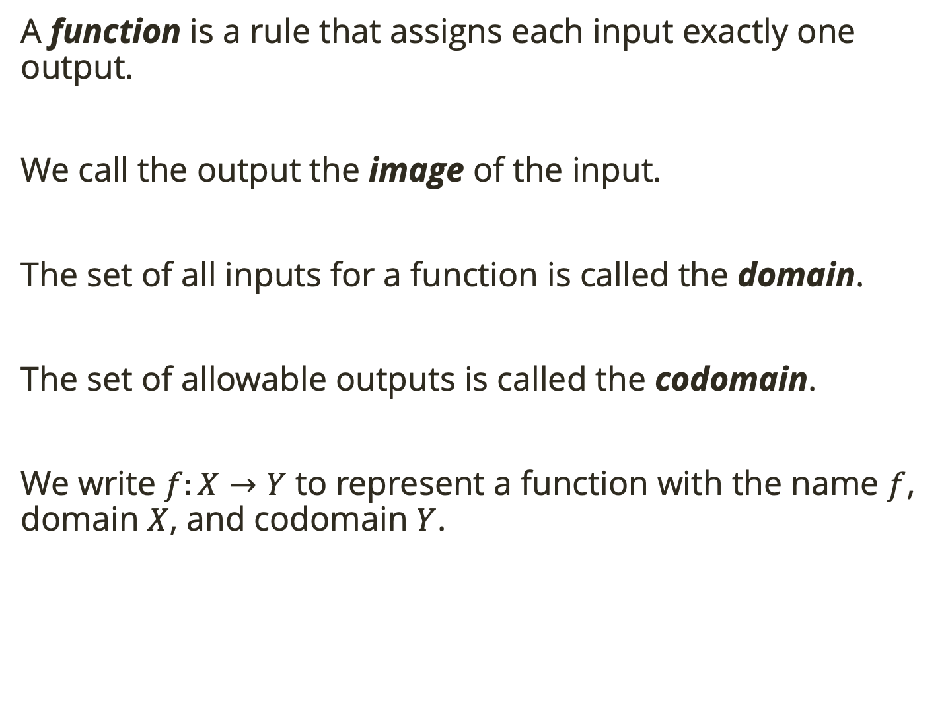
Definitions
A function is a rule that assigns each input exactly one output.
We call the output the image of the input.
The set of all inputs for a function is called the domain.
The set of allowable outputs is called the codomain.
We write $f:X→Y$ to represent a function with the name $f$, domain $X$, and codomain $Y$.

Slide 5
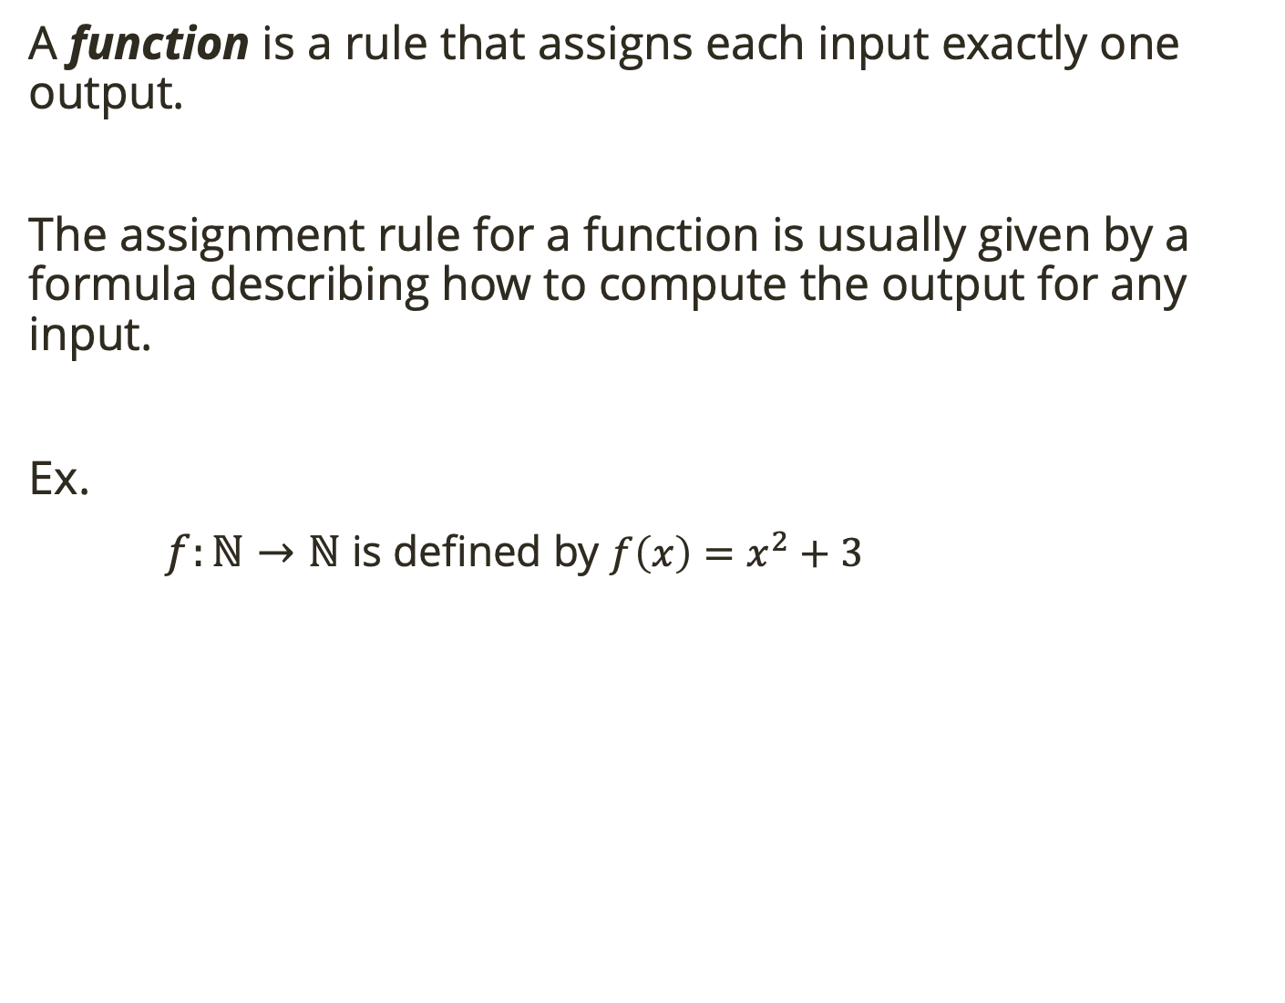
Definitions
A function is a rule that assigns each input exactly one output.
The assignment rule for a function is usually given by a formula describing how to compute the output for any input.
Ex.
$f:ℕ→ℕ$ is defined by $f\left(x\right)=x^{2}+3$

Slide 6
Definitions
A function is a rule that assigns each input exactly one output.
The assignment rule for a function is usually given by a formula describing how to compute the output for any input.
Ex.
$f:ℕ→ℕ$ is defined by $f\left(x\right)=x^{2}+3$
domain
codomain
rule

Slide 7
Definitions
A function is a rule that assigns each input exactly one output.
The assignment rule for a function is usually given by a formula describing how to compute the output for any input.
Ex.
$f:ℕ→ℕ$ is defined by $f\left(x\right)=x^{2}+3$
domain
codomain
rule
Practice: Describe the set of outputs for this function using set builder notation.

Slide 8
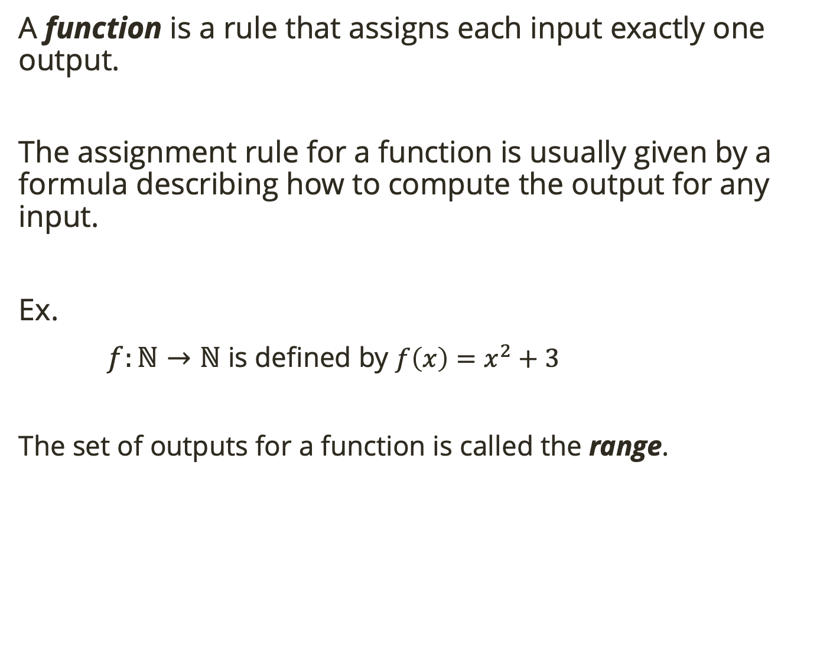
Definitions
A function is a rule that assigns each input exactly one output.
The assignment rule for a function is usually given by a formula describing how to compute the output for any input.
Ex.
$f:ℕ→ℕ$ is defined by $f\left(x\right)=x^{2}+3$
The set of outputs for a function is called the range.
domain
codomain
rule

Slide 9
Definitions
A function is a rule that assigns each input exactly one output.
The assignment rule for a function is usually given by a formula describing how to compute the output for any input.
Ex.
$f:ℕ→ℕ$ is defined by $f\left(x\right)=x^{2}+3$
The set of outputs for a function is called the range.
domain
codomain
rule
Practice: What is the difference between codomain and range?

Slide 10
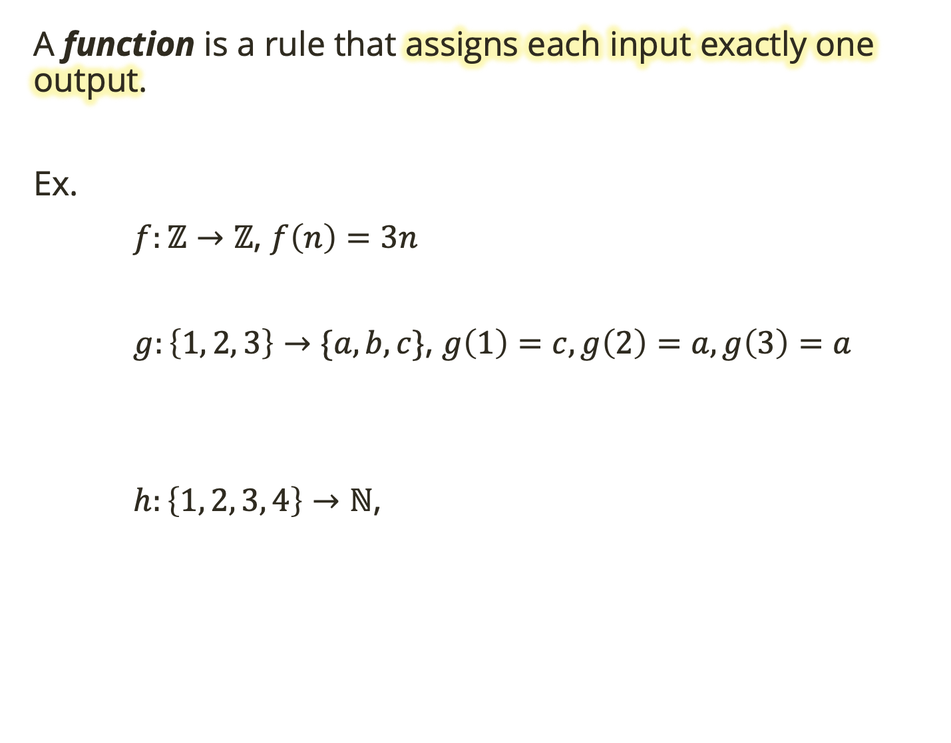
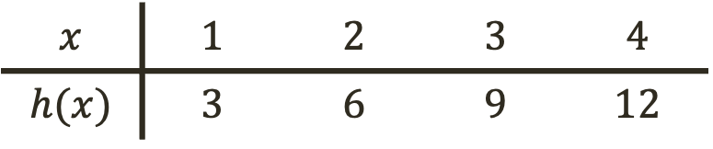
Definitions
A function is a rule that assigns each input exactly one output.
Ex.
$f:ℤ→ℤ$, $f\left(n\right)=3n$
$g:\left\{1, 2, 3\right\}→\{a, b, c\}$, $g\left(1\right)=c, g\left(2\right)=a, g\left(3\right)=a$
$h:\left\{1, 2, 3, 4\right\}→ℕ$,
$$x$$ | $$1$$ | $$2$$ | $$3$$ | $$4$$
$$h(x)$$ | $$3$$ | $$6$$ | $$9$$ | $$12$$

Slide 11
Definitions
A function is a rule that assigns each input exactly one output.
Ex.
$f:ℤ→ℤ$, $f\left(n\right)=3n$
$g:\left\{1, 2, 3\right\}→\{a, b, c\}$, $g\left(1\right)=c, g\left(2\right)=a, g\left(3\right)=a$
$h:\left\{1, 2, 3, 4\right\}→ℕ$,
$$x$$ | $$1$$ | $$2$$ | $$3$$ | $$4$$
$$h(x)$$ | $$3$$ | $$6$$ | $$9$$ | $$12$$
Practice: ID the domain, codomain, and range for each function above.

Slide 12
Definitions
A function is a rule that assigns each input exactly one output.
Ex.
$f:ℤ→ℤ$, $f\left(n\right)=3n$
$g:\left\{1, 2, 3\right\}→\{a, b, c\}$, $g\left(1\right)=c, g\left(2\right)=a, g\left(3\right)=a$
$h:\left\{1, 2, 3, 4\right\}→ℕ$,
Input can map to the same output as long as each input maps to exactly one output
rule
$$x$$ | $$1$$ | $$2$$ | $$3$$ | $$4$$
$$h(x)$$ | $$3$$ | $$6$$ | $$9$$ | $$12$$

Slide 13

Definitions
A function is a rule that assigns each input exactly one output.
Ex.
$f:ℤ→ℤ$, $f\left(n\right)=3n$
$g:\left\{1, 2, 3\right\}→\{a, b, c\}$, $g\left(1\right)=c, g\left(2\right)=a, g\left(3\right)=a$
$h:\left\{1, 2, 3, 4\right\}→ℕ$,
$f$ and $h$ are not the same because their domain and codomains differ
rule
$$x$$ | $$1$$ | $$2$$ | $$3$$ | $$4$$
$$h(x)$$ | $$3$$ | $$6$$ | $$9$$ | $$12$$

Slide 14
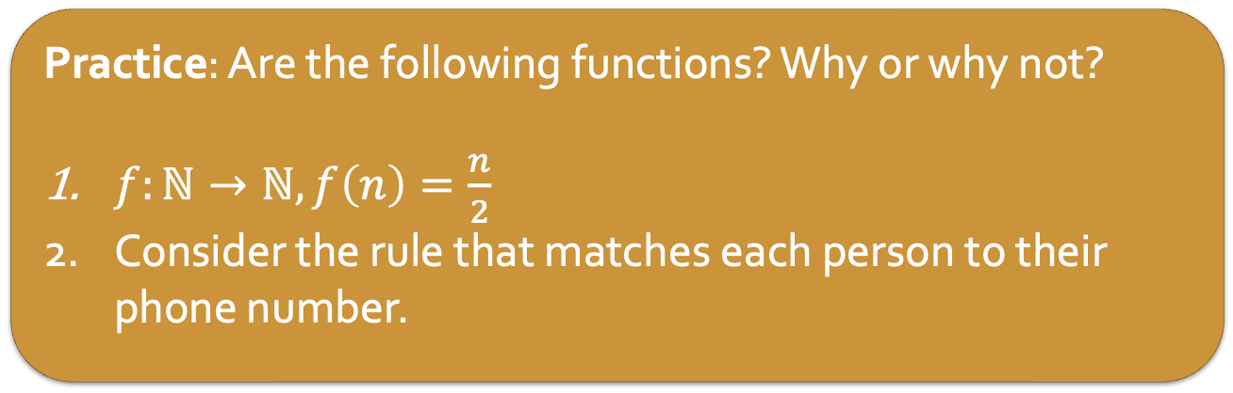
Definitions
A function is a rule that assigns each input exactly one output.
Practice: Are the following functions? Why or why not?
$f:ℕ→ℕ, f\left(n\right)=\frac{n}{2}$
Consider the rule that matches each person to their phone number.
Notes:
no, not every input has an output. Ex. f(3) = 3/2 but that’s not in N
No because some people have two phone numbers. Reversed also no because some numbers have two people.

Slide 15
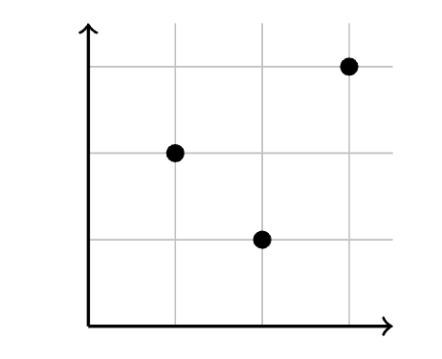
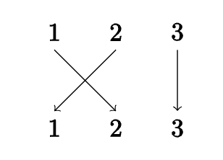

Describing Functions
We can describe functions many ways.
algebraically, with a formula
numerically, with a table
graphically
in words
and more!
Ex. $f:\left\{1, 2, 3\right\}→\{1, 2, 3\}$
Notes:
in graph don’t connect lines by implies larger domain and codomain!!

Slide 16
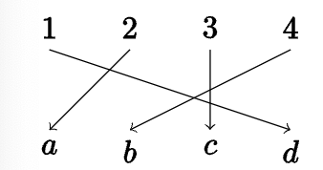
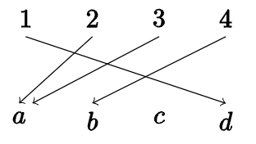
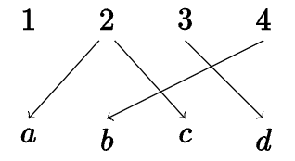

Describing Functions
We can describe functions many ways.
algebraically, with a formula
numerically, with a table
graphically
in words
and more!
Ex. $f:\left\{1, 2, 3\right\}→\{1, 2, 3\}$
Practice: Are the following functions? Why or why not?
$$X=\left\{1, 2, 3, 4\right\}, Y=\{a, b, c, d\}$$
$f:X→Y$ $g:X→Y$ $h:X →Y$
Notes:
f and g are functions
h is not bc (1) 2 goes to two outputs, 1 has not been mapped

Slide 17
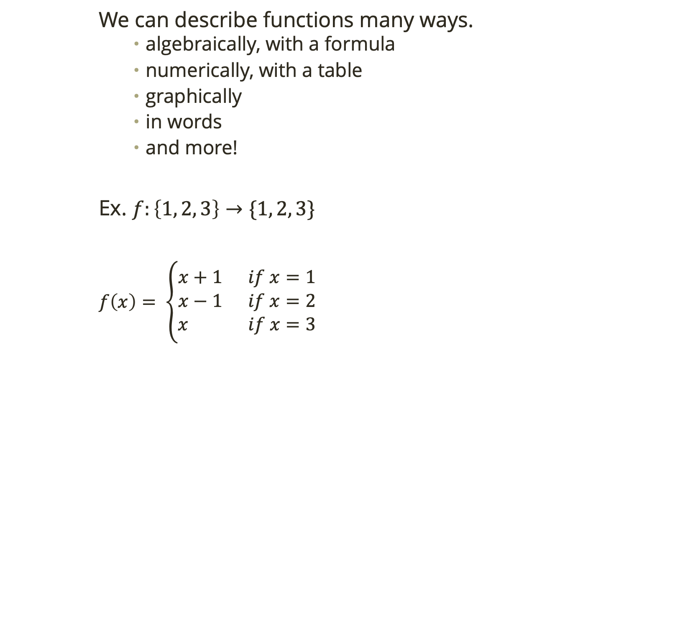
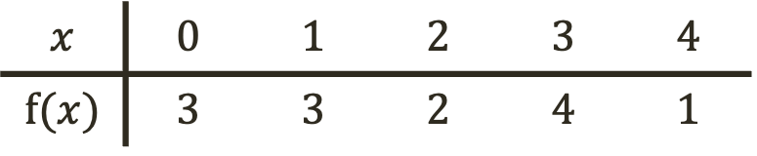
Describing Functions
We can describe functions many ways.
algebraically, with a formula
numerically, with a table
graphically
in words
and more!
Ex. $f:\left\{1, 2, 3\right\}→\{1, 2, 3\}$
$f\left(x\right)= \left\{\begin{aligned}x+1 if x=1 \\ x−1 if x=2 \\ x if x=3\end{aligned}\right.$
$$x$$ | $$0$$ | $$1$$ | $$2$$ | $$3$$ | $$4$$
$$f(x)$$ | $$3$$ | $$3$$ | $$2$$ | $$4$$ | $$1$$

Slide 18

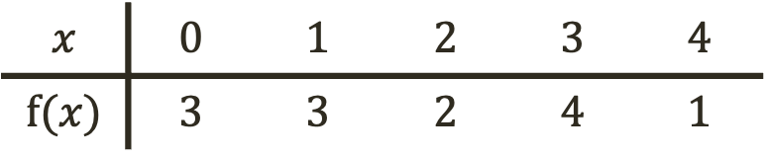
Describing Functions
We can describe functions many ways.
algebraically, with a formula
numerically, with a table
graphically
in words
and more!
Ex. $f:\left\{1, 2, 3\right\}→\{1, 2, 3\}$
$$f=\left(\begin{matrix}0 & 1 & 2 & 3 & 4 \\ 3 & 3 & 2 & 4 & 1\end{matrix}\right)$$
$$x$$ | $$0$$ | $$1$$ | $$2$$ | $$3$$ | $$4$$
$$f(x)$$ | $$3$$ | $$3$$ | $$2$$ | $$4$$ | $$1$$
Notes:
matrix is simply notation, not linear algebra matrix

Slide 19
Describing Functions
We can describe functions many ways.
algebraically, with a formula
numerically, with a table
graphically
in words
and more!
Ex. $f:\left\{1, 2, 3\right\}→\{1, 2, 3\}$
$$f=\left(\begin{matrix}0 & 1 & 2 & 3 & 4 \\ 3 & 3 & 2 & 4 & 1\end{matrix}\right)$$
$$x$$ | $$0$$ | $$1$$ | $$2$$ | $$3$$ | $$4$$
$$f(x)$$ | $$3$$ | $$3$$ | $$2$$ | $$4$$ | $$1$$
Notes:
matrix is simply notation, not linear algebra matrix

Slide 20
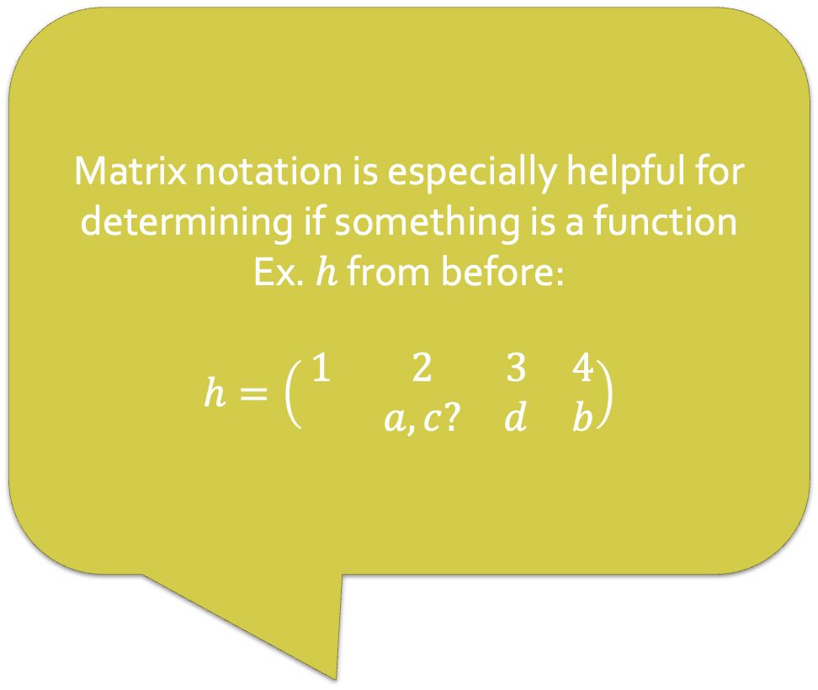
Describing Functions
We can describe functions many ways.
algebraically, with a formula
numerically, with a table
graphically
in words
and more!
Ex. $f:\left\{1, 2, 3\right\}→\{1, 2, 3\}$
$$f=\left(\begin{matrix}0 & 1 & 2 & 3 & 4 \\ 3 & 3 & 2 & 4 & 1\end{matrix}\right)$$
Matrix notation is especially helpful for determining if something is a function
Ex. $h$ from before:
$$h=\left(\begin{matrix}1 & 2 & 3 & 4 \\ & a,c? & d & b\end{matrix}\right)$$
$$x$$ | $$0$$ | $$1$$ | $$2$$ | $$3$$ | $$4$$
$$f(x)$$ | $$3$$ | $$3$$ | $$2$$ | $$4$$ | $$1$$
Notes:
matrix is simply notation, not linear algebra matrix

Slide 21
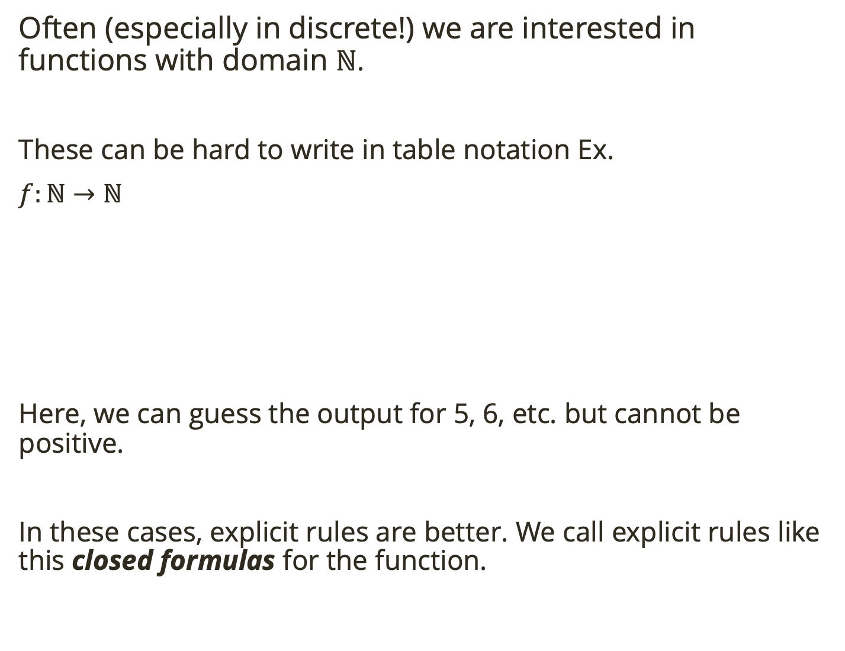
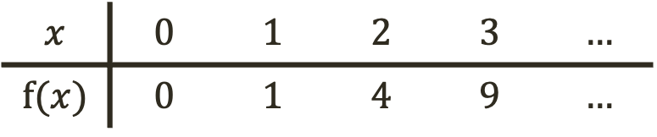
Describing Functions
Often (especially in discrete!) we are interested in functions with domain $ℕ$.
These can be hard to write in table notation Ex.
$f:ℕ→ℕ$
Here, we can guess the output for 5, 6, etc. but cannot be positive.
In these cases, explicit rules are better. We call explicit rules like this closed formulas for the function.
$$x$$ | $$0$$ | $$1$$ | $$2$$ | $$3$$ | $$…$$
$$f(x)$$ | $$0$$ | $$1$$ | $$4$$ | $$9$$ | $$…$$
Notes:
matrix is simply notation, not linear algebra matrix

Slide 22
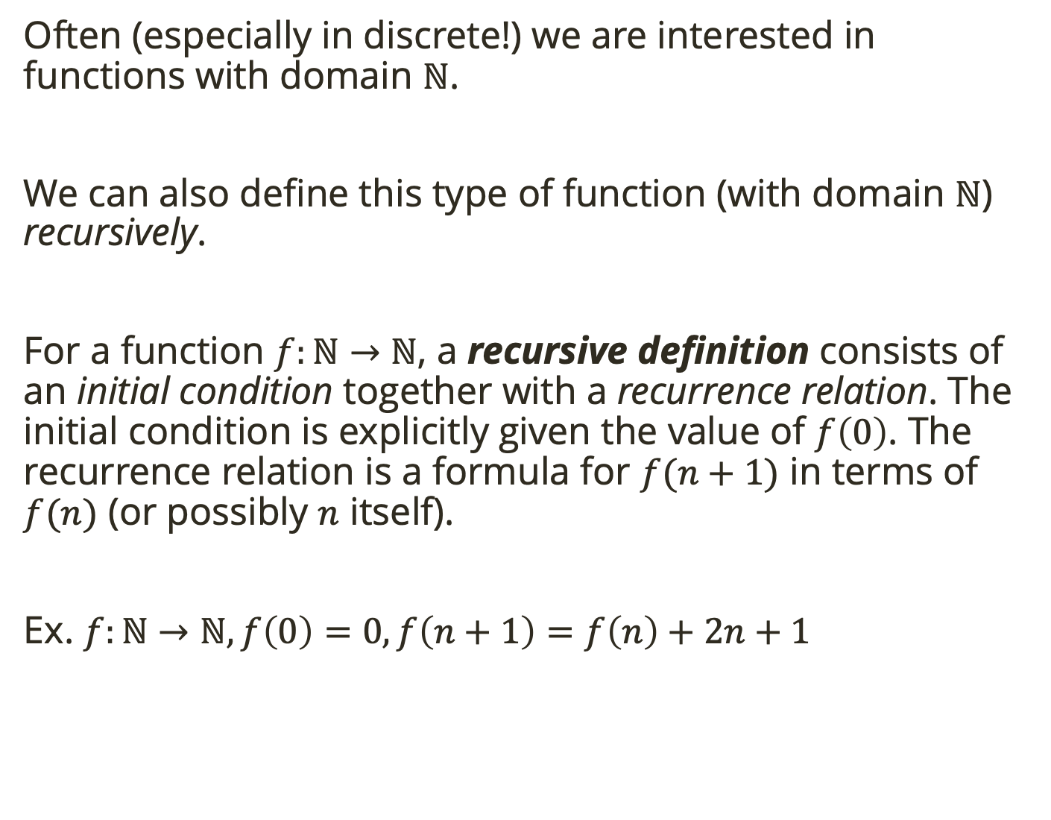
Describing Functions
Often (especially in discrete!) we are interested in functions with domain $ℕ$.
We can also define this type of function (with domain $ℕ$) recursively.
For a function $f:ℕ→ℕ$, a recursive definition consists of an initial condition together with a recurrence relation. The initial condition is explicitly given the value of $f\left(0\right)$. The recurrence relation is a formula for $f(n+1)$ in terms of $f(n)$ (or possibly $n$ itself).
Ex. $f:ℕ→ℕ, f\left(0\right)=0, f\left(n+1\right)=f\left(n\right)+2n+1$
Notes:
matrix is simply notation, not linear algebra matrix

Slide 23

Describing Functions
Often (especially in discrete!) we are interested in functions with domain $ℕ$.
We can also define this type of function (with domain $ℕ$) recursively.
For a function $f:ℕ→ℕ$, a recursive definition consists of an initial condition together with a recurrence relation. The initial condition is explicitly given the value of $f\left(0\right)$. The recurrence relation is a formula for $f(n+1)$ in terms of $f(n)$ (or possibly $n$ itself).
Ex. $f:ℕ→ℕ, f\left(0\right)=0, f\left(n+1\right)=f\left(n\right)+2n+1$
Practice: What is $f(6)$?
Notes:
matrix is simply notation, not linear algebra matrix

Slide 24

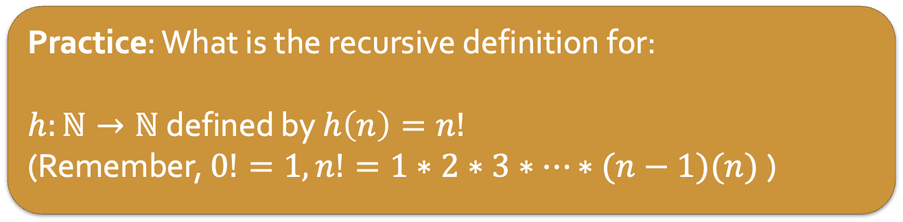
Describing Functions
For a function $f:ℕ→ℕ$, a recursive definition consists of an initial condition together with a recurrence relation. The initial condition is explicitly given the value of $f\left(0\right)$. The recurrence relation is a formula for $f(n+1)$ in terms of $f(n)$ (or possibly $n$ itself).
Ex. $f:ℕ→ℕ, f\left(0\right)=0, f\left(n+1\right)=f\left(n\right)+2n+1$
Practice: What is the recursive definition for:
$h:ℕ→ℕ$ defined by $h\left(n\right)=n!$
(Remember, $0!=1, n!=1∗2∗3∗…∗(n−1)(n)$)
Notes:
h(0) = 1
h(n+1) = (n+1)h(n)

Slide 25
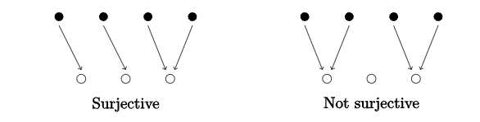
Function Properties
When a function maps the domain to everything in the codomain (i.e the codomain is the range) we say it is onto.
An onto function is a surjective function.
Notes:
think maps domain directly onto codomain

Slide 26
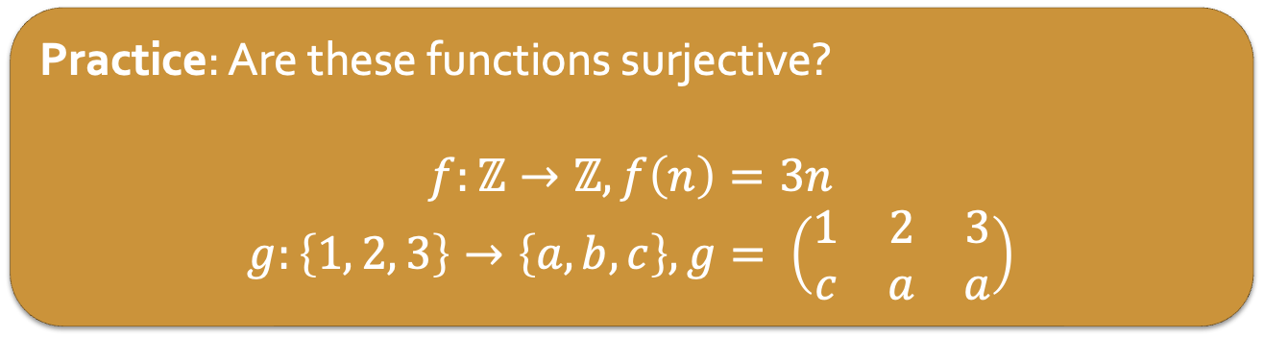
Function Properties
When a function maps the domain to everything in the codomain (i.e the codomain is the range) we say it is onto.
An onto function is a surjective function.
Practice: Are these functions surjective?
$$f:ℤ→ℤ, f\left(n\right)=3n$$
$$g:\left\{1, 2, 3\right\}→\left\{a, b, c\right\}, g= \left(\begin{matrix}1 & 2 & 3 \\ c & a & a\end{matrix}\right)$$
Notes:
no and no.

Slide 27
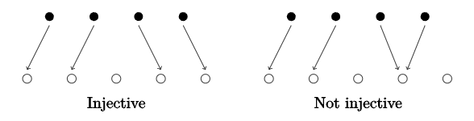
Function Properties
When a function is such that each element of the codomain is the image of at most one element of the domain, we say it is one-to-one.
A one-to-one function is an injective function.
Notes:
no and no.

Slide 28
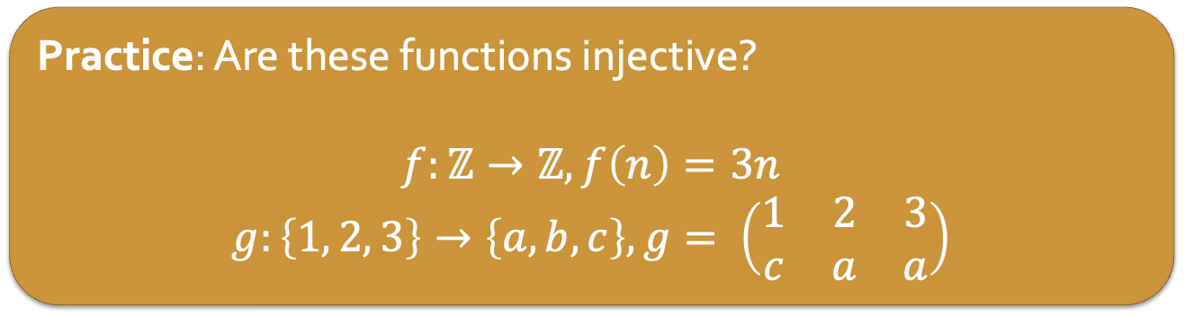
Function Properties
When a function is such that each element of the codomain is the image of at most one element of the domain, we say it is one-to-one.
A one-to-one function is an injective function.
Practice: Are these functions injective?
$$f:ℤ→ℤ, f\left(n\right)=3n$$
$$g:\left\{1, 2, 3\right\}→\left\{a, b, c\right\}, g= \left(\begin{matrix}1 & 2 & 3 \\ c & a & a\end{matrix}\right)$$
Notes:
yes and no.

Slide 29
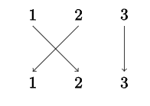
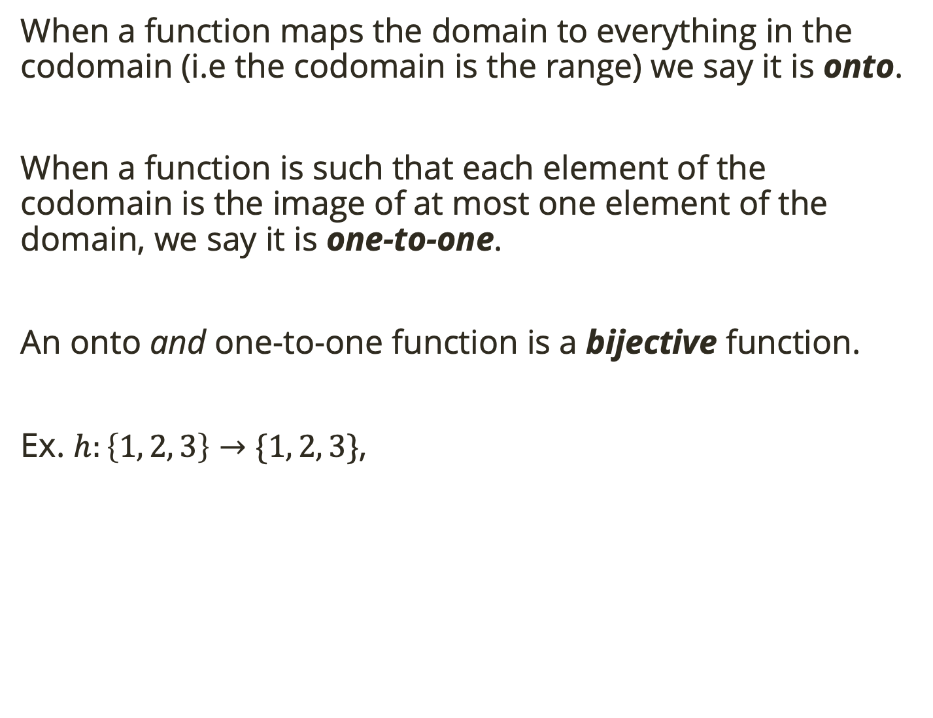
Function Properties
When a function maps the domain to everything in the codomain (i.e the codomain is the range) we say it is onto.
When a function is such that each element of the codomain is the image of at most one element of the domain, we say it is one-to-one.
An onto and one-to-one function is a bijective function.
Ex. $h:\left\{1, 2, 3\right\}→\{1, 2, 3\}$,
Notes:
yes and no.

Slide 30
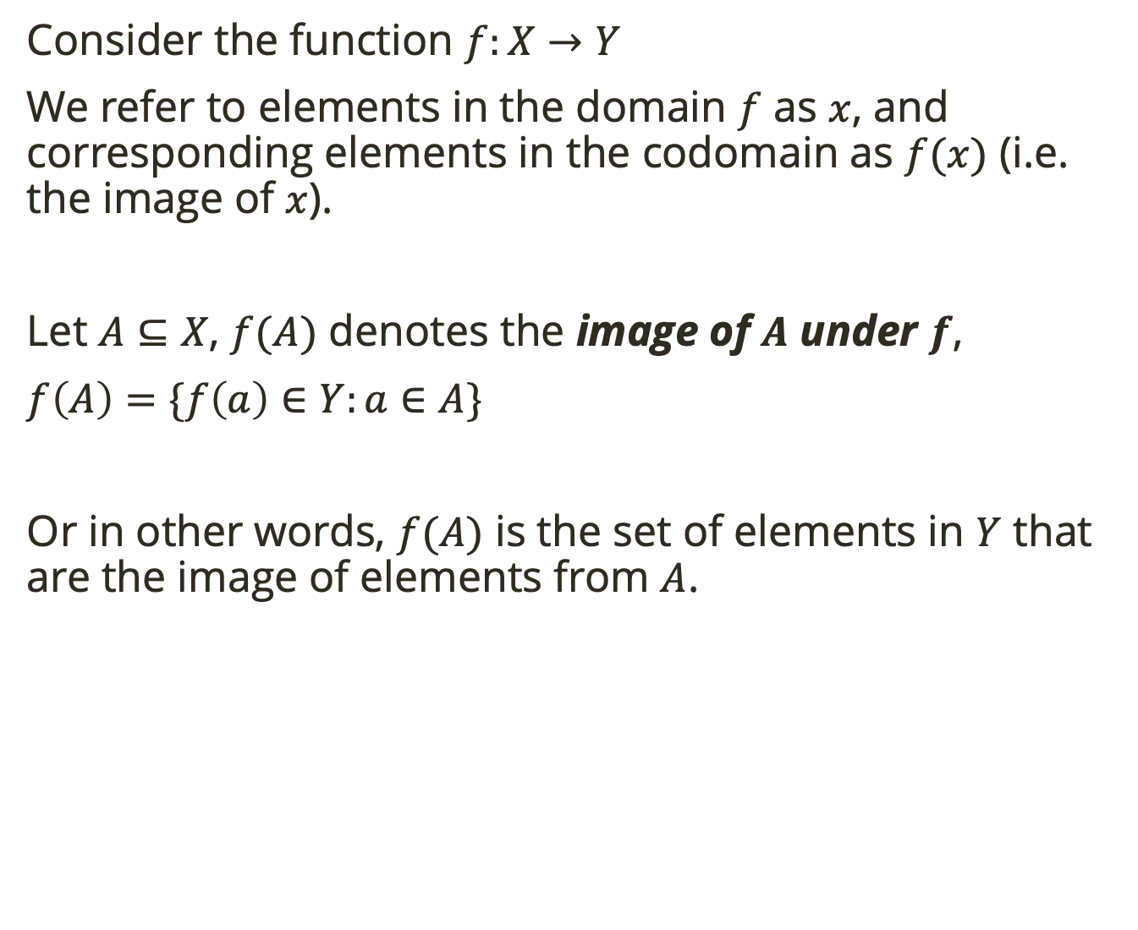
Image and Inverse Image
Consider the function $f:X→Y$
We refer to elements in the domain $f$ as $x$, and corresponding elements in the codomain as $f(x)$ (i.e. the image of $x$).
Let $A⊆X$, $f(A)$ denotes the image of $A$ under $f$,
$f\left(A\right)=\{f\left(a\right)∈Y:a∈A\}$
Or in other words, $f(A)$ is the set of elements in $Y$ that are the image of elements from $A$.
Notes:
yes and no.

Slide 31
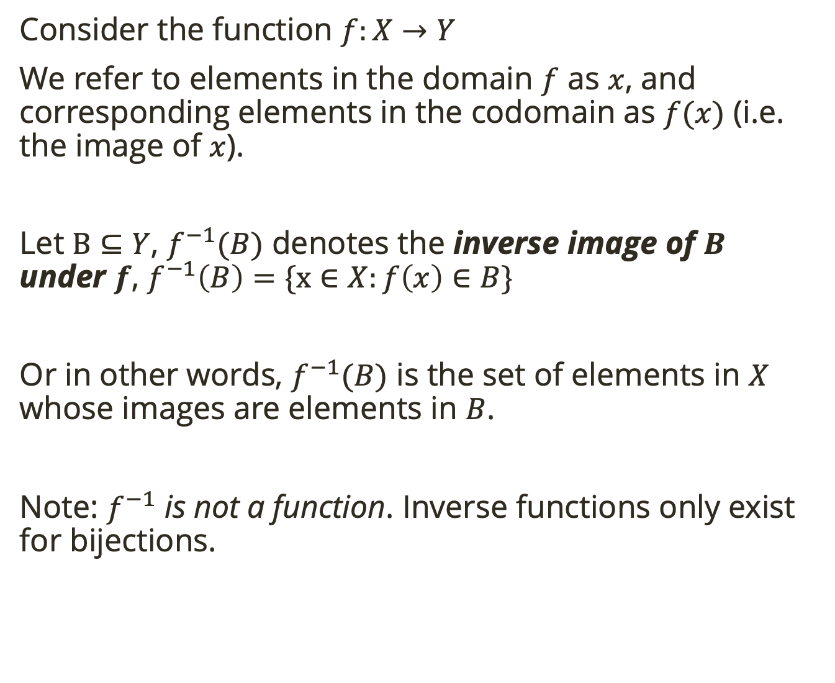
Image and Inverse Image
Consider the function $f:X→Y$
We refer to elements in the domain $f$ as $x$, and corresponding elements in the codomain as $f(x)$ (i.e. the image of $x$).
Let $B⊆Y$, $f^{−1}(B)$ denotes the inverse image of $B$ under $f$, $f^{−1}\left(B\right)=\{x∈X:f\left(x\right)∈B\}$
Or in other words, $f^{−1}(B)$ is the set of elements in $X$ whose images are elements in $B$.
Note: $f^{−1}$ is not a function. Inverse functions only exist for bijections.
Notes:
yes and no.

Slide 32

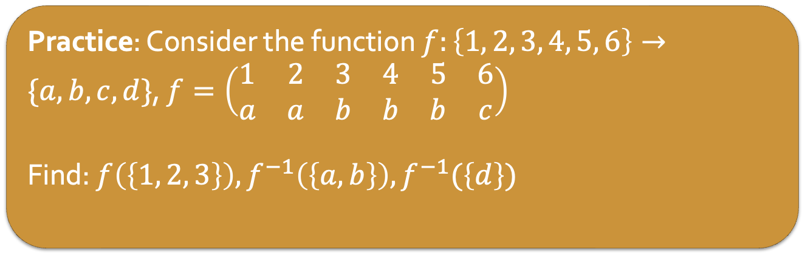
Image and Inverse Image
Consider the function $f:X→Y$
We refer to elements in the domain $f$ as $x$, and corresponding elements in the codomain as $f(x)$ (i.e. the image of $x$).
Let $A⊆X$, $f(A)$ denotes the image of $A$ under $f$,
$f\left(A\right)=\{f\left(a\right)∈Y:a∈A\}$
Let $B⊆Y$, $f^{−1}(B)$ denotes the inverse image of $B$ under $f$, $f^{−1}\left(B\right)=\{x∈X:f\left(x\right)∈B\}$
Practice: Consider the function $f:\left\{1, 2, 3, 4, 5, 6\right\}→\{a, b, c, d\}$, $f=\left(\begin{matrix}1 & 2 & 3 & 4 & 5 & 6 \\ a & a & b & b & b & c\end{matrix}\right)$
Find: $f\left(\left\{1, 2, 3\right\}\right), f^{−1}\left(\left\{a, b\right\}\right), f^{−1}(\left\{d\right\})$
Notes:
{a. b}
{1, 2, 3, 4, 5}
empty set

Slide 33
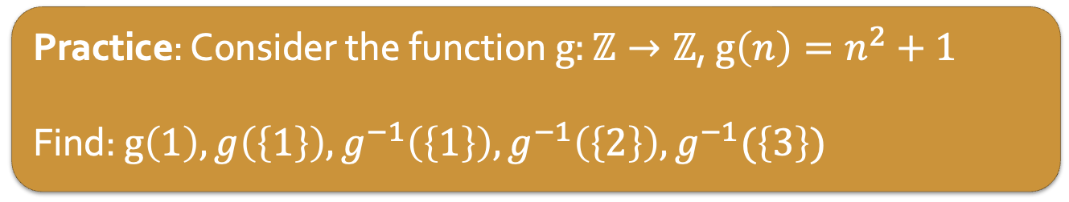
Image and Inverse Image
Consider the function $f:X→Y$
We refer to elements in the domain $f$ as $x$, and corresponding elements in the codomain as $f(x)$ (i.e. the image of $x$).
Let $A⊆X$, $f(A)$ denotes the image of $A$ under $f$,
$f\left(A\right)=\{f\left(a\right)∈Y:a∈A\}$
Let $B⊆Y$, $f^{−1}(B)$ denotes the inverse image of $B$ under $f$, $f^{−1}\left(B\right)=\{x∈X:f\left(x\right)∈B\}$
Practice: Consider the function $g:ℤ→ℤ$, $g\left(n\right)=n^{2}+1$
Find: $g\left(1\right), g\left(\left\{1\right\}\right), g^{−1}\left(\left\{1\right\}\right), g^{−1}\left(\left\{2\right\}\right), g^{−1}(\left\{3\right\})$
Notes:
2
{2}
{0} (need ints such that n^2 + 1 = 1
{-1, 1}
emptyset

Slide 34
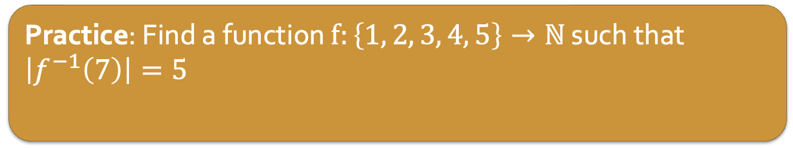
Image and Inverse Image
Consider the function $f:X→Y$
We refer to elements in the domain $f$ as $x$, and corresponding elements in the codomain as $f(x)$ (i.e. the image of $x$).
Let $A⊆X$, $f(A)$ denotes the image of $A$ under $f$,
$f\left(A\right)=\{f\left(a\right)∈Y:a∈A\}$
Let $B⊆Y$, $f^{−1}(B)$ denotes the inverse image of $B$ under $f$, $f^{−1}\left(B\right)=\{x∈X:f\left(x\right)∈B\}$
Practice: Find a function $f:\left\{1, 2, 3, 4, 5\right\}→ℕ$ such that $\left|f^{−1}\left(7\right)\right|=5$
Notes:
must be a function that maps every domain elem to 7

