Slide 1
Discrete Structures– Sequences Pt. 2
Dr. Ab Mosca (they/them)

Slide 2
Plan for Today
Sequences
Sums
Solving recurrences

Slide 3
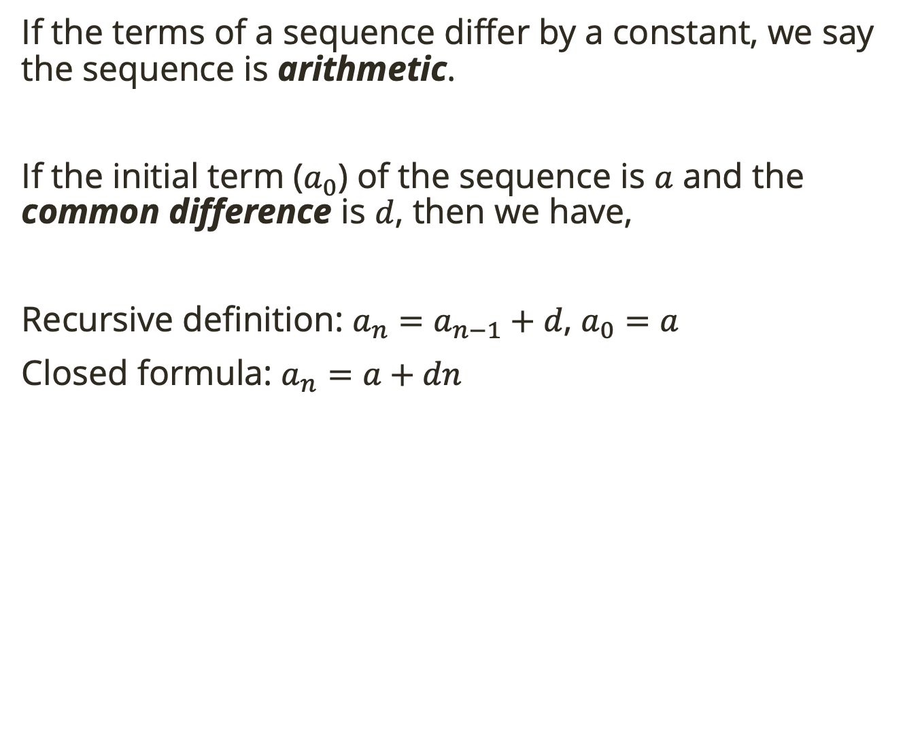
Warm Up: Arithmetic Sequences
If the terms of a sequence differ by a constant, we say the sequence is arithmetic.
If the initial term ($a_{0}$) of the sequence is $a$ and the common difference is $d$, then we have,
Recursive definition: $a_{n}=a_{n−1}+d$, $a_{0}=a$
Closed formula: $a_{n}=a+dn$
Find the recursive definition and closed formula for this sequence:
8, 14, 20, 26, …
Notes:
a_0 = 8, d = 6

Slide 4
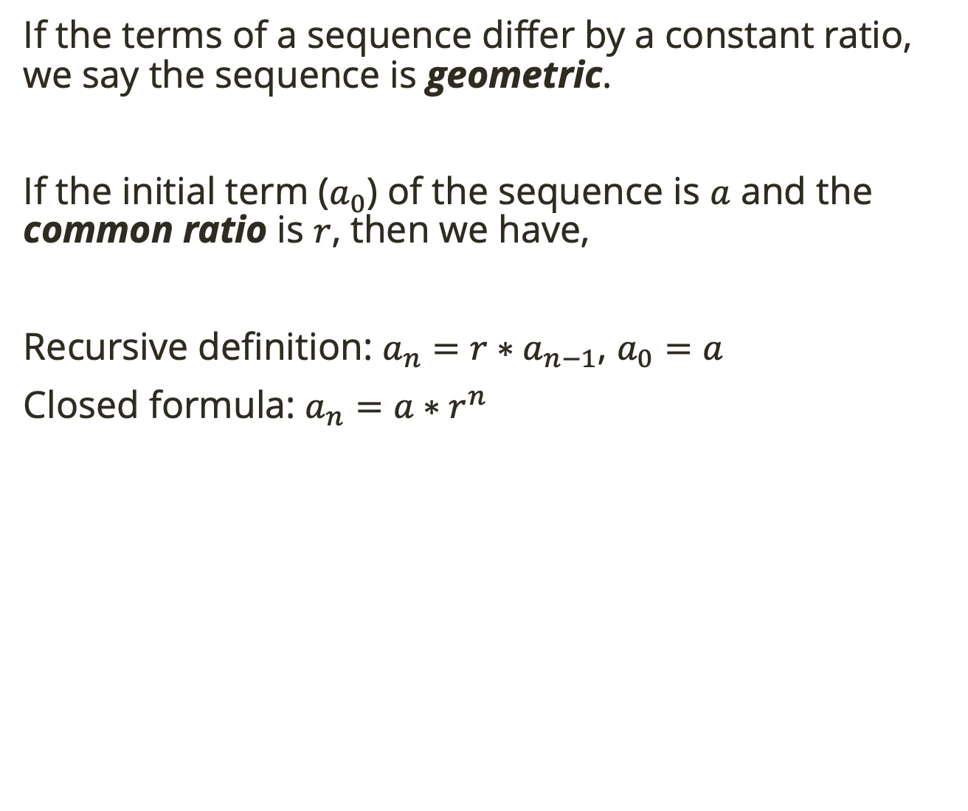
Warm Up: Geometric Sequences
If the terms of a sequence differ by a constant ratio, we say the sequence is geometric.
If the initial term ($a_{0}$) of the sequence is $a$ and the common ratio is $r$, then we have,
Recursive definition: $a_{n}={r∗a}_{n−1}$, $a_{0}=a$
Closed formula: $a_{n}=a∗r^{n}$
Find the recursive definition and closed formula for this sequence:
8, 32, 128, 512, …
Notes:
a_0 = 8, r = 4

Slide 5
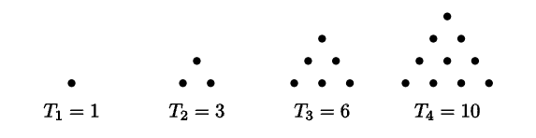
Motivation
Consider the triangular numbers
Is this sequence arithmetic, geometric, or neither?
Notes:
a_0 = 8, r = 4

Slide 6
Motivation
Consider the triangular numbers
Is this sequence arithmetic, geometric, or neither?
What if you look at the sequence of differences between consecutive terms?
Notes:
differences between terms are arithmetic: 2, 3, 4, 5, 6, …
That means the nth term (T_n) is the sum of the first n terms of the sequence 1, 2, 3
Write as a triangle to see
1 = 1
3 = 1+2
6 = 1+2+3
10=1+2+3+4
…
T_n = 1+2+3+…+n

Slide 7

Motivation
Consider the triangular numbers
$\left(T_{n}\right)$ is a sequence of partial sums.
Notes:
differences between terms are arithmetic: 2, 3, 4, 5, 6, …
That means the nth term (T_n) is the sum of the first n terms of the sequence 1, 2, 3
Write as a triangle to see
1 = 1
3 = 1+2
6 = 1+2+3
10=1+2+3+4
…
T_n = 1+2+3+…+n

Slide 8
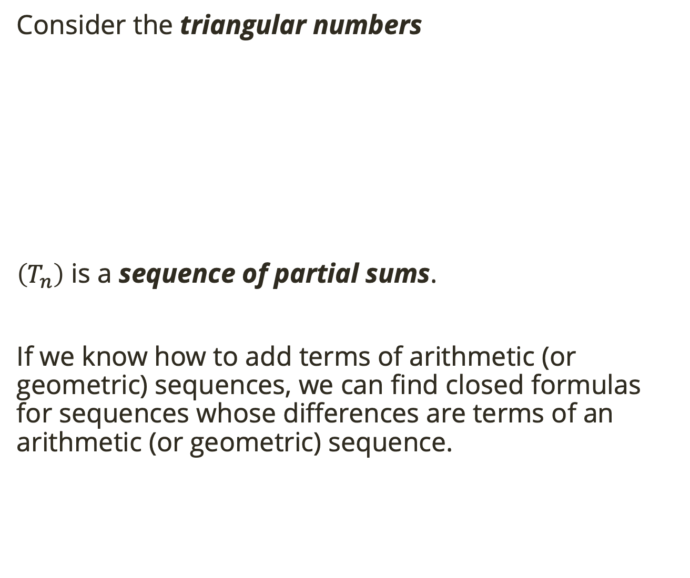
Motivation
Consider the triangular numbers
$\left(T_{n}\right)$ is a sequence of partial sums.
If we know how to add terms of arithmetic (or geometric) sequences, we can find closed formulas for sequences whose differences are terms of an arithmetic (or geometric) sequence.
Notes:
differences between terms are arithmetic: 2, 3, 4, 5, 6, …
That means the nth term (T_n) is the sum of the first n terms of the sequence 1, 2, 3
Write as a triangle to see
1 = 1
3 = 1+2
6 = 1+2+3
10=1+2+3+4
…
T_n = 1+2+3+…+n

Slide 9

Summing Arithmetic Sequences
Ex. Find the sum of the first 100 integers: $1, 2, 3, …, 98, 99, 100$
Notice that if we add pairs starting from the smallest and largest to the next smallest and largest to the next, we get the same number.
$1+100=101$
$2+99 =101$
$3+98 =101$
Notes:
regroup to get 1+100 = 101, then 2+99 = 101, then 3 + 98 = 101
so I’m adding 101 how many times? How does that compare to the number of terms in the sum?
T_n = n(n+1)/2

Slide 10

Summing Arithmetic Sequences
Ex. Find the sum of the first 100 integers: $1, 2, 3, …, 98, 99, 100$
Notice that if we add pairs starting from the smallest and largest to the next smallest and largest to the next, we get the same number.
$1+100=101$
$2+99 =101$
$3+98 =101$
If we continue, we end up adding 50 pairs (half the number of terms) all equal to our last term (100th) + 1.
So, $T_{n}=\frac{n(n+1)}{2}$
Notes:
regroup to get 1+100 = 101, then 2+99 = 101, then 3 + 98 = 101
so I’m adding 101 how many times? How does that compare to the number of terms in the sum?
T_n = n(n+1)/2

Slide 11

Summing Arithmetic Sequences
The partial sum, $S_{n}$, of any arithmetic sequence can be computed by reversing terms and adding, then multiplying by $\frac{n}{2}$.

Slide 12

Summing Arithmetic Sequences
The partial sum, $S_{n}$, of any arithmetic sequence can be computed by reversing terms and adding, then multiplying by $\frac{n}{2}$.
Ex. $2+5+8+11+14+…+470$

Slide 13

Summing Arithmetic Sequences
The partial sum, $S_{n}$, of any arithmetic sequence can be computed by reversing terms and adding, then multiplying by $\frac{n}{2}$.
Ex. $2+5+8+11+14+…+470$
$d=3, a_{0}=2, a_{n}=2+3n$

Slide 14

Summing Arithmetic Sequences
The partial sum, $S_{n}$, of any arithmetic sequence can be computed by reversing terms and adding, then multiplying by $\frac{n}{2}$.
Ex. $2+5+8+11+14+…+470$
$d=3, a_{0}=2, a_{n}=2+3n$
$S=2 +5 +8 +…+464+467+470$
$S=470+467+464+…+8 +5 +2$
$2S=472+472+472+…+472+472+472$

Slide 15

Summing Arithmetic Sequences
The partial sum, $S_{n}$, of any arithmetic sequence can be computed by reversing terms and adding, then multiplying by $\frac{n}{2}$.
Ex. $2+5+8+11+14+…+470$
$d=3, a_{0}=2, a_{n}=2+3n$
$S=2 +5 +8 +…+464+467+470$
$S=470+467+464+…+8 +5 +2$
$2S=472+472+472+…+472+472+472$
We know $2+3n=470, n=156$, so there are $157$ terms

Slide 16

Summing Arithmetic Sequences
The partial sum, $S_{n}$, of any arithmetic sequence can be computed by reversing terms and adding, then multiplying by $\frac{n}{2}$.
Ex. $2+5+8+11+14+…+470$
$d=3, a_{0}=2, a_{n}=2+3n$
$S=2 +5 +8 +…+464+467+470$
$S=470+467+464+…+8 +5 +2$
$2S=472+472+472+…+472+472+472$
We know $2+3n=470, n=156$, so there are $157$ terms
So, $2S=157∗472, S=\frac{157}{2}∗472=37052$

Slide 17

Summing Arithmetic Sequences
Find the sum of $5+9+13+17+21+…+533$
The partial sum, $S_{n}$, of any arithmetic sequence can be computed by reversing terms and adding, then multiplying by $\frac{n}{2}$.
Ex. $2+5+8+11+14+…+470$
$d=3, a_{0}=2, a_{n}=2+3n$
$S=2 +5 +8 +…+464+467+470$
$S=470+467+464+…+8 +5 +2$
$2S=472+472+472+…+472+472+472$
We know $2+3n=470, n=156$, so there are $157$ terms
So, $2S=157∗472, S=\frac{157}{2}∗472=37052$
Notes:
35777

Slide 18
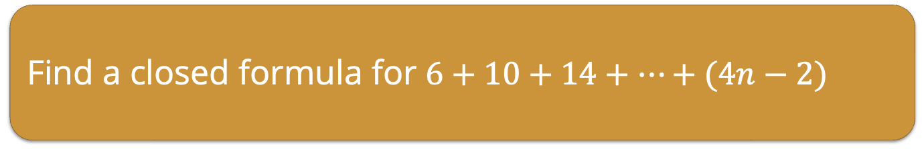
Summing Arithmetic Sequences
Find a closed formula for $6+10+14+…+(4n−2)$
The partial sum, $S_{n}$, of any arithmetic sequence can be computed by reversing terms and adding, then multiplying by $\frac{n}{2}$.
Ex. $2+5+8+11+14+…+470$
$d=3, a_{0}=2, a_{n}=2+3n$
$S=2 +5 +8 +…+464+467+470$
$S=470+467+464+…+8 +5 +2$
$2S=472+472+472+…+472+472+472$
We know $2+3n=470, n=156$, so there are $157$ terms
So, $2S=157∗472, S=\frac{157}{2}∗472=37052$
Notes:
S = (n-1)(4n+4)/2

Slide 19

Summing Arithmetic Sequences
Find a closed formula for ${\left(a_{n}\right)}_{n≥0}:2, 3, 7, 14, 24, 37, …$
The partial sum, $S_{n}$, of any arithmetic sequence can be computed by reversing terms and adding, then multiplying by $\frac{n}{2}$.
Ex. $2+5+8+11+14+…+470$
$d=3, a_{0}=2, a_{n}=2+3n$
$S=2 +5 +8 +…+464+467+470$
$S=470+467+464+…+8 +5 +2$
$2S=472+472+472+…+472+472+472$
We know $2+3n=470, n=156$, so there are $157$ terms
So, $2S=157∗472, S=\frac{157}{2}∗472=37052$
Notes:
arithmetic sequence of differences
a_n = 2 +1+4+7+10+…+(1+3(n-1)) [makes indices line up]
keep the 2 out of the reverse part bc it doesn’t fit pattern
a_n = (4+(3n-1)n)/2
Check with a few

Slide 20

Summing Geometric Sequences
The partial sum, $S_{n}$, of any geometric sequence can be computed by multiplying by the common ratio, shifting, then subtracting.
Ex. $3+6+12+24+…+12288$
Notes:
multiplying by the common ration makes each term the next, so we shift the sum to get cancelation

Slide 21

Summing Geometric Sequences
The partial sum, $S_{n}$, of any geometric sequence can be computed by multiplying by the common ratio, shifting, then subtracting.
Ex. $3+6+12+24+…+12288$
$r=2, a_{0}=3, a_{n}=3∗2^{n}$
Notes:
multiplying by the common ration makes each term the next, so we shift the sum to get cancelation

Slide 22

Summing Geometric Sequences
The partial sum, $S_{n}$, of any geometric sequence can be computed by multiplying by the common ratio, shifting, then subtracting.
Ex. $3+6+12+24+…+12288$
$r=2, a_{0}=3, a_{n}=3∗2^{n}$
$S=3+6+12+24+…+12288$
$2S= 6+12+24+…+12288+24576$
$−S=3+0+ 0+ 0 +…+0 −24576$
$S=24573$
Notes:
multiplying by the common ration makes each term the next, so we shift the sum to get cancelation

Slide 23
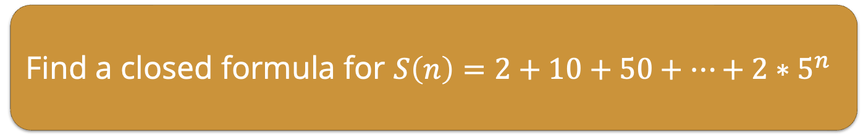
Summing Geometric Sequences
The partial sum, $S_{n}$, of any geometric sequence can be computed by multiplying by the common ratio, shifting, then subtracting.
Ex. $3+6+12+24+…+12288$
$r=2, a_{0}=3, a_{n}=3∗2^{n}$
$S=3+6+12+24+…+12288$
$2S= 6+12+24+…+12288+24576$
$−S=3+0+ 0+ 0 +…+0 −24576$
$S=24573$
Find a closed formula for $S\left(n\right)=2+10+50+…+2∗5^{n}$
Notes:
r=5
S=2-2*5^(n+1)/-4

Slide 24
Solving Recurrence Relations
Converting a recursive definition into a closed formula is called solving a recurrence relation.
Sometimes, you can use your knowledge of known sequences to determine the closed formula for a recurrence relation.
Other times, finding the closed formula is more difficult.
Notes:
r=5
S=2-2*5^(n+1)/-4

Slide 25

Solving Recurrence Relations
Characteristic roots
Given a recurrence relation $a_{n}+αa_{n−1}+βa_{n−2}$, the characteristic polynomial is
$$x^{2}+αx+β$$
giving the characteristic equation:
$$x^{2}+αx+β=0$$
If $r_{1}$ and $r_{2}$ are two distinct roots of the characteristic polynomial, then the solution to the recurrence relation is
$$a_{n}=ar_{1}^{n}+br_{2}^{n}$$
where $a,b$ are constants determined by the initial conditions.
Notes:
roots = solution

Slide 26

Solving Recurrence Relations
Characteristic roots: Given a recurrence relation $a_{n}+αa_{n−1}+βa_{n−2}$, the characteristic polynomial is
$$x^{2}+αx+β$$
giving the characteristic equation:
$$x^{2}+αx+β=0$$
If $r_{1}$ and $r_{2}$ are two distinct roots of the characteristic polynomial, then the solution to the recurrence relation is
$$a_{n}=ar_{1}^{n}+br_{2}^{n}$$
where $a,b$ are constants determined by the initial conditions.
Ex. $a_{n}=7a_{n−1}−10a_{n−2}, a_{0}=2, a_{1}=3$
Notes:
roots = solution

Slide 27

Solving Recurrence Relations
Characteristic roots: Given a recurrence relation $a_{n}+αa_{n−1}+βa_{n−2}$, the characteristic polynomial is
$$x^{2}+αx+β$$
giving the characteristic equation:
$$x^{2}+αx+β=0$$
If $r_{1}$ and $r_{2}$ are two distinct roots of the characteristic polynomial, then the solution to the recurrence relation is
$$a_{n}=ar_{1}^{n}+br_{2}^{n}$$
where $a,b$ are constants determined by the initial conditions.
Ex. $a_{n}=7a_{n−1}−10a_{n−2}, a_{0}=2, a_{1}=3$
$$a_{n}−7a_{n−1}+10a_{n−2}=0$$
Notes:
roots = solution

Slide 28

Solving Recurrence Relations
Characteristic roots: Given a recurrence relation $a_{n}+αa_{n−1}+βa_{n−2}$, the characteristic polynomial is
$$x^{2}+αx+β$$
giving the characteristic equation:
$$x^{2}+αx+β=0$$
If $r_{1}$ and $r_{2}$ are two distinct roots of the characteristic polynomial, then the solution to the recurrence relation is
$$a_{n}=ar_{1}^{n}+br_{2}^{n}$$
where $a,b$ are constants determined by the initial conditions.
Ex. $a_{n}=7a_{n−1}−10a_{n−2}, a_{0}=2, a_{1}=3$
$$a_{n}−7a_{n−1}+10a_{n−2}=0$$
$$x^{2}−7x+10=0$$
Notes:
roots = solution

Slide 29

Solving Recurrence Relations
Characteristic roots: Given a recurrence relation $a_{n}+αa_{n−1}+βa_{n−2}$, the characteristic polynomial is
$$x^{2}+αx+β$$
giving the characteristic equation:
$$x^{2}+αx+β=0$$
If $r_{1}$ and $r_{2}$ are two distinct roots of the characteristic polynomial, then the solution to the recurrence relation is
$$a_{n}=ar_{1}^{n}+br_{2}^{n}$$
where $a,b$ are constants determined by the initial conditions.
Ex. $a_{n}=7a_{n−1}−10a_{n−2}, a_{0}=2, a_{1}=3$
$$a_{n}−7a_{n−1}+10a_{n−2}=0$$
$$x^{2}−7x+10=0$$
$$\left(x−2\right)\left(x−5\right)=0$$
So, $x=2, x=5$ are the characteristic roots and
$$a_{n}=a2^{n}+b5^{n}$$
Notes:
roots = solution

Slide 30

Solving Recurrence Relations
Characteristic roots: Given a recurrence relation $a_{n}+αa_{n−1}+βa_{n−2}$, the characteristic polynomial is
$$x^{2}+αx+β$$
giving the characteristic equation:
$$x^{2}+αx+β=0$$
If $r_{1}$ and $r_{2}$ are two distinct roots of the characteristic polynomial, then the solution to the recurrence relation is
$$a_{n}=ar_{1}^{n}+br_{2}^{n}$$
where $a,b$ are constants determined by the initial conditions.
Ex. $a_{n}=7a_{n−1}−10a_{n−2}, a_{0}=2, a_{1}=3$
$$a_{n}−7a_{n−1}+10a_{n−2}=0$$
$$x^{2}−7x+10=0$$
$$\left(x−2\right)\left(x−5\right)=0$$
So, $x=2, x=5$ are the characteristic roots and
$$a_{n}=a2^{n}+b5^{n}$$
Solve for $a,b$ with the initial conditions
$$2=a2^{0}+b5^{0}=a+b$$
$$3=a2^{1}+b5^{1}=2a+5b$$
Notes:
roots = solution

Slide 31

Solving Recurrence Relations
Characteristic roots: Given a recurrence relation $a_{n}+αa_{n−1}+βa_{n−2}$, the characteristic polynomial is
$$x^{2}+αx+β$$
giving the characteristic equation:
$$x^{2}+αx+β=0$$
If $r_{1}$ and $r_{2}$ are two distinct roots of the characteristic polynomial, then the solution to the recurrence relation is
$$a_{n}=ar_{1}^{n}+br_{2}^{n}$$
where $a,b$ are constants determined by the initial conditions.
Ex. $a_{n}=7a_{n−1}−10a_{n−2}, a_{0}=2, a_{1}=3$
$$a_{n}−7a_{n−1}+10a_{n−2}=0$$
$$x^{2}−7x+10=0$$
$$\left(x−2\right)\left(x−5\right)=0$$
So, $x=2, x=5$ are the characteristic roots and
$$a_{n}=a2^{n}+b5^{n}$$
Solve for $a,b$ with the initial conditions
$$2=a2^{0}+b5^{0}=a+b$$
$$3=a2^{1}+b5^{1}=2a+5b$$
$$a=\frac{7}{3}, b=−\frac{1}{3}$$
So, $a_{n}=\frac{7}{3}2^{n}−\frac{1}{3}5^{n}$
Notes:
roots = solution

Slide 32

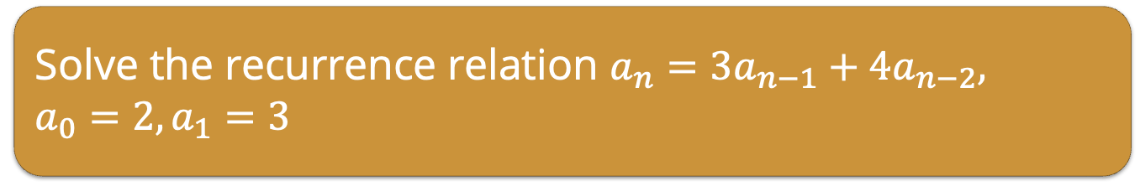
Solving Recurrence Relations
Characteristic roots: Given a recurrence relation $a_{n}+αa_{n−1}+βa_{n−2}$, the characteristic polynomial is
$$x^{2}+αx+β$$
giving the characteristic equation:
$$x^{2}+αx+β=0$$
If $r_{1}$ and $r_{2}$ are two distinct roots of the characteristic polynomial, then the solution to the recurrence relation is
$$a_{n}=ar_{1}^{n}+br_{2}^{n}$$
where $a,b$ are constants determined by the initial conditions.
Solve the recurrence relation $a_{n}=3a_{n−1}+4a_{n−2},$
$a_{0}=2, a_{1}=3$
Notes:
a_n=4^n+(-1)^n

Slide 33

Solving Recurrence Relations
Characteristic roots: Given a recurrence relation $a_{n}+αa_{n−1}+βa_{n−2}$, the characteristic polynomial is
$$x^{2}+αx+β$$
giving the characteristic equation:
$$x^{2}+αx+β=0$$
If $r_{1}$ and $r_{2}$ are two distinct roots of the characteristic polynomial, then the solution to the recurrence relation is
$$a_{n}=ar_{1}^{n}+br_{2}^{n}$$
where $a,b$ are constants determined by the initial conditions.
Note: You might need to use the quadratic formula to find roots:
$$ax^{2}+bx+c=0, x=\frac{−b±\sqrt{b^{2}−4ac}}{2a}$$
Notes:
a_n=4^n+(-1)^n

Slide 34

Solving Recurrence Relations
Characteristic roots: Given a recurrence relation $a_{n}+αa_{n−1}+βa_{n−2}$, the characteristic polynomial is
$$x^{2}+αx+β$$
giving the characteristic equation:
$$x^{2}+αx+β=0$$
If $r_{1}$ and $r_{2}$ are two distinct roots of the characteristic polynomial, then the solution to the recurrence relation is
$$a_{n}=ar_{1}^{n}+br_{2}^{n}$$
where $a,b$ are constants determined by the initial conditions.
If the characteristic polynomial has only one root, $r$, the solution to the recurrence relation is
$$a_{n}=ar^{n}+bnr^{n}$$
Notes:
a_n=4^n+(-1)^n

Slide 35
Solving Recurrence Relations
Characteristic roots: Given a recurrence relation $a_{n}+αa_{n−1}+βa_{n−2}$, the characteristic polynomial is
$$x^{2}+αx+β$$
giving the characteristic equation:
$$x^{2}+αx+β=0$$
If $r_{1}$ and $r_{2}$ are two distinct roots of the characteristic polynomial, then the solution to the recurrence relation is
$$a_{n}=ar_{1}^{n}+br_{2}^{n}$$
where $a,b$ are constants determined by the initial conditions.
If the characteristic polynomial has only one root, $r$, the solution to the recurrence relation is
$$a_{n}=ar^{n}+bnr^{n}$$
Solve the recurrence relation $a_{n}=6a_{n−1}−9a_{n−2}, a_{0}=1, a_{1}=4$
Notes:
a_n=3^n+1/3n3^n

