Slide 1
Communicating with Data – Choosing the Visual Channel
Dr. Ab Mosca (they/them)
Slides based off slides courtesy of Jordan Crouser (https://jcrouser.github.io/)

Slide 2
Plan for Today
Refresher: mental models
Putting marks together
Group activity: what we draw vs. what we see
Refresher: building blocks
Choosing visual channels
Group activity: does this follow the rules?

Slide 3
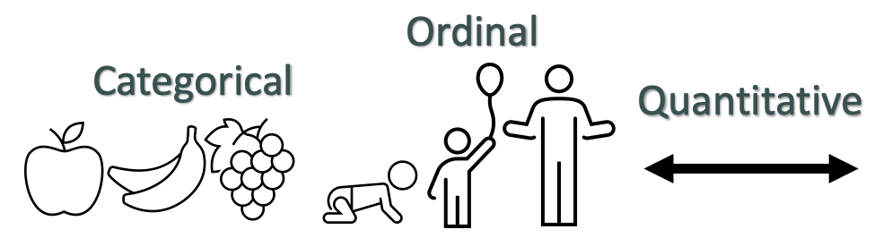
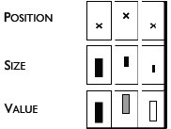

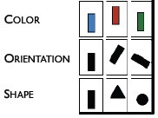
Data → Visuals
Remember… Big idea behind visualization
Map data dimensions to visual dimensions in a principled way
Not all visual dimensions can represent all data types
Jacques Bertin, Semiologie Graphique
(Semiology of Graphics), 1967.

Slide 4
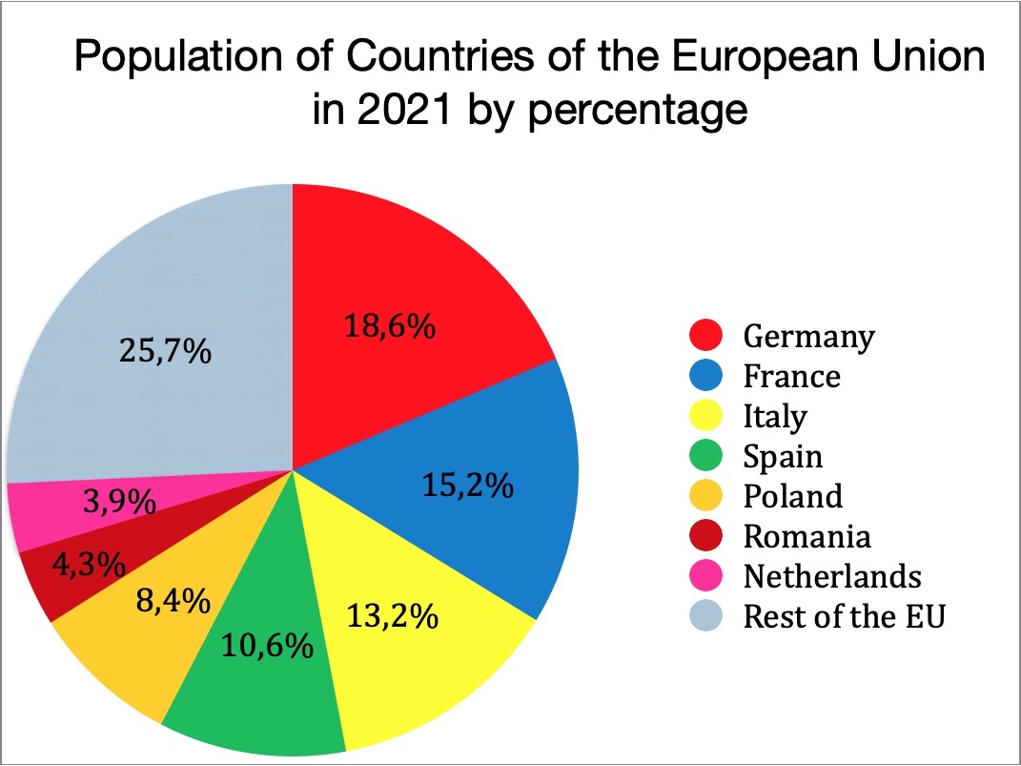
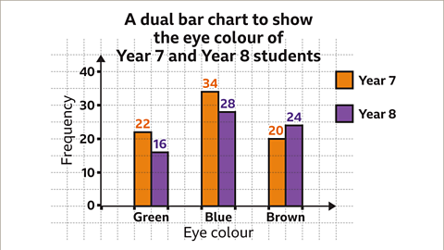
Data → Visuals
Data → Visual Mapping is the description of what data is represented by what visual channel.
Ex.
Remember… Big idea behind visualization
Map data dimensions to visual dimensions in a principled way
Not all visual dimensions can represent all data types
Jacques Bertin, Semiologie Graphique
(Semiology of Graphics), 1967.

Slide 5
Match Channel Type to Data Type
Ordered Data / Magnitude Channels
Principle 1: expressiveness
Fig. Courtesy of M Krzywinski
Notes:
The expressiveness of a visual encoding should “express all of, and only, the attributes of the data.” It is violated when we use encodings that do not match our data type or our visualization goals. When it fails, a chart is not only sub-optimal and confusing, it can be incorrect and misleading. Charts can fail the expressiveness test if their encodings imply ordering when there actually is none, or they mis-order a variable.

Slide 6
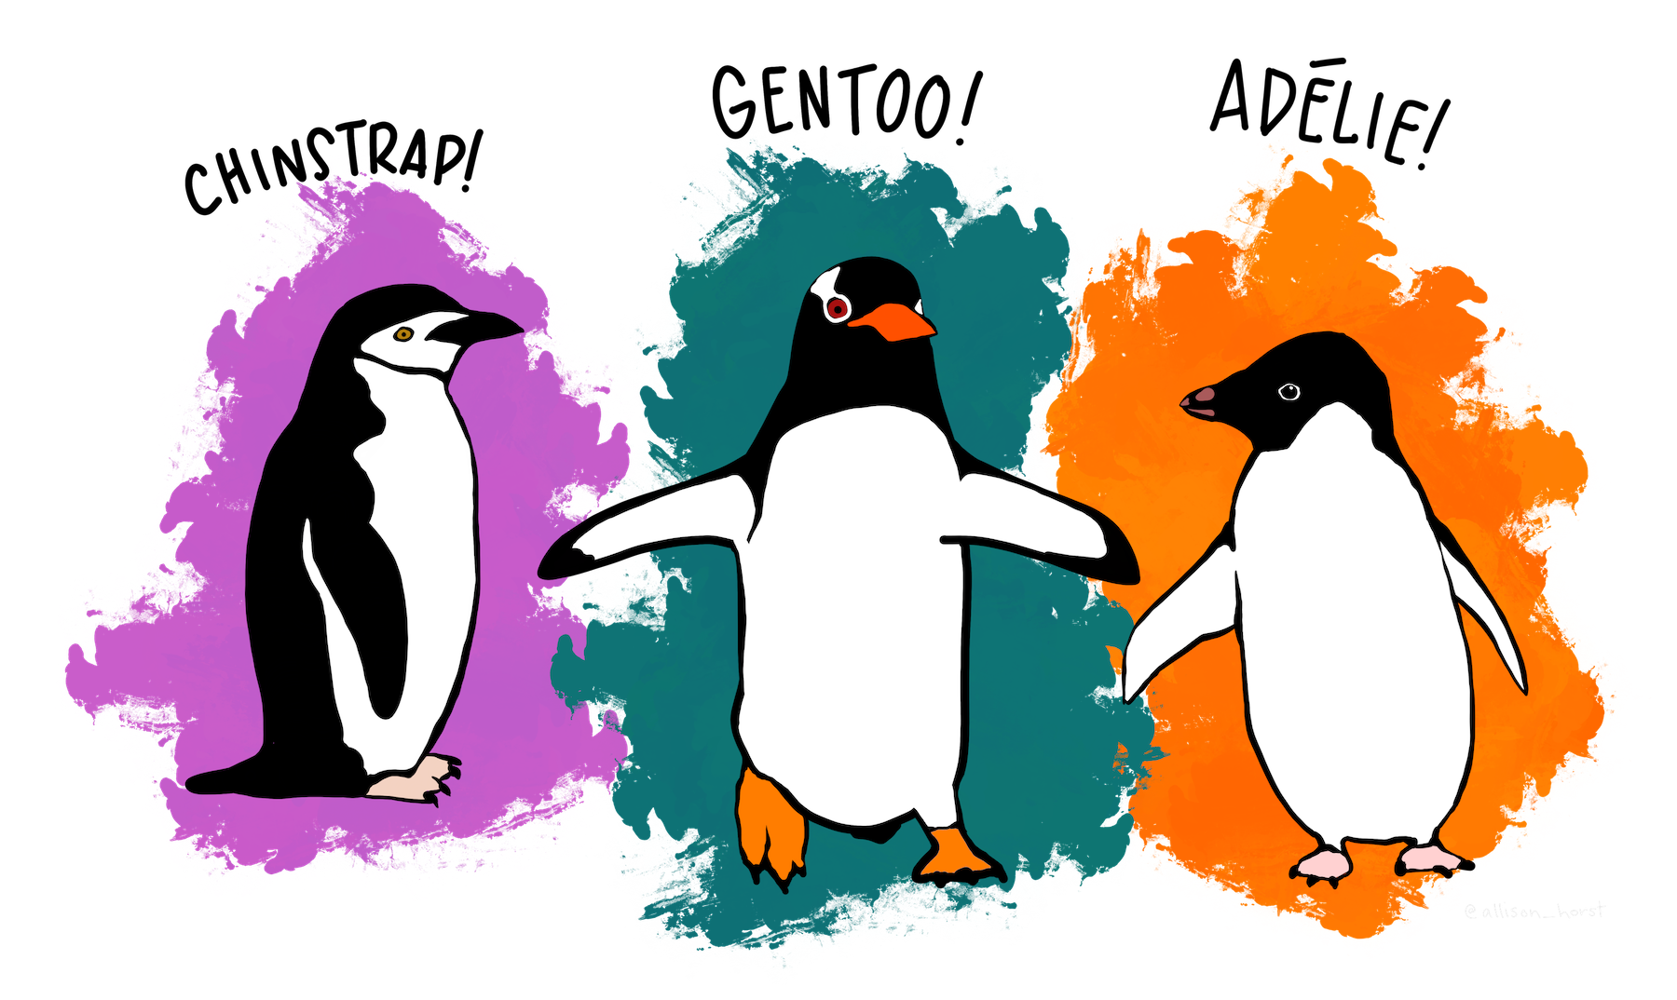
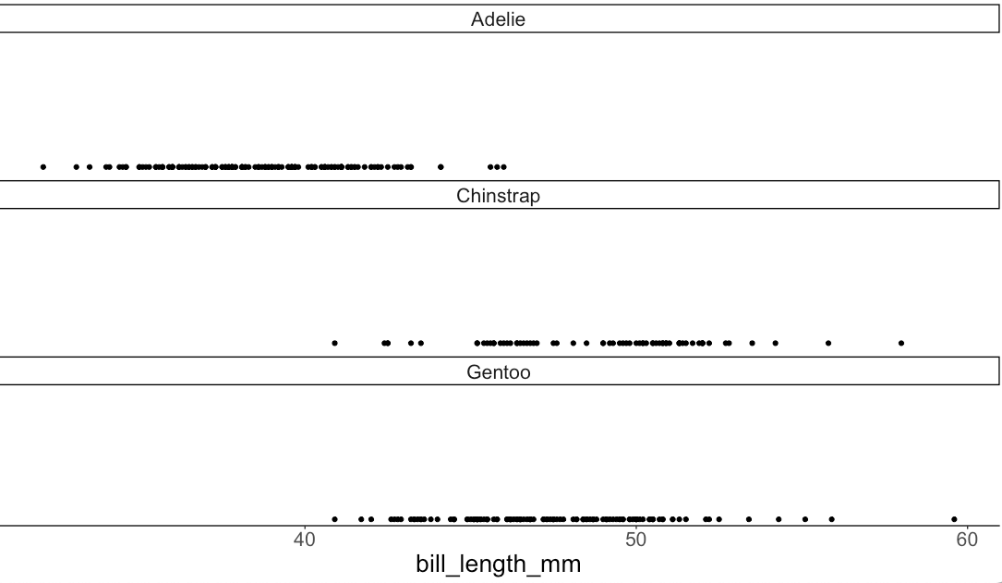
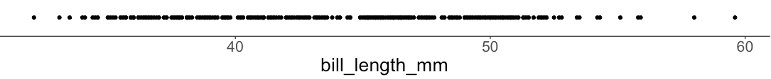
Encode all the facts
Principle 1: expressiveness
https://allisonhorst.github.io/palmerpenguins/#meet-the-palmer-penguins
Notes:
https://allisonhorst.github.io/palmerpenguins/#meet-the-palmer-penguins
Species, island, bill_length, bill_depth, flipper_length, body_mass

Slide 7
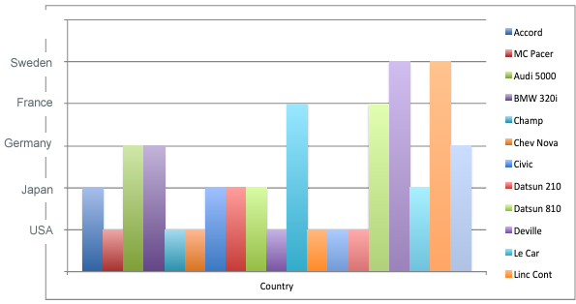
Only the facts
Principle 1: expressiveness
Adapted from Mackinlay J (1986) Automating the design of graphical presentations of relational information.
Notes:
Height implied sweeden is better

Slide 8
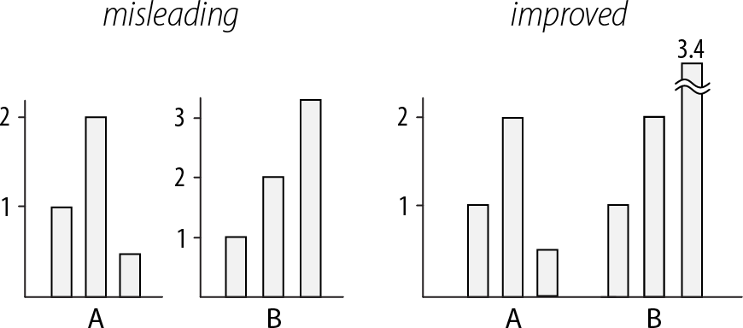
Use consistent axes when comparing charts
Principle 2: consistency
Raina SZ, et al. (2005) Evolution of base-substitution gradients in primate mitochondrial genomes. Genome Res 15: 665-673.
M. Krzwinski, behind every great visualization is a design
principle, 2012

Slide 9
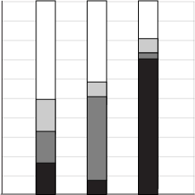
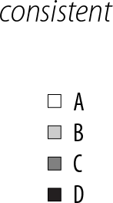
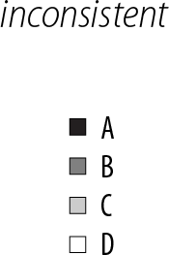
A note on legends: order items according to appearance
Principle 2: consistency
M. Krzwinski, behind every great visualization is a design principle, 2012

Slide 10
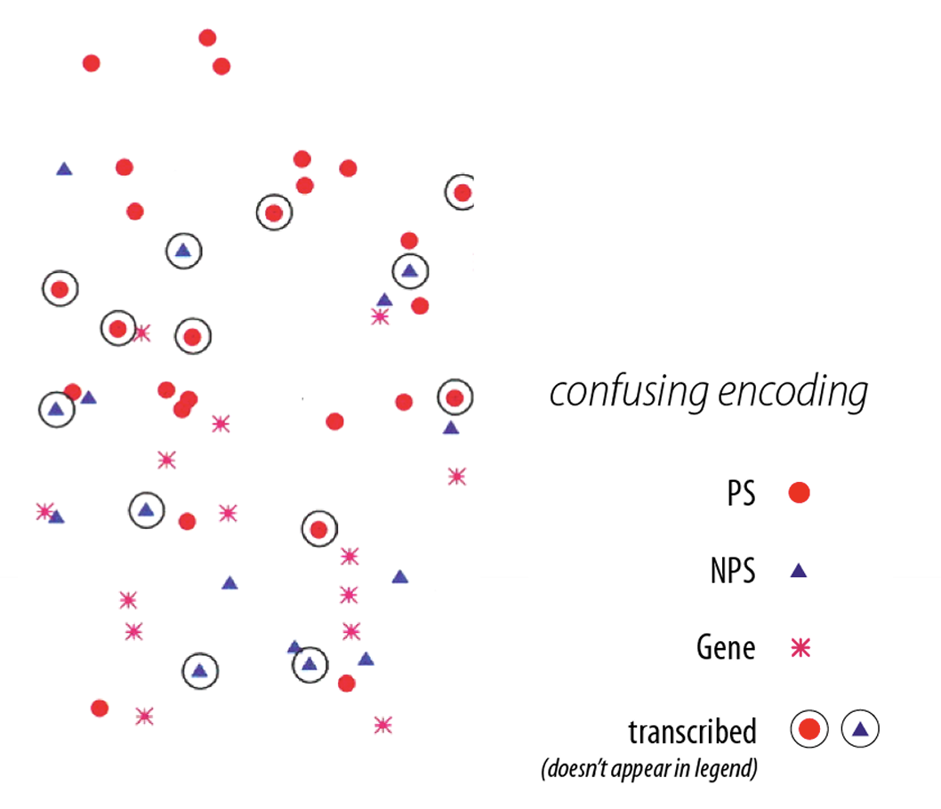
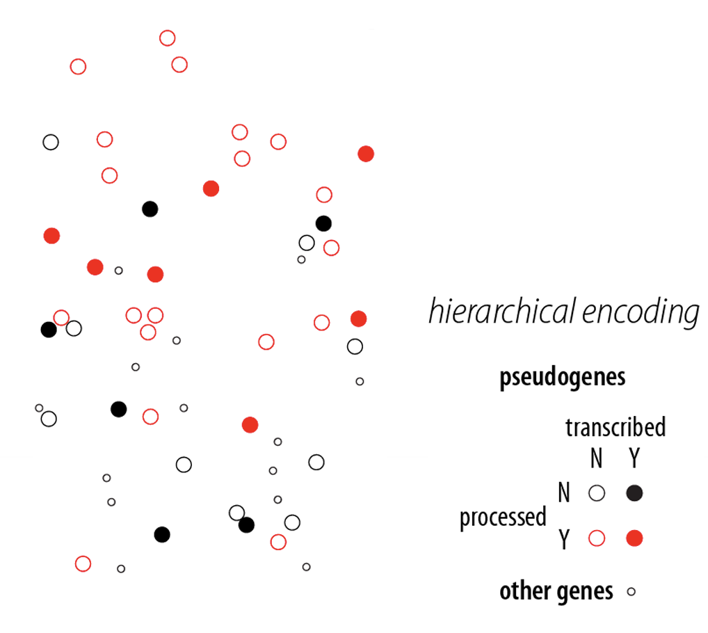
Visual variation should reflect and enhance the underlying variation in the data
Avoid visually similar encodings for independent variables
Example:
Principle 2: consistency
Fig. 2: M. Krzwinski, behind every great visualization is a design principle, 2012
Notes:
red - processed genes, but salience attenuated Ø ➢ other genes encoded with competing glyph - red star.

Slide 11
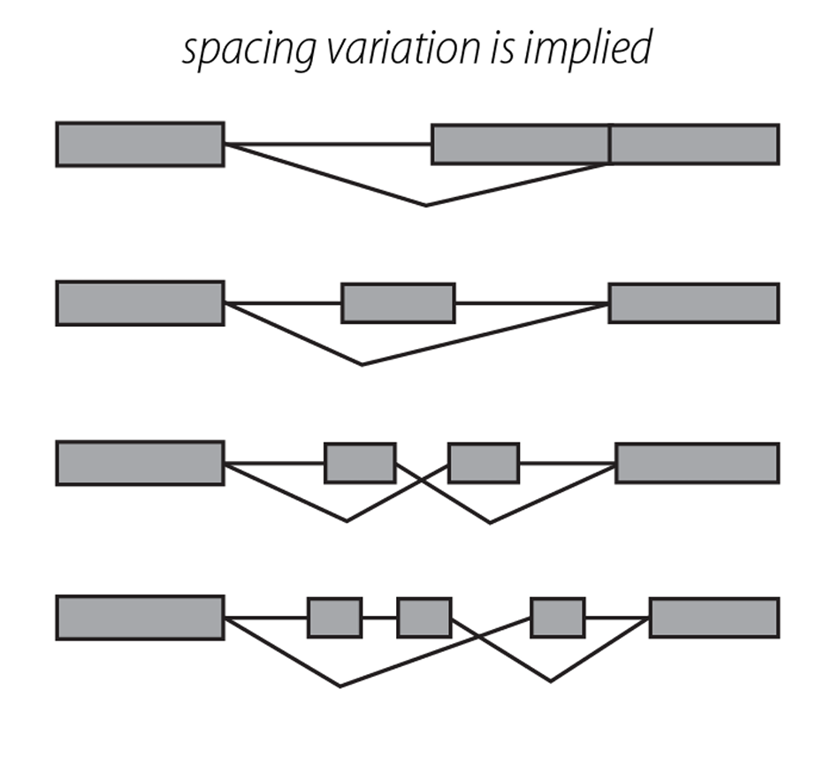
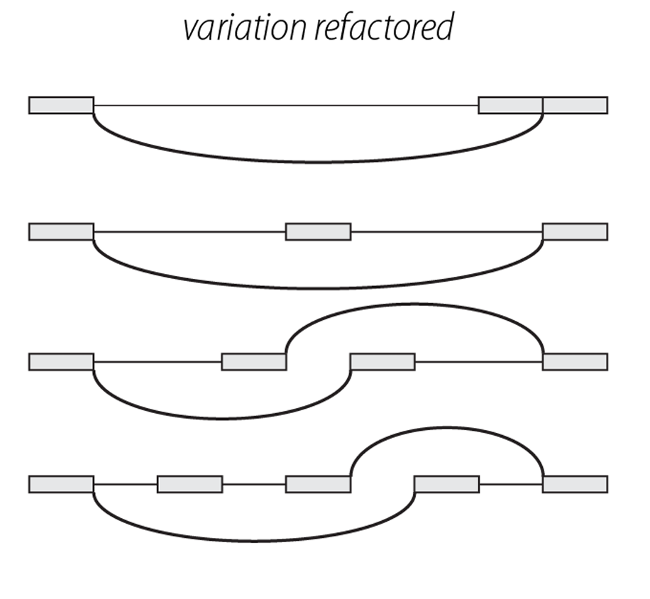
Uniform size and alignment reduces visual complexity and aids interpretation
Example:
Principle 2: consistency
Fig. 1: Sharov AA et al. (2005) Genome-wide assembly and analysis of alternative transcripts in mouse. Genome Res 15: 748-754.
Fig. 2: M. Krzwinski, behind every great visualization is a design principle, 2012

Slide 12

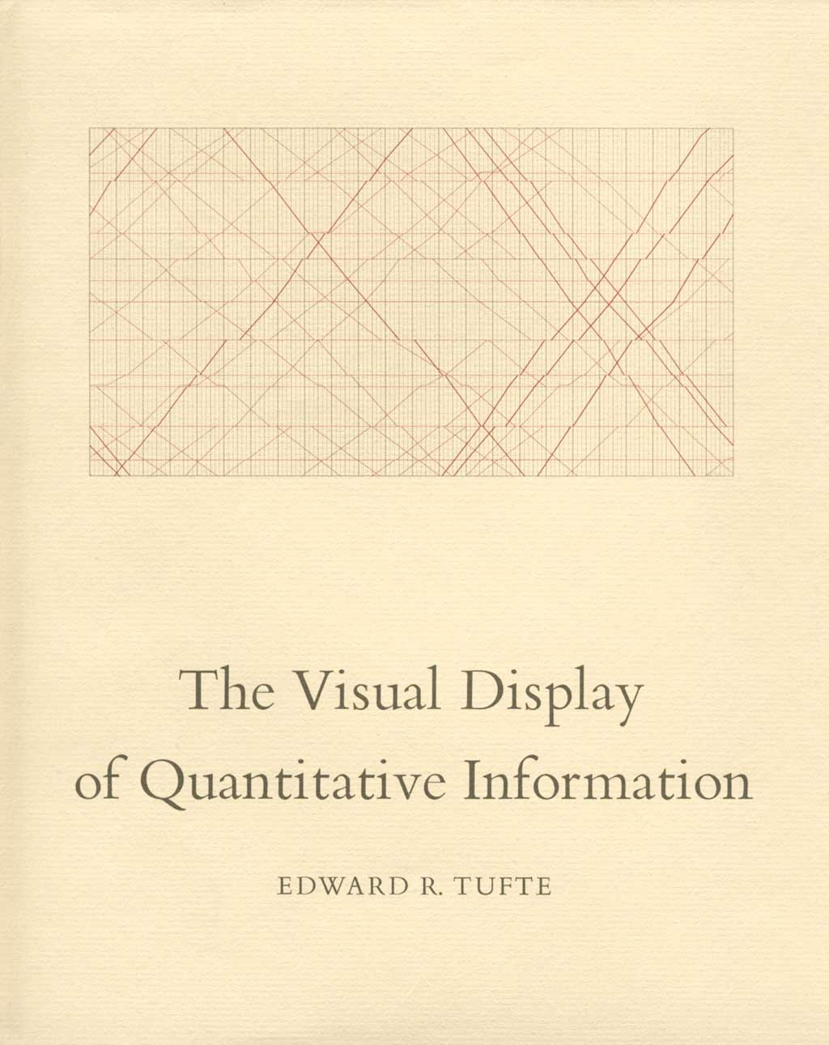
Tufte, 1983
“Above all else, show the data.”
Notes:
Kind of old news

Slide 13
Tufte, 1983
Data-ink
Data-ink ratio =
Total ink used to print the graphic
= proportion of a graphic's ink devoted to the non-redundant display of data-information
= 1 - proportion of a graphic that can be erased

Slide 14
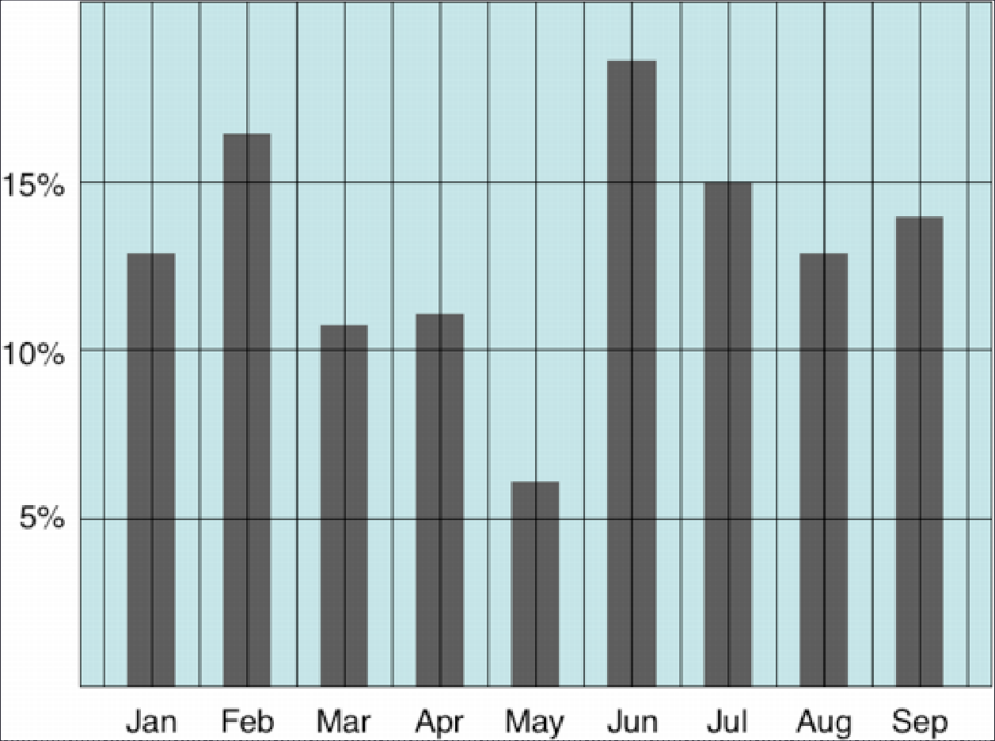
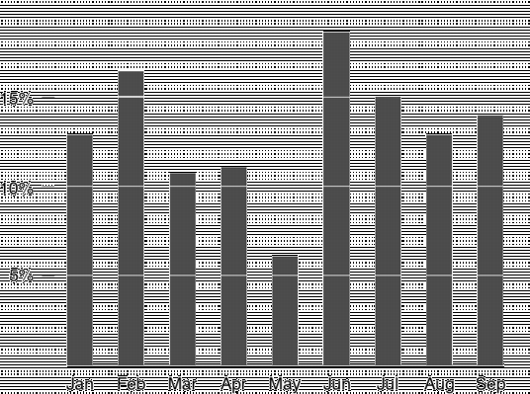

Tufte: maximize the data-ink ratio

Slide 15
Discussion
What do you think of the data-ink ratio?
Think of 3 specific ways to maximize it
Do you think there are limits or tradeoffs to this design approach?

Slide 16
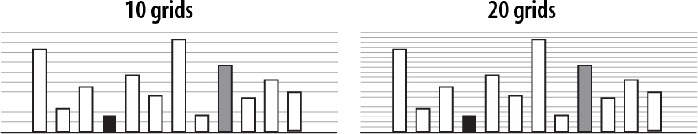
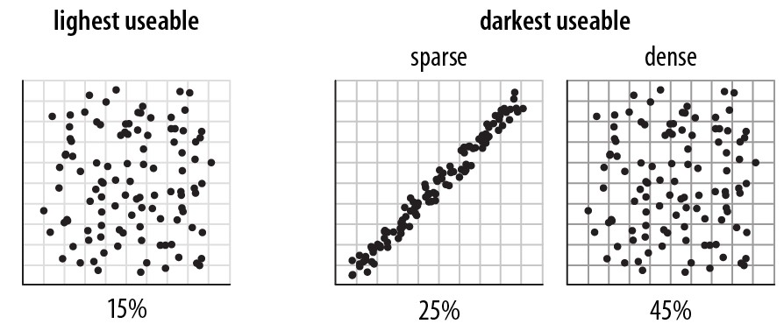
Navigational aids shouldn’t compete with data
Avoid: heavy axes, error bars and glyphs
Principle 3: importance ordering
Heer J, Bostock M (2010) Crowdsourcing graphical perception: using mechanical turk to assess visualization design. Proceedings of the 28th international conference on Human factors in computing systems. Atlanta, Georgia, USA: ACM. pp. 203-212.

Slide 17
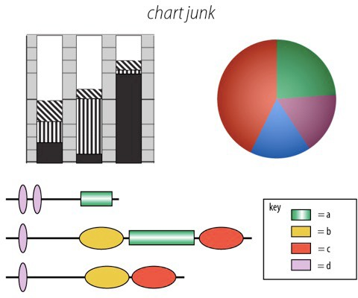
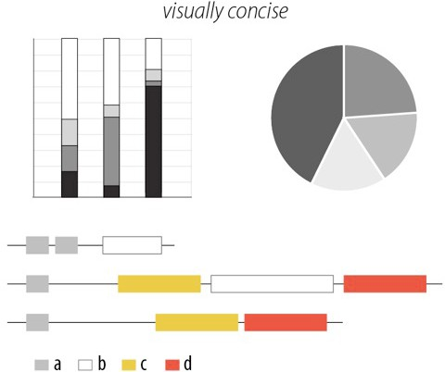
Simplify, simplify, simplify…
Principle 3: importance ordering
Sharov AA, et al (2006) Genome Res 16: 505-509.
Peterson J, et al. (2009) Genome Res 19: 2317-2323.
Thomson NR, et al. (2005) Genome Res 15: 629-640.
DB, Ko MS (2005) Genome Res 15: 748-754.
M. Krzwinski, behind every great visualization is a design
principle, 2012

Slide 18
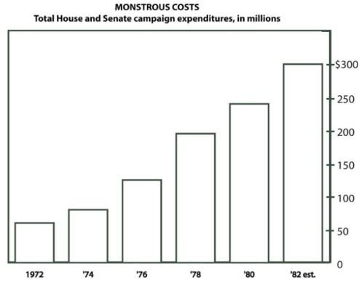
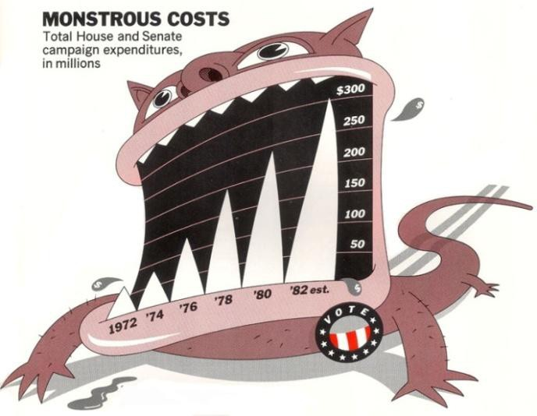

A caveat: “chart junk” and recall
Bateman et al. “Useful Junk? The Effects of Visual Embellishment on Comprehension and Memorability of Charts”, CHI 2010

Slide 19
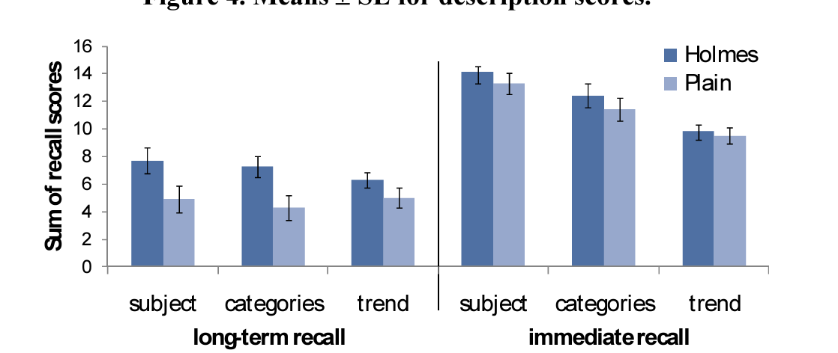
A caveat: “chart junk” and recall
Bateman et al. “Useful Junk? The Effects of Visual Embellishment on Comprehension and Memorability of Charts”, CHI 2010

Slide 20
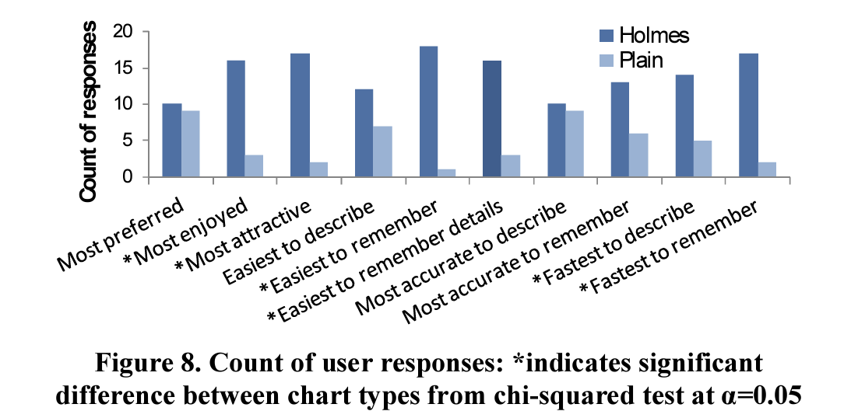
A caveat: “chart junk” and preference
Bateman et al. “Useful Junk? The Effects of Visual Embellishment on Comprehension and Memorability of Charts”, CHI 2010

Slide 21
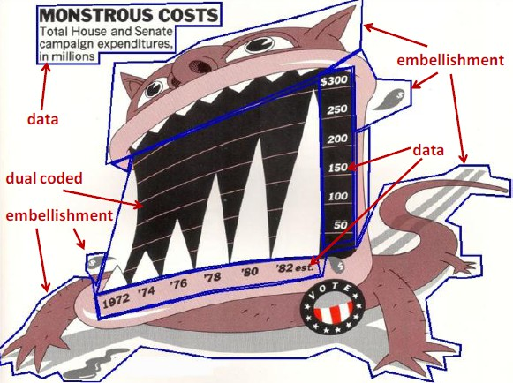
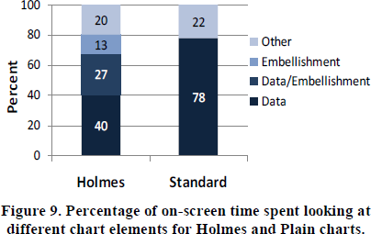
Chart junk and eye gaze
Notes:
Although 40% of users’ time was spent looking at embellishments for Holmes charts, this did not result in a longer time to describe the charts.

Slide 22
Activity: Does it follow the rules?
Work with 2 other people. Be prepared to share your work with the class.
Find a data visualization you think is interesting
Some ideas: New sites, government sites, Tableau, massvis.mit.edu
Answer:
Why did you choose this specific visualization?
Does the visualization follow all the design principles we just looked at?
If not, which are violated and how?
Do you think your answer to (2) impacted your answer to (1)?

