Slide 1
Communicating with Data – Text
Dr. Ab Mosca (they/them)
Slides based off slides courtesy of Jordan Crouser (https://jcrouser.github.io/)

Slide 2
Plan for Today
What is text data?
Why visualize text?
Techniques
Lab

Slide 3

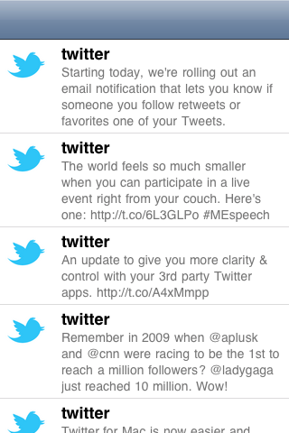
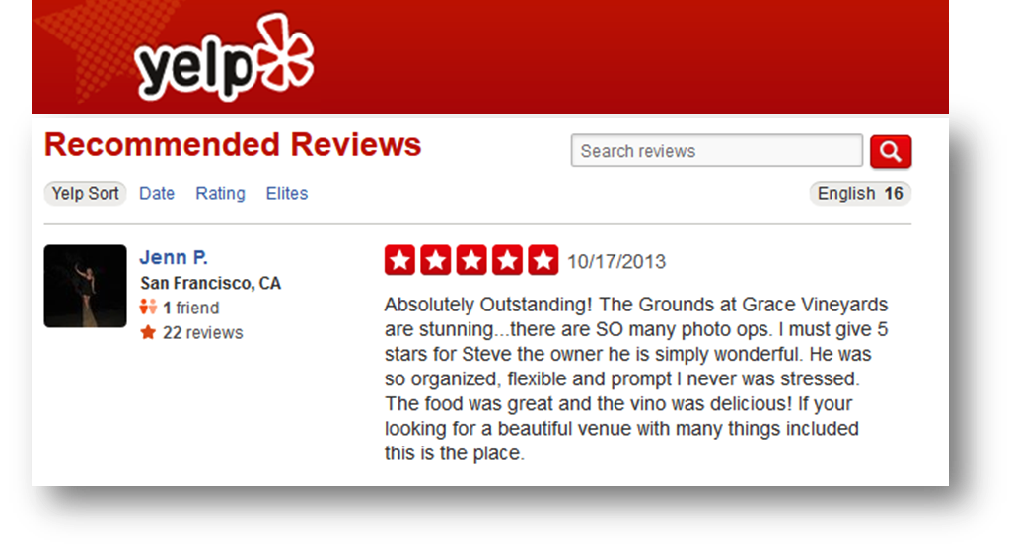
What is text data?
Documents
Articles, books and novels
E-mails, web pages, blogs
Text snippets
Tweets, SMS messages
Tags, comments, profiles
And more...
Computer programs, logs
Collections of documents
This slide!

Slide 4
Overview
Question: what are some characteristics of text data?
Answer:
Often high dimensional (over 228,000 words in OED)
Packed with meaning and relationships:
Correlations: Hong Kong, San Francisco, Bay Area
Order: April, February, January, June, March, May
Membership: Tennis, Running, Swimming, Hiking, Piano
Hierarchy, antonyms & synonyms, entities, …

Slide 5
Understand – read a document
Summarize – get the “gist” of a document
Cluster – group together similar contents
Quantify – convert to numerical measures
Correlate – compare patterns in text to those in other data, e.g., test scores with conversations on social media
Why visualize text data?

Slide 6
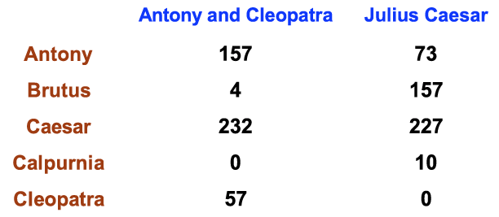
Ignore ordering relationships within the text
A document ≈ vector of term weights
Each dimension corresponds to a term (10,000+)
Each value represents the relevance
For example, simple term counts
Aggregate into a document-term matrix
“Bag of words” model

Slide 7

Example: health care reform
Recent history
Initiatives by President Clinton
Overhaul by President Obama
Text data
News articles
Speech transcriptions
Legal documents
What questions might you want to answer?

Slide 8
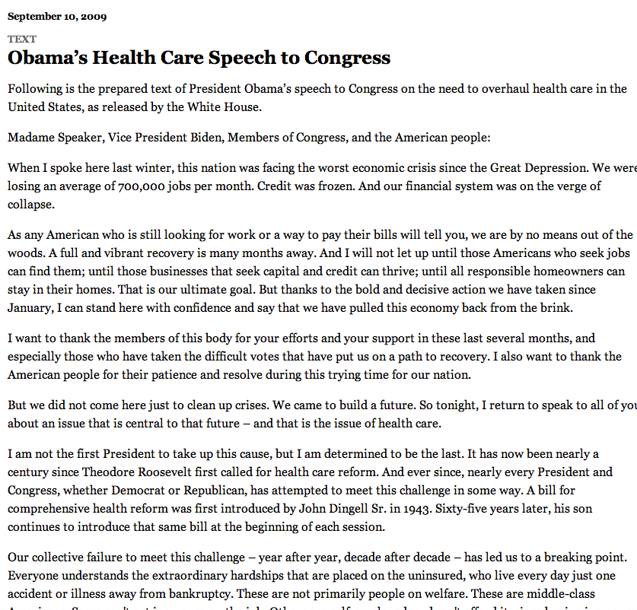
A concrete example

Slide 9
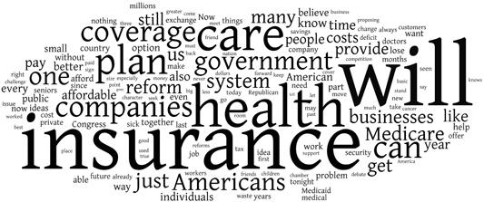
New York Times: Obama 2009
economix.blogs.nytimes.com/2009/09/09/obama-in-09-vs-clinton-in-93

Slide 10
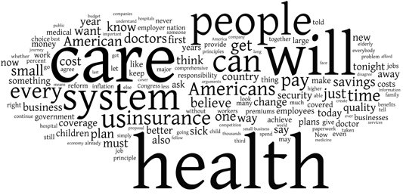
New York Times: Clinton 1993
economix.blogs.nytimes.com/2009/09/09/obama-in-09-vs-clinton-in-93

Slide 11
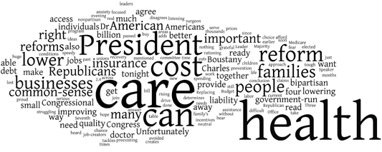
Comparison
Obama 2009
Clinton 1993
Rep. Charles Boustany of Louisiana 2009
economix.blogs.nytimes.com/2009/09/09/obama-in-09-vs-clinton-in-93

Slide 12
Word clouds
Strengths
Familiar to many people
Can help with “gisting” and initial query formation
Weaknesses
Does not show the structure of the text
Sub-optimal visual encoding (position is not meaningful)
Inaccurate size encoding (long words are bigger)
May not facilitate comparison (unstable layout)
Term frequency may not be meaningful

Slide 13
Flashback
Obama 2009
Clinton 1993
Rep. Charles Boustany of Louisiana 2009
economix.blogs.nytimes.com/2009/09/09/obama-in-09-vs-clinton-in-93

Slide 14
Weighting words
Term Frequency
tf_{td} = # of times term t appears in document d
TF-IDF: Term Frequency by Inverse Document Frequency
tf-idf_{td} = # of times term t appears in document d
# of times term t appears in all documents

Slide 15
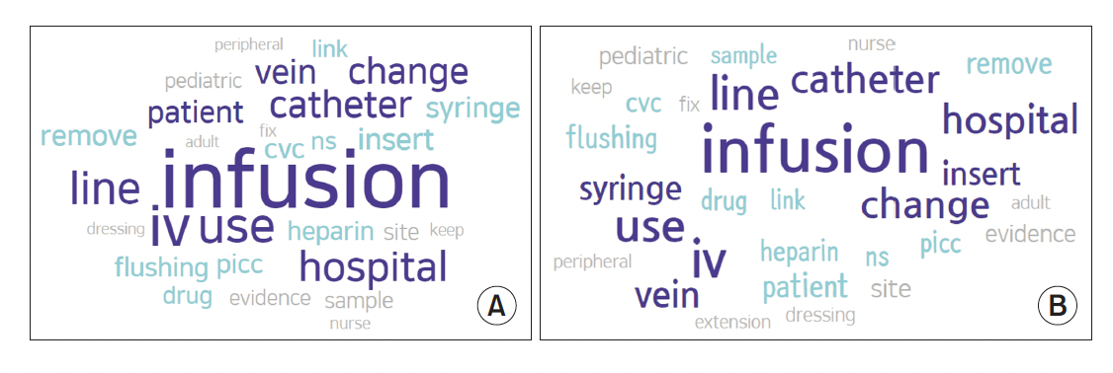
Frequency example
Keyword Network Analysis of Infusion Nursing
from Posts on the Q&A Board in the Intravenous
Nurses Caf.

Slide 16
TF-IDF example
Keyword Network Analysis of Infusion Nursing
from Posts on the Q&A Board in the Intravenous
Nurses Caf.

Slide 17
Often favors frequent (TF) or rare (IDF) terms
Still not clear that these provide best description
A “bag of words” ignores additional information
Grammar / part-of-speech
Position within document
Recognizable entities
Typically focus on unigrams (single terms)
Limitations of frequency statistics

Slide 18
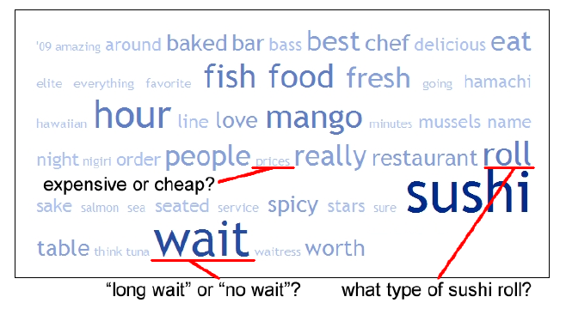
Example: Yelp reviews
Yatani 2011

Slide 19
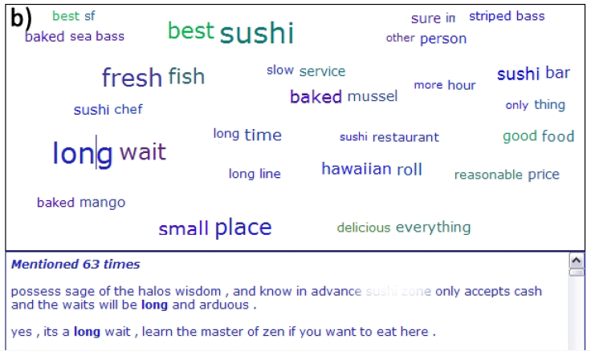
Example: Yelp reviews
Yatani 2011

Slide 20
Understand the limitations of your language model
Bag of words:
Easy to compute
Single words
Loss of word ordering
Select appropriate model and visualization
Generate longer, more meaningful phrases
Adjective-noun word pairs for reviews
Show key-phrases in context
Tips: descriptive key-phrases

Slide 21
Discussion
What are some other ways we might
visualize text data?

Slide 22
Find instructions for today’s lab on the course website
Text lab

