Slide 1
Communicating with Data – Storytelling
Dr. Ab Mosca (they/them)
Slides based off slides courtesy of Jordan Crouser (https://jcrouser.github.io/)

Slide 2
Plan for Today
Mid Semester Project pins
Narrative structures
Narrative structures in visualization
Roles of the reader and the author

Slide 3
Mid Semester Project
Let’s make some pins

Slide 4
Check in
Write down one visualization-related thing you’ve learned so far working on the mid-semester project
Write down one large-scale project related thing you’ve learned so far working on the mid-semester project
Turn to the person next to you and share.

Slide 5

Storytelling with visualization

Slide 6
storyteller
Discussion
What makes a good story?
audience

Slide 7


Story teller & Audience
Notes:
Audience for each film?
Differences in story telling? (linear vs not, why would they choose one over the other?)

Slide 8
Discussion
storyteller
What makes a good story?
point
audience

Slide 9
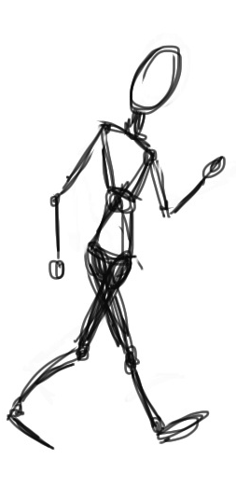


Slide 10
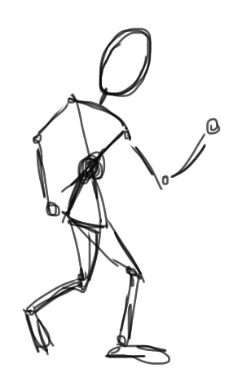

Slide 11
What is that
story about?

Slide 12

What is that
story about?
point

Slide 13
What is that
story about?
point

Slide 14
Ways to get to the point
Climax
of Act 2
Midpoint
(plot twist!)
Crisis
Disaster
Climax
of Act 3
Obstacle
Climax
of Act 1
Obstacle
Obstacle
DESCENDING ACTION
Second
Thoughts
ASCENDING ACTION
Inciting
Incident
Wrap-up
Beginning
End
Act 1
(set up)
Act 2
(confrontation)
Act 3
(resolution)
Three Act Structure

Slide 15
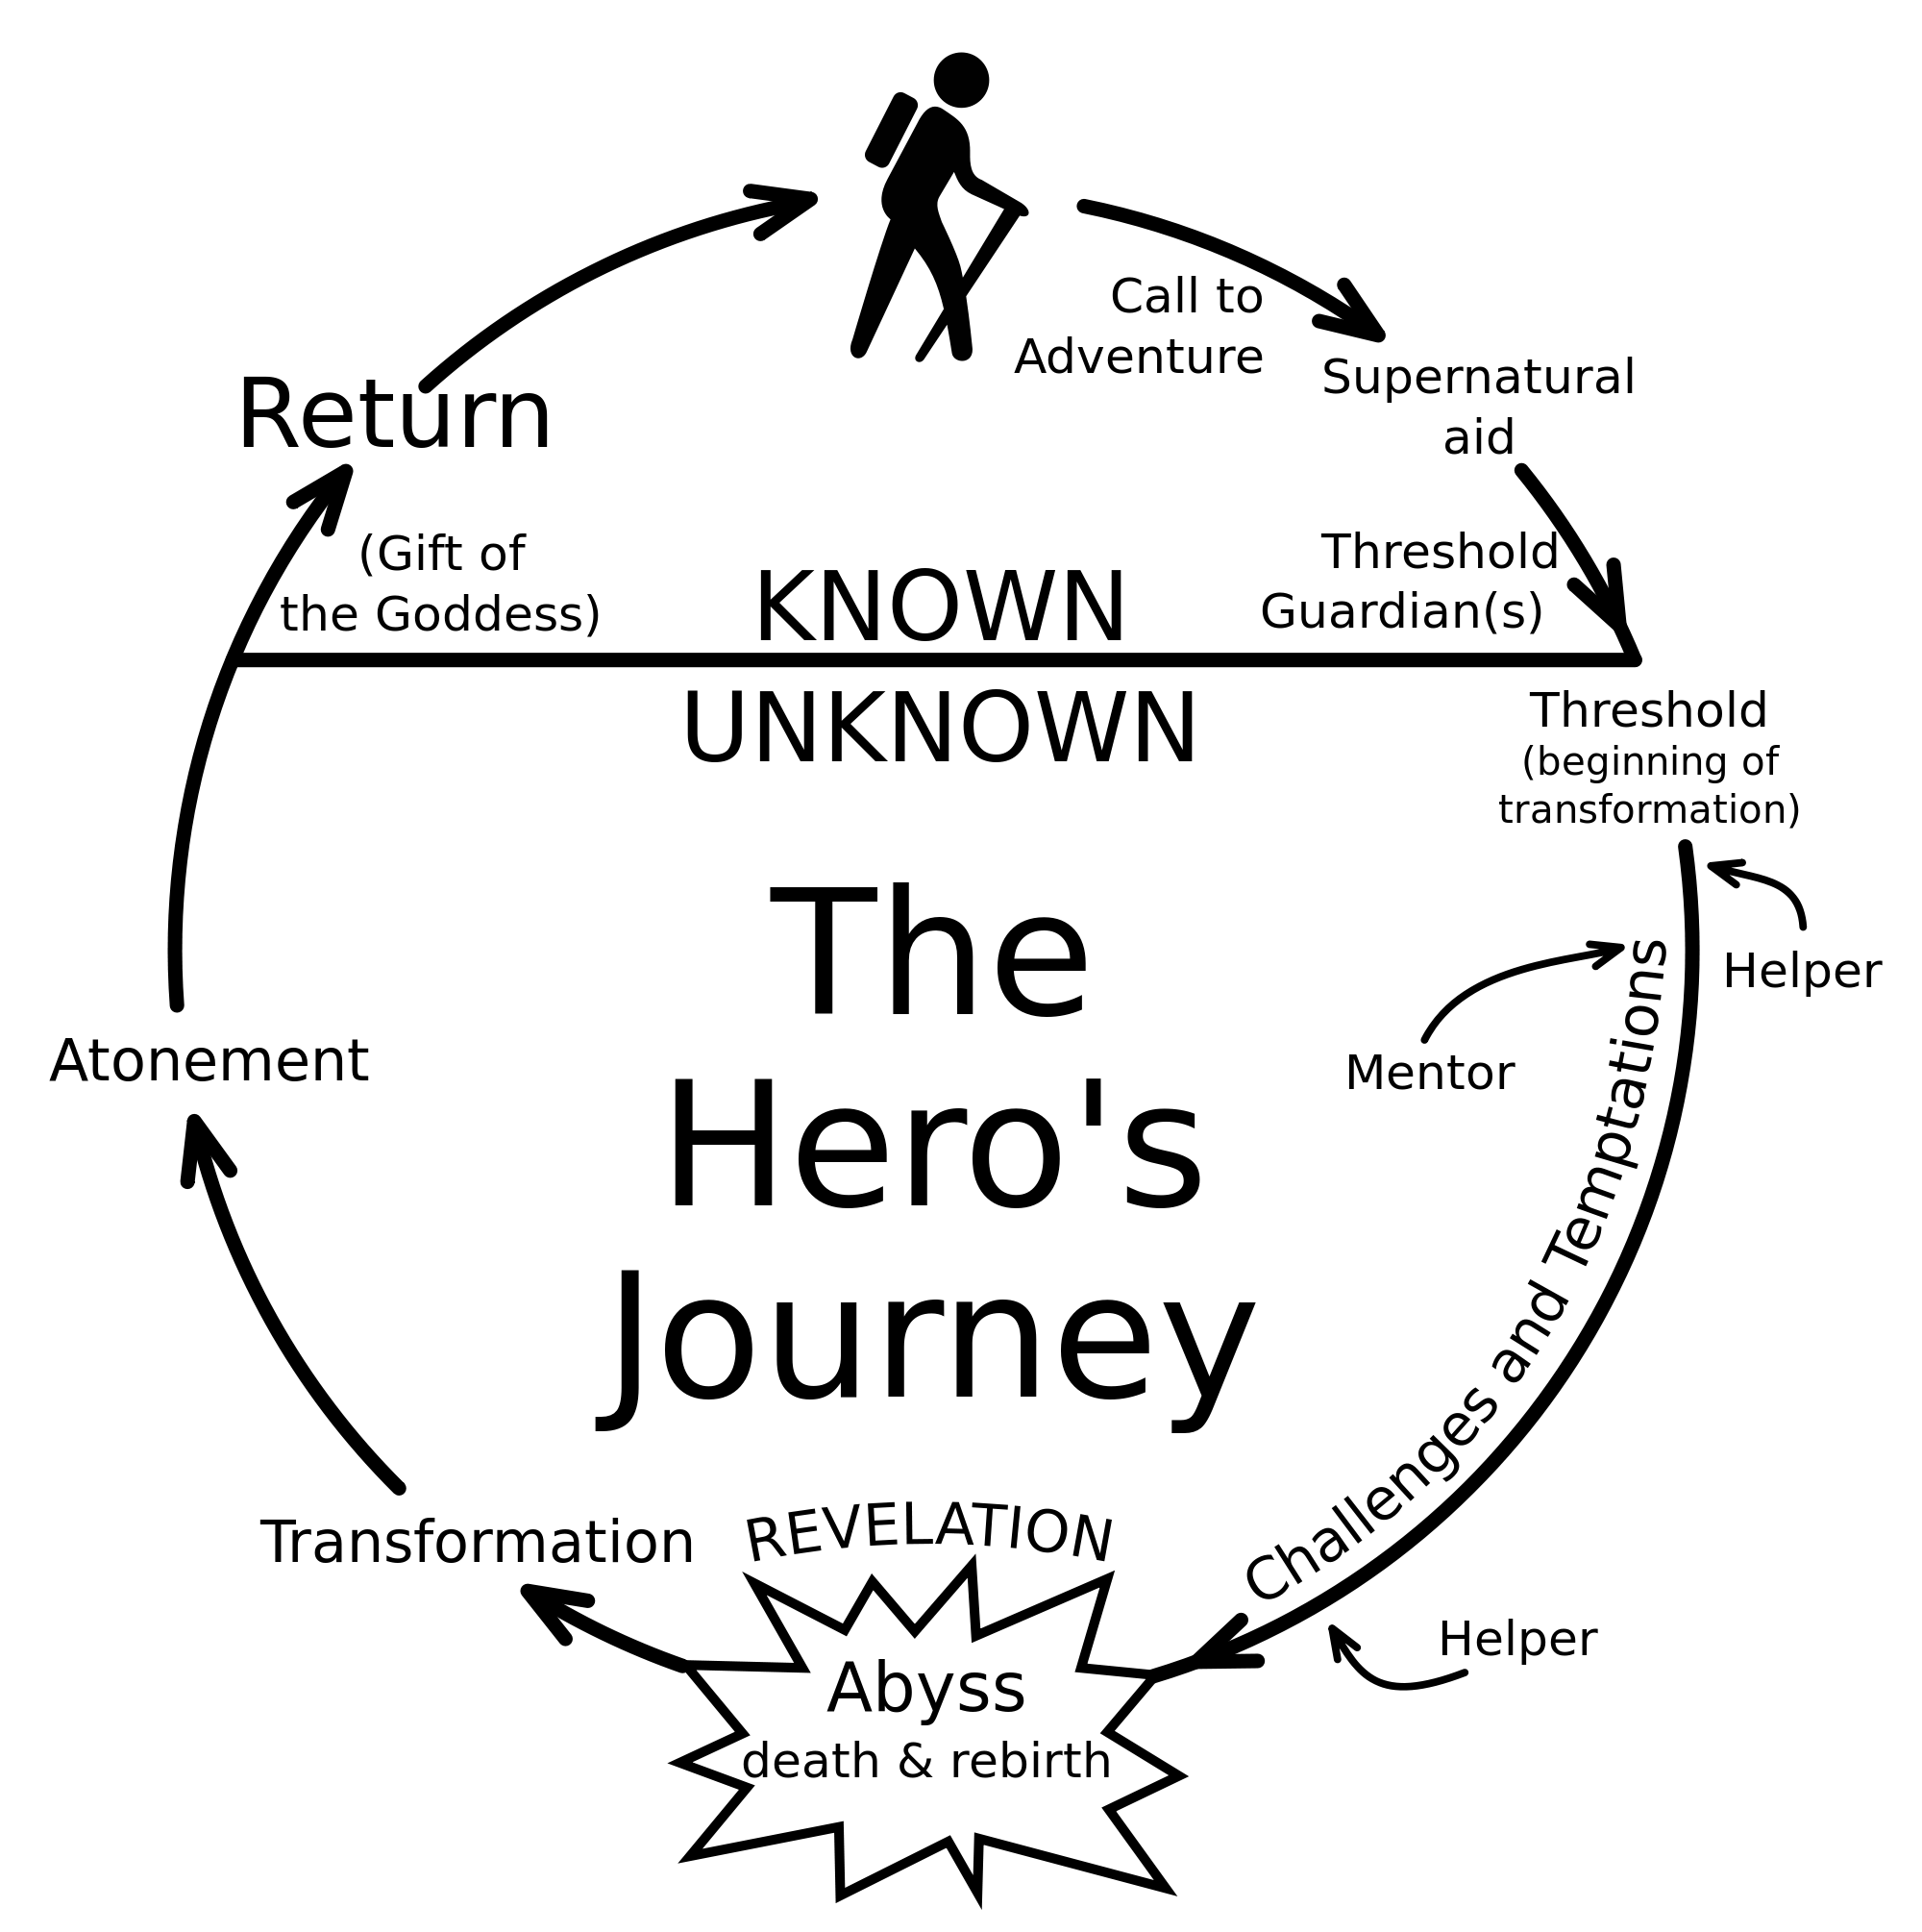
Ways to get to the point

Slide 16
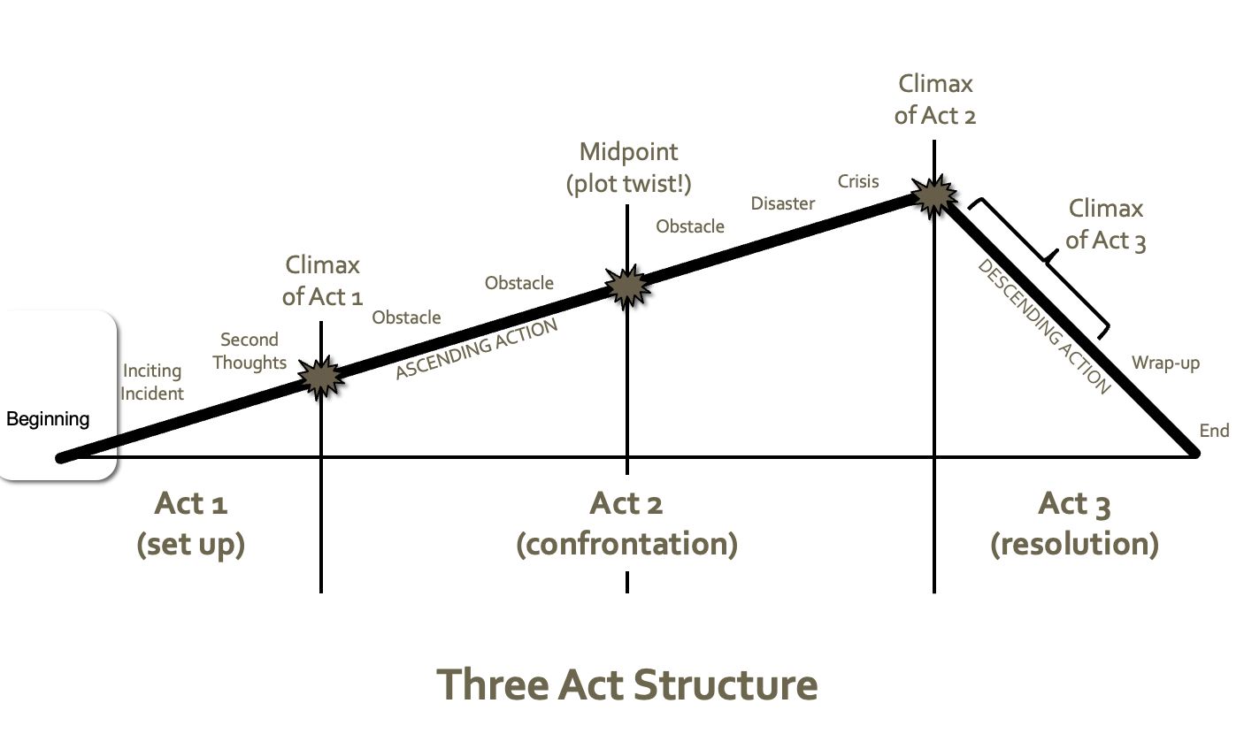
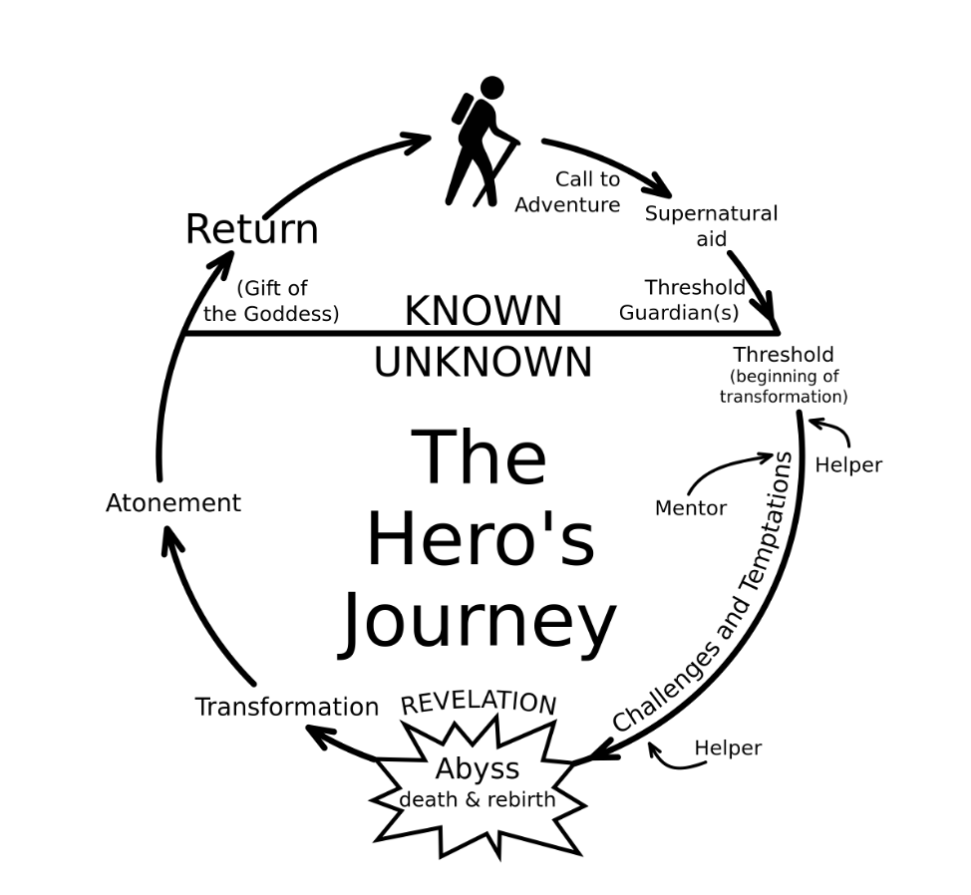
What movies use what arc?

Slide 17
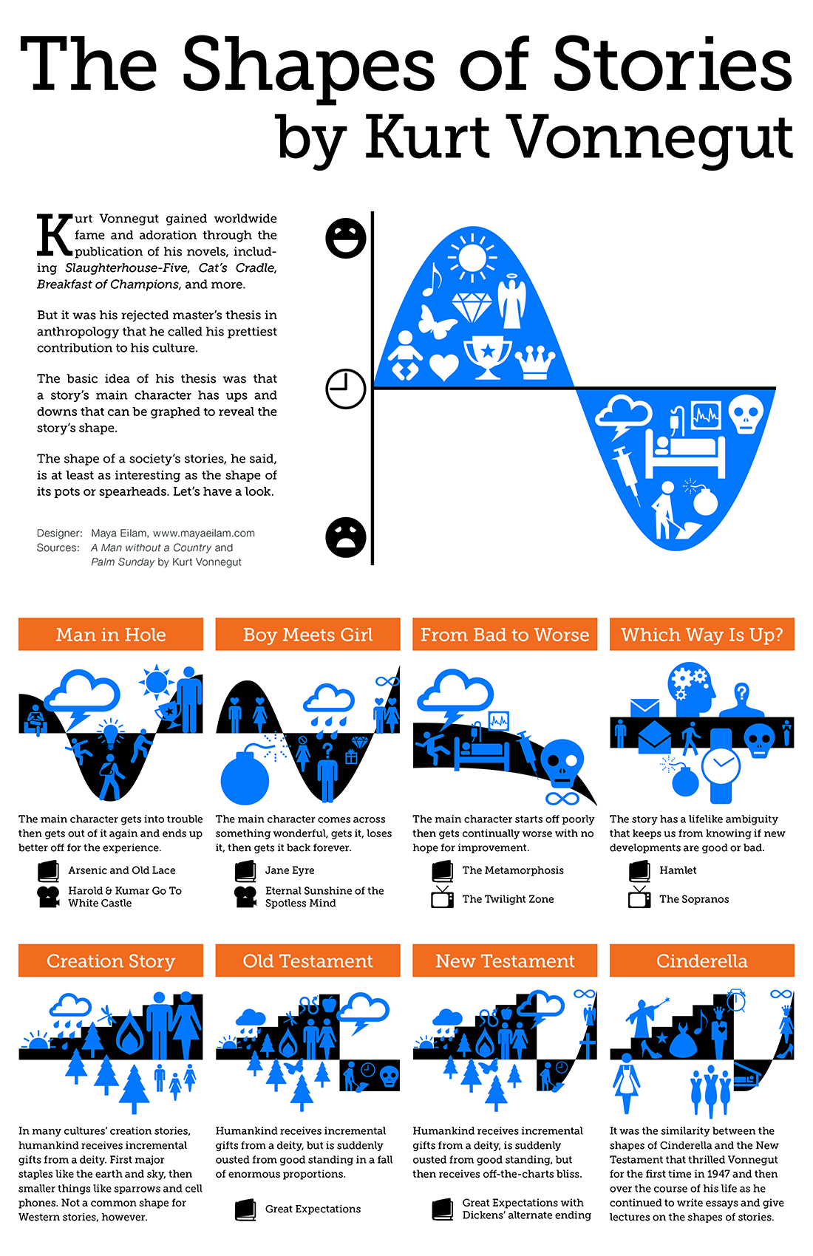

Ways to get to the point (according to Vonnegut)
Notes:
Author of Slaughterhouse 5

Slide 18
What movies use what arc?

Slide 19
Touches people
Characters change through experience
And a bunch of other stuff, too…
Has substance
What makes a good story?
storyteller
Makes people laugh
Has good characters
Representative of the human condition
Embraces idiosyncrasies
Relatable
Have something non-trivial at stake
point
Honest
audience
Must arrive somewhere
Makes people cry
Outer struggle
Imaginable setting
Creates vivid images
Plot structure
Inner struggle
Goes beyond the five senses
Doesn’t default to an easy solution

Slide 20
Storytelling with visualization

Slide 21
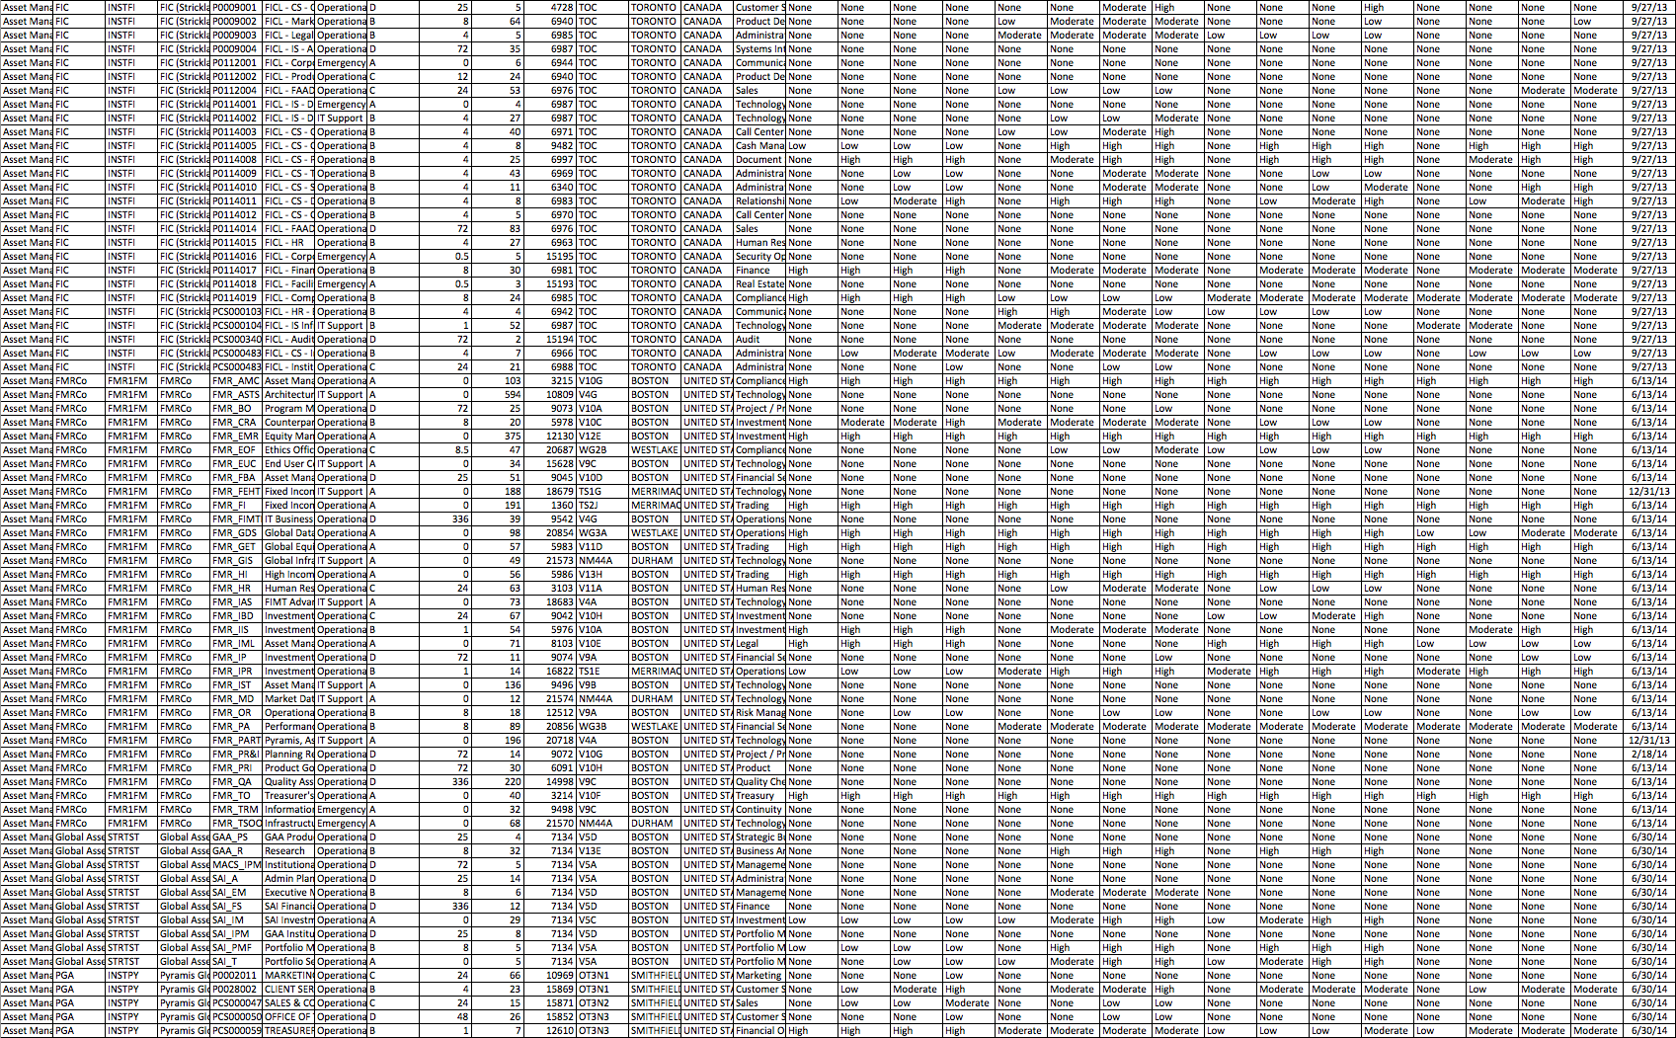
What makes a good data story?
Discussion

Slide 22
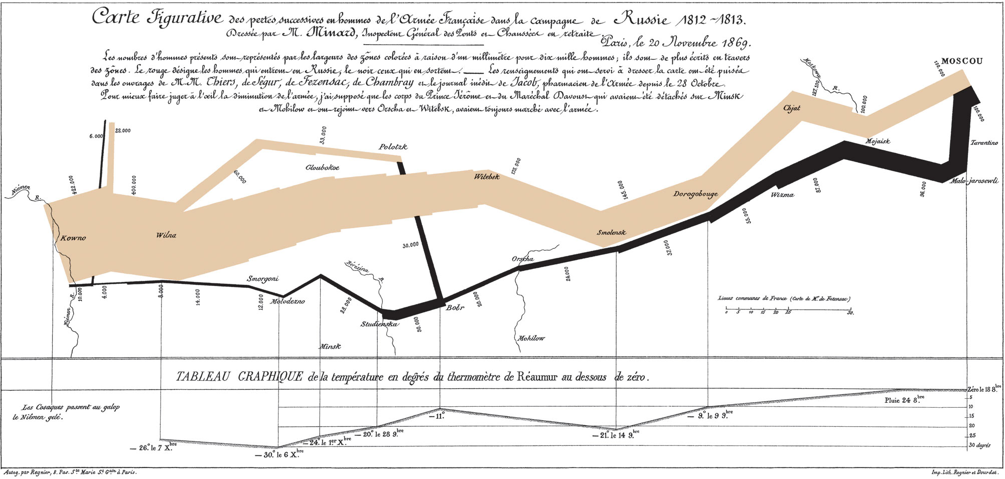
Napoleon’s March
“Probably the best statistical graphic ever drawn, this map by Charles Joseph Minard portrays the losses suffered by Napoleon’s army in the Russian campaign of 1812. Beginning at the Polish-Russian border, the thick band shows the size of the army at each position. The path of Napoleon’s retreat from Moscow in the bitterly cold winter is depicted by the dark lower band, which is tied to temperature and time scales.” - Edward Tufte
Notes:
Why does Tufte think this is such an effective graphic?

Slide 23
Design Space of Narrative Visualization
Genre
Visual Narrative Tactics
Narrative Structure

Slide 24
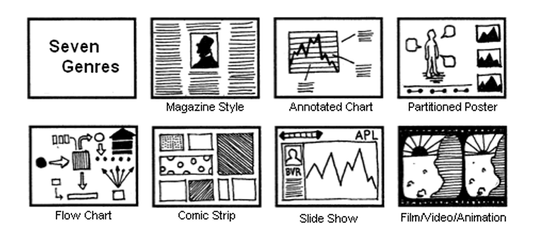
Genre
Narrative Visualization: Telling Stories with Data. Edward Segel and Jeffrey Heer

Slide 25





Visual Narrative Tactics
Visual devices that assist and facilitate the narrative
Visual structuring
Highlighting
Transition guidance
Narrative Visualization: Telling Stories with Data. Edward Segel and Jeffrey Heer
Notes:
Visual structuring refers to mechanisms that communicate the overall structure of the narrative to the viewer and allow him to identify his position within the larger organization of the visualization. These design strategies help orient the viewer early on (establishing shot, checklist, consistent visual platform) and allow the viewer to track his progress through the visualization (progress bar, timeline slider).
Highlighting refers to visual mechanisms that help direct the viewer’s attention to particular elements in the display. This can be achieved through the use of color, motion, framing, size, audio, and more, which augment the salience of an element relative to its surroundings. Many of these strategies are also used in film, art, and comics.
Transition guidance concerns techniques for moving within or between visual scenes without disorienting the viewer. A common technique from film is continuity editing, though other strategies (e.g., animated transitions, object continuity, camera motion) also exist.

Slide 26
Narrative Structure
Author Driven
Linear ordering of scenes
Heavy messaging
No interactivity
Reader Driven
No prescribed ordering
No messaging
Free interactivity
Narrative Visualization: Telling Stories with Data. Edward Segel and Jeffrey Heer
Notes:
must balance a narrative intended by the author with story discovery on the part of the reader.

Slide 27


Narrative Structure: Martini Glass
Narrative Visualization: Telling Stories with Data. Edward Segel and Jeffrey Heer
Notes:
must balance a narrative intended by the author with story discovery on the part of the reader.

Slide 28



Narrative Structure: Interactive Slide Show
Narrative Visualization: Telling Stories with Data. Edward Segel and Jeffrey Heer
Notes:
must balance a narrative intended by the author with story discovery on the part of the reader.

Slide 29
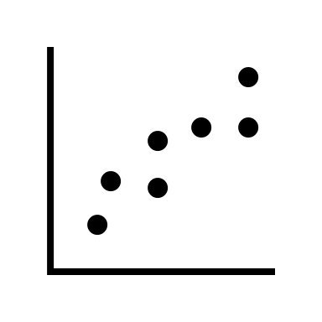


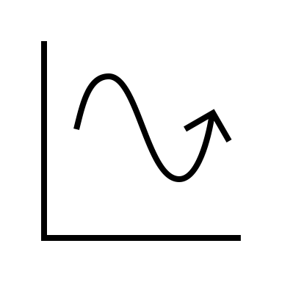
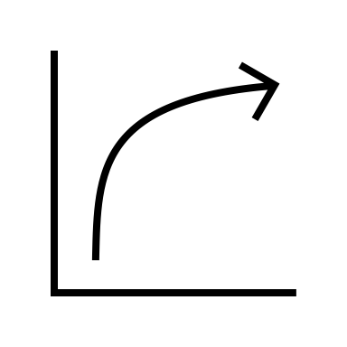


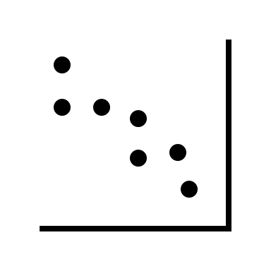
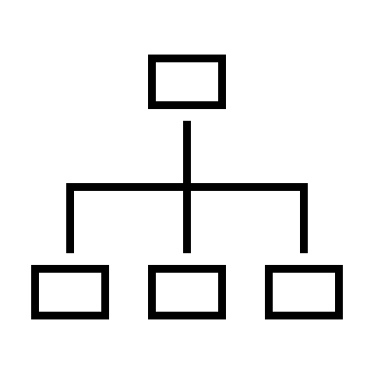


Narrative Structure: Drill-Down Story
Narrative Visualization: Telling Stories with Data. Edward Segel and Jeffrey Heer
Notes:
must balance a narrative intended by the author with story discovery on the part of the reader.

Slide 30
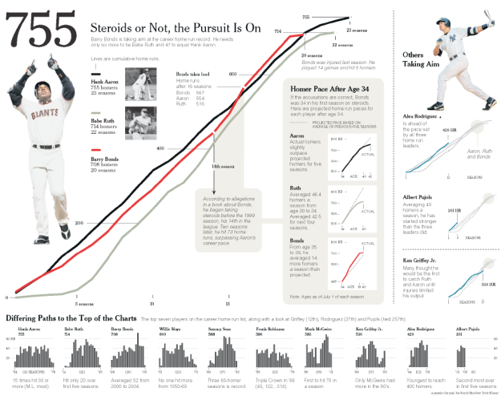
Example: Baseball (static)
Notes:
Sized prominently and placed in the upper left corner of the page, the image of Bonds grabs the eye and points the viewer towards the title, establishing the topic for the rest of the graphic.
A legend consisting of photos and text introduce Hank Aaron and Babe Ruth, previous home run leaders whose careers provide points of comparison for Bonds’ career.
A line-chart of accumulated home runs shows the three hitters’ careers in alignment, with Bonds’ home runs accelerating at a time when the other hitters slow down.
A shaded annotation notes that the acceleration coincides with the first reports of steroid use in Bonds’ 14th season, accompanied by a second annotation just two years later when Bond takes the lead over Ruth and Aaron.
The shaded path then f lows to a similarly-colored inset to the right containing a comparison of each player’s home run pace after age 34, emphasizing the suspicious acceleration in Bonds’ hitting so late in his career.
The viewer may then move to other sections.
On the right, the eye is invited by a large image of a swinging Alex Rodriguez and a bold caption noting “Others Taking Aim.” Here we see the other current players who are chasing the career home run record.
The bottom section (“Differing Paths to the Top of the Charts”), devoid of color and consisting of smaller plots, is given minimum visual priority but completes the story.
Small multiples show the home runs per season for top players on the career home run list, each captioned by a factoid.
The visualization resembles a poster one might see at a science fair, with the space subdivided into smaller sections, each telling its own sub-story with charts, pictures, and text.
The three sections are linked together graphically through the use of color, shape, and text.
For example, the largest section introduces the hitters according to their order on the career home run list: Hank Aaron(blackline), Babe Ruth(green line), and Barry Bonds (red line). Subtly matching on content, the inset in this section maintains this same scheme, presenting the players in the same order with their associated colors. The section below also begins in the same order (Aaron, Ruth, Bonds) before proceeding to the other players.
This order not only carries informational content (i.e., who has the most home runs) but also prevents the viewer from having to reorient while switching between sections.
Finally, the section to the right charts the performance of current players over a shadow of the initial chart, a shape we immediately identify as belonging to Aaron, Ruth, and Bonds.
While these elements provide seamless transitions between sections, they do not dictate the order in which the viewer explores the visualization. Rather, a path is accomplished through the use of visual highlighting (color, size, boldness) and connecting elements such as arrows and shaded trails. When looking at the visualization, the viewer begins with the largest image, in part because of its size, central positioning, and coloring, but also because it is capped with a large headline and a picture of Bonds himself telling the viewer where to look.

Slide 31

Example: Wealth inequality in the US (animated)
https://youtu.be/QPKKQnijnsM?si=j_hPOOsIxFGkNgHM
Notes:
What makes this effective?

Slide 32

Example: Wealth inequality in the US (interactive)
https://www.npr.org/sections/money/2015/02/11/384988128/the-fall-and-rise-of-u-s-inequality-in-2-graphs

Slide 33
Practice
Work in small groups or pairs
Pick a topic of interest to you
Sketch 3 possible narrative visualizations for your topic
One should be primary author-driven
One should be primarily reader-driven
And the last should be somewhere between

