Slide 1
Communicating with Data – Bar and Line Charts
Dr. Ab Mosca (they/them)
Slides based off slides courtesy of Jordan Crouser (https://jcrouser.github.io/)

Slide 2
Plan for Today
Introduction to Tableau
Lab pt. 1 - Getting started:
Connecting to a data file
Creating views
Using “Show Me”: a recommender system for views
Lab pt. 2 - Exploring other datasets
Discussion (time permitting)
Lab pt. 1 modeled on “Getting Started with Tableau Desktop” Version 8.2
Last Updated June 11, 2014 3:09 PM Copyright © 2014 Tableau Software

Slide 3
Announcements
Great first visit to SCMA!
Reflection post is now live on Piazza
Please submit before next Tuesday’s class
Office hours schedule for this week:
Jordan: Tuesday from 2:30 – 4pm in Ford 344
Subashini: Wednesday from 6:30pm - 8:30pm in Burton 209
Grace: Thursday from 6:30pm - 8pm in Burton 209

Slide 4
Outline
Bar charts and line charts
Definitions
Variations
What gets encoded?
Pros and cons
Questions to ask
Things to watch out for
Lab 2: Building bar and line charts in Tableau

Slide 5
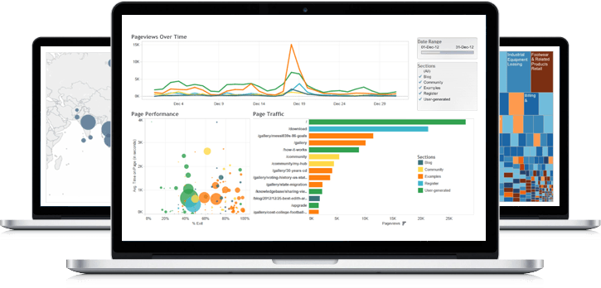
What visualization techniques do we know?

Slide 6
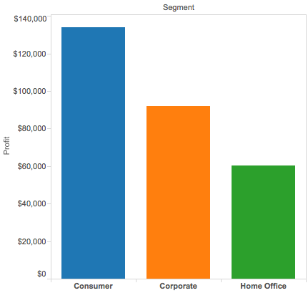
Bar chart
Definition: a visualization that uses either horizontal or vertical bars to show comparisons among categories
One axis shows a quantitative value
The other axis shows the classes (nominal or ordinal) being compared

Slide 7
Variations: vertical
Discrete “bins” along the horizontal (x) axis
Height of bar indicates the total value for each bin
Note: each data point falls into just one category (why is this important?)

Slide 8
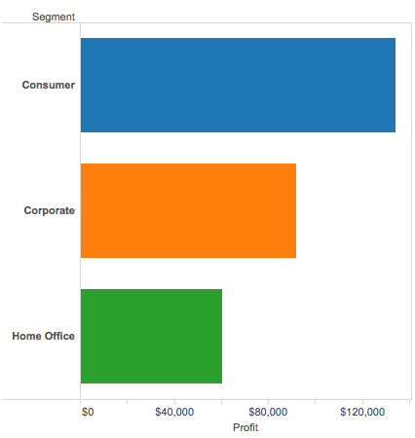
Variations: horizontal
Discrete “bins” along the vertical (y) axis
Width of bar indicates the total value for each bin
Note: each data point falls into just one category (why is this important?)

Slide 9
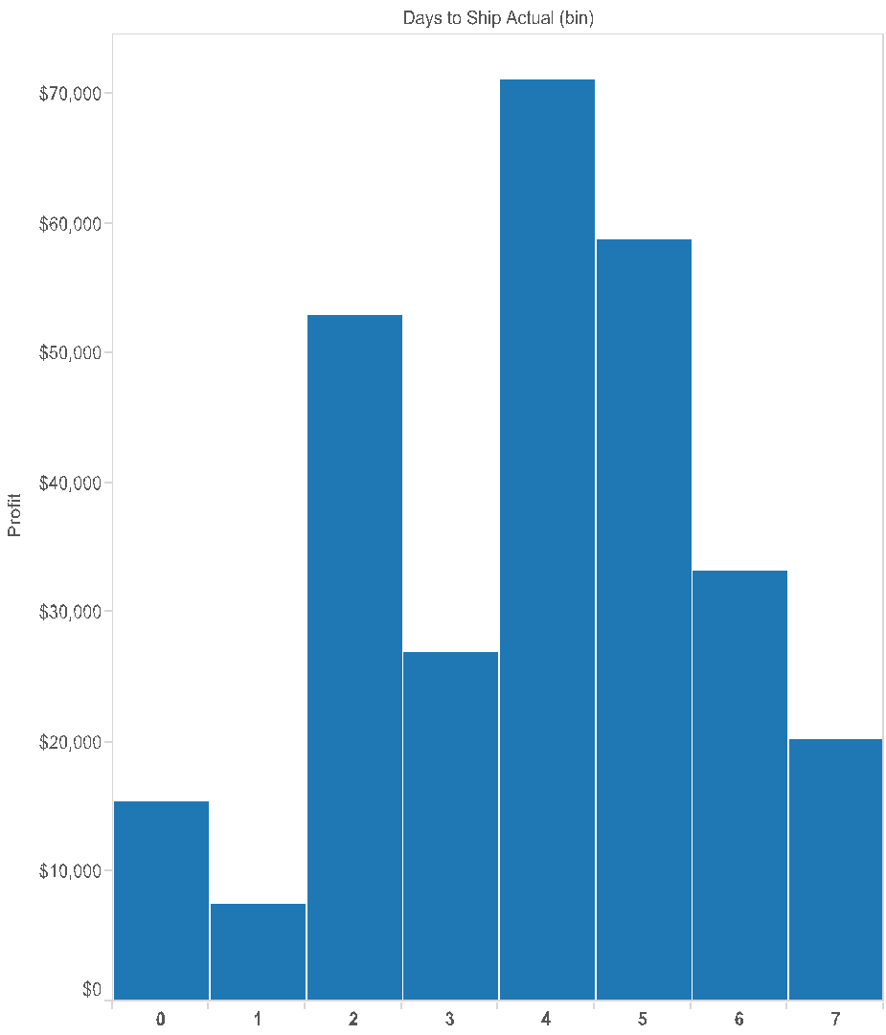
Variations: histogram
Presents continuous data broken into bins
In theory, we could see any value in the range
Often have minimal spacing between bars to help show the “shape”

Slide 10
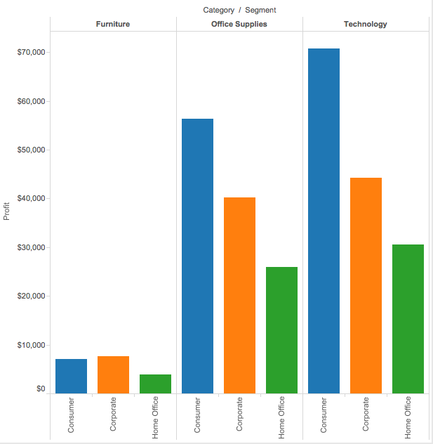
Variations: grouped
Each category is split into sub-categories
Bars in the same top-level category are adjacent to one another
Note: each category is split into the same sub-categories, and they appear in the same order (why is this important?)

Slide 11
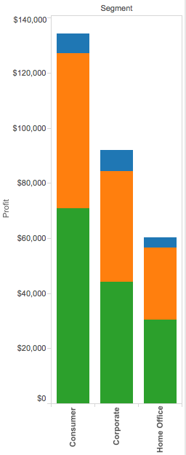
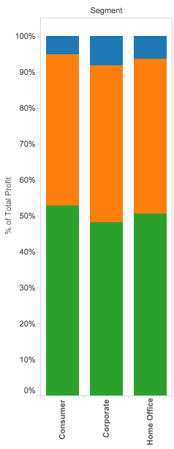
Variations: stacked
Each category is split into sub-categories
Bars in the same top-level category are stacked on top of one another
Note: each category is split into the same sub-categories, and they appear in the same order (why is this important?)
Can also stacking to show part-of-whole relationships

Slide 12
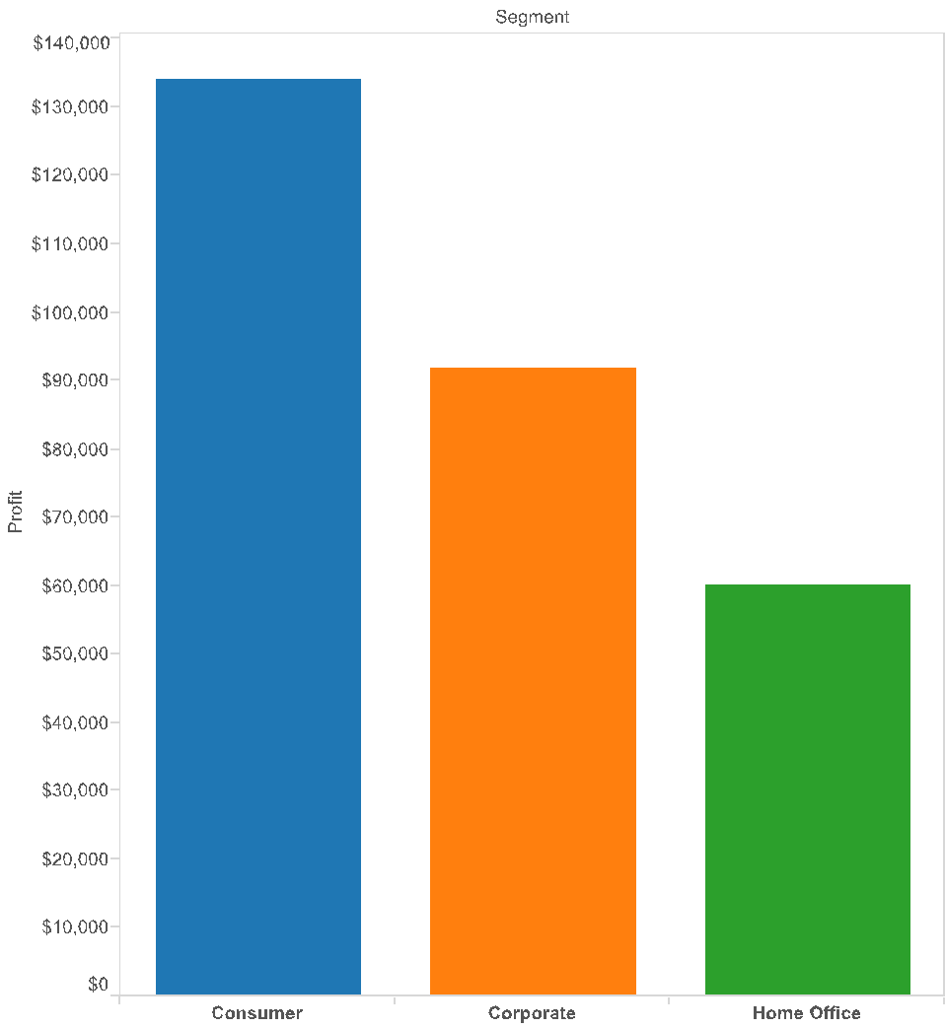

What gets encoded
Maximum value (tallest bar)
Use reference lines to show average value
Range (difference b/t tallest and shortest bars)
Minimum value (shortest bar)

Slide 13

Pros and cons
What’s good about bar charts?
What’s not so good?

Slide 14
Questions to ask
How many categories?
Examine the data to figure out how many different categories you have
Use this to draw the bars (don’t forget labels!)
What’s the range?
Examine the data to identify the category with the largest value
Use this value to scale your bars, and to space out the tick marks
What’s the order?
The bars can be arranged in any order; they each tell a different story
Just remember: if you have subcategories, they should always appear in the same order

Slide 15
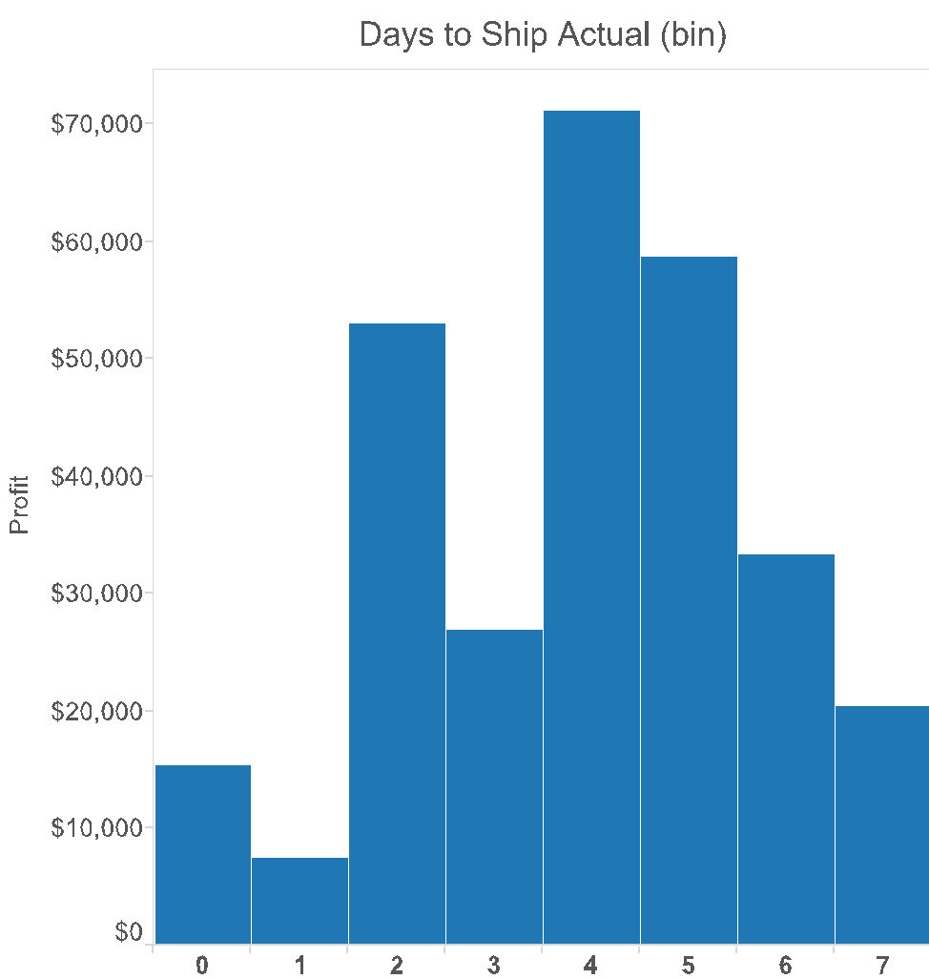
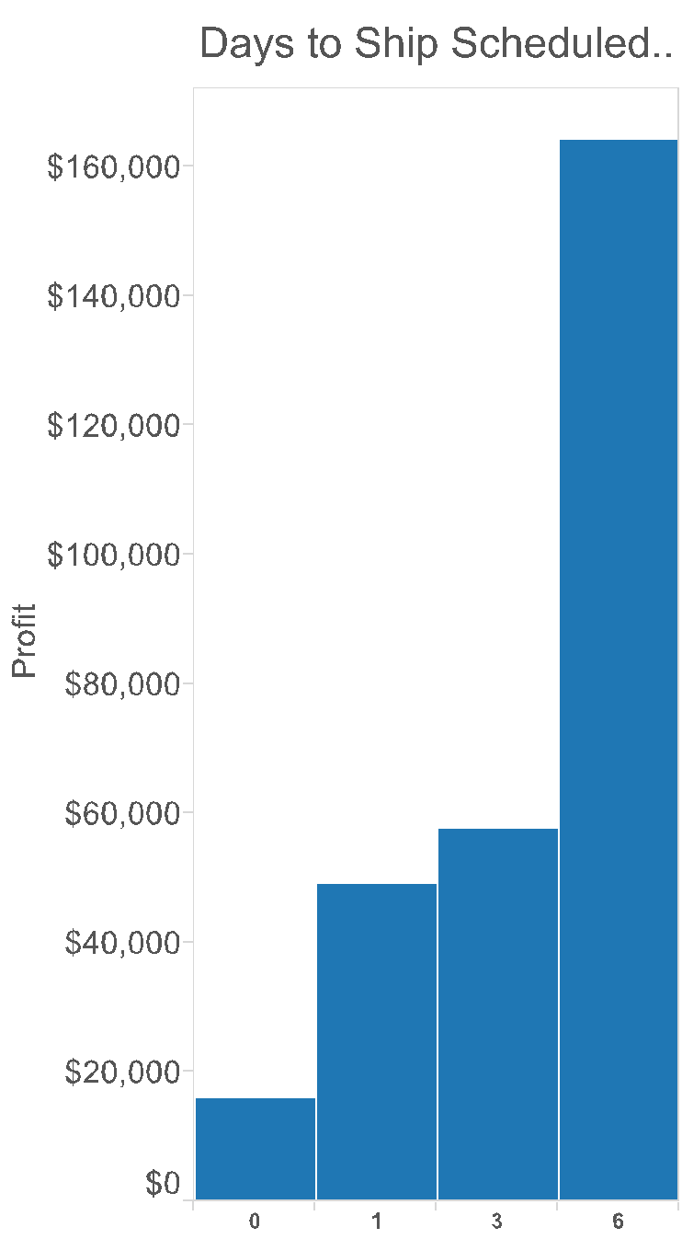
Things to watch out for

Slide 16
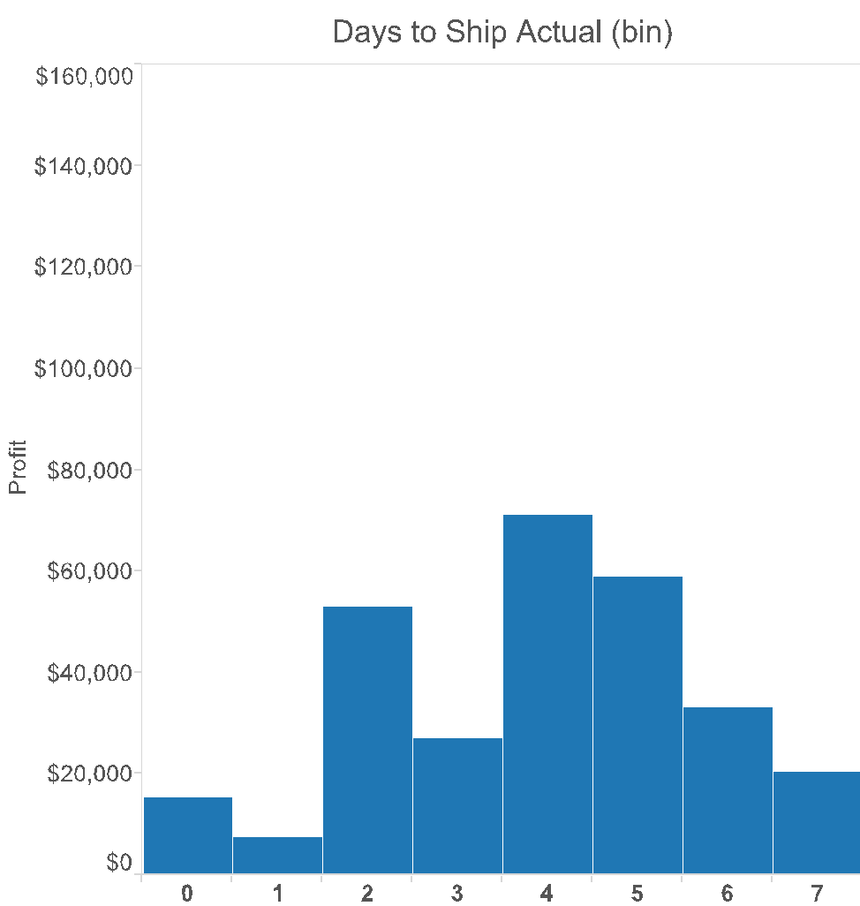
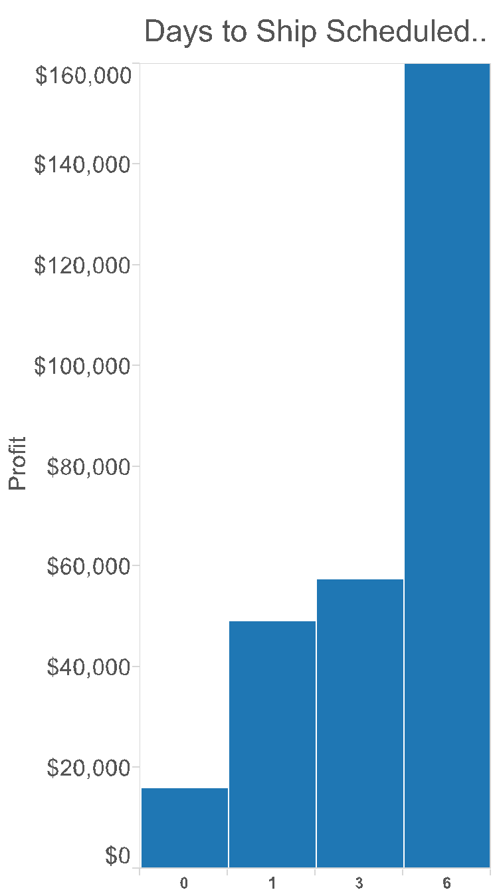
Things to watch out for
Inconsistent scales: if you’re comparing between two or more charts, be sure they have the same scale!

Slide 17
Things to watch out for

Slide 18
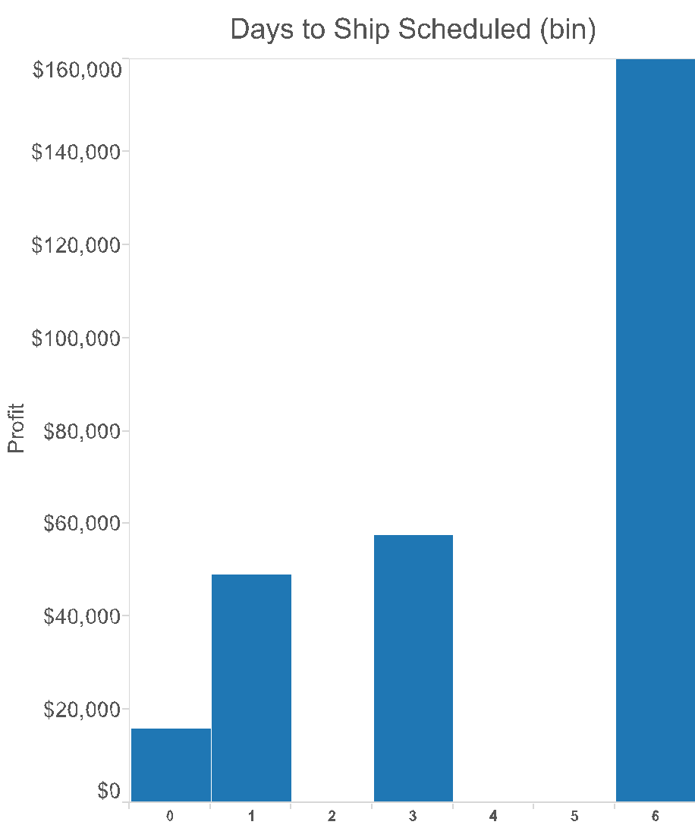
Things to watch out for
Inconsistent intervals: if you’re comparing between two or more charts, be sure they’re divided the same way!

Slide 19
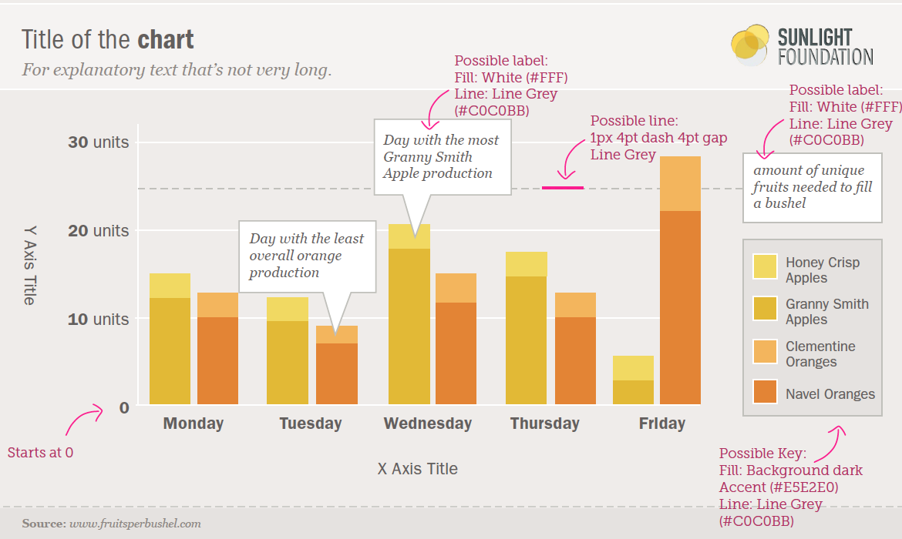
Recap: bar charts
Generally used for comparable variables
Shows quantitative values for different observations
Highlights relative amounts
Grouped/stacked bars can break variables into different sub-groups

Slide 20
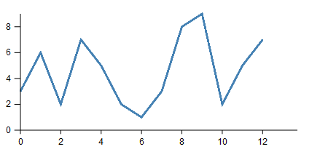
Line chart
Definition: a visualization that uses lines to show changes in continuous data
Vertical axis shows the dependent variable
Horizontal axis shows the independent variable

Slide 21
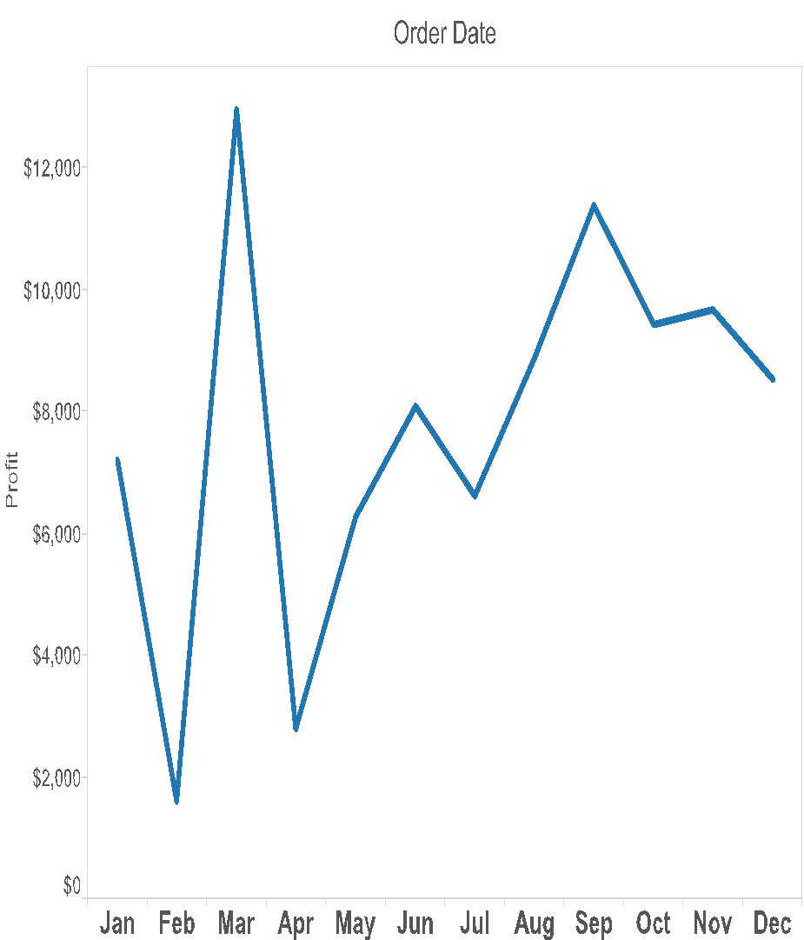
Variations: time series
Most commonly appearing line charts in practice
Used to show data that changes over time

Slide 22
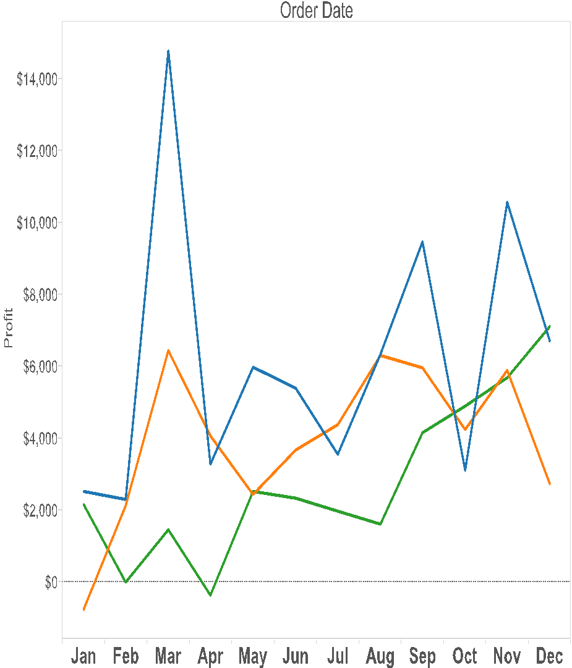

Variations: multiple independent lines
Compare changes across multiple categories
Use a legend to help distinguish between categories
Important: if you’re showing multiple trends, they should all have the same scale (why?)

Slide 23
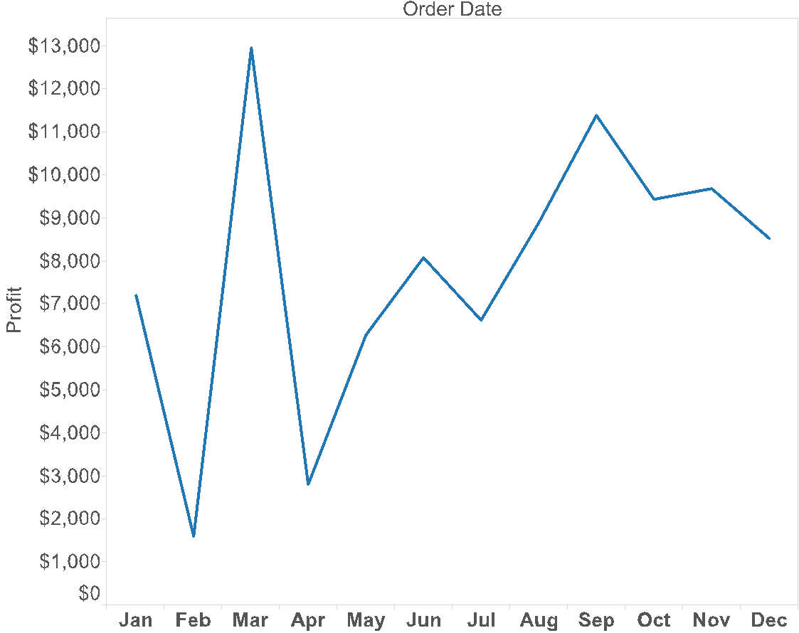
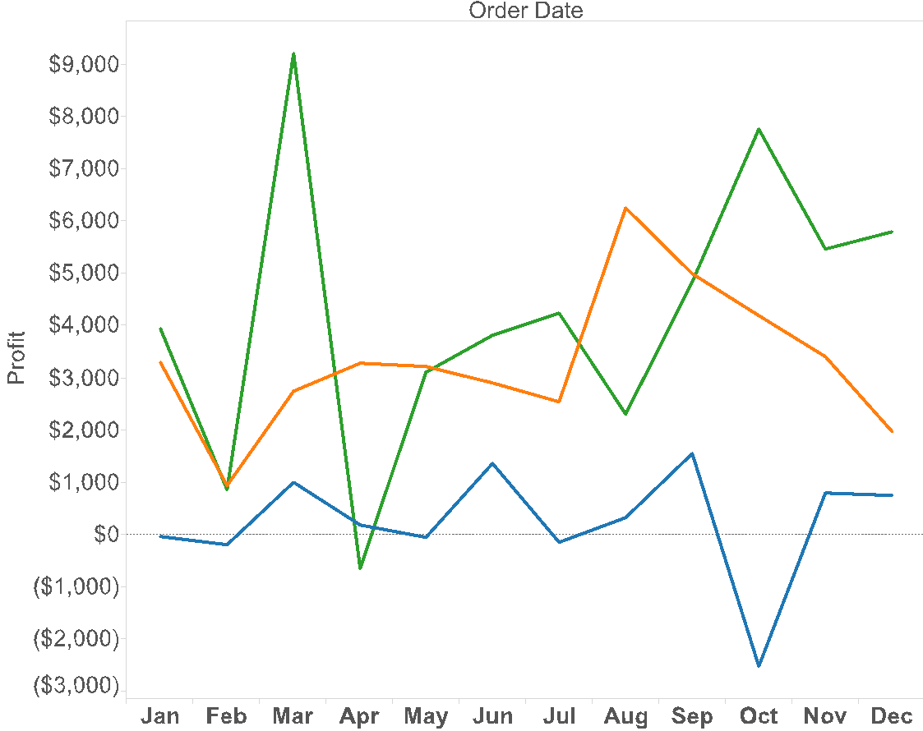
What gets encoded
Use trend lines to show overall rate of change
Maximum value (tallest peak)
Highlights position changes
Minimum value (lowest valley)

Slide 24
Pros and cons
What’s good about line charts?
What’s not so good?

Slide 25
Questions to ask
What’s the right granularity?
Examine the data to figure out how you want to aggregate the samples
Use this to draw the tick marks for the independent axis (don’t forget labels!)
What’s the range?
Examine the data to identify the largest value
Use this value to scale your axes, and to space out the tick marks on the dependent axis
Multiple trends to compare?
You can use multiple lines to compare multiple trends
Just remember: if you have multiple lines, they should always have the same scale

Slide 26
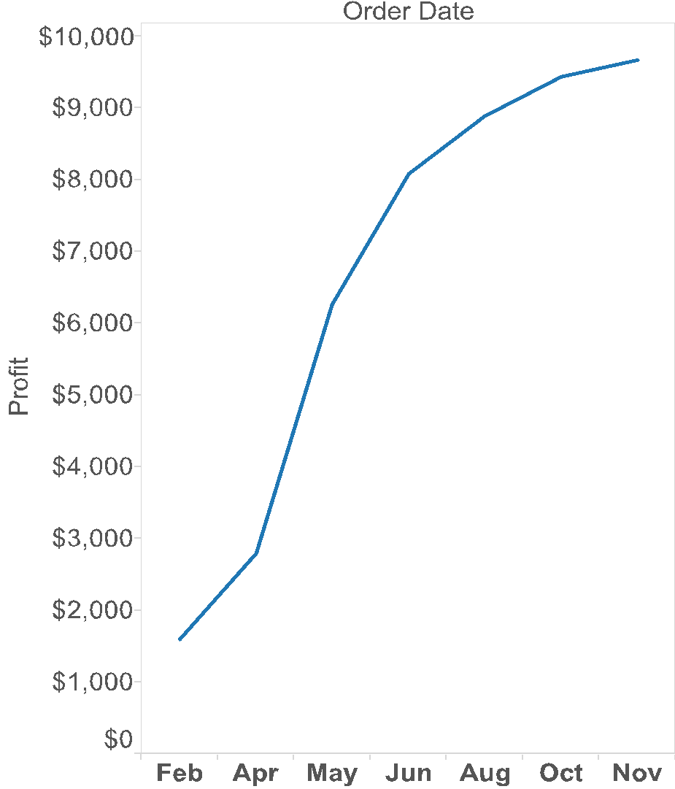
Things to watch out for
Intervals should always be equal in size
If there are missing values, indicate it
But we should only connect values that are adjacent
How might we show missing values?

Slide 27
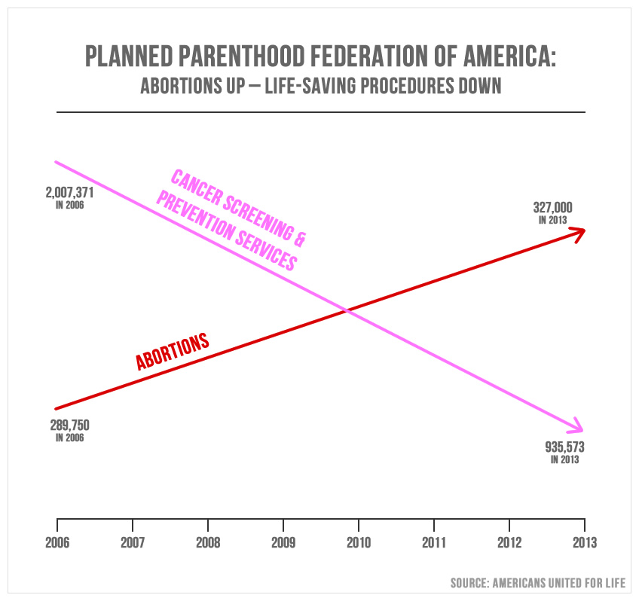
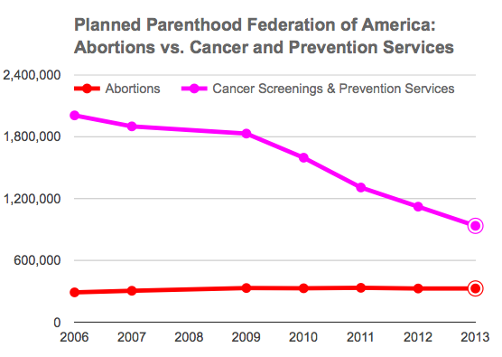
Things to watch out for
Beware comparisons that have different scales!

Slide 28
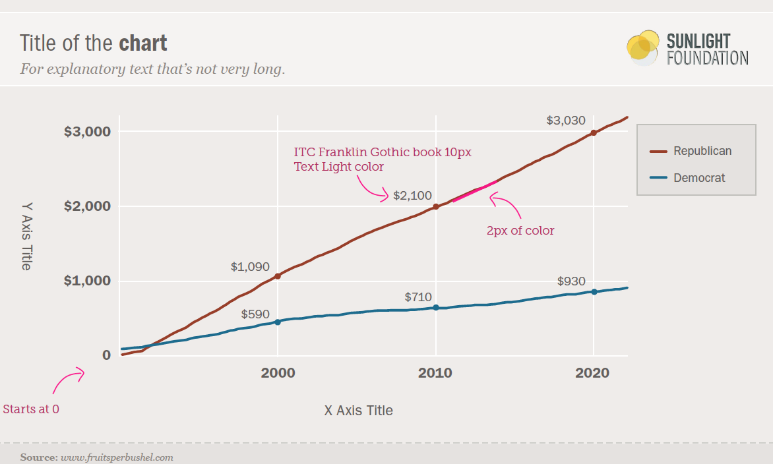
Recap: line charts
Shows the trend in one variable, often over time
Multiple lines can show multiple variables, or the same variable for multiple observations (must have the same scale!)
Highlights “position switches”

Slide 29
Questions?

Slide 30
Lab 2: bar and line charts
Instructions for today’s lab are available at:
www.science.smith.edu/~jcrouser/SDS136/labs/lab2/

Slide 31
Up next
Assignment 1
Due Thursday Sept. 29 by 11:59pm
Submission via Moodle
Thursday: Correlation and Scatterplots

