Slide 1
Data Feminism

Slide 2
Plan for today
Power structures in data science
Ways of knowing
Context

Slide 3
Flashback: Data
Data is a set of variables that capture various aspects of the world

Slide 4
One way to think about this:
VARIABLES
 | Tuition | Enrollment | Public vs. Private | …
Smith College | $46,288 | 2,563 | private
UMass Amherst | $16,115 | 28,635 | public
Hampshire College | $48,065 | 1,400 | private
Mount Holyoke College | $43,886 | 2,189 | private
Amherst College | $50,562 | 1,792 | private
⋮
OBSERVATIONS

Slide 5
Another way to think about this
class school_obs:
def __init__(tuition, enrollment,
pub_or_priv):
self.tuition = tuition
self.enrollment = enrollment
self.pub_or_priv = pub_or_priv
smith = school_obs(46288, 2563, “private”)
umass = school_obs(16115, 28635, “public”)
VARIABLES
OBSERVATIONS

Slide 6

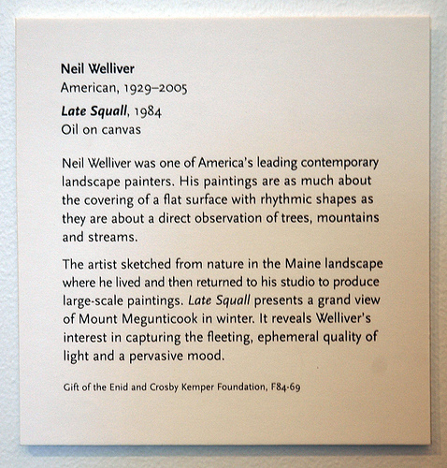
Yet another way to think about this
Information about the artist:
Name, place/date of birth,
date of death (if deceased)
Information about the piece:
Title, date, medium
Information about the donation:
Name of donor, reference number
Curated description and
relevant contextual information
Kinds of information = variables
Actual text on the placard = observations

Slide 7
Discussion
Where does data come from?

Slide 8
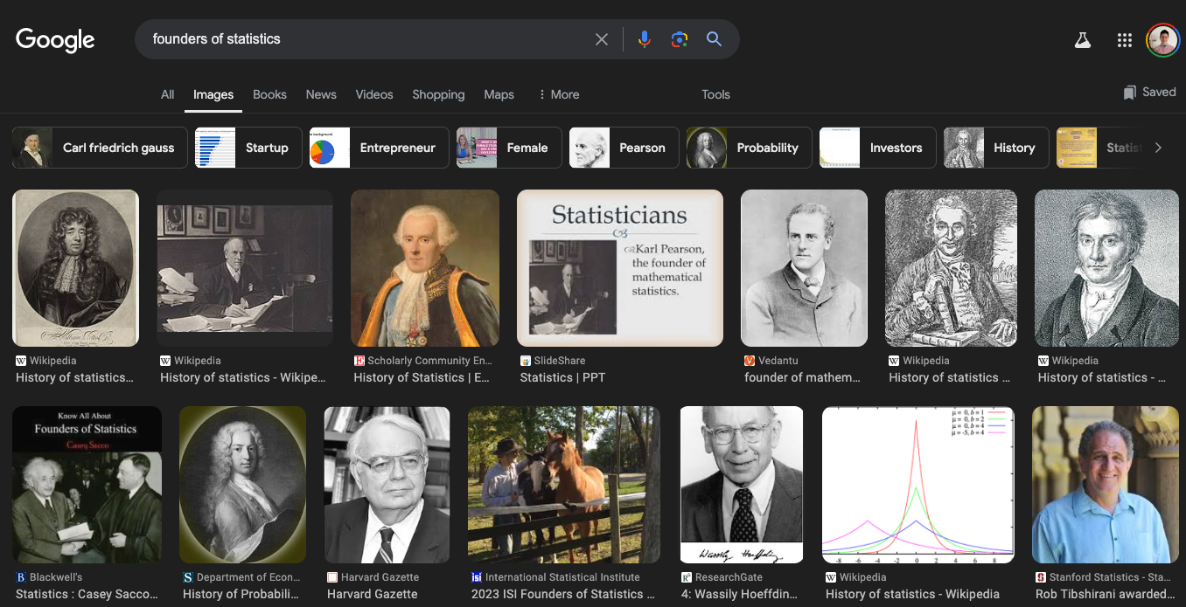
Power
https://data-feminism.mitpress.mit.edu/

Slide 9
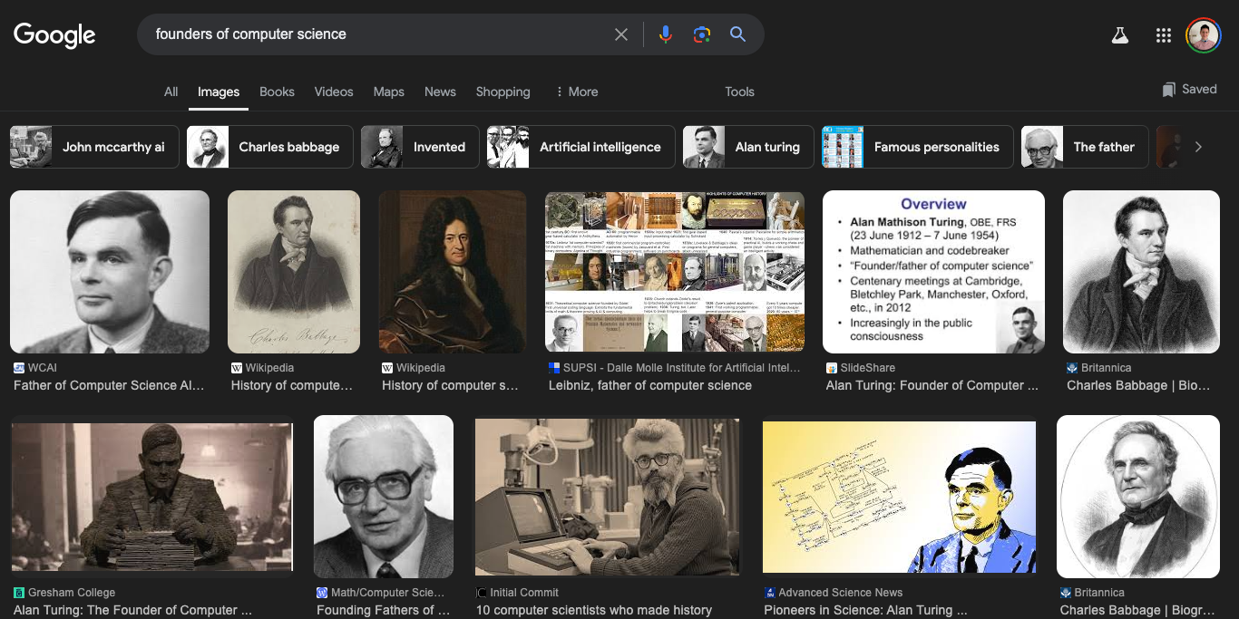
Power
https://data-feminism.mitpress.mit.edu/

Slide 10
Power
Hmmm….. Seems like data science is born from white cis males
Fun fact: this is not actually true if you dig deeper! But that’s for another class
So, just like most systems, data science as a field is build on practices and principles that privilege white cis males
As a result, data collection is also built on practices and principles that privilege white cis males
https://data-feminism.mitpress.mit.edu/

Slide 11

Example
https://data-feminism.mitpress.mit.edu/

Slide 12
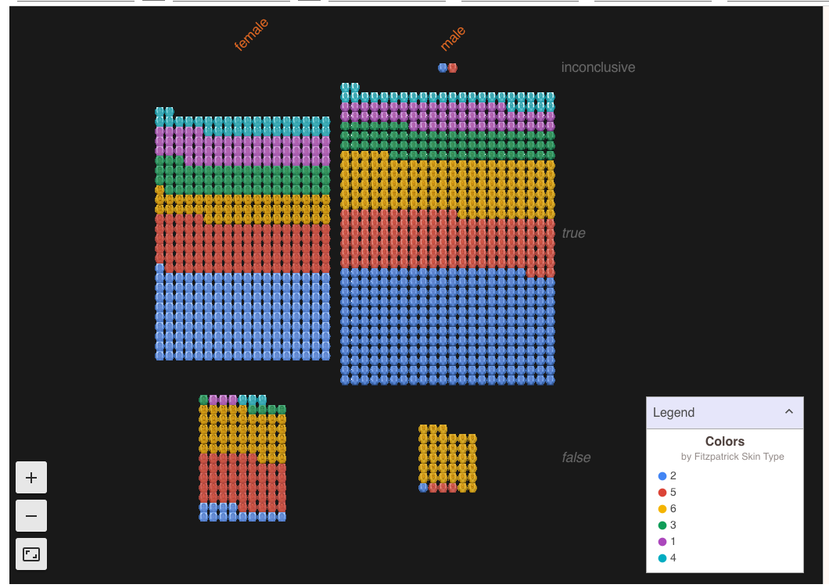
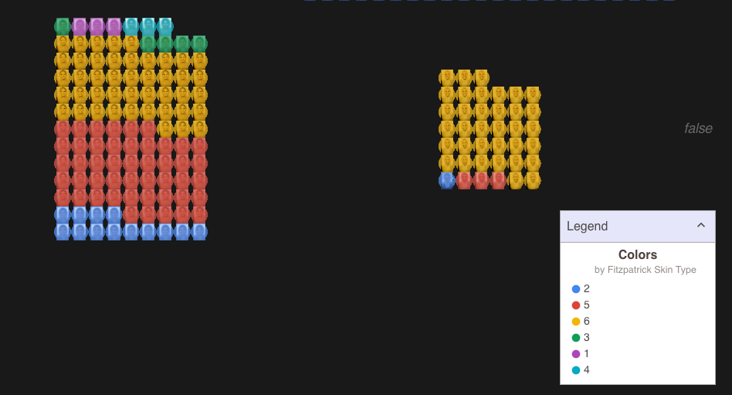
Example
https://data-feminism.mitpress.mit.edu/

Slide 13
Example
Training dataset used for most facial recognition systems contains
78% male faces
84% white faces
Only 4% were women and dark-skinned
https://data-feminism.mitpress.mit.edu/

Slide 14

Example
2022 prostate cancer research funding: 280.5 million
2022 uterine cancer research funding: 15.0 million
https://www.cancer.gov/about-nci/budget/fact-book/data/research-funding
https://data-feminism.mitpress.mit.edu/

Slide 15
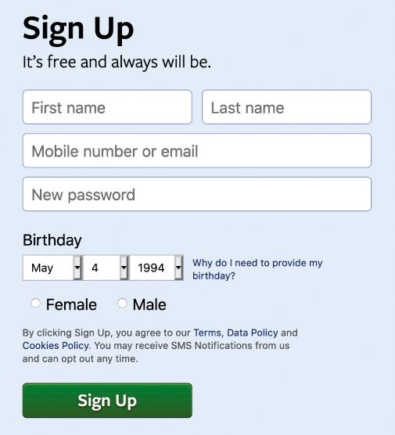
“What gets counted counts”
Data is often used to inform policy and allocate resources
What is not counted in that data collection can become invisible
Ex. Expansive gender
https://data-feminism.mitpress.mit.edu/

Slide 16
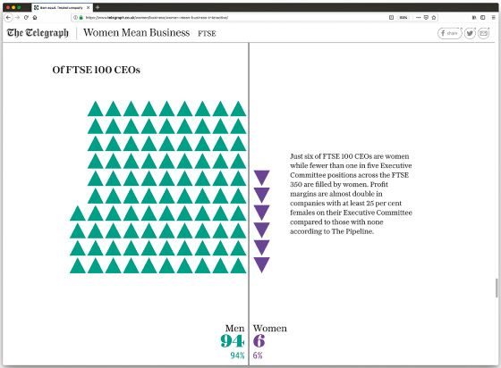
What can we do?
Subvert norms
https://data-feminism.mitpress.mit.edu/

Slide 17
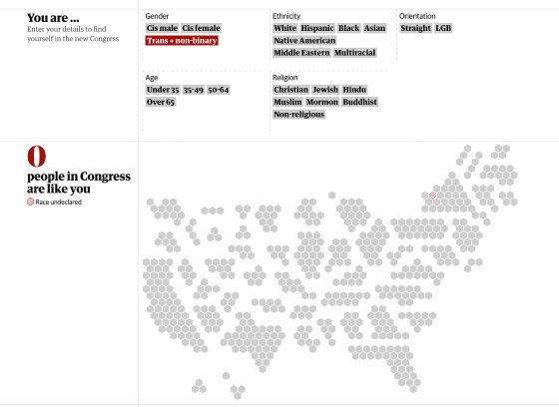
What can we do?
Highlight missing categories
https://data-feminism.mitpress.mit.edu/

Slide 18
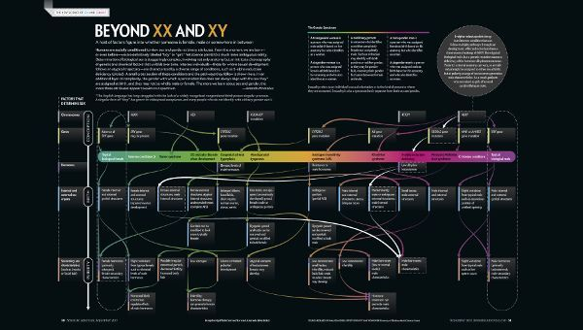
What can we do?
Educate
https://data-feminism.mitpress.mit.edu/

Slide 19
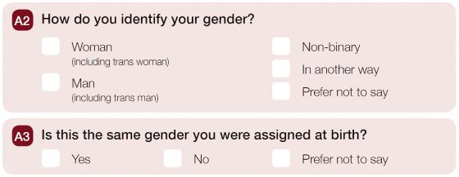
What can we do?
Rethink data collection
https://data-feminism.mitpress.mit.edu/

Slide 20
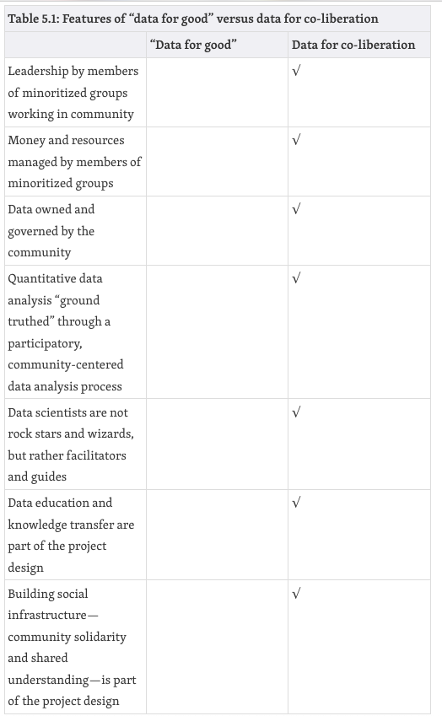
What can we do?
Many voices are better than a single all-knowing one
https://data-feminism.mitpress.mit.edu/

Slide 21

What can we do?
Acknowledge context
What is the historical context of the data?
Where did the data come from? Who collected it?
Why was the data collected?
How was the data collected?
How is the data used?
What’s in the data?
What “counts” as a data point?
What data is missing?
How is uncertainty handled?
https://www.responsible-datasets-in-context.com/datasets.html

Slide 22
Lab
Go to the course website to find instructions for today’s lab

