Slide 1
Communicating with Data – Ethical and Deceptive Visualizations
Dr. Ab Mosca (they/them)
Slides based off slides courtesy of Jordan Crouser (https://jcrouser.github.io/)

Slide 2
Plan for Today
Avoiding bias and trickery in visualization design
Identifying bias and trickery

Slide 3
Flashback
What are some perceptual tricks we learned about previously?
Notes:
The last thing I want us to think about is avoiding bias and trickery in the visualization we make, and when we’re reading visualizations designed by others.
The first thing to think about when you look at any visualization is your data source and potential biases. Who collected the data being visualized? Was it collected in a way that creates biases? Things to look for include over collection of one group and lack of representation of other groups, poor (or undisclosed) data cleaning practices, etc..
For example, if we look at this example dataset, can anyone point out any biases?

Slide 4
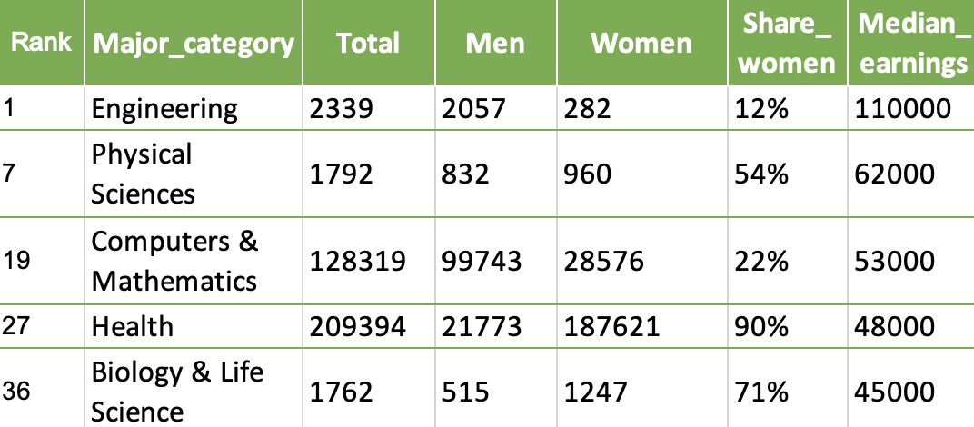
How do we avoid bias & trickery?
Inspect the data
→ Source?
→ Biases?
Data: https://github.com/fivethirtyeight/data/blob/master/college-majors/women-stem.csv
Notes:
The last thing I want us to think about is avoiding bias and trickery in the visualization we make, and when we’re reading visualizations designed by others.
The first thing to think about when you look at any visualization is your data source and potential biases. Who collected the data being visualized? Was it collected in a way that creates biases? Things to look for include over collection of one group and lack of representation of other groups, poor (or undisclosed) data cleaning practices, etc..
For example, if we look at this example dataset, can anyone point out any biases?

Slide 5
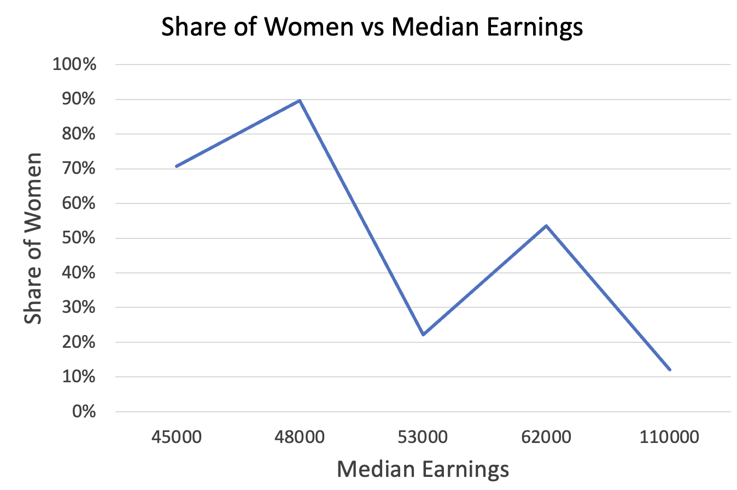
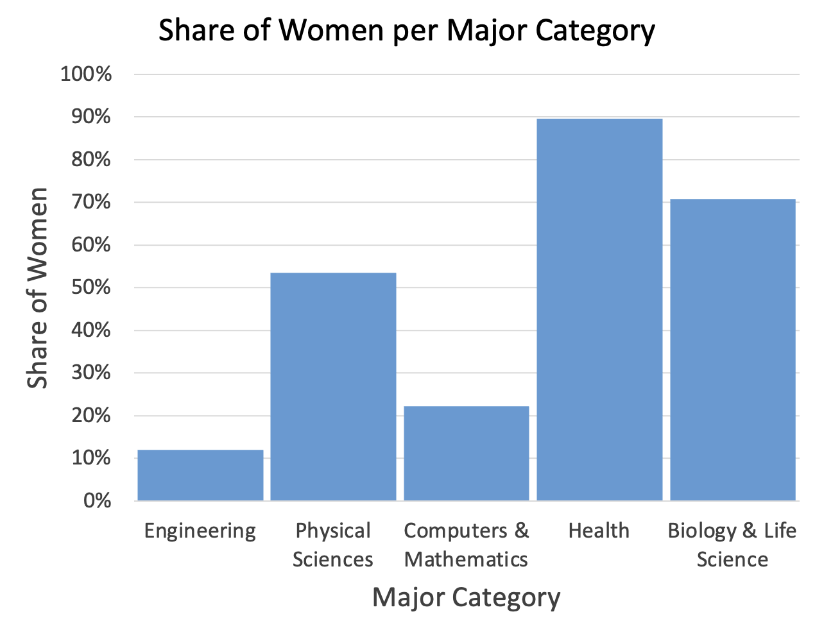
How do we avoid bias & trickery?
Design Contentiously & Read Critically
→ What’s shown vs not?
Data: https://github.com/fivethirtyeight/data/blob/master/college-majors/women-stem.csv
Notes:
Even if we don’t have access to raw data, careful critical reading of visualizations can show biases present in the under laying data.
For example, you could look at either of these charts and postulate that the underlaying data might only be divided into women and not women and therefore misses groups of people.

Slide 6
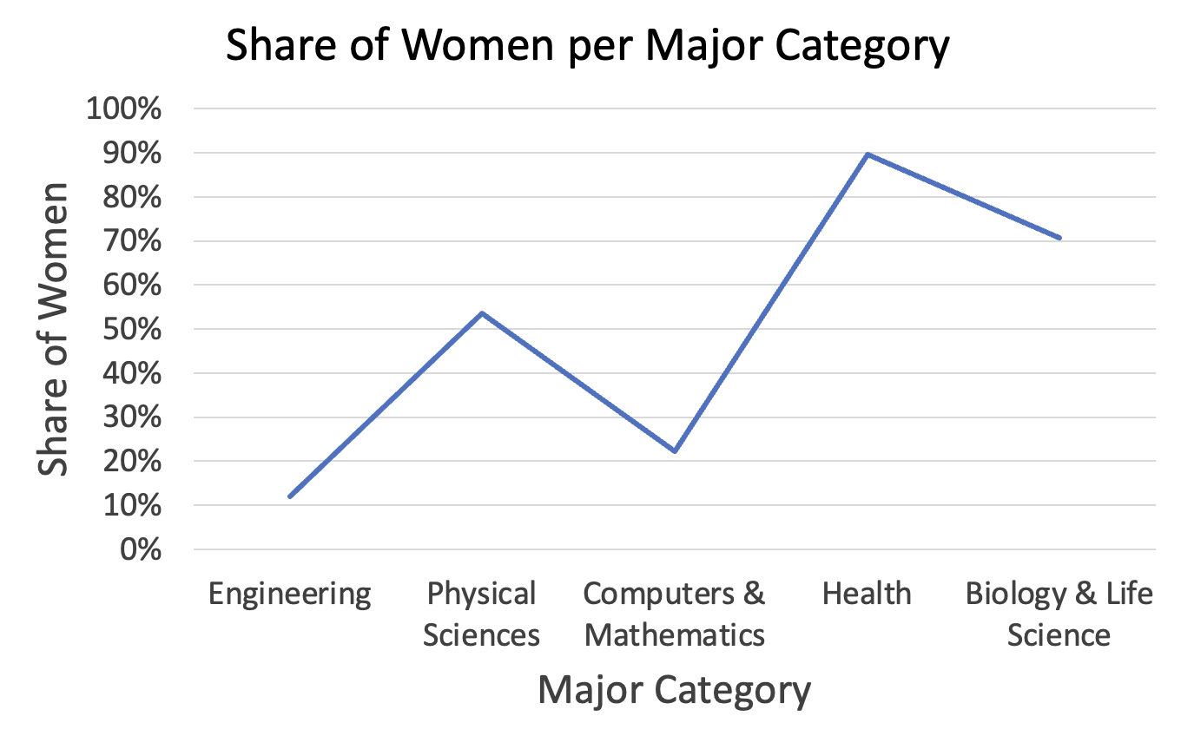
How do we avoid bias & trickery?
Design Contentiously & Read Critically
→ Goal
→ Data types
Data: https://github.com/fivethirtyeight/data/blob/master/college-majors/women-stem.csv
Notes:
Another point to think about is designing contentiously and reading critically.
We know goals and data types inform what kind of visualization is appropriate to use. And we can use this information to inform our reading of visualizations.
For example, can anyone point out the issue with this chart based on what we just discussed with respect to line charts?

Slide 7
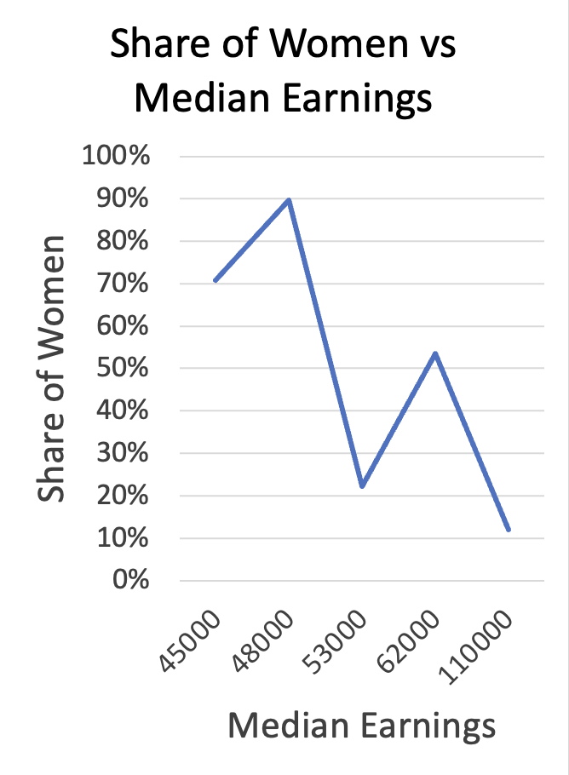
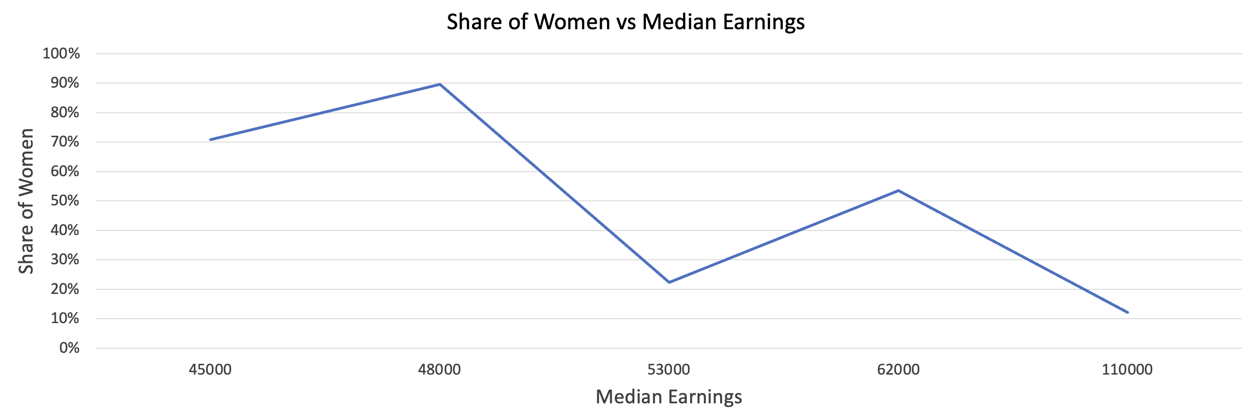
How do we avoid bias & trickery?
Design Contentiously & Read Critically
→ Aspect ratio
Data: https://github.com/fivethirtyeight/data/blob/master/college-majors/women-stem.csv
Notes:
Another way that visualizations can be deceptive is through the aspect ratio chosen for them.
For example here I’m showing one chart with 3 different aspect ratios. You can see when I stretch the chart width-wise, my changes look much less dramatic.
Likewise, when I squish it width-wise my changes look far more dramatic.

Slide 8
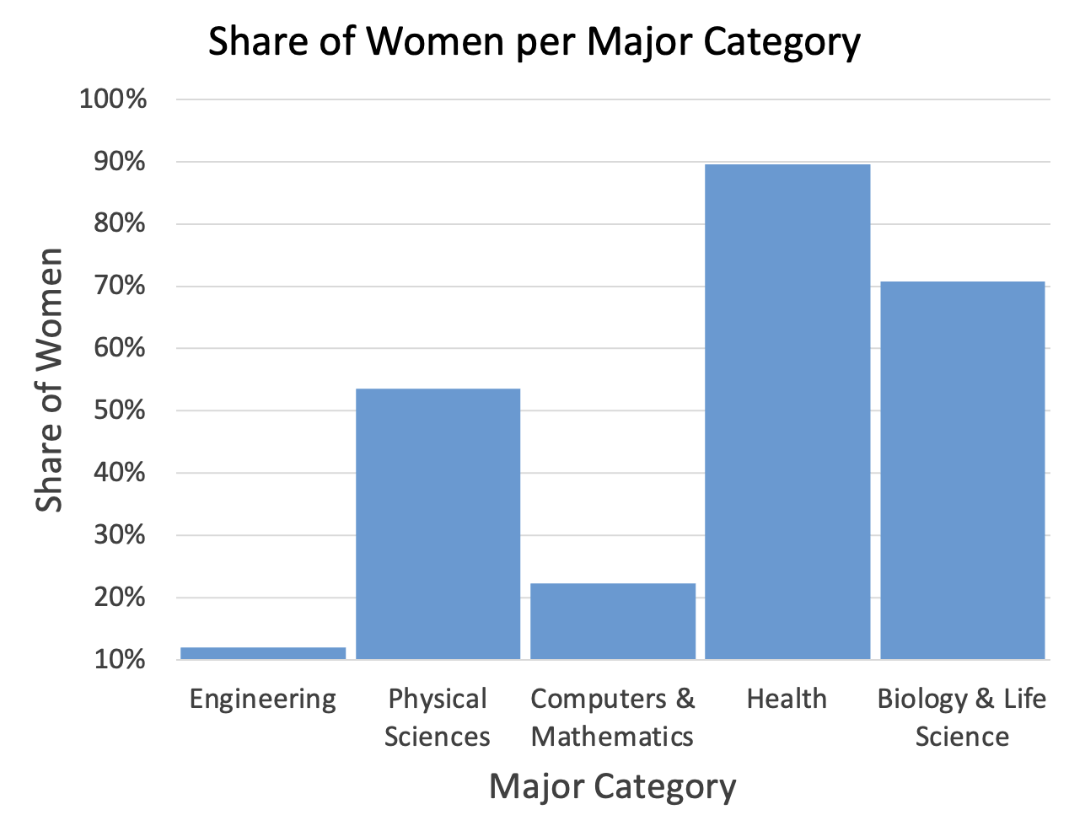
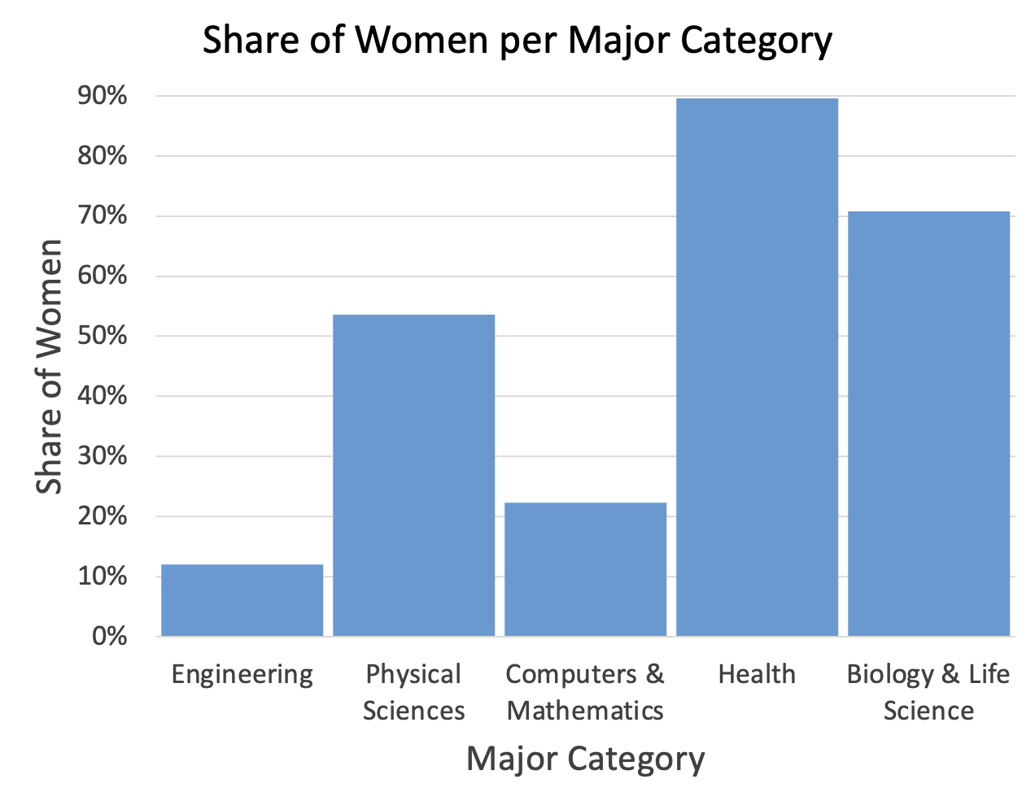
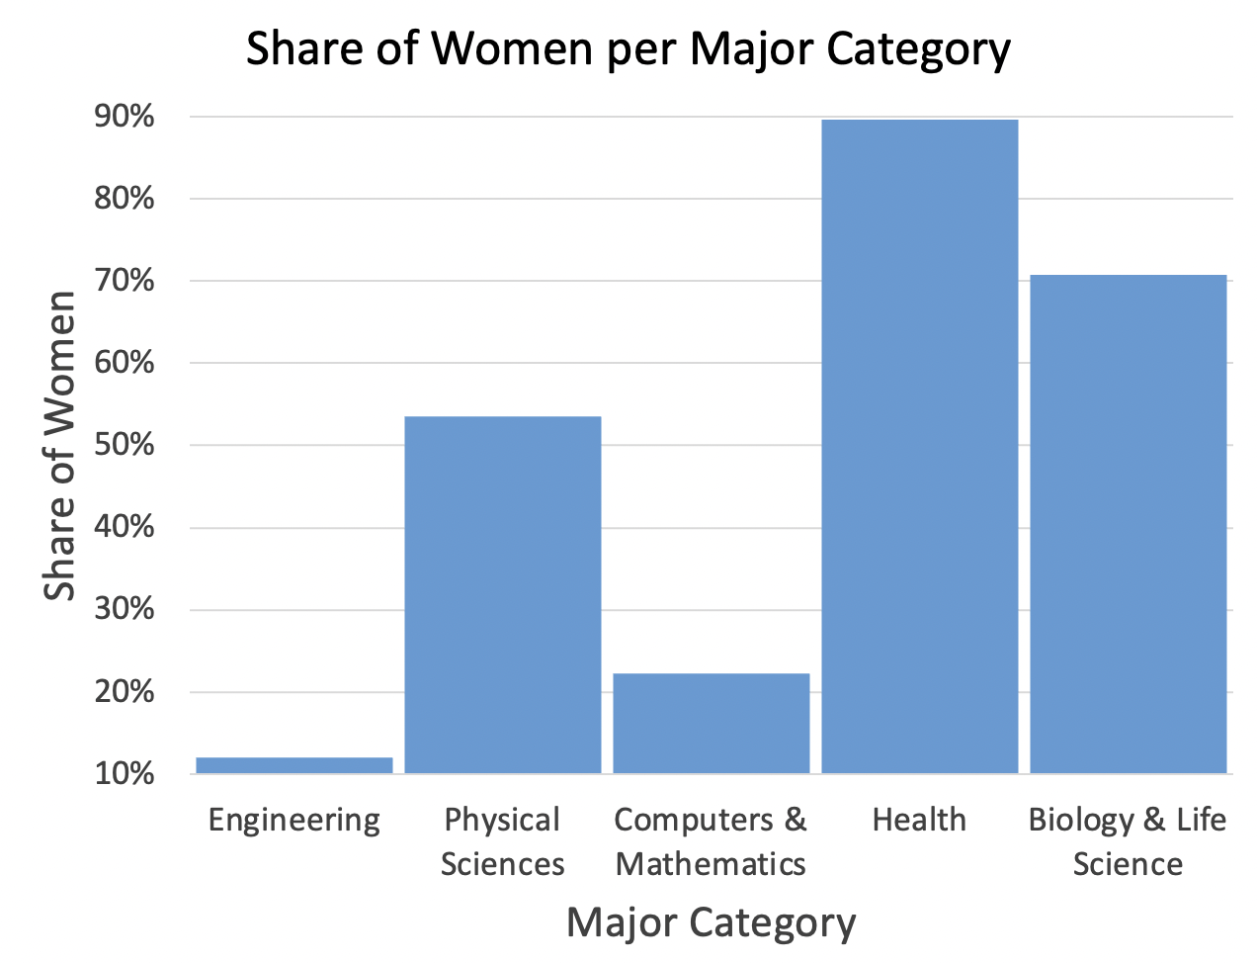
How do we avoid bias & trickery?
Design Contentiously & Read Critically
→ Axes
Data: https://github.com/fivethirtyeight/data/blob/master/college-majors/women-stem.csv
Notes:
Last but not least, another way to bias a chart is by choosing unexpected or unusual axis ranges. For example here I have the same data plotted 4 times. In each plot I use a different range of values on the y-axis.
The first is chosen to make engineering look even smaller, the second is chosen to make health look even better, and the third employs both of these tricks at once.

Slide 9
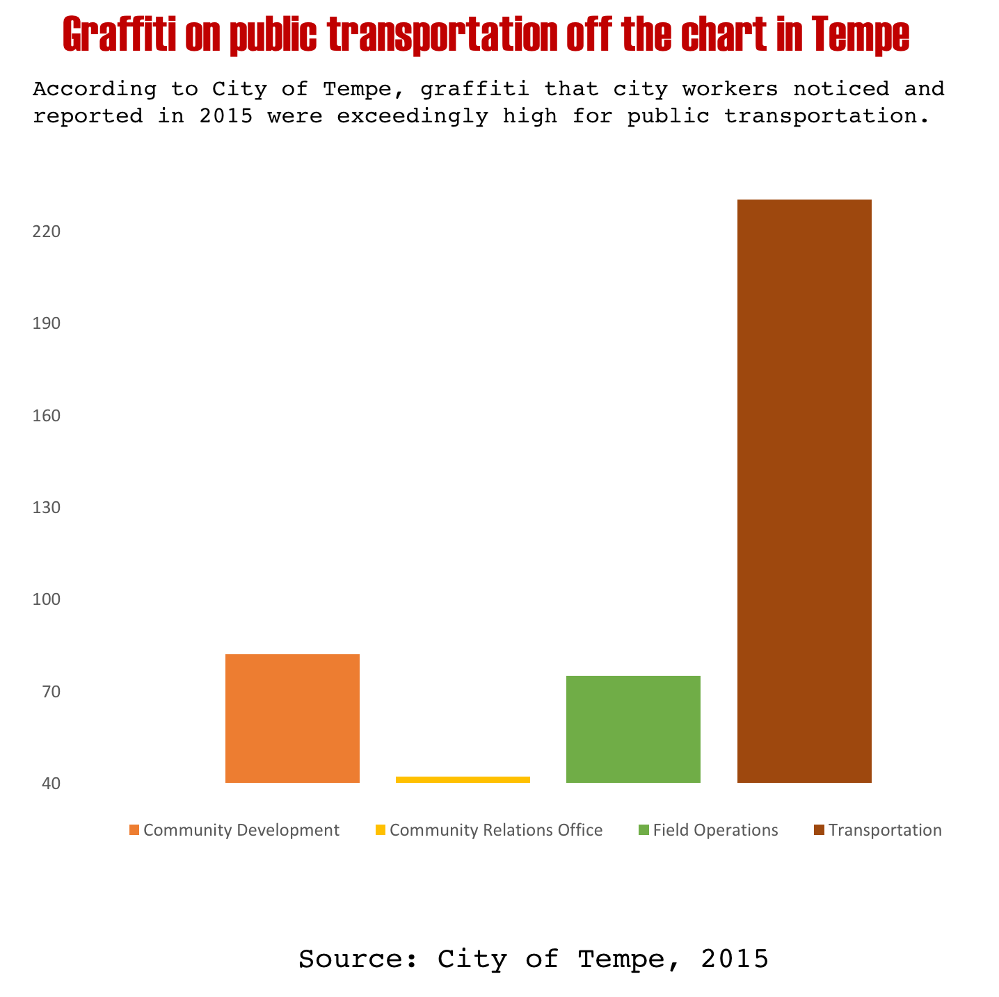
Let’s practice
Take a critical look at this chart. Notice anything?
https://www.vislies.org/2017/gallery/
Notes:
Strange categorization where one group is far larger than the others

Slide 10
Let’s practice
Take a critical look at this chart. Notice anything?
Re-design the chart (you can add more data if you want)
https://www.vislies.org/2017/gallery/
Notes:
Doesn’t start at 0,
Strange categories that don’t span a lot of area

Slide 11
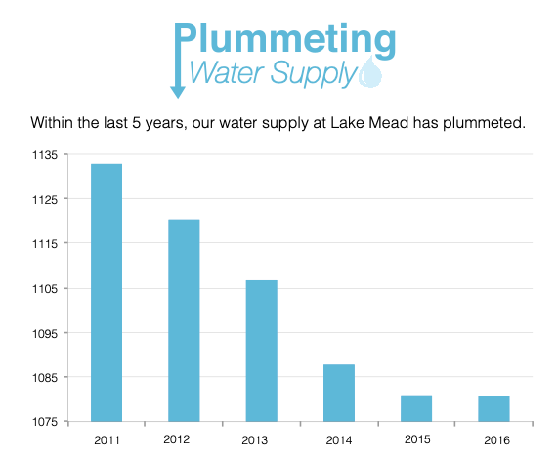
Let’s practice
Take a critical look at this chart. Notice anything?
https://www.vislies.org/2017/gallery/
Notes:
Super tiny range shown on the y-axis

Slide 12
Let’s practice
Take a critical look at this chart. Notice anything?
Re-design the chart (you can add more data if you want)
https://www.vislies.org/2017/gallery/

Slide 13
Let’s practice
Find instructions for today’s lab on the course website.
Notes:
https://github.com/fivethirtyeight/data/blob/master/college-majors/women-stem.csv

