Slide 1
Communicating with Data – Data humanism
Dr. Ab Mosca (they/them)
Slides based off slides courtesy of Jordan Crouser (https://jcrouser.github.io/)

Slide 2
Plan for Today
Giorgia Lupi
Data Humanism

Slide 3
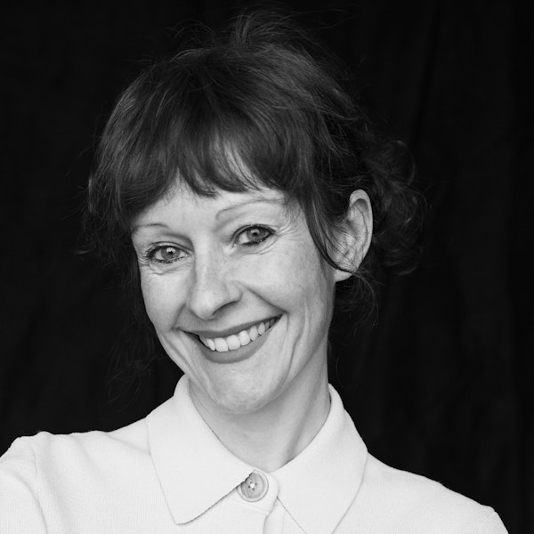
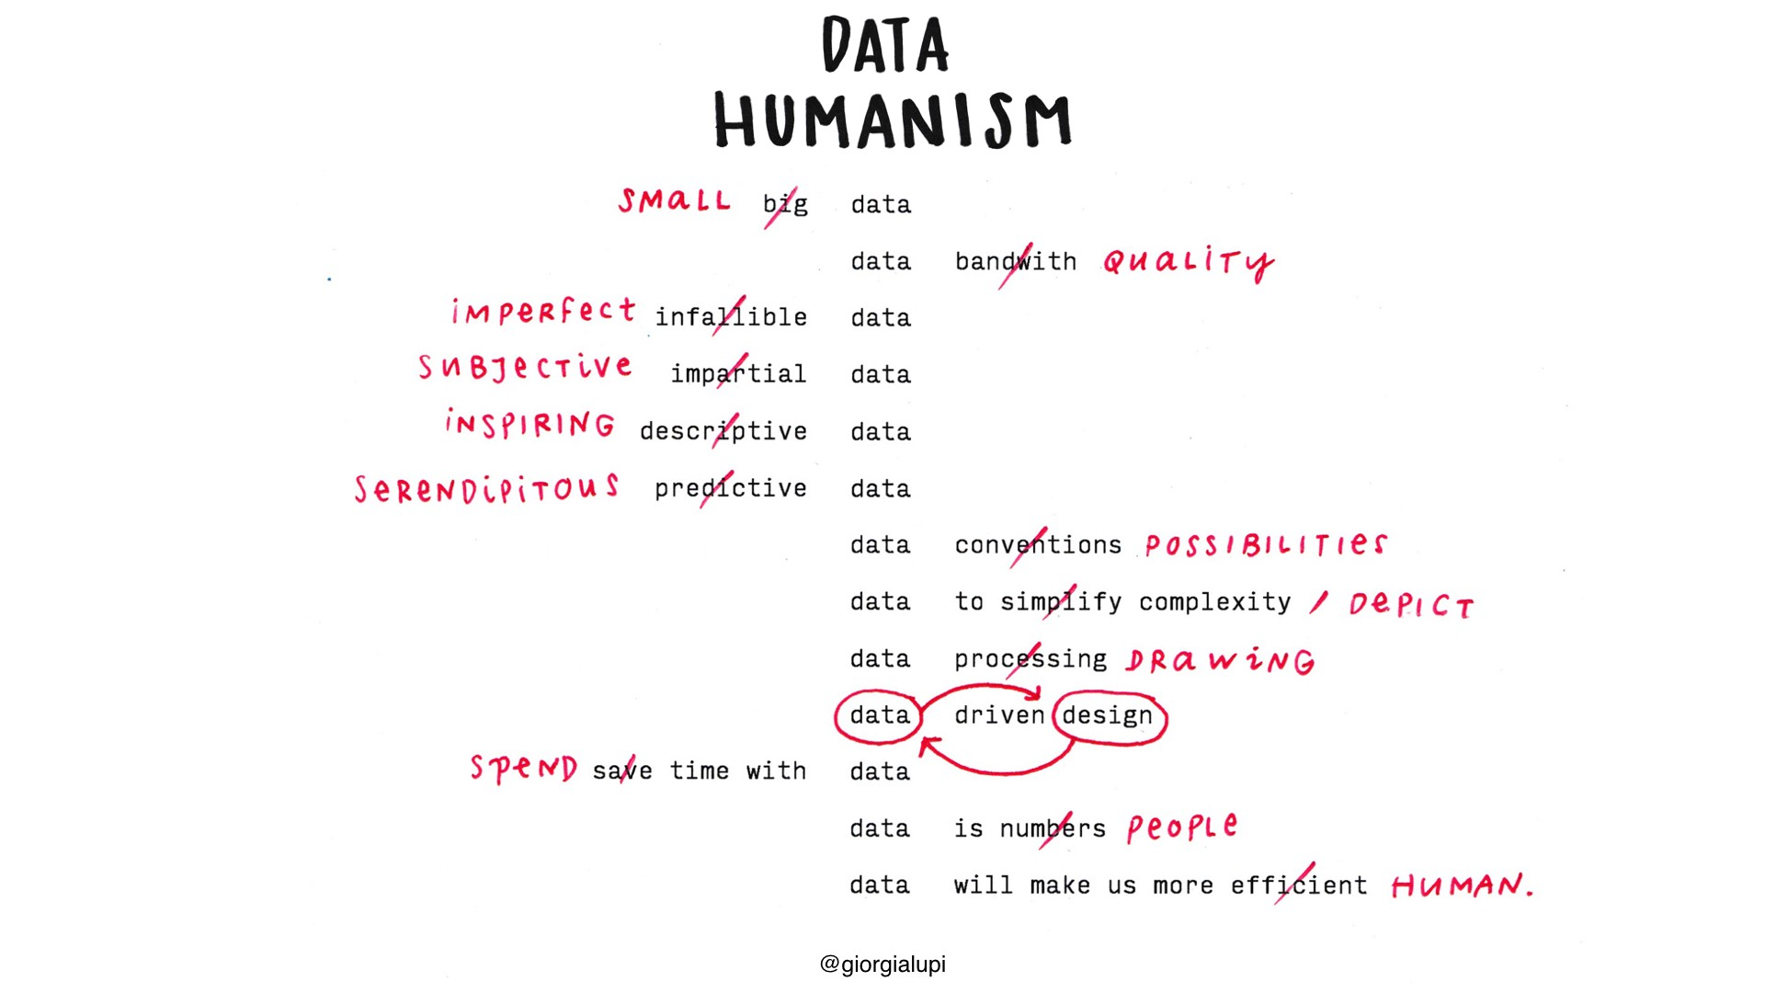
Giorgia Lupi
Wait…. What is data humanism?
Notes:
Data represents real life
ways to connect numbers to what they really stand for: knowledge, behaviors, people.

Slide 4
Exploration
Form groups of ~3
Each group will be assigned one of Giorgia’s projects
1,374 days
Mindworks
What Counts
Unraveling Stories
Bulletin of the Atomic Scientists
The Room of Change
Bruises – The Data We Don’t See
Dear Data
Read about the project, look at the associated visualization(s)
Prepare a short presentation to explain the project to your classmates. Your presentation must include:
An overview of the project. What do you think its big picture takeaway is?
An overview of the data included in the project
How was it collected?
What does it represent?
A look at the visualizations in the project
At least one visualization for which you id marks and channels
What do you think of the project? Any unexpected thoughts or feelings in response to engaging with it? What new thing did you learn?

Slide 5
Discussion
Okay, now who has a hypothesis about what data humanism is?
Notes:
Data represents real life
ways to connect numbers to what they really stand for: knowledge, behaviors, people.

Slide 6
Giorgia Lupi
Notes:
Data represents real life
ways to connect numbers to what they really stand for: knowledge, behaviors, people.

Slide 7
Discussion
Does this approach fit into the theoretical picture we’ve developed so far? Why or why not?

