Slide 1
Communicating with Data – Persuasive Vis
Dr. Ab Mosca (they/them)
Slides based off slides courtesy of Jordan Crouser (https://jcrouser.github.io/)

Slide 2
Plan for Today
Visualization Rhetoric
Editorial choice and visualization
Persuasion activity

Slide 3
Editorial Choices
Visualizations are created by human beings
In that process editorial choices must be made

Slide 4
Editorial Choices
Visualizations are created by human beings
In that process editorial choices must be made
What aspects of a person’s mental model of the world might influence the editorial choices they make?

Slide 5
Editorial Choices
Visualizations are created by human beings
In that process editorial choices must be made
What aspects of a person’s mental model of the world might influence the editorial choices they make?
Is all bias bad?

Slide 6
Rhetoric
Narrative Visualizations result in framing effects due to visualization rhetoric:
Information Access (what data gets shown)
Provenance
Mapping (the data-visual mapping)
Linguistic-based (words used and formatting)
Procedural (how the viewer is led through the vis)
Visualization Rhetoric: Framing Effects in Narrative Visualization; Hullman and Diakopoulos
Notes:
Hierarchy of intent with persuasion

Slide 7
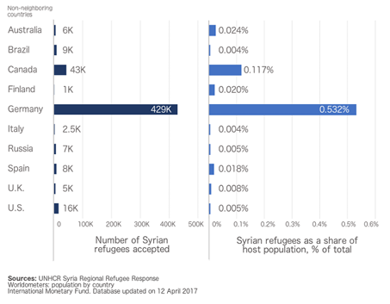
Editorial Choices: Title
U.S. has accepted a lower percentage of Syrian refugees than the U.K., Spain, Finland, and Australia
U.S. has accepted more Syrian refugees than the U.K., Italy, Russia, and Finland combined
Frames and Slants in Titles of Visualizations on Controversial Topics; Kong et al.
What is the takeaway message of this visualization?
Notes:
Two visualizations on popular foreign policies that show two variables supporting opposite sides of the policy.
shows the number of Syrian refugees accepted in each country and Syrian refugees as a share of host population
Policy: The United States should increase the number of Syrian refugees admitted.
Supporting title: U.S. has accepted a lower percentage of Syrian refugees than the U.K., Spain, Finland, and Australia
Non-supporting title: U.S. has accepted more Syrian refugees than the U.K., Italy, Russia, and Finland combined
b) shows the U.S. defense budget in the last 50 years in constant fiscal year 2015 dollars and as a percentage of GDP
Policy: The United States should increase its military budget to fight ISIS.
Supporting title: Defense budget on a steady decrease as a percentage of GDP over the past 50 years
Non-supporting title: Defense budget on an increase in constant dollars heading towards $500 billion by 2019

Slide 8
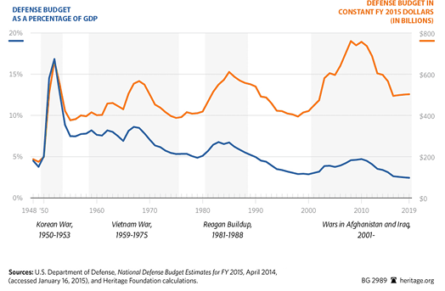
Editorial Choices: Title
Defense budget on a steady decrease as a percentage of GDP over the past 50 years
Defense budget on an increase in constant dollars heading towards $500 billion by 2019.
Frames and Slants in Titles of Visualizations on Controversial Topics; Kong et al.
What is the takeaway message of this visualization?
Notes:
Two visualizations on popular foreign policies that show two variables supporting opposite sides of the policy.
shows the number of Syrian refugees accepted in each country and Syrian refugees as a share of host population
Policy: The United States should increase the number of Syrian refugees admitted.
Supporting title: U.S. has accepted a lower percentage of Syrian refugees than the U.K., Spain, Finland, and Australia
Non-supporting title: U.S. has accepted more Syrian refugees than the U.K., Italy, Russia, and Finland combined
b) shows the U.S. defense budget in the last 50 years in constant fiscal year 2015 dollars and as a percentage of GDP
Policy: The United States should increase its military budget to fight ISIS.
Supporting title: Defense budget on a steady decrease as a percentage of GDP over the past 50 years
Non-supporting title: Defense budget on an increase in constant dollars heading towards $500 billion by 2019

Slide 9
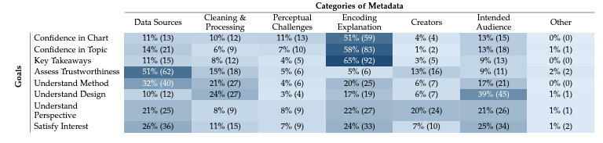
Editorial Choices: Metadata
From Invisible to Visible: Impacts of Metadata in Communicative Data Visualization; Burns et al.

Slide 10
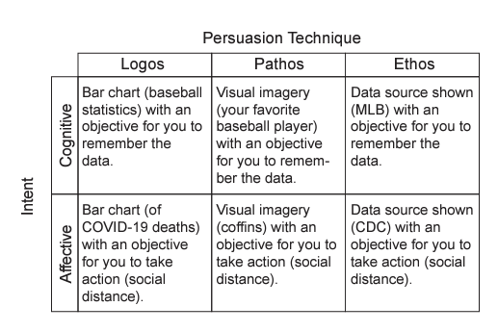
Editorial Choices: Intent
Affective Learning Objectives for Communicative Visualizations; Lee-Robins and Adar

Slide 11
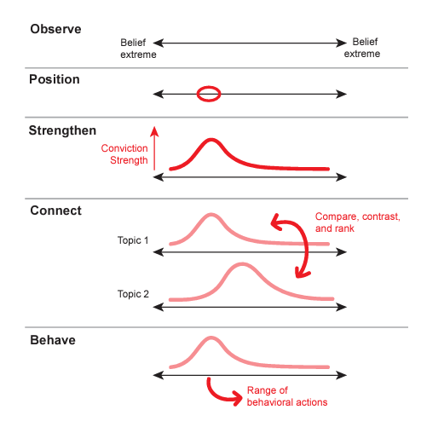
Editorial Choices: Intent
Affective Learning Objectives for Communicative Visualizations; Lee-Robins and Adar
Notes:
Hierarchy of intent with persuasion

Slide 12
Activity
Form groups, each will be assigned one of the following datasets:
Human Development Indicators
Climate Change Indicators
Abortion Data by U.S. State from the Guttmacher Institute
Explore your dataset and devise a proposition about it: a statement that asserts a judgement or opinion about the trends you might have uncovered
Your proposition can be contentious but cannot be dehumanizing or demeaning
Split into two subgroups to design two persuasive visualizations; one for each side of your proposition. If you use deception, it should not be immediately obvious.
Be prepared to share your visualizations with the class
Adapted from: https://vis-society.github.io/assignments/A4.html

