Slide 1
Communicating with Data – Data Humanism
Dr. Ab Mosca (they/them)

Slide 2
Notes
Next week…
Mid-semester project!
A lot of the work will happen during class time—it’s a good week to do revise and resubmit on past assignments if you have any waiting
I will be here next Thursday, but class time will still be saved for project ideation
I recommend reading the instructions for the project before class!

Slide 3
Plan for Today
The human side of data
Visualization as art
Visualization as experience

Slide 4

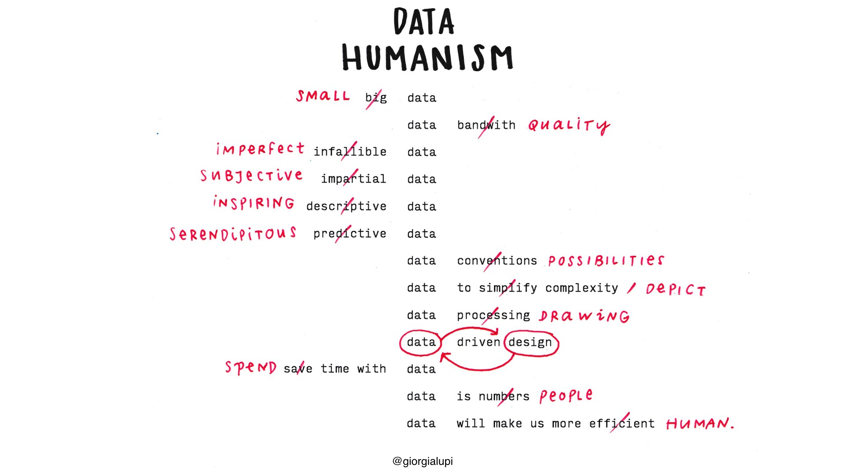
Giorgia Lupi
Wait…. What is data humanism?
Notes:
Data represents real life
ways to connect numbers to what they really stand for: knowledge, behaviors, people.

Slide 5
Exploration https://giorgialupi.com/
Form groups of ~3
Each group will be assigned one of Giorgia’s projects
1,374 days
Mindworks
What Counts
Unraveling Stories
Bulletin of the Atomic Scientists
The Room of Change
Bruises – The Data We Don’t See
Dear Data
Read about the project, look at the associated visualization(s)
Prepare a short (5 min) presentation to explain the project to your classmates. Your presentation must include:
An overview of the project. What do you think its big picture takeaway is?
An overview of the data included in the project
How was it collected?
What does it represent?
A look at the visualizations in the project
At least one visualization for which you id marks and channels
What do you think of the project? Any unexpected thoughts or feelings in response to engaging with it? What new thing did you learn?

Slide 6
Discussion
Okay, now who has a hypothesis about what data humanism is?
Notes:
Data represents real life
ways to connect numbers to what they really stand for: knowledge, behaviors, people.

Slide 7
Giorgia Lupi

Slide 8
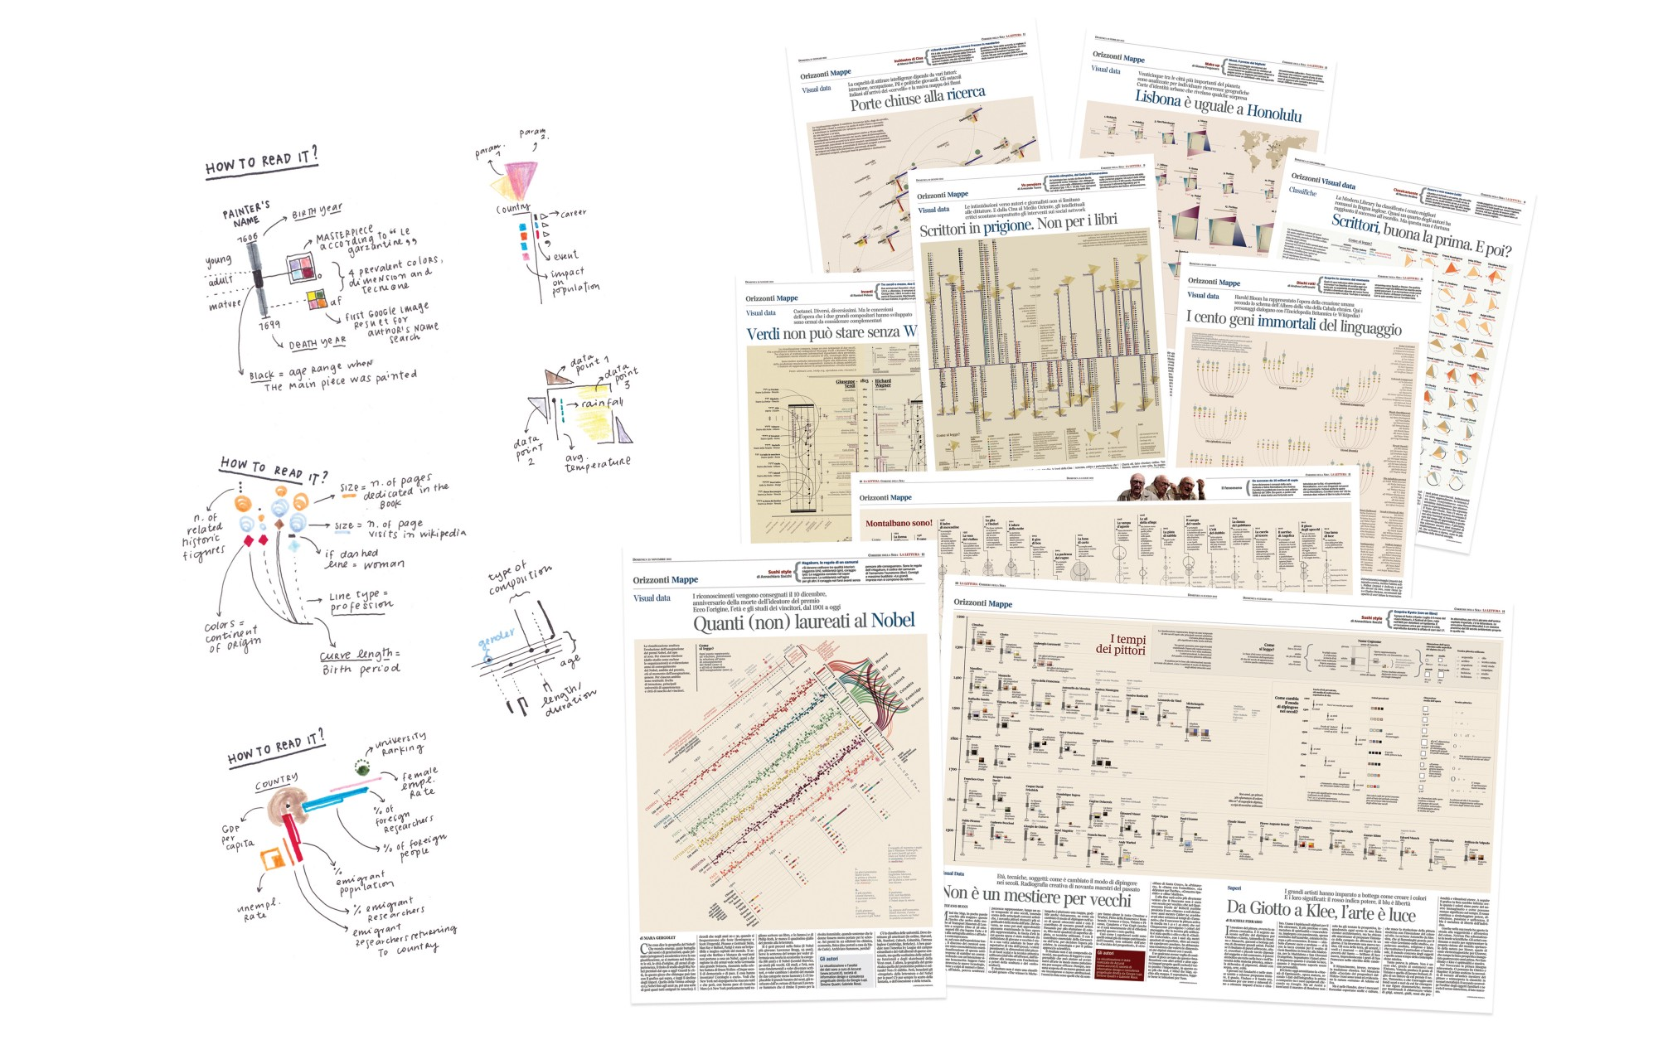
Data Humanism: Embrace Complexity
Notes:
Complexity is an inherent feature of our existence — the world is rich in information that can be combined in endless ways. Creating new points of view or uncovering something new typically cannot happen at a mere glance;this process of revelation often needs and requires an in-depth investigation of the context.
Whenever the main purpose of data visualization is to open people’s eyes to fresh knowledge, it is impractical to avoid a certain level of visual complexity.
We can write rich and dense stories with data. We can educate the reader’s eye to become familiar with visual languages that convey the true depth of complex stories.
Dense and unconventional data visualizations promote slowness — a particularly poignant goal to set in our era of ever shortening attention spans. If we can create visuals that encourage careful reading and personal engagement, people will find more and more real value in data and in what it represents.

Slide 9
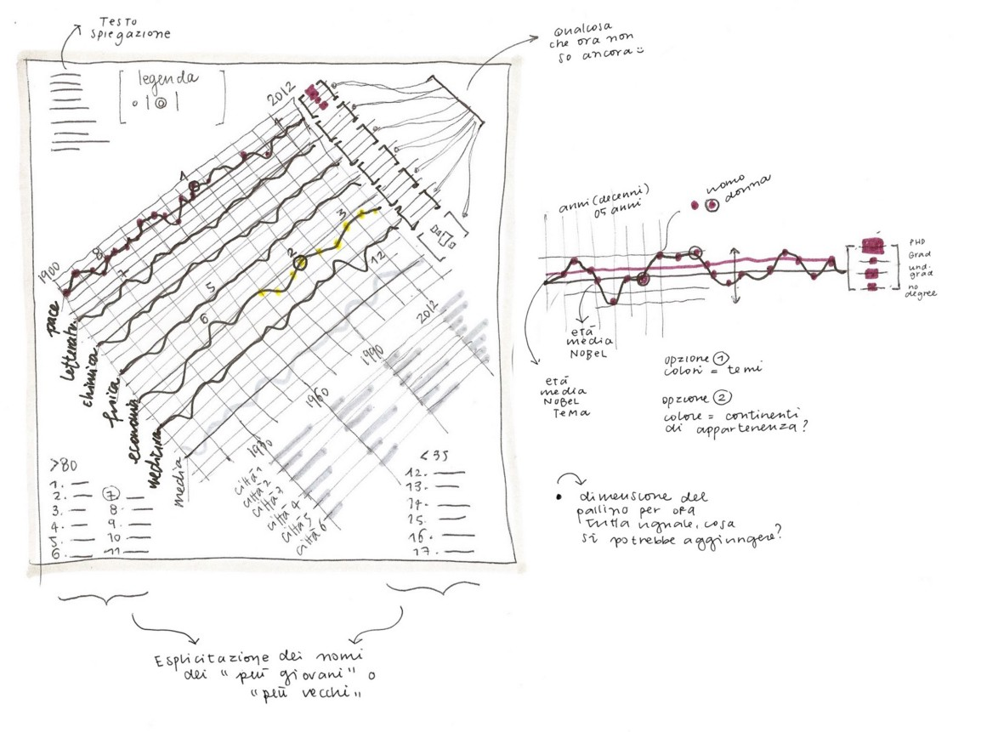
Data Humanism: Move Beyond Standards
Notes:
One size does not fit all. Business intelligence tools and dataviz tools for marketers have led many to believe that the ideal way to make sense of information is to load data into a tool, pick from among a list of suggested out-of-the-box charts, and get the job done in a couple of clicks. This common approach is actually nothing more than blindly throwing technology at the problem, sometimes without spending enough time framing the question that triggered the exploration in the first place. This often leads to results that are not only practically useless, but also deeply wrong, because prepackaged solutions are rarely able to frame problems that are difficult to define, let alone solve.
Sketching with data — so, in a way, removing technology from the equation before bringing it back to finalize the design with digital tools — introduces novel ways of thinking, and leads to designs that are uniquely customized for the specific type of data problems we are working with. I draw to freely explore possibilities. I draw to visually understand what I am thinking, I draw to evaluate my ideas and intuitions by seeing them coming to life on paper, I draw to help my mind think without limitations, without boundaries.
Drawing with data is an invaluable tool to discover what is unique about the numbers at hand. It also raises new questions about the data itself. This limiting practice helps to reveal new possible analyses to perform: Instead of being overwhelmed by the size of a dataset and by millions of numbers,we focus only on their nature, their organization,and doing so often opens new opportunities originating from this vantage point.
To expand their data-drawing vocabulary, designers can access hundreds of years of visual information encoding — the evolution of music notation from medieval times to contemporary music, the experimentation with geometric shapes that characterized avant-garde artists of the last century. These visual languages, while clearly pursuing different goals, have a lot in common with data visualization: they draw on common perception principles and use simple shapes, select symbols, and a defined range of colors to create basic visual compositions that deliver a message and please the eye.

Slide 10
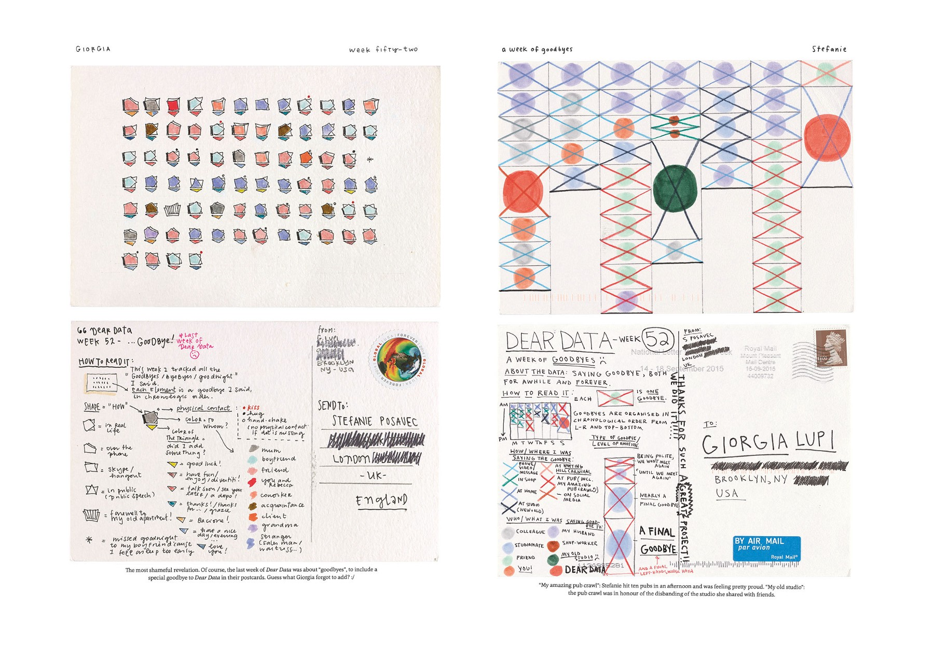
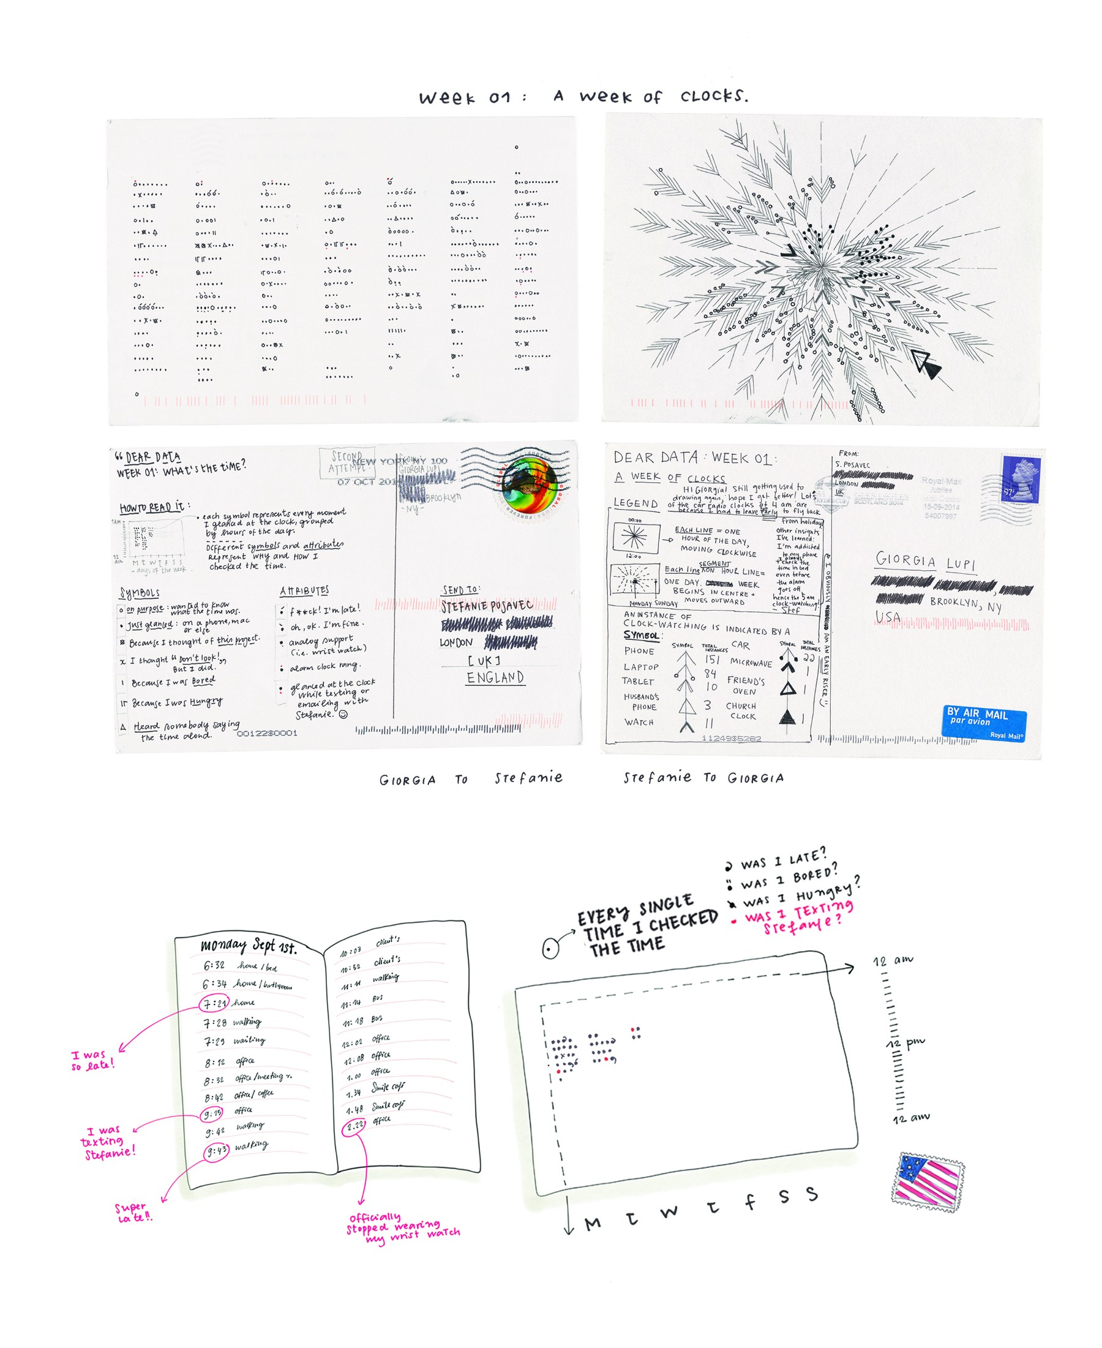
Data Humanism: Sneak Context In (Always)
Notes:
A dataset might lead to many stories. Data is a tool that filters reality in a highly subjective way, and from quantity, we can get closer to quality. Data, with its unique power to abstract the world, can help us understand it according to relevant factors. How a dataset is collected and the information included — and omitted — directly determines the course of its life. Especially if combined, data can reveal much more than originally intended. As semiologists have theorized for centuries, language is only a part of the communication process — context is equally important.
This is why we have to reclaim a personal approach to how data is captured, analyzed and displayed, proving that subjectivity and context play a big role in understanding even big events and social changes — especially when data is about people.
Data, if properly contextualized, can be an incredibly powerful tool to write more meaningful and intimate narratives.
For the first seven days of Dear Data we chose a seemingly cold and impersonal topic: how many times we checked the time in a week. As the weeks moved on, we shared everything about ourselves through our data: our envies, the sounds of our surroundings, our private moments and our eating habits.

Slide 11
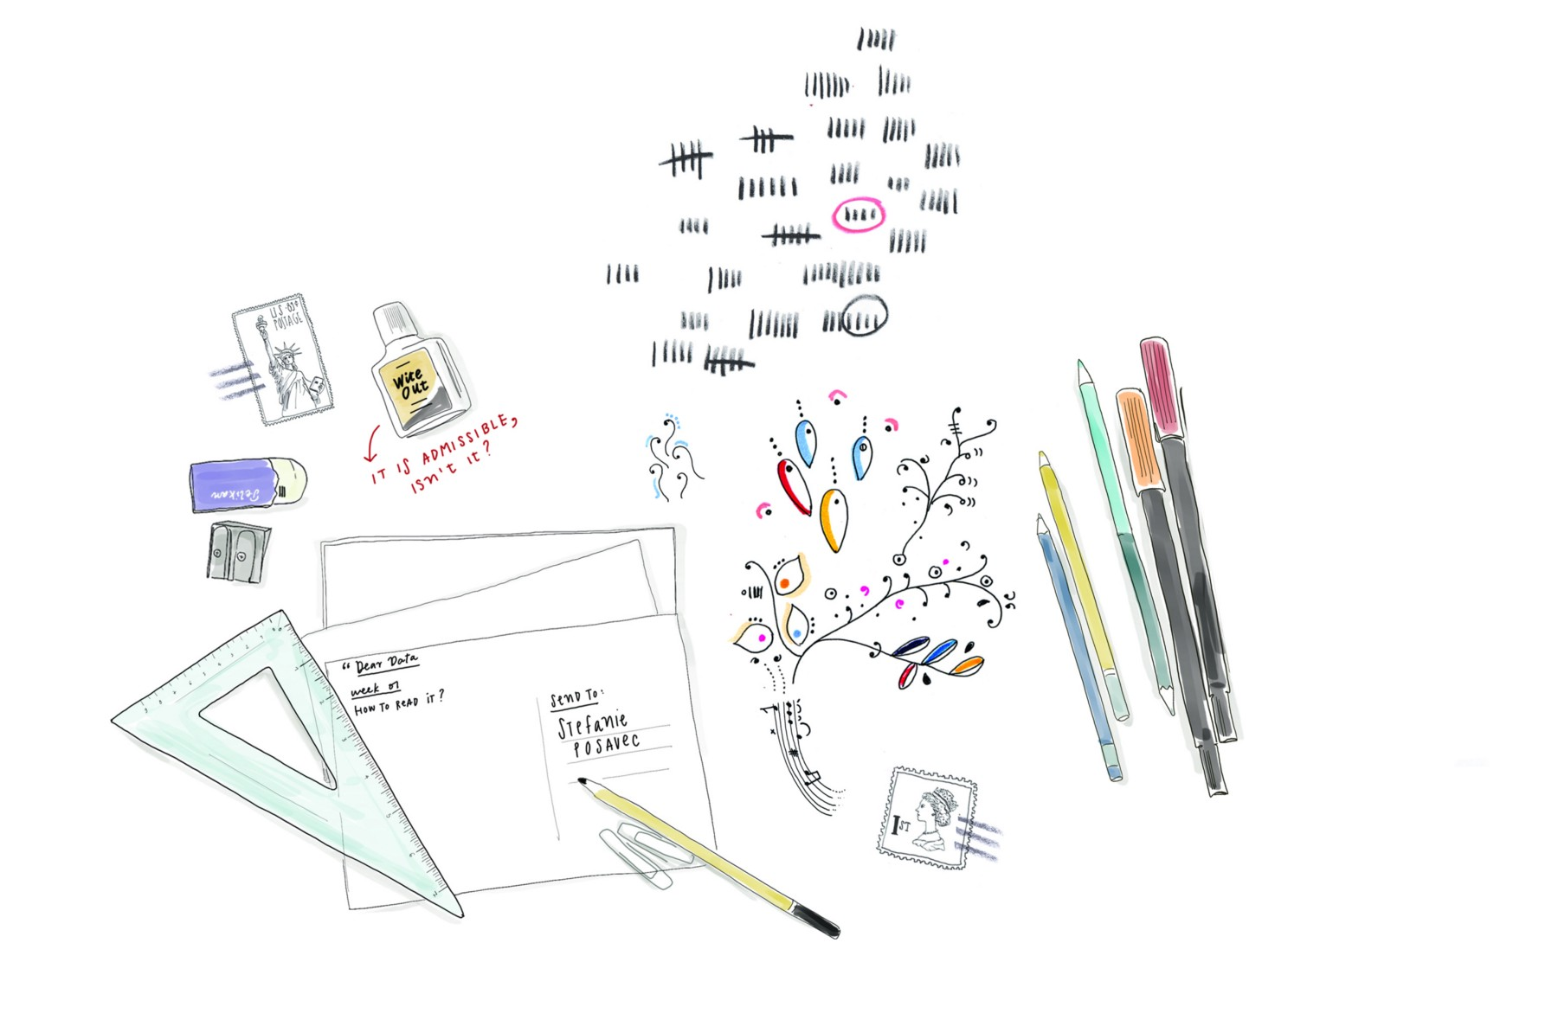
Data Humanism: Remember That Data is Imperfect
Notes:
Let’s just stop thinking data is perfect. It’s not. Data is primarily human-made. “Data-driven” doesn’t mean “unmistakably true,” and it never did.
It’s time to leave behind any presumption of absolute control and universal truth and embrace an informed depiction of the big numbers and small imperfections that work together to describe reality. And data visualization should embrace imperfection and approximation, allowing us to envision ways to use data to feel more empathic, to connect with ourselves and others at a deeper level. The more effort we put into researching and translating, the easier the reader will understand and relate to the stories we tell.
But this requires a paradigm shift in the way we represent information visually.
We should learn how to include and render the more qualitative and nuanced aspects of data. We should experiment with how to visualize uncertainty, possible errors and imperfections in our data. And most importantly, we should keep in mind how data can be a powerful tool for all designers, bringing stories to life in a visual way and adding structural meaning to our projects.

Slide 12
Discussion
Does this approach fit into the theoretical picture we’ve developed so far? Why or why not?

