Slide 1
Communicating with Data – Persuasive Vis
Dr. Ab Mosca (they/them)

Slide 2
Reminder
Final Project Presentations start Thursday! (12/05)
Be prepared to present on Thursday (order will be random)
Milestone 4 instructions list everything that I’m looking for in your visualization and your presentation
You may revise and resubmit any assignments until the end of finals (12/18)

Slide 3
Plan for Today
Visualization Rhetoric
Persuasive Visualization Activity

Slide 4
Editorial Choices
Visualizations are created by human beings
In that process editorial choices must be made

Slide 5
Editorial Choices
Visualizations are created by human beings
In that process editorial choices must be made
What aspects of a person’s mental model of the world might influence the editorial choices they make?

Slide 6
Editorial Choices
Visualizations are created by human beings
In that process editorial choices must be made
What aspects of a person’s mental model of the world might influence the editorial choices they make?
Is all bias bad?

Slide 7
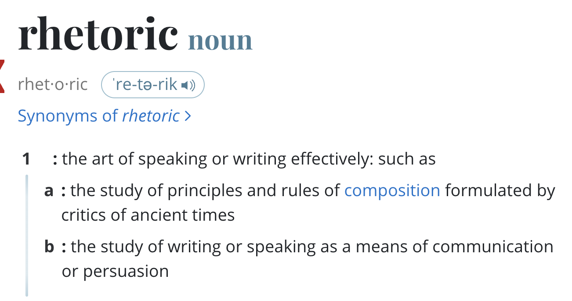
Rhetoric
Notes:
We demonstrate visualization rhetoric as an analytical framework for understanding how design techniques that prioritize particular interpretations in visualizations that “tell a story” can significantly affect end-user interpretation

Slide 8
Visualization Rhetoric
An analytical framework for understanding how design techniques that prioritize particular interpretations in visualizations that “tell a story” can significantly affect end-user interpretation.
Visualization Rhetoric: Framing Effects in Narrative Visualization; Hullman and Diakopoulos
Notes:
We demonstrate visualization rhetoric as an analytical framework for understanding how design techniques that prioritize particular interpretations in visualizations that “tell a story” can significantly affect end-user interpretation

Slide 9
Visualization Rhetoric
Editorial Layers
The Data
Visual Representation
Textual Annotations
Interactivity
ID one editorial decision to be made in each layer. How might that decision affect the takeaway message of the visualization?
Visualization Rhetoric: Framing Effects in Narrative Visualization; Hullman and Diakopoulos
Notes:
four editorial layers that can be used to convey meaning
A given rhetorical technique might be applied to some layers more easily than others. Yet omissions, emphases, and ambiguity can be accomplished at each level.
a narrative visualization represents a sequence of choices to either add information (such as by adding suggestions of an intended message using textual annotations) or omit information (such as by omitting some variables or interactivity features).
DATA
creator of a visualization makes choices about the data source to represent, including
-what variables to include and which to leave out
-removing outliers, scaling, or aggregating values
-Both lead to loss of information in the final representation, yet are necessary choices in the act of visualization design
VISUAL REPRESENTATION
choices made about how the data will be mapped to the visual domain
Mapping is lossy (JND)
TEXTUAL ANNOTATIONS
Direct the user’s attention
INTERACTIVITY
constrain a user’s interaction in ways that lead her to explore certain subsets of data.
This can occur through navigation menus that limit the number of views of the data set that are possible, or linked search suggestions that likewise encourage the user to explore particular views over others

Slide 10
Visualization Rhetoric Techniques
Information Access Rhetoric
Omission
Neglecting to cite data sources
Defining variables ambiguously
Knowledge assumptions of the end-user
Thresholding values
Omitting exceptional cases
Thresholding axes
Filtering
Metonymy (techniques the require part-to-whole relationships)
Selection of variables
Averaging
Textual and visual summaries
Categorizing, binning, or aggregating
Visualization Rhetoric: Framing Effects in Narrative Visualization; Hullman and Diakopoulos

Slide 11
Visualization Rhetoric Techniques
Provenance Rhetoric
Data provenance
Citing and/or linking...
Data sources
Additional references
Methodological choices
Relevant facts
Annotating exceptions and corrections
Representing uncertainty
Error bars
Descriptions of inferential limits (ex. CI)
“leap-of-faith” or forecast annotations
Expressions of doubt
Identification
Author bios or personal anecdotes
Visualization Rhetoric: Framing Effects in Narrative Visualization; Hullman and Diakopoulos
Notes:
Forecast annotations == show where interpolation starts

Slide 12
Visualization Rhetoric Techniques
Mapping Rhetoric
Obscuring
Gratuitous third dimension
Sizing transformations
Discriminability limits
Oversizing
Neglect to map information to most salient visual judgement types
False cause-and-effect
Double-axis
Visual metaphor and metonymy
Suggestive spatial mappings (ex. Left = past)
Typographical mappings
Color mappings
Visual noise
Visualization Rhetoric: Framing Effects in Narrative Visualization; Hullman and Diakopoulos
Notes:
Mapping rhetoric refers to manipulating the information presentation via the data-to-visual transfer function, the constraints that determine how a piece of information will be translated to a visual feature

Slide 13
Visualization Rhetoric
Mapping Rhetoric
Contrast
Visual contrasts
Variable splices
Classification
Grouping by size, position, or color
Consistent typographic manipulations
Equations of significance
Redundancy
Disaggregating homogenous values or visual marks
Visual noise
Visualization Rhetoric: Framing Effects in Narrative Visualization; Hullman and Diakopoulos
Notes:
Mapping rhetoric refers to manipulating the information presentation via the data-to-visual transfer function, the constraints that determine how a piece of information will be translated to a visual feature

Slide 14
Visualization Rhetoric Techniques
Linguistic-Based Rhetoric
Typographic emphases
Bolding
Italicizing
Irony
Rhetorical questions (ex. Titles)
Quotation marks
Deliberate understatement
Visualization Rhetoric: Framing Effects in Narrative Visualization; Hullman and Diakopoulos

Slide 15
Visualization Rhetoric Techniques
Linguistic-Based Rhetoric
Similarity
Contrast
Analogy
Metaphoric statements
Parallelism
Simile
Double entendre
Individualization
Apostrophe
Sorting and filtering
Phrasing or imagery framed from an individual-citizen level view
Visualization Rhetoric: Framing Effects in Narrative Visualization; Hullman and Diakopoulos

Slide 16
Visualization Rhetoric Techniques
Procedural Rhetoric
Anchoring
Default views
Fixed comparisons
Spatial ordering
Animations
Partial animation
Search suggestions
Goal suggestions
Filtering
Visualization Rhetoric: Framing Effects in Narrative Visualization; Hullman and Diakopoulos
Notes:
"Procedural rhetoric" is based in an artifact’s procedural mode of representation, in other words, the expression of meanings through rule-based representations and interactive functions

Slide 17
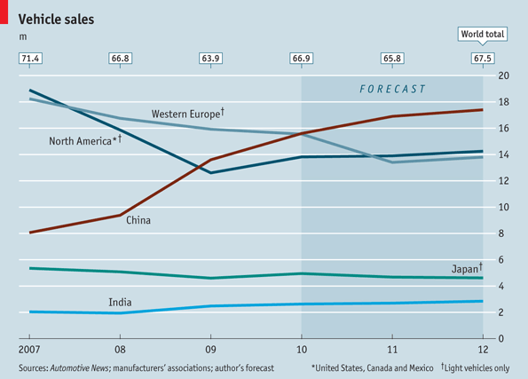
What forms of Visualization Rhetoric do you see here?
Visualization Rhetoric: Framing Effects in Narrative Visualization; Hullman and Diakopoulos
Notes:
Information access – metonymy -- Categorizing, binning, or aggregating values can be used to make an intended effect more apparent. An Economist graph on car sales [47] (Fig. 2) depicts only ‘light vehicles’ for some countries’ data, yet all sales for other countries
Provenance – representing uncertainty -- expressions of doubt regarding potential conclusions (see Fig. 2, tag line below title)
Mapping – obscuring -- double-axis, which experts have noted are difficult to decode even when properly used [50], (see Fig. 2 ‘Vehicle Sales’ [47] and Fig. 7 ‘Poll Dancing’ [29]

Slide 18
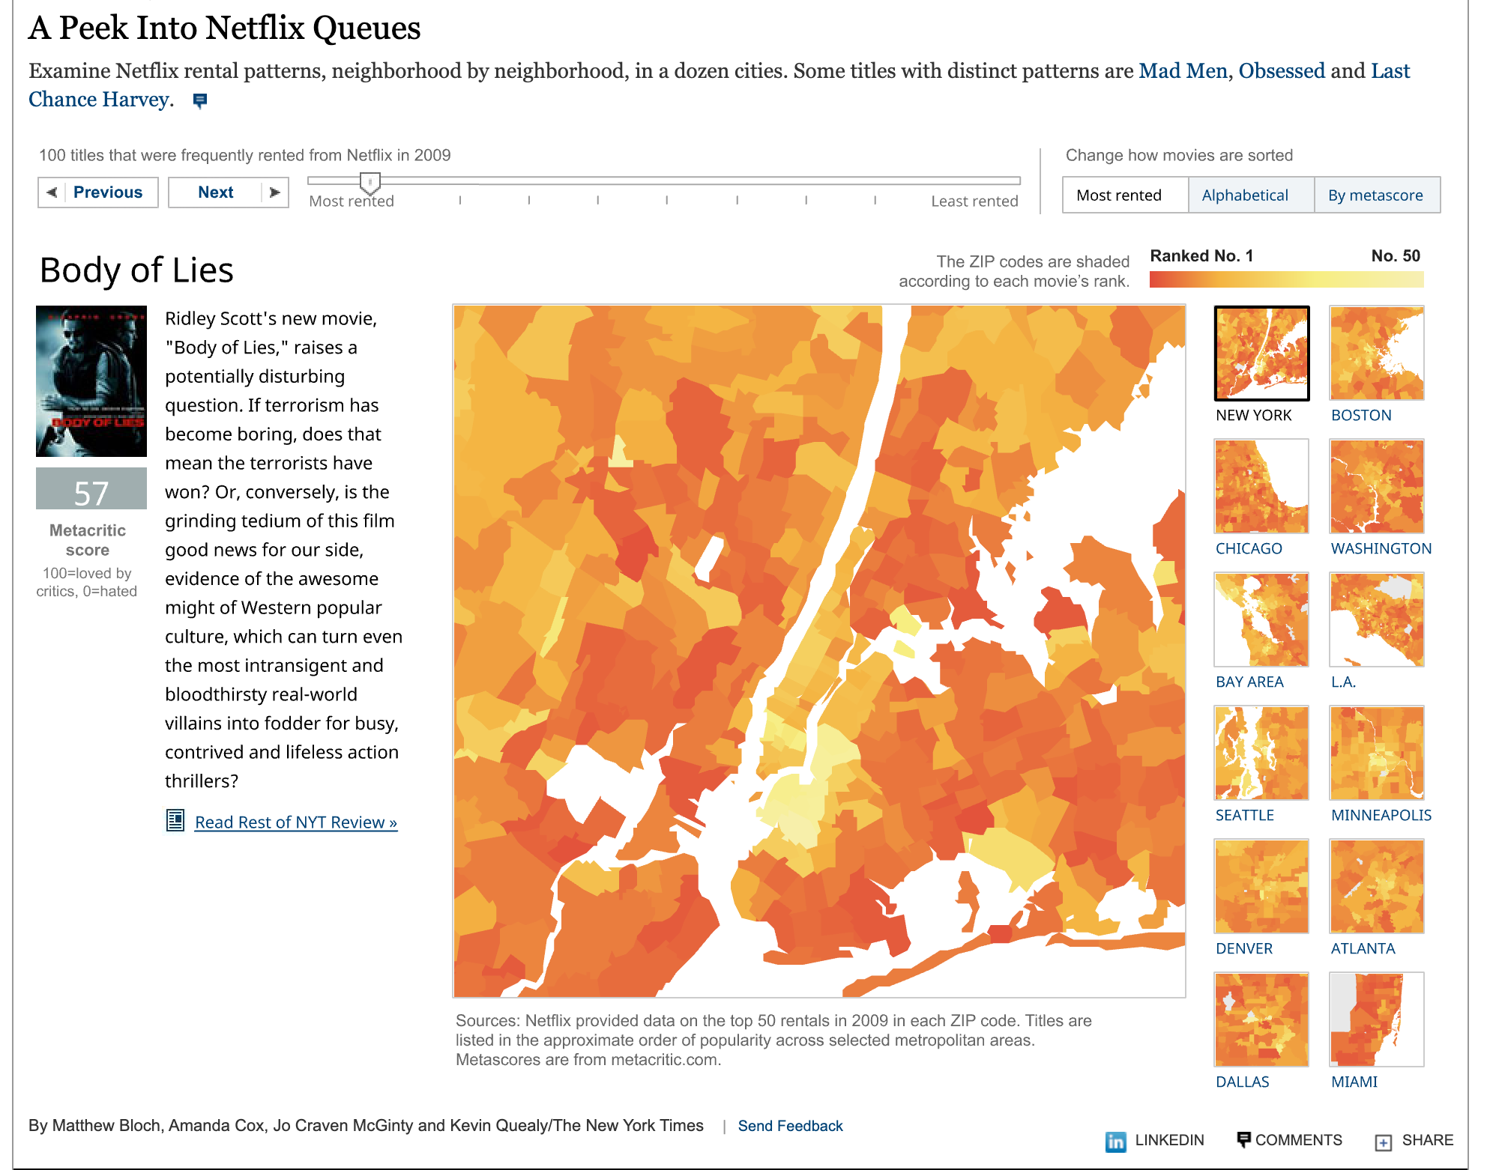
What forms of Visualization Rhetoric do you see here?
Visualization Rhetoric: Framing Effects in Narrative Visualization; Hullman and Diakopoulos
Notes:
Mapping – contrast -- An example can be found in the NYT interactive visualization entitled ‘A Peek Into Netflix Queues’ [5] (Fig. 4). The title and two variables of rental lists and movie rank variables are mapped to the important visual dimensions of spatial position and color. These mappings imply an overall message organized around geographic patterns in top rentals. However, a choice was made to include the less obviously relevant critic metascores for each movie, along with a sample NYT review of each, to the left of the map frame. The result is an implication that this information may generate further insight through comparisons with the geographic patterns

Slide 19
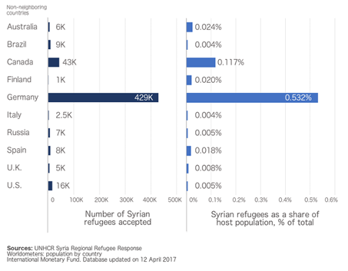
Visualization Rhetoric in Action
U.S. has accepted a lower percentage of Syrian refugees than the U.K., Spain, Finland, and Australia
U.S. has accepted more Syrian refugees than the U.K., Italy, Russia, and Finland combined
Frames and Slants in Titles of Visualizations on Controversial Topics; Kong et al.
What is the takeaway message of this visualization?
Notes:
Two visualizations on popular foreign policies that show two variables supporting opposite sides of the policy.
shows the number of Syrian refugees accepted in each country and Syrian refugees as a share of host population
Policy: The United States should increase the number of Syrian refugees admitted.
Supporting title: U.S. has accepted a lower percentage of Syrian refugees than the U.K., Spain, Finland, and Australia
Non-supporting title: U.S. has accepted more Syrian refugees than the U.K., Italy, Russia, and Finland combined
b) shows the U.S. defense budget in the last 50 years in constant fiscal year 2015 dollars and as a percentage of GDP
Policy: The United States should increase its military budget to fight ISIS.
Supporting title: Defense budget on a steady decrease as a percentage of GDP over the past 50 years
Non-supporting title: Defense budget on an increase in constant dollars heading towards $500 billion by 2019

Slide 20
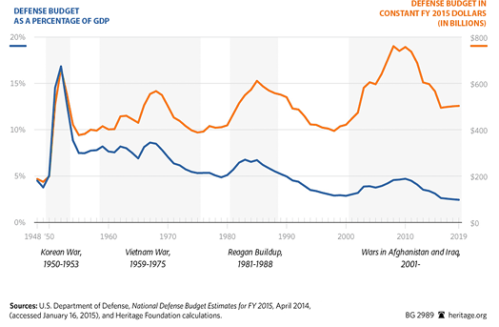
Visualization Rhetoric in Action
Defense budget on a steady decrease as a percentage of GDP over the past 50 years
Defense budget on an increase in constant dollars heading towards $500 billion by 2019.
Frames and Slants in Titles of Visualizations on Controversial Topics; Kong et al.
What is the takeaway message of this visualization?
Notes:
Two visualizations on popular foreign policies that show two variables supporting opposite sides of the policy.
shows the number of Syrian refugees accepted in each country and Syrian refugees as a share of host population
Policy: The United States should increase the number of Syrian refugees admitted.
Supporting title: U.S. has accepted a lower percentage of Syrian refugees than the U.K., Spain, Finland, and Australia
Non-supporting title: U.S. has accepted more Syrian refugees than the U.K., Italy, Russia, and Finland combined
b) shows the U.S. defense budget in the last 50 years in constant fiscal year 2015 dollars and as a percentage of GDP
Policy: The United States should increase its military budget to fight ISIS.
Supporting title: Defense budget on a steady decrease as a percentage of GDP over the past 50 years
Non-supporting title: Defense budget on an increase in constant dollars heading towards $500 billion by 2019

Slide 21
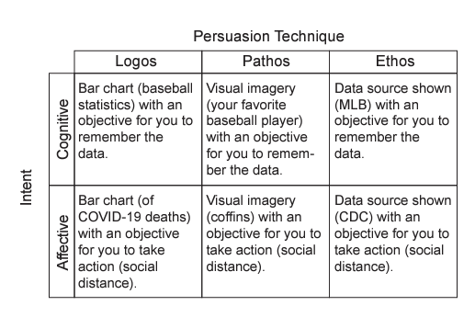
Persuasion Techniques vs. Intent
Affective Learning Objectives for Communicative Visualizations; Lee-Robins and Adar
Notes:
Examples of persuasion techniques (logos, pathos, ethos) used to achieve intents (cognitive, affective).

Slide 22
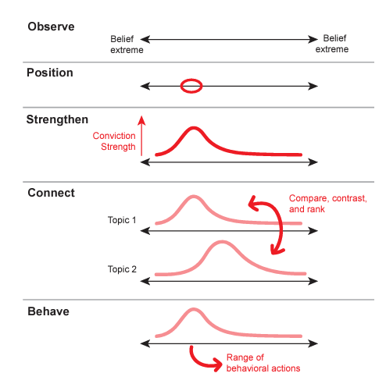
Affective Intents
Affective Learning Objectives for Communicative Visualizations; Lee-Robins and Adar
Notes:
The affective intents start at observe the range of beliefs, then to position oneself within that range of beliefs, then to strengthen one’s belief, then to connect and compare several beliefs with each other, and finally to behave consistent with that belief (see Figure 3).
In observe, the intent is simply to make the viewer aware of the range of beliefs
position, is when the designer intends to point out a specific place along the range of beliefs where they would like the viewer to be
strengthen, is when the designer tries to increase the strength of an attitude
connect, is when the designer wants the audience to compare two of their beliefs
behave, is when the designer wants the audience to act in ways consistent with the desired belief

Slide 23
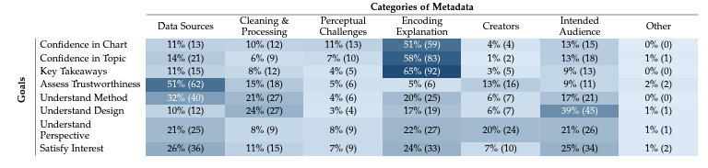
Impact of Metadata
From Invisible to Visible: Impacts of Metadata in Communicative Data Visualization; Burns et al.
Notes:
In Experiment 1, participants selected which kind of metadata they would most want to see when provided one of the eight goals. This table provides the number and percentages of times each metadata category (columns) was selected per goal (rows). Participants most frequently requested in Encoding Explanation metadata, followed by Data Sources. Percentages are rounded up to the next integer; rows may not sum to 100.

Slide 24
Activity
Form groups, each will be assigned one of the following datasets:
Human Development Indicators
Climate Change Indicators
Abortion Data by U.S. State from the Guttmacher Institute
Explore your dataset and devise a proposition about it: a statement that asserts a judgement or opinion about the trends you might have uncovered
Your proposition can be contentious but cannot be dehumanizing or demeaning
Split into two subgroups to design two persuasive visualizations; one for each side of your proposition. If you use deception, it should not be immediately obvious.
Be prepared to share your visualizations with the class
Adapted from: https://vis-society.github.io/assignments/A4.html

