Slide 1
LECTURE 08: THE RIGHT TOOL FOR THE JOB
November 8, 2016
SDS136:
Communicating with Data

Slide 2
Announcements
Most people have submitted their FP1 – 53 different topics! ☺
Airline comparison from tweets | Humans' impact on the environment
Biopics in Hollywood | Immigration on Brexit
Campaign spending based on public events | Impact of income inequality
Country's literacy rate vs wealth | International students picking multiple majors
Countrywise education comparison among genders | Maine’s entrepreneurial ecosystem
Demographic & Health Survey of Rwanda | Marriage rates vs age and education
Distribution of Pokemon in Pokemon Go | Minorities in Stem
Economies of developing countries | Opiates abuse
Education in countries | Pokemon types vs stats
Educational funds allocaction to states | Prevalence of Irish Gaelic
Effect of Governor Brownback on Kansas economy | Private companies in different market sectors
Factors for Baby Names | Pro ISIS tweet analysis
Factors for customers' influence on cuisines | Quality of public schools in Boston
Factors for Housing Prices/Places | Recidivism and Incarceration
Factors for success of movies | Reddit trending topics
Factors in Dating | Refugee Crisis
Features of cells to determine benign or malignant | Sleep pattern for students
Fundings for startups | Stackoverflow community
Gender equality in parliaments | Strategies in NFL
Gentrification of NY households | Student alcohol consumption
Global agricultural land use over time | Sugar and other additives consumption in countries
Global Warming in USA | Technology in education
Happiness Index vs GDP to measure well being | Transgender and gender non-conforming students in education
Happiness of college students | Unemployment rates, inflation and the US economy
Homeless population vs 911 incidence | Variation in Bond Prices
Hospitals vs healthcare | Women's economic independence vs the fertility rate
If you haven’t found a team and you want one,
let me know

Slide 3

Overview
As you start making design choices about your final project, how do you know you’re building the right thing?
Slides adapted from D. Staheli

Slide 4
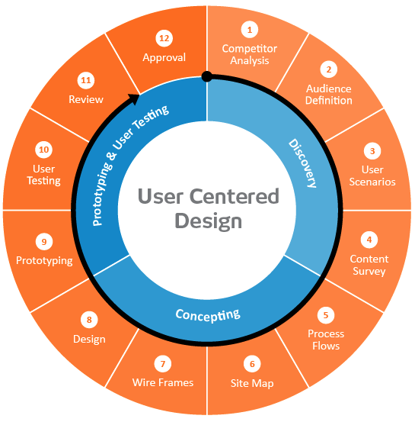

User-centered design framework
1) Discovery
Learning about your users
Modeling your users
Analyzing your users’ tasks
Eliciting and defining clear product requirements
2) Concepting Phase
Developing conceptual models
Solving design problems through ideation
Detailed design activities
3) Prototyping + User Testing
Delivery of a high-quality product that meets users’ needs and is easy to learn and use
Users
http://www.uxmatters.com/mt/archives/2010/07/design-is-a-process-not-a-methodology.php
Notes:
All Phases
Each phase feeds into the next
Iteration is key!
Users involved at all phases of the process

Slide 5
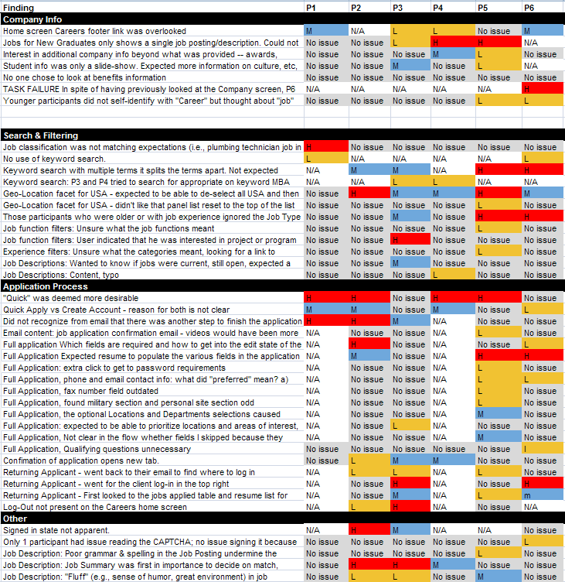
Competitive review
Why?
Know the lay of the land, avoid reinventing the wheel
Situate your tool appropriately in the landscape
Establish your unique contribution
How?
Literature review or product review
Analysis
What are the existing tools?
What are their purpose?
What audience are they aiming for?
What kinds of data or visualization are they using?
What functionality do they contain?
What are their strengths and shortcomings?
Identify opportunities and design constraints

Slide 6
Defining your audience
Learning about your users (data collection)
Semi-structured interview
Contextual inquiry
Analyzing your users’ tasks (data analysis)
Hierarchical task analysis
Modeling your users (data analysis)
Personas

Slide 7
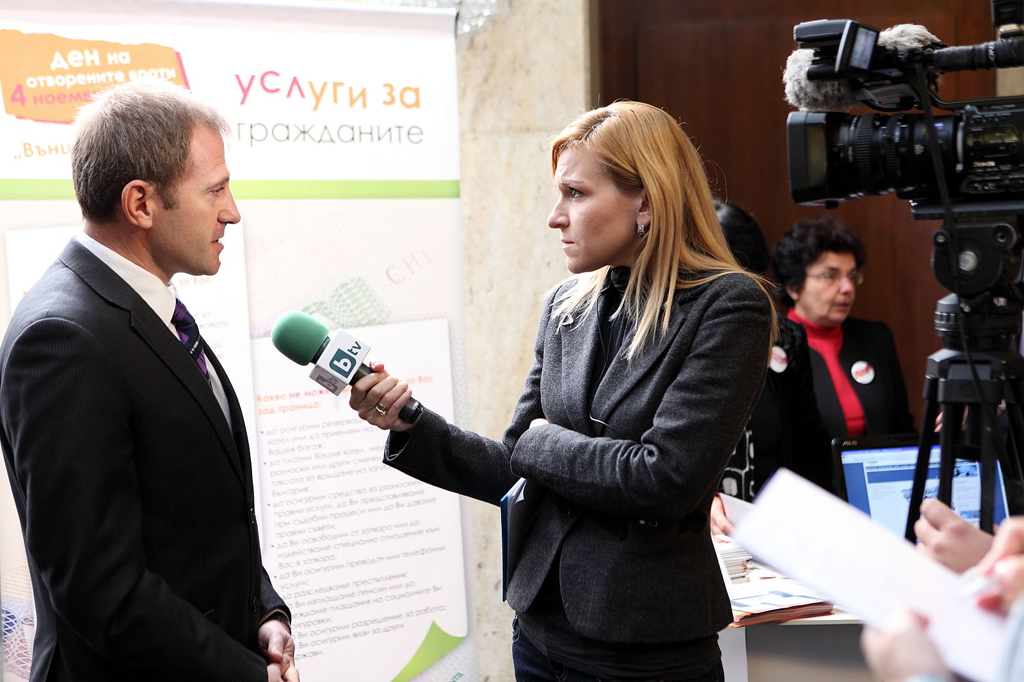
Interviews
Why?
Gather qualitative data about users to understand the problem space
How?
Prep: Interview guide
Semi-structured
“Cheat sheet” to ensure that you gather all the information you need
Open-ended questions
During: Managing the interview
Establish trust
Participant engagement will vary
Be flexible!
Recording or note-taking
Wood, L. E. (1997). Semi-structured interviewing for user-centered design. interactions, 4(2), 48-61.

Slide 8
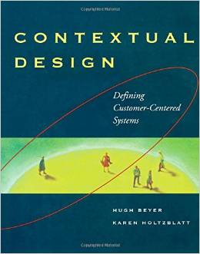
Contextual Inquiry
Why?
Understand how work is actually done in context
Identify pain points, shortcuts, workarounds, etc.
How?
"Shoulder to shoulder” in user’s environment
Apprenticeship paradigm – learn by watching
Alternative
Participant-observer paradigm – learn by doing
http://www.amazon.com/Contextual-Design-Customer-Centered-Interactive-Technologies/dp/1558604111

Slide 9
Hierarchical task analysis
Why?
Understand user workflow
Identify pain points and areas for optimization
How?
Decompose tasks into 4-8 sequential steps
Identify patterns, sequences and skips in the tasks
Hackos, J. & Redish, J. (1998). User and Task Analysis for Interface Design. Chichester: Wiley.

Slide 10
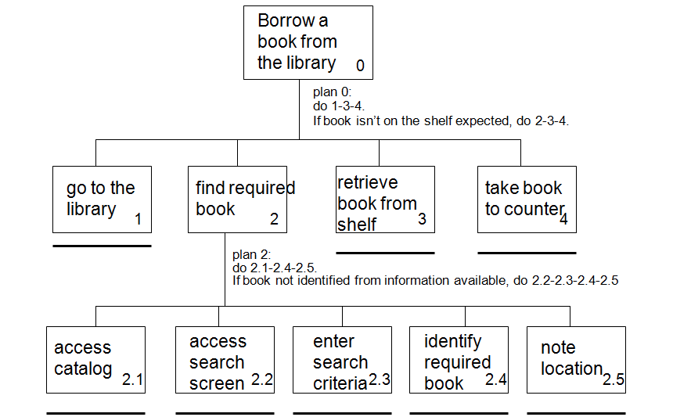
Task analysis example
http://i1206241.blogspot.com/2013/01/task-descriptions-hierarchical-task.html

Slide 11

Personas
Why?
Model behavioral characteristics of your target users
Mechanism for reasoning about user needs
How?
Fictionalization
Narrative, goals, needs, pain points
Attributes specific to the problem space
Data-driven method* using information gathered from interviews
Mapping persona to software features
http://www.amazon.com/The-Inmates-Are-Running-Asylum/dp/0672326140
* McGinn, J. J., & Kotamraju, N. (2008, April). Data-driven persona development. In Proceedings of the SIGCHI Conference on Human Factors in Computing Systems (pp. 1521-1524). ACM.

Slide 12
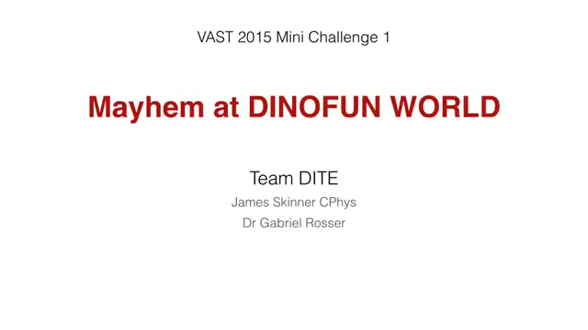
Example
Notes:
https://www.youtube.com/watch?v=DEM001V0EzI&index=3&list=PLEIoFNo17mJWuB-zUsJlsCW2sRKYTBZwG

Slide 13
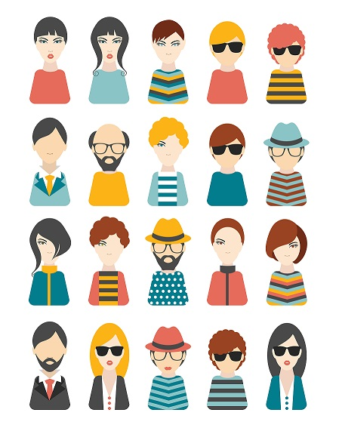
Mini-Lab: personas
Goal: come up with 3 personas that characterize
the people who might be interested in your project

Slide 14
Wrap-up
In today’s class, we covered:
Competitive Review
Audience Definition
Learning about your users
Semi-structured Interview
Contextual Inquiry
Analyzing your users’ tasks
Hierarchical Task Analysis
Modeling your users
Personas
Now that you’ve thought a little more about your audience, how does that refine your initial visualization?

Slide 15
Coming up
FP2 due next Tuesday by 11:59pm
Refine one of the personas you developed today: this is your audience
Perform a preliminary competitive review: what else is out there?
Post your persona and review to Piazza
Thursday: “Details”
After Lab 7, you posted things you still wanted to learn to do in Tableau
We’ll cover as many as we can in a hands-on tutorial

