Slide 1
LAB 04: VISUALIZING MULTIPLE VARIABLES
October 13, 2016
SDS 136
Communicating with Data

Slide 2
Outline
Recap: visualizing correlation
Example: buying a car seat
Creating new variables: calculated fields
What about multidimensional data?
Scatterplot matrix (SPLOM)
Parallel coordinates
Lab 3: SPLOMs and parallel coordinates in Tableau

Slide 3



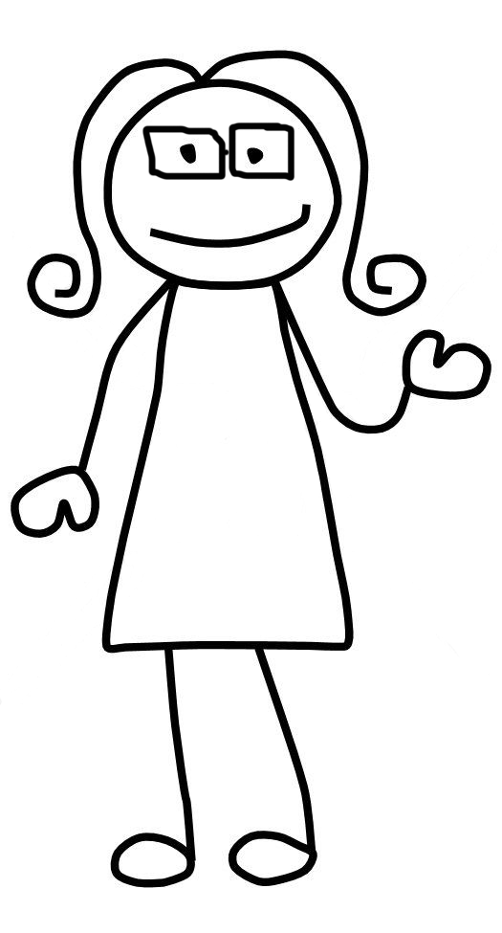
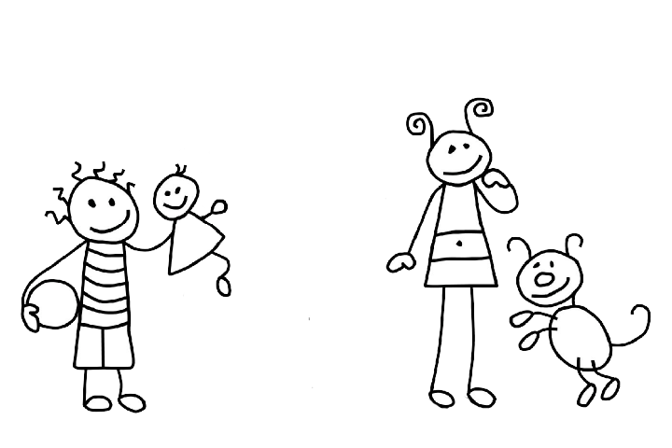

Slide 4
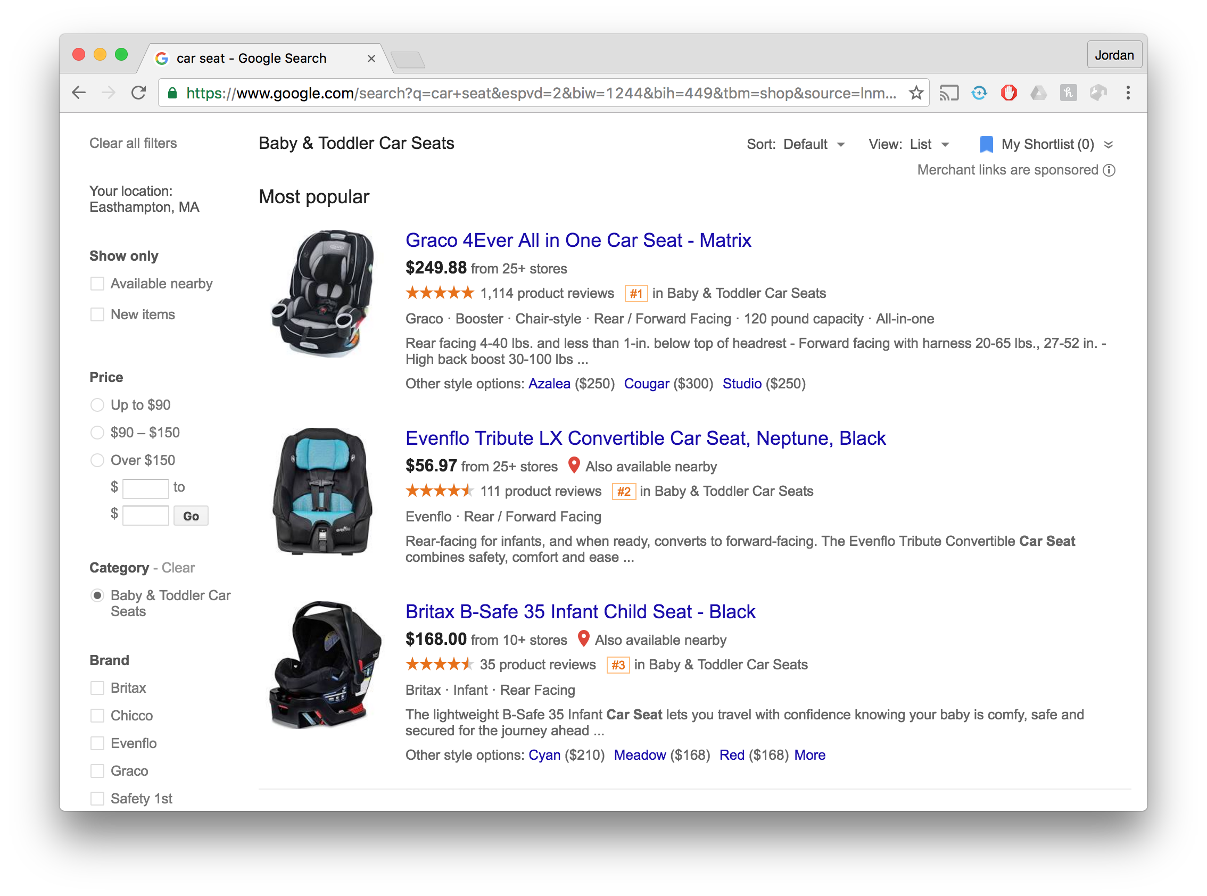

Slide 5
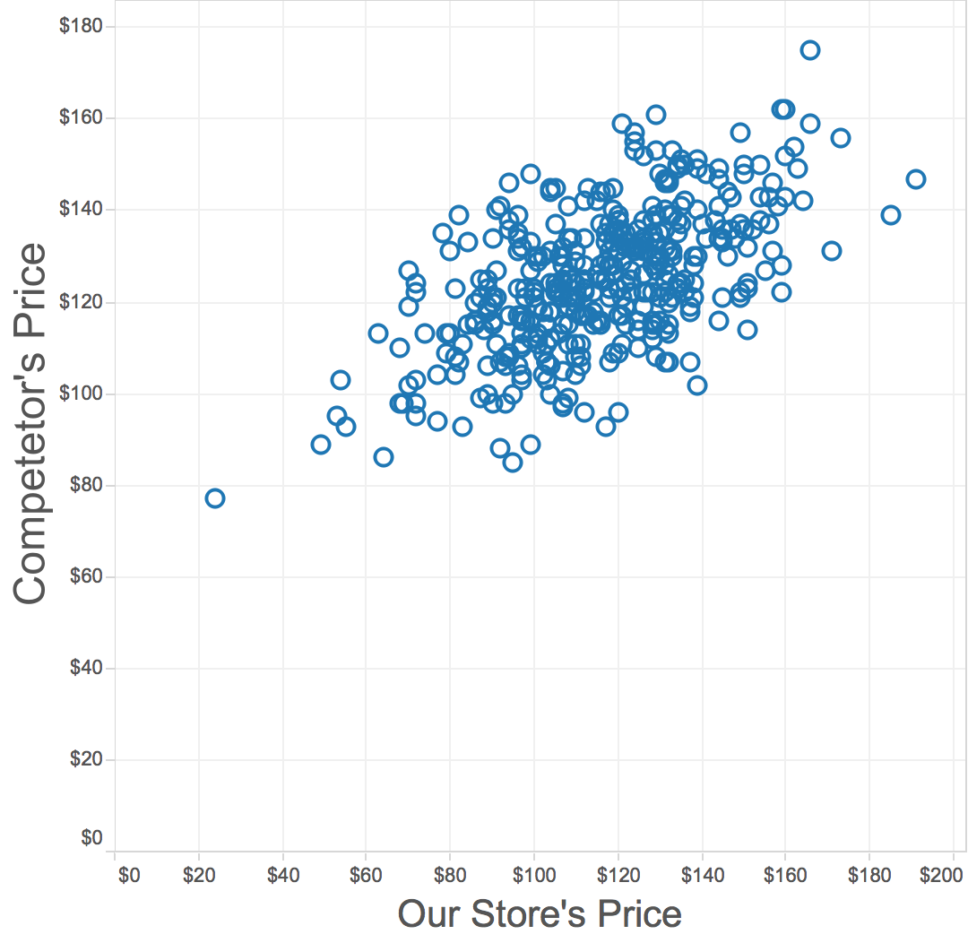
Recap: scatterplot
Goal: show the correlation between two quantitative (numerical) variables
Maximum value(s) in each dimension
General
trend
Positive correlation:
Two variables moving in the same direction
Trend line points up and to the right
Minimum value(s) in each dimension

Slide 6
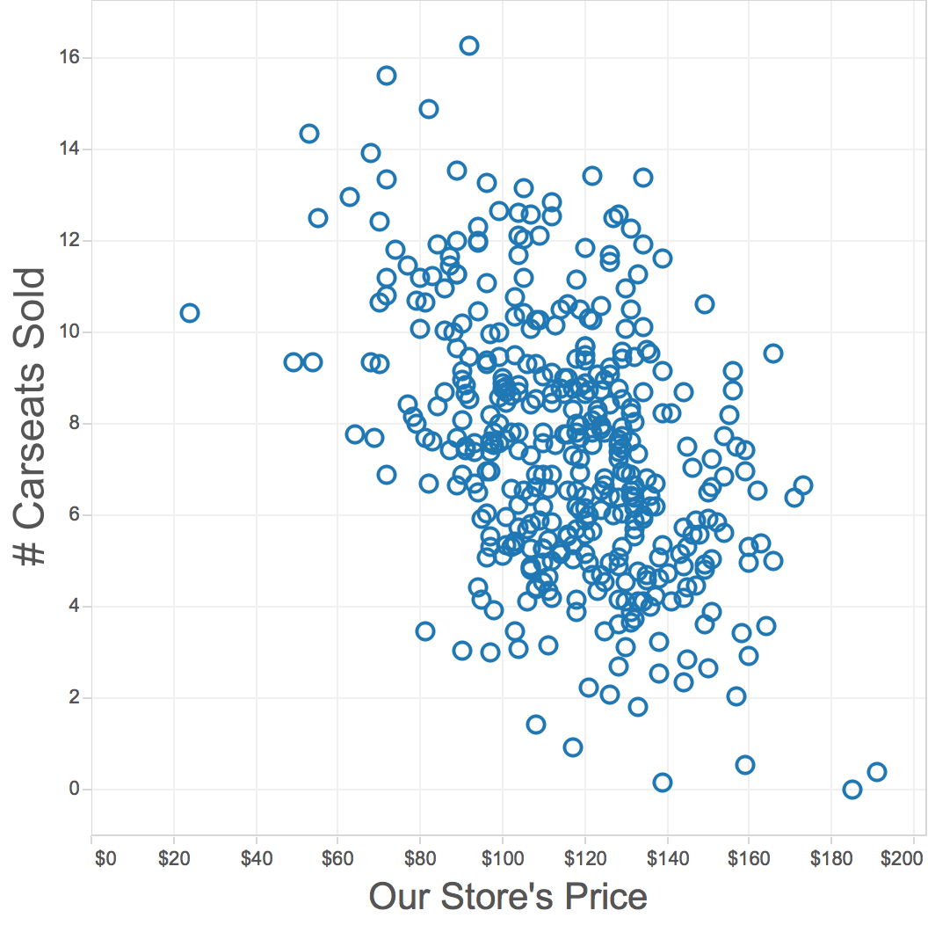
Recap: scatterplot
Goal: show the correlation between two quantitative (numerical) variables
Negative correlation:
Two variables moving in different directions
Trend line points down and to the right
General
trend

Slide 7
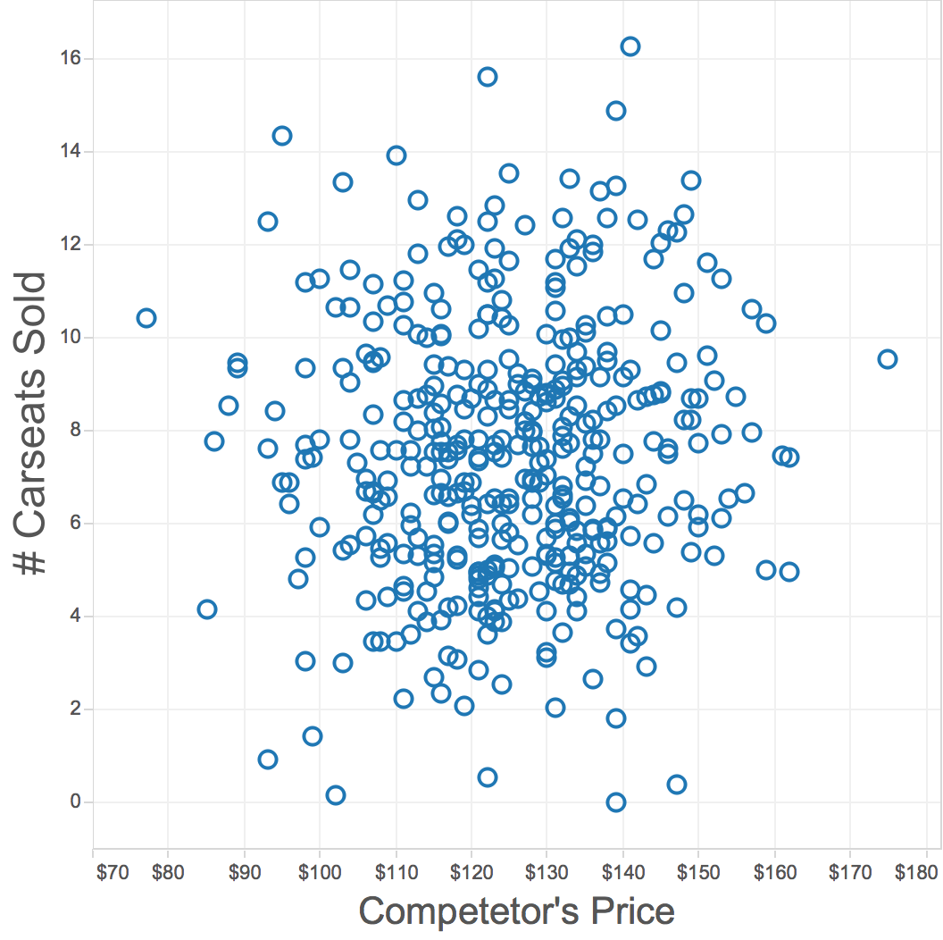
Recap: scatterplot
Goal: show the correlation between two quantitative (numerical) variables
No correlation:
Two variables are independent of one another
No discernable pattern

Slide 8
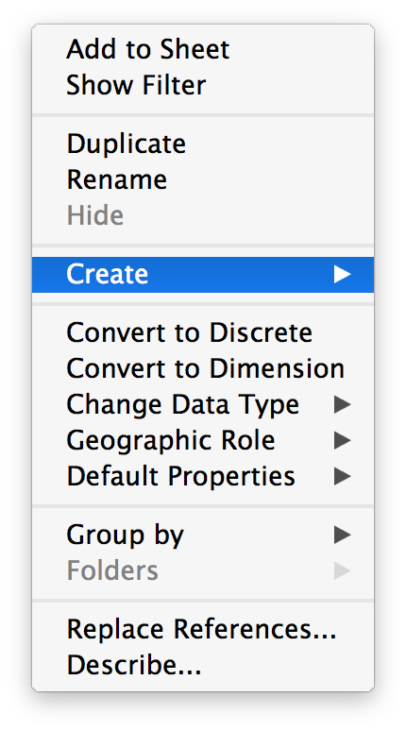
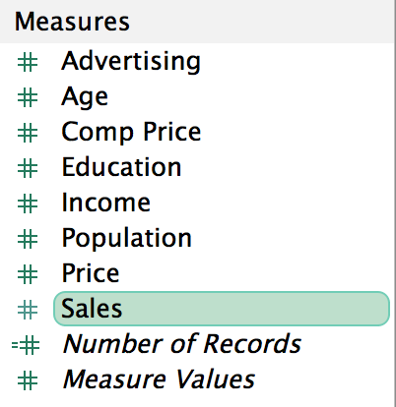
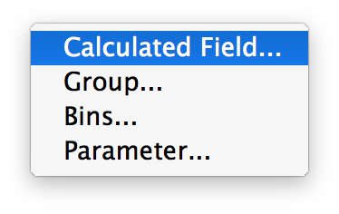
What if I want a new “variable”?

Slide 9
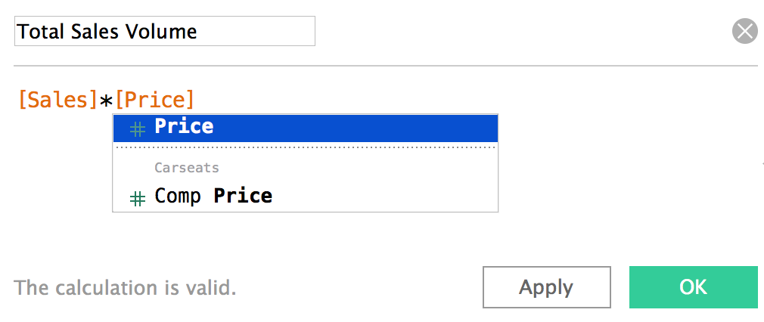
What if I want a new “variable”?

Slide 10
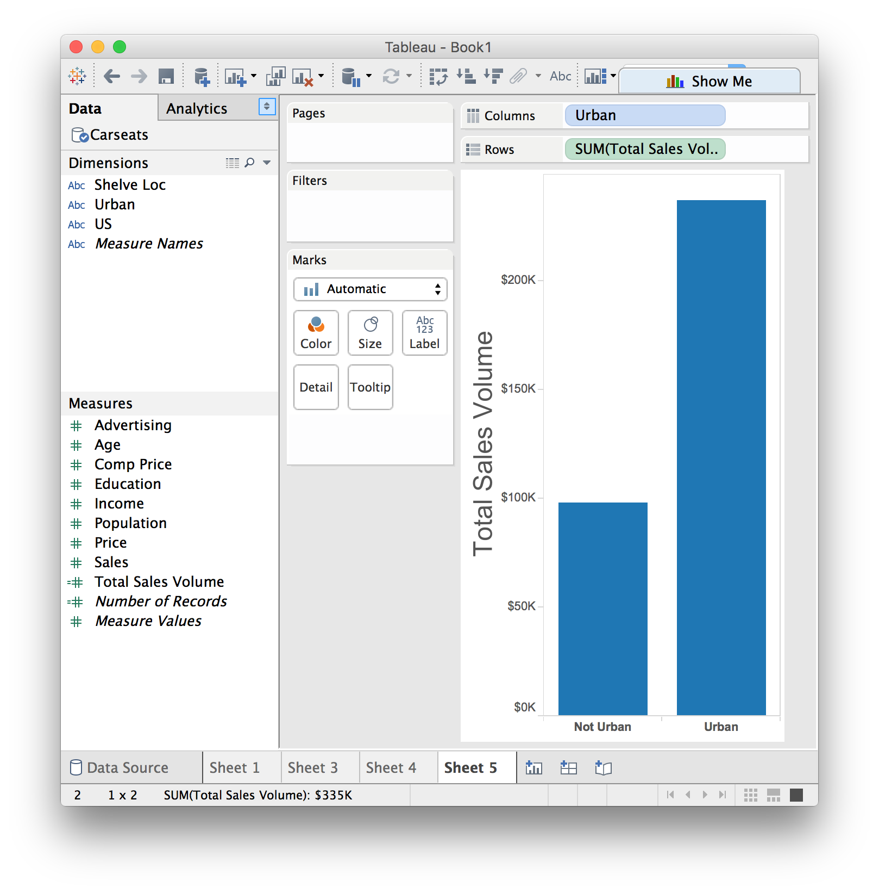

Slide 11

Discussion
Scatterplots show us the relationship between just two variables at a time
Question: how could we use this same idea to get a sense for an entire dataset?
Answer: multiple scatterplots!

Slide 12
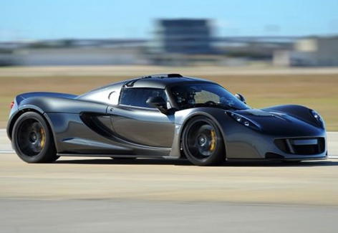
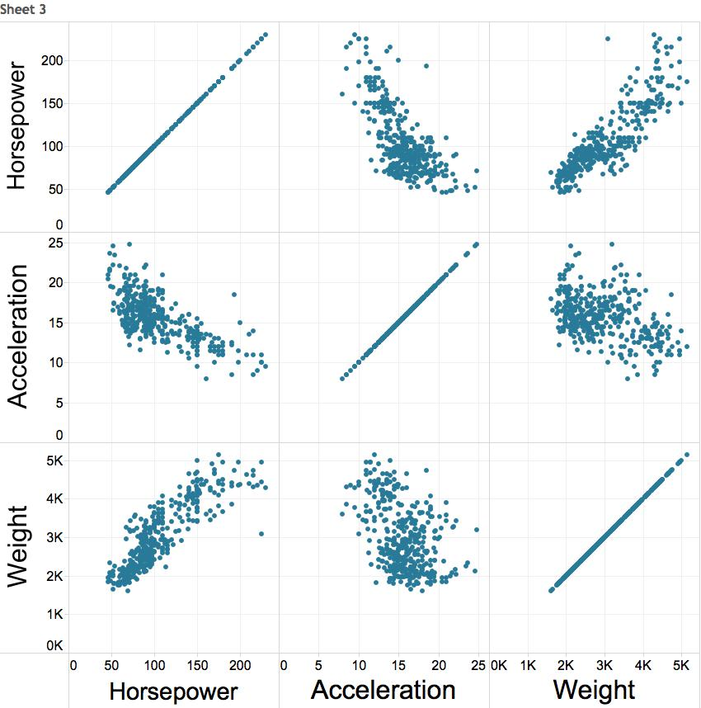
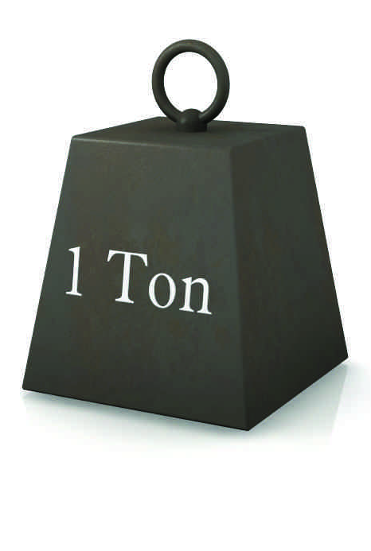
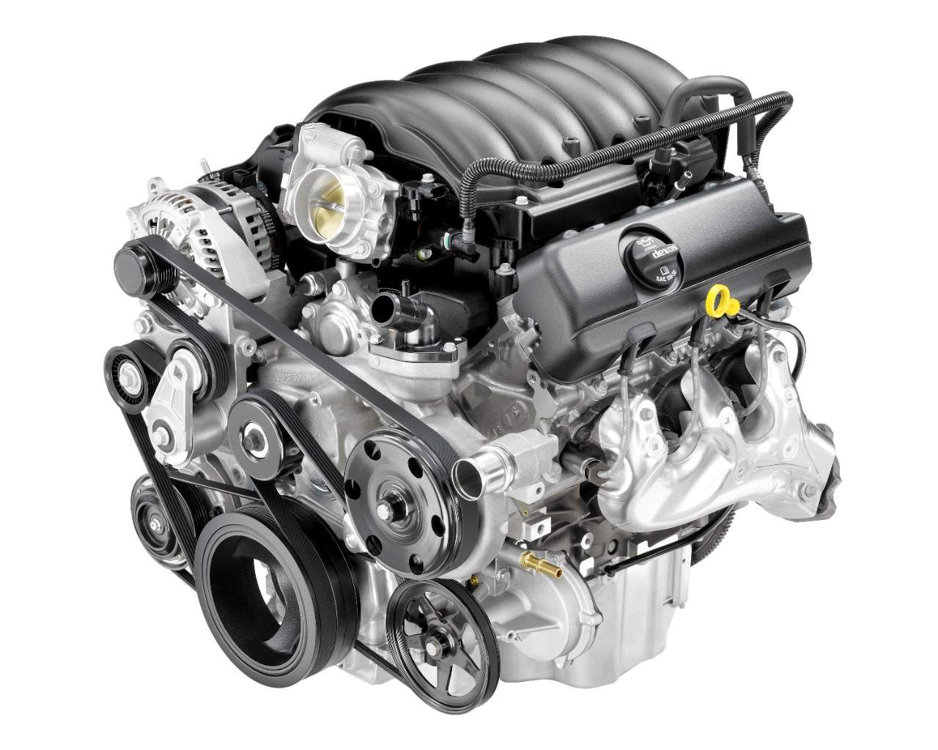
Example: Auto data
acceleration
horsepower
weight

Slide 13
Scatterplot matrix (SPLOM)

Slide 14
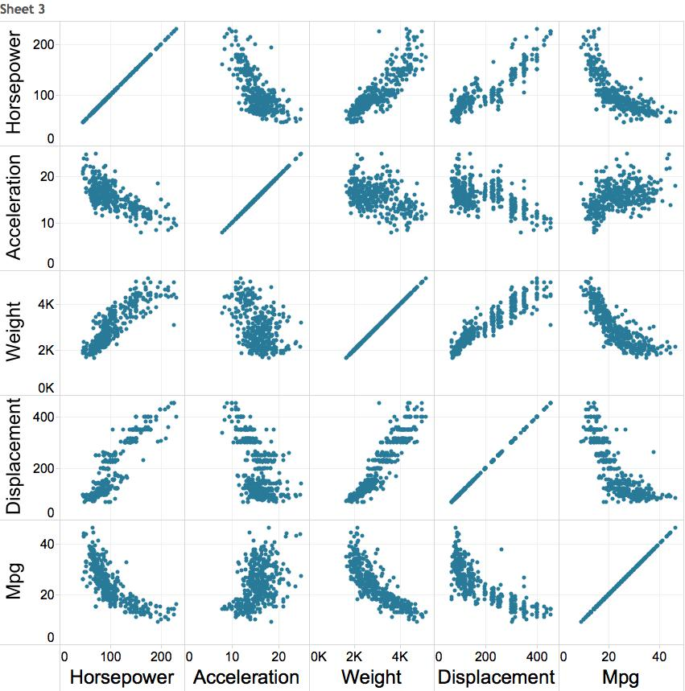
Scatterplot matrix (SPLOM)

Slide 15
Discussion: pros and cons
What’s good about SPLOMs?
What’s not so good?
What other visualizations have we seen that show correlation (i.e. “changing together”)?

Slide 16
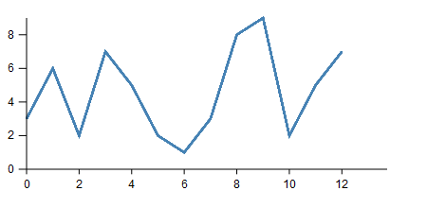
Recap: line charts
Definition: a visualization that uses lines to show relative changes in two continuous variables
Vertical axis shows the dependent variable
Horizontal axis shows the independent variable

Slide 17
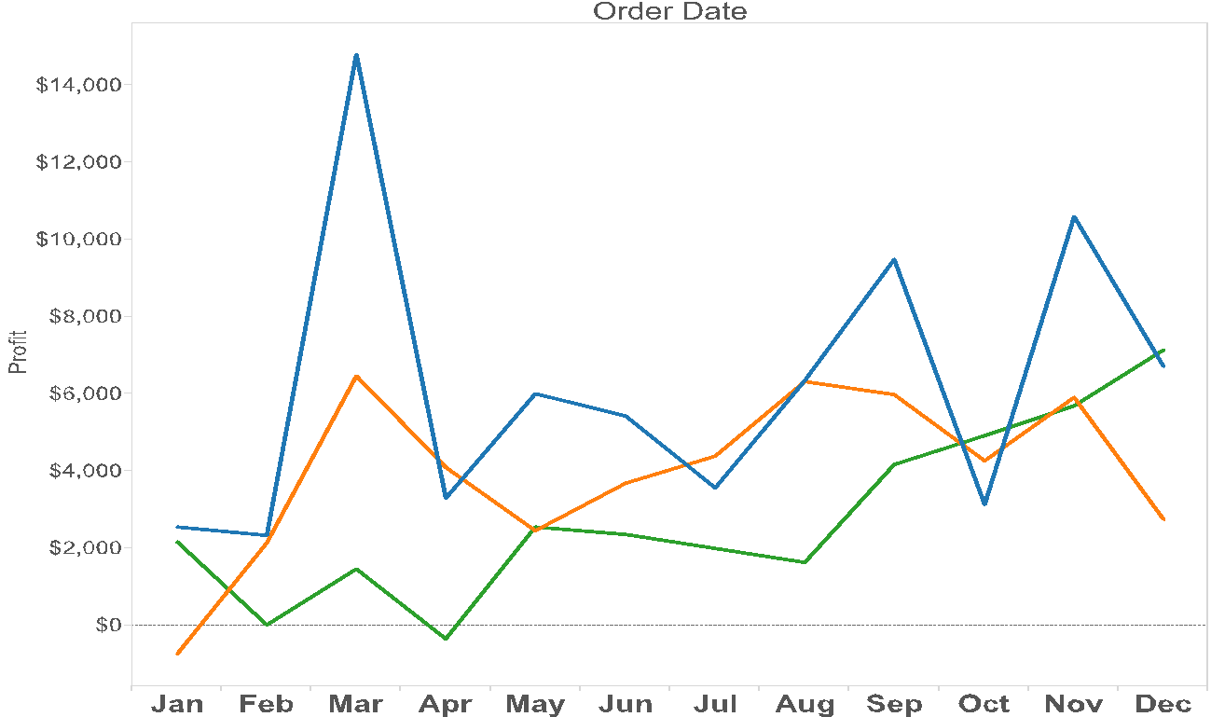

Variations: multiple independent lines

Slide 18
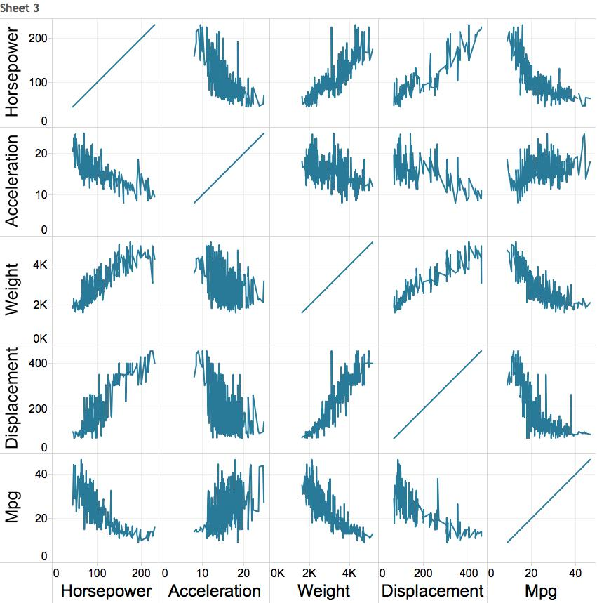
First idea: line chart matrix?

Slide 19
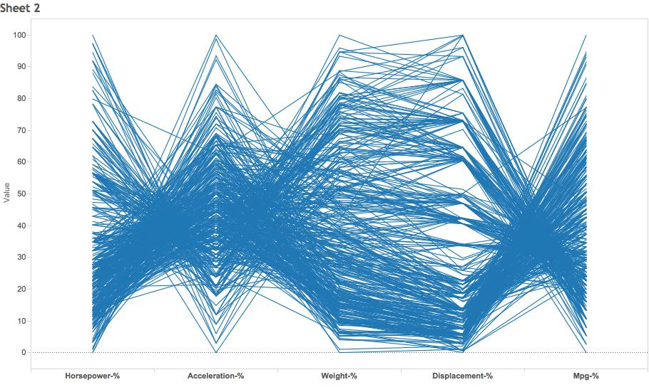
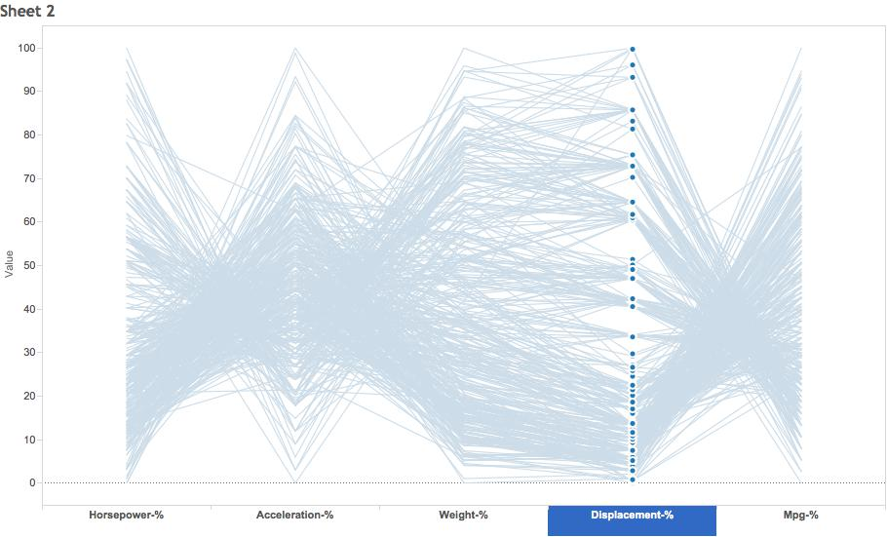
Weirder idea
H A W D M
“parallel coordinates plot”

Slide 20
Discussion: parallel coordinates
What patterns do you see?
Is anything pre-attentive?
Any potential problems?
H A W D M

Slide 21
Lab 4: SPLOMs and Parallel Coordinates
Instructions for today’s lab are available at:
www.science.smith.edu/~jcrouser/SDS136/labs/lab4
You’ll find several do-it-yourself pieces scattered throughout the lab, along with some questions
It’s okay if you get stuck! Just ask for help ☺
To get credit for this lab, post responses to Piazza

Slide 22
Up next
A3 due tonight by 11:59pm
A4 will be out later this afternoon, due Oct. 20th
Tuesday: interactive visualization

