Slide 1
Communicating with Data – Data Feminism
Dr. Ab Mosca (they/them)
Slides based off Data Feminism by Catherine D’Ignazio and Lauren F. Klein

Slide 2
Plan for today
Recap/Last bits from last class
Power structures in data science
Importance of context & documentation

Slide 3
Flashback: Late Policy + Revisions
Keeping up with weekly programing assignments is crucial to your success in this class:
assignments in this class generally build on one another
missing assignments often has ☹ downstream consequences
That said, we all have outside lives that sometimes take priority over schoolwork – this is normal and healthy
Self-managed extensions on HW + unlimited revisions
No budget / limit – take what you need to learn effectively
Must be requested before the original deadline
Caveat: late assignments get lower grading priority
See course website for full instructions on taking an extension and submitting a revision

Slide 4
Flashback: Data
Data is a set of variables that capture various aspects of the world

Slide 5
One way to think about this:
VARIABLES
 | Tuition | Enrollment | Public vs. Private | …
Smith College | $46,288 | 2,563 | private
UMass Amherst | $16,115 | 28,635 | public
Hampshire College | $48,065 | 1,400 | private
Mount Holyoke College | $43,886 | 2,189 | private
Amherst College | $50,562 | 1,792 | private
⋮
OBSERVATIONS

Slide 6
Another way to think about this
class school_obs:
def __init__(tuition, enrollment,
pub_or_priv):
self.tuition = tuition
self.enrollment = enrollment
self.pub_or_priv = pub_or_priv
smith = school_obs(46288, 2563, “private”)
umass = school_obs(16115, 28635, “public”)
VARIABLES
OBSERVATIONS

Slide 7

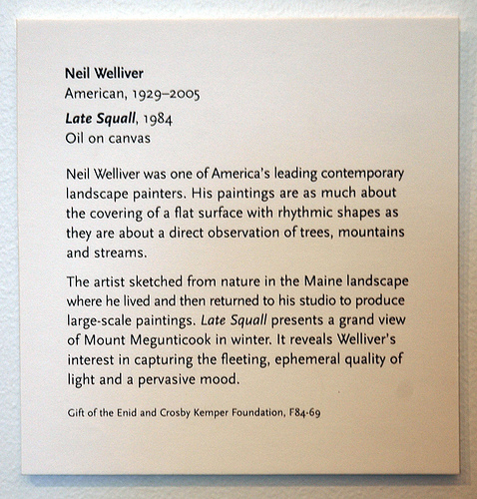
Yet another way to think about this
Information about the artist:
Name, place/date of birth,
date of death (if deceased)
Information about the piece:
Title, date, medium
Information about the donation:
Name of donor, reference number
Curated description and
relevant contextual information
Kinds of information = variables
Actual text on the placard = observations

Slide 8
Discussion
Where does data come from?

Slide 9
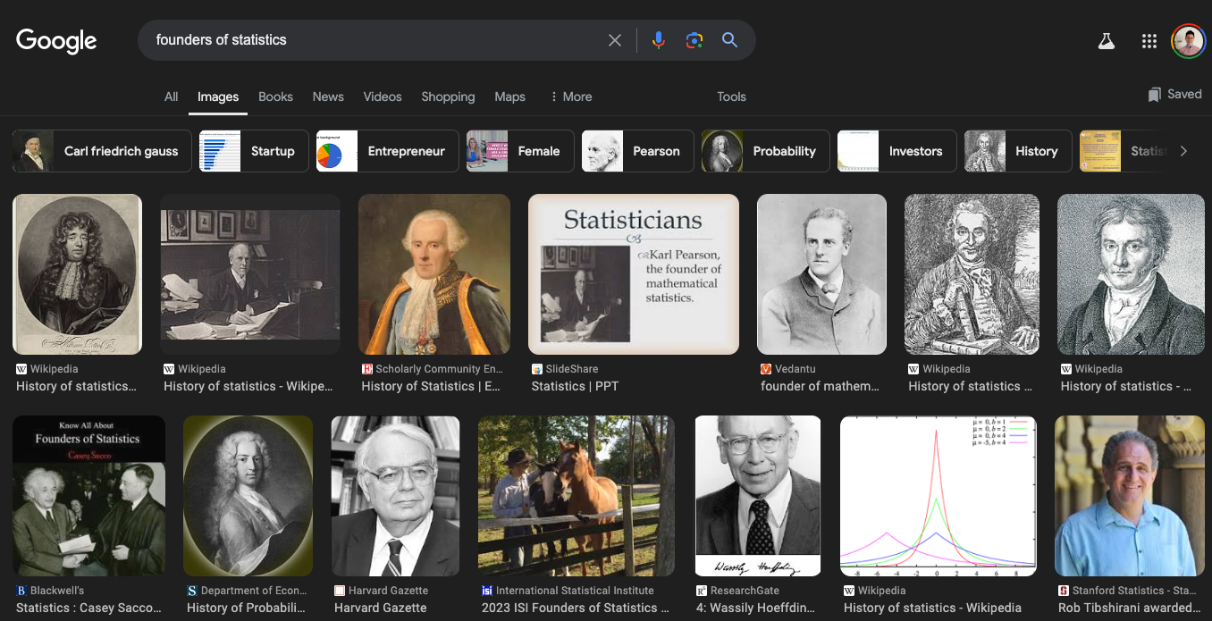
Power
https://data-feminism.mitpress.mit.edu/

Slide 10
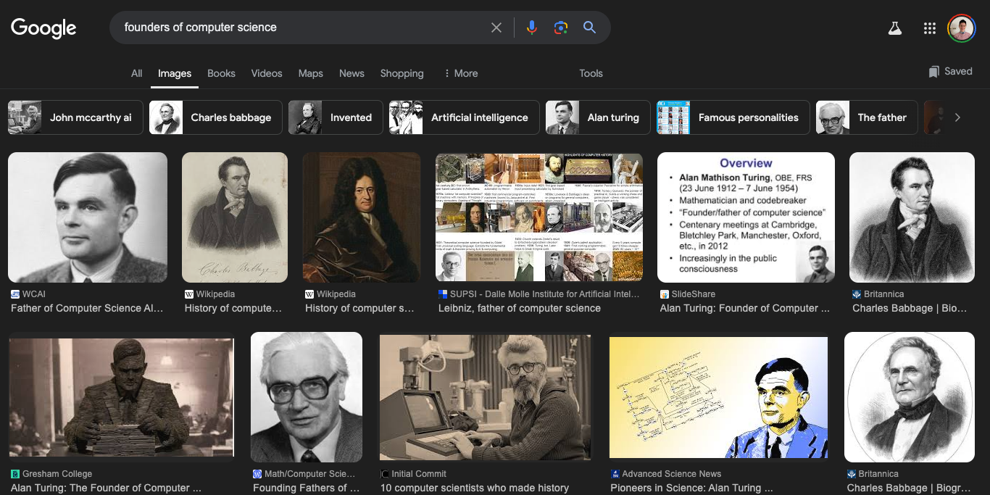
Power
https://data-feminism.mitpress.mit.edu/

Slide 11
Power
Hmmm….. Seems like data science is born from white cis males
Fun fact: this is not actually true if you dig deeper! But that’s for another class
So, just like most systems, data science as a field is build on practices and principles that privilege white cis males
As a result, data collection is also built on practices and principles that privilege white cis males
https://data-feminism.mitpress.mit.edu/

Slide 12

Example: Facial Recognition
Dr. Joy Buolamwini
https://data-feminism.mitpress.mit.edu/

Slide 13
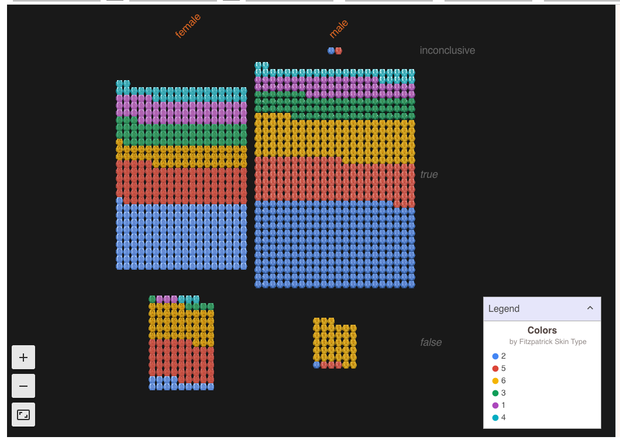
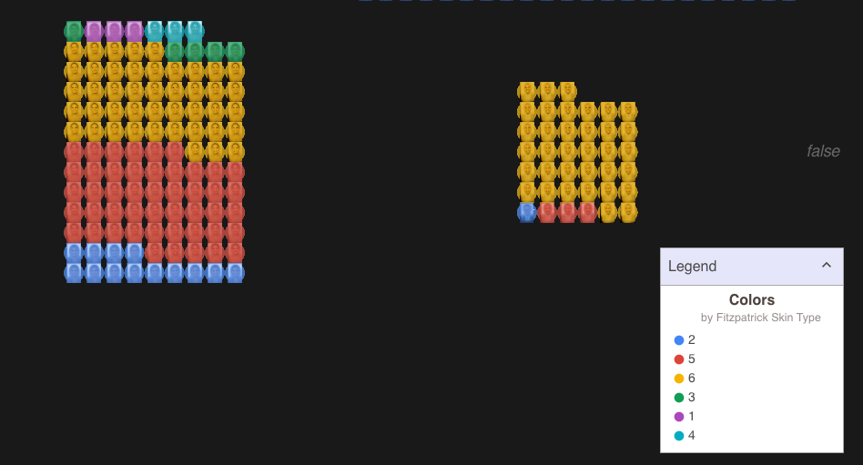
Example: Facial Recognition
https://data-feminism.mitpress.mit.edu/

Slide 14
Example: Facial Recognition
Training dataset used for most facial recognition systems contains
78% male faces
84% white faces
Only 4% were women and dark-skinned
What are downstream real life impacts of this data bias?
https://data-feminism.mitpress.mit.edu/

Slide 15

Example: Research Funding
2022 prostate cancer research funding: 280.5 million
2022 uterine cancer research funding: 15.0 million
How does this monetary breakdown perpetuate systems of power?
https://www.cancer.gov/about-nci/budget/fact-book/data/research-funding
https://data-feminism.mitpress.mit.edu/

Slide 16
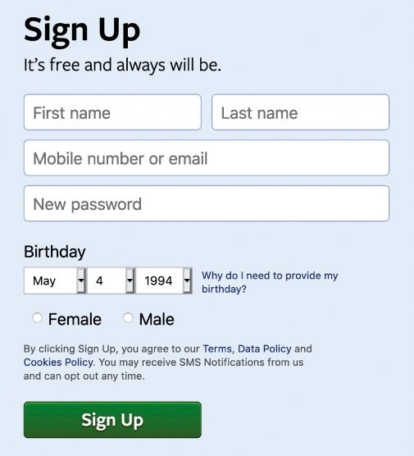
“What gets counted counts”
Data is often used to inform policy and allocate resources
What is not counted in that data collection can become invisible
Ex. Expansive gender
https://data-feminism.mitpress.mit.edu/

Slide 17
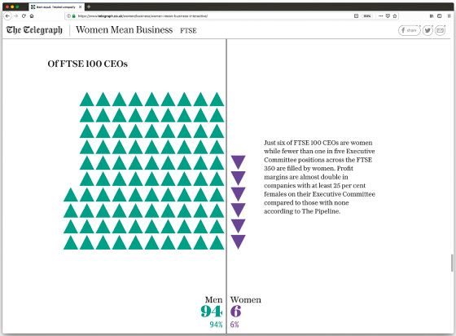
What can we do?
Subvert norms
https://data-feminism.mitpress.mit.edu/

Slide 18
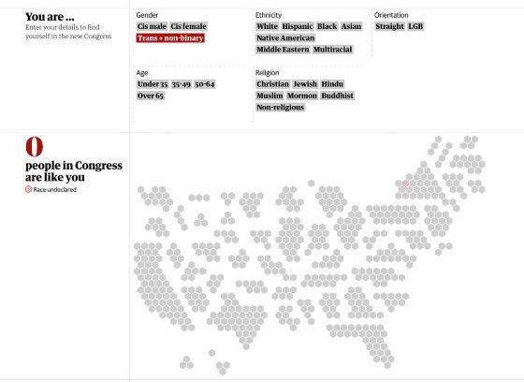
What can we do?
Highlight missing categories
https://data-feminism.mitpress.mit.edu/

Slide 19
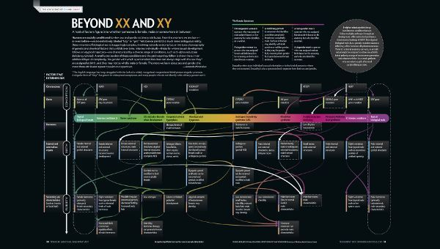
What can we do?
Educate
https://data-feminism.mitpress.mit.edu/

Slide 20
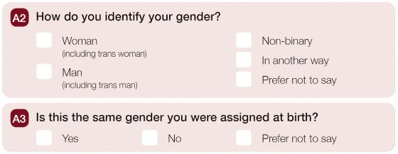
What can we do?
Rethink data collection
https://data-feminism.mitpress.mit.edu/

Slide 21
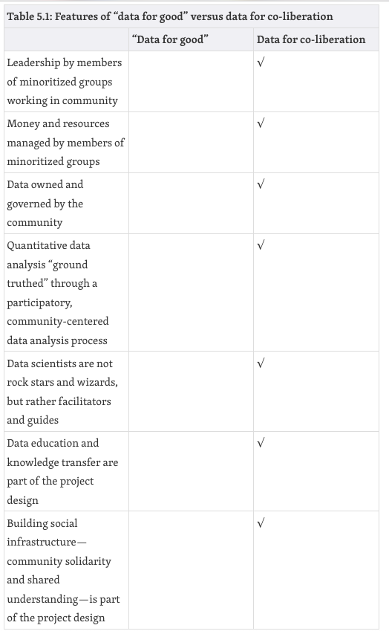
What can we do?
Many voices are better than a single all-knowing one
https://data-feminism.mitpress.mit.edu/
Notes:
Think about collecting data for co-liberation; not just good!

Slide 22

What can we do?
Acknowledge context
What is the historical context of the data?
Where did the data come from? Who collected it?
Why was the data collected?
How was the data collected?
How is the data used?
What’s in the data?
What “counts” as a data point?
What data is missing?
How is uncertainty handled?
https://www.responsible-datasets-in-context.com/datasets.html

Slide 23
Lab
Go to the course website to find instructions for today’s lab

